Slide 1
Child Maltreatment between Knowledge, Attitude and Beliefs Among Saudi Pediatricians and
Medical Students
Yossef Alnasser Amani Albijadi Waad Abdullah Dana Aldabeeb Alanoud Alomar Sara Alsiddiqi Yara Alsalloum

Slide 2
Introduction &
Rationale
Child maltreatment is the abuse and neglect that occurs in children under 18 years of age.
In Saudi Arabia, the first case of child abuse was identified in 1990.
Child maltreatment is not included in many medical schools and pediatric residency curriculums, which might limit knowledge
and spread misconceptions.

Slide 3
Objectives
To quantify level of knowledge and acceptance of child maltreatment definitions.
To explore how do Saudi medical students, trainees and pediatricians feel about child maltreatment and reporting.
To investigate impact of religion and traditions on beliefs toward child maltreatment.

Slide 4
Hypothesis
We hypothesize that medical students and pediatric trainees have limited knowledge, oblivious attitude and misbeliefs regarding child maltreatment in comparison to experienced pediatricians.
On the other hand, medical students and trainees might hold higher motives and willingness to learn about child maltreatment and their consequences.

Slide 5
Methods
Quantitative, observational, cross-sectional study.
Inclusion criteria: pediatricians, pediatrics’ trainees and medical students in different areas of pediatric services in King Saud University Medical City.
Informed consent was obtained by stating the purpose of the study and assured the confidentiality of the responses.

Slide 6
Methods
Data Collection using self-administered online questionnaires in English which included
Socio-demographic characteristics.
Questions to assess the level of knowledge and acceptance of child maltreatment.
Pilot Study
Notes:
What to say for Pilot Study: Initially, it was evaluated for clearness and easiness by a pilot study of ten physicians, interns and senior medical students.

Slide 7
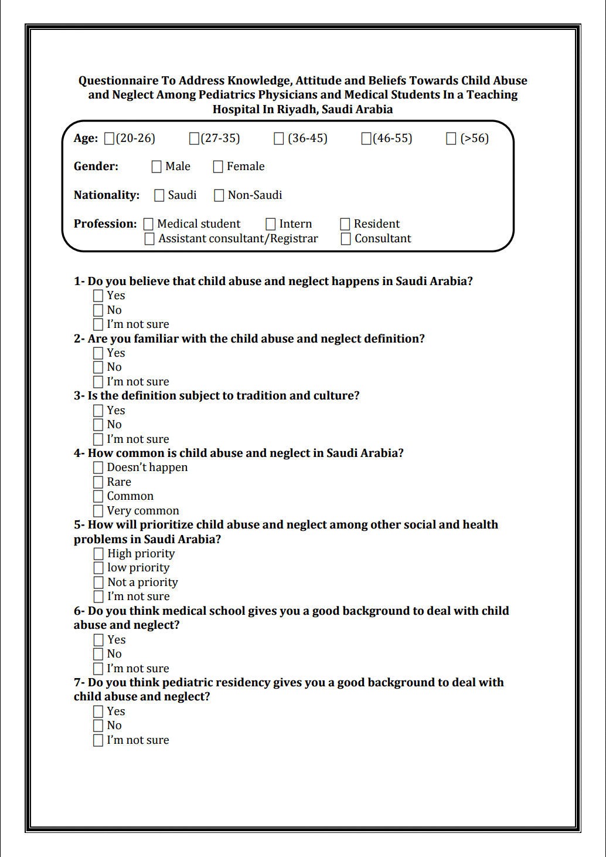
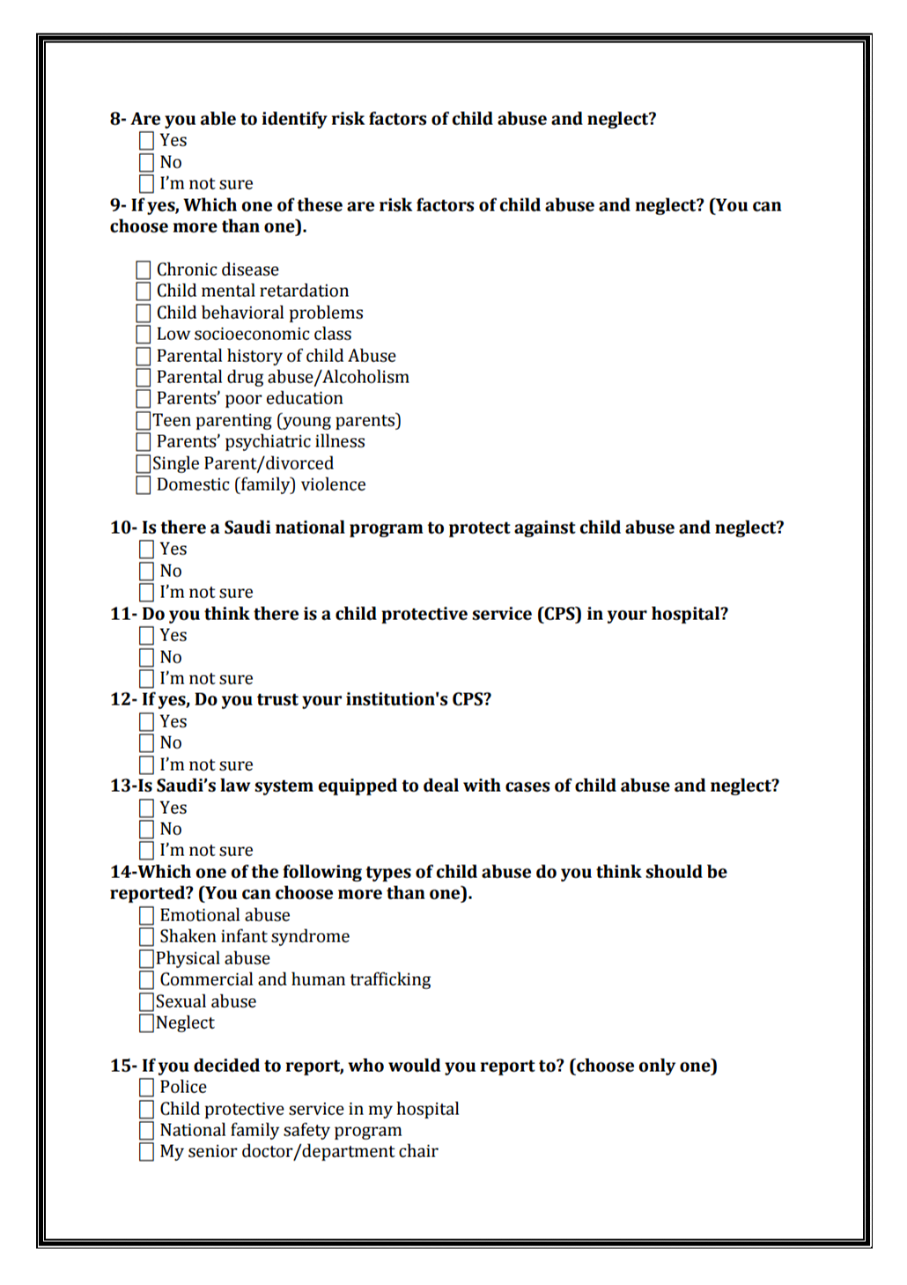
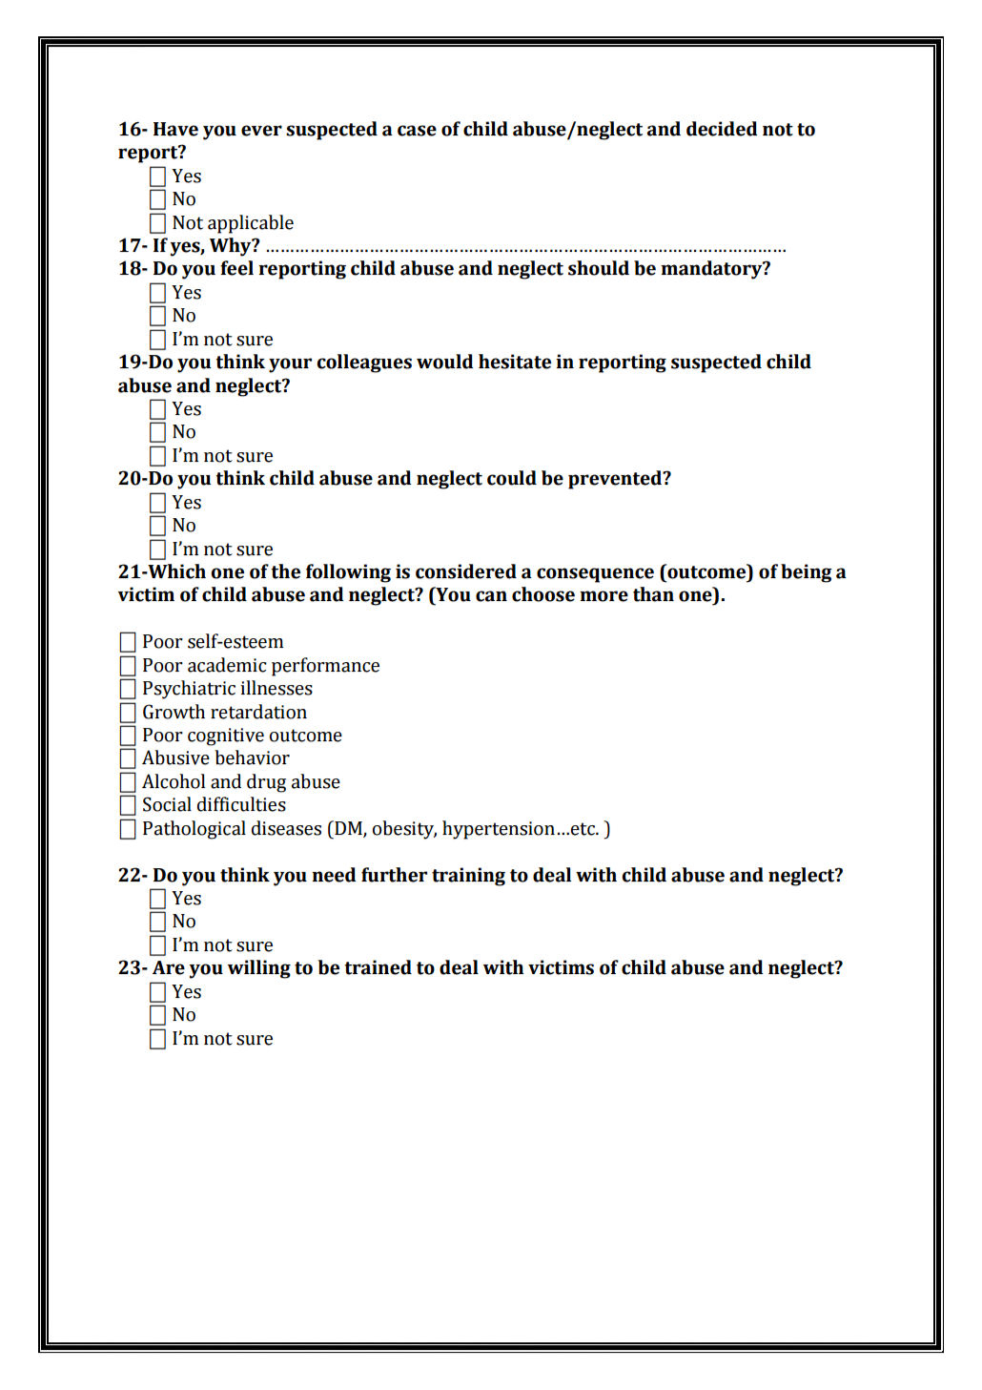

Slide 8
Methods
Data Management
Descriptive statistics were used to describe the categorical variables.
Data was analyzed using SPSS version 20.0 statistical software.
Student t-test and chi-squared test were applied to assess the association between categorical study and outcome variables.
A p-value of <0.05 was considered statistically significant.

Slide 9
Methods
Study Variables gender, level of physicians’ education and experience
Outcome Variables incidence of intention to report suspected cases of child abuse and neglect.

Slide 10
Results

Slide 11

Identified Risk Factors of Child Abuse

Slide 12
Consequences of Child Maltreatment

Slide 13
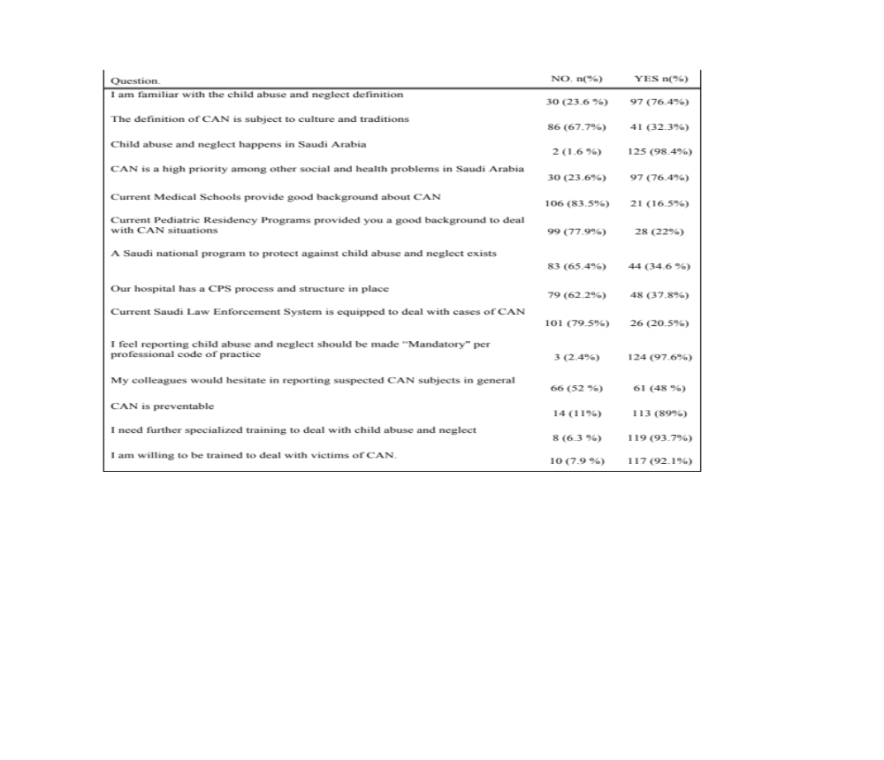
Table 1. Knowledge, Attitude and Beliefs of Medical Students and Physicians

Slide 14
Medical students and physicians were more likely to report sexual and physical abuse

Slide 15
Multivariate Logistic Regression

Slide 16
Recognition of Risk Factors and Consequences of CAN

Slide 17
Conclusion
In general, good basic knowledge, positive attitude and willingness to obtain further training were observed among study participants.
Experienced physicians were more knowledgeable and more likely to report neglect.
Finally, female respondents showed higher enthusiasm to report and acquire further training. However, reporting is a major observed defect.

Slide 18
Limitations
Our results do not represent the city of Riyadh as a whole, but are only limited to one hospital, lack generalizability.
Data was collected in the form of self administered questionnaires, the responses could be affected with recall bias.
Notes:
What to say for Pilot Study: Initially, it was evaluated for clearness and easiness by a pilot study of ten physicians, interns and senior medical students.

Slide 19
Recommendations
Further education and training are needed to combat Child Abuse and Neglect in Saudi Arabia.
Notes:
What to say for Pilot Study: Initially, it was evaluated for clearness and easiness by a pilot study of ten physicians, interns and senior medical students.

Slide 20
References
World Health Organization. Child abuse and neglect by parents and other caregivers. World Rep Violence Heal. 2002;59–86.
Gateway CWI. Long-term consequences of child abuse and neglect. 2013.
Akmatov MK. Child abuse in 28 developing and transitional countries-results from the multiple indicator cluster surveys. Int J Epidemiol. 2011;40(1):219–27.
Yehuda Y Ben, Attar-Schwartz S, Ziv A, Jedwab M, Benbenishty R. Child abuse and neglect: Reporting by health professionals and their need for training. Isr Med Assoc J. 2010;12(10):598–602.
Borres MP, Hägg A. Child abuse study among Swedish physicians and medical students. Pediatr Int. 2007;49(2):177–82.
Chang A, Oglesby AC, Wallace HM, Goldstein H, Hexter AC. Child Abuse and Neglect : Physicians ’ Knowledge , Attitudes , and Experiences. public Heal Br. 1976;66(12).
Feng JY, Chen YW, Fetzer S, Feng MC, Lin CL. Ethical and legal challenges of mandated child abuse reporters. Child Youth Serv Rev [Internet]. Elsevier Ltd; 2012;34(1):276–80. Available from: http://dx.doi.org/10.1016/j.childyouth.2011.10.026
Al Eissa M, Almuneef M. Child Abuse and Neglect in Saudi Arabia: Journey of recognition to implementation of national prevention strategies. Child Abus Negl. 2010;34(1):28–33.
Program NFS. Domestic Violence and Child Abuse and Neglect in Saudi Arabia Annual Report. www.nfsp.org.sa. 2014. p. 1–14.

Slide 21
References
Mogaddam M, Kamal I, Merdad L, Alamoudi N, Meligy O El, El-derwi D. Prevalence of Child Abuse in Saudi Arabia from 2000 to 2015 : A Review of the Literature. Oral Hyg Heal. 2015;3(6):1–4.
Al-Eissa YA. Child abuse and neglect in Saudi Arabia: What are we doing and where do we stand? Ann Saudi Med. 1998;18(2):105–6.
Wright RJ, Wright RO, Farnan L, Isaac NE. Response to child abuse in the pediatric emergency department: need for continued education. Pediatric emergency care. 1999. p. 376–82.
Al-Shail E, Hassan A, Aldowaish A, Kattan H. The Cultural Reinforcers of Child Abuse. Child Abus Negl - A Multidimens Approach. 2012;20–38.
Fadheela Taher Al-Mahroos. Child abuse and neglect in the Arab Peninsula. Saudi Med J. 2007;(July):241–8.
Almuneef M, Al-Eissa M. Preventing child abuse and neglect in Saudi Arabia: Are we ready. Ann Saudi Med. 2011;31(6):635–40.
Lane WG, Dubowitz H. Primary care pediatricians’ experience, comfort and competence in the evaluation and management of child maltreatment: Do we need child abuse experts? Child Abus Negl. 2009;33(2):76–83.
Jaudes PK, Mackey-Bilaver L. Do chronic conditions increase young children’s risk of being maltreated? Child Abus Negl. 2008;32(7):671–81.
Sullivan, P.M.,& Knutson JF. Maltreatment and Disabilities : a Population- Based Epidemiological Study. Child Abus Negl. 2000;24(10):1257–73.

Slide 22
References
Glasser S, Chen W. Survey of a pediatric hospital staff regarding cases of suspected child abuse and neglect. Isr Med Assoc J. 2006;8(3):179–83.
Biehler JL, Apolo J, Burton L. Views of pediatric emergency fellows and fellowship directors concerning training experiences in child abuse and neglect. Pediatric emergency care. 1996. p. 365–9.
Al-Dabaan R, Newton JT, Asimakopoulou K. Knowledge, attitudes, and experience of dentists living in Saudi Arabia toward child abuse and neglect. Saudi Dent J [Internet]. King Saud University; 2014;26(3):79–87. Available from: http://dx.doi.org/10.1016/j.sdentj.2014.03.008
Habib HS. Pediatrician knowledge, perception, and experience on child abuse and neglect in Saudi Arabia. Ann Saudi Med. 2012;32(3):236–42.
Fung DS, Chow MH. Doctors’ and lawyers' perspectives of child abuse and neglect in Singapore.[Erratum appears in Singapore Med J 1998 Jul;39(7):299]. Singapore Med J [Internet]. 1998;1–7. Available from: http://ovidsp.ovid.com/ovidweb.cgi?T=JS&CSC=Y&NEWS=N&PAGE=fulltext&D=med4&AN=9676146
Ashoor L, Al F, Grant N. Children abuse: Factors affecting case reporting by physicians. Bahrain Med Bull. 2012;34(3).
Alsehaimi A. A Systematic Review of Literature on Child Sexual Abuse in Saudi Arabia. iMedPub Journals. 2016;1–5.
Newton AW, Vandeven AM. Child abuse and neglect: a worldwide concern. Curr Opin Pediatr [Internet]. 2010;22(2):226–33. Available from: http://www.ncbi.nlm.nih.gov/pubmed/20164772
AlMadani O, Bamousa M, Alsaif D, Kharoshah MAA, Alsowayigh K. Child physical and sexual abuse in Dammam, Saudi Arabia: A descriptive case-series analysis study. Egypt J Forensic Sci [Internet]. Forensic Medicine Authority; 2012;2(1):33–7. Available from: http://dx.doi.org/10.1016/j.ejfs.2012.01.001
Elayyan K. Violance Against Children Jordan Study. UNICEF. 2007.

Slide 23
You treat a disease, you win, you lose. You treat a person, I guarantee you, you will win, no matter what the outcome.
-Patch Adams
“

Slide 24
Thanks!
Any questions?
You can find me at sara.alsiddiqi@gmail.com

