Slide 1



Developing Novel Drug Delivery Systems for the Treatment of Epilepsy
SUPERVISORS
Prof Wallace
A/Prof Moulton
Prof Cook
Sara Ahmadi

Slide 2
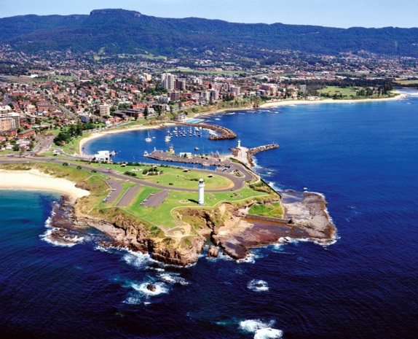
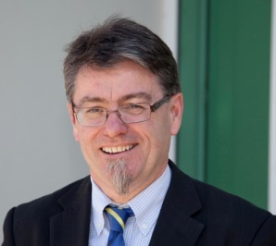
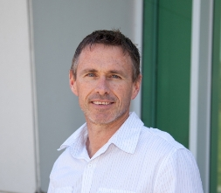
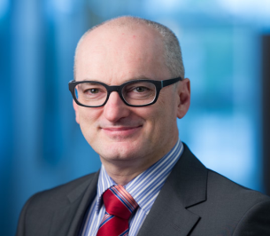
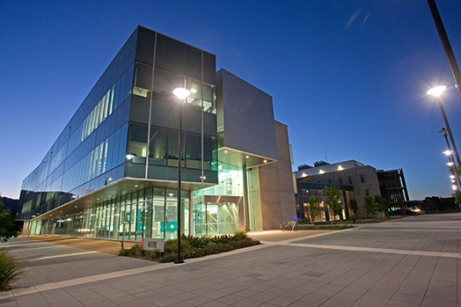
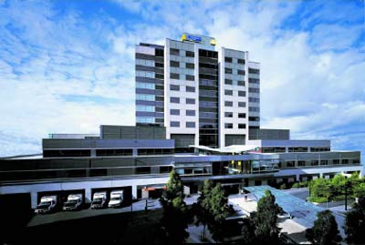
Prof Wallace Prof Moulton Prof Cook
Wollongong City
Bionics Program of ACES/IPRI
Synthetic BioSystems program builds on the new material developments and additive fabrication techniques at ACES to develop implantable structures that support the development of tissue structure.
These devices provide opportunities to monitor, maintain and (where necessary) restore function in neural tissues.
Applications include epilepsy and schizophrenia sufferers and the ageing human brain.
Intelligent polymer Research Institute, Wollongong
Saint Vincent Hospital, Melbourne

Slide 3
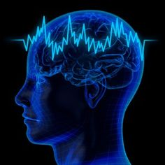
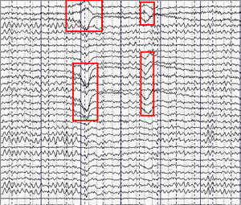
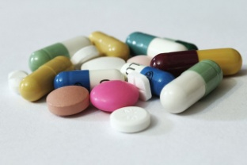
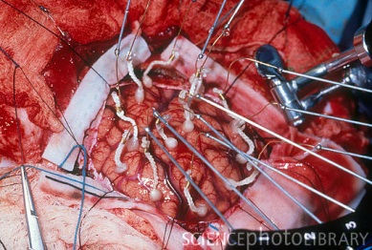
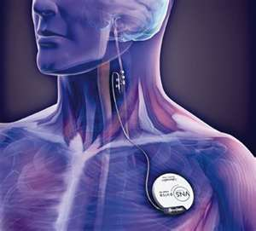
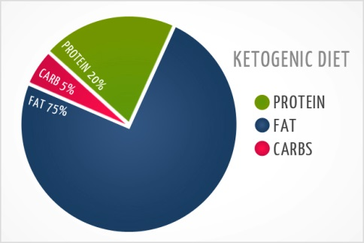
Background
Epilepsy is characterized by abnormal electrical activity within the brain.
During a seizure a person’s consciousness, movement or action maybe altered for a short time.
60 million people worldwide have epilepsy.
Treatment Options for Epilepsy
Medication or Drug therapy
Brain Surgery
VNS
Vagus Nerve Stimulation
Ketogenic diet

Slide 4
What is needed to treat 30% untreatable Epilepsy Sufferers?
Motivation
Eliminate or reduce side effects of oral administration
Release of small doses of drug to minimise toxicity and side effects
Localize delivery which releases drug directly to the brain (by-passing the blood brain barrier - BBB)
Administration of an anti-epileptic drug directly to the brain tissue

Slide 5
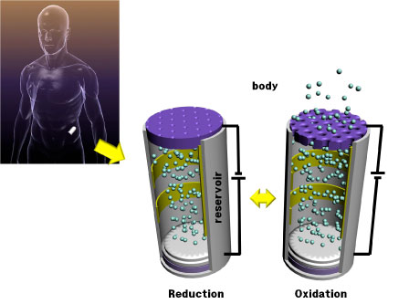
Project Aims
Designing and fabrication of a reservoir with encapsulated drugs
Drug release will be mitigated by opening and closing a conducting polymer coated porous “gate”.
body
Oxidation
(Gate closed)
Reduction
(Gate open)

Slide 6
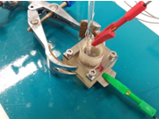
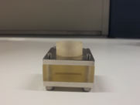
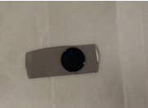
CP Coated Pt/PVDF Flat Membrane; Step1
This gate is a platinised PVDF membrane which Pyrrole with different dopants such as pTS, DBSA, CS, HA, DS and PSS has been grown galvano statistically on the surface of these membranes.
Growth cell
Conducting polymer coated Pt/PVDF membrane
Conducting polymer | Current Density(mA/cm2) | Electropolymerization Time (min)
PPy/pTS | 0.5,1, 2,3 | 1, 1.5, 2, 5, 10
PPy/DBSA | 2 | 1.5
PPy/CS | 0.25, 0.5 | 1, 2, 5
PPy/HA | 0.25 | 12
PPy/DS | 0.5 | 15
PPy/PSS | 0.5, 1 | 1, 1.5, 6

Slide 7
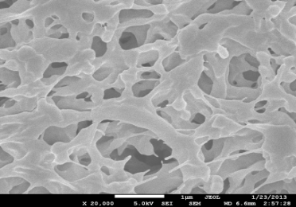
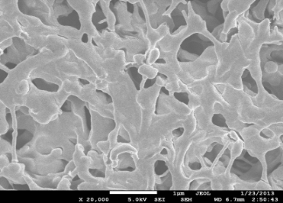
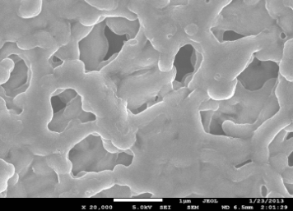
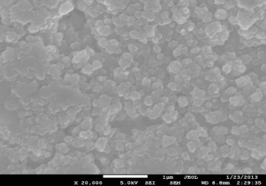
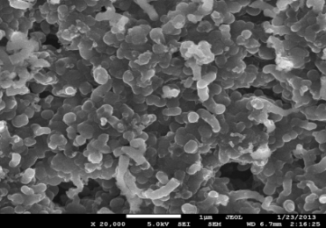
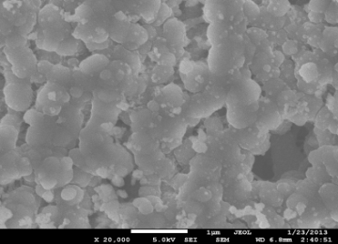
CP Coated Pt/PVDF Flat Membrane; Step1
Conductivity
Electroactivity
Morphology;
(Porosity and Cross Section)
Water and ACSF Flux
Goniometry
XPS mapping
PVDF Pt/PVDF PPy-pTS/Pt/PVDF
PPy-DBS/Pt/PVDF PPy-DS/Pt/PVDF PPy-HA/Pt/PVDF
SEM images of PVDF membranes with different dopants
Water flux of PVDF, Pt/PVDF, 5 min growth PPy/pTS/Pt/PVDF and 10 min growth PPy/pTS/Pt/PVDF membranes

Slide 8
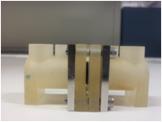
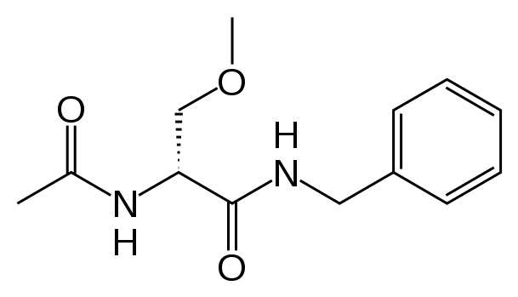
CP Coated Pt/PVDF Flat Membrane; Step1
Drug transport studies has been carried out using transport cell and artificial cerebrospinal fluid (ACSF) and phosphate buffer saline (PBS) as solvents.
Drug transport has been investigated for “long time” (i.e. 120 min) and “short time” (i.e. 10 min) and sampling has been done every 1, 5, 10, 30 and 60 minutes for long time studies and every 15 seconds and 1 minute for short term studies.
Also drug transport has been investigated at passive, active and pulsed states.
Drug transport cell
Concentration of transported LCM through PPy/CS/Pt/PVDF membrane at passive and active states
Lacosamide (LCM) chemical structure

Slide 9
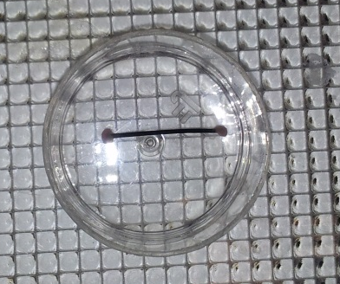
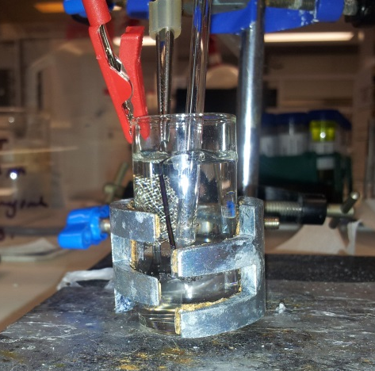
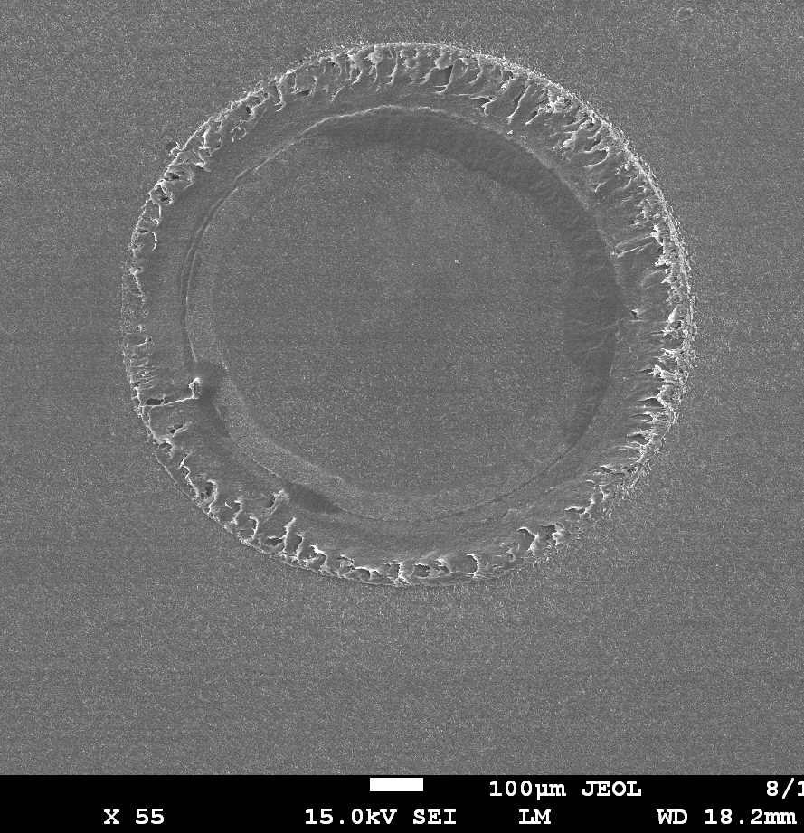
CP Coated Pt/PVDF Hollow Fibre Membrane; Step 2
CP coated Pt/PVDF hollow fibre membrane
CP | Constant current(mA/cm2) | Time (sec )
PPy/CS | 0.25, 0.5, 1 | 15, 30, 60
PPy/DBS | 0.5, 1 | 15, 30, 60
PPy/PSS | 0.5, 1 | 15, 30, 60
PPy/pTS | 0.5, 1 | 15, 30, 60, 120
Electropolymerization of CP on Pt/PVDF membrane using three electrode system
Characterization study of CP/Pt/PVDF hollow fibre membranes
Conductivity
Electroactivity
Morphology (Porosity and
Cross Section)
Water and ACSF Flux
Cross-section image of PPy/CS/Pt/PVDF hollow fibre membrane
PPy/CS layer

Slide 10
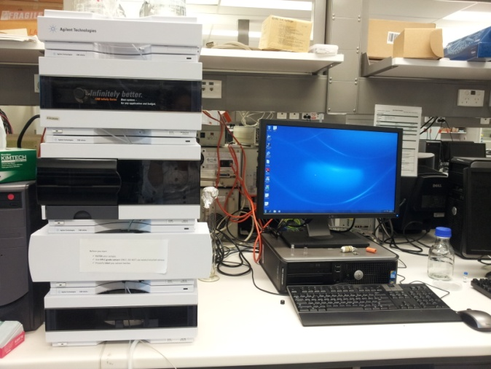
CP Coated Pt/PVDF Hollow Fibre Membrane; Step 2
HPLC system
One Pulse
Concentration of released LCM from inside of PPy/CS/Pt/PDVF hollow fibre membrane at passive, reduced and oxidized states.
Gate closed
Concentration of released LCM from inside of PPy/CS/Pt/PVDF hollow fibre membrane at pulsed potential state.
Gate open

Slide 11
Conclusion
Drug transport at reduced state is higher than oxidized and passive states in both CP coated platinized flat and hollow fibre PVDF membranes.
At pulsed potential state on/off release of anti-epilepsy drug through CP coated membranes was successfully controlled.

Slide 12




Acknowledgments
Supervisors
Prof G. G Wallace
Prof S. E Moulton
Prof M. J Cook
Collaborators
Dr Rikky Muller
Mr Winston Ng
The University of Melbourne, Department of Electrical and Electronics Engineering
A/Prof Michael Higgins
Dr Paul Molino
Dr Stephen Beirne
Dr Zhilian Yue
Dr Tony Romeo
Dr Patricia Hayes
Dr Dorna Esrafilzadeh
Dr Ali Jalili
Ali Jeirani
Dr Javad Foroughi
Faculty of Science (Matching Scholarship)
IPRI Staffs and Students

