Slide 1
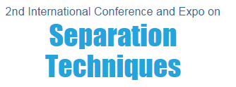



Valencia –September 28th
“SFC-MS as a Tool for Flower absolutes composition analysis”
Cyrille SANTERRE –Analytical chemistry engineer / Cosmetologist

Slide 2
CHAPTER I
THEORY

Slide 3
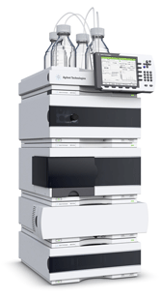
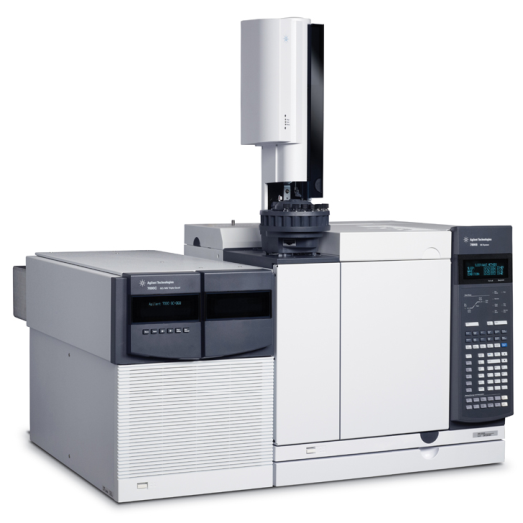
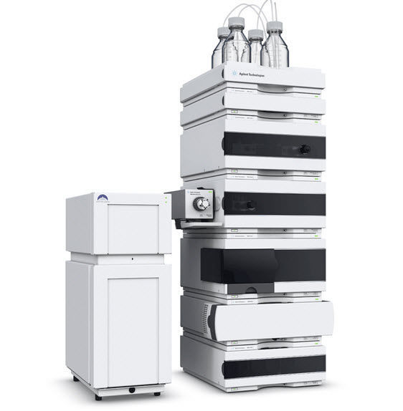
SEPARATIVE METHODS
Versus
Versus
GC : analytical et …
HPLC : analytical and preparative
* Non-volatil, polar, no derivatization
* thermolabile compound
* Heavy molecular weight compounds
* Faster analysis
* Less pressure
* Same columns
* Numerous detectors easy hyphenation
* High resolution power~5X/HPLC
Supercritical chromatography : analytical and preparative

Slide 4
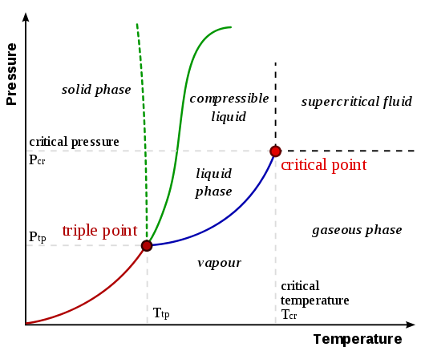
CO₂ STATE DIAGRAM
73,8 bar
31,1 °C
http://chemwiki.ucdavis.edu/Core/Physical_Chemistry/Physical_Properties_of_Matter/States_of_Matter/Phase_Transitions/Phase_Diagrams

Slide 5
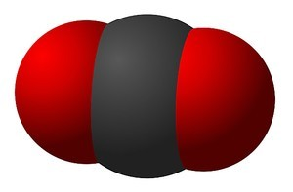
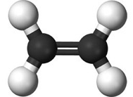
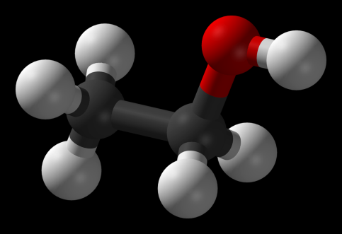
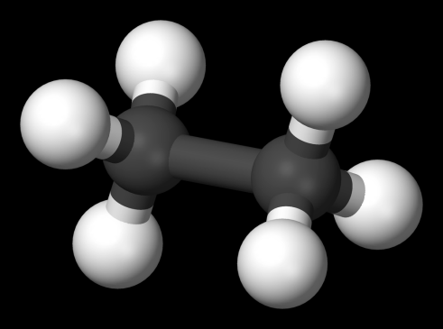
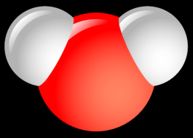
OTHER POSSIBLE FLUIDS
T Critique (°C) : 31,1
P Critique (Bar) : 73,8
T Critique (°C) : 9,5
P Critique (Bar) : 50,8
T Critique (°C) : 241
P Critique (Bar) : 61,4
T Critique (°C) : 374
P Critique (Bar) : 220
T Critique (°C) : 32,2
P Critique (Bar) : 48,8
http://www.portail-fluides-supercritiques.com/Fluides-supercritiques.55.0.html
CO₂ easy to produce
Water : corrosive and possible thermal damages for products
Propane uses in other countries

Slide 6
BENEFITS OF CO₂
Not expensive : 1 kg = 1 euro
Non-toxic fluid: analytical and extraction methods are « green »
Bit agressive for compounds and colums (vs HPLC)
Physical properties:
  Low viscosity = less pressure drop (quicker analysis),
  diffusivity = increased efficiency.
 | LIQUID | SUPERCRITICAL (T~Tc P~1 à 4 Pc) | GAS (T & P room)
Density(kg/m³) | 600-1600 | 100 - 900 | 0,6 - 2
Viscosity (Pa.s) | 10⁻³ | 10⁻⁵ - 10⁻⁴ | 10⁻⁵
Diffusivity D (m²/s) | 10⁻⁹ | 10⁻⁸ | 10⁻⁵
What is a Supercritical Fluid ? Author: Michel PERRUT - SEPAREX

Slide 7
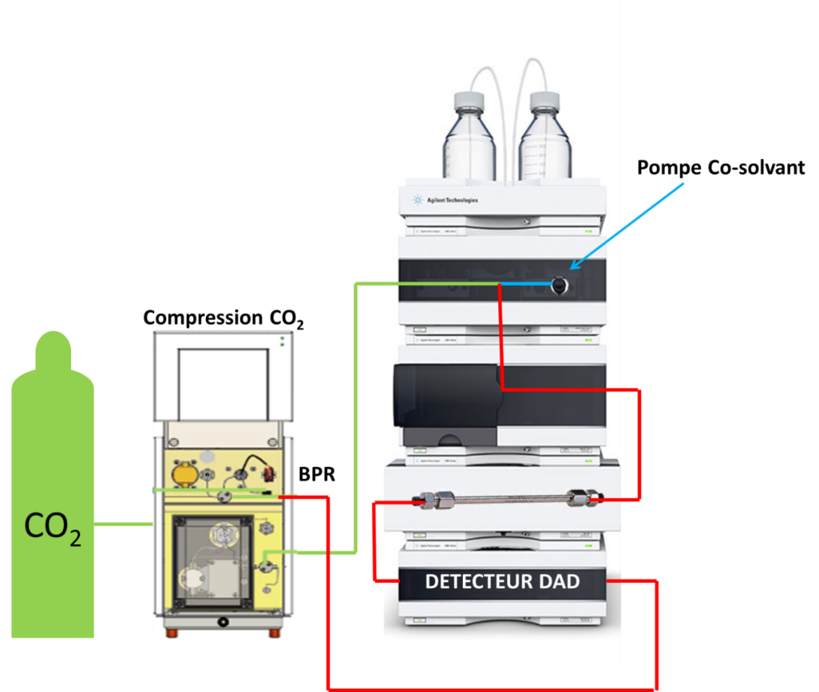

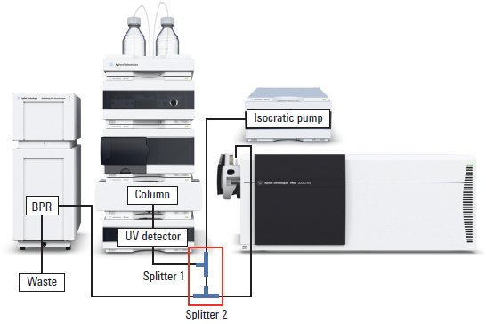

OUR APPARELS
SFC-UV
SFC-QTOF
Co-solvent pump
CO₂ pump
UV detector

Slide 8
CHAPTER II
COSMETIC ALLERGENS

Slide 9

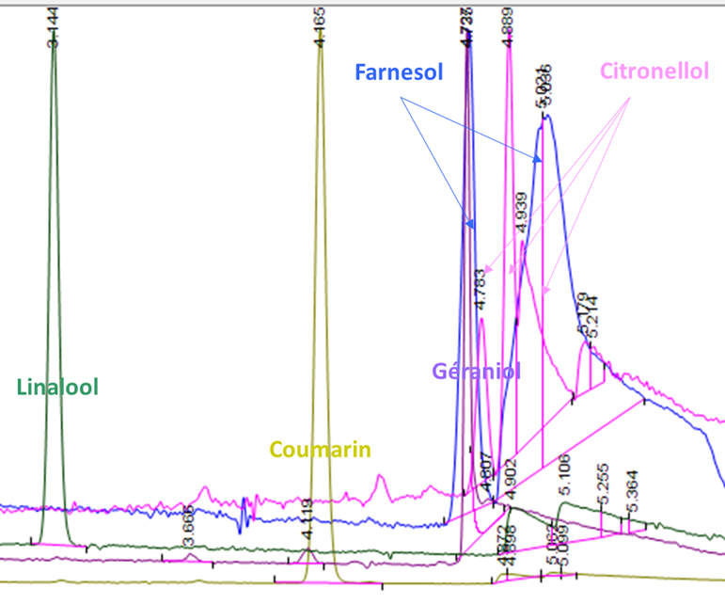
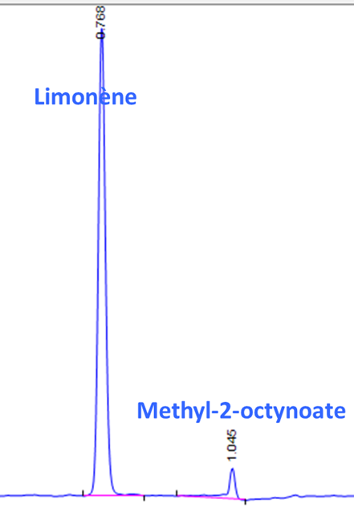
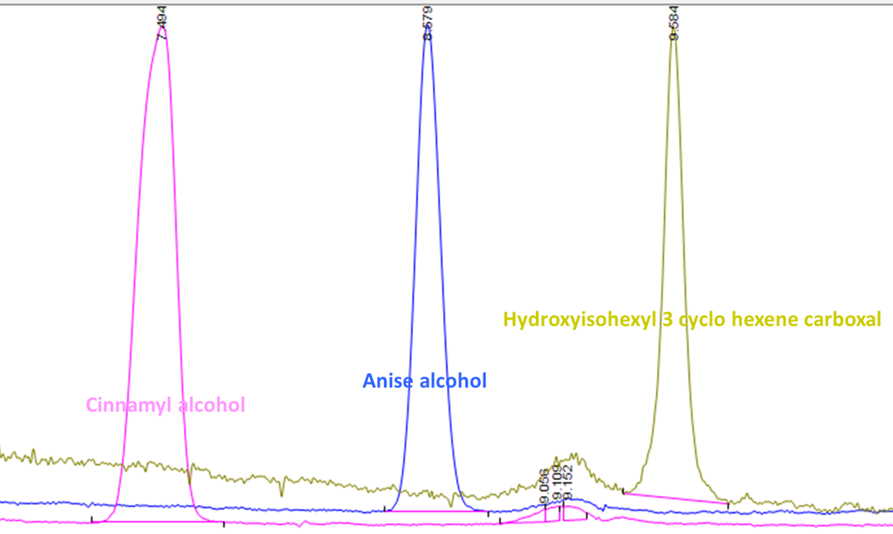
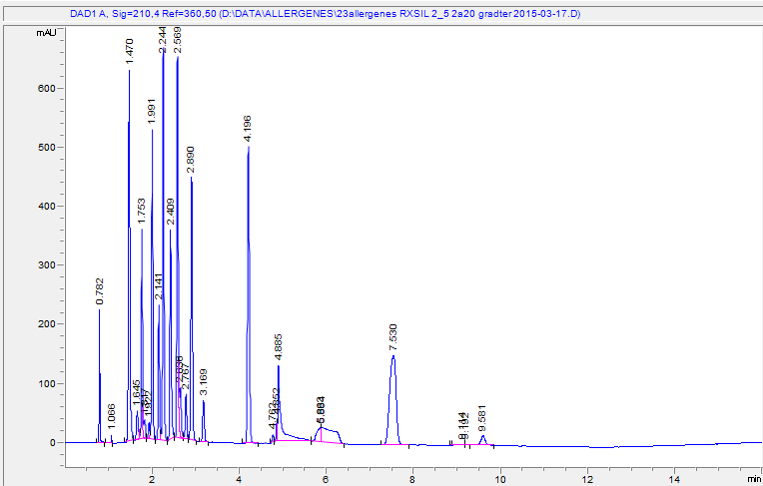
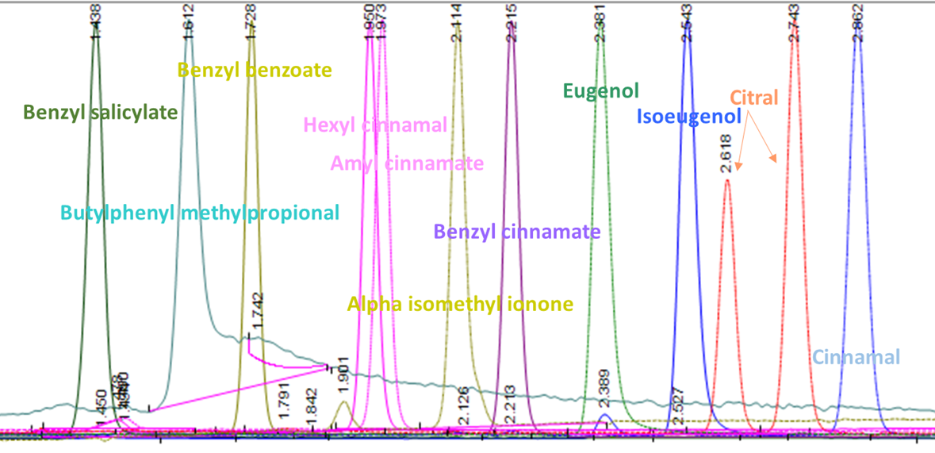
COSMETIC ALLERGENS
Column RXSIL 150mm*4,6mm*5µm
Time (Min) | %A | %B | Flow (ml/min)
0,00 | 98,0 | 2,0 | 2,500
6,00 | 98,0 | 2,0 | 2,500
10,00 | 80,0 | 20,0 | 2,500
11,00 | 80,0 | 20,0 | 2,500
14,00 | 98,0 | 2,0 | 2,500
Chromatographic conditions:
BPR : 150 bar
Column temperature: 30 °C
Flow : 2,5 mL/min
Mobile phase : CO₂ / ACN
Analysis run time 16 minutes and 3 minutes post-run
UV detection :
Wavelength : 210 nm Width : 4 nm
Wavelength : 254 nm Width : 4 nm
Wavelength : 280 nm Width : 4 nm
Reference : 360 nm Width : 50 nm

Slide 10
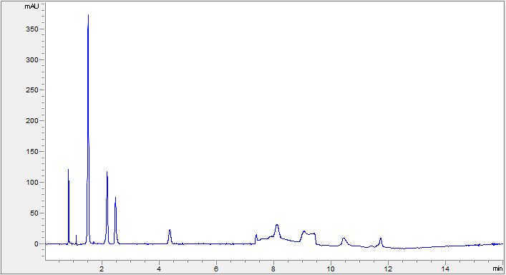
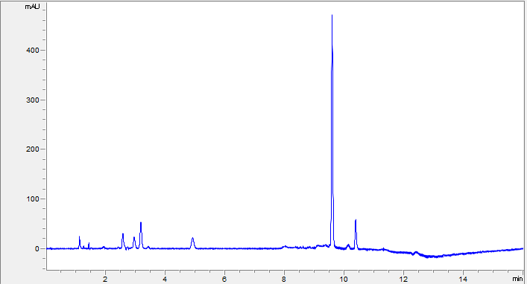
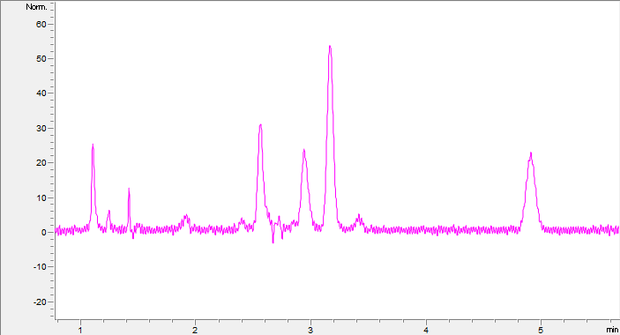
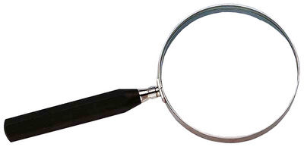
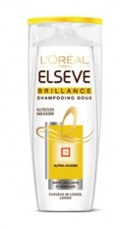
COSMETIC PRODUCT FROM MARKET
Benzyl salicylate
STANDARD
Limonène
Hexyl cinnamal
Alpha isomethyl ionone
hexyl cinnamal
SHAMPOO AFTER EXTRACTION
limonène
linalol
Géraniol
Benzyl alcohol
Citronellol
Linalol
Lyral
Lilial
Formula :
Aqua / water, sodium laureth sulfate, dimethicone, coco-betaine, cetyl alcohol, hydroxystearyl cetyl ether, sodium chloride, ci 47005 / acid yellow 3, guar hydroxypropyltrimonium chloride, cocamide mipa, sodium benzoate, sodium cocoate, sodium hydroxide, ppg-5-ceteth-20, jojoba wax peg-120 esters, salicylic acid, limonene, linalool, propylene glycol, carbomer, methyl cocoate, citric acid, hexyl cinnamal, parfum / fragrance.

Slide 11
CHAPTER III
ESSENTIAL OILS

Slide 12

CLOVE ESSENTIAL OIL
Material & Method
UV detection:
Wavelength: 200 nm Width: 4 nm
Wavelength : 254 nm Width : 4 nm
Wavelength : 280 nm Width : 4 nm
Reference : 360 nm Width : 50 nm
Column HYPERCARB 150mm*4,6mm*5µm
Chromatographic condition:
BPR : 150 bar
Column temperature: 30 °C
Flow: 2,5 mL/min
Mobile phase : CO₂ / ACN
Time (Min) | %A | %B | Flow (ml/min)
0,00 | 95,0 | 5,0 | 2,500
3,00 | 95,0 | 5,0 | 2,500
15,00 | 80,0 | 20,0 | 2,500
17,00 | 95,0 | 5,0 | 2,500

Slide 13
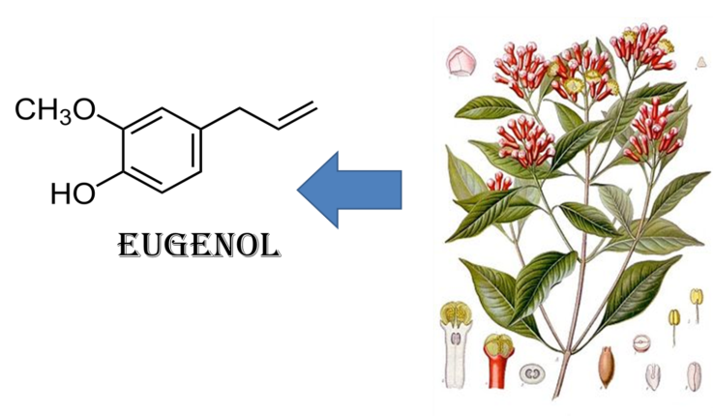
CLOVE ESSENTIAL OIL
Calibration curve
Repeatability & reproducibility
AVERAGE | 3014,61
STD DEV | 22,33
%REPETA | 0,74
AVERAGE | 7637,02
STD DEV | 50,36
%REPRO | 0,66
Repeatability and reproducibility parameters are « acceptable » to use for an assay method.

Slide 14
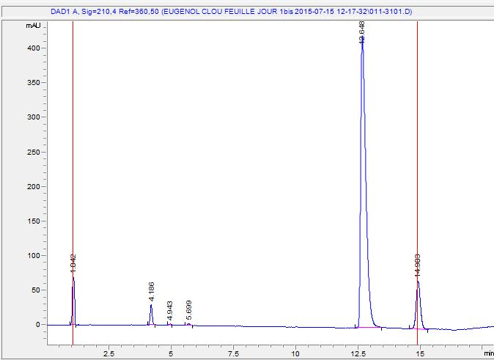
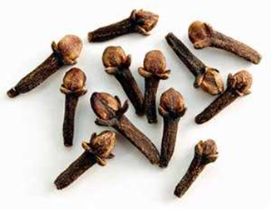
CLOVE ESSENTIAL OIL
Clove essential oil analysis
Eugenol
Other compound could be detected and analyzed.
LOD : 3 ppm
LOQ : 11 ppm
Recovery rate: 99,1%
AVERAGE | 81,46
STD DEV | 0,68
RSD% | 0,83

Slide 15
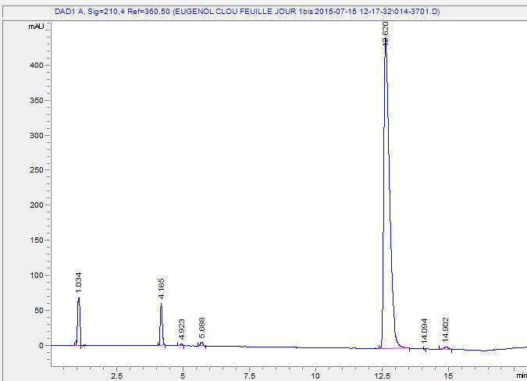
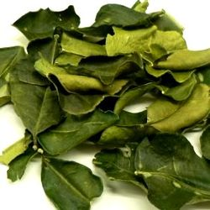
CLOVE LEAF OIL
Clove leaf oil analysis
Eugenol
AFNOR?
LOD : 3 ppm
LOQ : 11 ppm
Recovery rate : 99,1%
β-Caryophyllène
Acétate Eugenyl
AVERAGE | 86,67
STD DEV | 0,23
RSD% | 0,27

Slide 16
CHAPTER IV
FLOWER ABSOLUTES

Slide 17
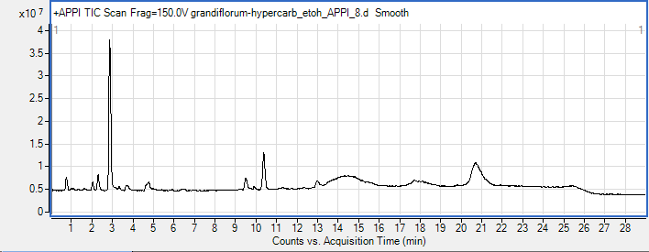
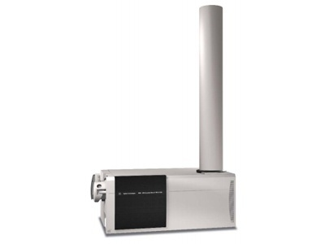
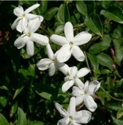
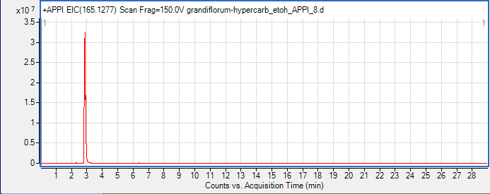
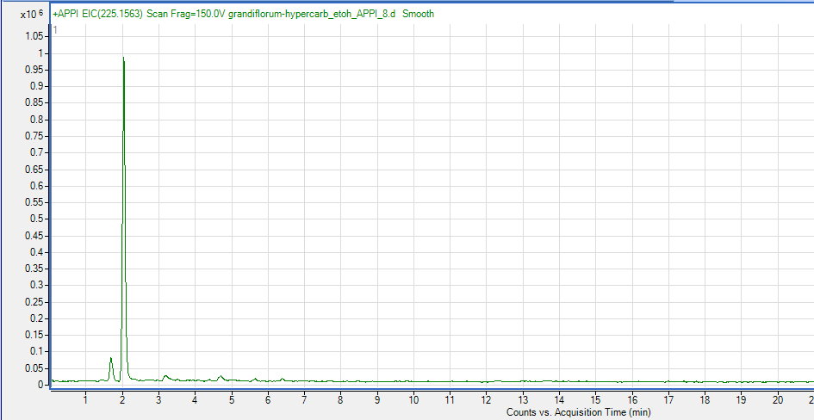
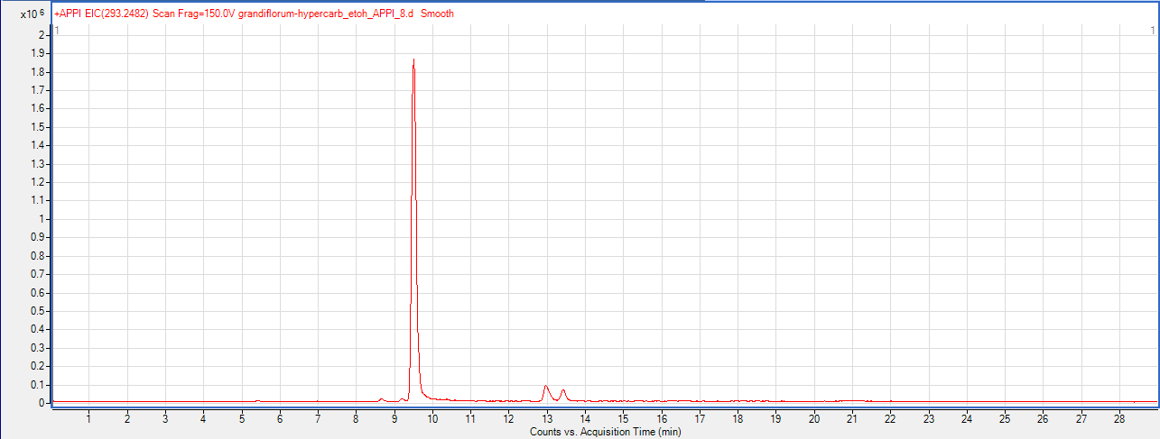
JASMINE ABSOLUTE
165.1277 jasmone
225,1563 (Z)-methyl epi-jasmonate
293,2482 methyl (Z)-linolenate
Jasminum grandiflorum

Slide 18
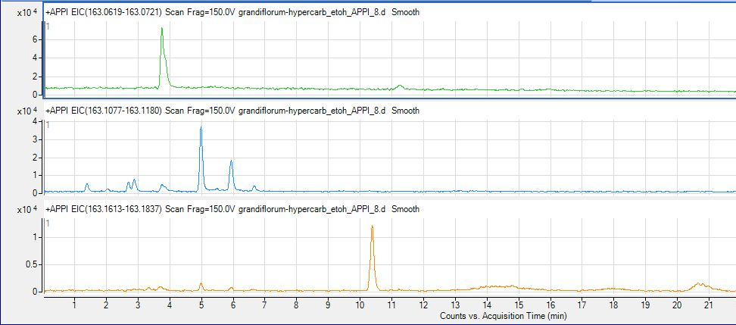
JASMINE ABSOLUTE
163,0752 C₁₀H₁₀O₂
163,1111 C₁₁H₁₄O
163,1481 C₁₂H₁₈
Jasminum grandiflorum

Slide 19

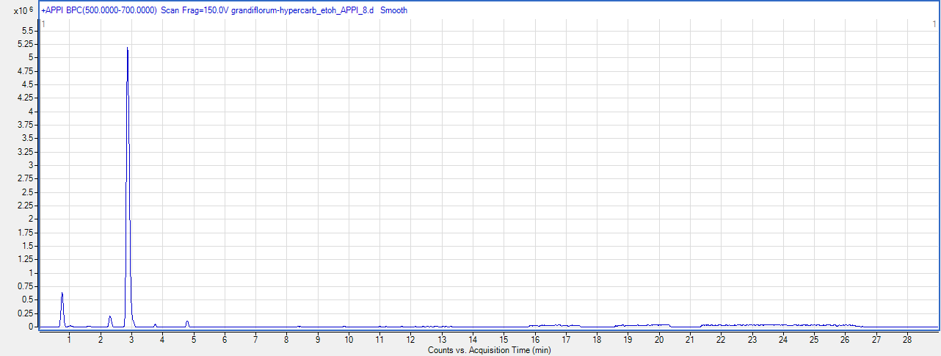
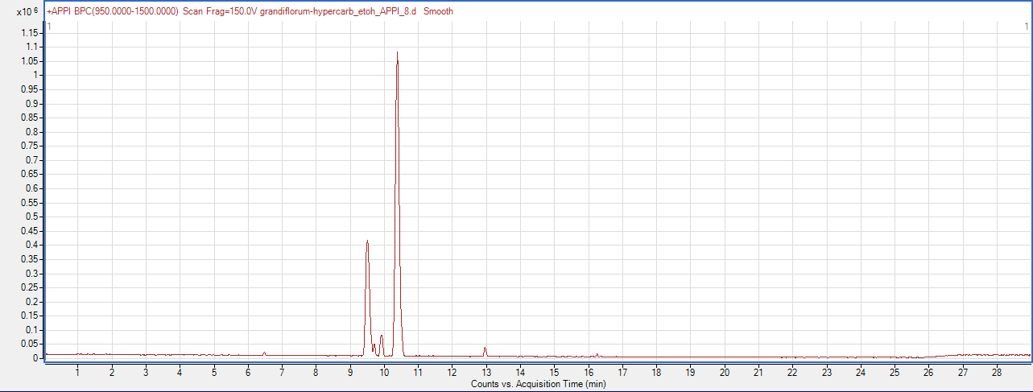
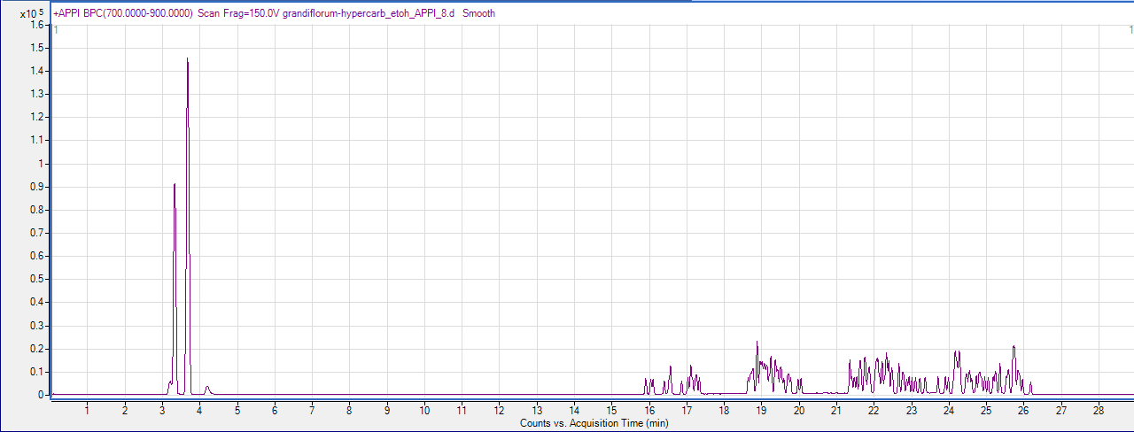
JASMINE ABSOLUTE
500-700
950-1500
700-900
Jasminum grandiflorum

Slide 20
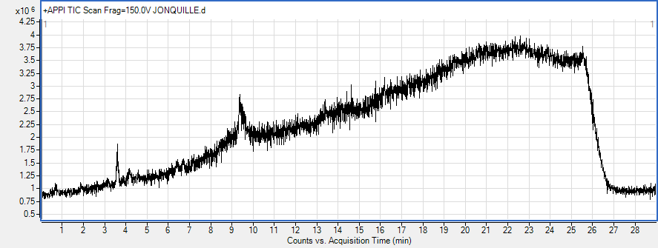
TIC
SFC-QTOF Generic Method

Slide 21
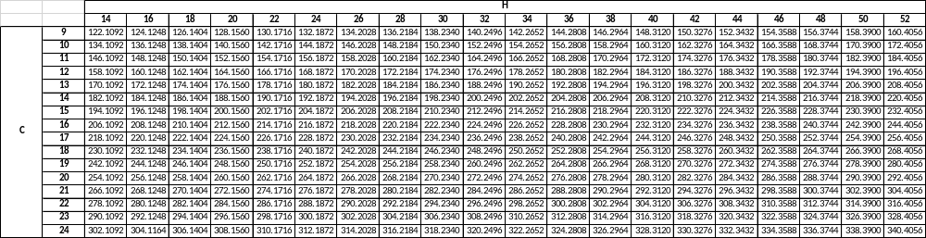
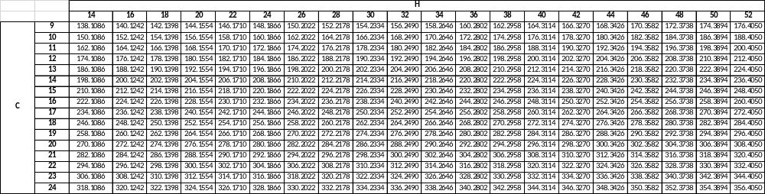
EXACT MASS ARE CREATED
1 Oxygène, 2 O …

Slide 22
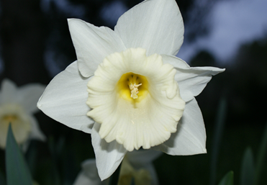
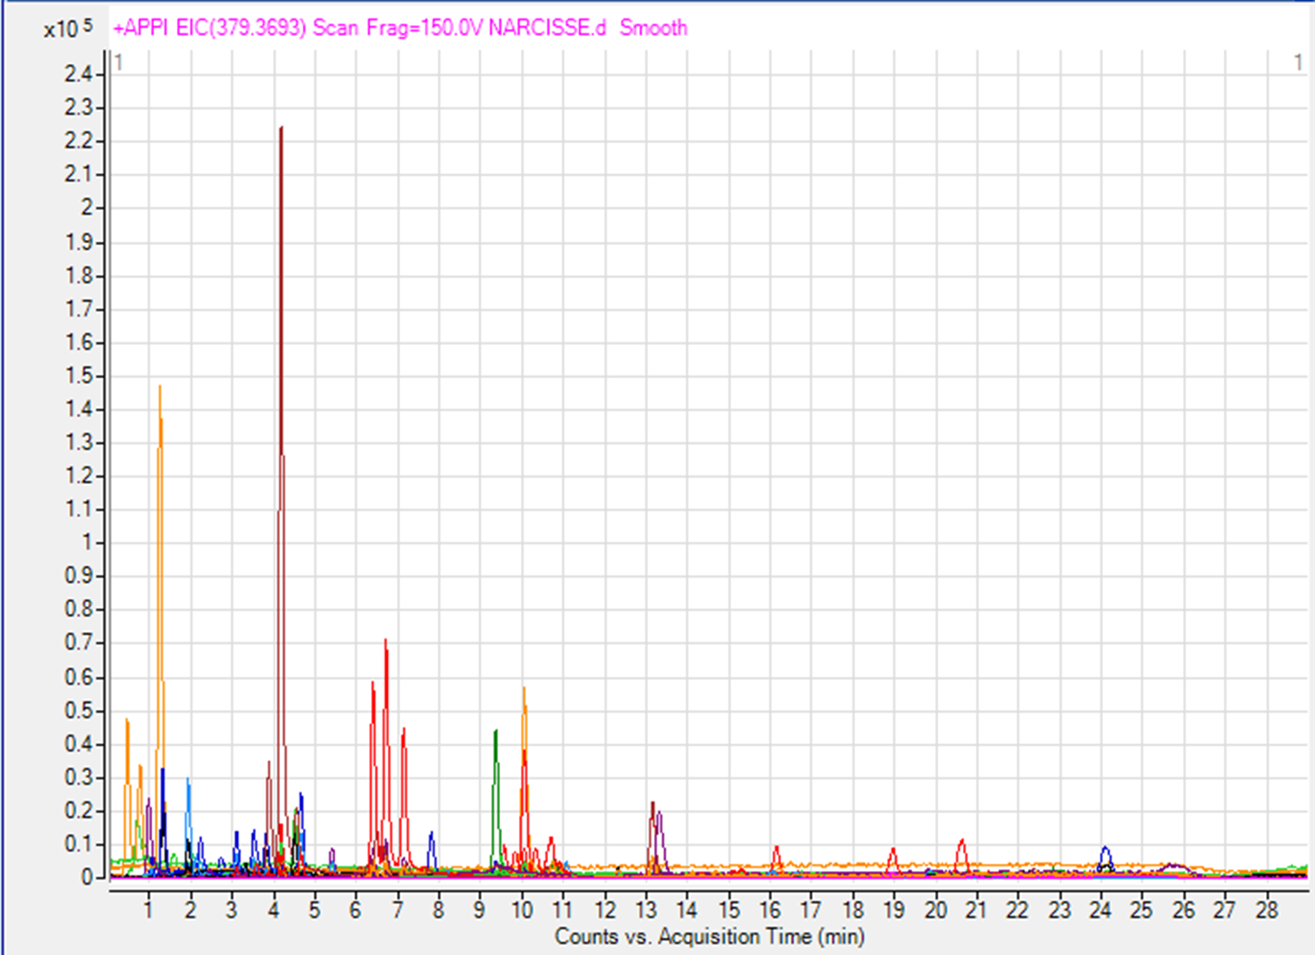
NARCISSUS

Slide 23

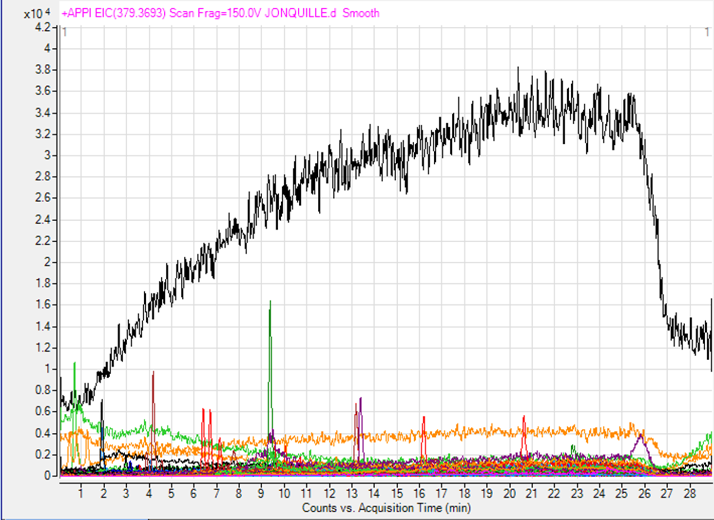
JONQUIL

Slide 24

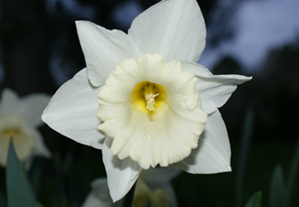


NARCISSUS VS JONQUIL
Family : Amaryllidaceae,
Sub-family : Amaryllidoideae,

Slide 25
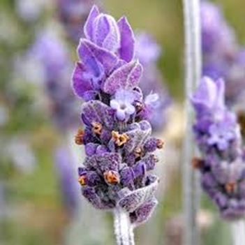
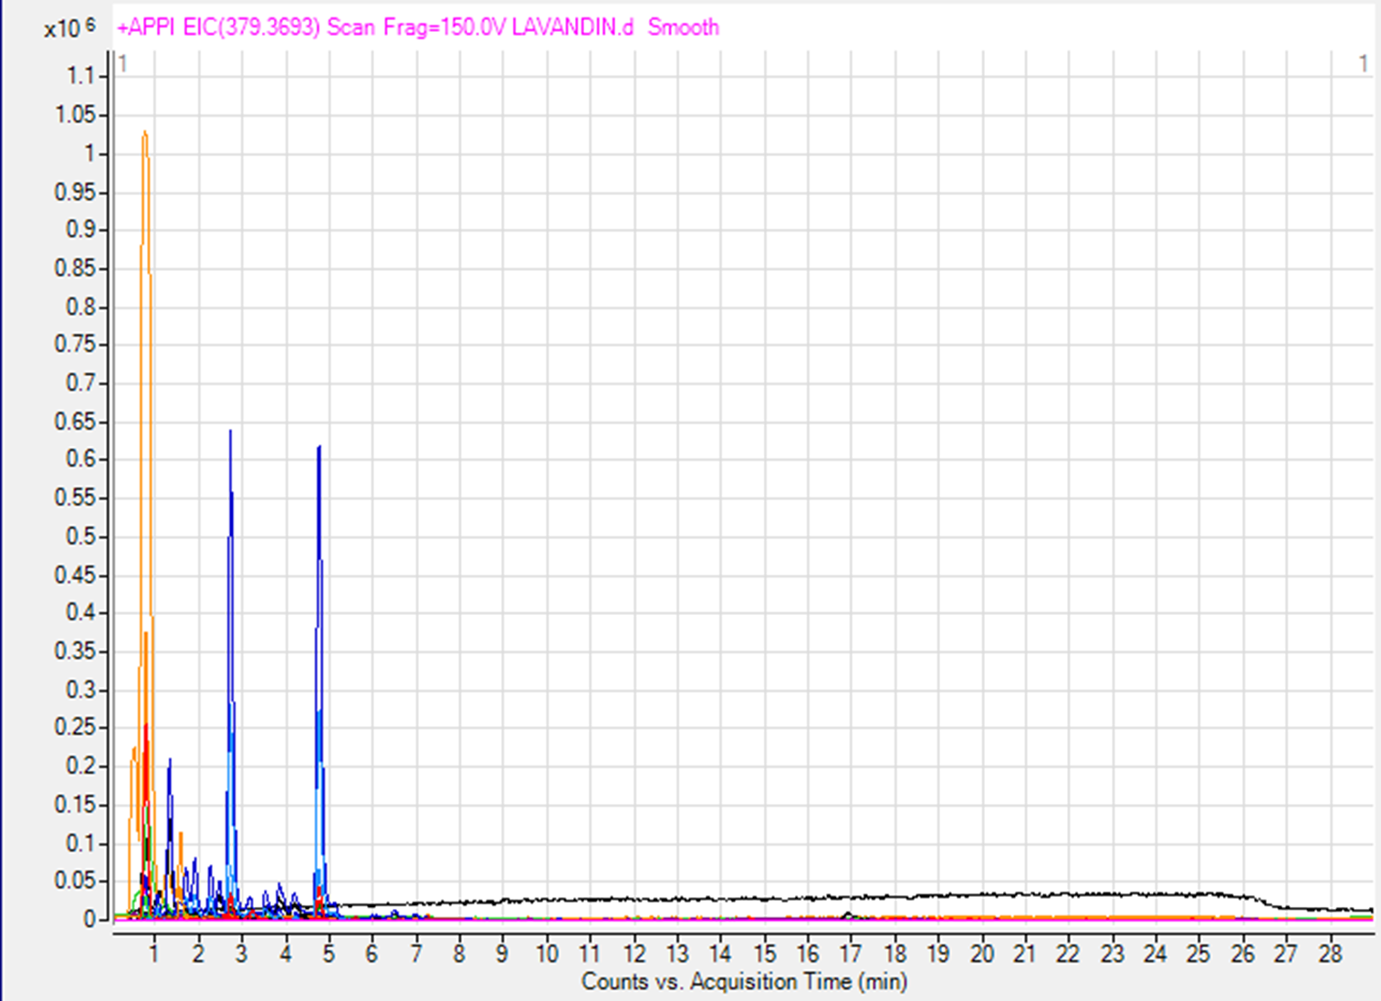
LAVANDIN

Slide 26
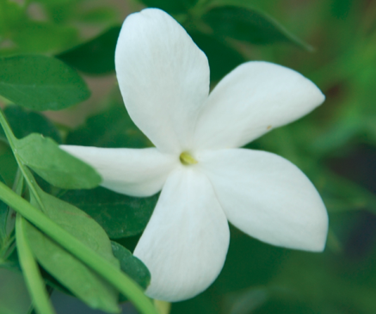
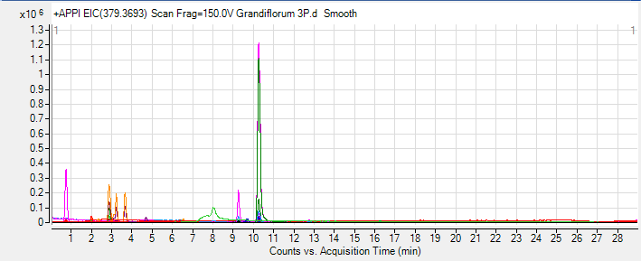
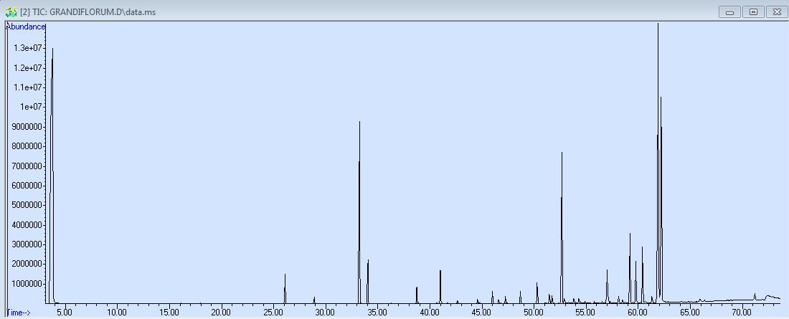
GRANDIFLORUM JASMINE
SFC PROFILE
GC PROFILE

Slide 27
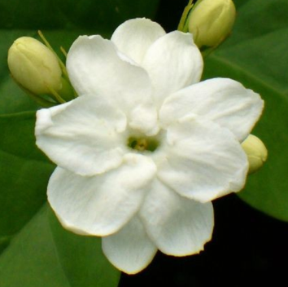


SAMBAC JASMINE
SFC PROFILE
GC PROFILE

Slide 28

PROFILES

Slide 29

POS MODE VS NEG MODE IN APPI

Slide 30

POS MODE VS NEG MODE IN APPI

Slide 31



GRANDIFLORUM VS SAMBAC IN POS MODE

Slide 32

GRANDIFLORUM VS SAMBAC IN NEG MODE

Slide 33



POS MODE POS VS NEG MODE IN APCI

Slide 34



POS MODE POS VS NEG MODE IN APCI

Slide 35


POS MODE VS NEG MODE IN ESI

Slide 36



POS MODE VS NEG MODE IN ESI

Slide 37

STATISTICAL ANALYSIS PCA (PRINCIPLE COMPONENT ANALYSIS)

Slide 38

STATISTICAL ANALYSIS MFA (MULTI FACTORIAL ANALYSIS)

Slide 39





STATISTICAL ANALYSIS PCA (PRINCIPLE COMPONENT ANALYSIS)

Slide 40
CONCLUSIONS
Complementary with GC information and more molecules in one analysis (HPLC + GC)
Better information with HRMS
Interest to test different ionization sources and modes
We could correlate graphical view and PCA treatment
Species are well separated
Same family are closed but separated
Confirm results with more samples
Try method with other absolutes

Slide 41






THANKS FOR YOUR ATTENTION
Mass Spectrometry team
Alain Brunelle (DR1)
David Touboul (CR1)
Nadine Vallet (PEPS team manager)

