Slide 1
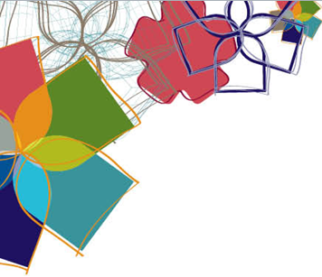

Development of an Angiogenesis-Inhibiting Anti-VEGF Fc-Fusion Protein
Sanjukta Chakrabarti
School of Life and Environmental Sciences
Deakin University, Australia
2nd World Bio Summit & Molecular Biology Expo
October 11, 2016

Slide 2

Outline
Background
    Angiogenesis
    VEGF & VEGF-Receptors
    Fc-Fusion Protein
Aim
Rationale
Methodology
Results
Conclusion

Slide 3
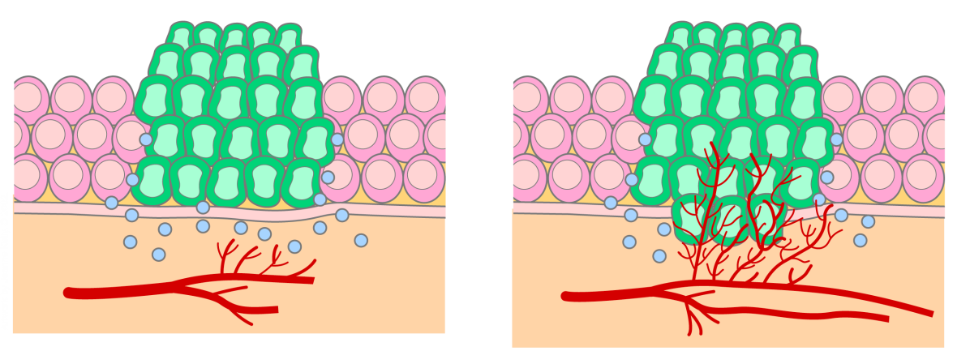
Angiogenesis
Pathological Angiogenesis
Physiological Angiogenesis
Wound healing
Embryo development
Organ regeneration
Angiogenesis
Cancer
Rheumatoid arthritis
Retinopathy
Psoriasis
Anti-angiogenesis
Pro-angiogenic molecules
Anti-angiogenic molecules
Pro-angiogenesis
VEGF Integrins
FGF NO
Eph Ang
EGF PlGF
TGFα/β TNF
ON
Angiostatin
Endostatin
INF
Thrombospondin
TIMP-1,2,3
Angiogenic Switch
Pro-angiogenesis
OFF
Anti-angiogenesis
Stroke
Ulcers
Chronic wounds
Angiogenesis is a fundamental step for transition of tumors from dormant to malignant state.

Slide 4
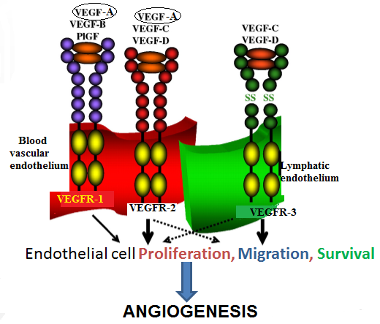
VEGF & VEGFRs
Image: Tuomas Tammela et al. Cardiovasc Res 2005;65:550-563

Slide 5
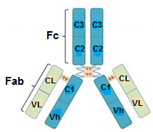
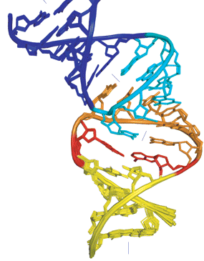

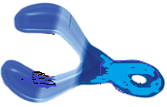
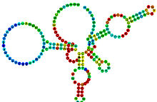
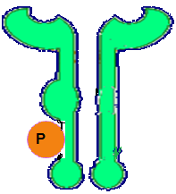

Angiogenesis Inhibitors
Monoclonal Antibodies (Anti-VEGF)
Aptamers
siRNA, Antisense
VEGF
Fc
Fc-Fusion (Decoys)
Ribozymes
Anti-VEGFR1/2 Antibodies
Receptor tyrosine kinase Inhibitors
VEGF Receptor
VEGF /VEGF R pathways are most targeted for therapeutic purposes.

Slide 6
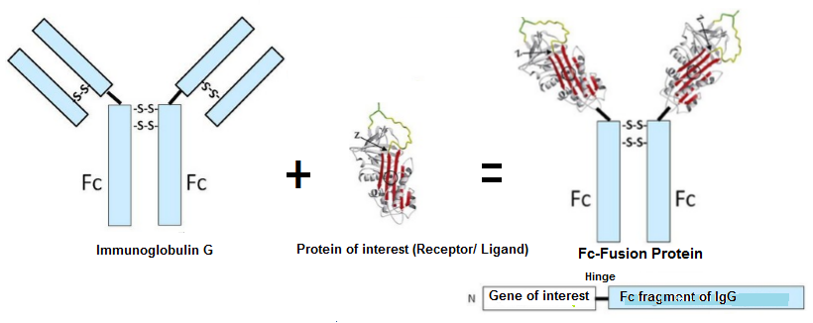
Fc-Fusion Proteins
Chimeric protein fused to immunoglobulin Fc-region
Mimics cellular receptor
Can bind to activated form of receptor
Advantages over antibodies
    Increases serum half-life (FcRn)
    Prolongs therapeutic activity (FcR on immune cells)
    Improves stability
    Increases solubility
    Easy cost-effective purification

Slide 7

Aims
Development of a VEGF-binding Fc-fusion protein
Assessment of anti-angiogenic properties of the protein
Assessment of anti-tumor effects in animal model

Slide 8
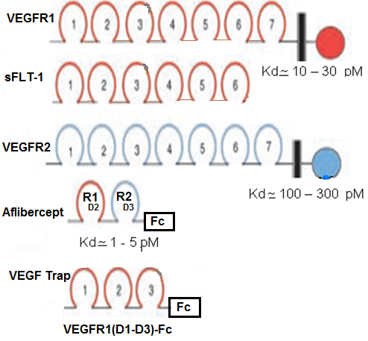
Rationale
Proposed molecule will have high ligand-
binding affinity (“D2” of VEGFR1)
Structure of proposed molecule based on requirement of flanking domains

Slide 9
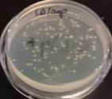
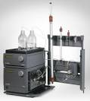
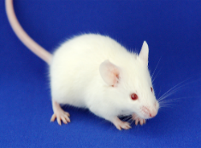
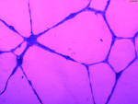
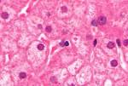
Methodology
Gene Synthesis
Ligation to vector (Cloning/Expression)
Cloning
Transformation (E.coli/CHO cells)
Clone selection
Protein Expression
Protein Purification
Protein Characterization
Functionality determination
Xenograft mice model
Histopathology
In vitro
In vivo
Immunohistochemistry

Slide 10
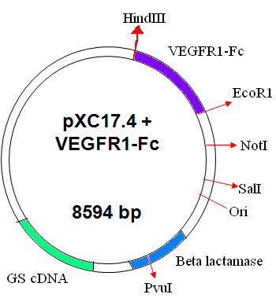
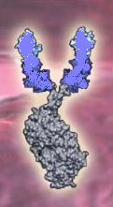
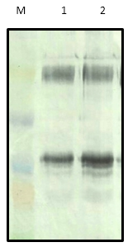
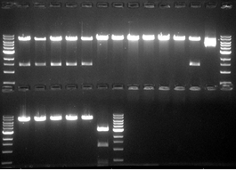
Cloning & Expression of VEGFR1(D1-D3)-Fc
VEGFR1 (D1+D2+D3)
Cloning
IgG1- Fc
40 kDa
30 kDa
78 kDa (monomer)
40 kDa (clipped protein)
30 kDa (clipped protein)
Selection of clone
Western Blot of Protein expressed

Slide 11
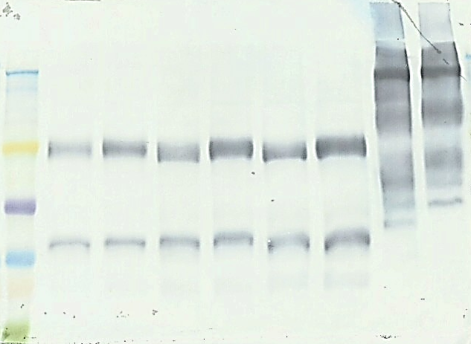
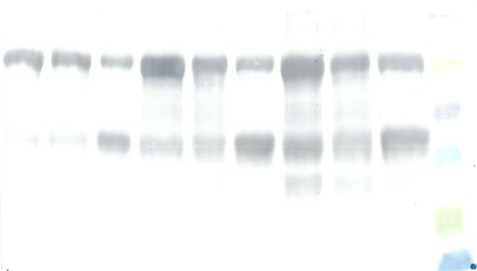
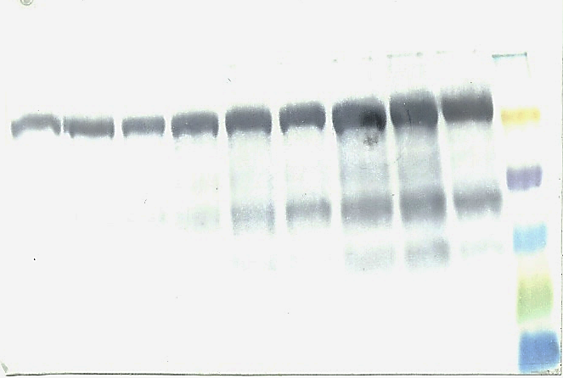
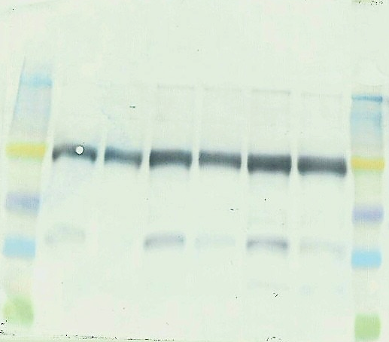
Inhibition of Proteolysis
With Ferric citrate
With Protease Inhibitor
Day 7
Day 5
Day 8
Day 12
Day 4
Day 11
1 2 3 4 5 6 7 8 9 10
1 2 3 4 5 6 7
++ + - ++ + - ++ + -
- + - + - +
78 kD
40 kD
37°C
37°C
1 2 3 4 5 6 7 8 9 10
++ + - ++ + - ++ + -
1 2 3 4 5 6 7 8
78 kD
- + - + - +
40 kD
30°C
30°C
Proteolysis inhibition observed with inhibitors, at shorter culture duration & lower temperature.

Slide 12
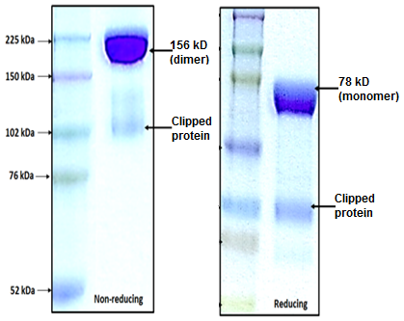
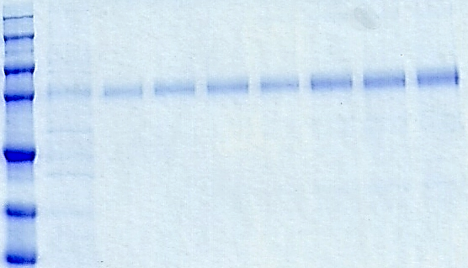
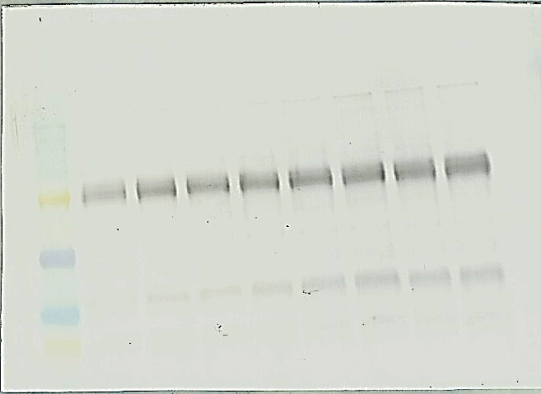
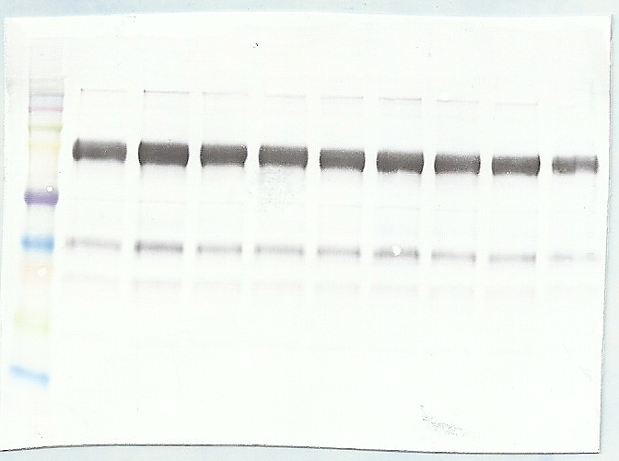
Production & Purification of Protein
4 litres culture; 30°C; 8 days
Harvest supernatant
Protein A affinity chromatography
Ion-exchange chromatography
Day 1
Day 3
Day 2
Day 4
Day 5
Day 6
Day 7
Day 8
78kD
SDS-PAGE (Reducing)
78kD
40kD
Western Blot (Reducing)

Slide 13
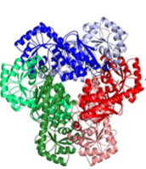
Physicochemical Characterization of Protein
SDS-PAGE
Western Blot
Capillary Electrophoresis
Mass Spectroscopy
Gel/CE-IEF
Mass & Size
Purity
Size Exclusion Chromatography
RP-HPLC
Electromagnetic
Circular Dichroism
Fluorescence spectroscopy
Absorption spectroscopy
Thermodynamic
Differential Scanning Calorimetry
Glycosylation
Capillary Electrophoresis

Slide 14
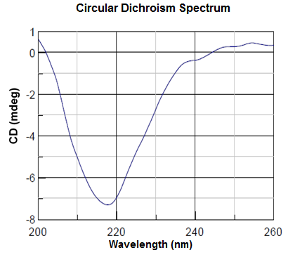
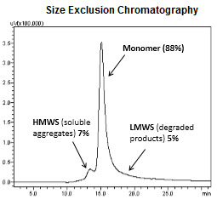
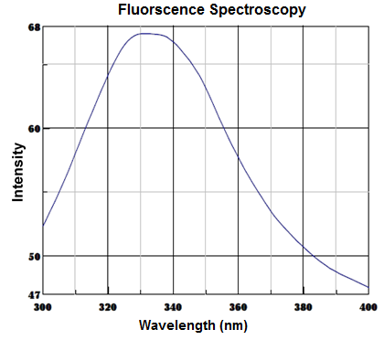
Physicochemical Characterization of Protein
Purity of protein : 88%
Alpha-helix content : 10%
Predominant β-sheet content : 66%
Stable & folded tertiary structure

Slide 15
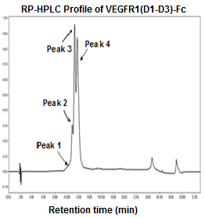
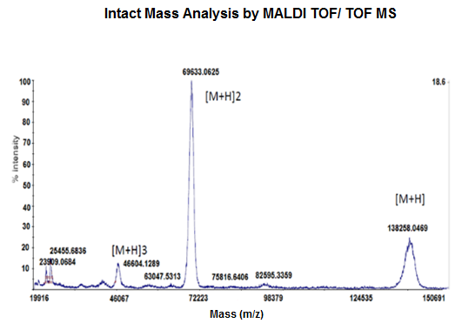
Physicochemical Characterization
Most abundant glycoform of VEGFR1(D1-D3)-Fc showed a mass of 139.1 kDa.

Slide 16
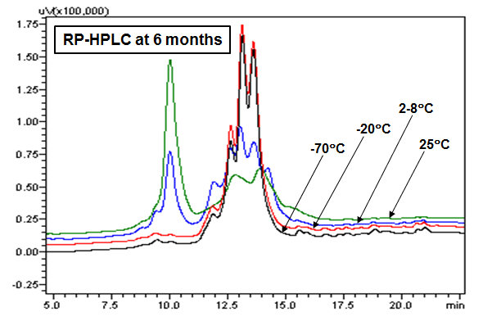
Binding Affinity & Stability of Protein
Impurities (Oxidised protein)

Slide 17
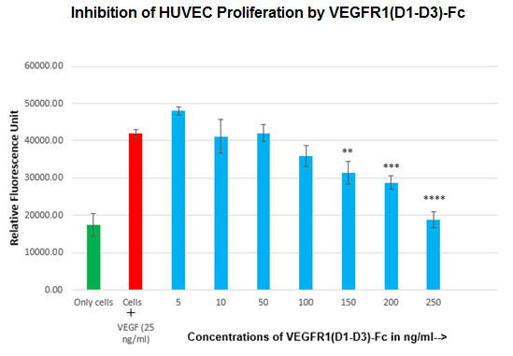
In vitro Assays
Inhibition of Endothelial Cell Proliferation
Cells (HUVEC) grown in presence of VEGF
Cells (HUVEC) in presence of VEGF neutralized by VEGFR1(D1-D3)-Fc
**, p≤0.01; ***, p≤0.001; ****, p≤0.0001.
VEGFR1(D1-D3)-Fc inhibits proliferation of endothelial cells in vitro.

Slide 18
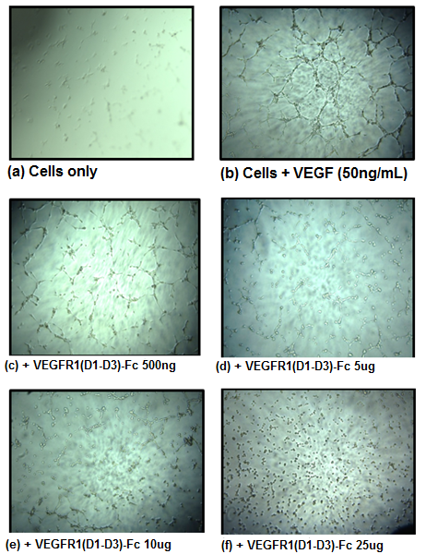
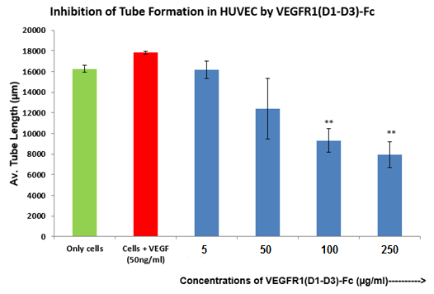
Inhibition of Tube Formation In vitro
**, p≤0.01
VEGFR1(D1-D3)-Fc inhibits capillary network formation in endothelial cells in vitro.

Slide 19
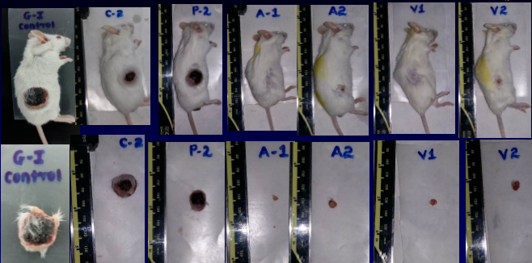
In vivo Efficacy Studies for VEGFR1(D1-D3)-Fc
    16 male SCID mice (6-7 weeks old) with A549 tumors were dosed twice a week for 4 weeks. Treatment groups were:
        Control (untreated) : n=3
        Placebo : n=3
        Aflibercept (15 mg/kg) : n=5
        VEGFR1(D1-D3)-Fc (15 mg/kg) : n=5

Slide 20
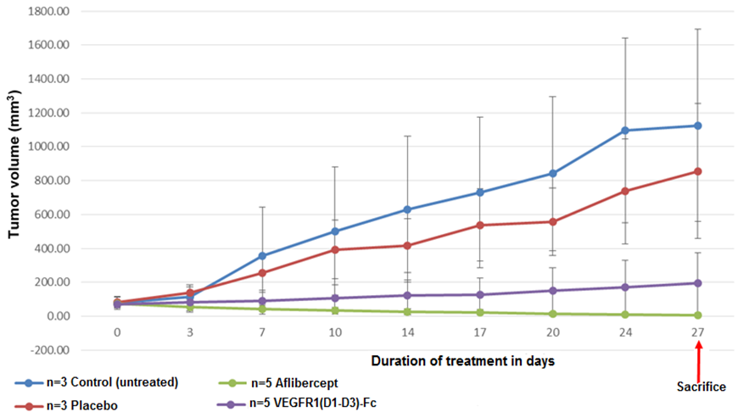
In vivo Efficacy Studies for VEGFR1(D1-D3)-Fc
Tumor Regression in Human Tumor (A549) Xenograft Model

Slide 21
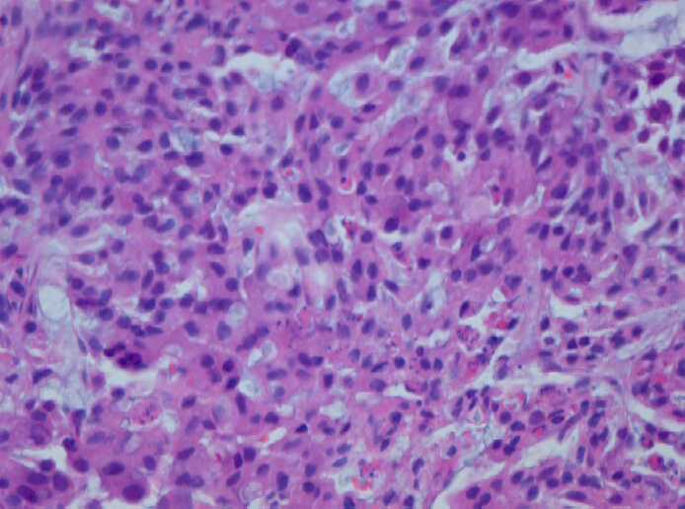
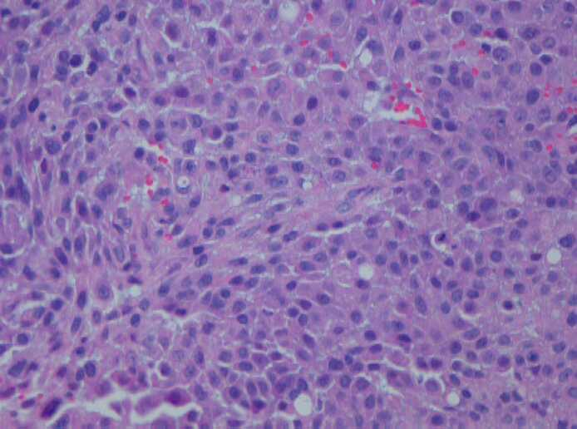
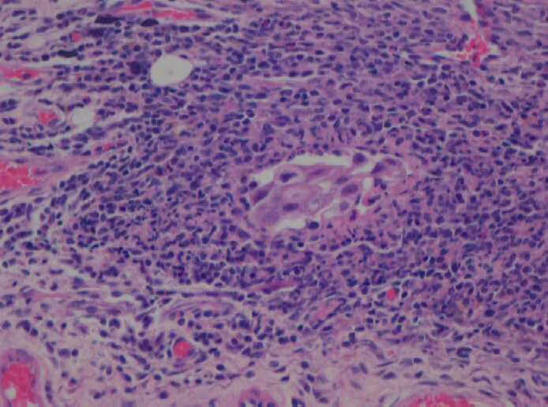
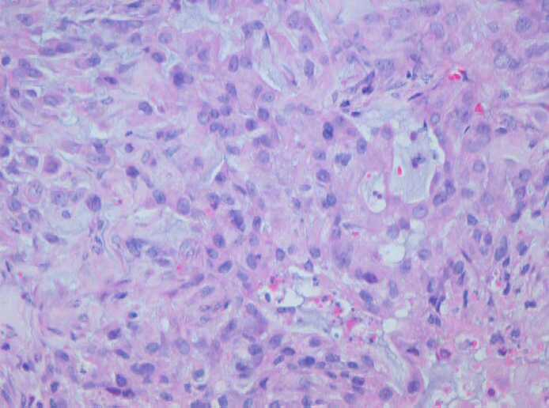
Histopathological analysis of tumors (H&E staining)
Untreated : 70-80% viable tumor
Placebo : 80-90% viable tumor
Aflibercept : 10% viable tumor
VEGFR1-Fc-: 50% viable tumor

Slide 22
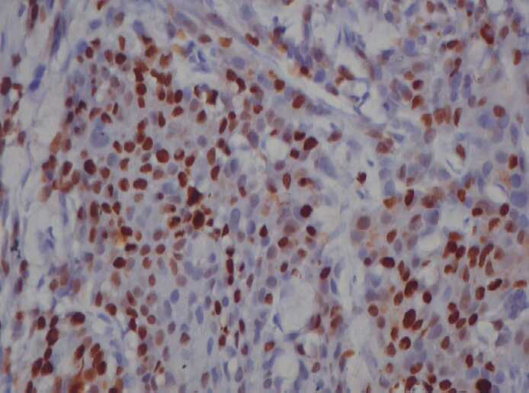
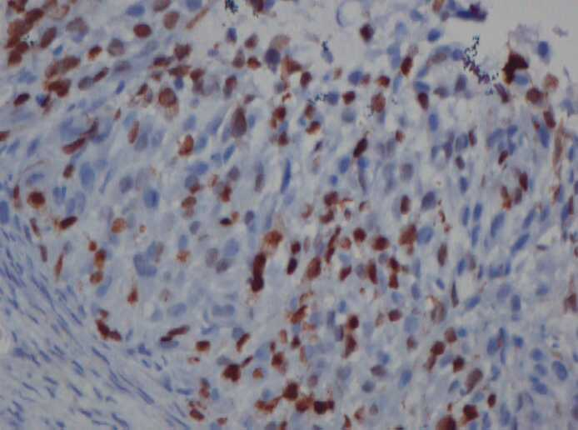
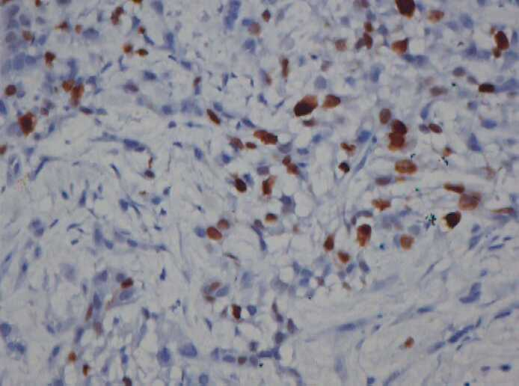
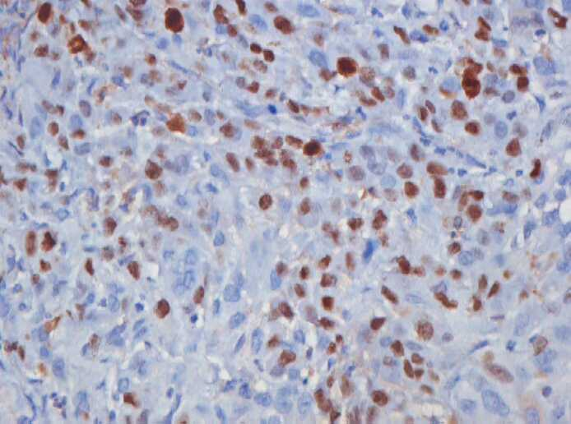
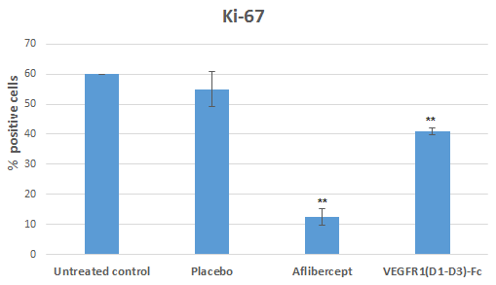
Immunohistochemistry (IHC) with Ki-67 Antibody
Untreated: Ki-67 index = 60%
Placebo: Ki-67 index = 50%
Aflibercept: Ki-67 index ∼15%
Ki67 is a nuclear marker protein for cell proliferation
VEGFR1-Fc: Ki-67 index= 40%
**; p<0.01

Slide 23
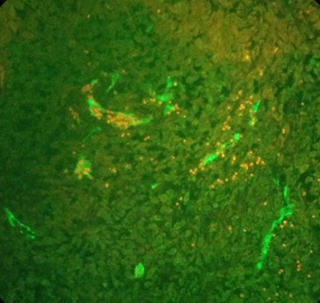
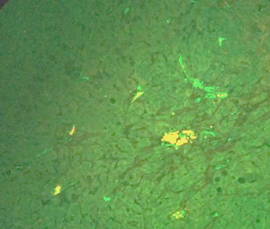


Immunohistochemistry (IHC) with CD31 Antibody
Untreated
Placebo
Aflibercept-treated
CD31 is a highly specific marker for endothelial cells and angiogenesis
VEGFR1-Fc-treated

Slide 24

Conclusion
VEGFR1(D1-D3)-Fc protein was generated by recombinant DNA technology
Clipping of protein markedly reduced by culturing cells at 30°C
Major peak in RP-HPLC corresponded to glycosylated form of VEGFR1(D1-D3)-Fc
Protein has stably folded tertiary structure as evident from FS data
SEC data implies presence of 88% of intact protein
Protein was stable at -70°C and -20°C for 6 months
It has comparable binding affinities to VEGF ligands
It inhibits cell proliferation and tube formation in primary endothelial cells
It reduces tumor growth in A549 xenografts
It inhibits viable tumors and angiogenesis in animal model
VEGFR1(D1-D3)-Fc has potential to develop as an anti-angiogenic agent

Slide 25


Acknowledgements
Prof. Colin Barrow
Prof. Jagat Kanwar
Dr. Venkata Ramana
Dr. Arnab Kapat
Dr. Rupinder Kanwar

