Slide 1
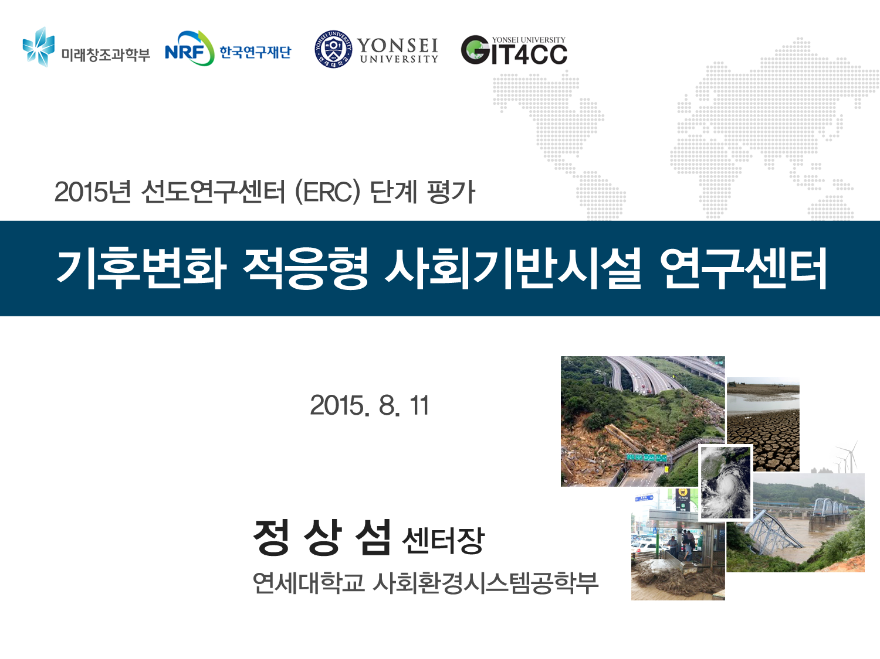

World Conference on climate Change
October 24-26, 2016 Valencia, Spain
Adaptation Technology of Infrastructure under Climate Change
2016. 10. 25
Jeong, Snagseom Ph.D
Director of GIT4CC
Professor of CEE, Yonsei University

Slide 2
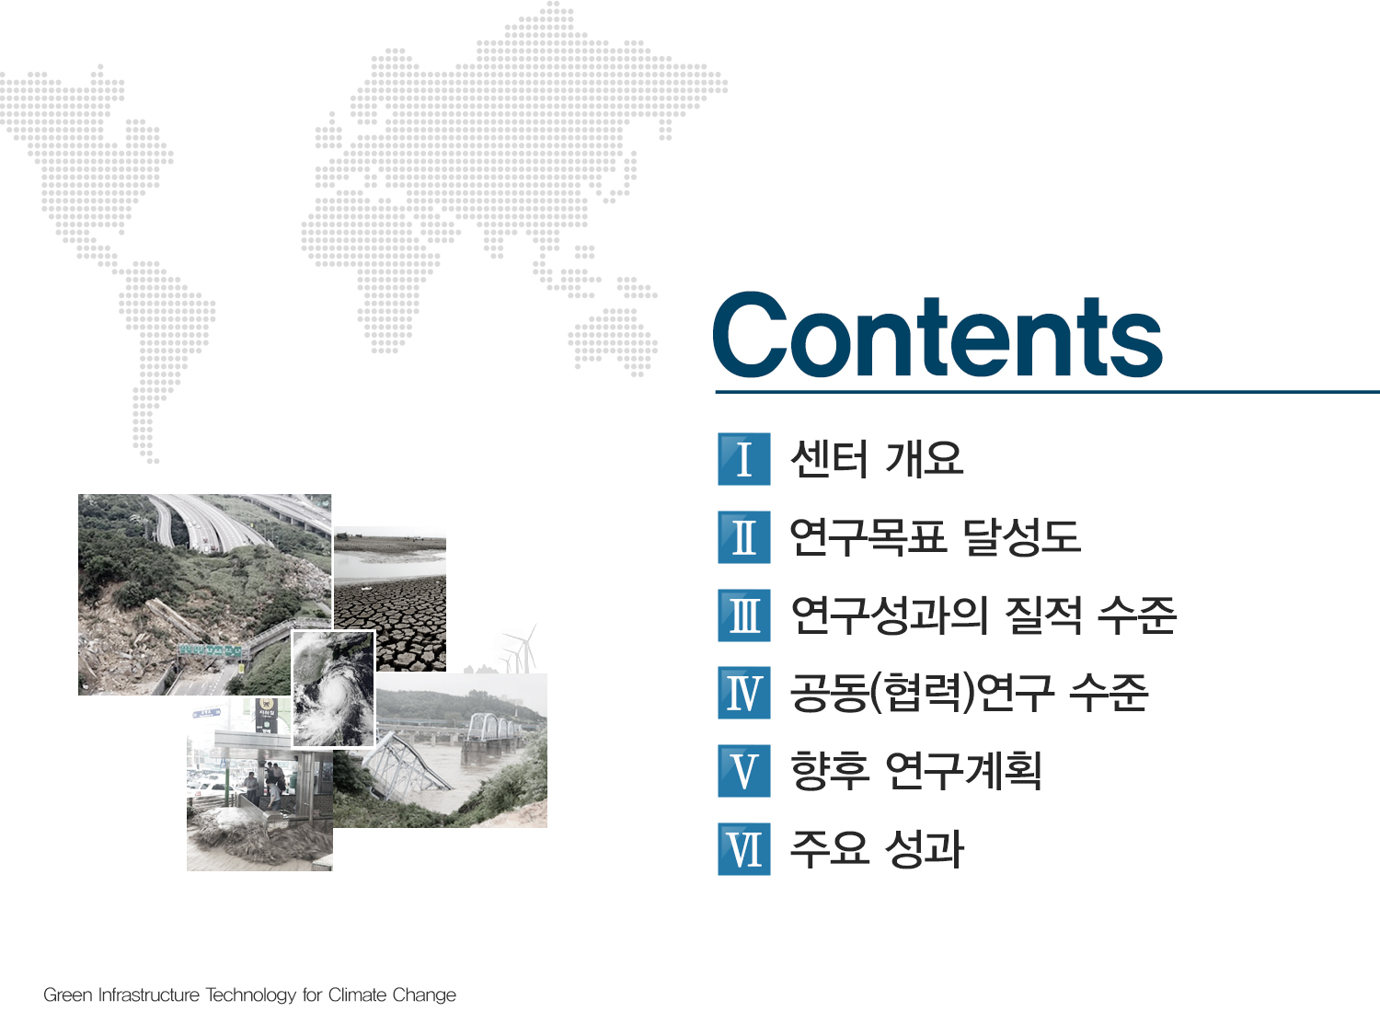
Introduction of GIT4CC
Climate Change-induced Geo-disaster
Conclusions
I
II
III

Slide 3
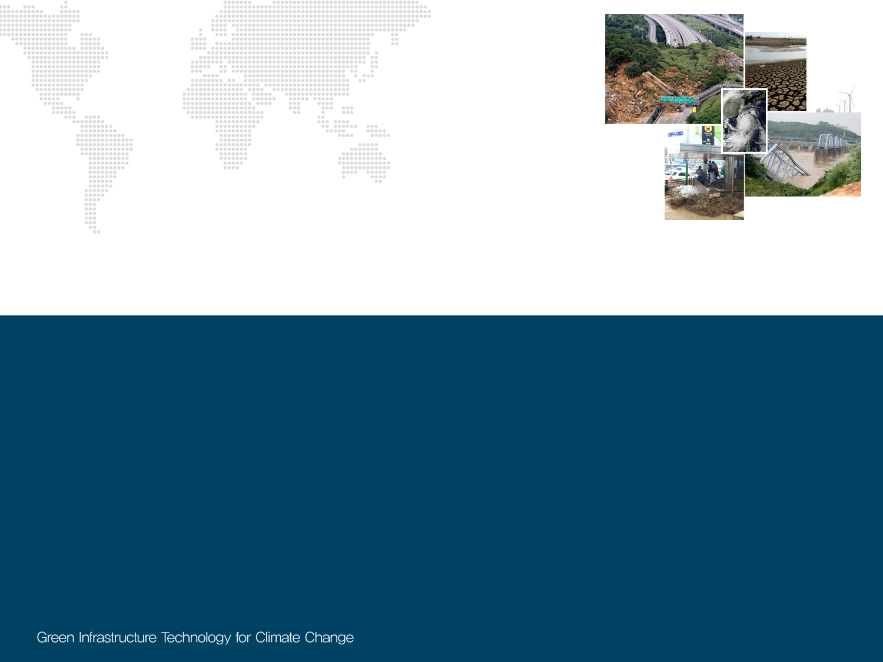

Ⅰ
Introduction of GIT4CC
1 .
Introduction
2 .
Objectives
3.
Study Areas
4.
Flow chart of research collaboration

Slide 4
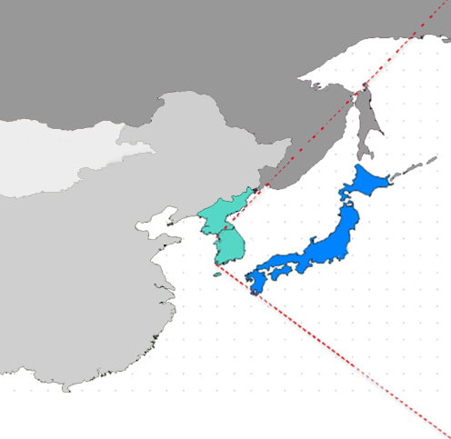
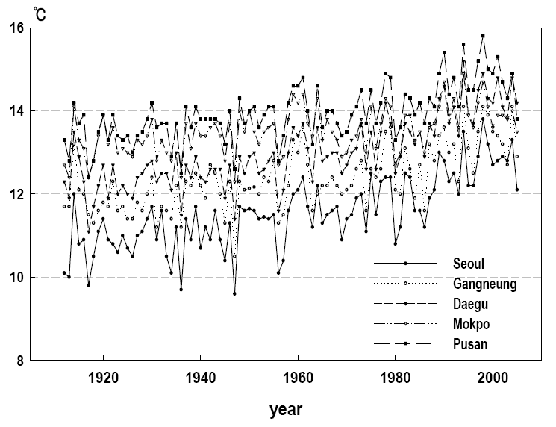
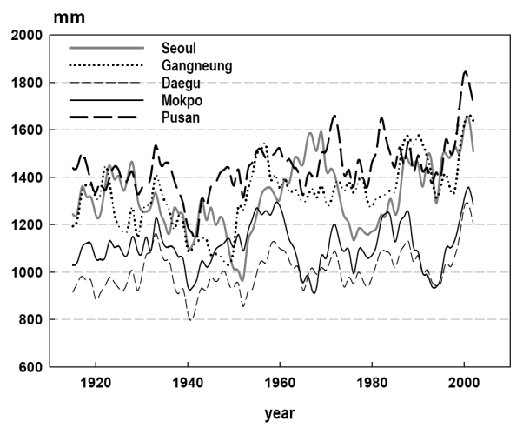
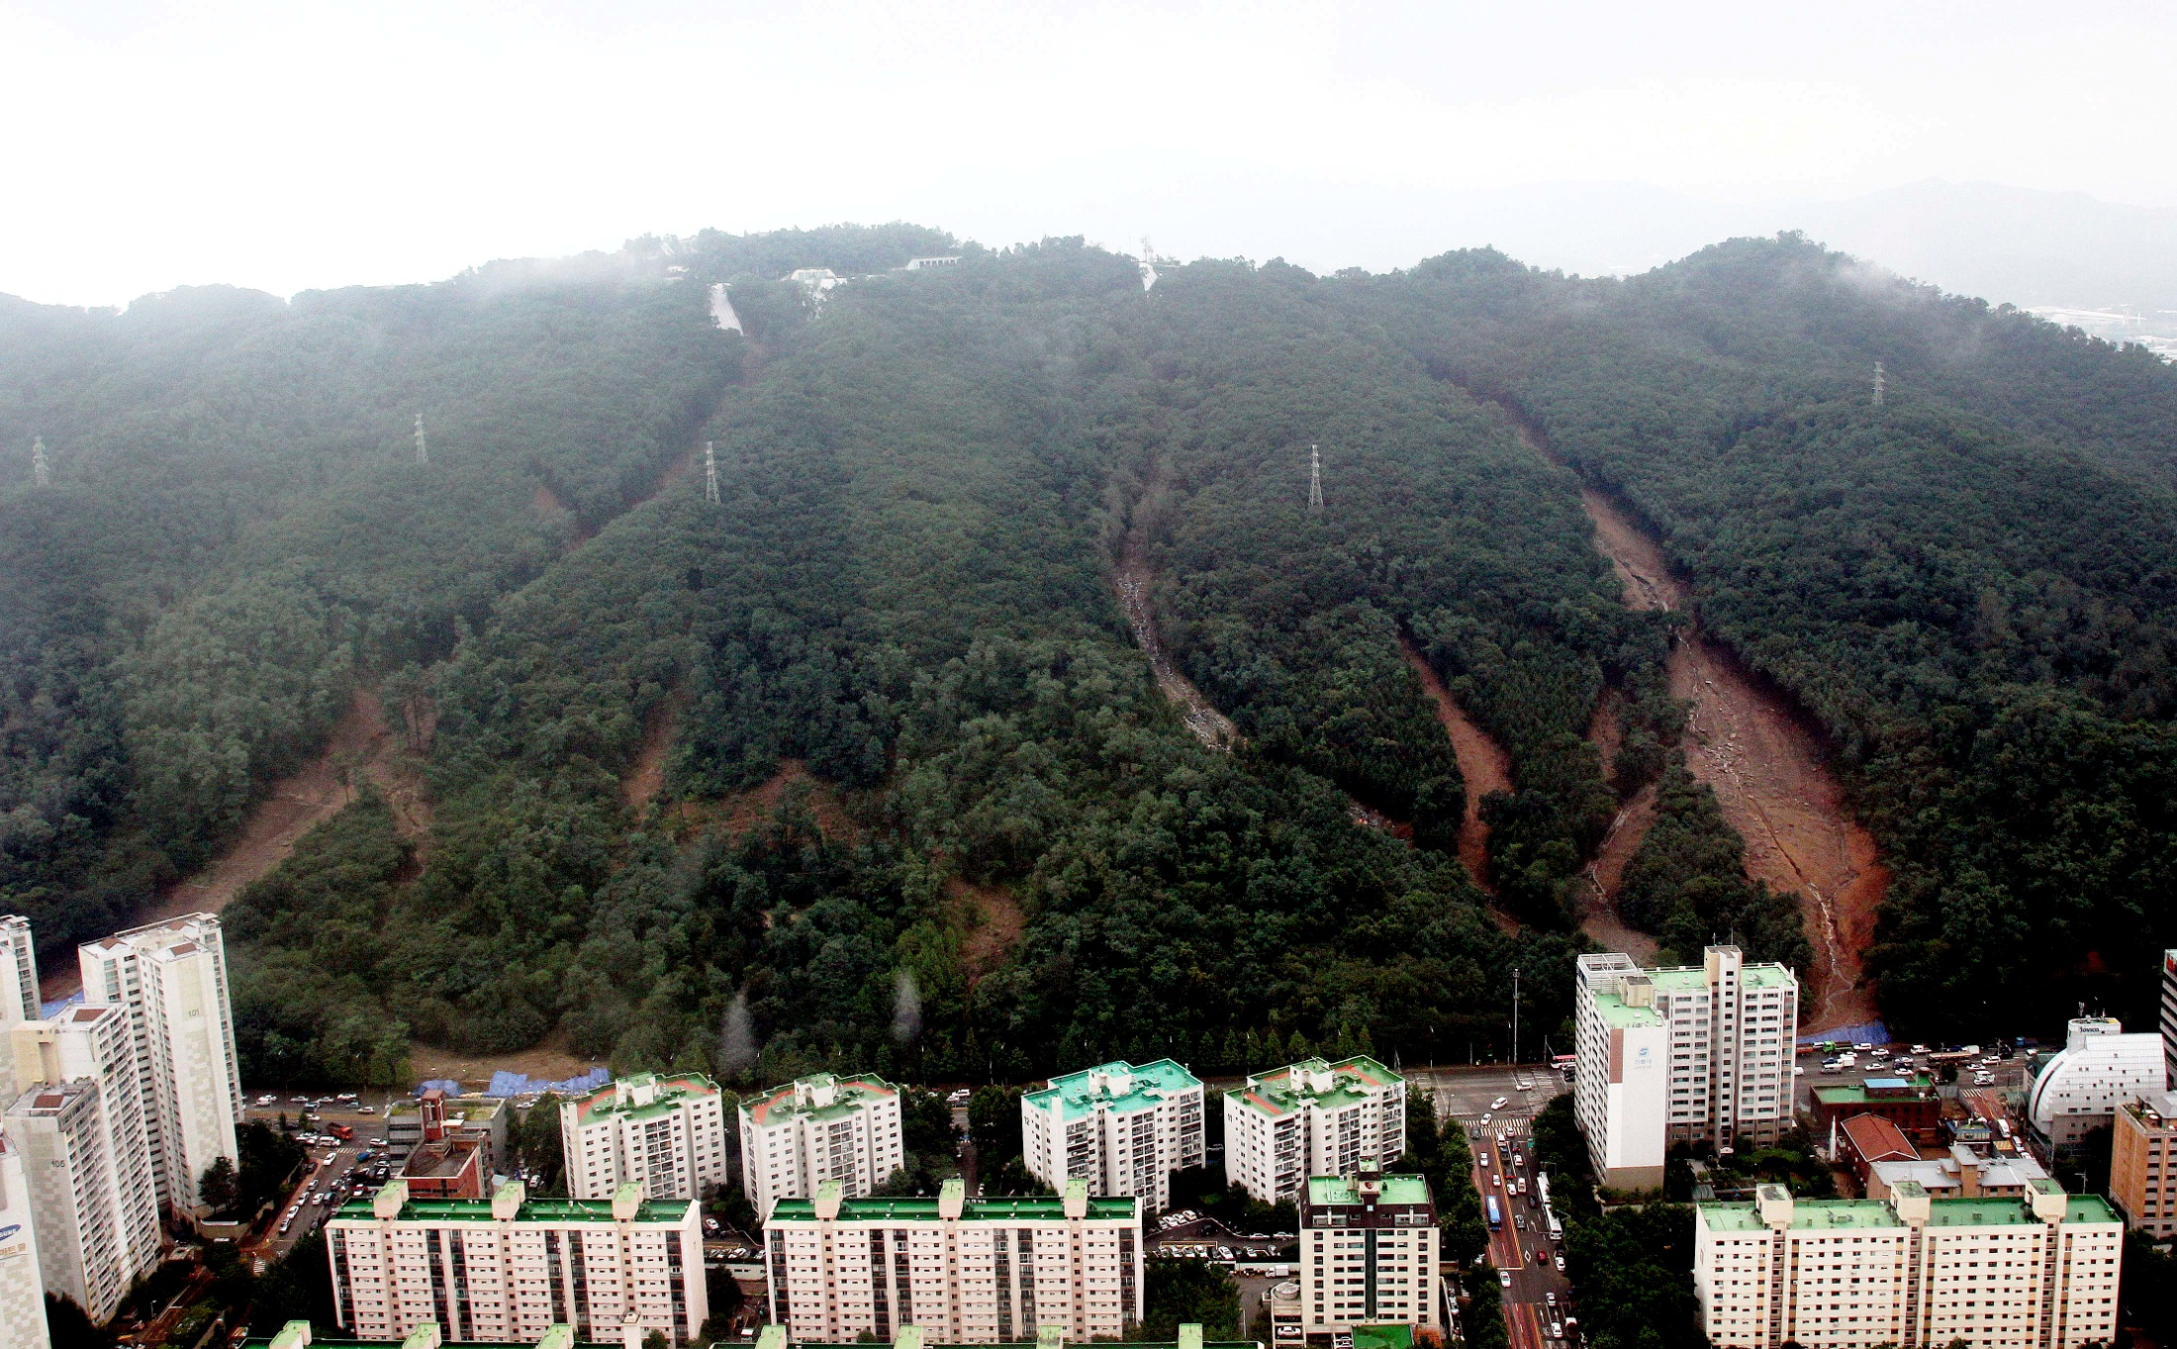

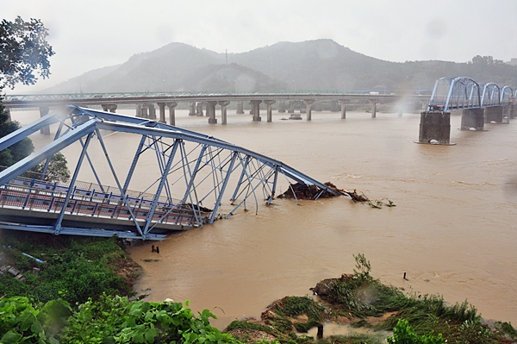
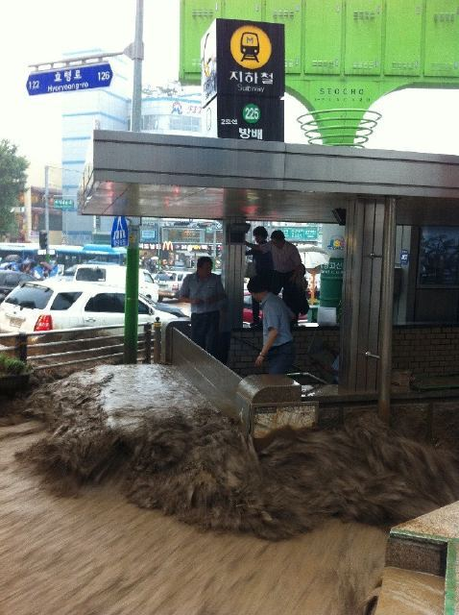
1
Introduction
Warming
Rainfall increase
South Korea
Infrastructure failure

Slide 5
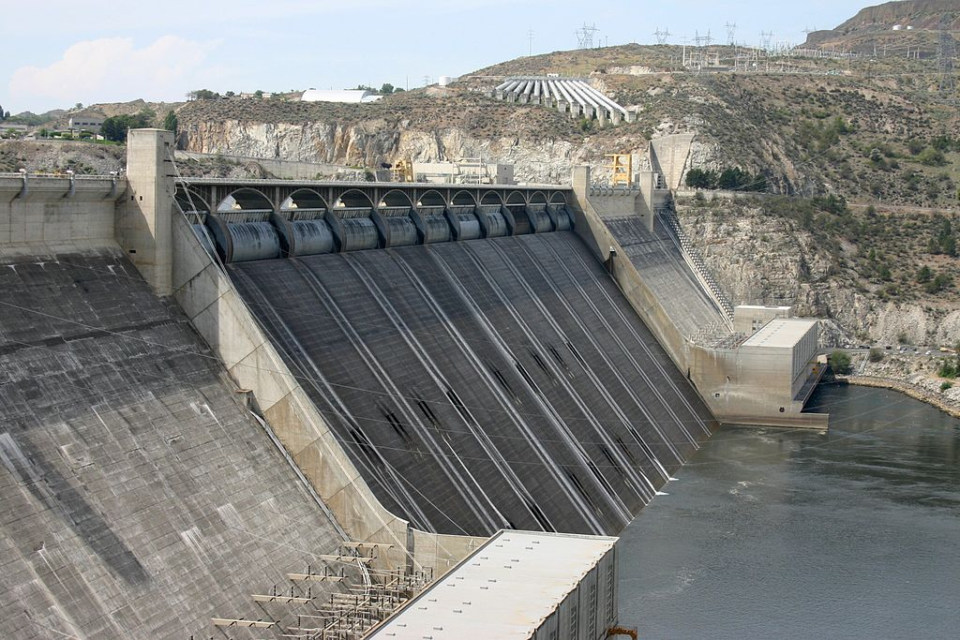
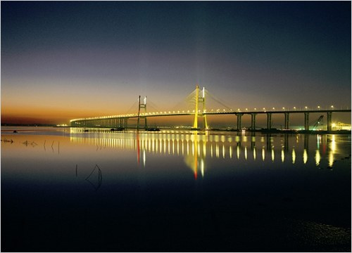
What is the Infrastructure?
Infrastructure refers to structures, systems, and facilities serving the economy of a business, industry, country, city, town, or area.
Infrastructure needs to be adapted to the climate change through new design, construction, or rehabilitation methods.
Grand Coulee Dam, USA
Seohae-daekyo, Korea

Slide 6
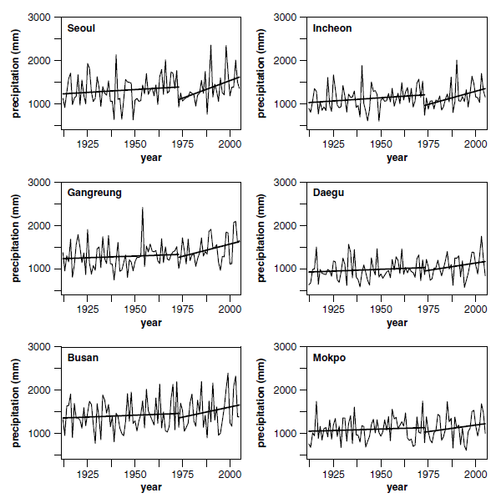
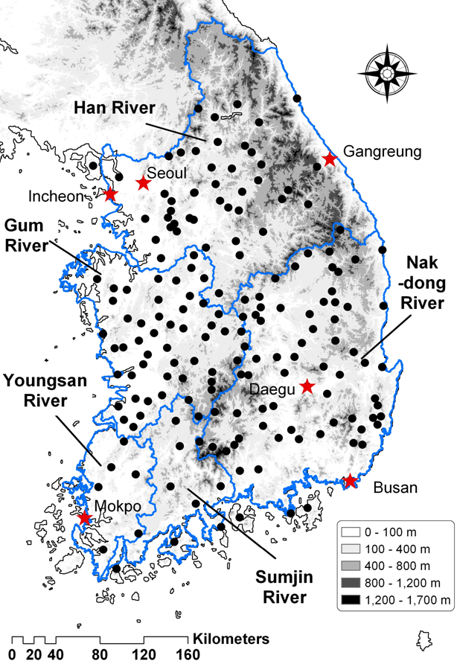
Increasing annual precipitation
Change of annual precipitation : 1,274mm/year to 1,441mm/year (13% increase) during last 10 years
1910-2005
183 weather stations
Source: Bae et al., (2015)
Notes:
Vulnerability from climate change and population growth

Slide 7
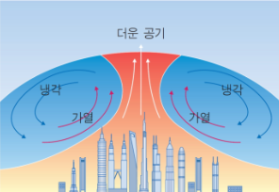
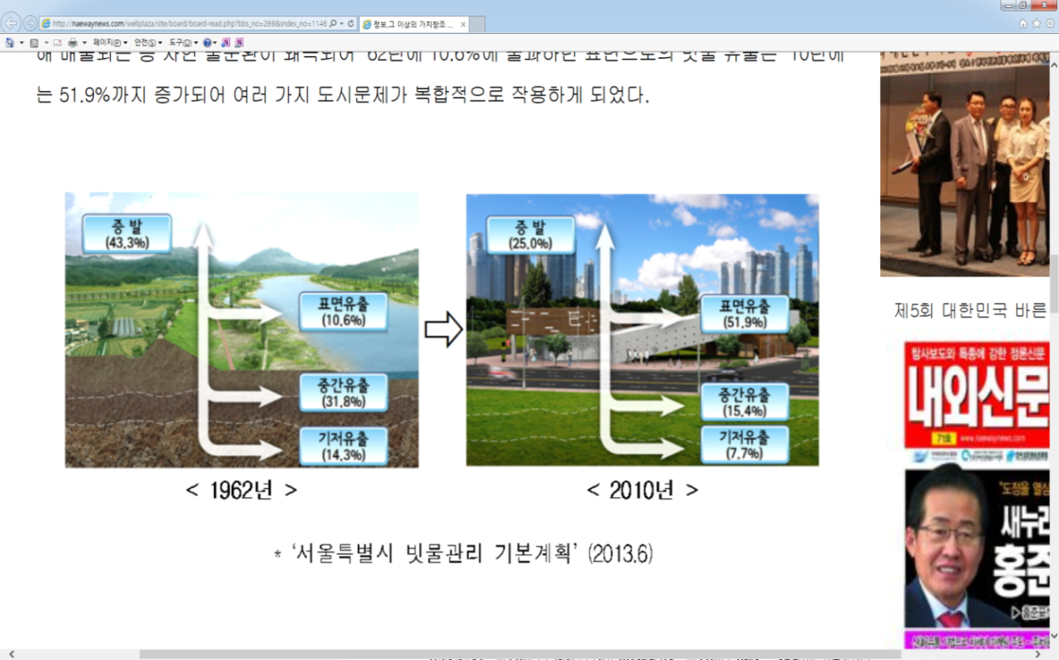
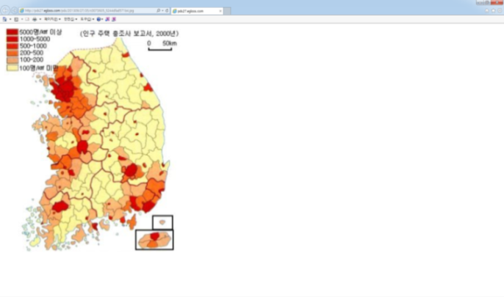
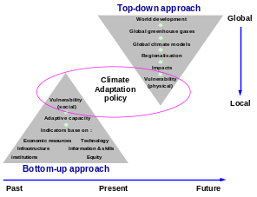

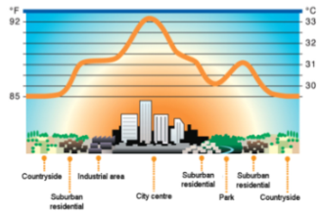
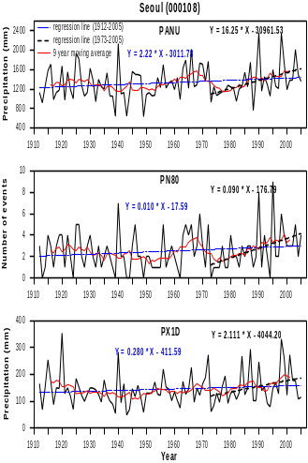
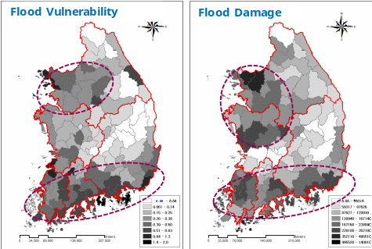
Urban disaster risk due to urbanization
Heavy rainfall (increases of frequency and intensity)
Increased runoff and reducing arrival time
Disaster risk increases with high densities of population and property
Increase in frequency and intensity
Increased runoff
Disaster risk increases
1962
Urban
heat island effect
Risk assessment
Increased runoff
High densities
of population and property
2010
1 days maximum rainfall
Urban
Heavy rainfall
Over 80mm/day
2010년
(Seoul city hall, 2013)
Disaster risk increases
Notes:
Vulnerability from climate change and population growth

Slide 8
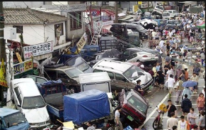
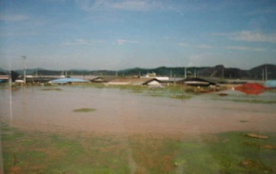
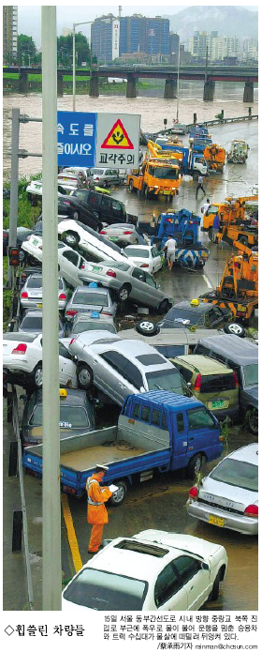
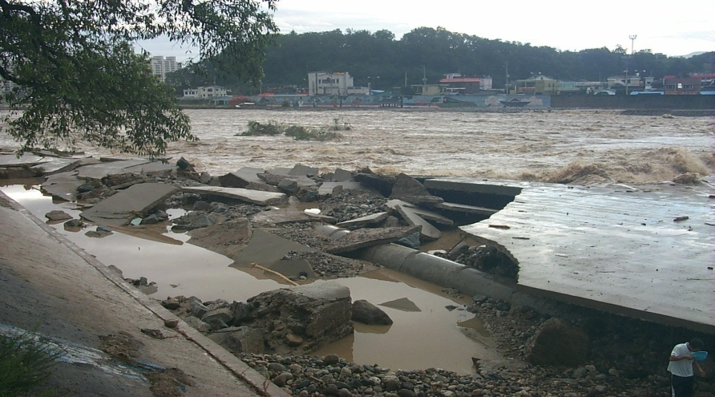
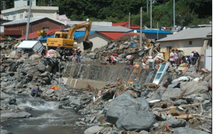
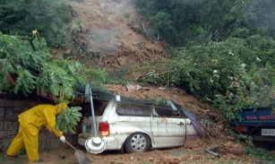
Chronicle of climate change induced urban disaster in Korea
The frequent occurrence of extreme events such as flood and drought
Seoul
Heavy rainfall
Busan
Typhoon “Maemi”
Seoul
Typhoon “Ewiniah”
2001~2002
2003~2004
2005~2006
2007~2008
Busan
Typhoon “Rusa”
Busan
Typhoon “Navy”
Jeju island
Typhoon “Nari”

Slide 9
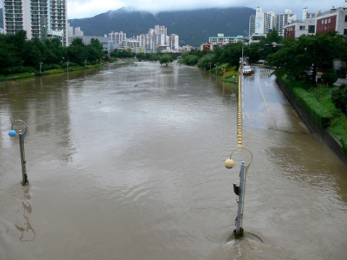
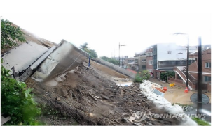
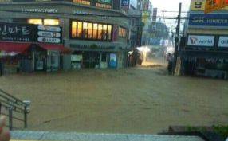
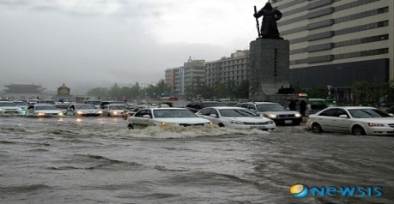
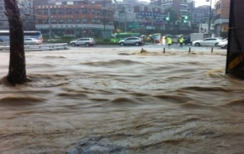
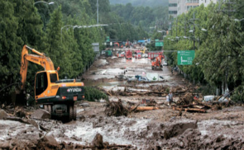
Busan
Heavy rainfall
Ulsan
Typhoon “Sanbi”
Busan
Heavy rainfall
2009~2010
2011 ~ 2014
Seoul
Heavy rainfall
Seoul
Heavy rainfall, landslide

Slide 10
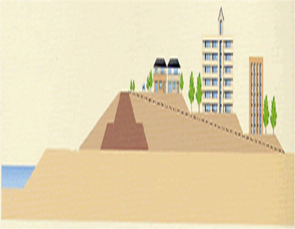
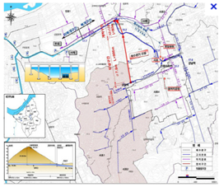
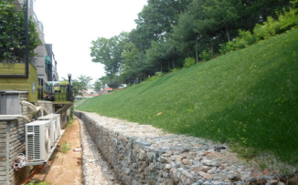
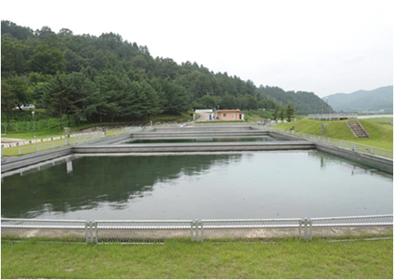
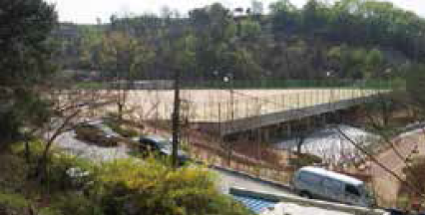
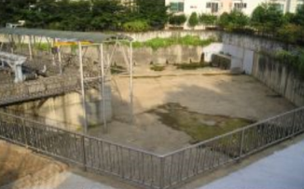
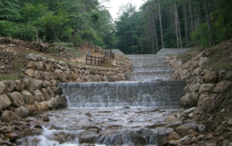
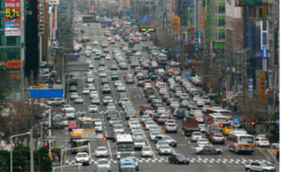
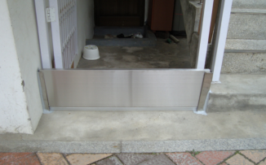
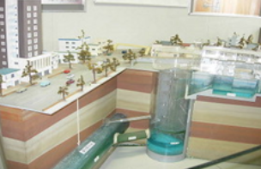
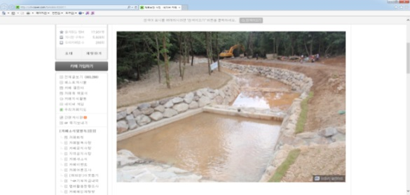
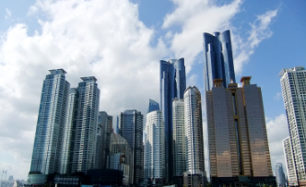

Adaptation under climate change in urban areas
    Risk assessment and climate change impacts analysis for flood defense structures, slope structures, underground structures are needed
    It requires appropriate measures to reduce the damage of urban disaster
Flood defense structures
Watershed storage
Urban structures
River bank
Sewer line
Slope management
Water transport
Rainfall storage
Water storage
Check dam
Roads and transportation
Prevent water plate
Underground storage
Mooring conservation
Skyscraper
Notes:
Practical strategies to adapt to an uncertain climate change in urban areas
Do the urban infrastructure perfom to
Is the role of urban infrasture
Performance assessment of resilience for urban infrastructure systems

Slide 11
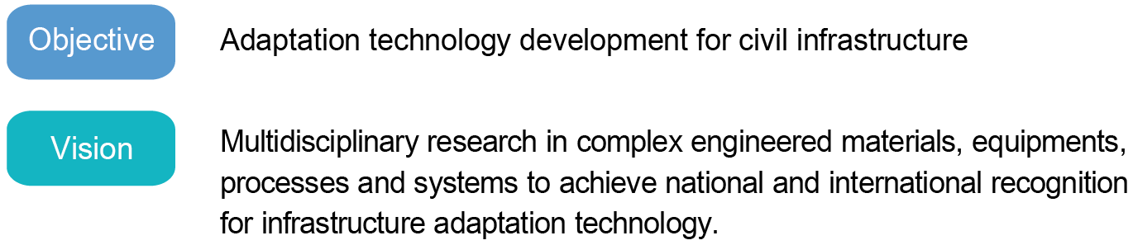
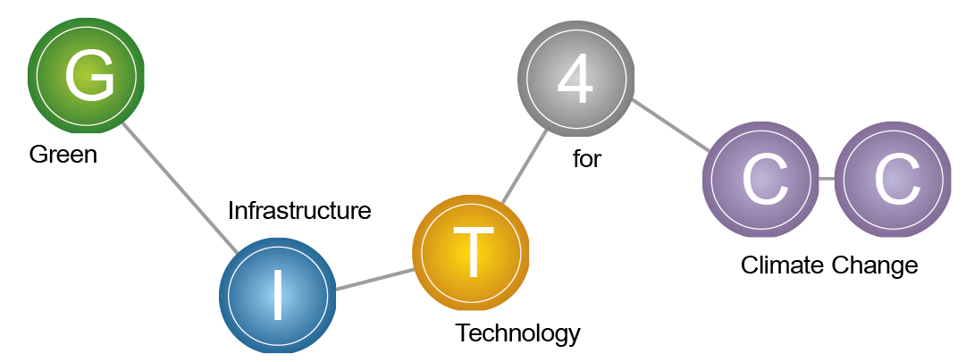
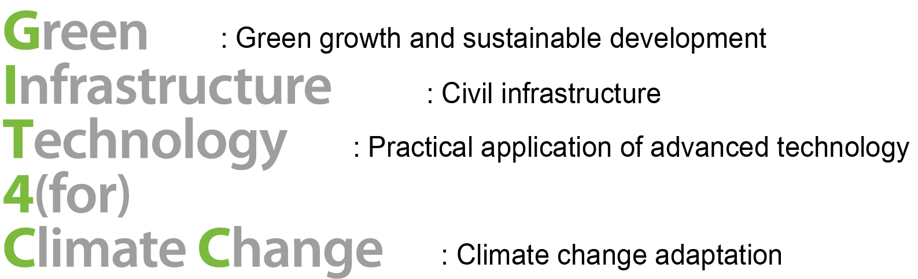
GIT4CC

Slide 12






2
Objectives
Green Infrastructure Technology
for Climate Change
Final
Objective
Step 2
Step 1
(2015-2018)
(2011-2015)
Step to independence
Research completion
Medium to long term
adaptation technologies
for climate change
Basic research
Integrated information
management system module,
Design Standards,
Legislation
Vulnerability assessment
of infrastructures and
development of
core technology

Slide 13
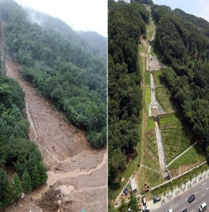
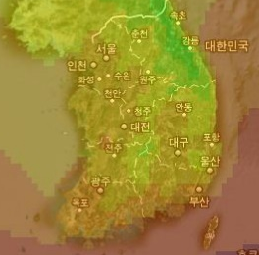
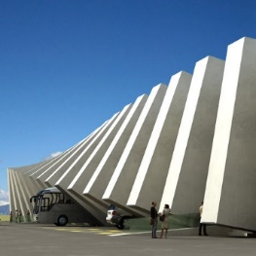







3
Study Areas
Slope structures
Climate Scenarios
Concrete
Geotechnical
structures
Water
management
Urban ecology
Pavement

Slide 14
3
Study Areas
Climate and hydrological models for infrastructure design
Adaptation strategies from planning and management perspectives
Disaster prediction and prevention methods
Adaptive engineering design for climate changes
New construction materials for extreme weather conditions
Urban hydro-ecology for climate adaption
Coastal management for sea level rise
Water reuse and rainwater management
Area I
Area II
Area III

Slide 15





Area I
Area I-1
Area I-3
Area I-2
Climate scenario for Korea
Hydrological model for infra design
Probabilistic LCC evaluation
Adaptation strategies
Integration of climate model and measured data
Standardized design parameters
Infrastructure Adaptation Framework

Slide 16






Area II
Adaptation technologies
for the weakest fields of infrastructure
in climate change
Slope failure prediction for natural disaster
Sustainable geotechnical design
Concrete in extreme weather
Slimming technology
Porous pavement technology
& Sidewalk block system
Core Adaptation Technologies

Slide 17



Area III
Urban hydro-ecology improvement
Costal management
for sea level rise
Water reuse and rainwater management
Bio-swale
Bio-barrier
Costal erosion prediction
Submerged structure for prevention of the erosion
New organic based water quality indicators
Regenerative water resource
and environmental technologies

Slide 18

4
Flow chart of research collaboration
Engineering parameters based on climate change scenarios
1
Development of core technologies in each area
Development of water/environmental technologies
Core technology
Assessment of
the economic value
Technology assessment and economic analysis
Economic assessment for climate change strategies
2
Integrated management system
Urban landslide and drainage management
Joint research in various fields
3
Amendment of design criteria
Design manual (adaptation to climate change)
4
Design manual
Proactive climate change adaptation of infrastructure

Slide 19

International Research
European
- Norwegian Geotechnical Institute (Norway)
- Delft Univ. of Technology (Netherlands)
Asia
- Univ. of Tokyo (Japan)
Hong Kong Polytechnic Univ. (China)
Universiti Teknologi Malaysia (Malaysia)
North America
- Texas A&M Univ. (USA)
- George Washington Univ. (USA)
- Univ. of Michigan (USA)
Oceania
- Queensland Univ. of Technology (Australia)

Slide 20
Ⅲ
Climate Change-induced Geo-disaster
1 .
A case study on Umyeonsan (Mt.) landslides analysis in Korea
2.
Result and discussion

Slide 21

1
A case study on Umyeonsan (Mt.)
landslides analysis in Korea
Umyeonsan (Mt.) landslide in July 2011
Seoul metropolitan
Umyeonsan(Mt.) is located in south-east of Seoul
151 landslides and 33 debris flows occurred in 20 watersheds
The accumulated rainfall of 24-h was 424.5 mm.

Slide 22

Lim Kwang APT
(Casualty : 1)
Yang Jae Driving School
(Casualty : 1)
Sin Dong-a APT
(Casualty : 3)
Raemian APT
(Casualty : 3)
Bo Doek Temple
(Casualty : 1)
Hyoung Chon Village
(Casualty : 1)
Jeon Won Village
(Casualty : 6)
151 landslides, 33 debris flows, 16 casualties

Slide 23

Rainfall characteristics
The accumulated rainfall of 24-h was 424.5 mm, which is very heavy rainfall.
2) The 1-h rainfall between 7:40 and 8:40 am was the most severe, corresponding to return period of > 120 years.
(Jeong et al., 2015, Landslide)

Slide 24


2
Result and discussion
Regional scale analysis
3D Spatial Data
Physical Model
Topography: Slope, slope direction
Hydrology : Precipitation data
Spatial data : Soil and forestry
Geotechnology: Unsaturated soil
Infiltration : Modified G-A Model
Failure model : Infinite slope model
Notes:
등

Slide 25



Experimental tests and suction monitoring
Test site located in Umyeonsan (Mt.)
Landslides in Ramian watershed : 6 locations
Landslides in Dukwooam watershed : 4 locations
Raemian
watershed
Dukwooam watershed

Slide 26

Site investigation
Seismic Prospecting
In-Situ Permeability
SWCC
Borehole Shear Test
Direct Shear Test
SPT

Slide 27

Typical soil profile
Colluvial Soil
Weathered soil
Weathered rock
NBH-12
Soft rock
NB-4

Slide 28


Soil-water characteristic curve (SWCC)
The GCTS pressure plate apparatus (Fredlund and Rahardjo, 1993)

Slide 29




Matric suction monitoring
매설 깊이
강우량(mm/10min)

Slide 30


Slide 31




1) Matric suction of dry soil
T1
T2
flow
T3
T4
T5
→ 80kPa
T1
T6
T1 = 72~80 kPa
T5 = 75~85 kPa
T6 = 74~88 kPa
T5
T6

Slide 32


2) Matric suction of unsaturated soil
T1
T2
flow
T3
→ 20 kPa
T4
T5
(in rainy season)
T6
T1

Slide 33
Soil property and depth
Soil Property
Parameters | Values
Hydraulic conductivity | 8×10⁻⁴ cm/sec (28.8 mm/h)
Initial water contents | 32.0~28.0 (30.0) %
Water-content deficit | 0.20
Wetting front suction head, | 830mm
Soil cohesion | 10.2~12.8 (11.0) kPa
Soil friction angle | 22.4~26.6 (26.5) ∘
Unit weight | 17.0~18.5 (18.0) kN/m³
Soil Depth
Raemian valley : 4.0~10.0 m
Dukwooam valley : 2.1~7.5 m

Slide 34





Raemian watershed
Type 1- Shallow failure
Type 2- Deep failure
Factor of safety
Factor of safety
Landslide in 2011
Landslides in 2011
0
0.1
0.2
0.4
0.6
0.8
0
0.1
0.2
0.4
0.6
0.8
km
km
Type-1 agreed 4 landslide observations
Type-2 agreed with all of landslide observations

Slide 35

Dukwooam watershed
Type 1- Shallow failure
Type 2- Deep failure
Type 1 and 2 agreed with all of landslide observations

Slide 36
Conclusions
  Extreme events like landslides, flooding, and drought related to civil engineering are caused by climate change.
  Damage to Infrastructures is highly influenced by severe rainfall and hot temperature. It is expected to guide decision making in prioritizing the most cost-effective adaptation strategies for infrastructure.
  Performing joint projects on climate change impact assessment and adaptation strategies in several countries. Sharing the ideas for design rainfall and their hydrologic and geotechnical analysis.

Slide 37


