Slide 1

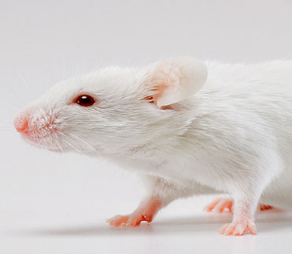
Biochemical and histopathological response of Swiss albino mice treated with uranyl nitrate
Sangeetha Vijayan P
Junior Research Fellow
Yenepoya Research Centre

Slide 2
Background
Human exposure to heavy metals such as uranium is of great concern to our society.
The wide spread uses of uranium for instance in the civilian and military applications, in nuclear power, counterweights in aircrafts and penetrators in shrapnel increase the release of it to the environment.
Uranium dispersion causes contamination of ground water as well as food chain and poses treat to the health of general population.

Slide 3
Background
Animals as well as human studies have shown the chemical toxicity of uranium
Toxicity of uranium varies with chemical form. More soluble uranium compounds have highest toxicity.
Inhalation, ingestion or skin contact is the main route of exposure to uranium and leads to respiratory diseases, kidney failure, reproductive diseases etc.
Kidney is the most sensitive organ for uranium toxicity. (Gilman et al., 1998)

Slide 4
Toxic effects of Uranium of uranium
Nephrotoxicity
Hepatotoxicity
Developmental toxicity
Reproductive toxicity
Bone toxicity
( Brugge et al., 2011)

Slide 5
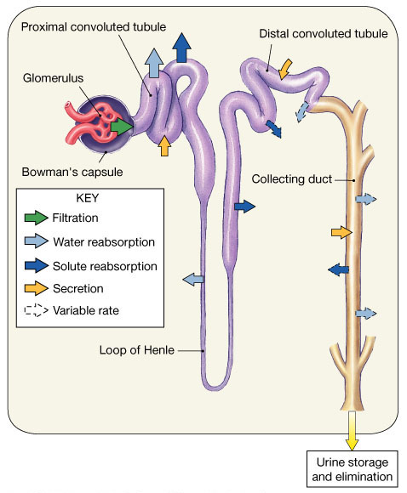
Effect of uranium on nephron
Notes:
nephrons are filtration units of the kidneys
normal kidney contains one million nephrons:

Slide 6
AIM
To determine the effect of Uranyl nitrate on mice kidney at different time intervals with respect to biochemical and histopathological changes

Slide 7
Materials and Methods
Animal model: Swiss albino mice
  8–10 weeks of age, weighing 25 ± 5g
Study groups
Treatment groups | Treatment | Uranyl nitrate Dose (mg/kg b.wt)
Control (Group1) | 0.9% saline
Day 1 (Group II) | UN treated | 1
 |  | 2
 |  | 4
Day 3 (Group III ) | UN treated | 2
 |  | 4
Day 5 (Group IV) | UN treated | 2
 |  | 4
Day 14 (Group V ) | UN treated | 2
 |  | 4
Day 28 (Group V1 ) | UN treated | 2
 |  | 4
  Each study group contains 5 animals (males )

Slide 8
Material and methods….
  Biochemical analysis
  Biochemical parameters such serum urea, creatinine and blood urea nitrogen was estimated.
  Biological diagnostic kits (Aggappe Diagnostic Ltd, India) were used and biochemical analyses were carried out using a biochemical analyzer (MispaPlus, India) as per the manufacturer’s protocols.

Slide 9
Materials and Methods…
Histopathological analysis
Tissue processing and staining
Kidneys were collected immediately after sacrifice of the mice and fixed in 10% neutral buffered formalin over night
▼
Fixed kidney specimens were dehydrated in graded ethanol, cleared in xylene and infiltrated with paraffin wax using an automatic tissue processor
▼
Processed specimens were embedded in paraffin wax using metallic blocks
▼
5 µm thick sections of kidneys were taken in a rotary microtome
▼
Sections were stained with Hematoxylin and Eosin counterstains (H-E) and observed at ×400 magnification under a light microscope (Motic BA210, Hong Kong).))

Slide 10
RESULTS

Slide 11
Figure 1: Difference in body weight of Swiss albino mice treated with 2mg/kg bd wt of uranyl nitrate at different time intervals

Slide 12
Figure 2: Difference in body weight of Swiss albino mice treated with 4mg/kg bd wt of uranyl nitrate at different time intervals

Slide 13
Fig 3: Serum biochemical parameters (Urea, Creatinine and BUN) of 1 mg/kg bd wt uranyl nitrate treated groups in comparison to control. Statistical difference was not observed between the groups (p > 0.05). Vertical bars represent mean ± S.D., n = 5

Slide 14
Fig 4: Serum creatinine levels of uranyl nitrate treated groups (2 mg/kg bdwt and 4 mg/kg bdwt ) in comparison to control. Statistical difference was observed between the groups (p < 0.05). Vertical bars represent mean ± S.D., n = 5

Slide 15
.
Fig 5: Serum urea levels of uranyl nitrate treated groups (2 mg/kg bdwt and 4 mg/kg bdwt ) in comparison to control. Statistical difference was observed between the groups (p < 0.05). Vertical bars represent mean ± S.D., n = 5

Slide 16
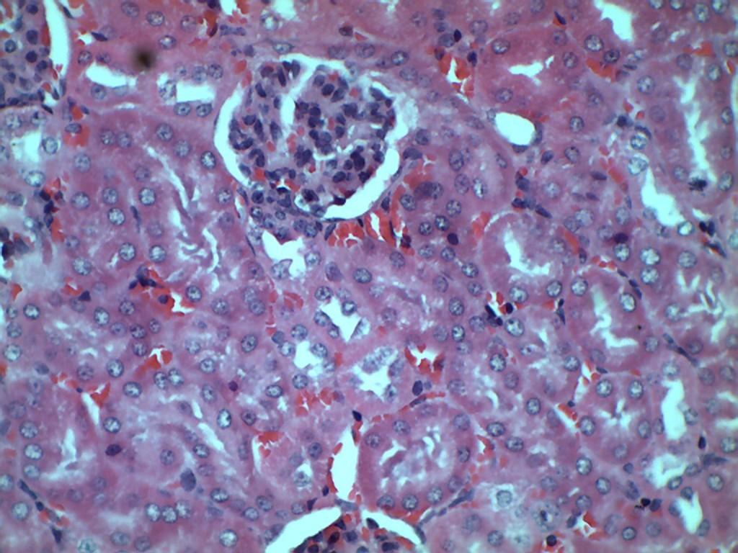
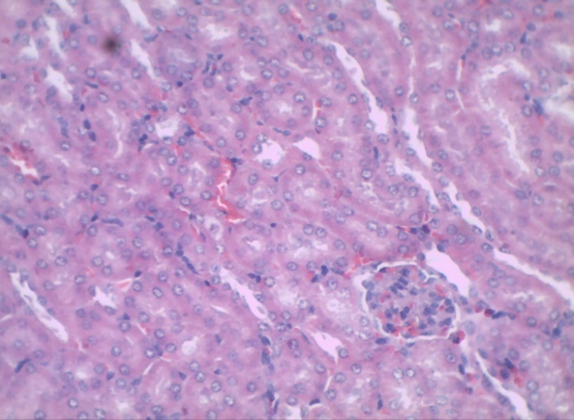
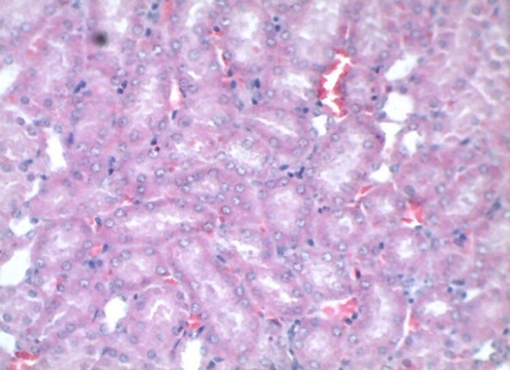
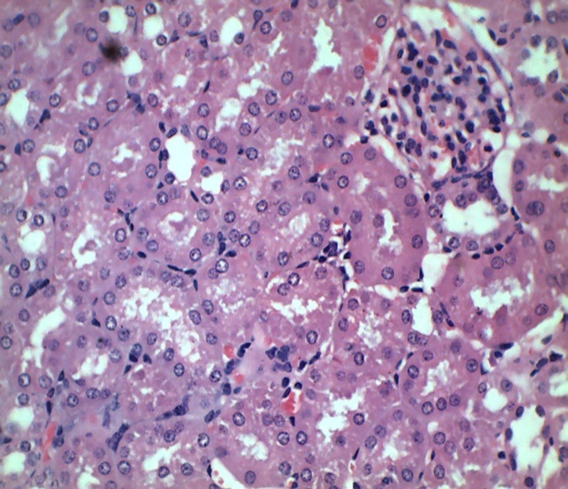
Figure 6: Histopathology of mice kidney treated with uranyl nitrate
Control
1mg/kg 1 day
2mg/kg 1 day
4mg/kg 1 day
Cortical region of kidney(H-E 400X)

Slide 17
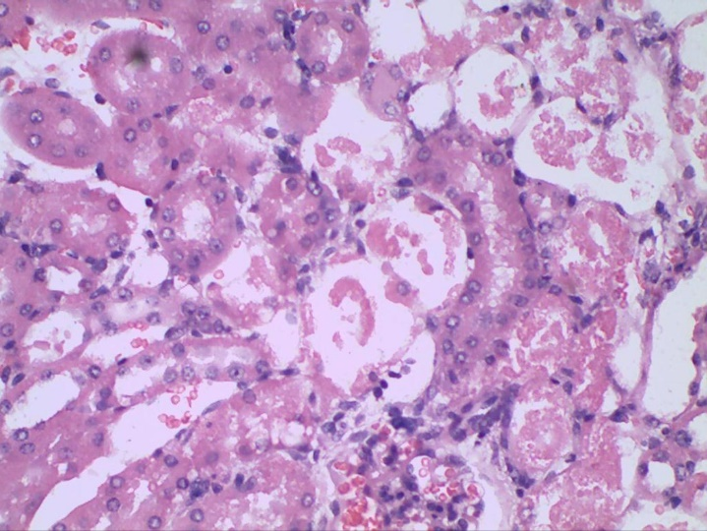
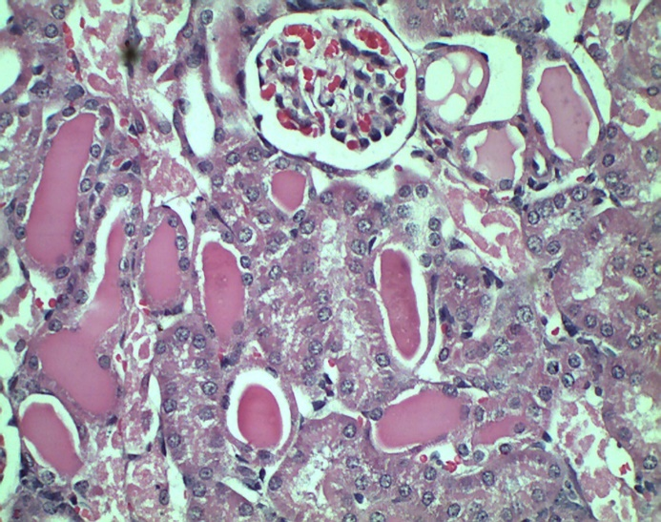
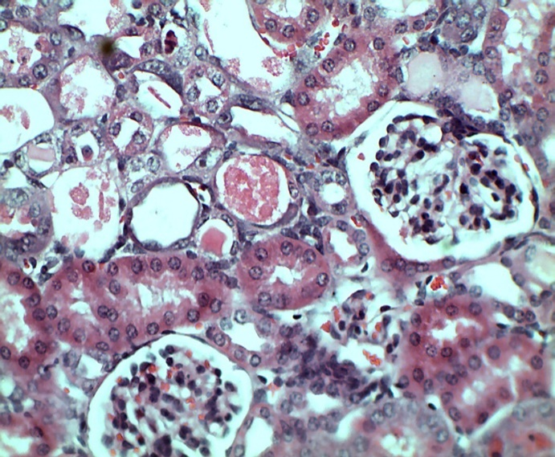
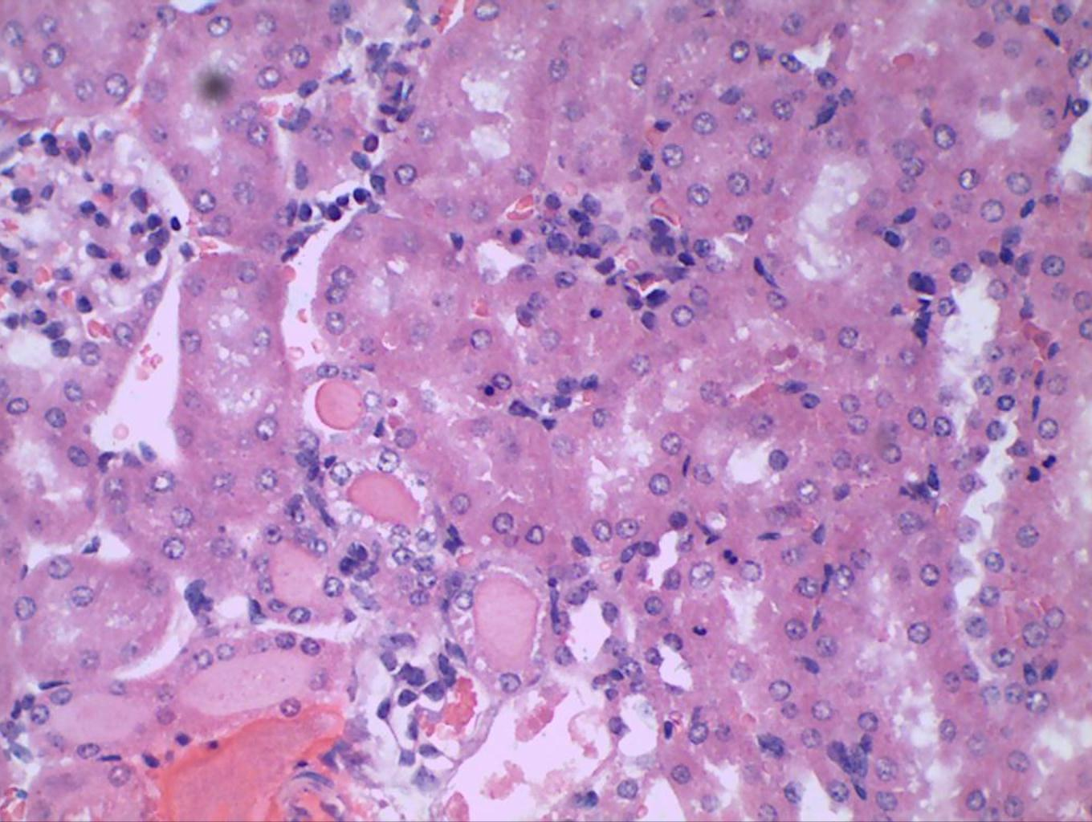

Figure 7: Histopathology of mice kidney treated with Uranyl nitrate
2mg,3 days
2mg 3 days
4mg 3 days
4mg 5 days
2mg 5 days
2mg 5 days
Cortex region of kidney. Arrows indicates the casts in tubular lumen

Slide 18
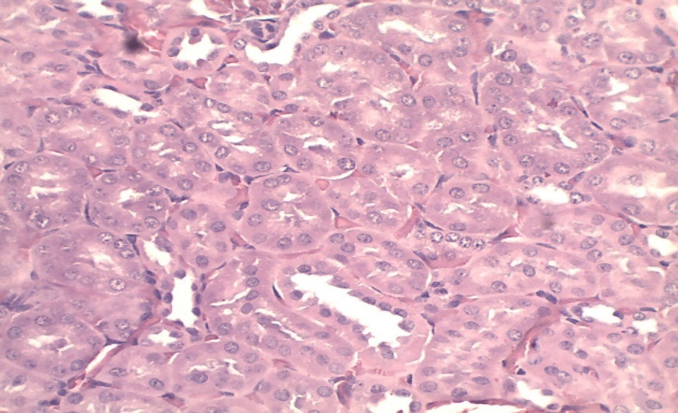
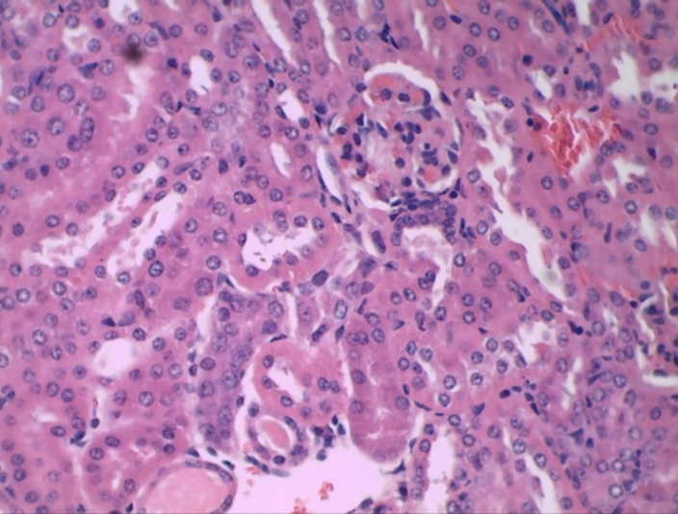
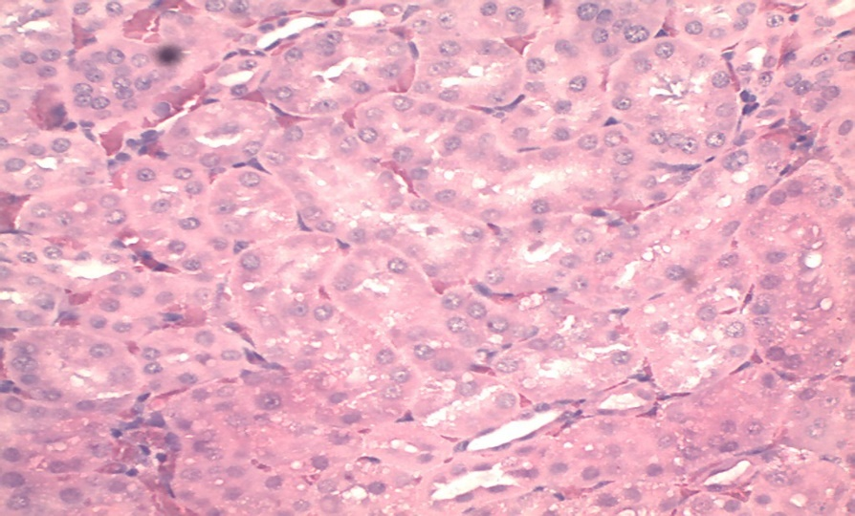
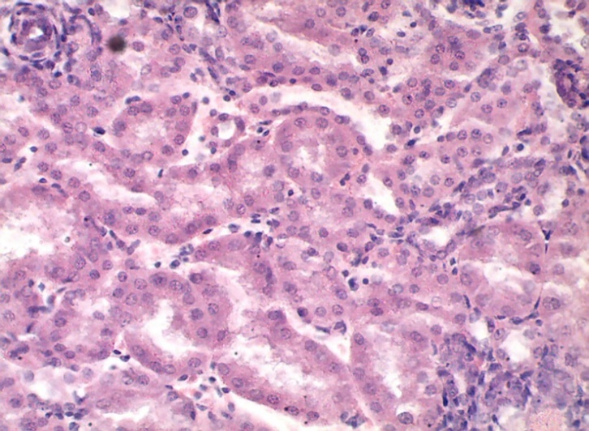
Figure 8: Histopathology of mice kidney treated with Uranyl nitrate
2mg 14 days
4mg 14 days
2mg 28 days
4mg 28 days
2mg 28 days
Cortex region of kidney. Arrow indicates damage in proximal convoluted tubule

Slide 19
Conclusions
Pathological alternations in kidney cells and elevated levels of serum creatinine and urea was shown at a dose of 4 mg/kg (ip)after 3 and 5 days of uranyl nitrate
Completed recovery was showed after 14 days in mice treated with 2 mg/kg bdwt of uranyl nitrate
Mice treated with 4mg/kg Uranyl nitrate showed almost recovery after 28 days
A dose of 4 mg/kg after 3 days to induce maximum nephrotoxicity in mice with respect to both biochemical and histopathological analysis.
Dose and time depended increase in toxicity and recovery was showed in animals treated with uranyl nitrate

Slide 20
References…
1. ATSDR 2013. Toxicological profile for Uranium.U.S. Department of Health and Human Services. Public Health Service. Agency for Toxic Substances and Disease Registry. Atlanta, GA.
2. Brugge D and Buchner V. Health effects of uranium: new research findings. Rev Environ Health.2011;26(4):231–249.
3. Basile DP, Anderson MD, Sutton TA. Pathophysiology of acute kidney. Comprehensive Physiology. 2012;2(2):1303-1353
4. Hodge HC, Stannard JN, Hursh JB. A review of the many aspects of uranium toxicity from animal studies. New York: Springer-Verlag; 1973; 165-96.
5. Gilman AP, Villeneuve DC, Secours VE, Yagminas AP, Tracy BL, Quinn JM, Valli VE, Willes RJ, Moss MA. Uranyl nitrate: 28-day and 91-day toxicity studies in the Sprague-Dawley rat. Toxicol Sci.1998;41:117-128

Slide 21

..

