Slide 1


New approaches for developing viral vaccines against influenza and respiratory syncytial virus
December 8, 2015
Virology-2015 Atlanta
Sang-Moo Kang
Georgia State University

Slide 2
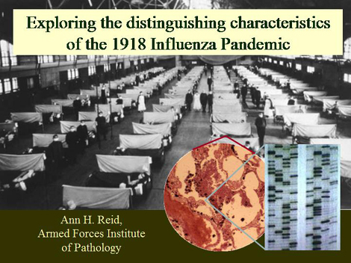
1918 (H1N1) : The worst and greatest pandemic
- deaths of 40 to 100 million people worldwide.
Lung inflammation

Slide 3
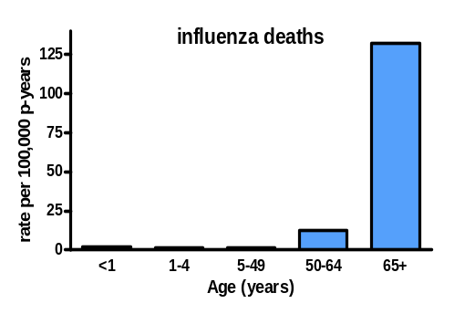
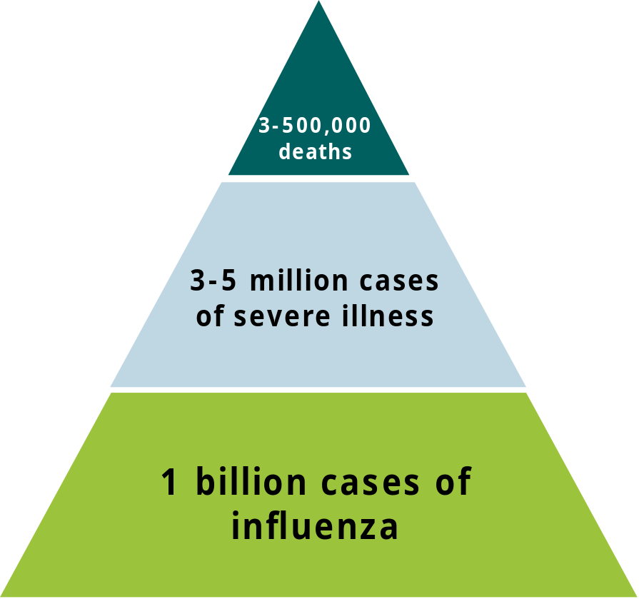
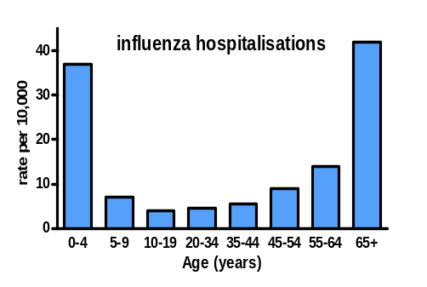
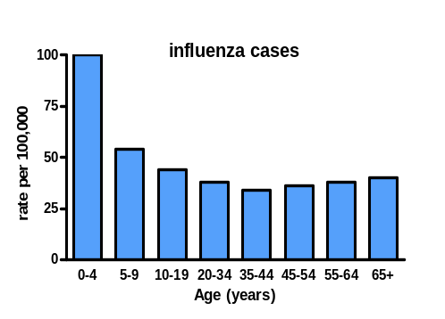
The yearly burden of influenza
deaths
hospitalizations
cases
90% of deaths occur in the elderly (>65 years)
MMWR, Aug 2008
(From Yuna Lee)

Slide 4
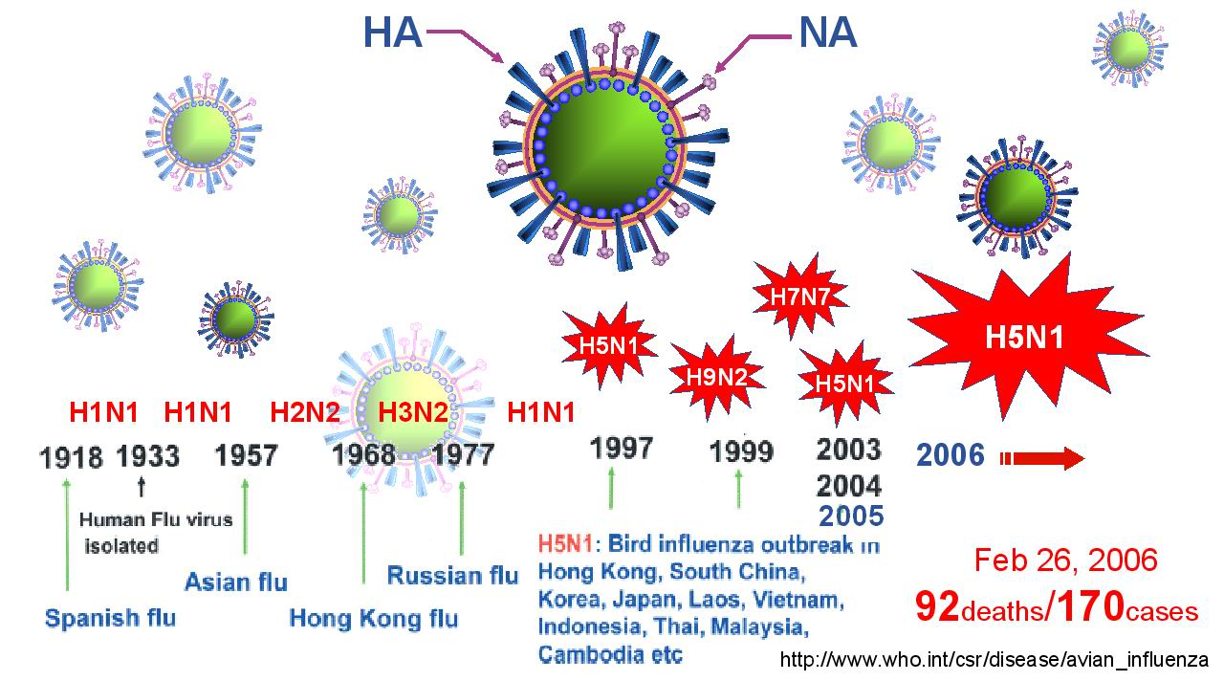
Influenza virus
Swine new
H1N1
H7N9
Swine
2009
H1N1
H7N9
2013-
127 deaths/
419 cases)
379 deaths/
638 cases
Over 18,000 deaths
(From Eunju Ko)

Slide 5
Challenges in influenza vaccination
No licensed vaccines against avian influenza viruses.
2. No good cross protection against drift epidemic and new pandemic flu.
3. Approximately 6 months’ time for vaccine production using chicken eggs.
4. Vaccine delivery (cold chain, syringe-needle flu shots, medically trained persons)…. Microneedle vaccine delivery.
5. Continuous mutations in natural reservoirs (humans, wild birds, poultry, pigs, etc..).

Slide 6
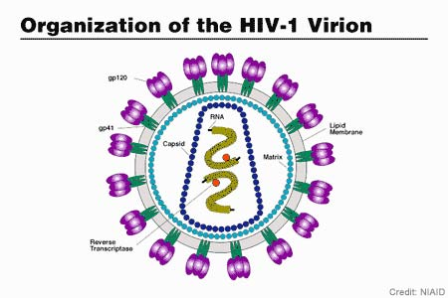
Structural similarity of Virus and VLPs
Replicating Virus
Non-replicating VLPs
(Virus-like particles )
as a new vaccine modality
M1
M2
HA
HA
M1
NA
NA
Viral
Genomes
In virions
Gag
Env

Slide 7
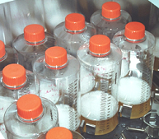


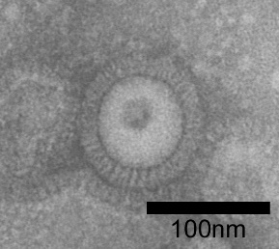

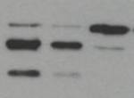
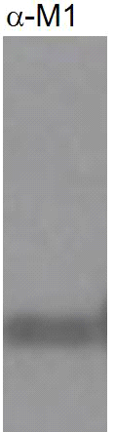


Production of Avian influenza H5 VLPs in insect cells
A
Recombinant
Baculovirus
HA1
HA2
WT H5
RRRKKR
Mutant H5
-TR
Influenza
VLPs
B
Anti-HA
M1
C
D
1234
kDa
VLP
rHA
HA0
Trypsin (-)
Trypsin (+)
75
1234
1234
HA1
50
37
75
75
25
50
50
37
37
(Song et al., 2010. Virology)

Slide 8
Pandemic potential influenza H5N1 and pandemic 2009 H1N1 VLP vaccines
are immunogenic and protective (1)
1. Avian H5 and pandemic 2009 H1 VLPs are highly immunogenic, inducing virus-specific antibody responses.
2. Avian H5 and pandemic 2009 H1 VLPs induce IgG2a, IgG2b antibodies as major isotypes and IFN-gamma cytokine secreting cells.
3. A single intramuscular immunization induces protective immunity and long-lasting plasma and memory B cells
4. VLP vaccines are superior to soluble protein and split vaccines in inducing protective immunity in mice and ferrets.

Slide 9
Clinical Trials of virus-like particle (VLP) influenza vaccines
Novavax Trivalent seasonal influenza VLP vaccine (2008-2009): second phase clinical phase II
Novavax 2009 H1N1 pandemic influenza VLP vaccine (2011): phase clinical phase II
Novavax pandemic potential Avian H5N1 VLP vaccine (2011) : FDA-approved phase I/II human clinical study.
Novavax pandemic potential Avian H7N9 VLP vaccine (2013) : phase I/II human clinical study, Saponin-based ISCOMATRIX adjuvant.

Slide 10
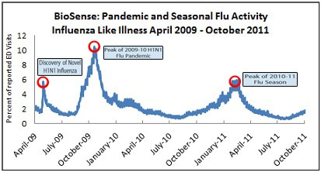
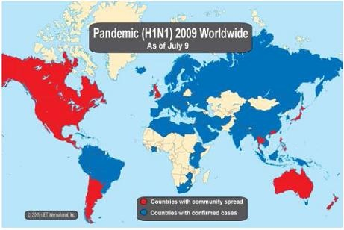

Slide 11
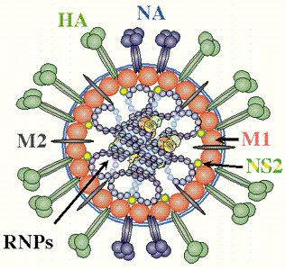
How is it possible to overcome the strain-specific protection of influenza vaccination?
HA is abundant, larger, dominates immune responses
HA
NA
Virus surface
proteins
M2
HA VLPs
M2 VLPs
NA VLPs
Surfaces of VLPs

Slide 12
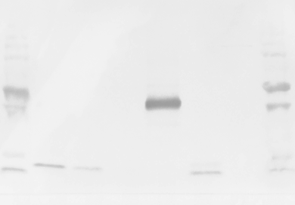
Designing better vaccines by molecular engineering?
(2nd generation M2e5x VLP)
Wild type M2
M2
Human
TM
C-tail
Tandem repeat M2e5x
M1
Human
Human
Swine
Avian I
Avian II
HA-TM-tail
M1
M
1
2
3
4
5
6
50kD
37kD
Influenza virus, 10 ug
Influenza virus, 5 ug
Influenza virus, 1 ug
M2e5x VLP, 0.1 ug
M2 WT VLP, 1 ug
No M2
25kD
20kD
15kD
(Kim MC et al., 2013 Mol Therapy)

Slide 13
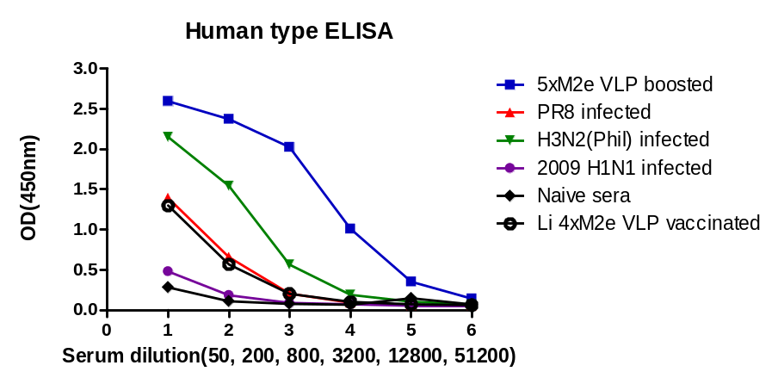
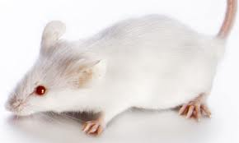
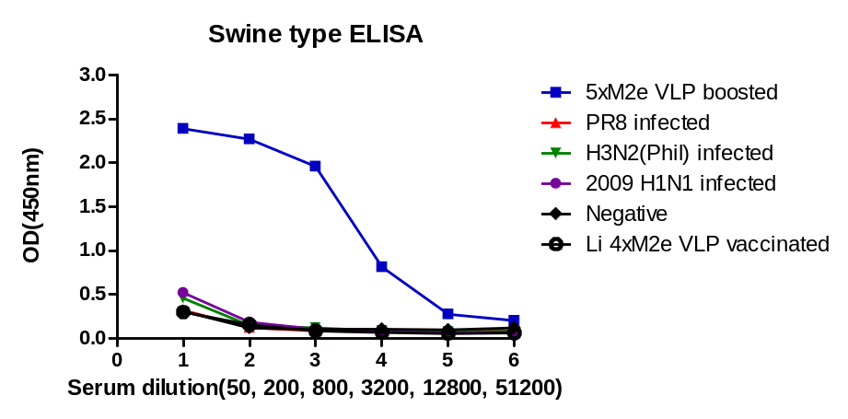
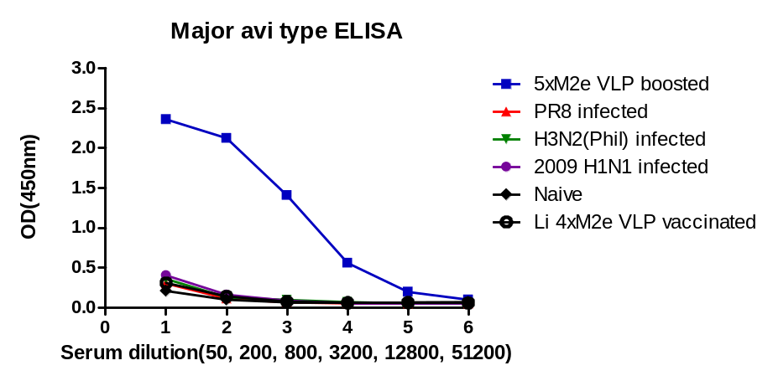
M2e5x VLP induce higher levels of diverse M2e antibodies
than virus
M2e5x VLP
A/PR8 H1N1 virus
A/Phil H3N2 virus
A/CA/2009 H1N1 virus
Homo.M2e4x VLP
Human M2e
VLP vaccination
Virus infection
Avian M2e
Swine M2e
(Kim MC et al., 2013 Antiviral Res)

Slide 14
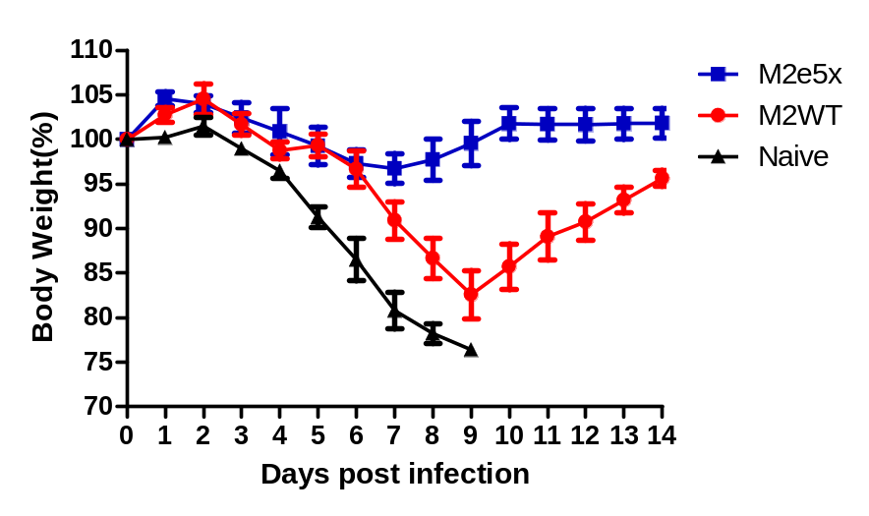
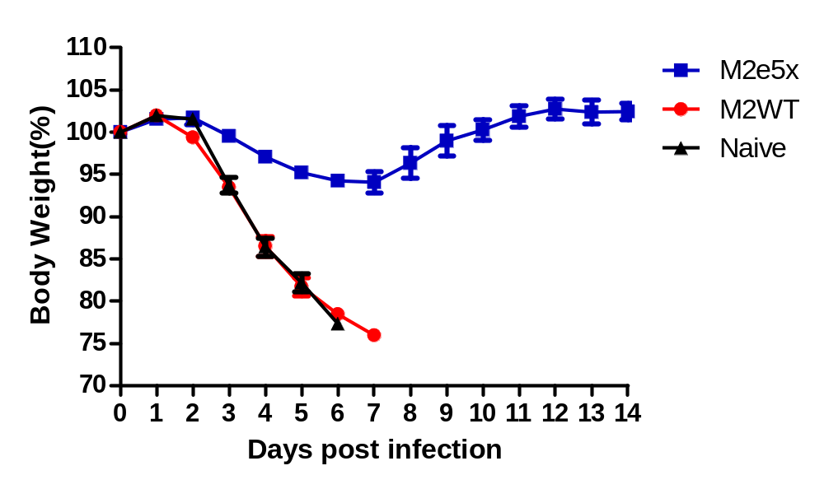
M2e5x VLPs confer better protection against Human H3N2 and avian H5N1
Figure 4
M2e5x VLP or
M2WT VLP
(10 ug)
Intramuscular
Weeks 0 and 4
Lethal challenge
Human H3N2 (A/Phil/82)
Avian H5N1 (rg A/Vietman/1203/04)
Kim MC et al (Mol. Therapy, 2013)

Slide 15
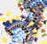
Hypothesis:
Supplementing human vaccines with M2e5x VLP
will improve the cross protective efficacy?
Commercial
Human Split vaccine (Green Cross)
M2e5x VLP

Slide 16
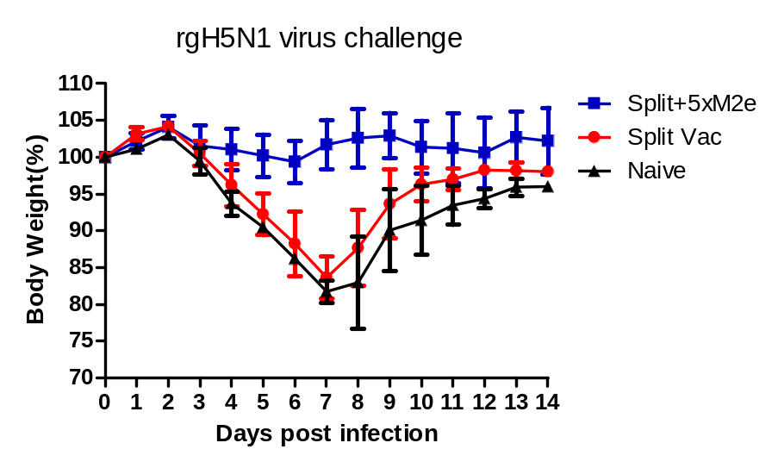
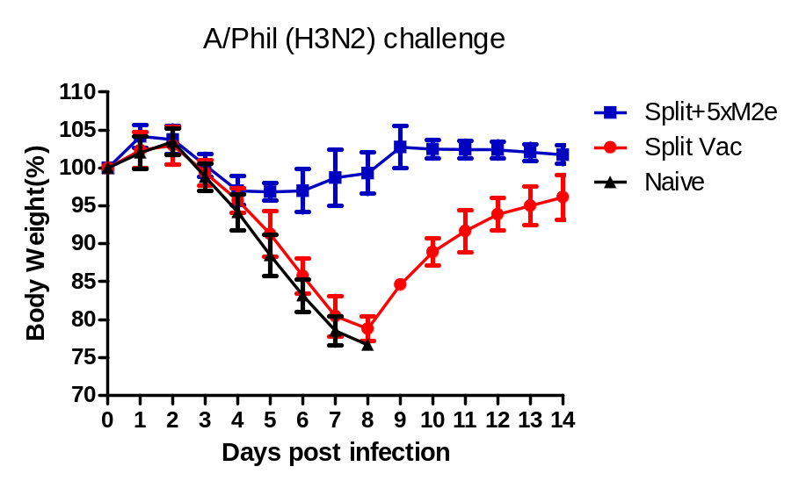
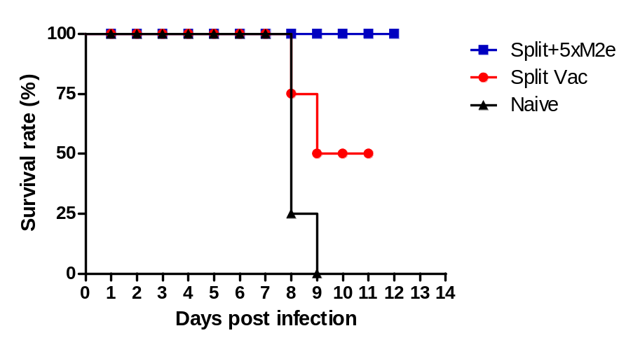
Supplementing human vaccines with M2e5x VLP
confers improved cross protection compared to the vaccine only
Split human vaccine
H5N1 virus
(re.A/VN/1203)
M2e5x VLP
H3N2 virus
(A/Phil/1203)
(Kim et al., 2014, Mol Ther)

Slide 17
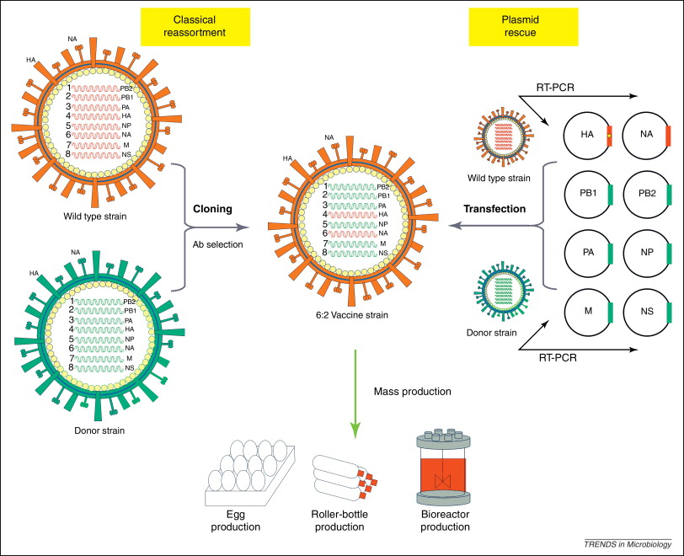
Recombinant Influenza Virus Carrying M2e4x in a chimeric hemagglutinin conjugate induces cross protective antibody responses
A. N-terminal chimeric 4xM2e-HA (N)
SP
N
HA1-HA2
M2eH-M2eH-M2eS-M2eA
4xM2e-HA

Slide 18
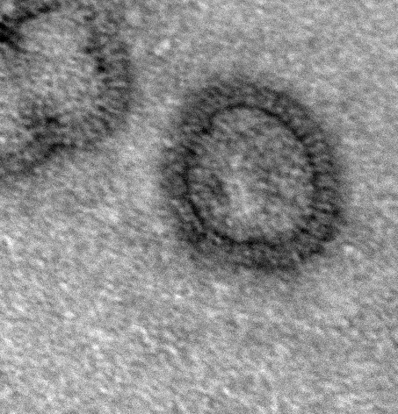
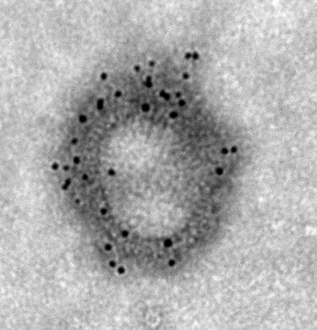
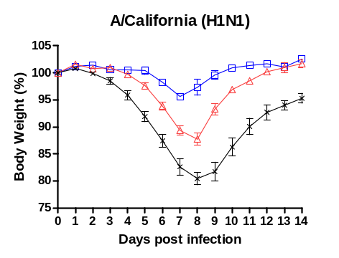
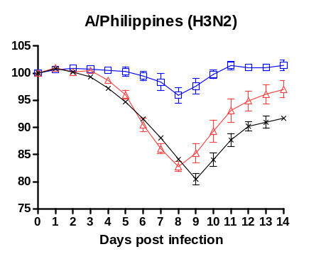
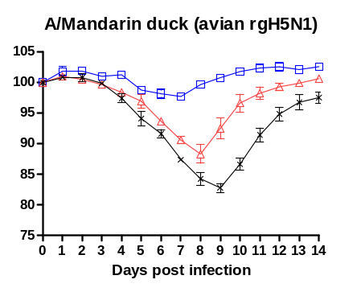
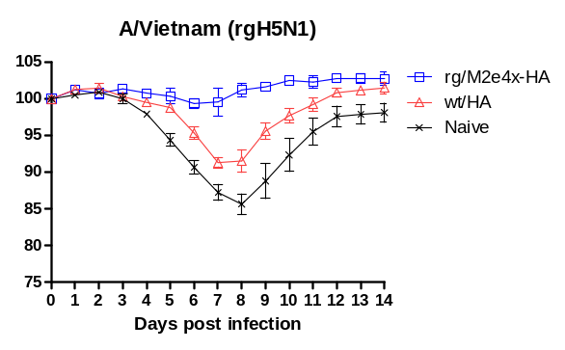
A)
B)
100 nm
100 nm
Protective efficacy to heterosubtypic influenza A viruses
P<0.01
P<0.05
P<0.01
P<0.05
P<0.05
P<0.05

Slide 19
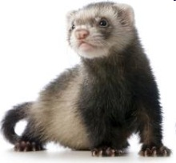
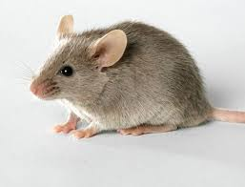
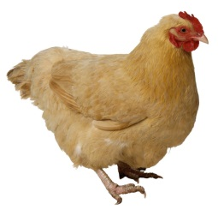
Summary (2)
Experimental flu universal vaccine
New M2e5x VLP vaccines can confer broad heterosubtypic cross protection in pre-clinical animal models (mice, ferrets)
Supplementation with M2e5x VLP significantly improves the cross protective efficacy of current flu vaccines
M2e antibodies, CD4 & CD8 T cells, dendritic/macrophage cells, Fc receptors are important for M2e-immune mediated protection.

Slide 20
Preclinical Efficacy of experimental vaccines against respiratory syncytial virus

Slide 21
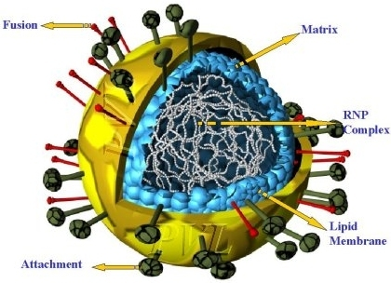
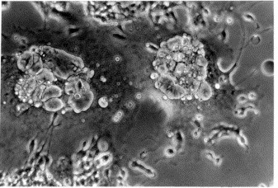
Respiratory Syncytial Virus (RSV)
64 – ~120 million hospitalizations and 160,000 – 234,000 deaths globally (up to 940,000 RSV pneumonia associated deaths mostly in developing countries: Luksic, 2013; Smith, 2013; Shi 2014)
Bronchiolitis and pneumonia in children under 1 (or 5) years old children
Recurrent wheezing and asthma
immunocompromised patients and infants born prematurely severe respiratory illness requiring hospitalizations
no vaccine exists
Palivizumab, a monoclonal antibody directed against RSV surface fusion protein

Slide 22
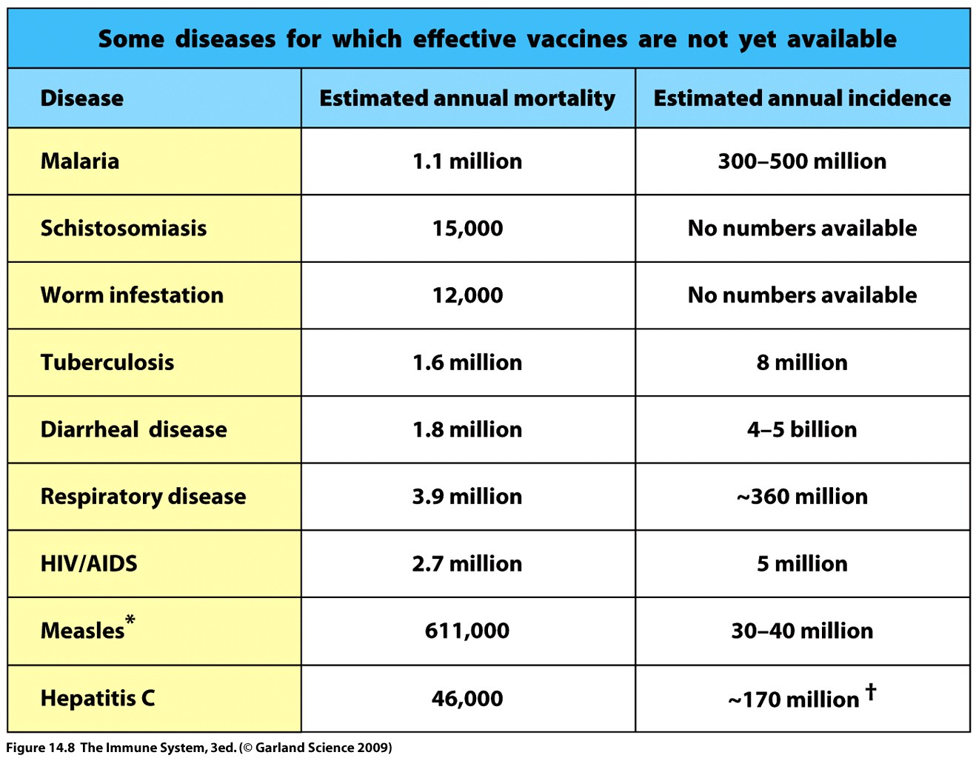

Slide 23
Clinical Trials of Novavax RSV F nano-particle protein vaccines
Novavax RSV F nano-particle (30 – 40 nm) protein vaccines
Phase I clinical study 18-19 years of age (2013)
2. Phase II clinical study (350 healthy women of child bearing ages 18 – 35 years of ages (2015)
3. Planning phase III study (2016) : Maternal immunization.

Slide 24
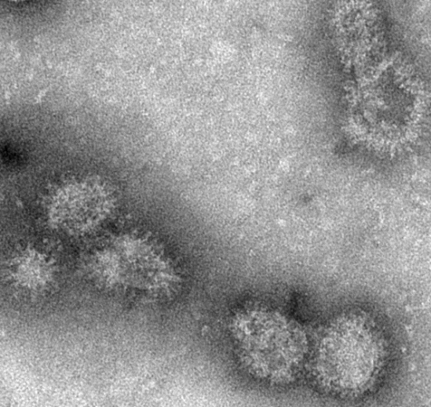
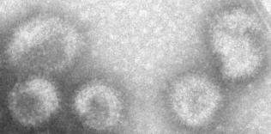

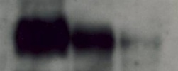

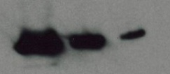
Production and characterization of RSV F and G VLPs in insect cells
Recombinant
Baculovirus
RSV-G Virus like particles
RSV-F Virus like particles
50 nm
50 nm
RSV-F Virus like particles
RSV-G Virus like particles
KD
70
25
20ug 5ug 1ug
KD
20ug 5ug 1ug
F
M1
75
G
25
M1
(Quan et al., 2011, J. Inf. Dis.)

Slide 25
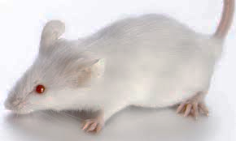
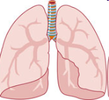
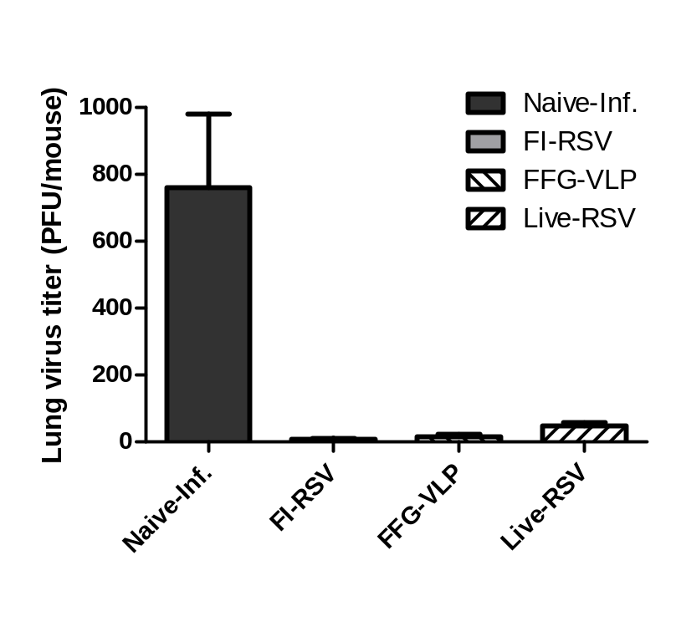
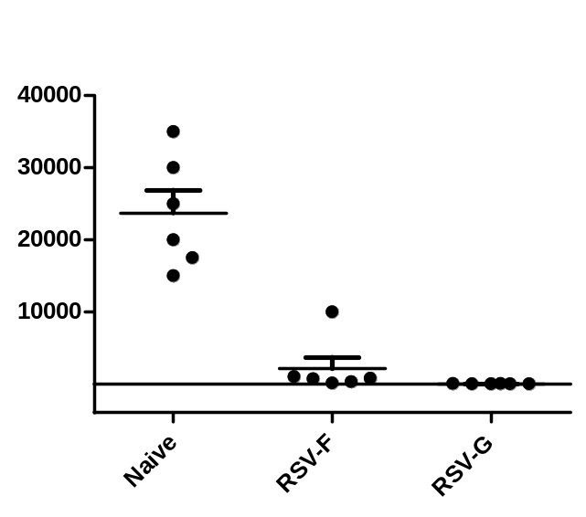
F or G VLP controls lung viral clearance similar to FI-RSV (and live RSV)
FI-RSV (IM)
Live RSV (IN)
Intramuscular
immunization
Live RSV
challenge
VLP vaccines
(RSV F + G )
Lung RSV titers
Lung RSV titers
Lung virus titer
( PFU/mouse)
RSV-F or G VLP immunization
(Quan et al., 2011, J. Inf. Dis.)
(Ko et al., 2014, Nanomedicine)

Slide 26
The most challenging difficulty in developing RSV vaccines:
Vaccine safety?
A safe vaccine should not induce “Vaccine-enhanced pulmonary (lung) respiratory disease?

Slide 27
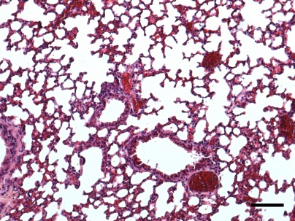
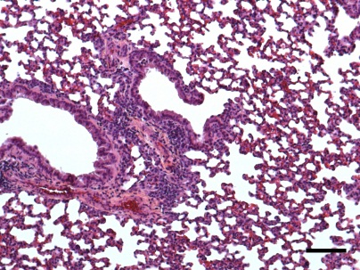
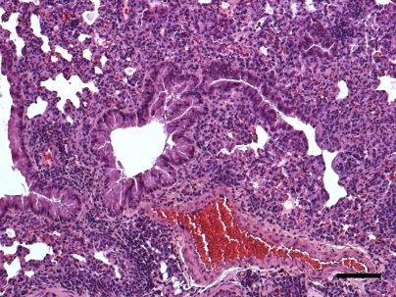
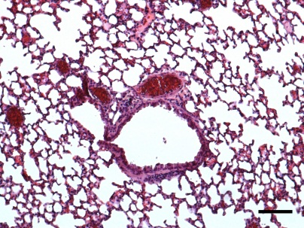







RSV VLP vaccines do not cause pulmonary
inflammatory disease upon live RSV challenge (1)
A
Naïve
Naïve-infection
FI-RSV
FFG-VLP
Live-RSV
H&E
B
C
D
(Hwang et al., 2014, Anti. Viral Res)

Slide 28
















RSV VLP vaccines do not cause inflammatory
eosinophilia upon live RSV challenge (2)
Naïve
Naïve-infection
FI-RSV
FFG-VLP
Live-RSV
PAS
A
B
H&CR
(Hwang et al., 2014, Anti. Viral Res)

Slide 29

Cotton rats are a more relevant animal model for RSV vaccine studies
RSV F
FI-RSV
Live RSV
Naive
Intramuscular
immunization
Live RSV
challenge

Slide 30
Summary
RSV VLP vaccines induce protection without vaccine-enhanced disease in mice and cotton rat animal models.
  RSV F specific IgG2a dominant production
  Neutralizing RSV activity and virus clearance
  T helper 1 immune responses
  No eosinophilia and inflammation in the lungs of mice and cotton rats
FI-RSV caused severe vaccine-enhanced disease (clinical trials, various animal models)
  High immunogenic (RSV specific antibody production)
  T helper 2 immune responses
  Severe eosinophilia and inflammation in lung after RSV challenge
Live RSV does not provide long-term immunity, recurring infections
  Good immune responses and protection
  Short memory duration and reinfection throughout life
  (Hall CB et al., J Infec Dis., 1991)
Notes:
SO, FdFG VLP induced RSV F specific IgG2a dominant antibody and effective neutralizing antibody production.
Also, it stimulated T helper 1 immune responses and CD8 T cell activities without vaccine-enhanced diseases.
Therefore, FdFG VLP may have a potential to be developed as an effective and safe RSV vaccine inducing protective immune responses.

Slide 31

Acknowledgements
Research support
NIH/NIAID
GSU RF
Collaborators
(Former members)
Eunju O
Sieun Yoo
Jae-Min Song (Sungshin U)
Fu Shi Quan (KyungHee U)
JongSeok Lee
Minkyoung Cho
Vu NGO
Daegoon Yoo (UGA)
Minkyung Park (C. W. U)
Yeu-Chun Kim (KAIST)
Ioanna Skountzou (Emory)
Sailaja Gangardhara (Emory)
Emory University
Martin Moore
CDC (Atlanta, USA)
Ruben Donis
Ian York
Nedzad Music
Georgia State University
Yuna Lee
Kihye Kim
YoungMan Kwon
Youngtae Lee
Minchul Kim
Eunju Ko
Hyesuk Hwang
Yujin Jung
Youri Lee
Yujin Kim
Ye Wang
Mercer University
Martin D’Souza
Georgia Inst. Technology
Mark Prausnitz
BEAMS BIOTECH
Cheol Kim
Jongsang Lee
QIA
Younjeong Lee
Research materials
Green Cross
(split vaccine)
NIH BEI
University of Alberta
Hyo-Jick Choi
Carlo Montemagno

Slide 32
Thank you
Questions?

