Slide 1

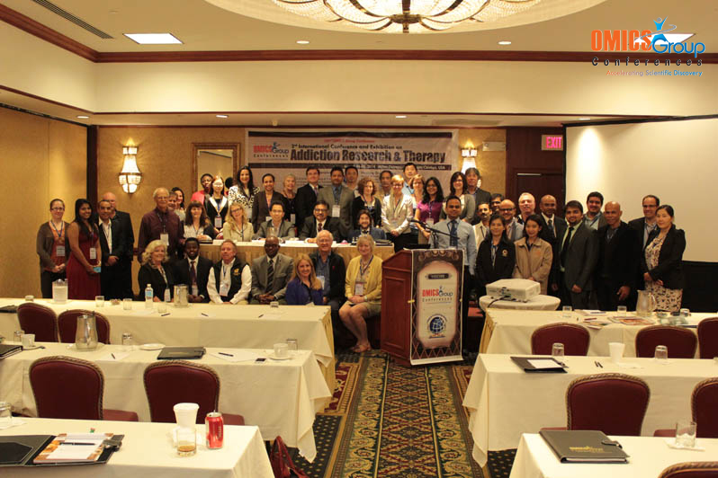
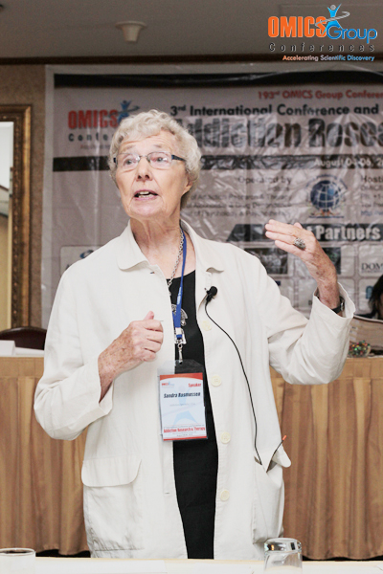
Addiction Therapy-2014
Chicago, USA
August 4 - 6, 2014
Sandra Rasmussen

Slide 2
3rd International Conference and Exhibition on
Addiction Research & Therapy
August 04-06, 2014 Chicago
Integrating Innovations & Advanced Technologies in Prevention and Treatment of Reward
Deficiency Syndrome
LIVE WELL:
A Recovery Model for Addiction and Other Reward Deficiency Syndrome Disorders
Sandra Rasmussen, PhD, RN, LMHC, CAS-F
Walden University
Williamsville Wellness

Slide 3
OBJECTIVES
Review concepts addiction and reward syndrome disorders.
Recognize recovery as an idea whose time has come.
Consider empowerment as a way to manage addiction and other RDS to realize recovery.
See how management strategies direct the recovery process.
See how self-efficacy actions drive recovery.
Live well: examine self and surroundings, embrace management and self-efficacy, evaluate recovery milestones and roadblocks.
Realize recovery: a different, better way of life with purpose and meaning.

Slide 4
RDS & ADDICTION
REWARD DEFICIENCY SYNDROME (RDS) is a gene-related condition characterized by compulsive, addictive, and impulsive behaviors such as smoking/smokeless tobacco use, overeating, drug addiction, pathological gambling, excessive internet gaming; compulsive exercise, shopping, work or sex; possibly ADHD, teen and adult aggression and criminal behavior, and more.
ADDICTION is a primary, chronic disease of brain reward, motivation, memory and related circuitry, characterized by craving, loss of control, physical dependence, and tolerance Genetics, together with bio-psycho-social-spiritual factors, account for the likelihood one will develop addiction or other RDS disorders.

Slide 5
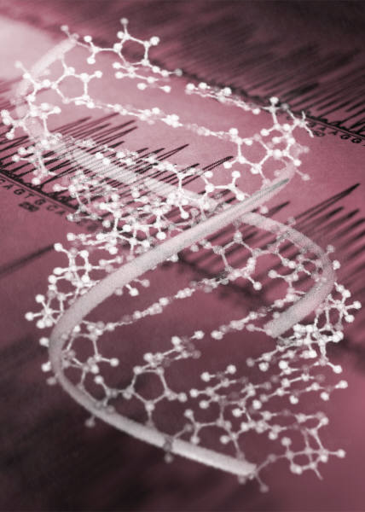
RDS: a gene-related condition

Slide 6
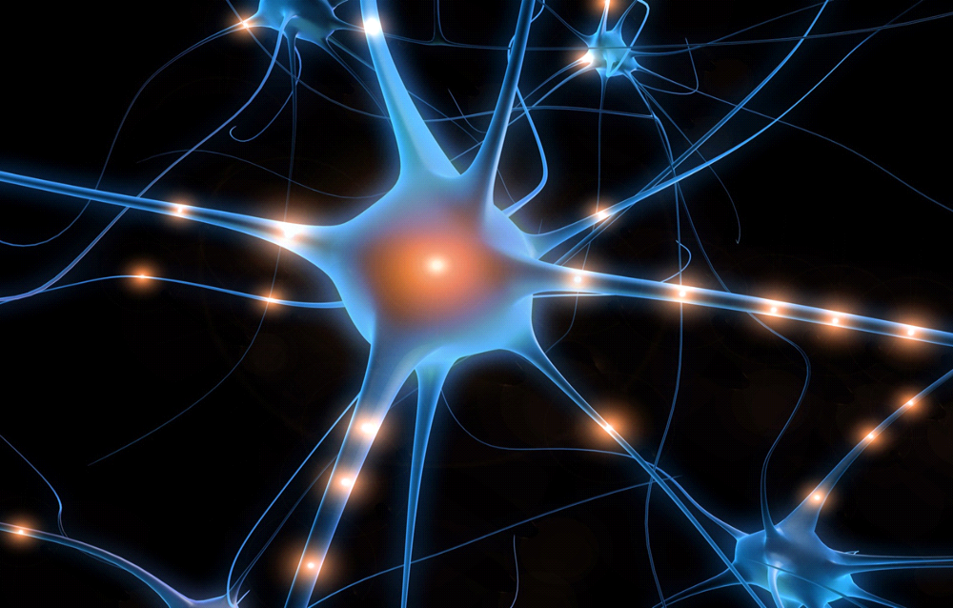
ADDICTION: a primary, chronic disease of brain reward, motivation, memory and related circuitry

Slide 7
RECOVERY
A shift from the traditional medical psychiatric model of care toward the concept of recovery began with the federal New Freedom Commission on Mental Health in the early 2000s.
In 2011, the Substance Abuse and Mental Health Administration (SAMHSA) defined recovery as a process of change through which individuals improve their health and wellness, live a self-directed life, and strive to reach their full potential.
Rasmussen defines recovery as a different, better way of life with purpose and meaning.

Slide 8


RECOVERY

Slide 9
EMPOWERMENT
Empowerment means to invest with power.
Empowerment is the ability to manage self and situations with
confidence and effectiveness.
Empowerment embraces intellectual, emotional, educational, and spiritual attributes together with social, political, economic, ethnic, and racial awareness.
Empowerment reflects an increase in personal and collective strength.
Management strategies direct empowerment process.
Self-efficacy actions drive empowerment.
Personal and social empowerment support addiction and RDS recovery.

Slide 10

EMPOWERMENT

Slide 11

Rosie, the Riveter, WWII

Slide 12
MANAGEMENT
Management is the ability to direct or handle something skillfully, effectively; to accomplish something; to achieve one’s purpose.
Management strategies are tactics, actually action plans, that direct the empowerment process.
Management is a major recovery dynamic for addiction and RDS recovery.
Public health protocols for chronic disease management, the Stanford Chronic Disease Self-Management Program, Recovery Oriented Systems of Care, twelve-step philosophy, and SMART Recovery® support addiction/RDS management.

Slide 13

Management Tactics
.

Slide 14

Remember the children’s book The Little Engine That Could. When other engines refuse to rescue the stranded train full of toys and food for good boys and girls, Little Blue Engine responds: “I think I can, I think I can, I think I can.” The engine overcomes insurmountable odds and pulls the train up the towering mountain to the other side. Addiction and RDS often paralyze or distort thoughts, feelings, and beliefs that “I can.” Self-efficacy is the belief one can act effectively here and now.

Slide 15
SELF-EFFICACY
Self-efficacy is an important part of the social-cognitive theory of personality developed by Albert Bandura.
Self-efficacy is the belief one can act effectively here and now.
People develop self-efficacy through mastery experiences, social modeling, social persuasion, and psychological responses.
People with a weak sense of self-efficacy experience and exhibit powerlessness.
People with a strong sense of self-efficacy embody and express empowerment.
Self-efficacy actions drive the addiction/RDS recovery process.

Slide 16
Empowerment: A Way to Manage Addiction & Other RDS
STRUCTURE PROCESS OUTCOME
Well-being
Lifestyle
Self
Change
Management & Self-efficacy
Surroundings
Risks for Complications,
Progression, Relapse
Prevention of Complications,
Progression,
Relapse
Complications,
Progression
Relapse
ECOLOGY
EMPOWERMENT
EVIDENCE

Slide 17
1. EXAMINE self and surroundings.
Focus on the whole person.
Consider age, gender, race and ethnicity
Pay attention to immediate surroundings: people, places, and things.
2. EMBRACE management and self-efficacy.
Mobilize management strategies.
Execute self-efficacy actions.
3. EVALUATE recovery milestones and roadblocks.
Realize recovery: a different, better way of life with purpose and meaning.
Prevent complications, progression, or relapse from addiction and other RDS.

Slide 18

LIVE WELL!
Consider empowerment as a way to manage addiction and other RDS.

Slide 19
REFERENCES
American Psychiatric Association. (2013). Diagnostic and statistical manual of mental disorders, 5th ed. (DSM-5). Washington, DC: APA.
American Society of Addiction Medicine (ASAM). Public policy statement: Definition of addiction, August 15, 2011.
Bandura, A. (1997). Self-efficacy: The exercise of control. New York: W.H. Freeman.
Blum, K., et al (2000). Reward deficiency syndrome: A biogenetic model for the diagnosis and treatment of impulsive, addictive, and compulsive behaviors. Journal of Psychoactive Drugs, 32 (Supplement): i–iv, 1–112.
Hur, M. H. (2006). Empowerment in terms of theoretical perspectives: exploring a typology of the process and components across disciplines. Journal of Community Psychology, 34 (5), 523-540.
The President’s New Freedom Commission on Mental Health (2003). Achieving the promise: Transforming mental health care in America. Washington, D.C.: The Commission.
SAMHSA (2011).Working definition of recovery. Washington, D.C. SAMHSA.
Rasmussen, S. (2000). Addiction treatment: Theory and Practice. Thousand Oaks, CA: SAGE
Rasmussen, S. (in process). Addiction management: Principles and practice. New York: Routledge
andur

Slide 20

Meet the eminent gathering once again at
Addiction Therapy-2015
Florida, USA
August 3 - 5, 2015
Addiction Therapy – 2015 Website:
addictiontherapy.conferenceseries.com

