Slide 1



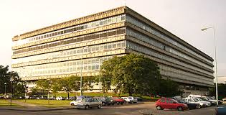


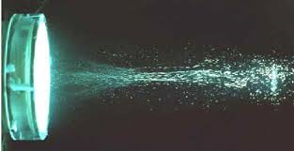
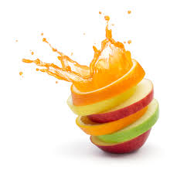

Combined use of Pulsed Light and High Intensity Ultrasound technologies to preserve apple juice. Study of microbial inactivation and induced damage
Sandra Guerrero, PhD, CFS
Notes:
First of all, I want to thank for the invitation to speak at this valuable event
Today I am presenting one part of a larger doctoral work c under my supervision involving the use of Pulsed Light assited by a pretreatment with US to preserve apple juice.

Slide 2
Emerging preservation factors
High Pressure Processing(HPP)
Pulsed Electric Fields (PEF)
Ultrasound (US)
Continuous UV-C light
Pulsed Light Technology (PL)
These technologies may inactivate microorganisms at sublethal temperatures, reducing detrimental effects on food quality
Notes:
Why using emerging preservation factors as replacement of traditional thermal processes ?
As it is well known, the application of non-thermal technologies for food preservation has received increasing attention because of the detrimental effects over sensory and nutritional properties of the freshly squeezed juices.
There is a wide range of emerging technologies which are being investigated as a total or partial replacement of traditional treatments (i.e., high hydrostatic pressure, pulsed electric fields, ultrasound (US), pulsed light (PL), and ultraviolet light (UV), among others) with different degree of development.
In particular, PL technology is based on the application of short intense pulses (100-400 µs) of an intense broad spectrum between 100 and 1100 nm with 54 % of emitted energy in the UV range
Because of its acidity, fruit juices were thought to be spoiled by yeasts, predominantly Saccharomyces spp.; moulds, and lactic acid bacteria. However, Alicyclobacillus acidoterrestris is a thermoacidophilic, heat-resistant bacteria that is capable of surviving the pasteurization procedures normally applied to fruit juices Therefore, the endospores can germinate and increase to cell concentrations high enough to produce taint compounds
For these reasons this study was focused on S. cer and A. responses…..

Slide 3
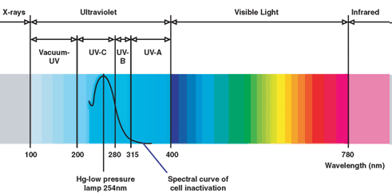
PL- Fundamental
Intense and short duration pulses of broad spectrum light from UV to near IR ( λ 200 – 1100 nm) produced using (Xenon) discharge lamps
One pulse:
  Duration: 1 μs to 0,1 s
  1 – 20 flashes per second
  Energy density ≈ up to 50 J/cm² per pulse
Inactivation mechanisms
I - Photochemical: DNA modification, protein desnaturalization and other cell alterations avoiding reproduction
II- Photothermal: cell disruption by localized heating produced by light absorption at doses ˃0,5 J/cm²
III- Photophysical: cell structures´damage and lost due to high energy peaks
UV-C
PL
Notes:
PL technology is based on the application of short intense pulses (100-400 µs) of an intense broad spectrum between 100 and 1100 nm with 54 % of emitted energy in the UV range
The germicidal action of PL has been attributed to the combination of the UV fraction which is responsible for the formation of thymine dimmers which impair cell replication and to the localized overheating
Besides, structural damages in microbial cells were also observed (photophysical effect)
Implementation of PL to inactivate microorganisms has gained interest due to the short-time treatments involved
Exposure to PL causes the formation of pyrimidine dimmers which impairs the process of cell replication(photochemical mechanism)
Moreover, membrane disruption was also reported as a result of a momentous overheating. This phenomenon is attributed to a difference in UV light absorption between the microorganism and its surrounding environment (photothermal effect).
Besides, structural damages in microbial cells like cytoplasmic membrane shrinkage were also reported (photophysical effect). It is possible for these mechanisms to coexist and, the relative importance of each one would depend on the fluence and target microorganism.

Slide 4

PL limitations in fruit juices
Superficial effect (penetration depth)
Heating effect depending on the fluence
Less effectiveness in juices with suspended solids (shadowing effect) , higher absortivities and turbidities
HURDLE APPROACH

Slide 5
Objective
Saccharomyces cerevisiae KE162 & Alyciclobacillus acidoterrestris ATCC 49025 spores response to pulsed light treatment combined with high intensity ultrasound as starting basis for processing design to obtain improved or more safe fruit juices
Notes:
.
The combination of US and PL may improve food microbial
stability due to their different inactivation mechanisms. The purpose
of this study was to analyse the response of Saccharomyces
cerevisiae cells and A. acidoterrestris spores in apple juice as affected
by combinations of US and PL with different temperature build-up
generated from the PL process itself.
How to produce safe and high quality foods; understand microorganism behaviour Design of food preservation techniques

Slide 6
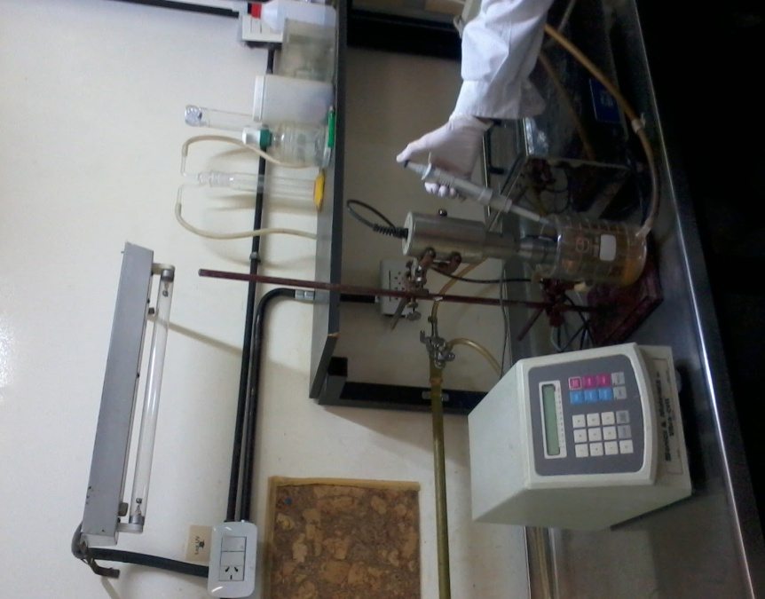
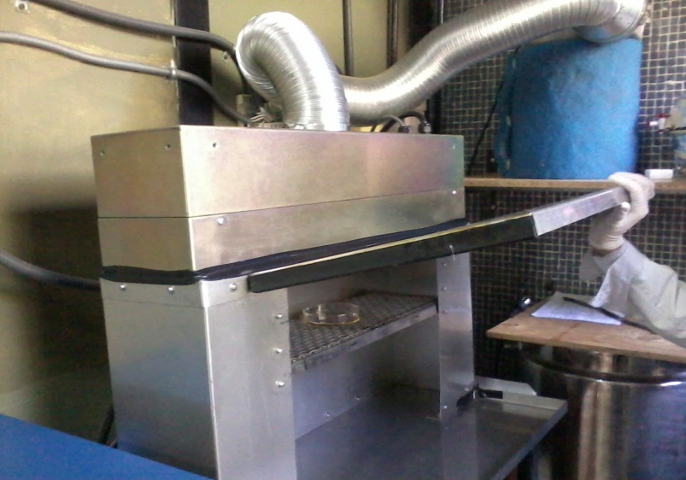
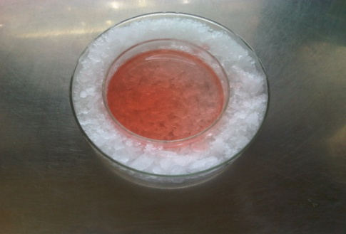
Treatments
Commercial Apple juice-CAJ
without additives
pH 3.5
Natural apple juice-NAJ
Fresh squeezed centrifuged (5000 rpm, 10 min)
pH 3.5
°Brix 10.5
A_{254 nm} 0.049
Turbidity (660 nm): 0.063
Particle size(nm):1.67
°Brix 12.6
A_{254 nm} 0.110
Turbidity (660 nm): 0.07
Particle size(nm):712
US TREATMENT
Vibracell 600, Sonic & Materials, NewTown, CT, USA)
20 kHz , 600 watts, WA: 95.2 µm (80 %)
10-30 minutes; 20 or 44 °C
Horn
Thermostatic
bath
US processor
Probe
Juice sample
PL TREATMENT
RS-3000B Steripulse-XL
system (Xenon Corporation, Wilmington, MA, USA),
3pulses/s (pulse width = 360 μs)
71.6 J/cm² (60s);
T_{initial -} T_{final}: ~ 2-12 °C; 44–56 °C
Air flow
Inoculation with S.cerevisiae KE162 cells or A. acidoterrestris ATCC4025 spores ( stationary phase, final cell density :10⁷ -10⁸ CFU/mL)
Lamp house
(inside: Xenon Flash lamp)
Innoculated juice (5 mL) in a Petri dish
0.1 m distance from the lamp
US+PL TREATMENT
LT treatments
US :10min (10US) or 30 min(30US), T= 15°C +
PL: 60 s (60PL), T_{PLi}= 2°C, T_{PLf}= 12 °C
MT treatments
US :10min (10US) or 30 min(30US), T= 44 °C+
PL: 60 s (60PL), T_{PLi}= 44°C, T_{PLf}= 56 °C
Juice temperature profile during PL treatment
MT
LT
Notes:
Commercial and natural apple juices were used in this study.
CAJ wascharacterized by a high penetration of light and was used in order to compare it with a juice with different characteristics of turbidity, particle size and absorbance.
NAJ was aseptically obtained and centrifuged in order to reduce pulp amounts (5000 rpm, 10 min)
Juices were inoculated
Ultrasonic treatment: Treatments were carried out in a double wall vessel connected to a thermostatically controlled water bath to attain 20 or 44 ± 1 °C in the vessel. Ultrasound (net power output: 600 wattst 20 kHz and 95.2 (80 %) µm of wave amplitude was applied to the medium with an immersed 13 mm diameter probe. After three minutes of sonication, the desired temperature was reached, and it was maintained constant at the predetermined temperature and treated 10 or 30 minutes.
sonicated juice samples were immediately PL processed US+PL
Pulsed light processing: was performed with a Steripulse-XL which produces polychromatic radiation in the wavelength range from 200 to 1100 nm. The PL device consisted of control module, a treatment chamber that housed a xenon flash lamp and an air cooling system attached to the lamp housing to avoid lamp overheating during operation. It generated high intensity PL at a pulse rate of 3 pulses per second and a pulse width of 360 μs.
Samples were exposed to PL treatment for 60 s (71.6 J/cm²) at a distance of 0.1 m from the quartz window with two different final temperatures (T_{PLf}) due to the heat build-up during PL treatment and the matrix.
For LT treatments, juice sample contained in the 100 mm Petri dish was placed into a bigger one, filled with ice flakes before PL treatment. Therefore, juice temperature immediately decreased to 2°C, reaching after PL processing a T_{PLf} of 12 °C.

Slide 7
Food safety engineering - Some indicators:
Bulk methods: Inactivation studies as function of dose
Single cell analysis
  Flow cytometry (FCM)
  Transmission Electron Microscopy (TEM)
Notes:
.
The combination of US and PL may improve food microbial
stability due to their different inactivation mechanisms. The purpose
of this study was to analyse the response of Saccharomyces
cerevisiae cells and A. acidoterrestris spores in apple juice as affected
by combinations of US and PL with different temperature build-up
generated from the PL process itself.
How to produce safe and high quality foods; understand microorganism behaviour Design of food preservation techniques

Slide 8
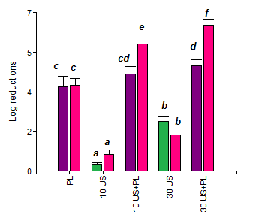
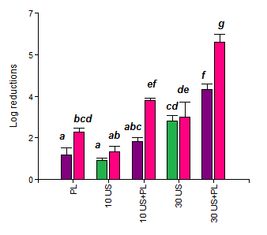
S. cerevisiae inactivation achieved by single and combined treatments
(US: 15 °C (■); 44 °C (■); PL: 2-12 °C (LT, ■) ; 44 -56 °C (MT, ■)
CAJ
NAJ
Higher final temperatures significantly increased the effect of the combined US+ PL treatments for both juices
US+PL treatments increased S. cerevisiae inactivation obtained by single treatments showing in general additive or less than additive effect.
The combined treatment 30 US/PL/ MT was the most effective one achieving 5.8 – 6.4 log reductions in apple juice
Notes:
The application of the combination 10 and 30 min US+PL increased the inactivation obtained by single treatments for both matrixes
The temperature build-up of T_{PLi} 44 °C improved the effectiveness of PL treatments
For both matrixes, the combination of 30 min US+PL (T_{PLi}: 44 ± 1 °C) resulted the most effective one in inactivating S. cerevisiae, as 6.4 and 5.8 log reductions were achieved in CAJ and NAJ, respectively

Slide 9
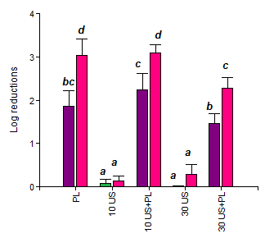
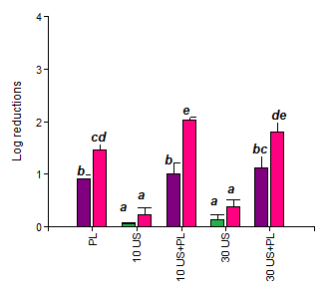
A. Acidoterrestris inactivation achieved by single and combined treatments
(US: 15 °C (■); 44 °C (■); PL: 2-12 °C (■) ; 44 -56 °C (■)
CAJ
NAJ
US was innefective inactivating A. acidoterrestris spores
Combined US+PL treatments did not improve single PL treatments
PL treatments with MT final temperature significantly improved inactivation
Notes:
US was innefective inactivating A. acidoterrestris spores for all assayed conditions and treatment temperatures
In general, the combination with US treatment did not improve the observed inactivation when single PL treatments were applied
PL treatments with MT build up significantly improved the observed inactivation

Slide 10
Food safety engineering - Some indicators:
Bulk methods: Inactivation studies as function of dose
Single cell analysis
  Flow cytometry (FCM)
  Transmission Electron Microscopy (TEM)

Slide 11
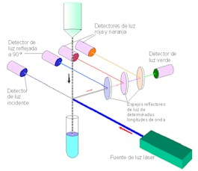
Flow cytometry: fundamentals & procedure
Through light deviation to different angles and, the fluorescence signals
Cell parameter information at single cell level
(size, surface granularity, physiological status)
90° reflected light detector
Red and orange light detectors
Green light detector
Incident light detector
Light reflectoring mirrors at preset wavelengths
Laser light power
Notes:
The application of flow cytometry (FCM) allows exploring changes in the physiological state of microorganisms from analyzing large populations of cells in a very short time
This goal can be achieved by adding fluorescent dyes, which are targeted on specific cellular structures, physiological status/activity. In this study a double-staining strategy using fluorescein diacetate (FDA) and propidium iodide (PI) was applied.

Slide 12
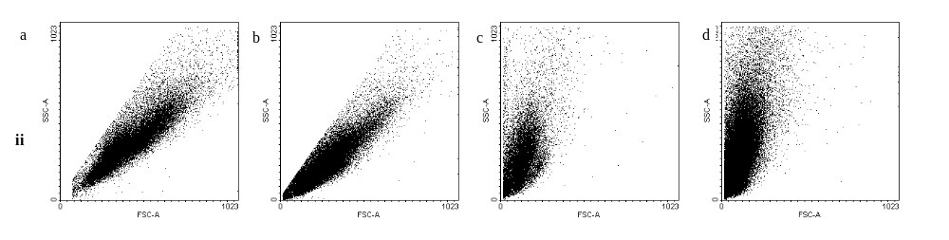
FLOW CYTOMETRY:
Dot plots representing forward scatter light (FSC) versus side scatter light (SSC) of S. cerevisiae cells in NAJ submitted to different treatments/MT
Untreated cells
PL
10 US
10 US+PL
For the combined treatment cell size dramatically decreased possibly due to damage in the membrane integrity and cytoplasmic disorder
Notes:
In flow cytometry analysis, cells pass individually through a laser beam and the scattered light is detected in two planes.
Forward scatter light (FSC) is measured in the plane of the beam and gives relative information on cell size.
Side scatter light (SSC) is measured at 90º to the beam and can provide information on cell granularity
Dot plots representing forward scatter light (FSC) versus side scatter light (SSC) were obtained during measurements.
Untreated S. cerevisiae cells (Figure 2i,iia) produced unimodal clustering with respect to SSC and FSC, with great heterogeneity with respect to their size and granularity, and extended practically from small to high sizes and granulometries, although more concentrated in the range from smaller to intermediate values. This could be attributed, at least partially, to the different orientation of the elongated cells as they travel through the laser beam generating different granularity and size
single PL in NAJ did not induce any changes in neither granularity nor size to control,
application of sole or combined US, considerably reduced forward values, corresponding to size reduction.
As it will be shown in this work, the reduction in cell size and granularity observed by FSC and SSC signals is well correlated with TEM observations, which demonstrated more rounded shape, and cells that lost partially or totally (i.e. “ghost” cells) their content.

Slide 13
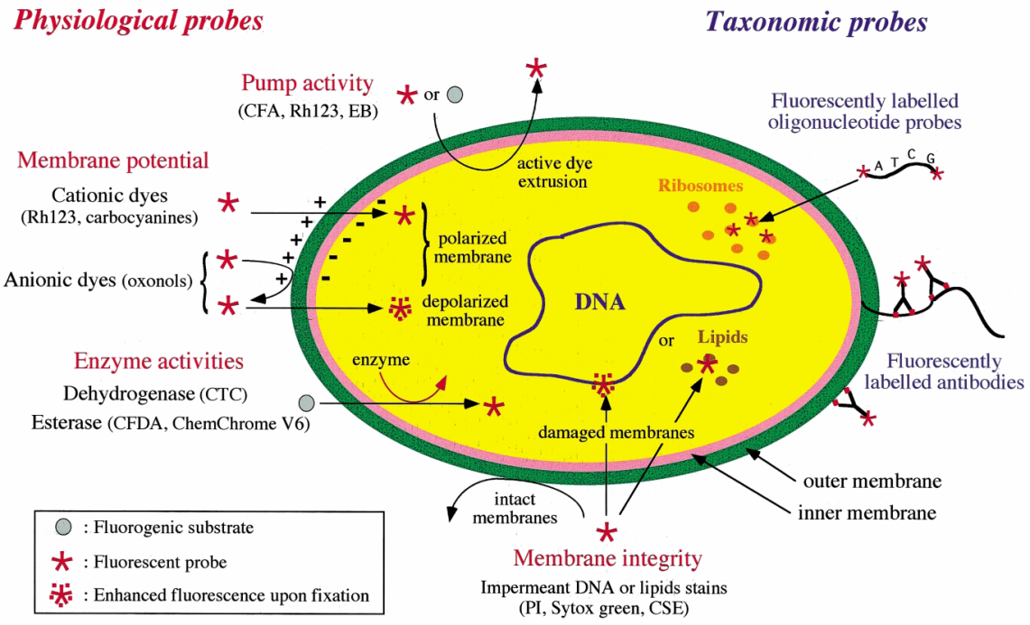
Flow cytometry: fundamentals & procedure
(Joux et al., 2000)
FCM Procedure
( BD FACSAria II; New Jersey, USA; Flow speed: 200 cells/s; 20.000 events/sample).
S. cerevisiae cells were double stained with fluorescein diacetate (FDA) and propidium iodide (PI).
Fluorescent and scattering signals of individual cells were collected as logarithmic signals.
Green fluorescence of cells stained with F was collected at channel FL1 (525 ± 15 nm), while red fluorescence of cells stained with PI was collected at channel FL2 (620 ± 15 nm)
WinMDI 2.8 was used for the analyses of data. Measurements were performed by triplicate and % cells ± standard deviation was calculated.
Notes:
Application of double staining with FDA and PI was used for FCM analysis. FDA is a non-fluorescent precursor that readily diffuses across membranes, and it is used for the evaluation of enzymatic activity and membrane integrity.
In the intracellular compartment of metabolically active cells, FDA undergoes hydrolysis by enzymes with esterase activity into fluorescein (F), a polar fluorescent green compound that is unable to diffuse out of the cell.
Thus, only cells with intact membranes will remain fluorescent due to the presence of internal F.
In contrast, PI is a nucleotide-binding probe, widely used for the assessment of membrane integrity, supposed to enter only cells with damaged membranes. PI diffuses into the cell and stains the DNA giving red fluorescence
Scatter and fluorescence signals of individual cells passing through the laser zone were collected as logarithmic signals. Green fluorescence of cells stained with FDA was collected in the FL1 channel (525 ± 15 nm),
red fluorescence of cells labeled with PI was collected in the FL2 Channel for (620 ± 15 nm).

Slide 14
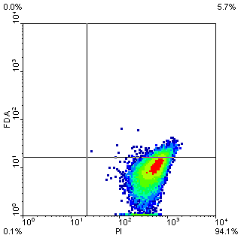
Viability assessed by FCM
Red fluorescence
Membrane damage
F+ PI+
Active esterase, membrane minimally damaged
i
ii
F+ PI-
Active esterase, intact membrane
Green fluorescence
Membrane integrity
F- PI+
Esterase activity non detectable, Membrane compromised
iii
iv
F- PI+
Esterase activity non detectable (or F extruded out of the cells), intact membrane
Notes:
Dot plot analysis of FL1 vs. FL2 was applied to determine the fluorescence properties of the population.
This plot describes the gate designation of stained cells.
It shows dual-parameter density plots of the green fluorescence (y-axis) and the red fluorescence (x-axis), monitoring the ability of S. cerevisiae cells in CAJ and NAJ to accumulate and retain F as an indicator of membrane integrity and enzyme activity, and uptake of PI to assess membrane damage. The percentage of microbial populations which falls in each quadrant can be found in the four edges of each plot

Slide 15
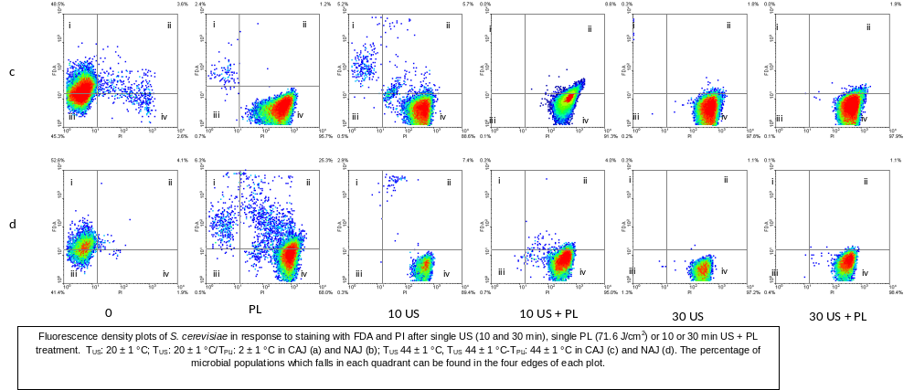
Fluorescence density plots of S. cerevisiae in response to staining with FDA and PI after single and combined MT treatments(US : 44 °C PL: 44-56 °C)
No differences in the percentages of F⁻PI⁺ subpopulation were observed for despite the observed differences in the inactivation degree.
Cell sorting of fractions in gate 4 showed that cells could not be able to recover in 30US+PL but 1 x 10² CFU/mL were recovered in 30US system at T_{US} 44 °C.
This suggests that membrane permeabilization occurred, but other mechanisms contribute to yeast inactivation.
% of cells in gate 4
3 %
96%
89%
91 %
98%
98%
CAJ
NAJ
0
PL
10 US
10US+ PL
30US
30US+ PL
1 %
68%
A great proportion of double-stained cells (F⁺PI⁺) were detected when single PL was applied ( ~26 % cells ).
cells with esterase activity and partially damaged too
The presence of this subpopulation is not detected by traditional method and could affect the product shelf life
89%
95%
97 %
98%
Notes:
Temperature increased the shift of cells from quadrant 1 (F+PI⁻) to 4 (F-PI⁺) at 10 min US at both matrixes, as a higher proportion of cells was found in this quadrant when the sonication temperature or the T_{PLi} was 44 °C.
After 10 US+60 PL, 30 US and 30 US+60 PL, cells were labeled as F-PI+ On the other hand, 10 US produced a less pronounced shift of cells
A great proportion of double-stained cells (F⁺PI⁺) were detected when 60PL was applied, being this fraction more important in NAJ, where ~26 % cells were found. This indicates that cytoplasmic membrane integrity was being affected while cells were capable or retaining esterase activity. The presence of this subpopulation could seriously affect shelf life in PL treated foods since cells are metabolically active but they cannot be detected by conventional cultivation assays
In concordance with the inactivation rate observed in Figure2, after 60PL at both temperature profiles (LT and MT) only ~35 % of cells were F⁻PI⁺ in NAJ , while ~90 % of cells were observed in the same quadrant for CAJ.
30US+PL and 30 US
No differences in the percentages of F-PI+ subpopulation were observed for despite observed differences in the inactivation degree.
Cell sorting of fractions in gate 4 showed that cells could not be able to recover in 30US+PL but 1 x 102 CFU/mL were recovered in 30US system at TUS 44 °C. This suggests that membrane permeabilization occurred, but would not the only responsible for yeast inactivation.
possible reversible permeabilization, which would not be revealed by the PI uptake ???

Slide 16
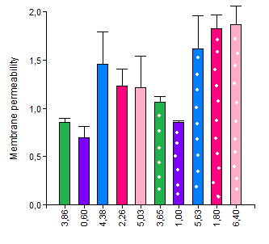
Permeabilized S. cerevisiae cells in CAJ determined by PI uptake as a function of non viable cells determined by CFU method
30 US
30 US+ PL
30 US + PL
10 US+ PL
The number of non viable cells for all PL treatments was higher than the number of permeabilized cells
Membrane integrity is critical but, there are other factors responsible for cell viability
10 US+ PL
30 US
PL
PL
10 US
Permeabilized cells (Log N_{0T} – Log N_{T})
10 US
LT
MT
Non viable cells (Log No – Log N)
Notes:
To analyze the relationship between the decrease in viable population determined by plate count method and the membrane permeabilization of S. cerevisiae, the increase of cells taking PI (permeabilized cells) was plotted against the increase of nonviable cells (Figure )a s a mode of example I am displaying the results for CAJ but we obtained the same trend for both type of juices
we obtained a higher number of inactivated cells in relation to the permeabilized cells. For example, 6.4log reductions were obtained after 30 US+PL treatment in CAJ, respectively, but only 1.8 log of permeabilized cells were detected.
PL More cells were determined as nonviable than cells with compromised membrane. For example, apple juice treated with 71.6 J/cm² -PL resulted in 4 log reductions of S. cerevisiae viability, but only 0.8 log reduction of membrane integrity.

Slide 17
Food safety engineering - Some indicators:
Bulk methods: Inactivation studies as function of dose
Single cell analysis
  Flow cytometry (FCM)
  Transmission Electron Microscopy (TEM)

Slide 18
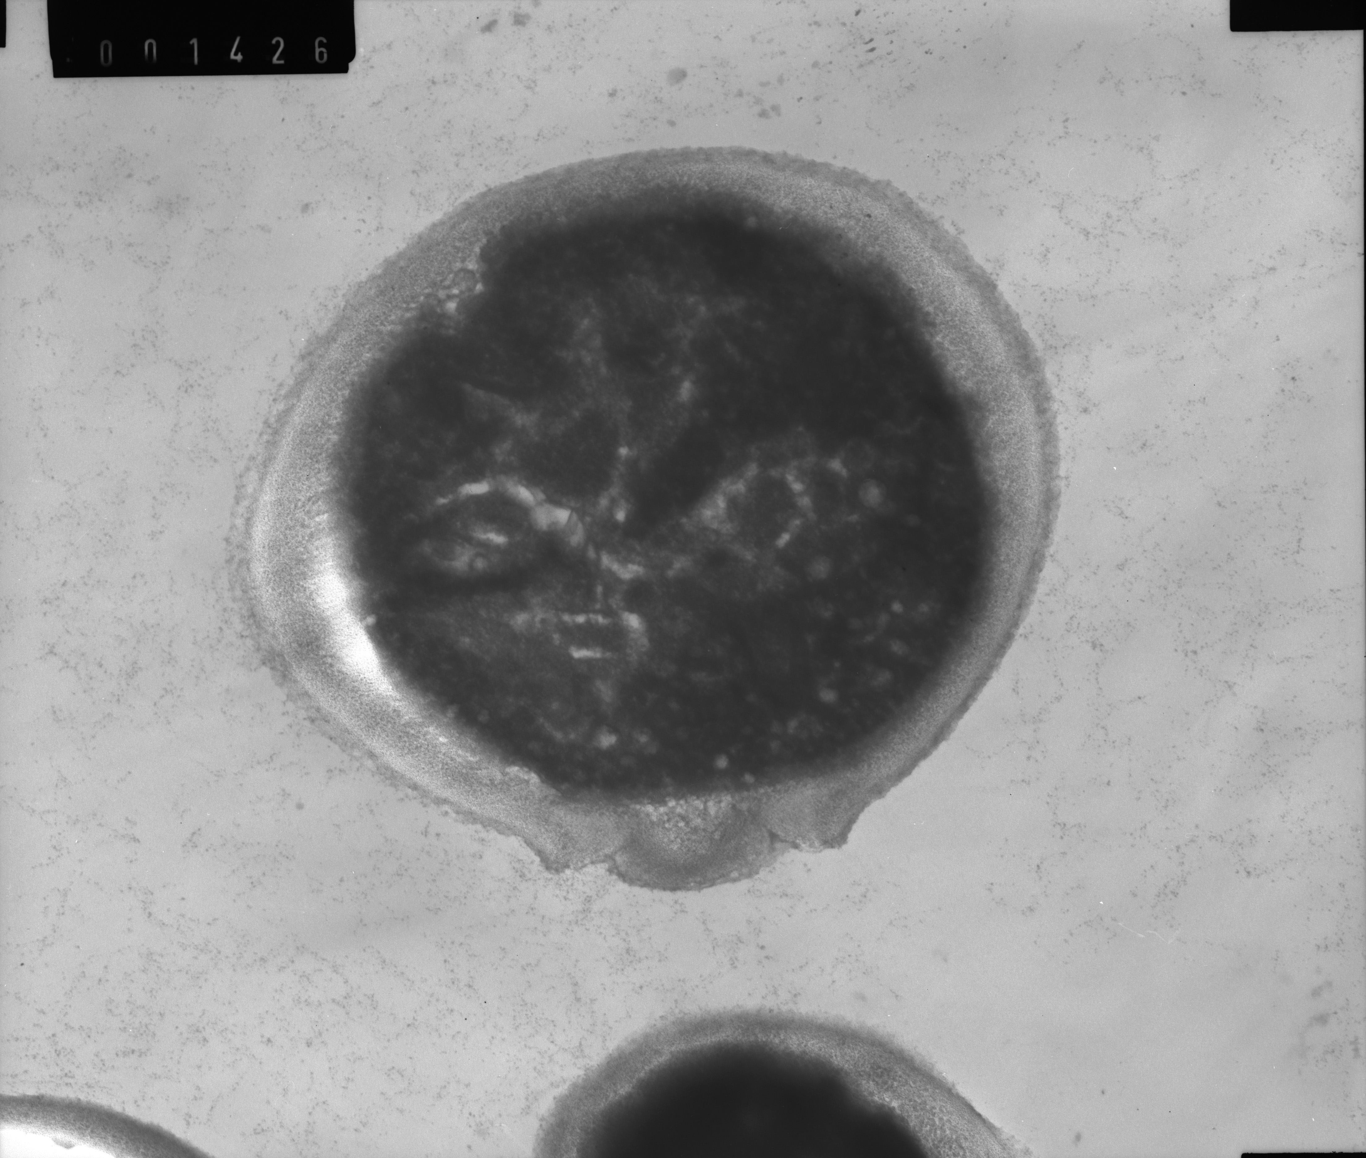
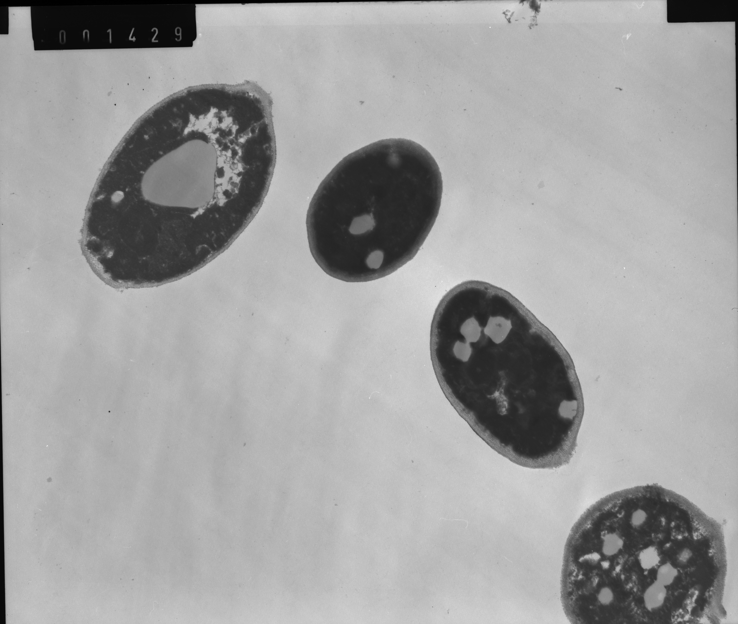
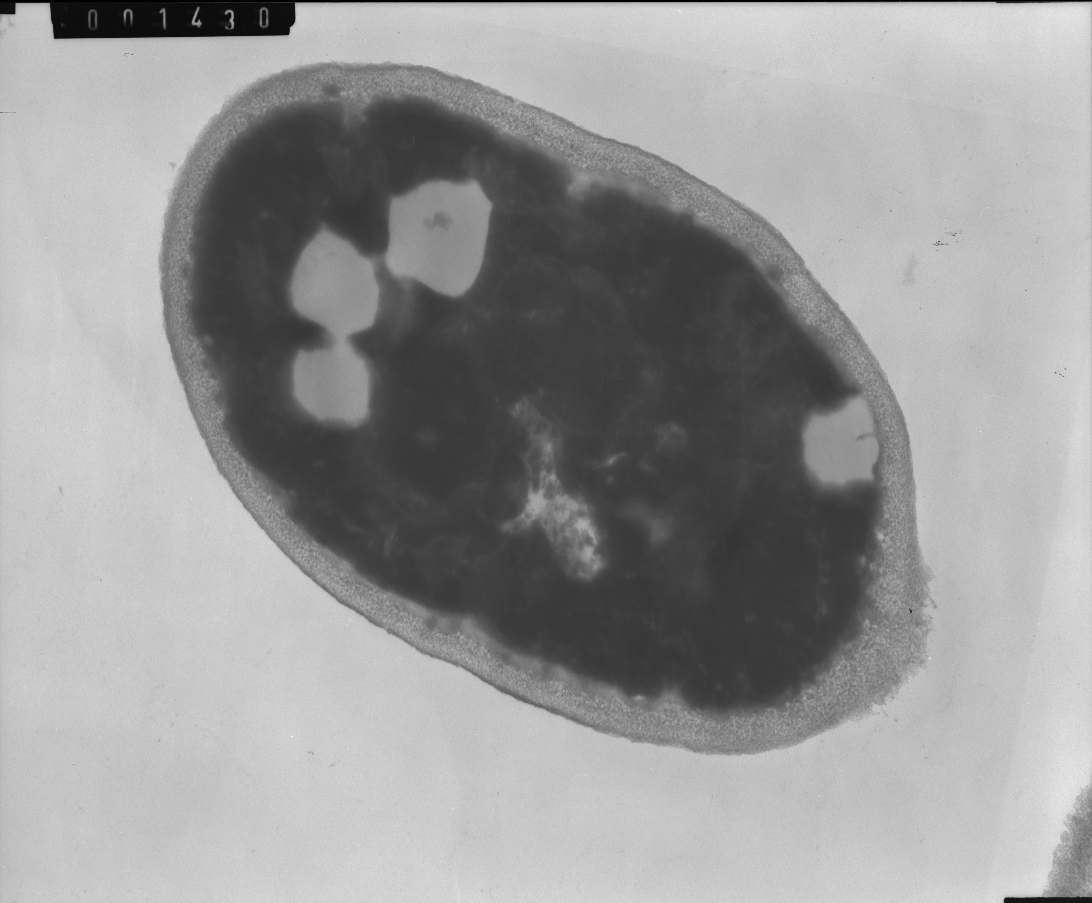
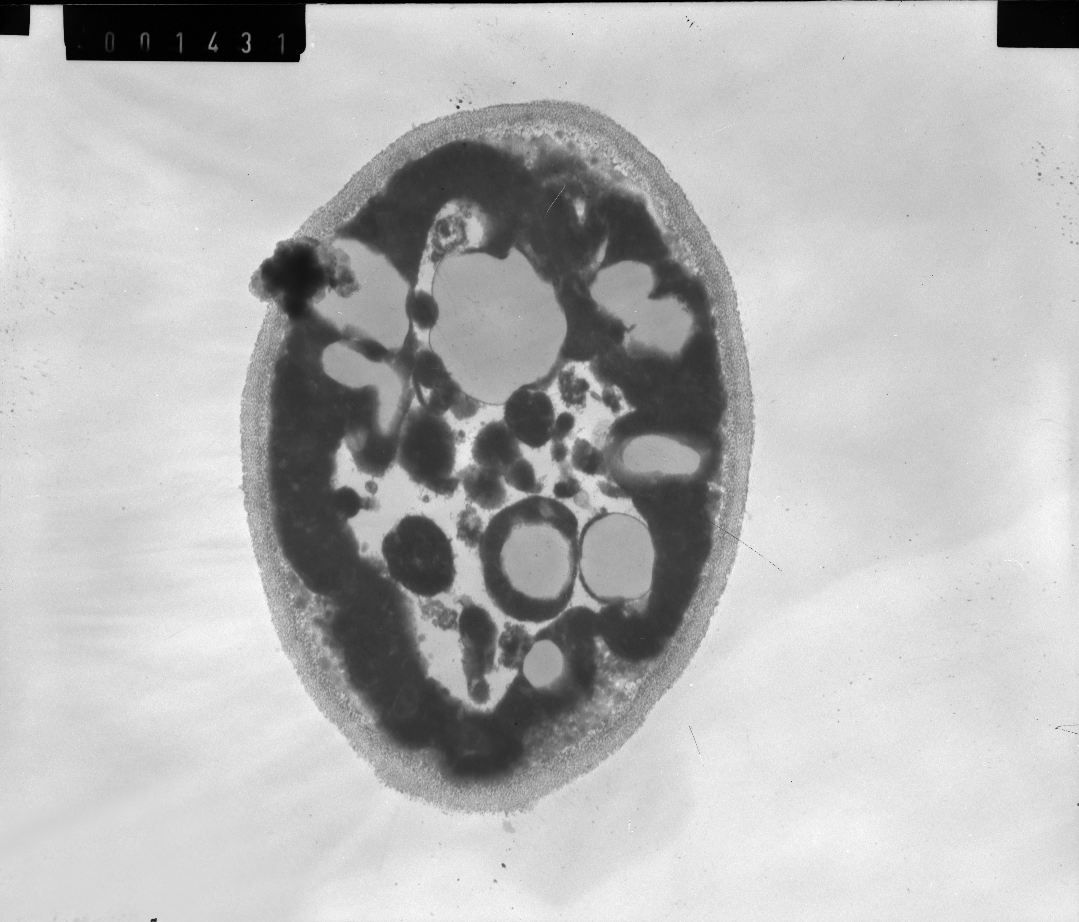
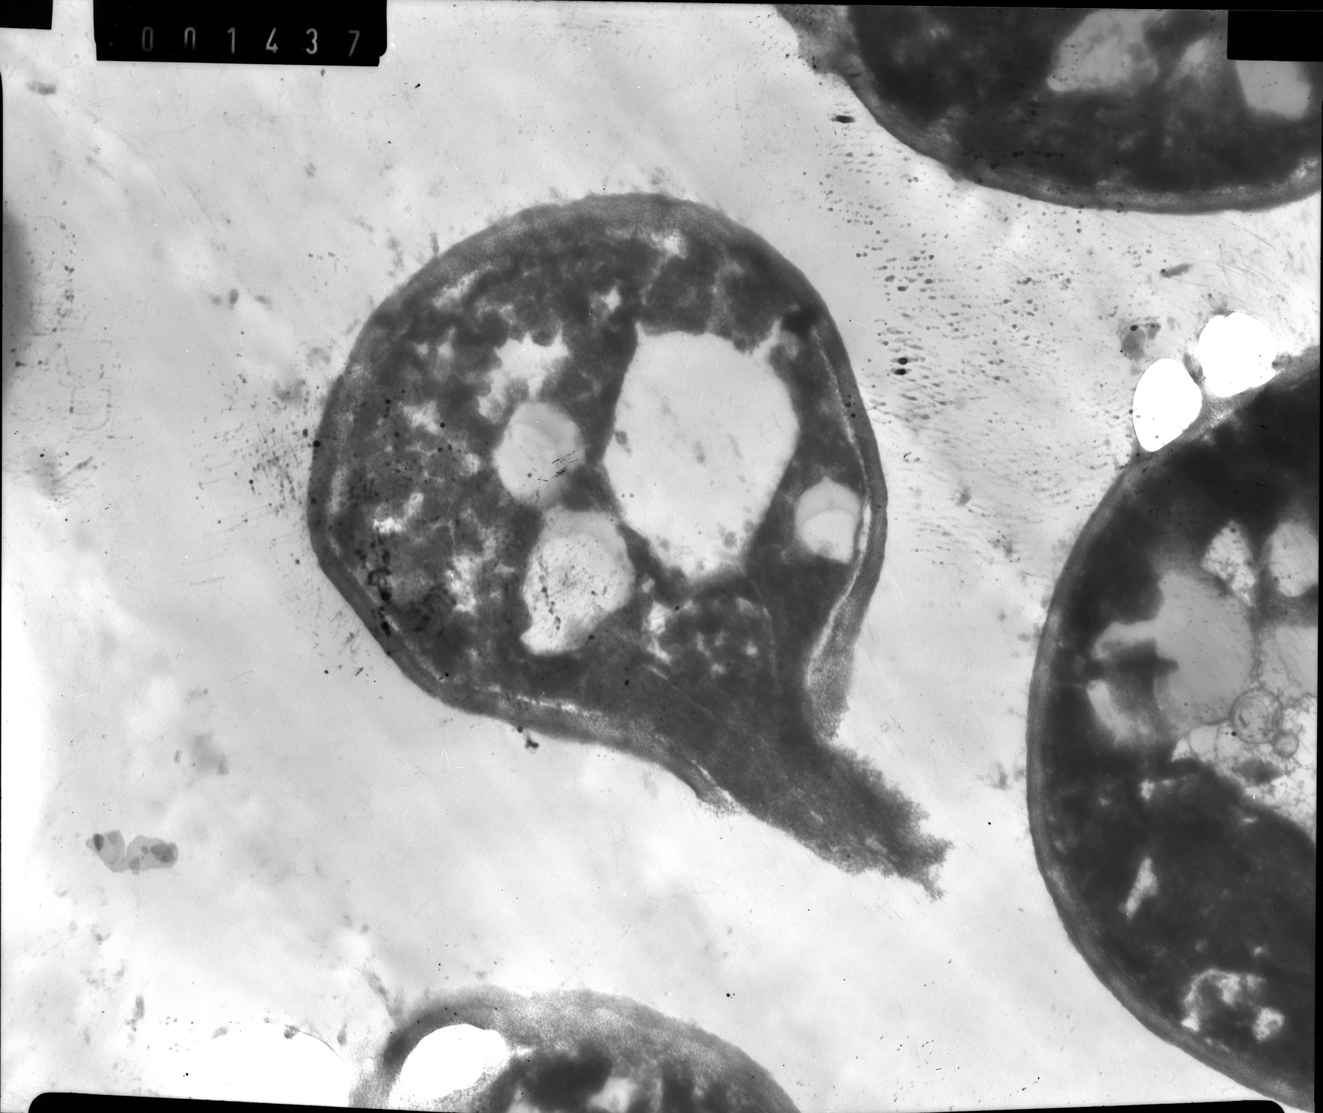
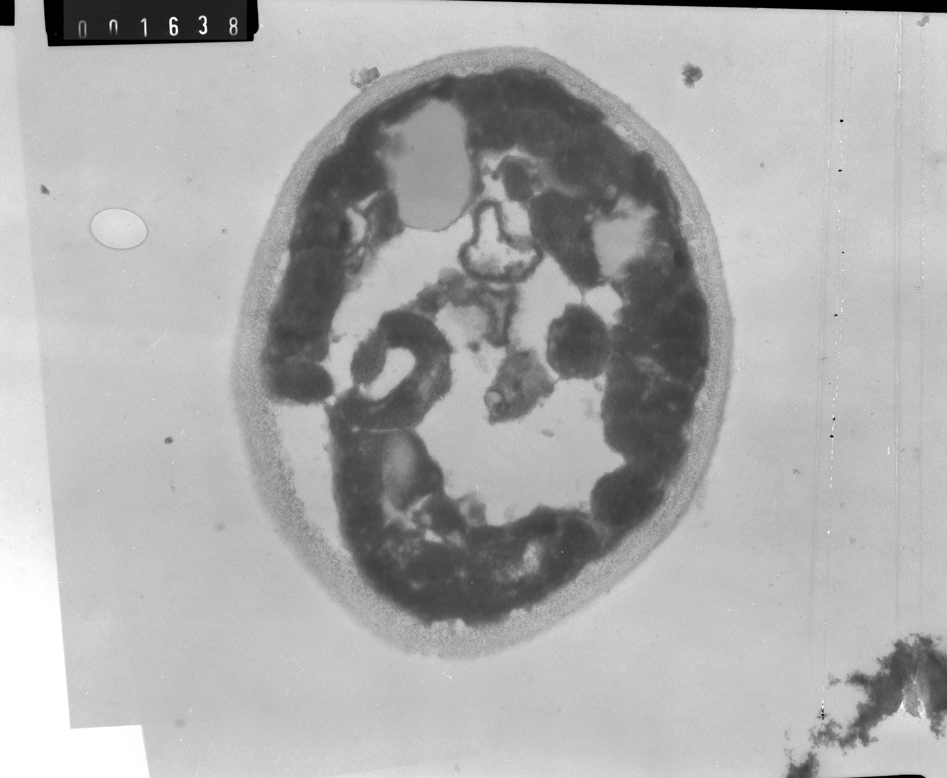
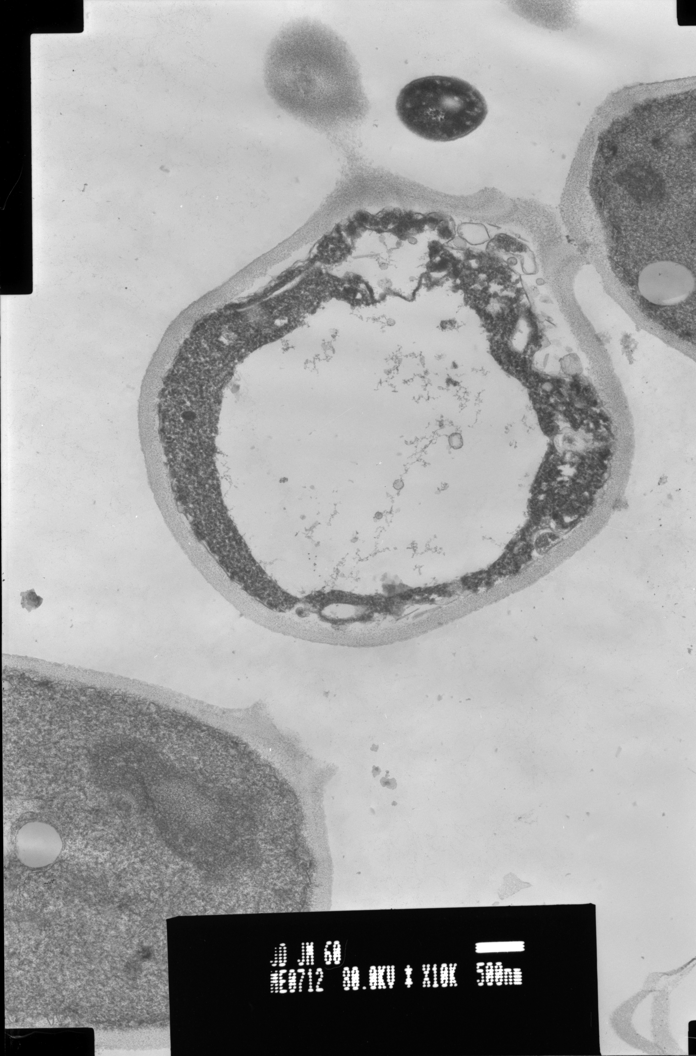
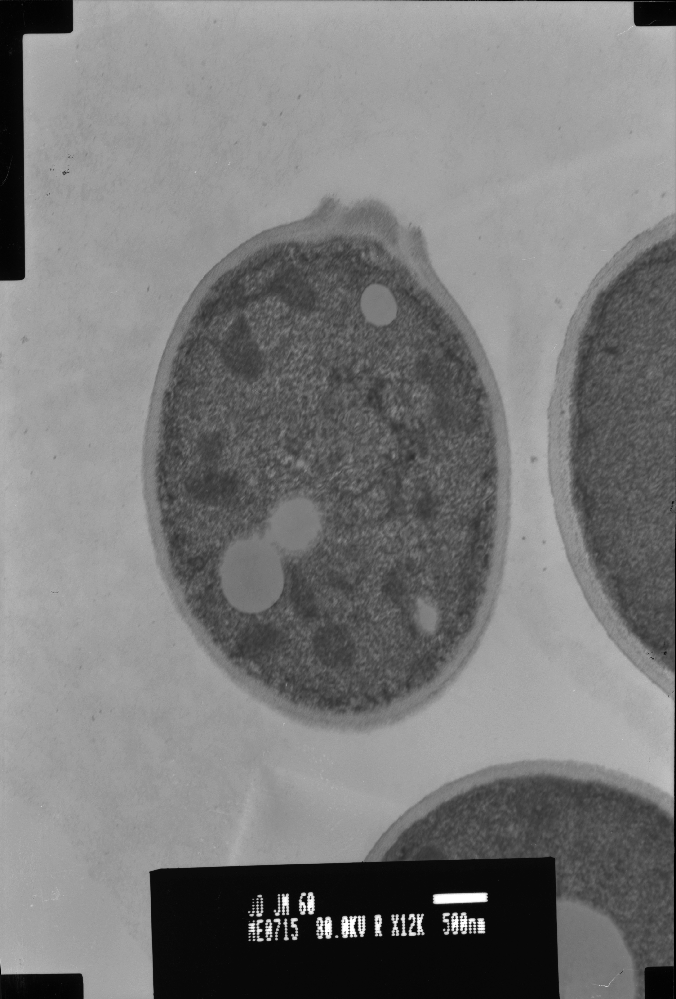
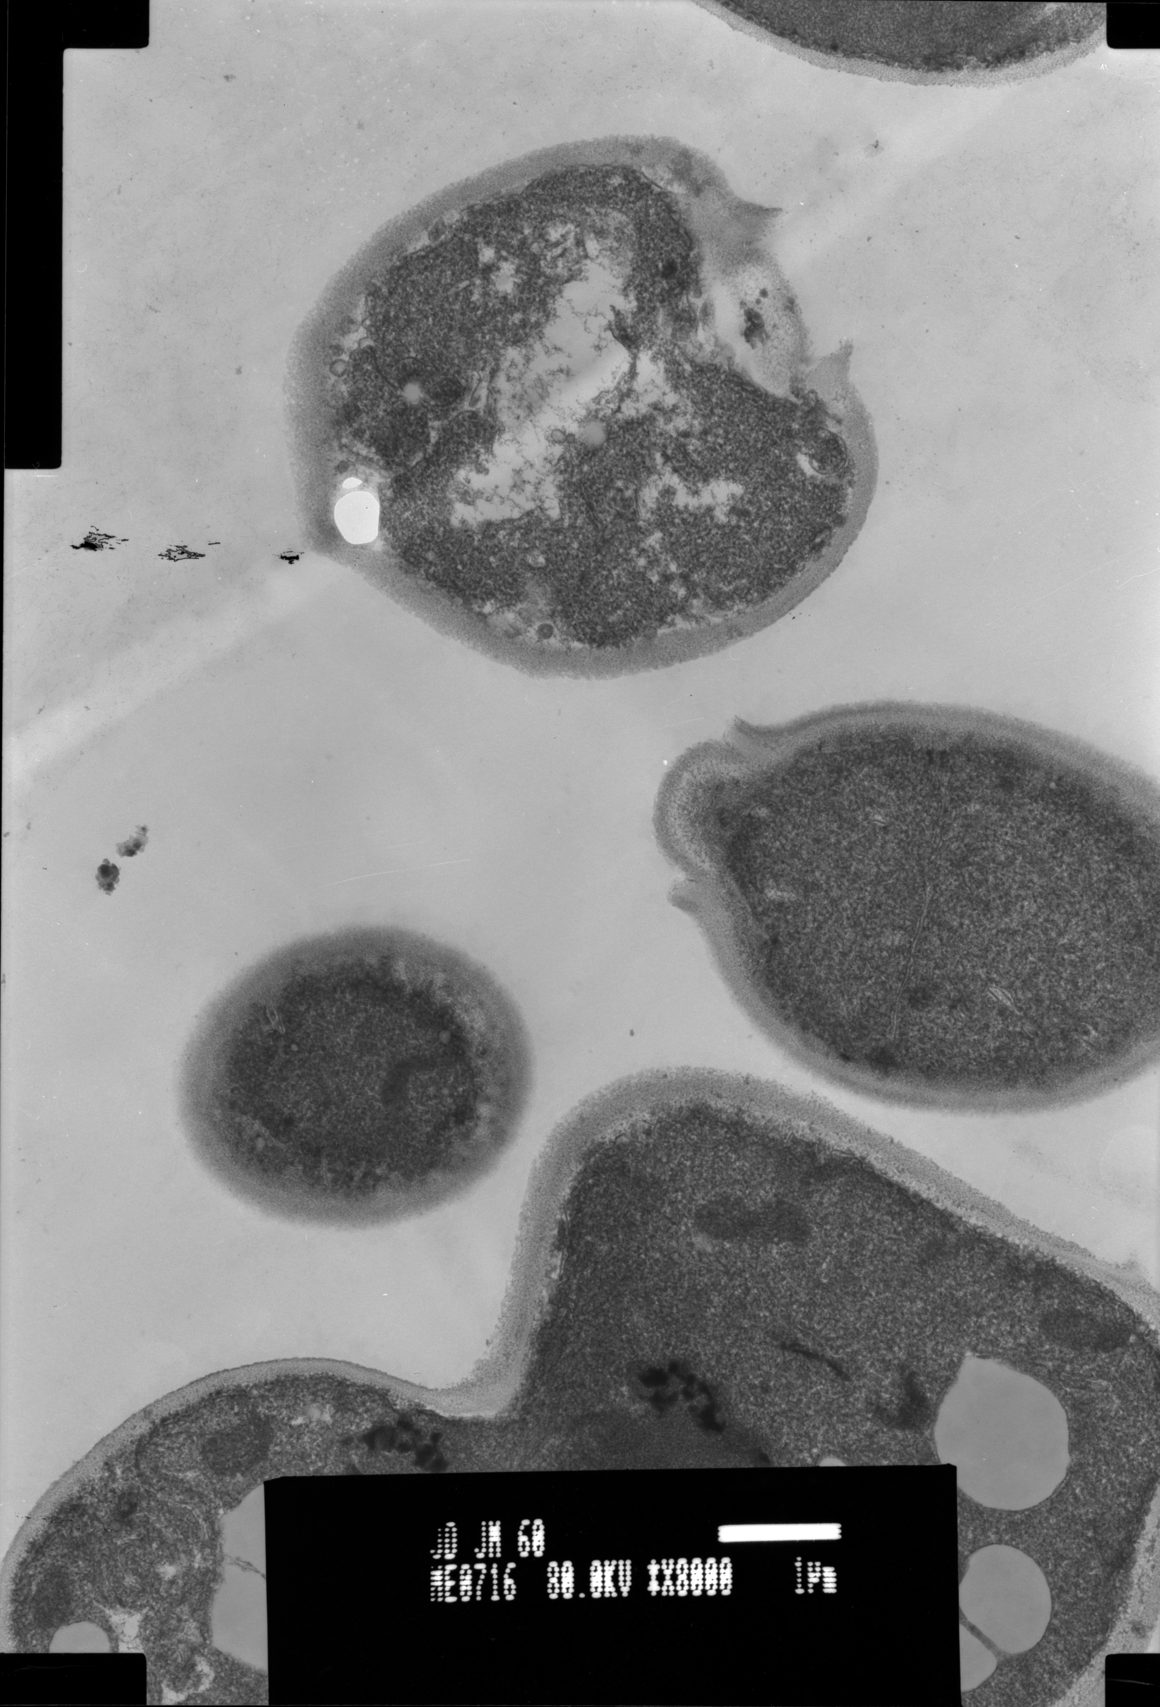
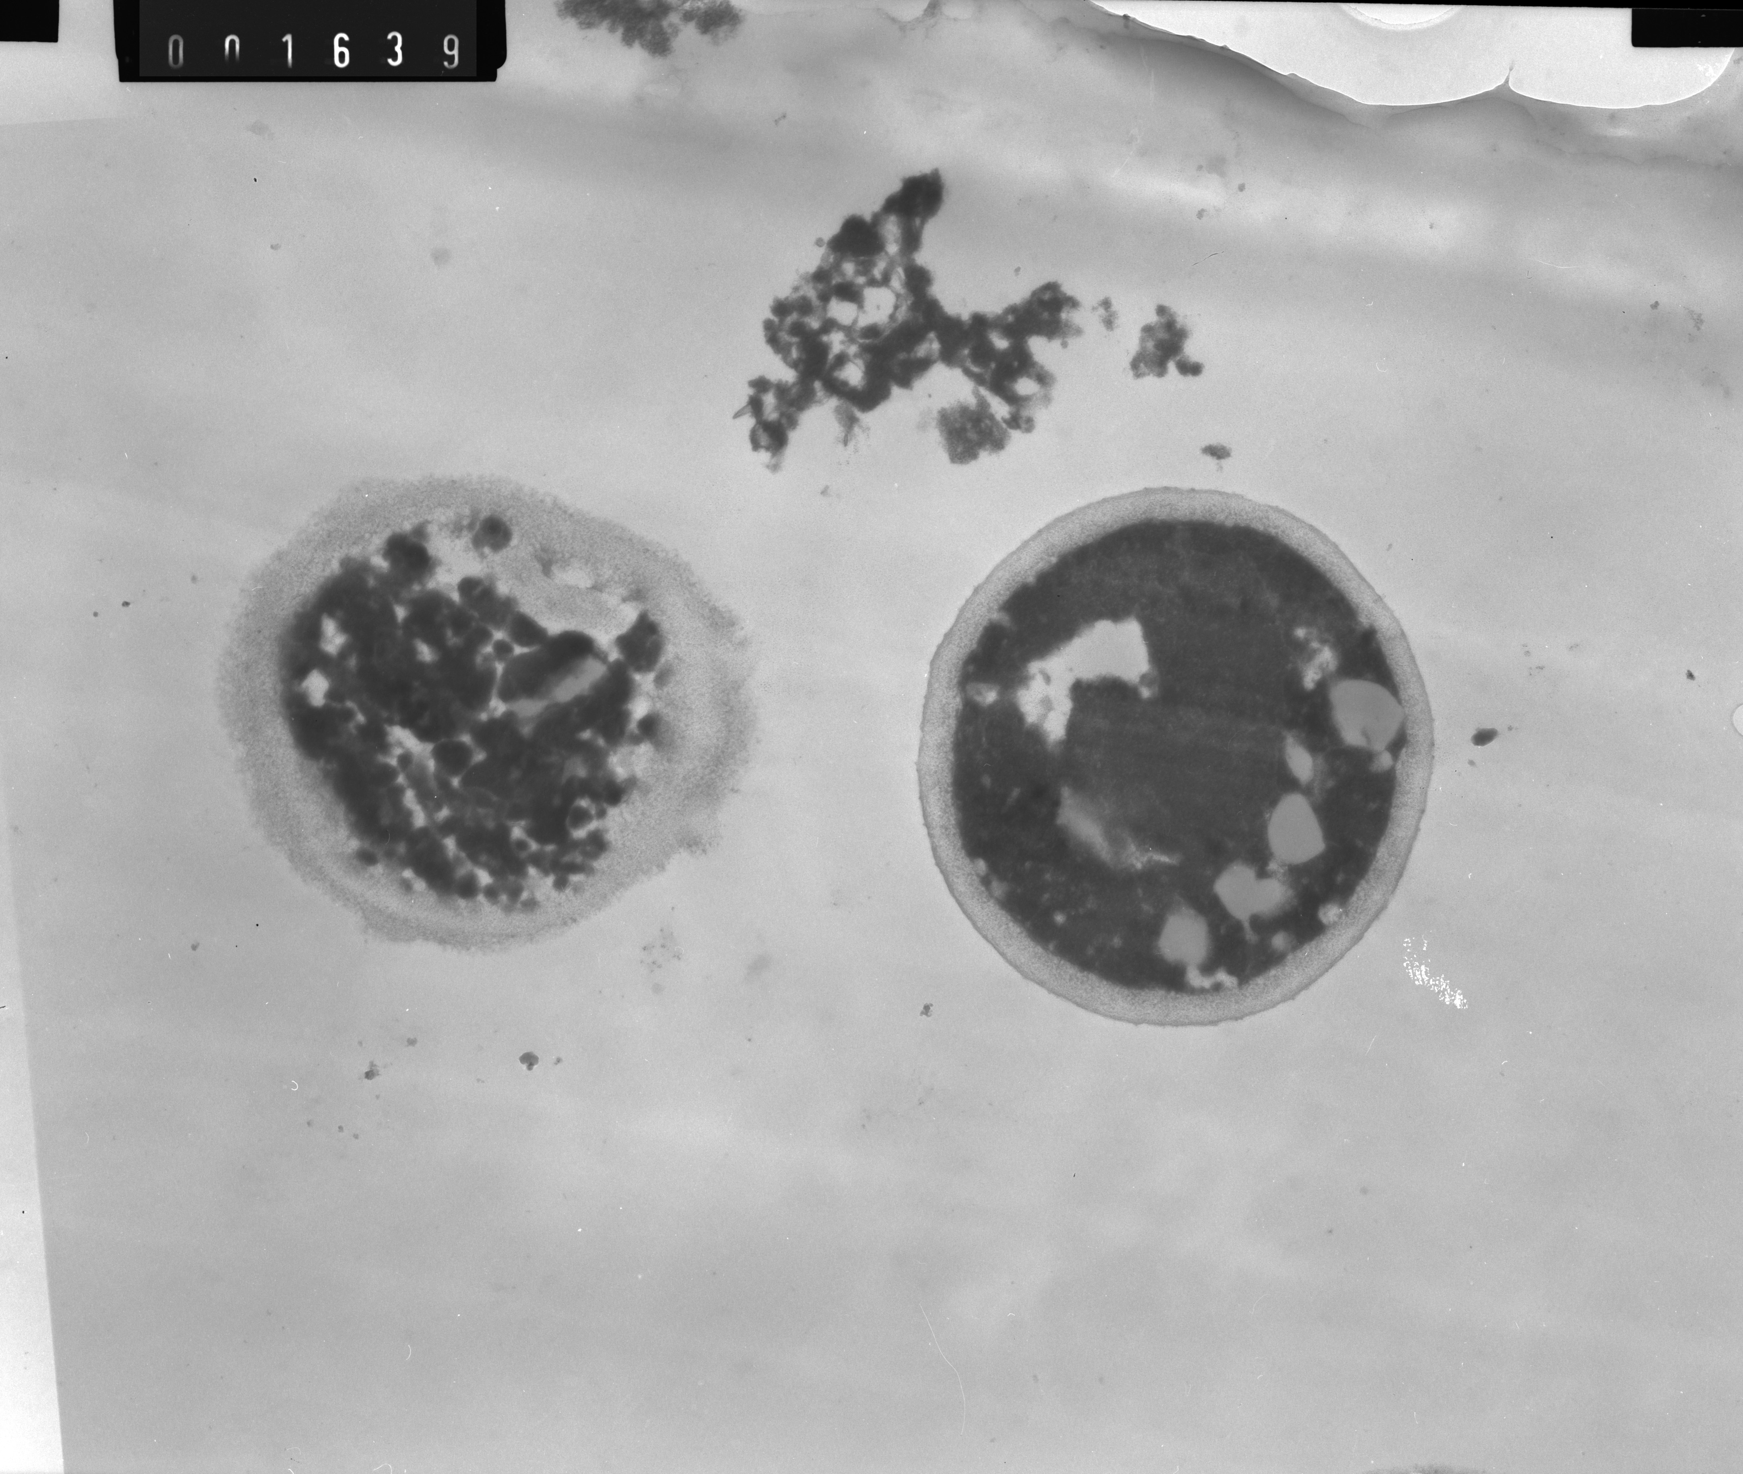
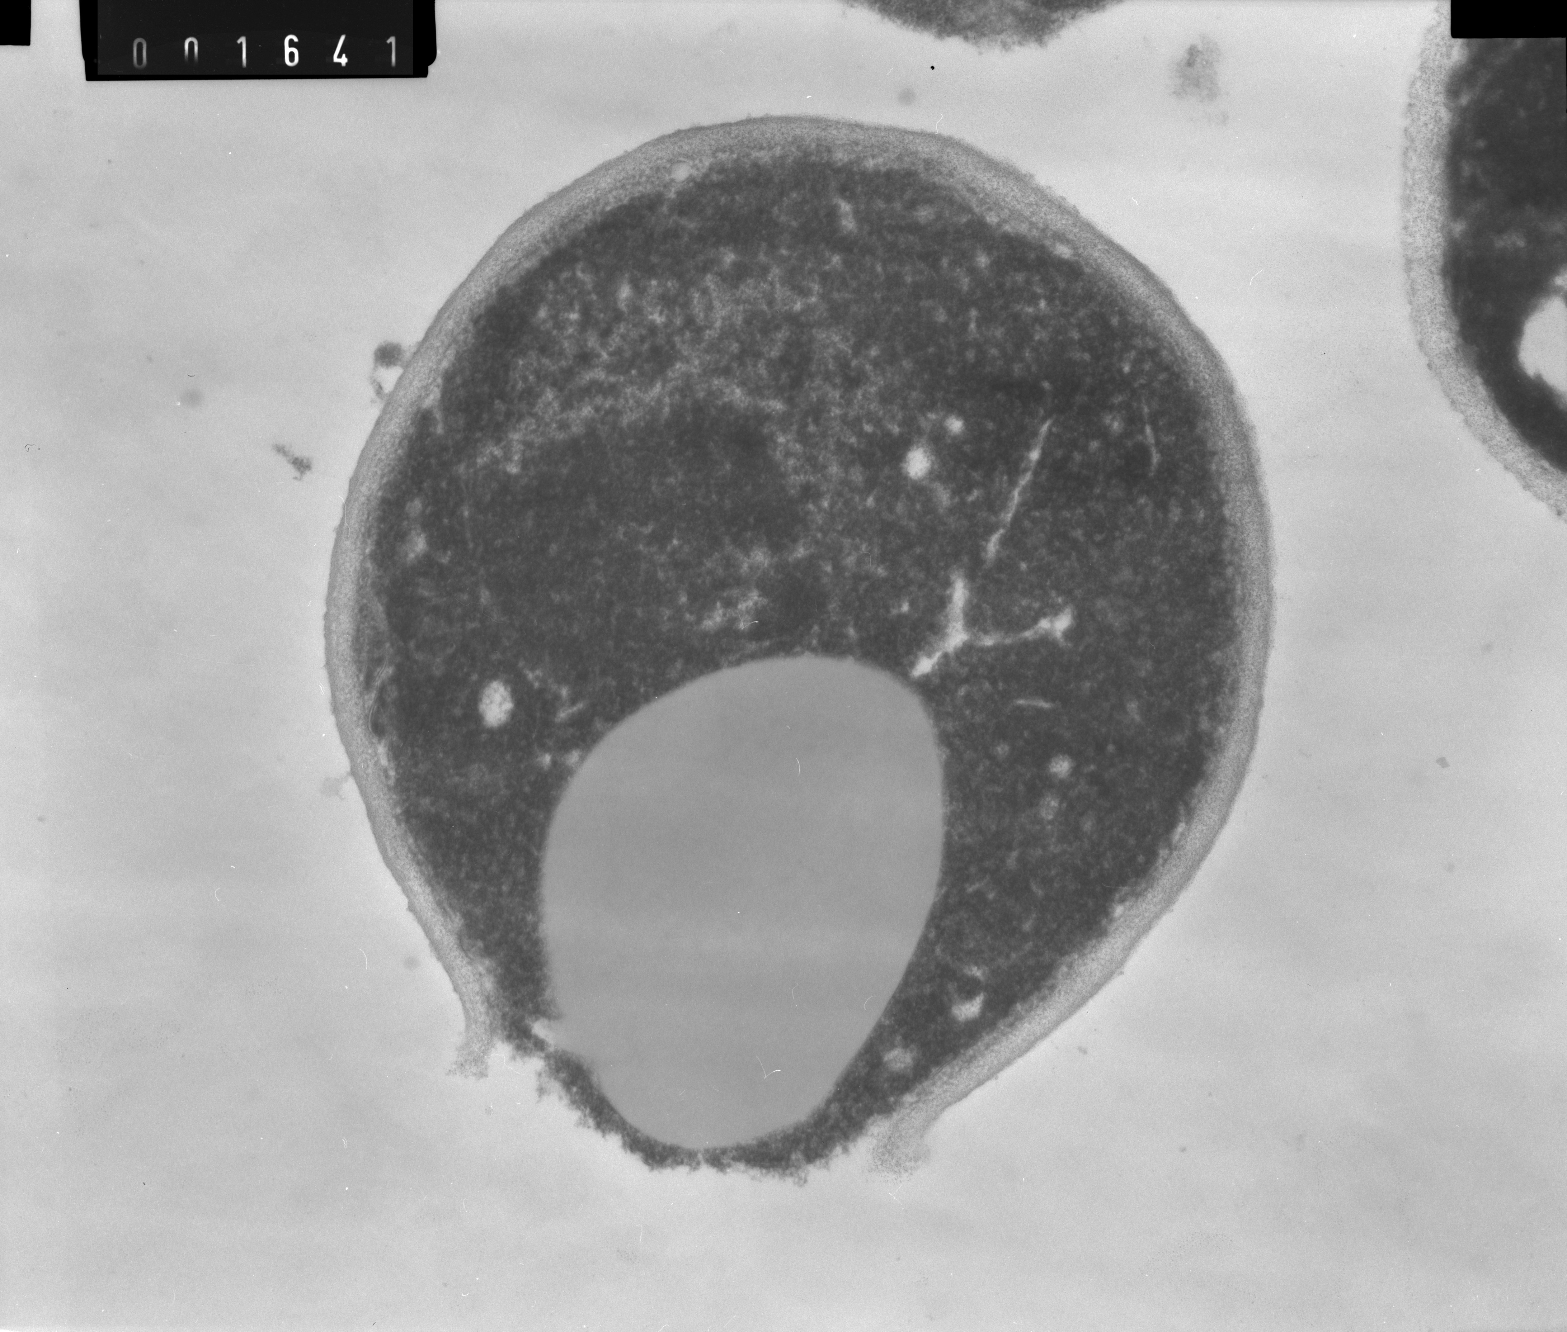
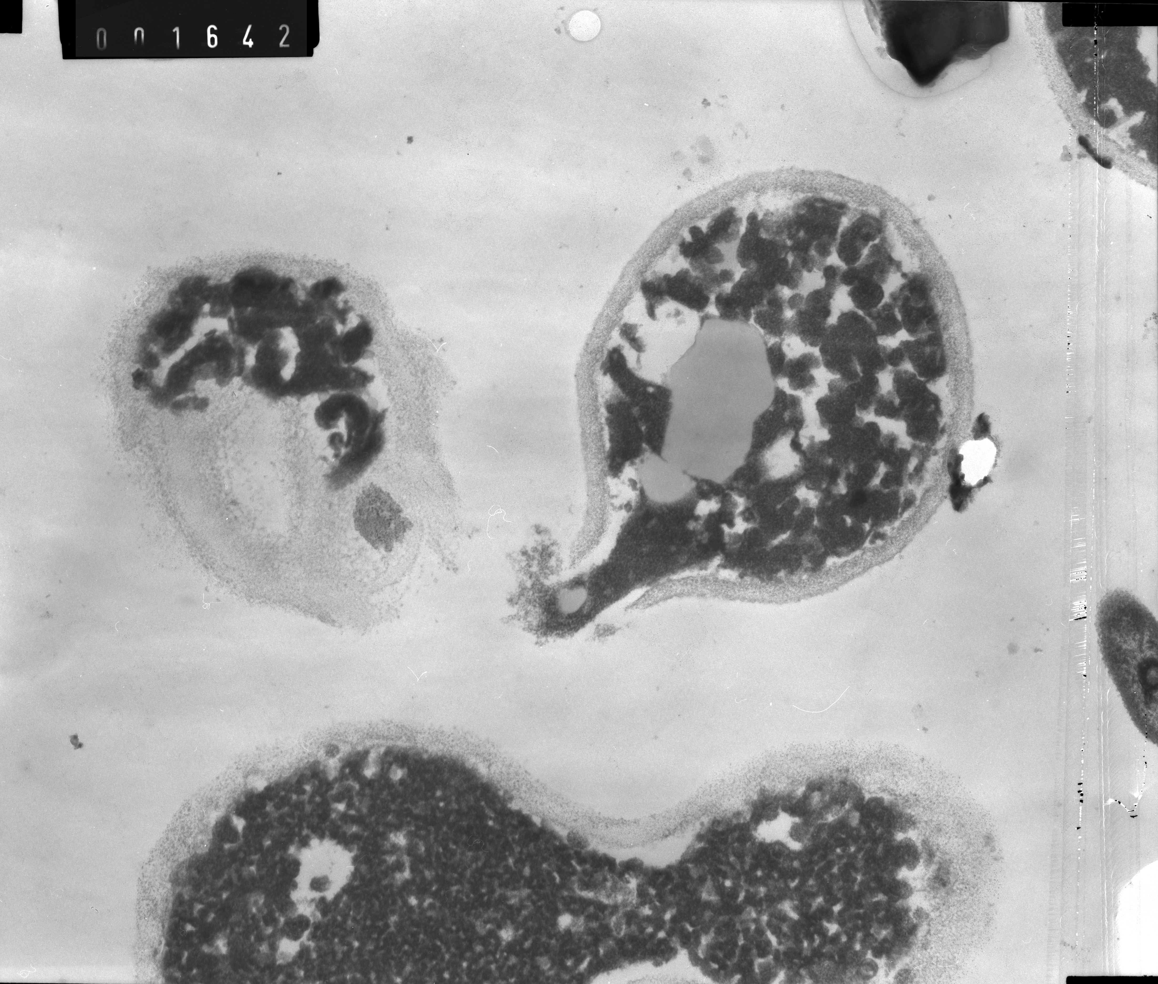
TEM examination of S. cerevisiae KE162 in apple juice (CAJ) with different treatments
Untreated cells
Intact yeast cells showed well defined organelles and membranes
Presence of vacuoles ; broken cell wall with partial release of cellular content
Disorganized inner structure, but cell wall non broken
10US
MT
d
Cells more rounded with unnatural shape, with less electronic density.
Inner content looked coagulated, extremely vacuolated and coarse.
60PL
MT
Cells deeply damaged with organelle disruption and generalized rupture of membranes
Presence of subcellular fragments out of the cell
Swollen damaged cell wall, vacuoles and shrinkage of cytoplasmic material from cell wall
Rupture of cell wall and release of inner content
10US + 60PL
MT
Notes:
TEM images revealed other structural changes that along with membrane permeabilization which might have caused yeast inactivation.
After confirming single and combined treatments effects we examined the structural changes in cells of S. cere and spores of A. acid . After treatments significant changes were observed
Intact yeast cells showed well defined organelles and membranes (a-c).
10US treated cells showed presence of vacuoles (d,e); broken cell wall with partial release of cellular content (e) and disorganized inner structure, but cell wall not broken (f) .
60 PL treated cells looked more rounded with unnatural shape (g-i), with less electronic density. Inner content looked coagulated (h,i), extremely vacuolated (g) and coarse (g-i).
Combined US + PL treated cells looked deeply damaged with disruption of organelles and generalized rupture of membranes, without any possibility of distinguishing any cell inner structure(j-l); presence of some subcellular fragments out of the cell (j); swollen damaged cell wall (j), vacuoles and shrinkage of cytoplasmic material from cell wall (k,l), rupture of cell wall and release of inner content (k,l)
TRANSMISSION ELECTRON MICROSCOPY
One mL of CAJ (pH 3.5) inoculated with S. cerevisiae and exposed to US; PL or US+PL treatments was centrifuged at 11,180×g for 5 minutes and the supernatant was discarded. The yeast cells were resuspended in 2 mL of glutaraldehyde (0.025 % ^{P}/_{V}) in 0.1 M phosphate buffer (pH 7.1) and post-fixed with KMnO4 (0.02 % ^{P}/_{V}) in 0.1 M phosphate buffer for 17 h at 4 °C, washed well with distilled water, dehydrated with alcohol series, and embedded in Epon 812 during 48 h (Bolondi et al., 1995). Ultrathin sections were stained with uranyl acetate and lead citrate and examined with a microscope TEM Philips EM 301 .

Slide 19
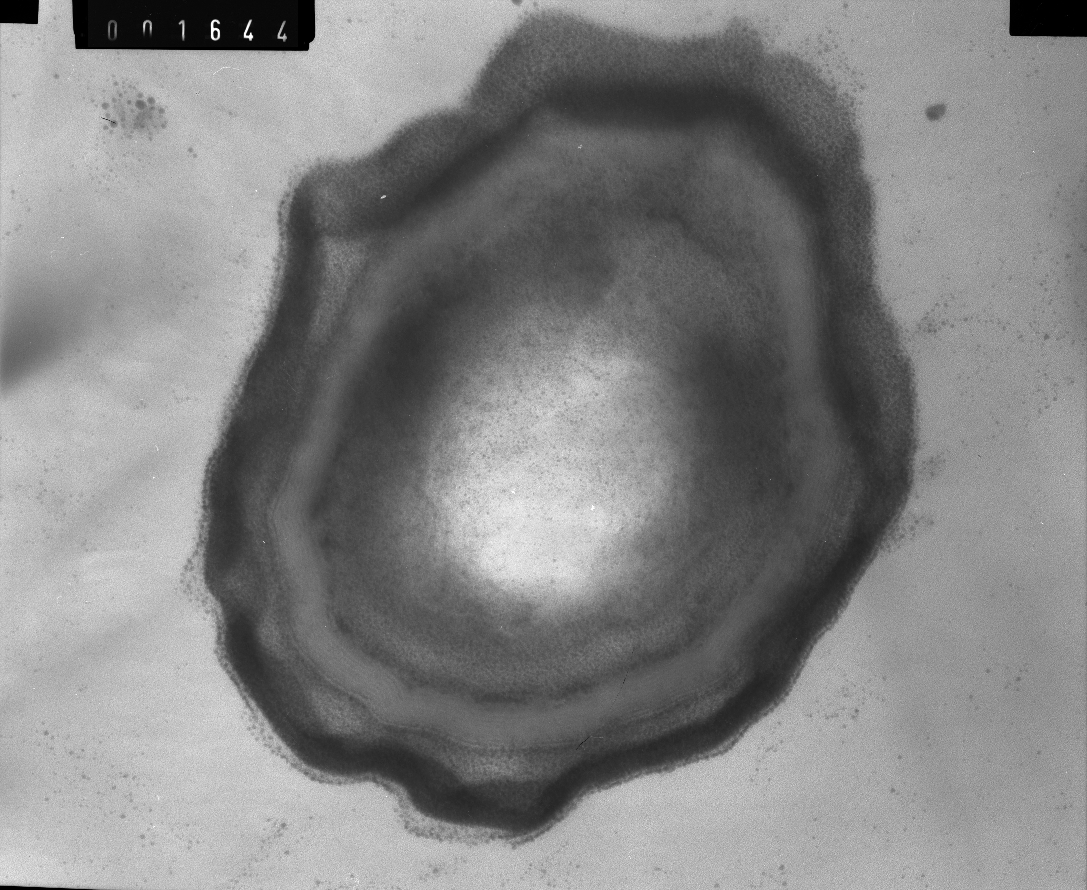
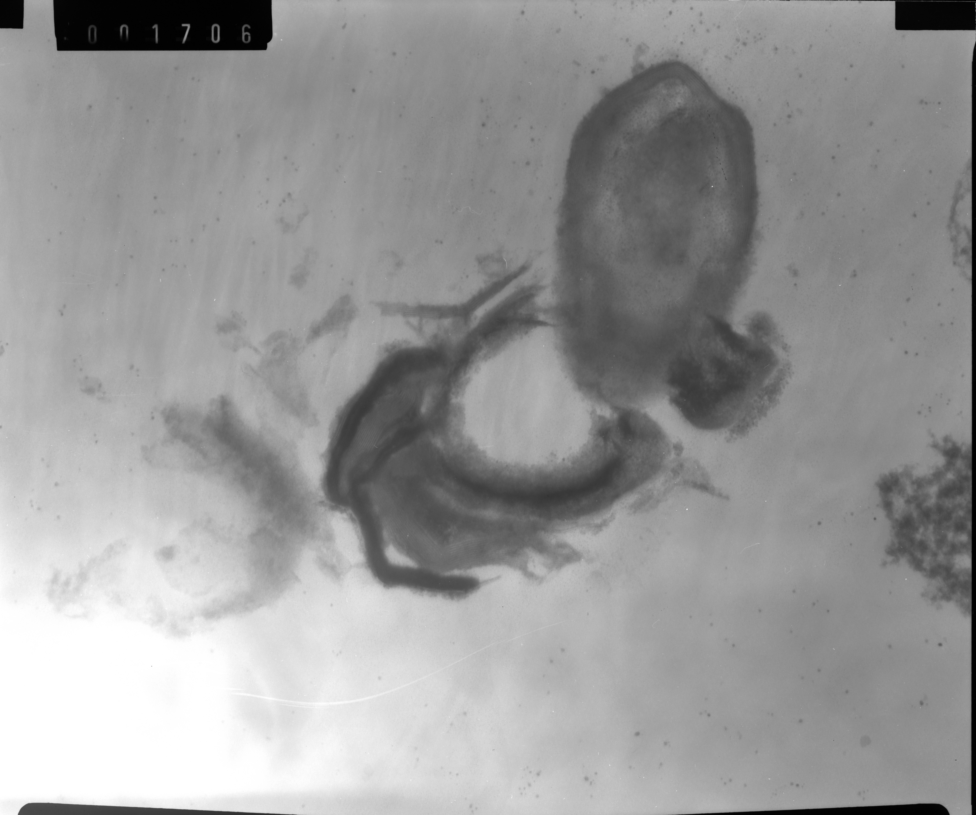
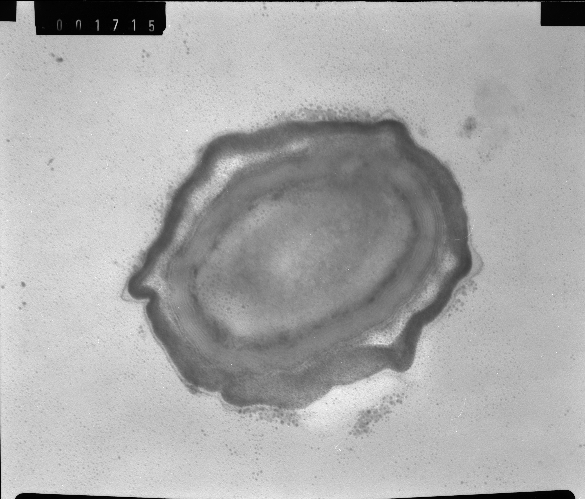
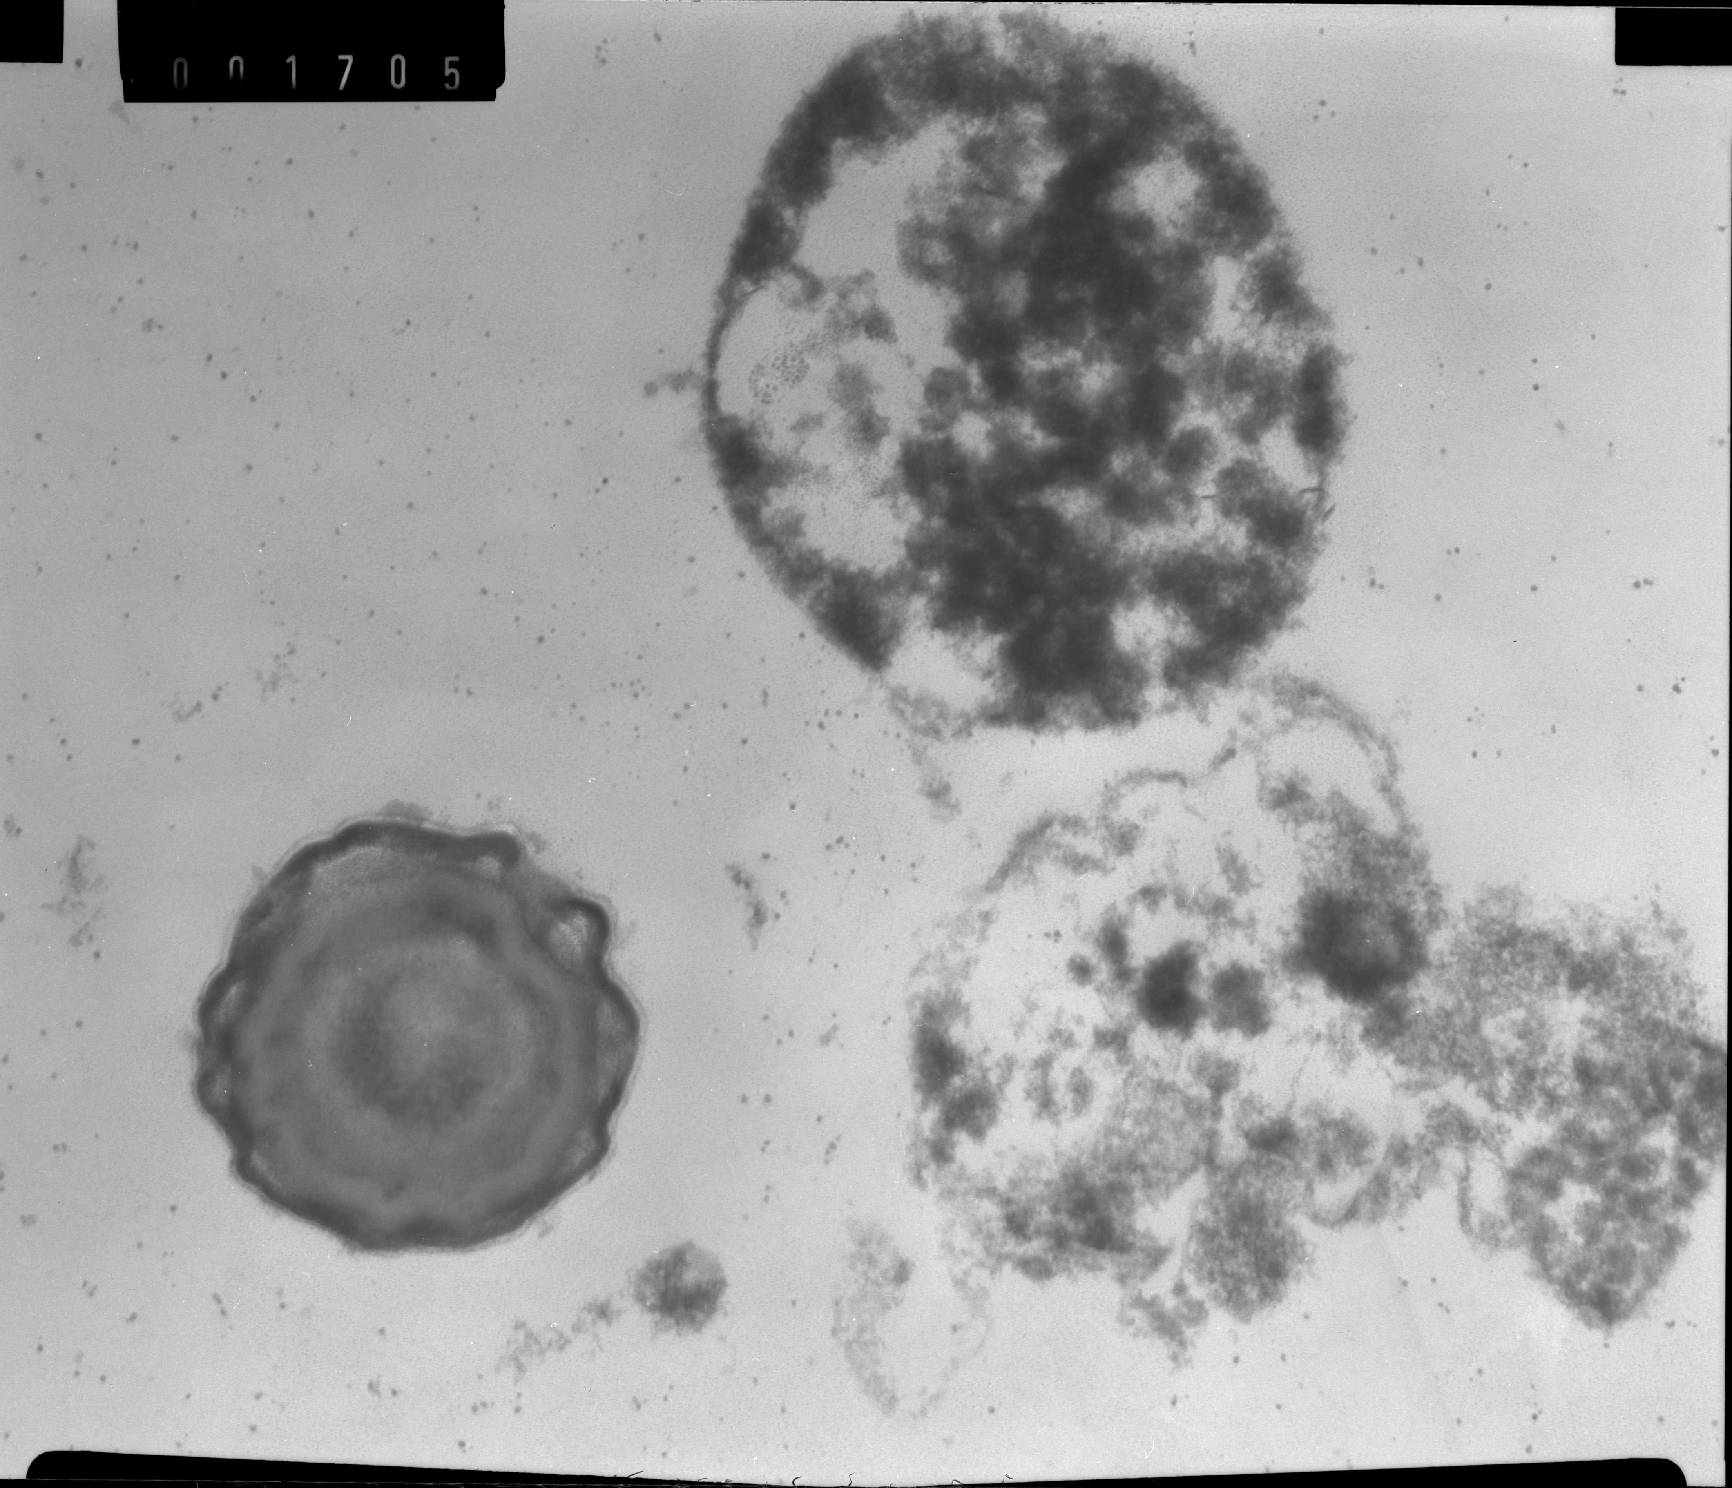
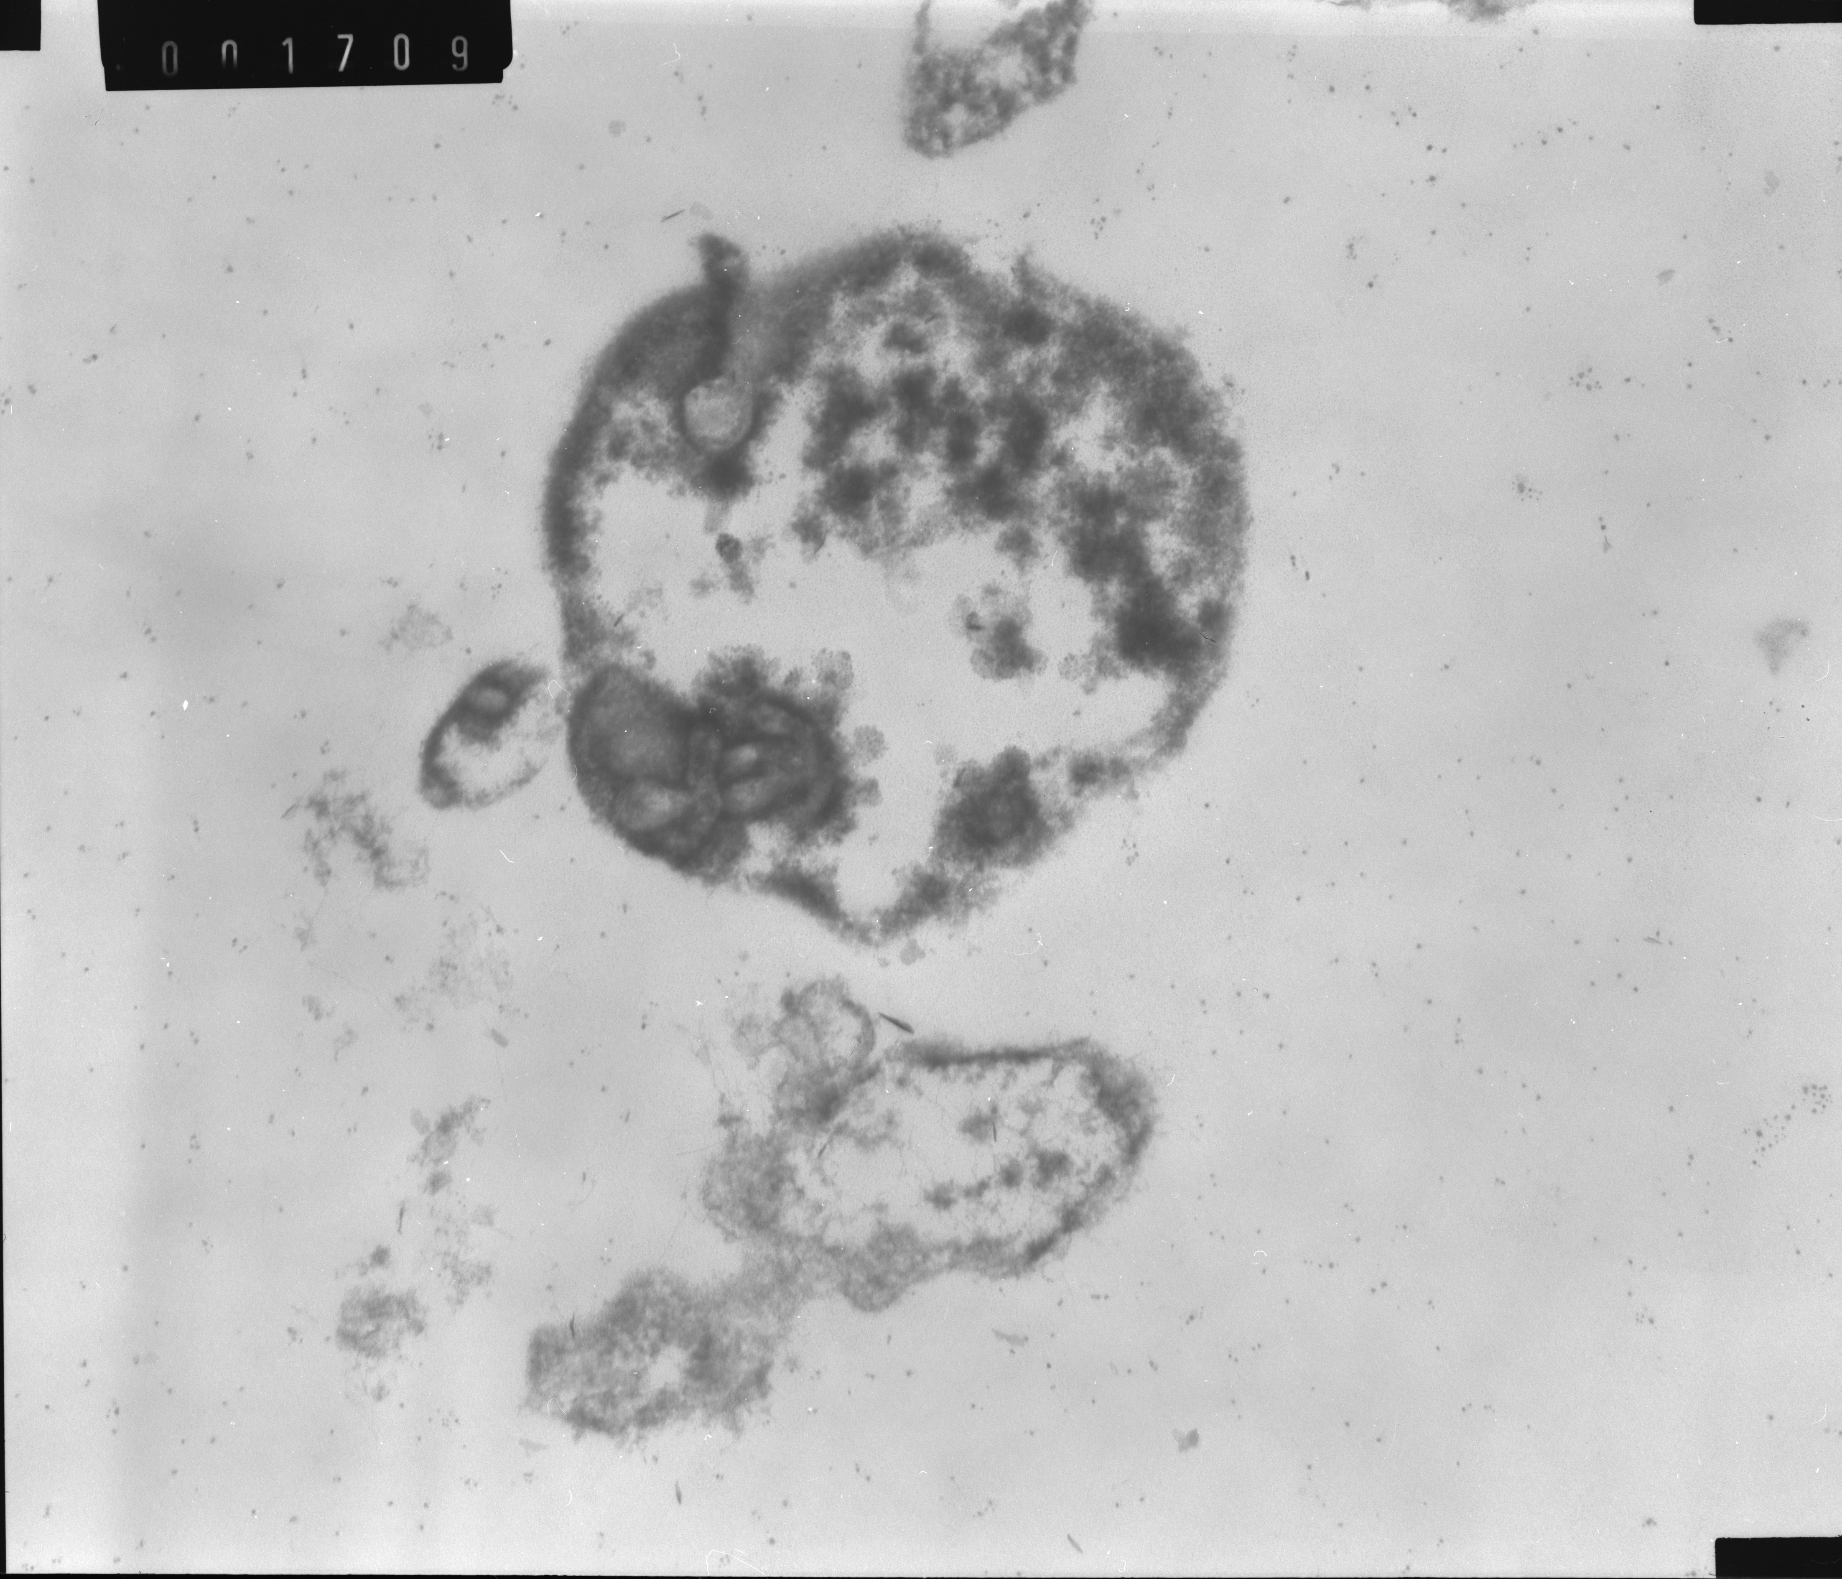
. Micrografías de esporas A. intracelular
TEM images of A. acidoterrestris ATCC 49025 in CAJ treated by PL (60 s, 44-56 ºC ,~ 3 log red)
Intact endospore showed well defined protoplast (P), cortex (C), Core wall (CW), multilayered spore coat (SC) and Exosporium (E)
C
P
E
CW
SC
A
B
Presence of subcellular fragments out of the spore (A)
Separation of exosporium from the spore coat (B)
Inner content looked coagulated (C,D)
Spores with unnatural shape and deeply damaged (A,C,D)
Spores that totally or partially lost their content (“ghost spores”) (C,D)
d
C
D
Notes:
The structure of a an intact endospore as seen with electron microscope differs from that of the vegetative cell. In particular it is more complex in that as it has many layers that are absent from the vegetative cell. The outer-most layer is the exosporium (a thin protein covering). Whithin this are the spore coats composed of layers of spore specific proteins. Below is the cortex which cosnsists of loosely cross-linked peptidoglycan and inside the cortex is the core which contains the core wall cytoplasmic membrane, cytoplasm, nucleotid, ribosames and other cellular esentials. Thus an endospore differes mainly in the kinds of structures found outside the core wall
These images demonstrate the remarckable

Slide 20
Conclusions
Temperature build up in the juice due to PL treatment may be used as an additional microbial stress factor
Loss of membrane integrity and metabolic activity were observed by FCM analysis
FCM allowed the detection of double stained cells which were not detected by PCM.
In PL treatments, membrane integrity was not the only factor in determining cell viability.
TEM observations revealed different changes in cell structure.
PL treated cells exhibited mainly significant disorder inside the cells, while US affected cell wall and membrane too.
Alterations in the inner content and in the cell wall deepened when the combined US + PL treatment was applied.
In food safety engineering , inactivation, FCM and TEM studies were altogether useful indicators as starting basis for processing design to obtain improved or more safe fruit juices

Slide 21


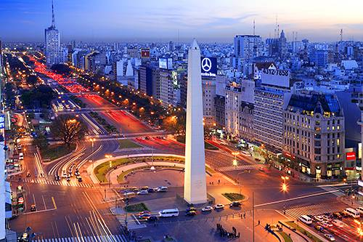

THANK YOU !
Sandra N. Guerrero
Natural and Exact Science School
Buenos Aires University
sguerrero@di.fcen.uba.ar
Buenos Aires. Argentina

Slide 22
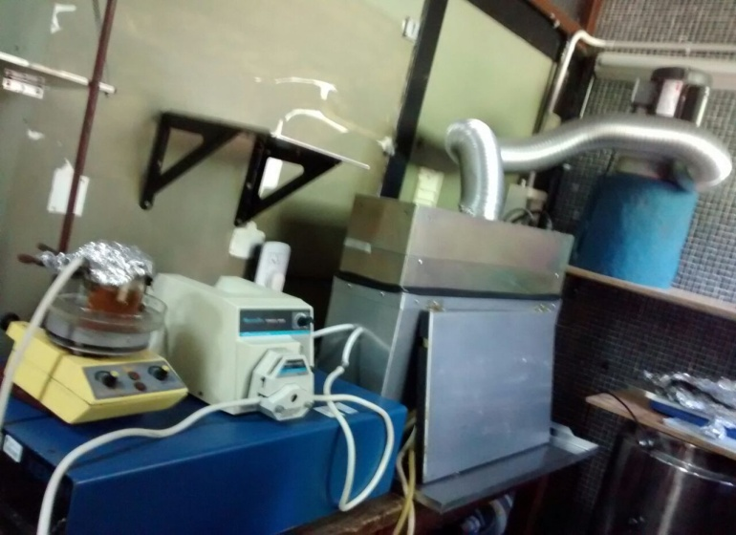
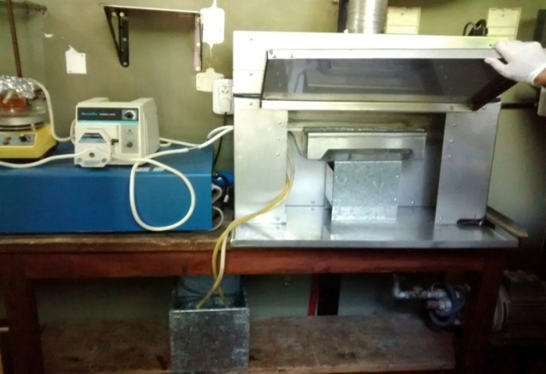
Two quartz tubes (i.d. 1 mm; 0.2 m length; 0.1 m distance from the lamp)
Two quartz tubes (i.d. 1 mm; 0.2 m length; 0.1 m distance from the lamp)
Apple juice (245 mL) + 5 mL inoculum
Two quartz tubes (i.d. 1 mm; 0.2 m length; 0.1 m distance from the lamp)
Apple juice (245 mL) + 5 mL inoculum
Air flow
Lamp house
(inside: Xenon Flash lamp)
Peristaltic pump
Hollow metal enclouser with coolant
Hollow metal enclouser with coolant
Hollow metal enclouser with coolant
RC-747 power/control module
Food grade
Tygon tubes
Coolant reservoir
Pump
Pump

Slide 23
Hurdle approach in the design of minimal preservation processes
Two stress factors that have different action modes to overwhelm the target cells´ repair systems
Possible arrangements
Two or more stress factors simultaneously applied to inactivate pathogens and deteriorative microorganisms
One or more stress factors to inactivate/damage microorganisms and then, on sequential mode, one or more factors to avoid growth/survival of sub lethally damaged or resistant cells
Two or more stress factors sequentially applied

Slide 24
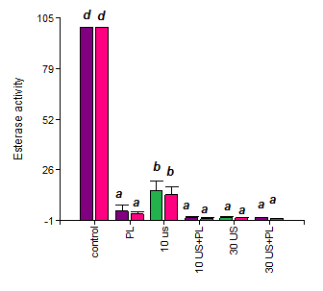
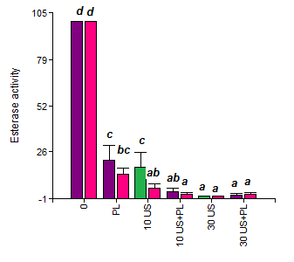
Esterase enzyme activity
1
2
3
iv4
US: 20 °C (■); 44 °C (■) PL: 2-12 °C (■) ; 44 -56 °C (■)
Notes:
Pronunciacion: “éstereis ensaim”
The relative changes of the esterase activity obtained after exposure to single US or combined US+PL at different temperature build-up, and the corresponding significant differences among treatments obtained by the Tukey Test are shown in Figure
Residual esterase activity was calculated using this equation, in which the post treatment enzyme activity of the population was set in relation to the activity of untreated cells.
Only cells solely labeled by F (in gate 1) were considered in the activity (%EA) of the whole population.
where %EA is the percentage of residual enzymatic activity in response to a particular treatment; #1_{T} is the percentage of population in gate 1 following single US, single PL or US + PL treatment, and #1_{Ctrl} is the percentage of population in gate 1 prior to treatment application.

Slide 25
High intensity ultrasound (US)
Energy generated by sound waves of 20 kHz or more
Microbial inactivation by “cavitation ” phenomenon.
Influencing factors: wave amplitude, temperature, volume, sample properties and composition
Actual/potential applications: No commercial food products. Limited to product modification and process efficiency improvements (enhancement of mass and heat transfer, degassing of liquids, cleaning of surfaces)
Gas or vapour microbubles formed during a tension cycle, violently collapse (compression cycle) generating high pressure shock waves and high local heating
Notes:
Recent studies suggest that the combined use of US and other technologies is more effective than the use of the single technique. Combined with heat, pressure, or both, sonication acts synergistically to reduce the time, temperature and pressure required in processing
Among physical hurdles, US (i.e. intensities higher than 1 W/cm2; frequencies between 18 and 100 kHz) has attracted considerable interest in food preservation
The lethal effect of US has been attributed to the cavitation phenomenon, in which microbubbles of gas and/or vapour formed within a liquid, undergo violent collapse during the compression cycle of the wave.
The
mechanism of microbial inactivation is mainly due to the thinning of cell membranes, localized heating and production of free radicals.
The use of ultrasonic waves as a unique preservation factor is unable to effectively
kill all the microorganisms since the high levels needed of US could adversely modify nutritional and sensory properties of the food.
This limitation has suggested that US could be more effective when used in combination with other techniques for inactivation of some pathogenic and spoilage microorganisms.

Slide 26
Inactivation kinetics by single US and PL treatments
US
PL
A. acidoterrestris
NAJ
CAJ
S.cerevisiae
CAJ
44 °C
NAJ
A. acidoterrestris
NAJ
CAJ
S.cerevisiae
Inactivation curves by single PL treatments at LT(▬) and MT(---) in commercial apple juice (▬) and natural apple juice (▬)
Notes:
During PL treatments, temperature of the pre-refrigerated samples increased with time as a consequence of the absorption of light by the food but it never reached lethal values (T< 20°C) according to the adopted process design (Figure 1)
Temperature build- up caused by the IR portion of PL increased the inactivation of S. cerevisae and A.acidoterrestris, specially in CAJ at MT. The temperature increase could not have been responsible for inactivating them as the highest temperature recorded was a non-lethal value.

Slide 27
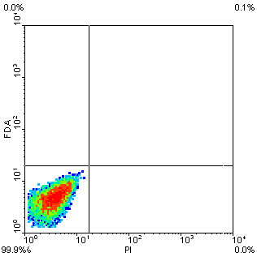
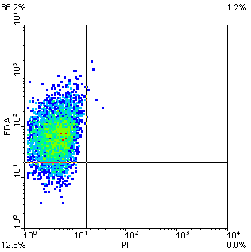
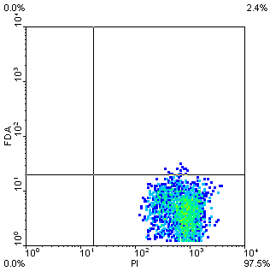
controls
Autofluorescence FDA PI
Notes:
Non-irradiated stained cells and cells treated at 85 °C for 15 min and subsequently stained with FDA or PI respectively were used as controls to define negative and positive histogram regions.
A non stained- non treated control was employed for determining the auto fluorescence of cells.

Slide 28
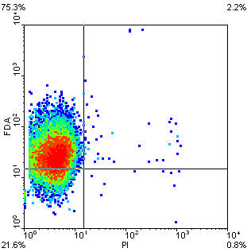
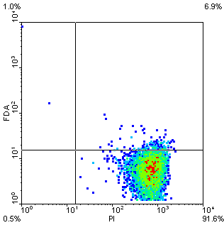
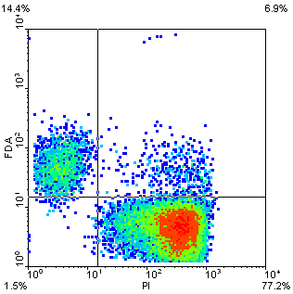
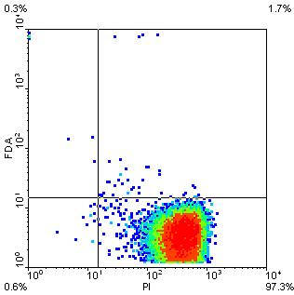
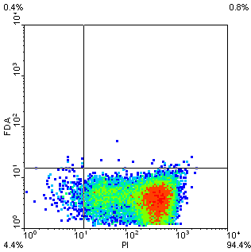
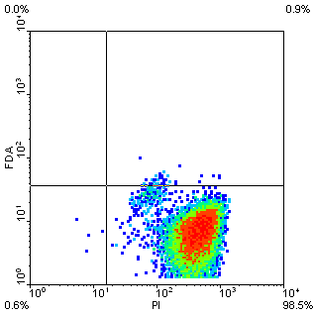
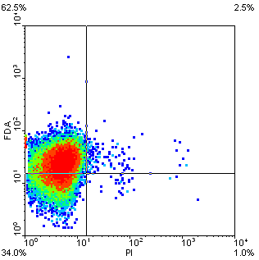
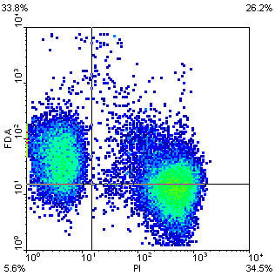




Fluorescence density plots of S. cerevisiae in response to staining with FDA and PI after single and combined LT treatments (US : 15 °C PL: 2-12 °C)
% of cells in gate 4
0 %
92%
77%
97 %
94 %
98%
i
ii
i
ii
i
ii
i
ii
i
ii
i
ii
a
CAJ
iii
iv
iii
iv
iii
iv
iii
iv
iii
iv
iii
iv
i
ii
i
ii
i
ii
i
ii
i
ii
i
ii
NAJ
iii
i
v
iii
iv
iii
iv
iii
iv
iii
iv
iii
iv
0
PL
10US
10US+ PL
30US
30US+ PL
1 %
35%
59%
89 %
92 %
91%
A great proportion of double-stained cells (F⁺PI⁺) were detected when 60PL was applied ( ~26 % cells ).
Cytoplasmic membrane integrity was being affected while cells were capable or retaining esterase activity.
The presence of this subpopulation could seriously affect shelf life in PL treated foods.
Notes:
Fluorescence density plots of S. cerevisiae in response to staining with FDA and PI after single US (10 and 30 min), single PL (71.6 J/cm²) or 10 or 30 min US + PL treatment. T_{US}: 20 ± 1 °C; T_{US}: 20 ± 1 °C/T_{PLi}: 2 ± 1 °C in CAJ (a) and NAJ (b); T_{US} 44 ± 1 °C, T_{US} 44 ± 1 °C-T_{PLi}: 44 ± 1 °C in CAJ (c) and NAJ (d).
-For cell sorting assay, cells corresponding to quadrant 2 (F+/PI+) were sorted for selected
times of treatment, at a threshold rate of 2,000 events/s until an acquisition of 100,000 events. Obtained aliquots were then cultured in PDA for 72 h to analyze possible recovery.
Treatment resulted more effective in commercial apple juice than in natural squeezed apple juice, probably due to the higher absorbance, reflection and scattering of light of the latter, which reduces the contact between photons and the target microorganisms. The less proportion of cells stained F-PI+ observed for NAJ is in concordance with the lower inactivation observed in Figure 1
Loss of membrane integrity and loss of metabolic activity was observed after exposure to single US, single PL or combined US + PL
Exposure to single US, single PL or US+PL led to a shift of cells from quadrant 1 (cells with esterase activity and intact membrane) to quadrant 4 (cells with permeabilized membrane.
For 30US treatments between 94.3 ± 2.3 and 98.1 ± 0.3 % of cells were F-PI+.
A great proportion of double-stained cells (F⁺PI⁺) were detected when 60PL was applied, being this fraction more important in NAJ, where ~26 % cells were found. This indicates that cytoplasmic membrane integrity was being affected while cells were capable or retaining esterase activity. The presence of this subpopulation could seriously affect shelf life in PL treated foodssince cells are metabolically active but they cannot be detected by conventional cultivation assaysIn concordance with the inactivation rate observed in Figure2, after 60PL at both temperature profiles (LT and MT) only ~35 % of cells were F⁻PI⁺ in NAJ , while ~90 % of cells were observed in the same quadrant for CAJ.
Combined treatment 30US+60PL generated the highest % of cells in quadrant 4 which were between 94.7 ± 1.6 (NAJ/LT) and 98.5 ± 0.7 (CAJ/MT) .

