Slide 1
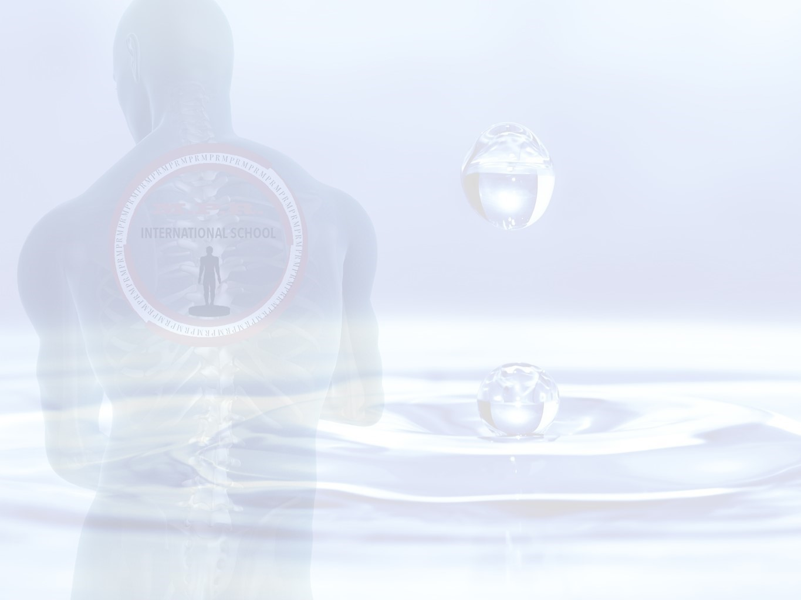
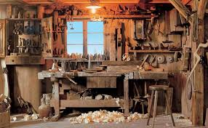
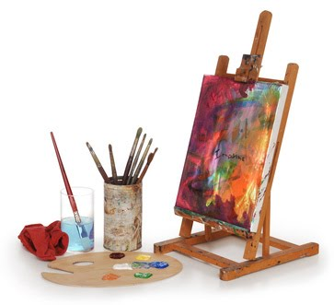
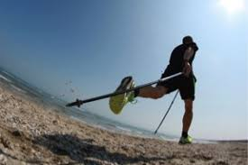
¿ Are you ready to listen to the story of a 53 old man, carpenter and artist, who finally, after years of illness, is able to start up again enjoing his life professionally, artistically and sportively ?
I’m sure you are asking yourself… . .
How it is possible ?

Slide 2
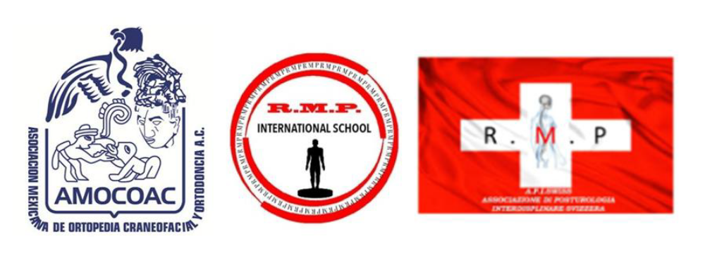
Trr
Description of a case
treated in
MYOFUNCTIONAL POSTURAL REHABILITATION
Di Rocca
By
Dr. Med. Sandra Isabella Schütz
Specialist in Physical Therapy and Rehabilitation
Expert in Posturology, Mesotherapy, Nutrition and Integrated Medicine
Councelor in the Swiss Society of Mesotherapy, President and cofounder of API swiss
Director of the M.P.R. International School

Slide 3
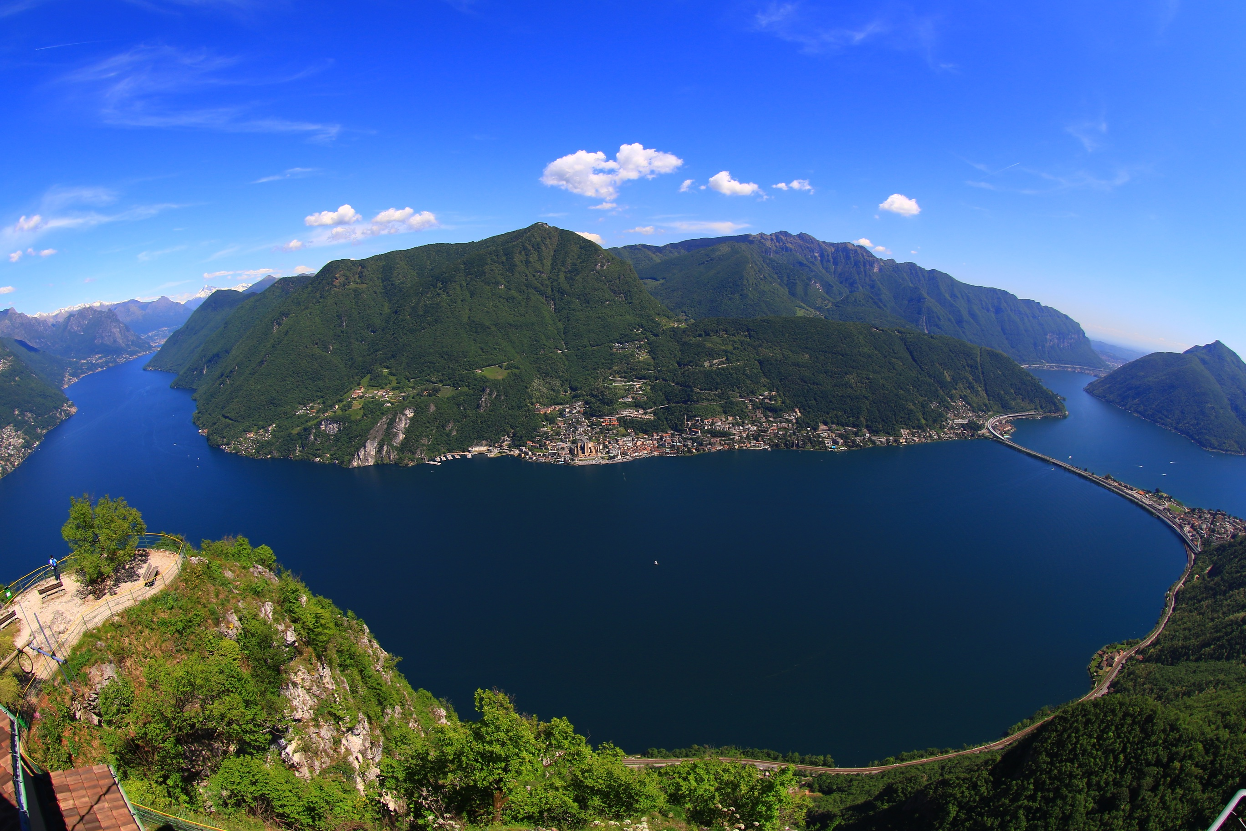

Slide 4
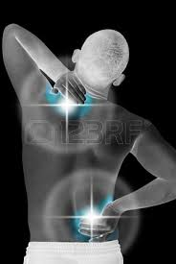
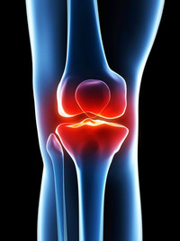
Clinical scene in 2007
Chronic low back pain, deficit L5 left, recurrent vertebral blockades:
-> severe degeneration with multiple discopathies and substenosis
-> slipped disc with radiculopathy L2-L3, L5-S1
-> retrolisthesis L5-S1
Recurrent cervico-dorsal pain:
-> loss of cervical lordosis, scoliosis left convex
-> degeneration, in particular C1-C2
-> discopathy C4-C5, C5-C6
Gonalgia, more on left side:
-> degeneration of menisci and ligaments, previous trauma, arthroscopy
-> femoro-patellar instability

Slide 5
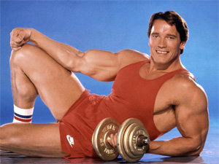
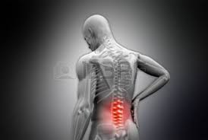
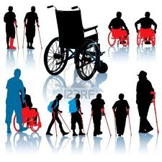
Clinical history
In youth body building
Subjected to following surgeries
-> appendectomy, inguinal hernia plasty, left knee arthroscopy,
both ankle ligaments repair
Since 1984 low back pain
-> first RX, MRI: L5 sacralization
1998 HE STOPS WORKING, INVALIDITY SINCE 2003

Slide 6
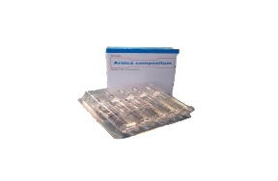
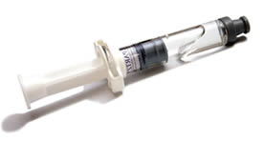
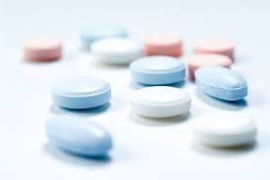

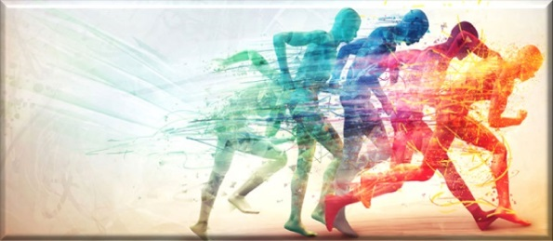
Treatment till 2014
Occasional infiltrations with hyaluronic acid and
homotoxical remedies
Oral administration of antiinflammatory and analgesic drugs
combined with detoxification of the cell matrix and gut, drainage of
the connective tissue, lymphatic system, emunctory drainage and
stimulation of excretory organs
Physiotherapy

Slide 7
In 2014
He was included in the study:
The scar as postural disruptor
Clinical-strumental study of 30 patients with painful symptomatology ,
presenting one or more scars.
Stabilometric-posturometric evaluation before and after
mesotherapic treatment with Procaine.

Slide 8
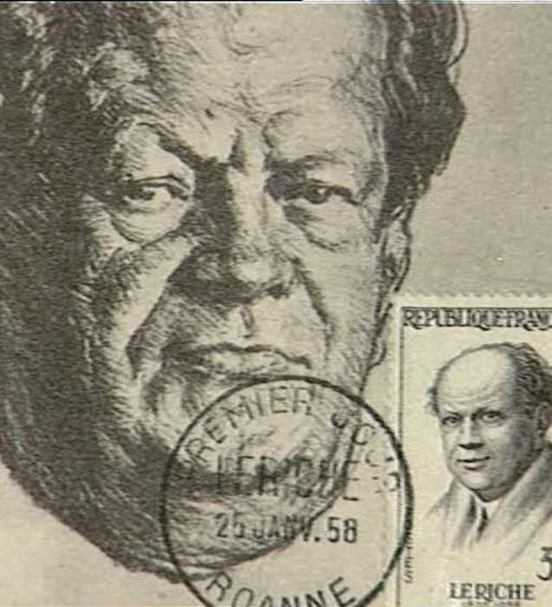
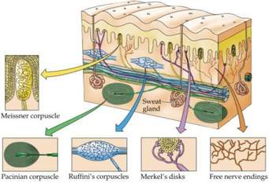
¿ Something about scars ?
In 1940, René Leriche, french surgeon, starts infiltration of scars
and… distant pain vanishes !
Pain is the result of an imperfect nerve regeneration during healing process
The scar leads to eccitation, to a reflex circle with sympathicotonic action on:
I) stellate ganglion
II) smooth muscle : vasomotoric peripheric phenomena with spasms, cyanosis, distrophy of
cutaneous annexex, secretory hyperactivity, sweating
III) striated muscle : contracture till epilepsy (face), hypotonia, motor deficit

Slide 9
There are various studies done to explain the correlation between scar-pain-dysfunction
nociceptive role and humoral-hormonal mechanisms
-> humoro-chemical message in correspondence of free nerve
endings
-> permanent local and distant irritative thorn
proprioceptive role
-> polysynaptic transmission to motoneurone
-> increase muscle tone to stretch the skin
-> postural disturbance
mechanic role
-> on muscle with consequent dysfunction

Slide 10
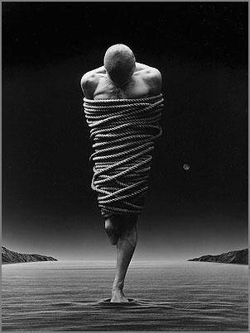
In 2015
He fell into DEPRESSION
He could NOT MOVE because of pain and functional impairment
He had gained WEIGHT
He was SICK of it all
¿ What is going on ?

Slide 11
Gene expression
Neuronal activation
Interference
oculomotricity
Multilevel Dysfunctional System
Nerve stress trigeminal
& vagus
Muscle
Chains
Stomatognatic System
Scars
Biochemistry
CNS
ANS
Overload
Regulation heart/gut
Meccanical
Humoral
stimuli
Dysfunction
Psychophysic
Sickness
Dysmorphism
Malnutrition
No Movement
Drugs
Pain
Movement impairment
Down-regulation
Dysbiosis, increased permeability
Leptin
Macrophages
Vagus
Metabolism
Cronic Inflammation
Gut Flora
Mood
S. Schütz RMP International School Arch.

Slide 12
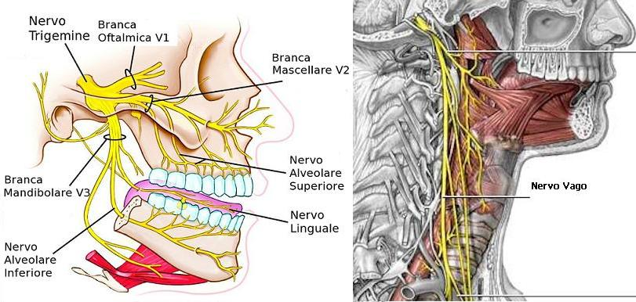
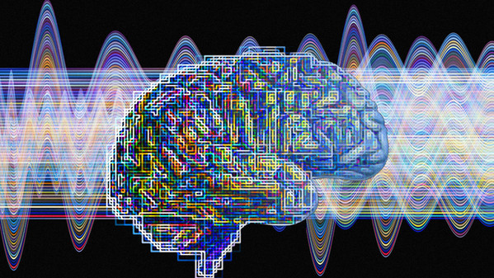
Vagus –trigeminus nerve
Modulators of NS

Slide 13
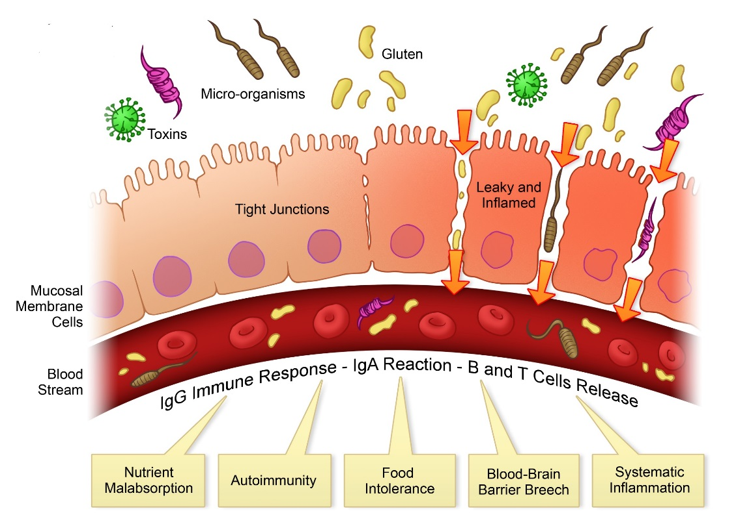
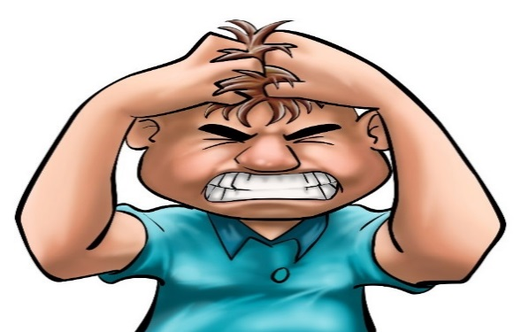
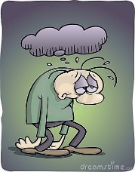
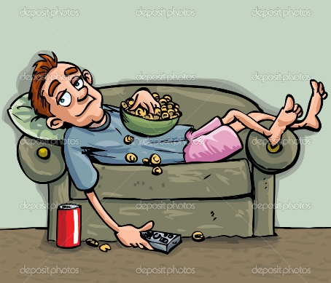
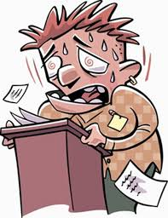
S. Schütz RMP International School Arch.
Gut - Brain Axis
decarboxylation
of essential
aminoacids
Tyrosine
Tyrosine
Triptophane
Cortisol
Catecolamins
Catecolamins
Serotonine
Dopamine
Stress
Anxiety
Depression
Demotivation

Slide 14
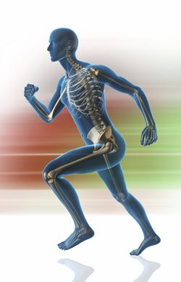
Health effects of muscle activation
improved mood and cognitive function
MYOKINES / IRISIN/ IL6
increased energy expenditure
enhanced oxygen uptake
weight loss
reduced cancer incidence
improved muscle strength
improved endurance performance
reduced cardiovascular
risk factors
improved insulin sensitivity
reduced bone loss during aging
local muscle adaptations
SYSTEMIC ADAPTATIONS
MUSCLE ADAPTATIONS
S. Schütz RMP International School Arch.
Notes:
some adaptations occur inside the muscle

Slide 15
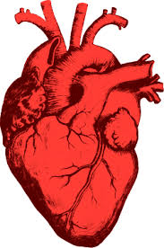
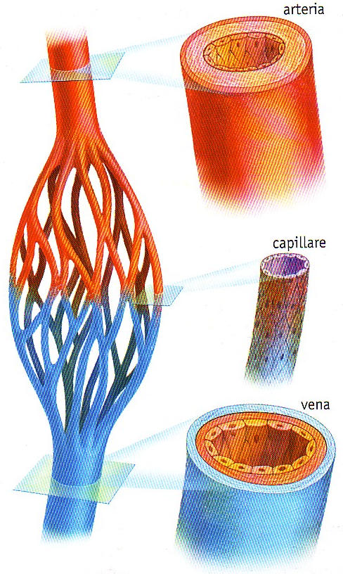
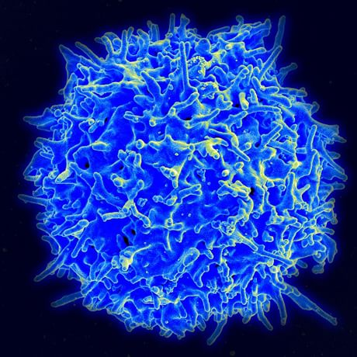

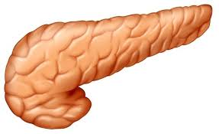
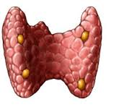
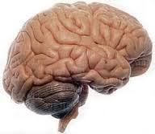
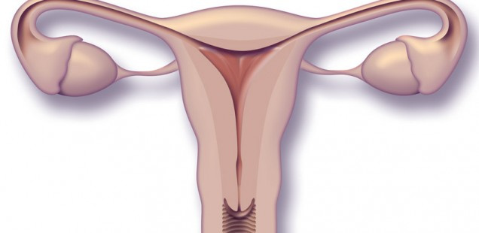
HEART RATE
IMMUNE ACTIVATION
BLOOD PRESSURE
ADIPONECTIN
α TNF
ESTROGEN
GLUCOSE DEP INSULIN SECRETION
INTERLEUKIN
LEPTIN
VISFATIN
ADIPOSE
TISSUE
LEPTIN
HORMON SYNTHESIS REG
BONE MASS REG
RESISTIN
CONTROL
APPETITE
ENERGY
METABOLISM
MENSTRUATION REG
APELIN
The rule of adipose tissue in regulation of
Hypotalamic-Metabolic System
S. Schütz RMP International School Arch.

Slide 16
There is only one solution:..
MPR
Deprogramming stomatognatic system
Correct Nutrition
Detoxification/Drainage
Gut riequilibration
Movement

Slide 17
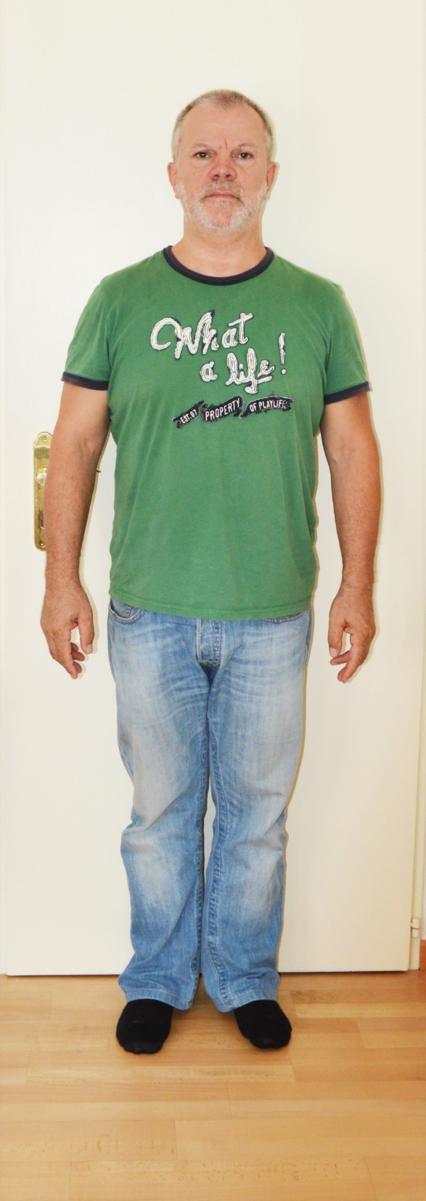
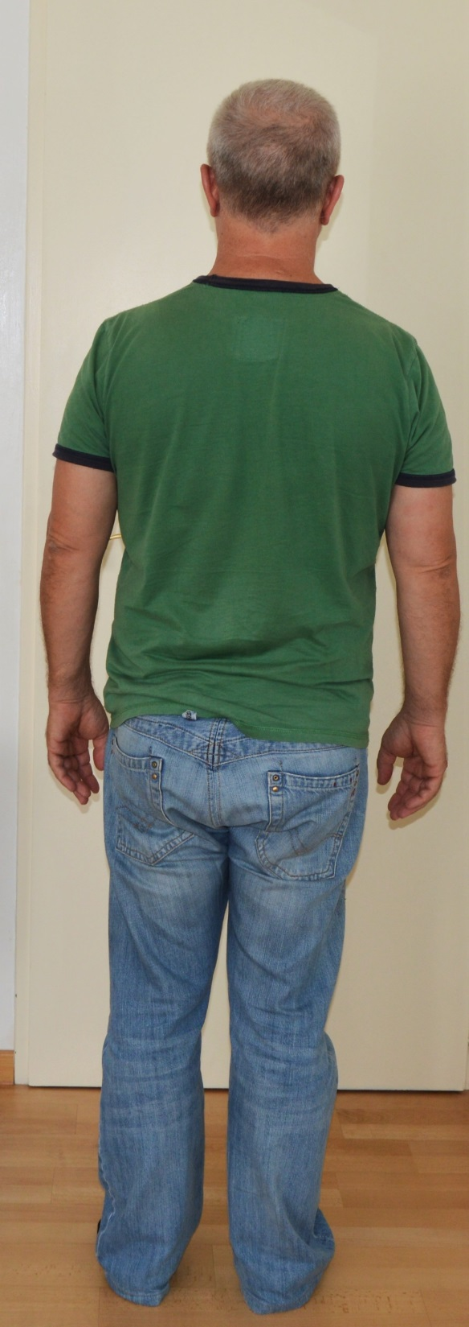

Slide 18
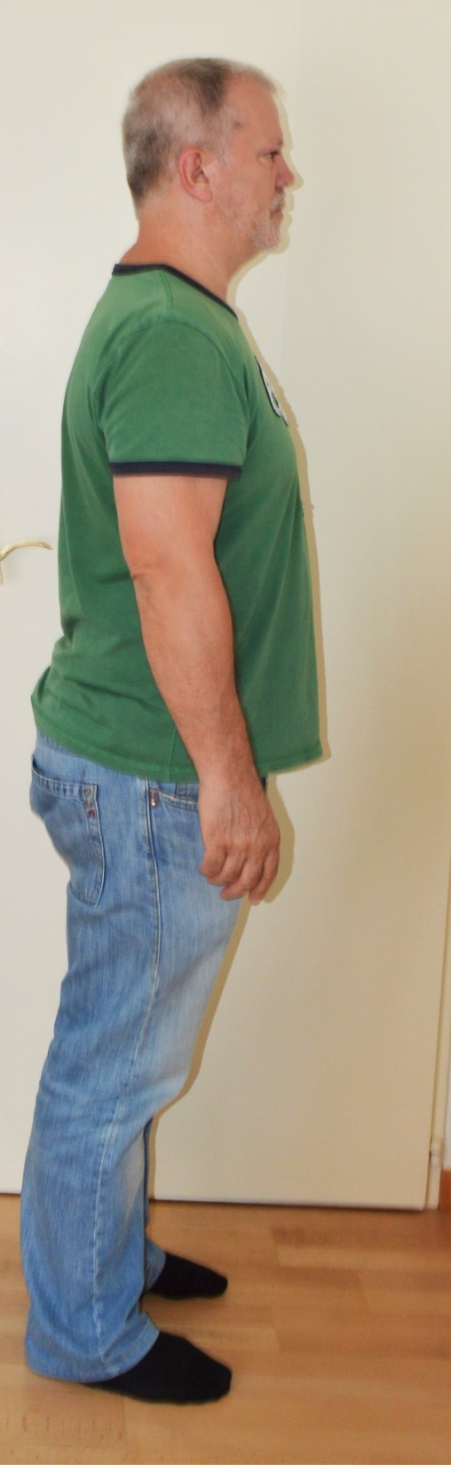
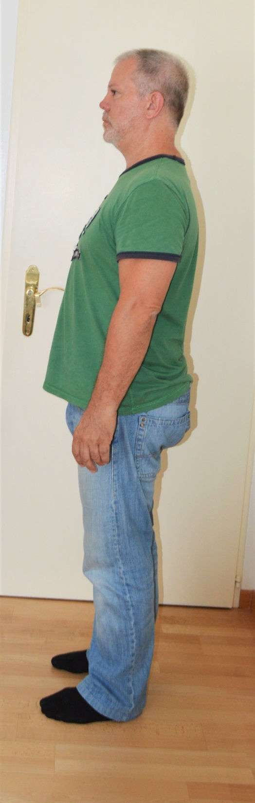

Slide 19
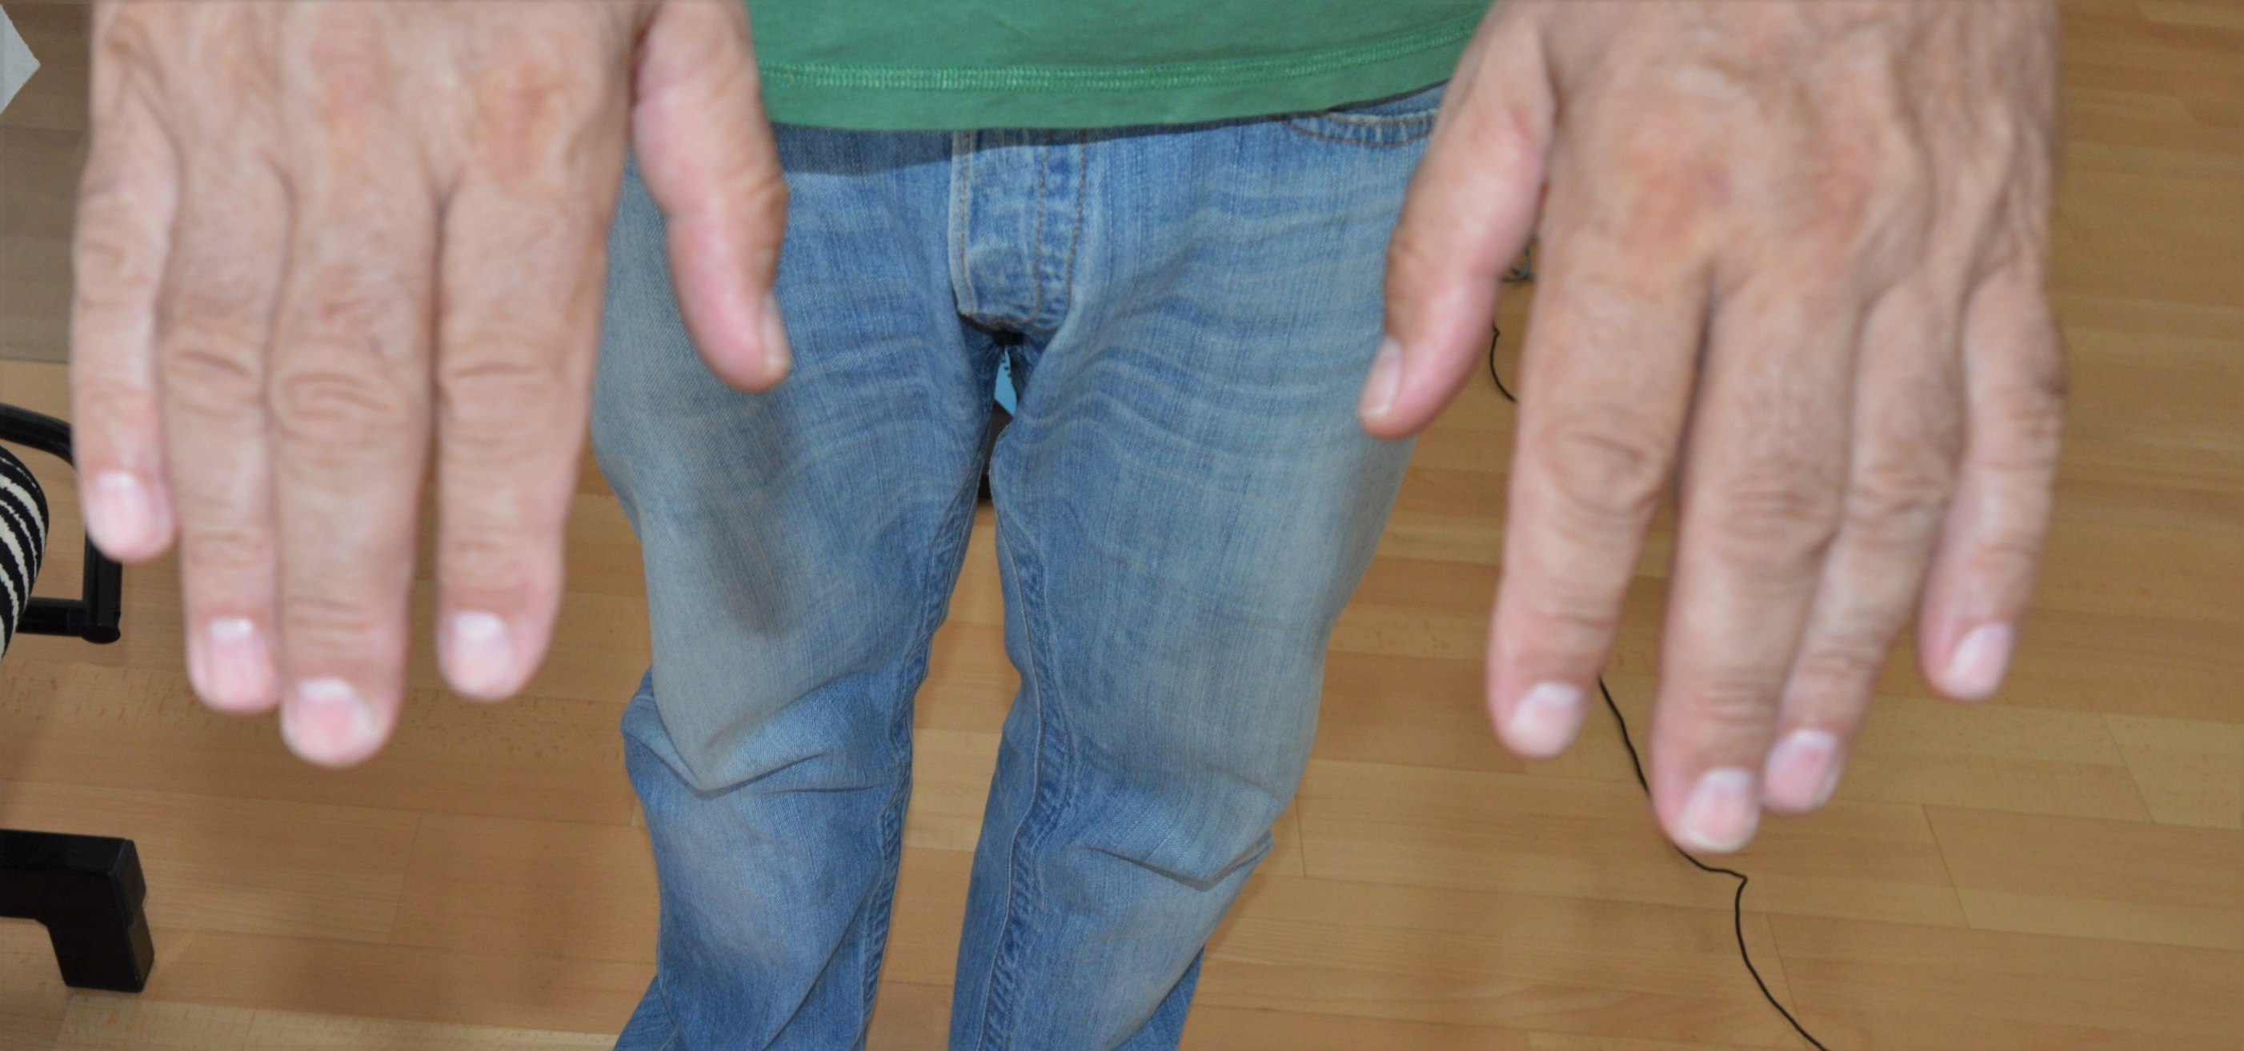

Slide 20
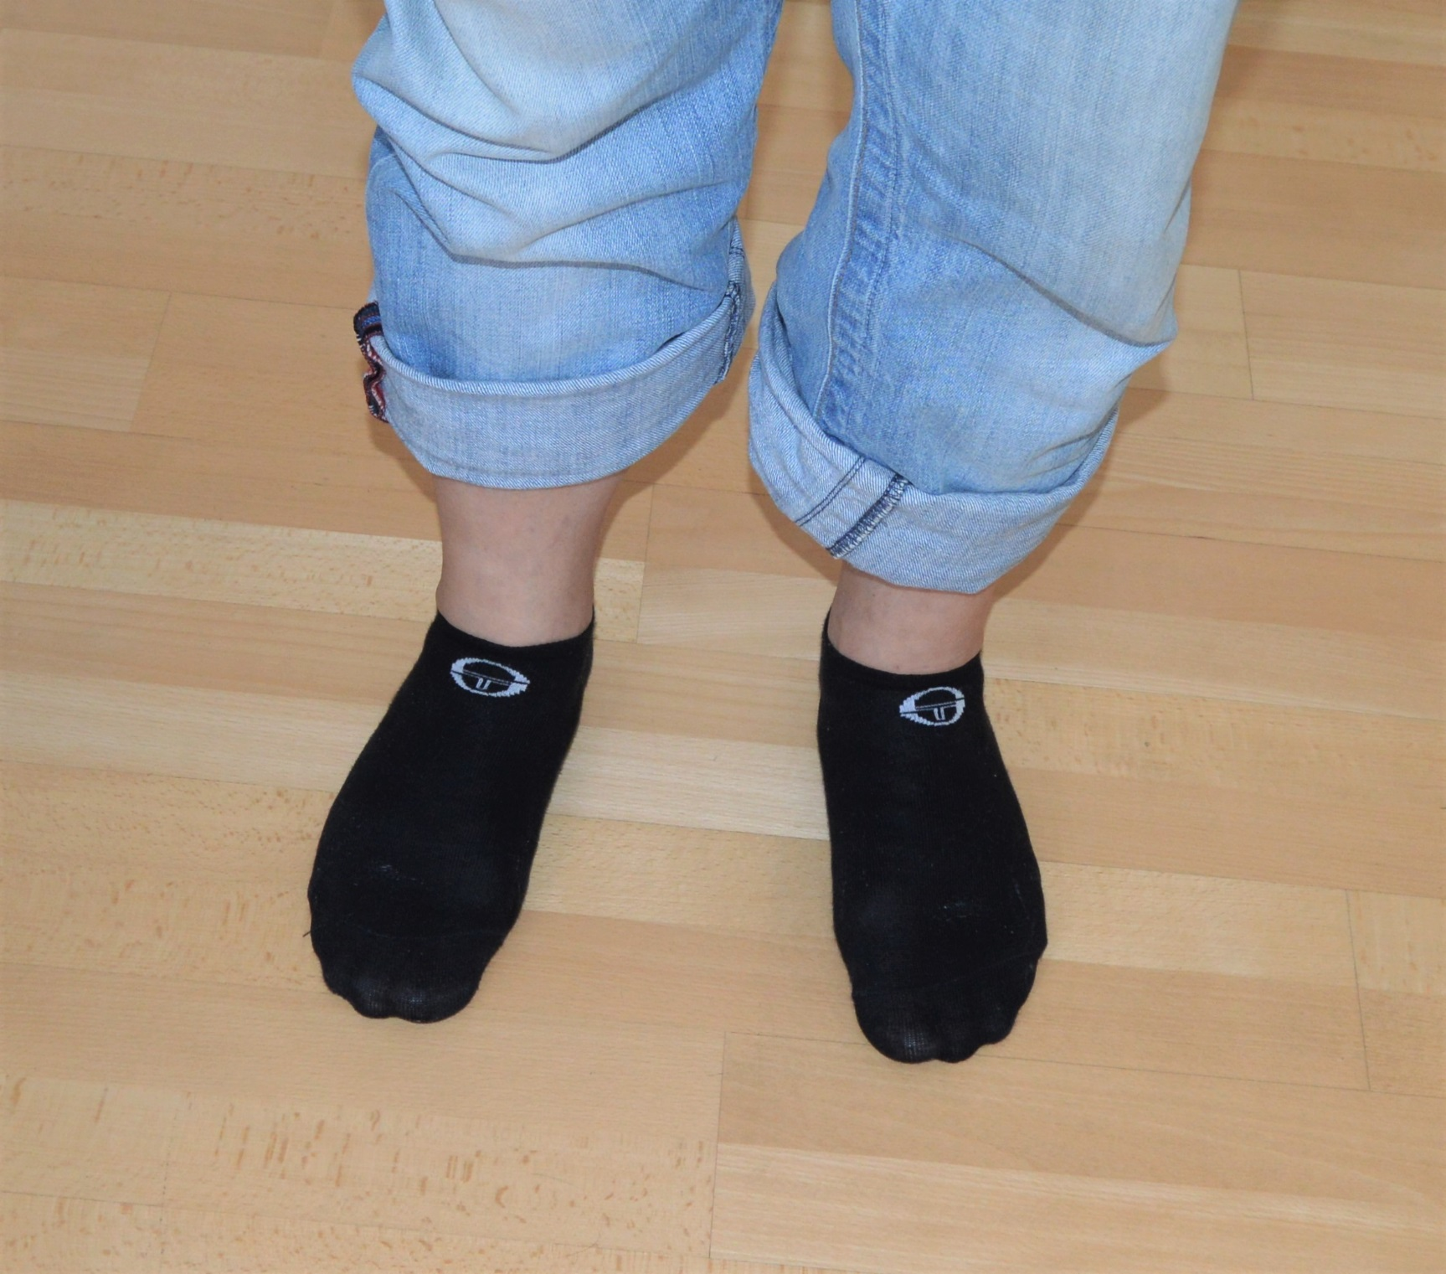

Slide 21
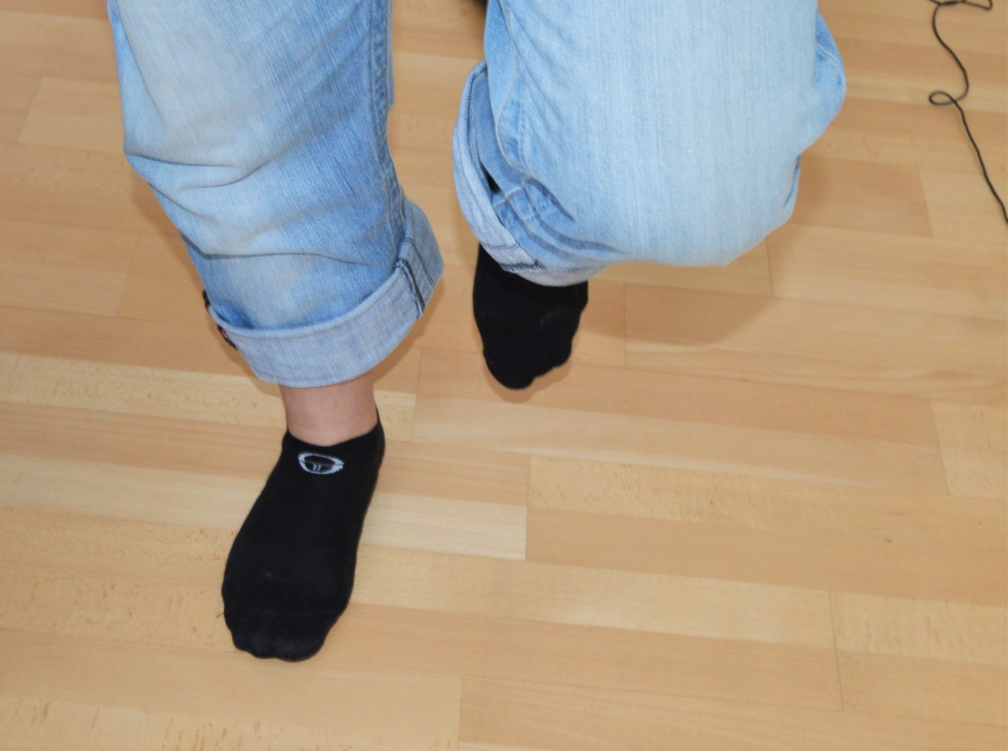

Slide 22
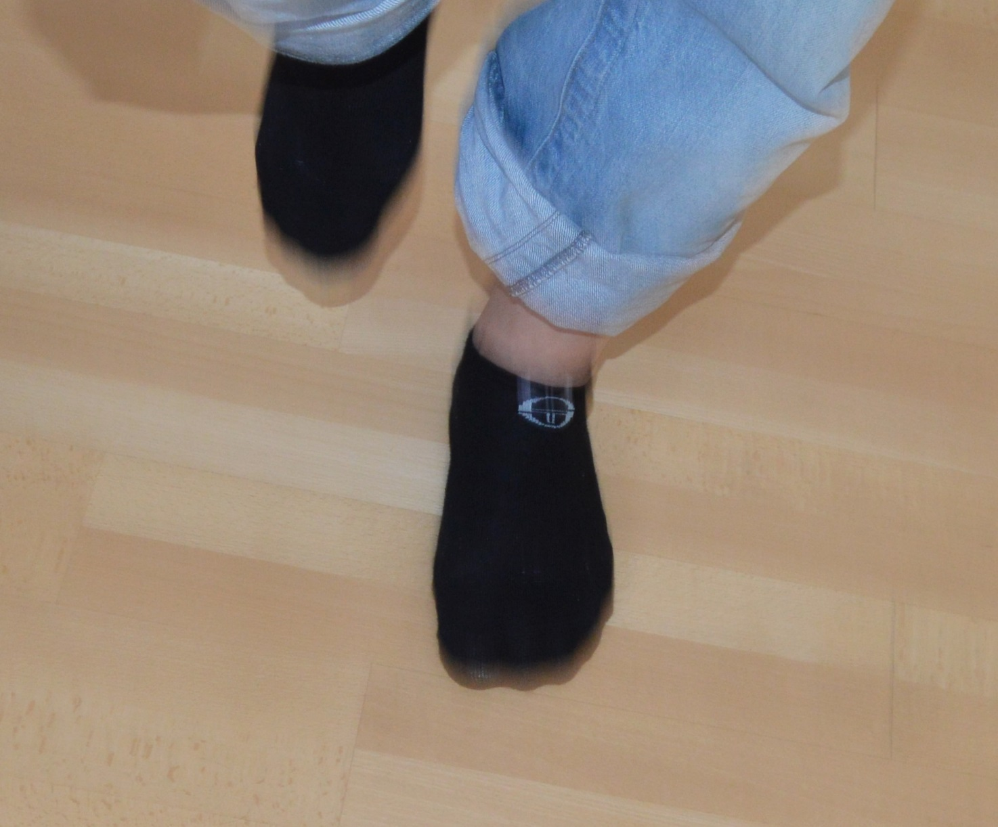

Slide 23
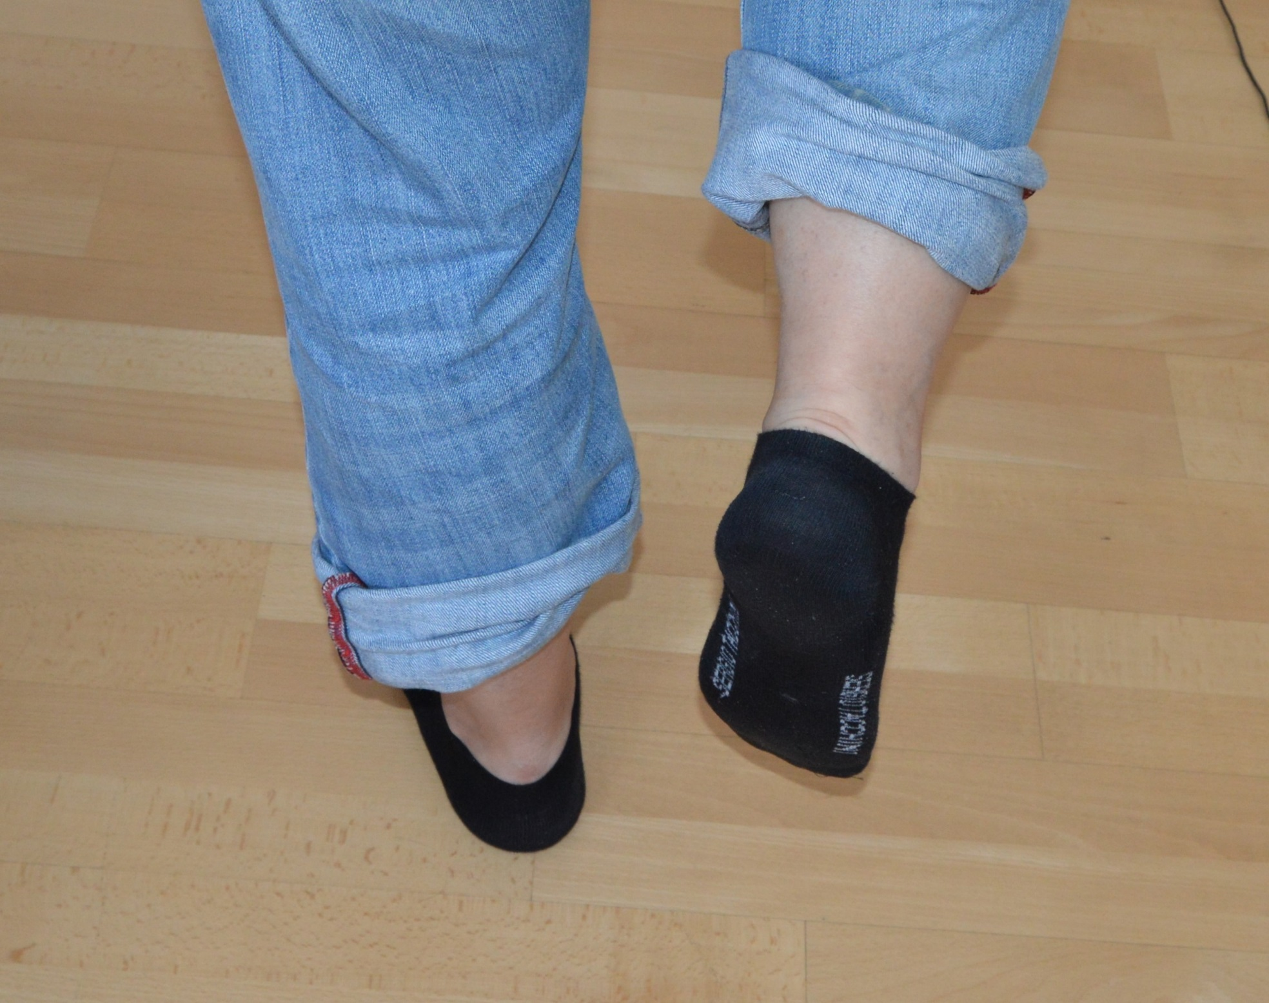

Slide 24
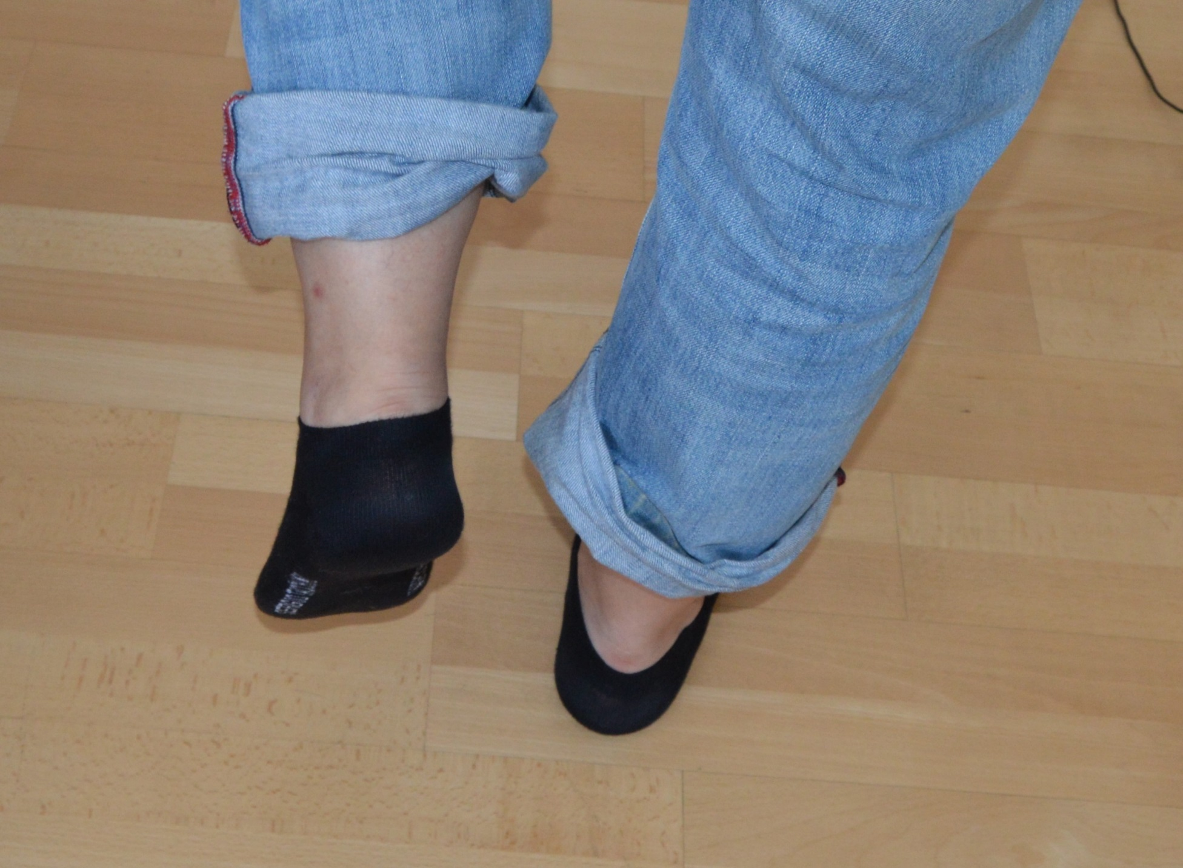

Slide 25
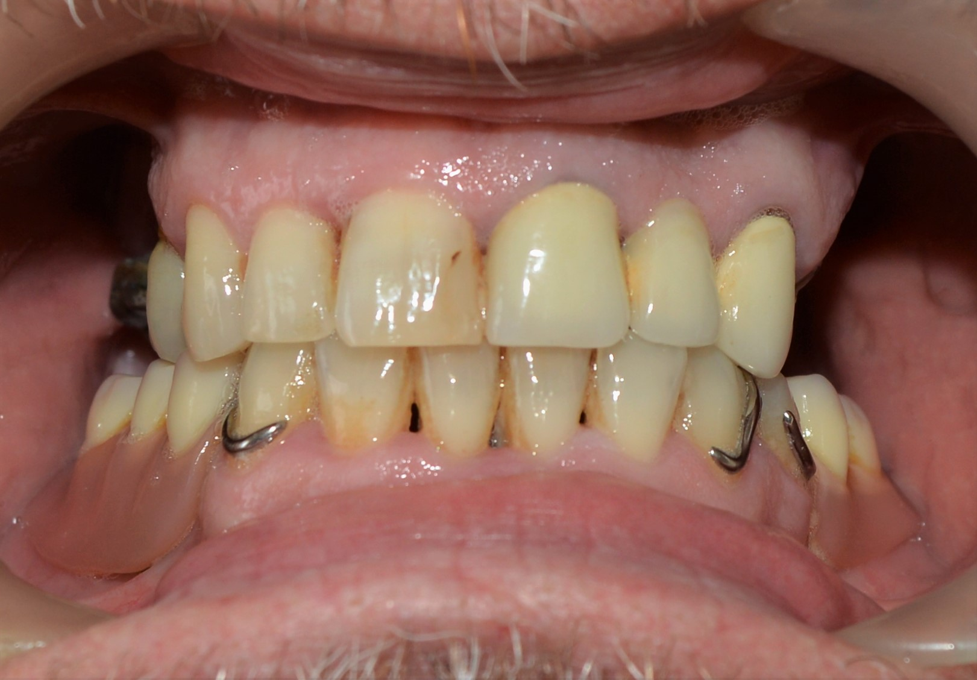

Slide 26
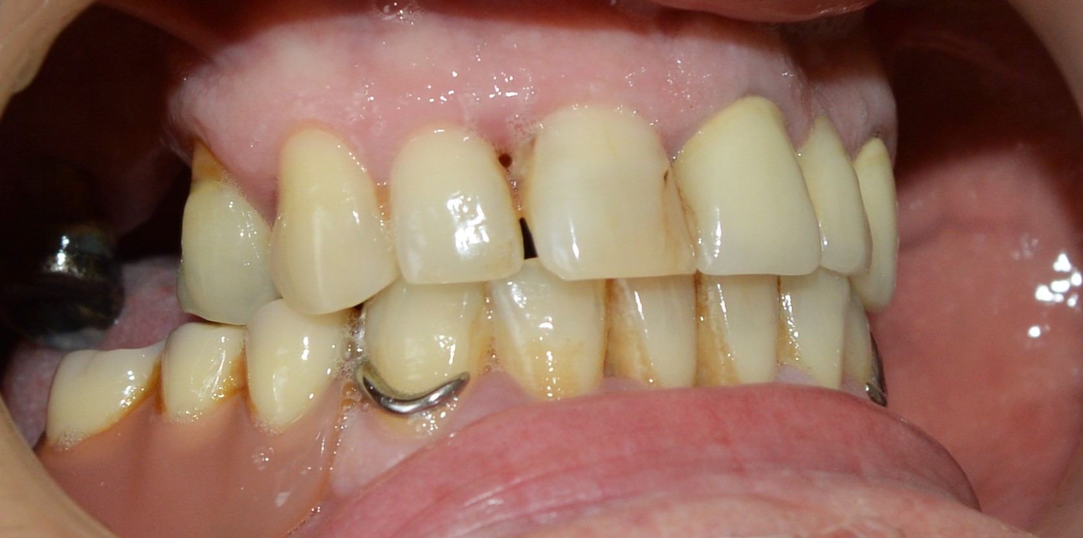

Slide 27
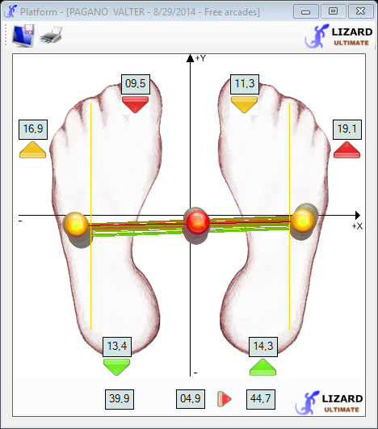
Posturometric evaluation before scar treatment
mouth/eyes open
barycenter
torsion
fluctuations
overload

Slide 28
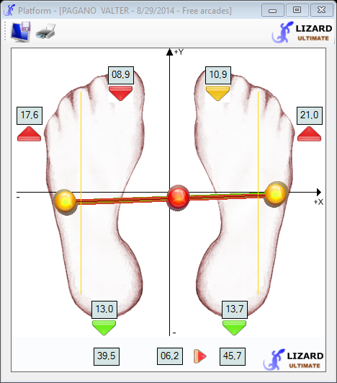
Posturometric evaluation after scar treatment
mouth/eyes open

Slide 29
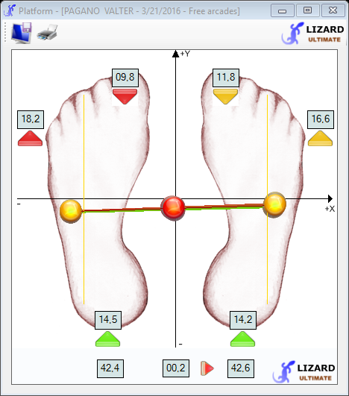
Posturometric evaluation after appliance of BED
mouth/ eyes open

Slide 30
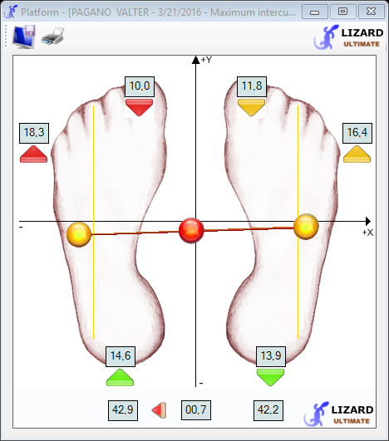
mouth closed

Slide 31
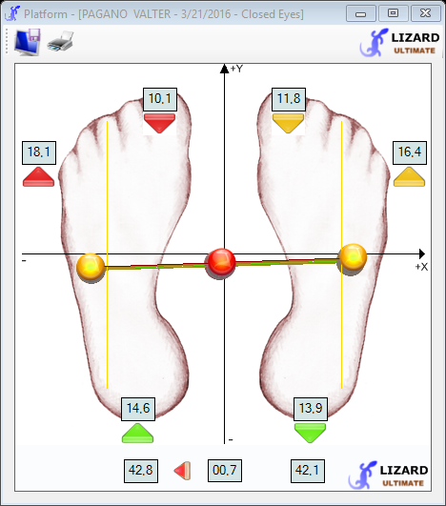
eyes shut

Slide 32

Podalic support before appliance of BED
eyes open
eyes shut
mouth close

Slide 33

Podalic support after appliance of BED
eyes open
eyes shut

Slide 34

Body torsion before appliance of BED
mouth close

Slide 35

Body torsion after appliance of BED

Slide 36

Stabilometry/ barycenter before appliance of BED
mouth close

Slide 37

Stabilometry/ barycenter after appliance of BED

Slide 38
There is only one solution:..
MPR
BodyEquilibriumDevice
Correct Nutrition
Detoxification/Drainage
Gut riequilibration
Movement

Slide 39



