Slide 1
Bioenergy Supply Chain Optimization:
Models and Applications
Sandra D. Eksioglu, PhD
Department of Industrial Engineering
World Bioenergy Congress and Expo, Rome, Italy
06/14/2016

Slide 2
Presentation Outline
1
Research Motivation and Literature Review
2
Supply Chain Model and Case Study
3
Data Analysis and Numerical Study
4
Conclusions
5
6

Slide 3
Introduction and Motivation
Increased interest in many areas of research related to bioenergy for the following reasons
  Bioenergy it is expected to contribute in meeting global future energy needs.
  Bioenergy is a clean source of energy; reduces the risk of oil embargos, price strikes, geopolitical dependence; supports farmers and local economy.
  In US, the Renewable Fuels Standard (RFS) established a target of 36BGY by 2022.
  Etc.
Current research has been focused (among other areas) on the optimization of the bioenergy supply chain.
“Bioenergy supply chain” includes the necessary operations to harvest biomass, preprocess, store and transport from the farm to a processing facility and distribution of bioenergy to consumers.
Notes:
Cellulosic biomass, such as corn stover, has 20 percent to 30 percent supply variations, compared to 12 percent to 15 percent variations for corn grain (http://www.renewableenergyworld.com/articles/2015/11/cellulosic-biofuel-reducing-cost-through-cellulosic-biomass-supply-strategy.html )
http://www.bioenergyconnection.org/article/billion-ton-update-where-biomass

Slide 4
Introduction and Motivation
  Bioenergy supply chain costs are high:
  Physical characteristics of biomass and biofuels.
  Biomass supply and costs are uncertain.
  The “Billion-Ton Study” of US DOE & ORNL estimates that the US could produce about 85BGY, 30% of current petroleum consumption.
  A 2012 study by the Idaho National Laboratory demonstrate a delivered biomass logistics cost of $35/dt.
  The main goal of research in bioenergy supply chains is to design sustainable and robust supply chains which lower bioenergy delivery cost, lessen environmental impacts, and improve social outcomes.
The long-term goal of the supply chain-related research is to contribute to a smooth switchover from a fossil fuel-based energy to bioenergy-based economy.
Notes:
Cellulosic biomass, such as corn stover, has 20 percent to 30 percent supply variations, compared to 12 percent to 15 percent variations for corn grain (http://www.renewableenergyworld.com/articles/2015/11/cellulosic-biofuel-reducing-cost-through-cellulosic-biomass-supply-strategy.html )
http://www.bioenergyconnection.org/article/billion-ton-update-where-biomass
Physical characteristics impact: transportation and collection costs. Uncertainties: impact inventory holding costs.

Slide 5
Supply Chains Decisions
Supply chain decisions are:
    Long-term: facility location, technology selection, etc.
    Mid-term: supplier selection, transportation mode selection, etc.
    Short-term: collection, storage, production and transportation schedule, etc.
Biomass supply chains decisions are impacted by:
  Biomass availability and seasonality
  Biomass quality, supply and price uncertainties
  Large number of farmers

Slide 6
Supply Chain Literature
Scope
Liquid
Strategic
Tactical
Operational
Objective
Product Characteristics
Perishable
Non-Perishable
Economic
Environmental
Social
Reviewed Models
LP
NLP
MIP
SP
Simulation
Non-coop.
Sequen.
Deterministic
Stochastic
Game theoretic
Modeling

Slide 7
Supply Chain Planning and Design for Biodiesel Production via Wastewater Sludge*
*Marufuzzaman, M, S.D. Ekşioğlu, R. Hernandez, “Environmentally Friendly Supply Chain Planning and Design for Biodiesel Production via Wastewater Sludge,” Transportation Science, 48(4), 555-574, 2014. http://dx.doi.org/10.1287/trsc.2013.0505
**Marufuzzaman, M, S.D. Ekşioğlu, Y. Huang, “Two-Stage Stochastic Programming Model for Biocrude Supply Chain,” Computers and OR, Vol. 49, 2014, 1-17. http://dx.doi.org/10.1016/j.cor.2014.03.010

Slide 8
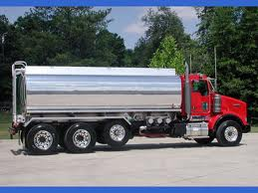
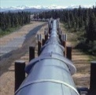
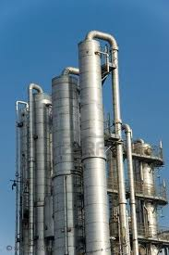
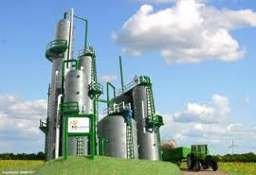
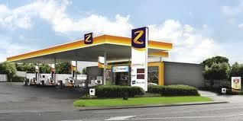
BIODIESEL Supply Chain Structure
Municipal WWT Plants
Pulp & Paper
Meat Packing
Poultry Slaughtering & Processing
Animal & Marine
Fresh/Frozen Fish
Sludge Supply
Biocrude
Plants
Diesel
Plants
Customers

Slide 9
BIODIESEL Supply Chain
  Research Questions
    Estimate supply-chain related costs for production of biodiesel.
  Biomass transportation (sludge):
    What factors have a great impact to the transportation cost of sludge?
    Under what conditions pipeline becomes a viable transportation mode?
  Supply chain design and management:
    Should a biocrude plant be co-located at a WWT facility?
    What factors have a great impact on the supply chain costs?
  Provide insights about biodiesel supply chain related costs to potential investors.

Slide 10
Solution Approach
        Sludge Transportation
        Techno-Economic Analysis
Input Analysis
        Sensitivity Analysis
        Sludge Supply Analysis
        Regression Analysis
        GIS Tools
Output Analysis
        Model Validation & Verification
        GIS Tools
        Supply Chain Design & Mgmt.:
      Optimization Model

Slide 11
Transportation Cost Analysis
Facility-owned Single Trailer Truck, 30m³ capacity.
Similar analyses is conducted for rented Single Trailer Truck, facility-owned and rented Tandem Trucks of 30m³ and 40m³ capacity.
Cost of ownership
Annual sale taxes
(b) Variable costs ($/m³/mile)
License fees and taxes
Management and overhead cost
Insurance cost
Fuel cost
Labor cost
Maintenance and repair cost
(a) Fixed costs ($/m³)
Tire cost

Slide 12
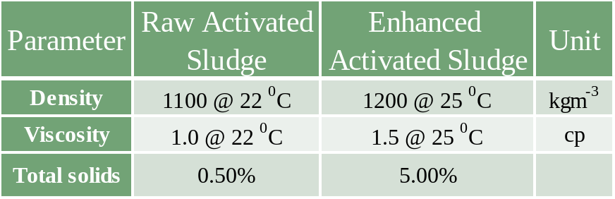
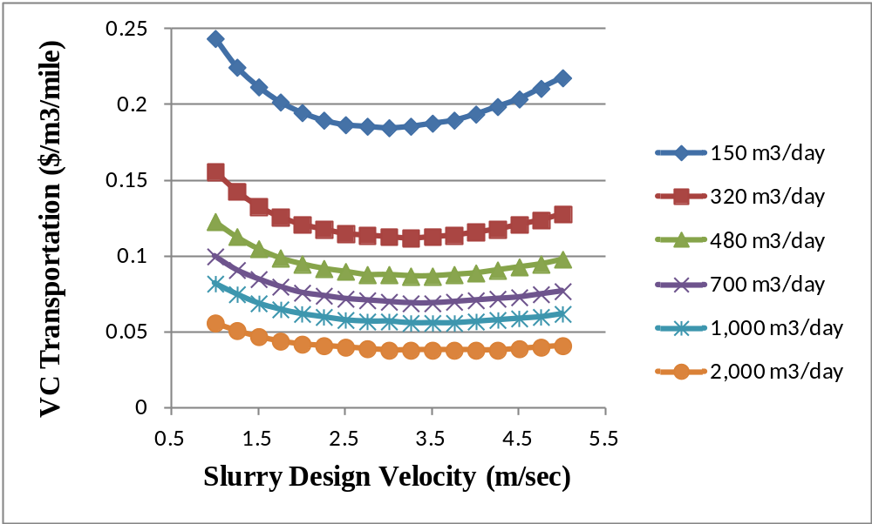
Transportation Cost Analysis
II. Pipeline Transportation of Sludge
Smaller the capacity, higher transp. costs.

Slide 13
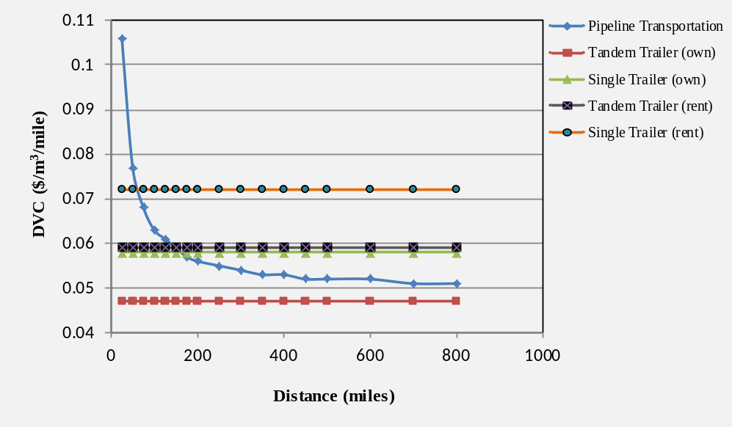
Transportation Cost Analysis
Data: Mississippi Department of Environmental Quality.
Pipeline vs. truck for volume of sludge shipped: 843.5 m³/day
Variable cost ($/mile/m³) is smallest for facility-owned tandem trailer truck.
As transportation distance increases, pipeline costs decrease.

Slide 14
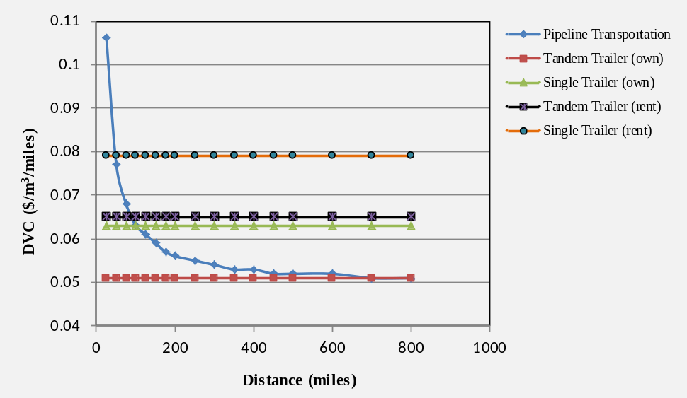
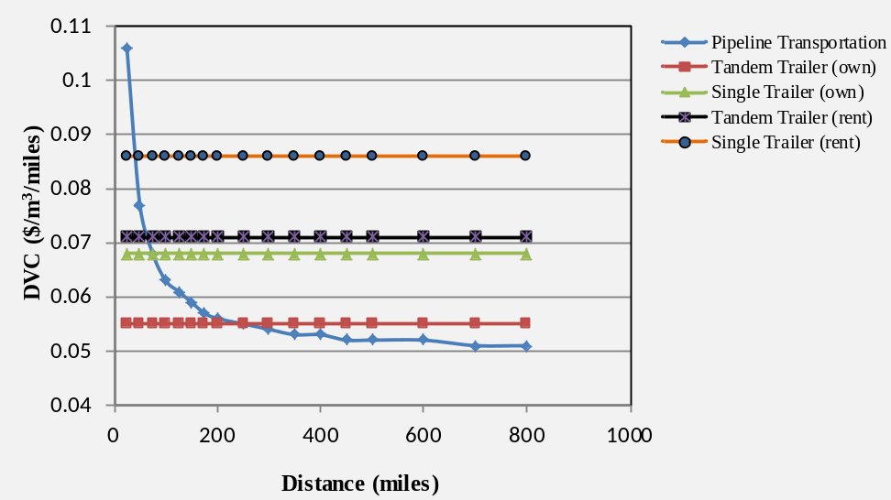
Sludge Transportation Costs in MS
A 20% increase in the cost of labor
and fuel:
VC of pipelines is smallest for
distances over 220 miles.
A 10% increase in the cost of labor
and fuel:
VC of pipelines is smallest for
distances over 700 miles.

Slide 15
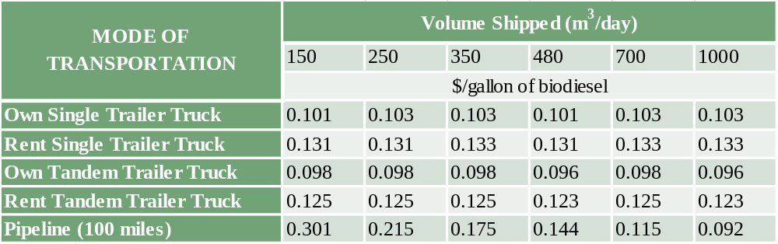
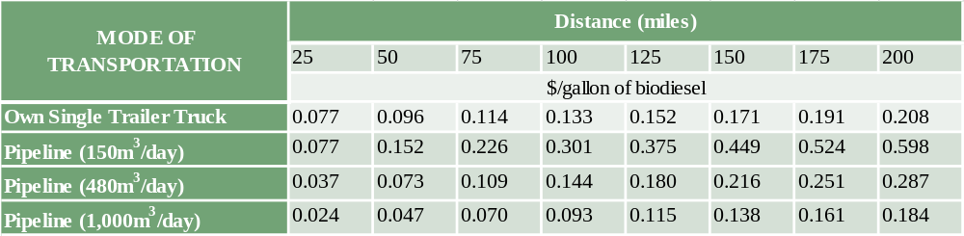
Summary: Sludge Transportation Costs

Slide 16
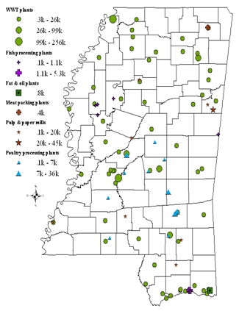
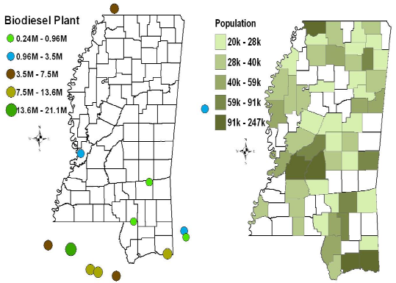
Distribution of Sludge supplier, Biodiesel Plants and Population in MS
Sludge Supply | No. Suppliers
WWT plants | 64
Pulp & paper mills | 8
Poultry slaughtering & processing | 11
Fresh & frozen fish processing plants | 9
Fat & oil from animal and marine | 1
Meat packing plants | 1
Total | 94
Sludge supplier
Biodiesel Plants
Population by county

Slide 17
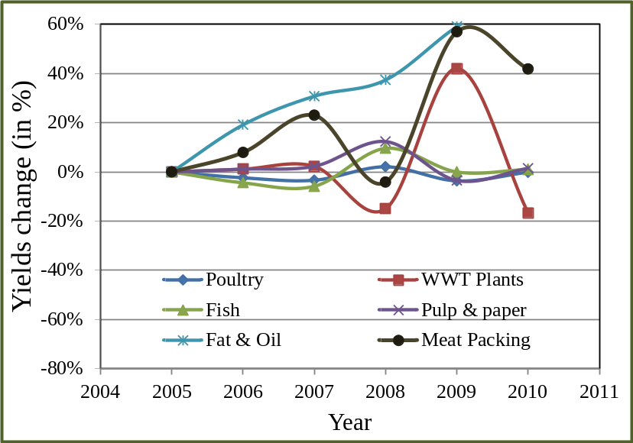
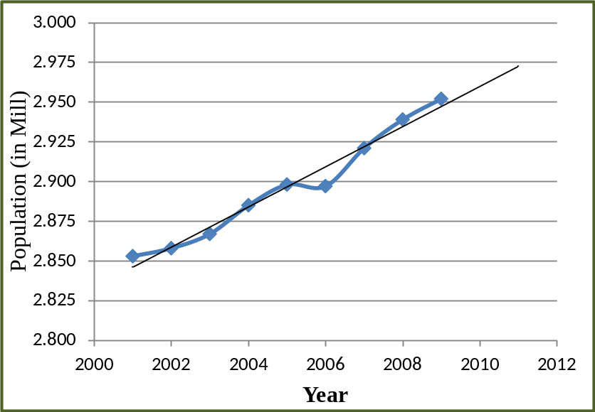
Trends Analysis
Sludge Yields in Mississippi
Population in MS
* Oil Spill in the Gulf, April 2010
* Hurricane Katrina, Aug. 2005

Slide 18

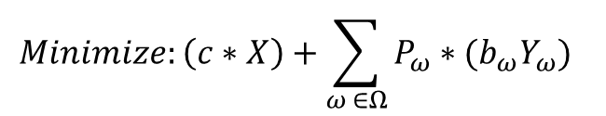
A Two-Stage Stochastic Programming Model
Biomass supply uncertainty
First-stage decisions x
Uncertainty
ζ(ω)
Second-stage
decisions y(ω, x)
Strategic decisions:
Plant locations/sizes
Pipeline location/size
Nr. of trucks purchased
Planning decisions:
Production
Transportation
Shortage
$$Minimize:\left(c∗X\right)+\sum_{ω ∈Ω}{P_{ω}∗(b_{ω}Y_{ω})}$$
$Subject to:\left(X,Y_{ω}\right)∈F_{ω} for all ω ∈Ω$.

Slide 19
Supply Chain Optimization Model
  Objective: Minimize the expected supply chain costs.
  Decision Variables
    Location and capacity of biocrude production plants
    Transportation mode selection
      Pipeline, facility-owned trucks, rented trucks
    Sludge processing and delivery
    Biocrude processing and delivery
    Biodiesel delivery

Slide 20
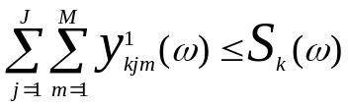
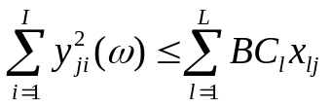

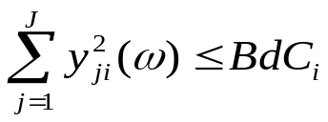


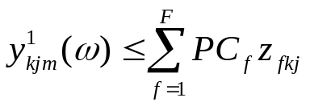



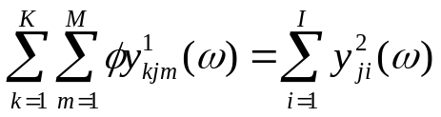
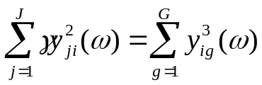
Model Formulation: Constraints
Trans. Mode m
Sludge Supply
Supply Point k
Plant j
Production Capacity
Supply
Point k+1
Plant j+1
Plant j
Refinery i
Pipeline & Truck Capacity
Plant j+1
Refinery i+1
Flow Balance

Slide 21








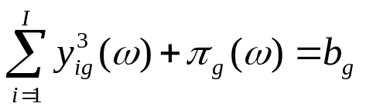
Model Formulation: Constraints
Market
Non-Negativity Const.
Refinery i
Customer g
Refinery i+1
Customer g+1
Binary Const.
Demand is Satisfied

Slide 22
Solving the Two-Stage SP Model
L-shaped algorithm
Optimality Cut
Initialize; n = 1
1. One aggregate cut
2. Multiple cuts
Solve the Master Prob.
(x^{n}, z^{n}, v^{n}) & LB
Solve Master Prob.
n = n +1
Add n^{th} optimality cut to MP.
Solve sub-problems
(y^{n}(ω), π^{n}) , Calc. UB
1. Using CPLEX
2. Lagrangean Relax.
UB – LB < ε
n > N_{max}
NO
YES
Stop; Report solution

Slide 23
Scenario Definitions & Probabilities:
Supply Uncertainty
Scenario | Explanation | Probability
1-5 | Historical data collected from previous five years | 0.15*5 = 0.75
6 | Sludge supply of every facility is increased by 20% | 0.05
7 | Sludge supply of every facility is decreased by 20% | 0.05
8 | Supply from WWT plants changes by as much average change of population in MS in the last 10 year | 0.05
9 | Sludge supply from pulp & paper industry decreases by 20% | 0.05
10 | Sludge supply from poultry increased by 20% | 0.05

Slide 24
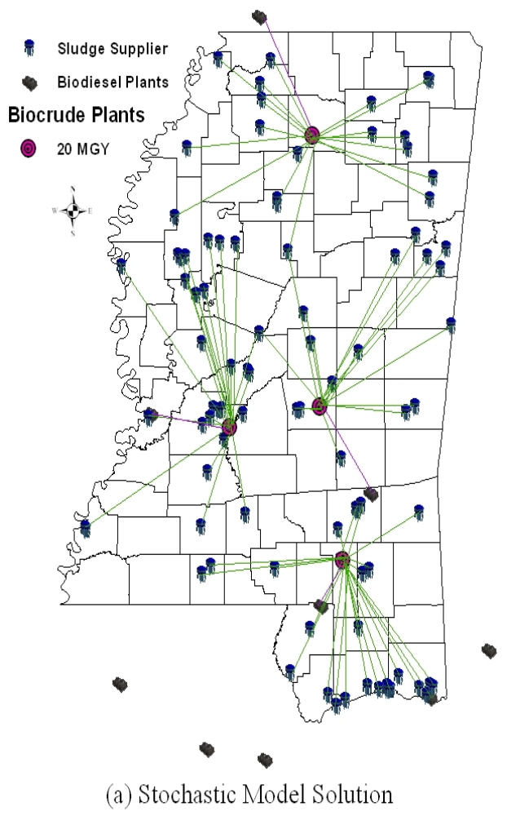
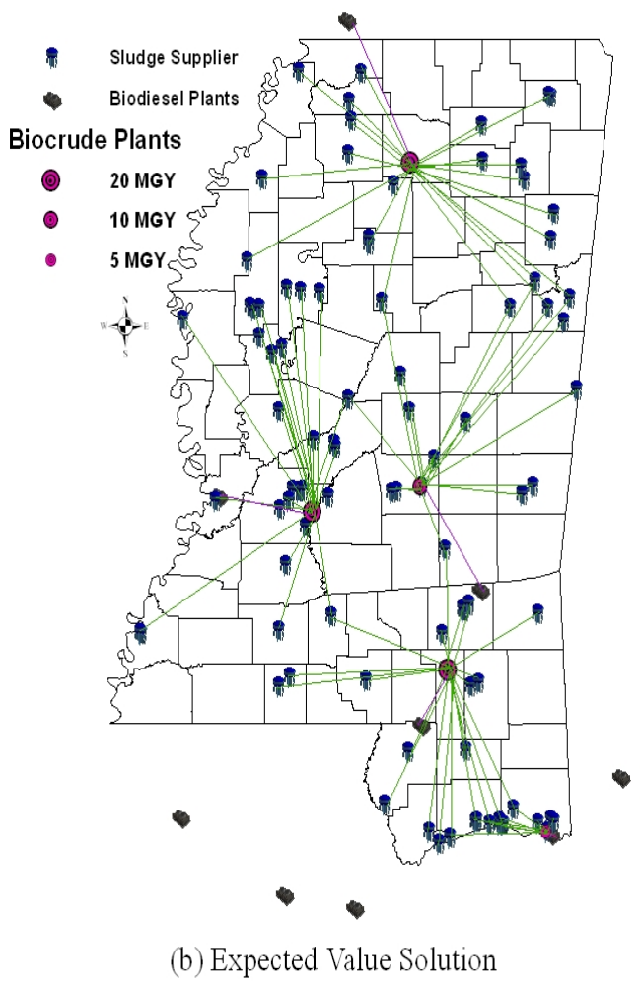
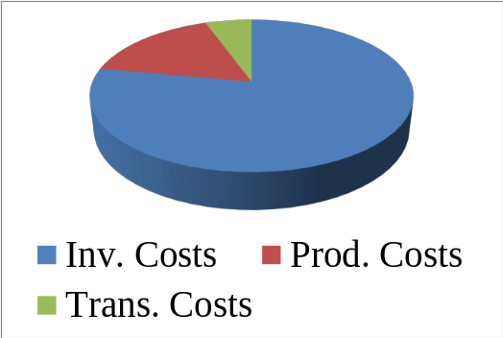
Supply Chain Decisions: Min Costs
Distribution of Unit Cost ($2.72/gal)
1. Large capacity plants centrally located.
2. Co-locate with large WWT facilities.
3. Truck transportation
Stochastic Solution
Costs: $311.60 M
Capacity: 80MGY
Production: 75.59MGY
Val. of Stochastic Solution
$3. 36M
Expected Val. Solution:
Costs: $314.96 M
Capacity: 75MGY
Production: 72.55MGY

Slide 25


Bioenergy and Environment
  US is committed to reduce GHG emissions by 17% below 2005 levels by 2020
  Environmental policy on physical processes
    Energy efficient facility/vehicles: USDA Alternative Fuel & Fleet Efficiency programs
    Alternative fuels: Biodiesel Income Tax Credit, Excise Tax Credit, Alternative Fuel Excise Tax
    Focus on physical processes overlooks the impact of business processes and operational practices on emissions
      Inventory replenishment decisions impact emissions
    Inventory Inventory
      Outsourcing, centralized warehousing, rapid-response logistics, just-in-time production, etc. impact emissions.
Notes:
Regional Greenhouse Gas Initiative (RGGI), the Western Climate
Initiative (WCI), and the Midwest Greenhouse Gas Reduction Accord (MGGRA)

Slide 26
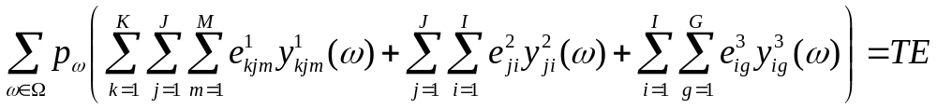
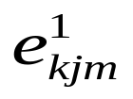
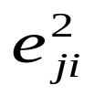
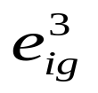
Adding an Environmental Objective
  The following function represents total emissions:
  Where, is the amount of carbon emitted by transportation mode m when shipping sludge from supply location k to biocrude plant j.
  the amount of carbon emitted for shipping biocrude
  the amount of carbon emitted for shipping biodiesel

Slide 27
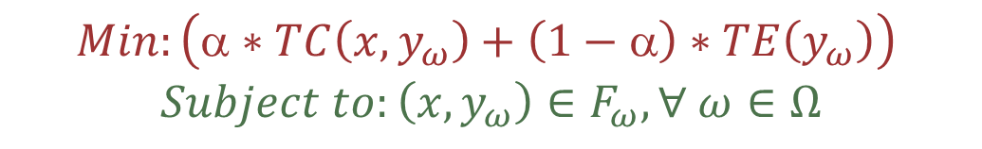
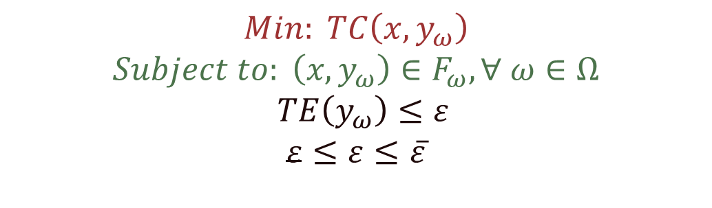
Solution Approaches
  Weighted sum method:
  ε-constraint method:

Slide 28
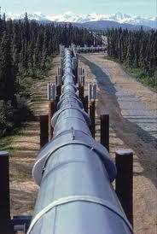
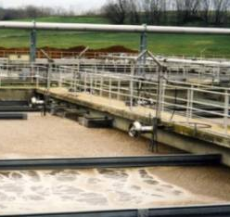
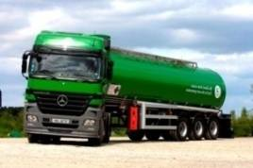
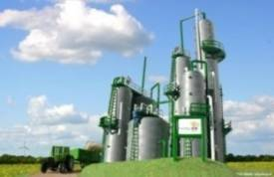
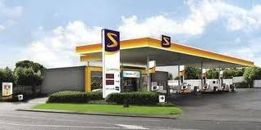
Modeling Environmental Policies
Evaluate the impact of environmental policies on supply chain operations.
Environmental Policies
Carbon Cap
Carbon Tax
Carbon Cap-and-Trade
Carbon Offset

Slide 29
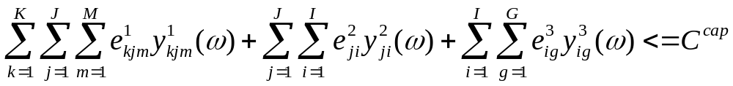
Modeling Carbon Cap
  The following constraints is added to the mathematical model:
  for each ω∈Ω

Slide 30
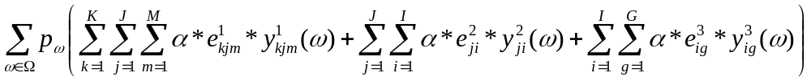

Modeling Carbon Tax
  The following term is added to the objective function:
  Where, is the carbon tax (in $/kg).

Slide 31
Pipeline Emissions Calculations
Input:
Pipeline capacity, Cpipe (tons/year)
Pump power, P_{p} (hp)
Pump Efficiency, η_{p}
Operating hour per year, O_{h} (hr/year)
CO₂ emissions to generate electricity E_{CO2} (kg/kWh)ª
Calculations:
Electricity required (kWh/year): E_{pump} = (P_{p} * 0.746 * O_{h}) / (η_{p})
Emissions per unit (kg/ton): Em_{pump} = (E_{pump} * E_{CO2}) / (C_{pipe})
Inlet Station
Outlet Station
Booster Stations
ª Greenhouse gas protocol: www.ghgprotocol.org
ª Energy Information Administration: http://www.eia.gov/cneaf/electricity/page/co2_report/co2emiss.pdf

Slide 32
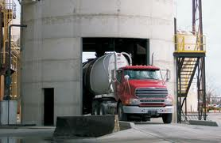
Truck Emissions Calculations
Fixed Emission
* Pump Power
* Pump Efficiency
* Volume Flow Rate
* Fluid properties
Variable Emission
* Fuel Efficiency for
Loaded & Unloaded
Truck
* Diesel CO₂ emission /gal
Fixed Emission
* Pump Power
* Pump Efficiency
* Volume Flow Rate
* Fluid properties
Loading
Transporting
Unloading

Slide 33
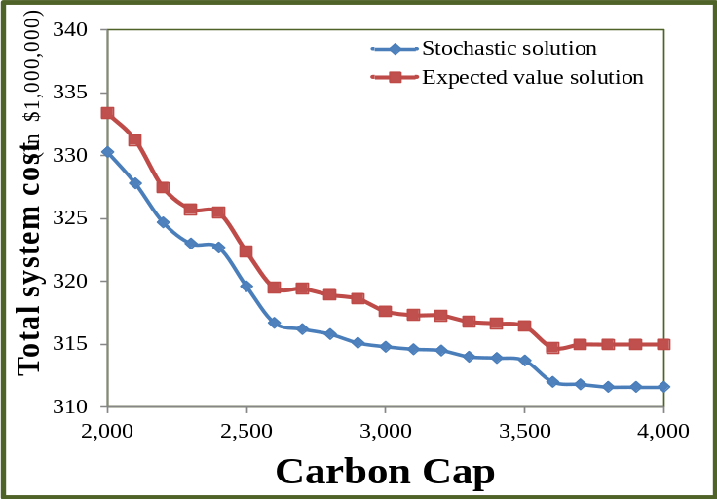
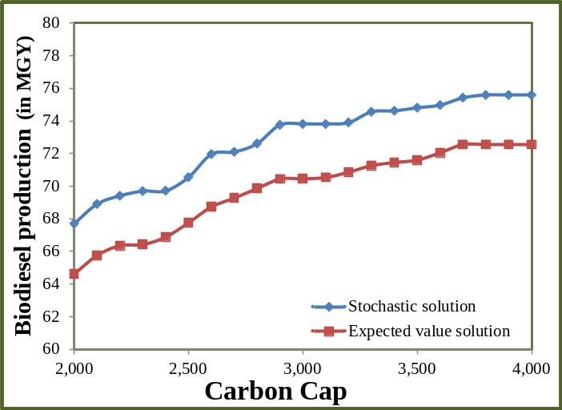
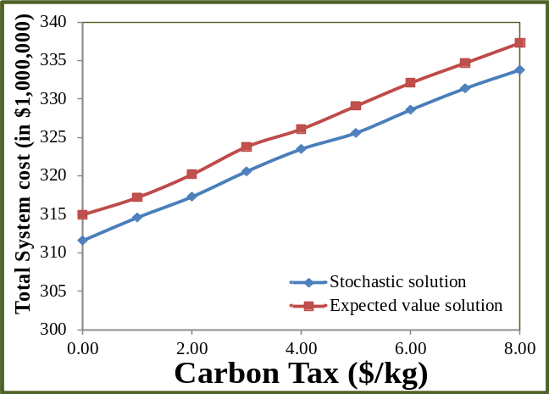
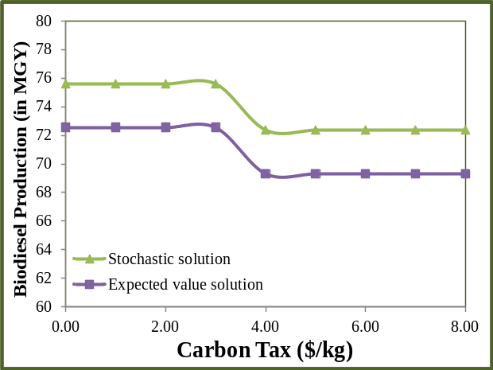
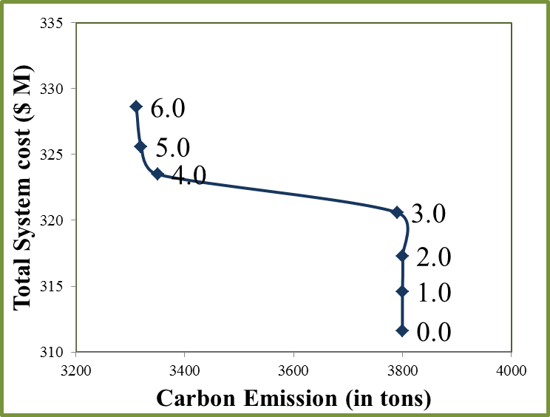
Carbon Cap and Tax Mechanism
Stochastic solution have smaller total systems costs & higher production
The system reacts faster to an emission cap than an emission tax.

Slide 34
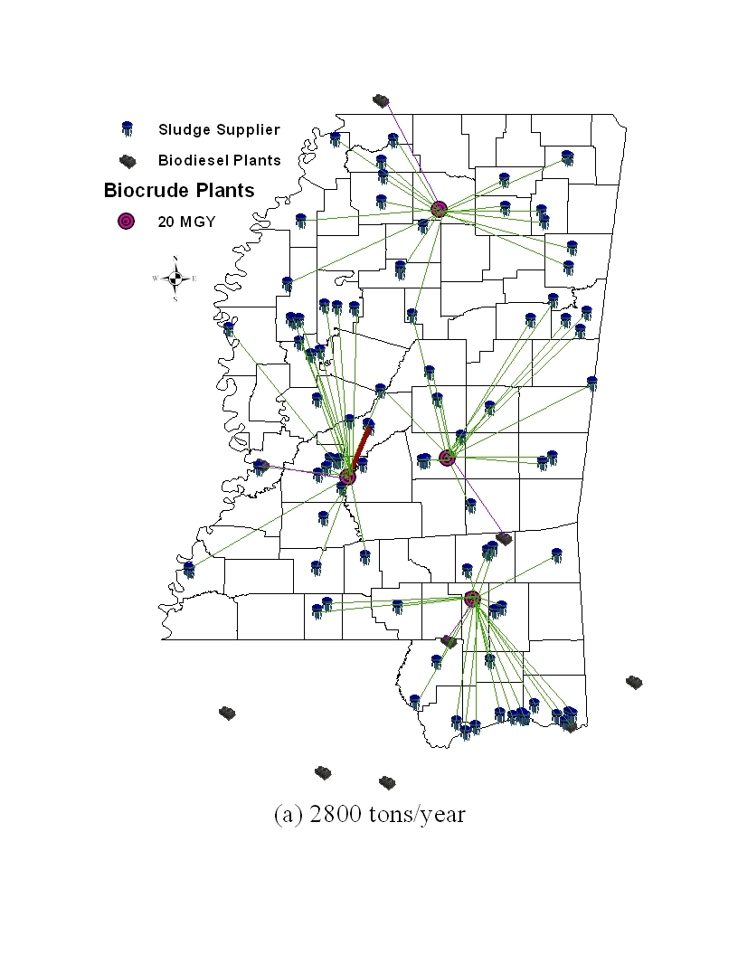
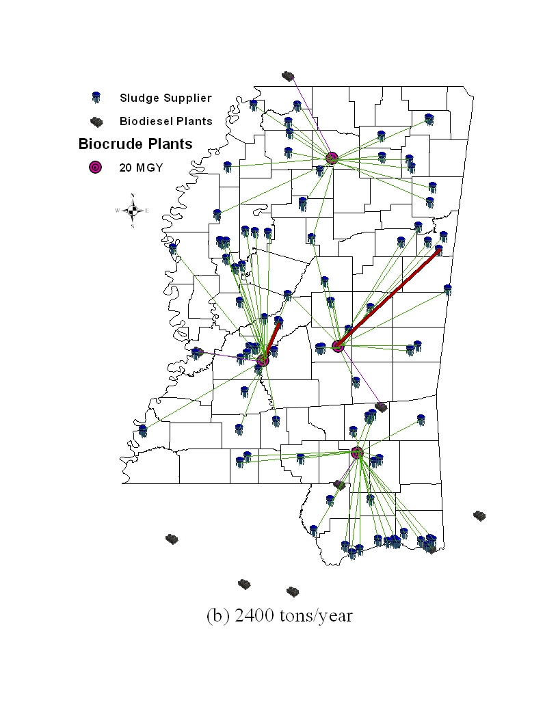
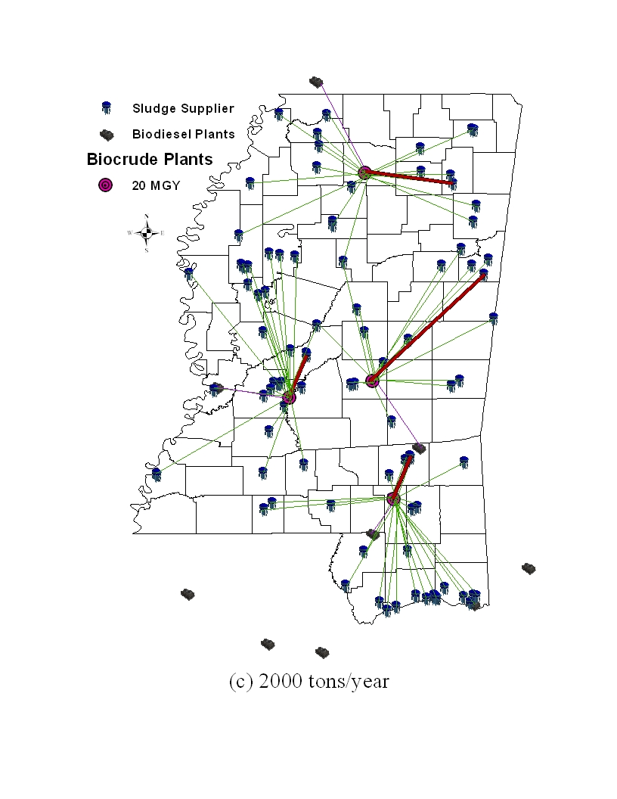
Supply Chain Decisions: Min CO2 Emissions
Weyerhaeuser Co.
Pulp & Paper Complex, Lowndes County
Oxford POTW, Lafayette County
Peco Foods, Madison County
Forest POTW, Scott County
Jackson POTW, Hinds County
Hattiesburg South Lagoon, Jones County
(a) Carbon Cap 2800 tons/year
(b) Carbon Cap 2400 tons/year
(c) Carbon Cap 2000 tons/year

Slide 35
Summary & Conclusions
Transportation activities in the supply chain will add on average $0.16/gal to the cost of sludge-based biodiesel.
Investments in improving biocrude technology will have a great impact on biodiesel production level and costs.
Carbon regulatory policies will have an impact on supply chain operations.
  Shifting transportation modes from truck to pipeline.
Stochastic programing model provides better solutions to our problem.

Slide 36


Research Team
  Department of Industrial Engineering, Clemson University
  Sandra D. Eksioglu, PhD
  E-mail: seksiog@clemson.edu
  Mohammad Marufuzzaman
  E-mail: maruf237@gmail.com
  Department of Chemical Eng. Mississippi State Univ.
  Rafael Hernandez, PhD
  Todd French, PhD
  Andro Mondala, PhD
  Department of Civil & Env. Eng. Mississippi State Univ.
  Dennis D. Traux, PhD

Slide 37
Thank you!
Questions ?
Sandra D. Eksioglu
E-mail: seksiog@clemson.edu

