Slide 1
Optimization Models in Support of Biomass Co-Firing Decisions in Coal Fired Power Plants
Dr. Sandra D. Eksioglu
Industrial Engineering Department
Clemson University
International Congress and Expo on
BIOFUELS & BIOENERGY
August 25-27, 2015

Slide 2
Biomass Co-firing
Co-firing biomass is an attractive renewable energy option:
  Increases renewable energy without major capital investments and investments in the infrastructure
  Low risk option
  Reduces emissions of CO₂, SO₂ and NO₂ emissions
    5% (15%) co-firing would reduce CO₂ emissions by 5.4% (18.2%)
  Minimizes waste - such as, wood waste, agricultural waste - and the environmental problem associated with waste disposal
  It is a near term market solution for biomass

Slide 3
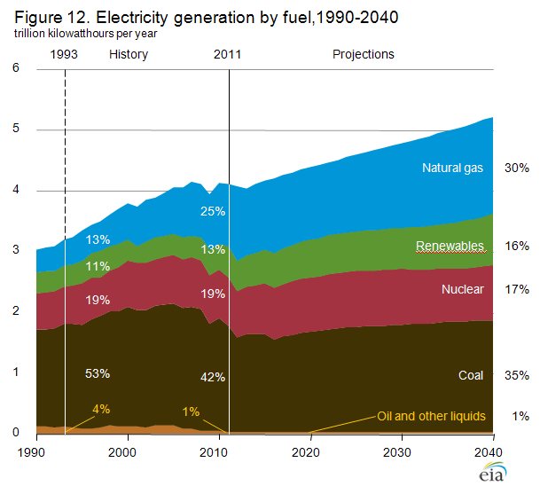

Motivation
Renewable electricity generation is expected to increase due to the following reasons (EIA):
  Increasing demand for electricity
  Programs encouraging renewable energy use (e.g. PTC, RPS etc.)
    PTC: An income tax credit of 1.1 cents/kilowatt-hour
  The implementation of new environmental rules dampens future coal use (e.g. Cross-State Air Pollution Rule of EPA)

Slide 4
Literature review
Currently, 40 of 560 coal-fired power plants in USA co-fire biomass.
Two major barriers for adopting co-firing are:
  Additional plant investment costs
  High cost of biomass transportation and inventory holding
The literature is mainly focused on analyzing its technological and economical feasibility.
There are no studies which integrate logistics and investment decisions in coal-fired power plants.

Slide 5
Research Objectives
Develop optimization models and solution algorithms to support decisions related to biomass co-firing at power plants.
The model captures the:
  Additional costs and savings
  Loss of process efficiencies due to co-firing
Evaluate the impact of Production Tax Credit (PTC) on renewable electricity production.

Slide 6
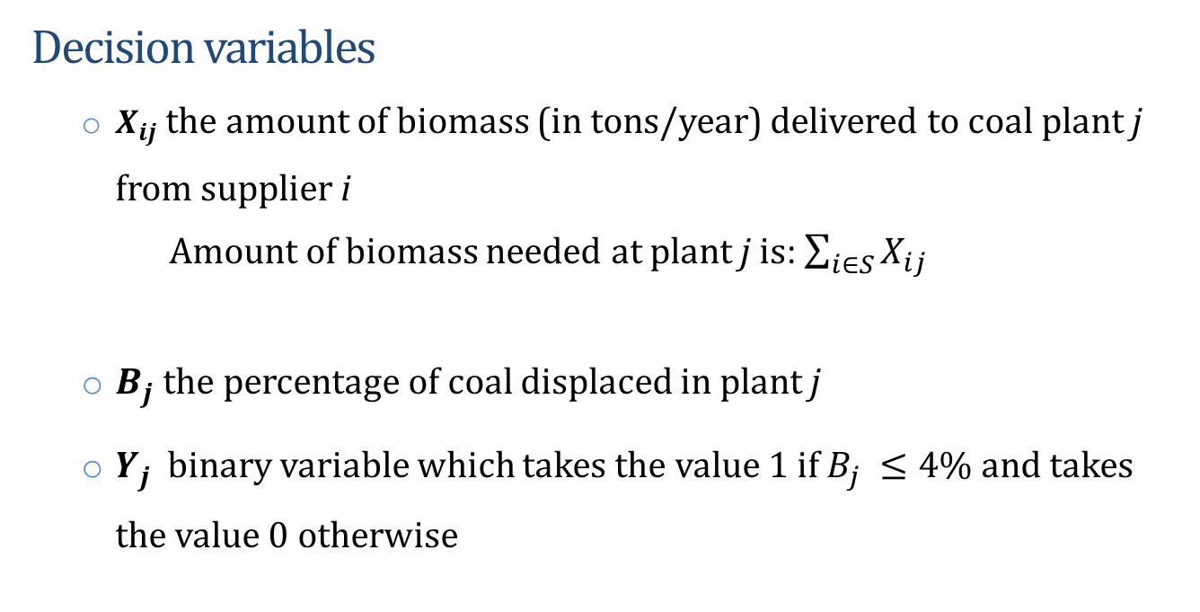
A Non-Linear Optimization Model
  Decision variables
    $X_{ij}$ the amount of biomass (in tons/year) delivered to coal plant j from supplier i
      Amount of biomass needed at plant j is: $\sum_{i∈S}{X_{ij}}$
    $B_{j}$ the percentage of coal displaced in plant j
    $Y_{j}$ binary variable which takes the value 1 if $B_{j} ≤4\%$ and takes the value 0 otherwise

Slide 7
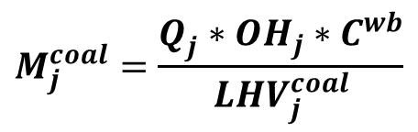
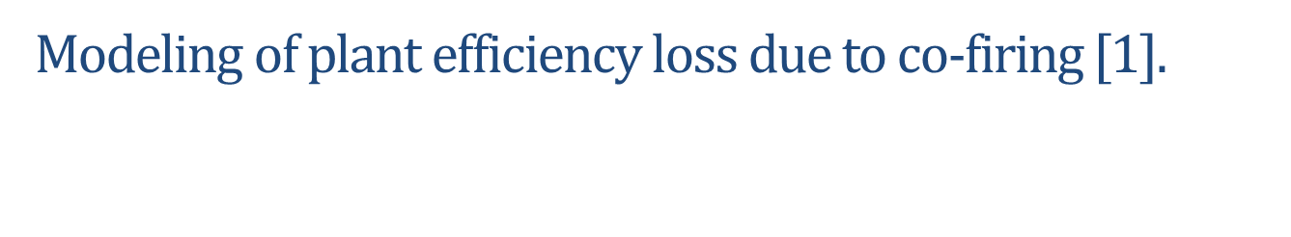
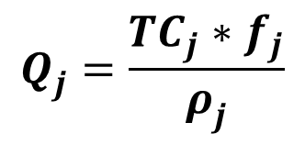
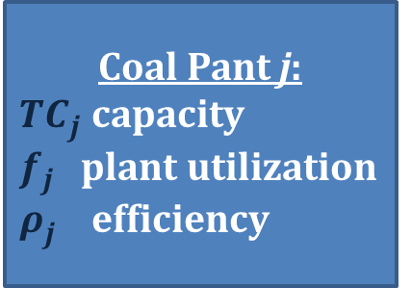
Model Formulation
  Modeling of plant efficiency loss due to co-firing [1].
Coal Pant j:
${TC}_{j}$ capacity
$f_{j}$ plant utilization
$ρ_{j}^{}$ efficiency
Heat input
Electricity output
$$Q_{j}^{}=\frac{{TC}_{j}∗f_{j}}{ρ_{j}^{}}$$
$$M_{j}^{coal}=\frac{Q_{j}^{}∗{OH}_{j}∗C^{wb}}{{LHV}_{j}^{coal}}$$
Notes:
$Q_{j}^{0}$ (in MW) be the initial (before co-firing) annual heat input rate of a coal plant j. The heat input is a function of plant's nameplate capacity (${TC}_{j}$ in MW), capacity factor f_{j} (or utilization rate), and initial plant efficiency rate ($ρ_{j}^{0}$). The annual heat input is equal:
A coal plant would typically use coal in order to generate electricity. The mass of coal used for this purpose is a function of the lower heating value of coal (${LHV}_{j}^{coal}$ in BTU/ton) and the total number of operating hours (OH_{j} in hours/year). The amount of coal used ($M_{j}^{coal}$ in tons) is equal to:
$M_{j}^{coal}=\frac{Q_{j}^{0}∗{OH}_{j}∗C^{wb}}{{LHV}_{j}^{coal}}$. (1)
Where, C^{wb} is the conversion factor from 1 MW to BTU/hr.

Slide 8
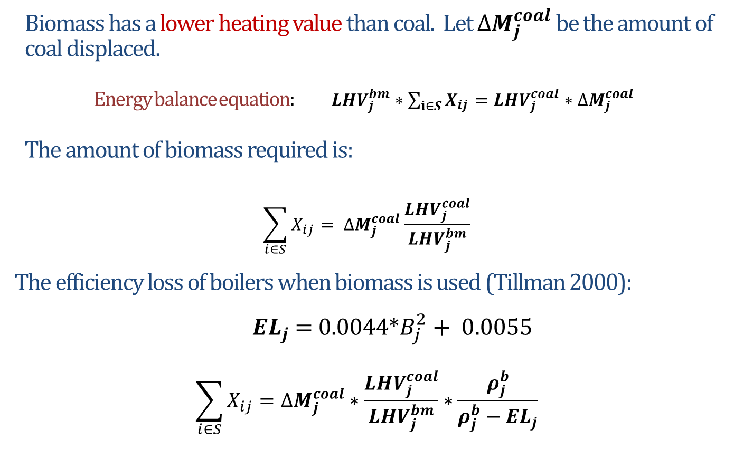
Model Formulation cont.
  Biomass has a lower heating value than coal. Let $∆M_{j}^{coal}$ be the amount of coal displaced.
  Energy balance equation: ${LHV}_{j}^{bm}∗\sum_{i∈S}{X_{ij}}={LHV}_{j}^{coal}∗∆M_{j}^{coal}$
  The amount of biomass required is:
  $$\sum_{i∈S}{X_{ij}}= ∆M_{j}^{coal}\frac{{LHV}_{j}^{coal}}{{LHV}_{j}^{bm}}$$
  The efficiency loss of boilers when biomass is used (Tillman 2000):
  ${EL}_{j}$ = 0.0044*$B_{j}^{2}+ 0.0055$
  $$\sum_{i∈S}{X_{ij}}=∆M_{j}^{coal}∗\frac{{LHV}_{j}^{coal}}{{LHV}_{j}^{bm}}∗\frac{ρ_{j}^{b}}{ρ_{j}^{b}−{EL}_{j}}$$
Notes:
$Q_{j}^{0}$ (in MW) be the initial (before co-firing) annual heat input rate of a coal plant j. The heat input is a function of plant's nameplate capacity (${TC}_{j}$ in MW), capacity factor f_{j} (or utilization rate), and initial plant efficiency rate ($ρ_{j}^{0}$). The annual heat input is equal:
A coal plant would typically use coal in order to generate electricity. The mass of coal used for this purpose is a function of the lower heating value of coal (${LHV}_{j}^{coal}$ in BTU/ton) and the total number of operating hours (OH_{j} in hours/year). The amount of coal used ($M_{j}^{coal}$ in tons) is equal to:
$M_{j}^{coal}=\frac{Q_{j}^{0}∗{OH}_{j}∗C^{wb}}{{LHV}_{j}^{coal}}$. (1)
Where, C^{wb} is the conversion factor from 1 MW to BTU/hr.

Slide 9
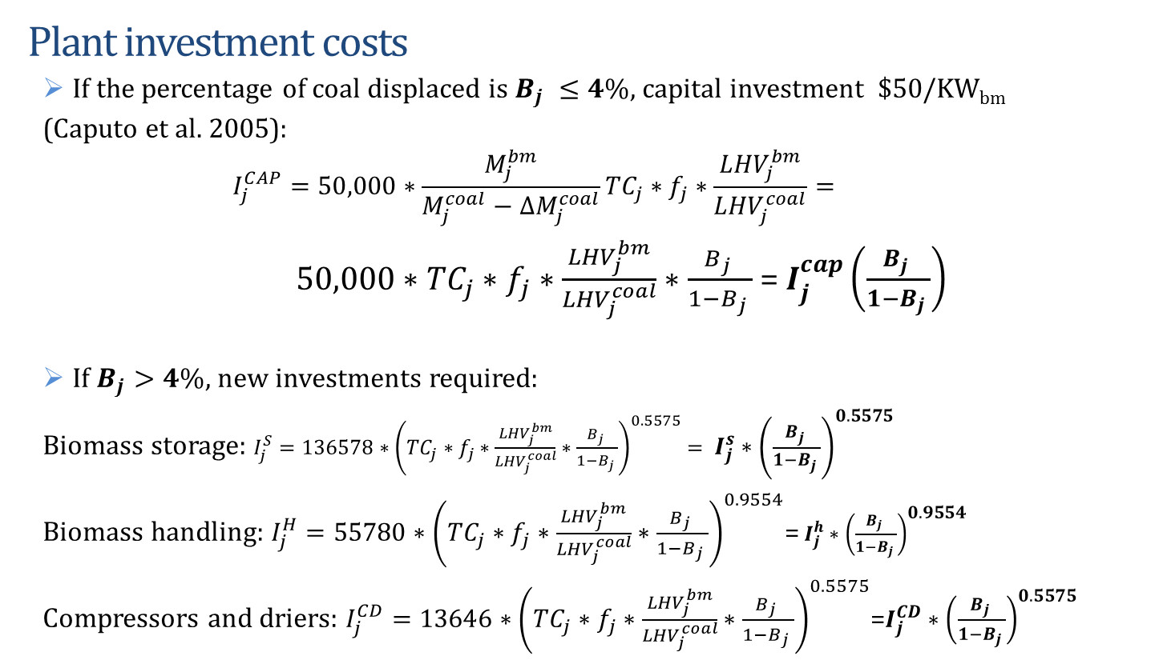
Problem Description
  Plant investment costs
    If the percentage of coal displaced is $B_{j} ≤4\%$, capital investment $50/KW_{bm}
    (Caputo et al. 2005):
    $$I_{j}^{CAP}=50,000∗\frac{M_{j}^{bm}}{M_{j}^{coal}−∆M_{j}^{coal}}{TC}_{j}∗f_{j}∗\frac{{LHV}_{j}^{bm}}{{LHV}_{j}^{coal}}=$$
    $50,000∗{TC}_{j}∗f_{j}∗\frac{{LHV}_{j}^{bm}}{{LHV}_{j}^{coal}}∗\frac{B_{j} }{1−B_{j} }$ = $I_{j}^{cap}\left(\frac{B_{j} }{1−B_{j} }\right)$
    If $B_{j}>4\%,$new investments required:
    Biomass storage: $I_{j}^{S}=136578∗{\left({TC}_{j}∗f_{j}∗\frac{{LHV}_{j}^{bm}}{{LHV}_{j}^{coal}}∗\frac{B_{j} }{1−B_{j} }\right)}^{0.5575}= I_{j}^{s}∗{\left(\frac{B_{j} }{1−B_{j} }\right)}^{0.5575}$
    Biomass handling: $I_{j}^{H}=55780∗{\left({TC}_{j}∗f_{j}∗\frac{{LHV}_{j}^{bm}}{{LHV}_{j}^{coal}}∗\frac{B_{j} }{1−B_{j} }\right)}^{0.9554}$=$I_{j}^{h}∗{\left(\frac{B_{j} }{1−B_{j} }\right)}^{0.9554}$
    Compressors and driers: $I_{j}^{CD}=13646∗{\left({TC}_{j}∗f_{j}∗\frac{{LHV}_{j}^{bm}}{{LHV}_{j}^{coal}}∗\frac{B_{j} }{1−B_{j} }\right)}^{0.5575}$=$I_{j}^{CD}∗{\left(\frac{B_{j} }{1−B_{j} }\right)}^{0.5575}$
Notes:
${TC}_{j}∗f_{j}= Q_{j}^{0}$* $ρ_{j}^{0}$
$$\frac{Q_{j}^{0}∗{OH}_{j}∗C^{wb}}{{LHV}_{j}^{coal}}$$

Slide 10
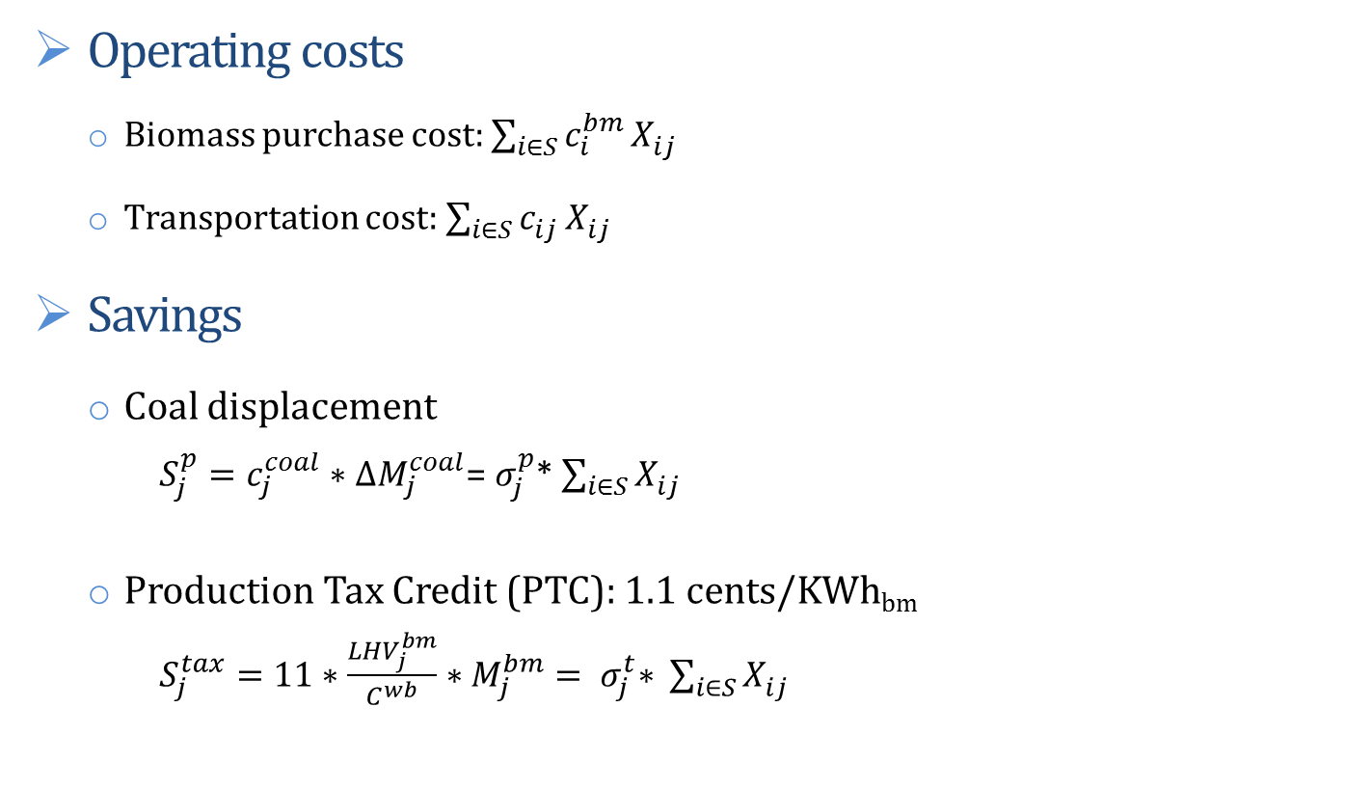
Problem Description
  Operating costs
    Biomass purchase cost: $\sum_{i∈S}{c_{i}^{bm}}X_{ij}^{ }$
    Transportation cost: $\sum_{i∈S}{c_{ij}^{}}X_{ij}^{}$
  Savings
    Coal displacement
    $S_{j}^{p}=c_{j}^{coal}∗∆M_{j}^{coal}$=${ σ}_{j}^{p}$* $\sum_{i∈S}{X_{ij}^{ }}$
    Production Tax Credit (PTC): 1.1 cents/KWh_{bm}
    $S_{j}^{tax}=11∗\frac{{LHV}_{j}^{bm}}{C^{wb}}∗M_{j}^{bm}={ σ}_{j}^{t}\text{∗ }\sum_{i∈S}{X_{ij}^{ }}$
Biomass market price $/ton
Unit transporting cost from supplier i to plant j
Coal market price $/ton

Slide 11
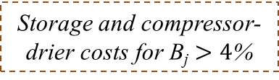
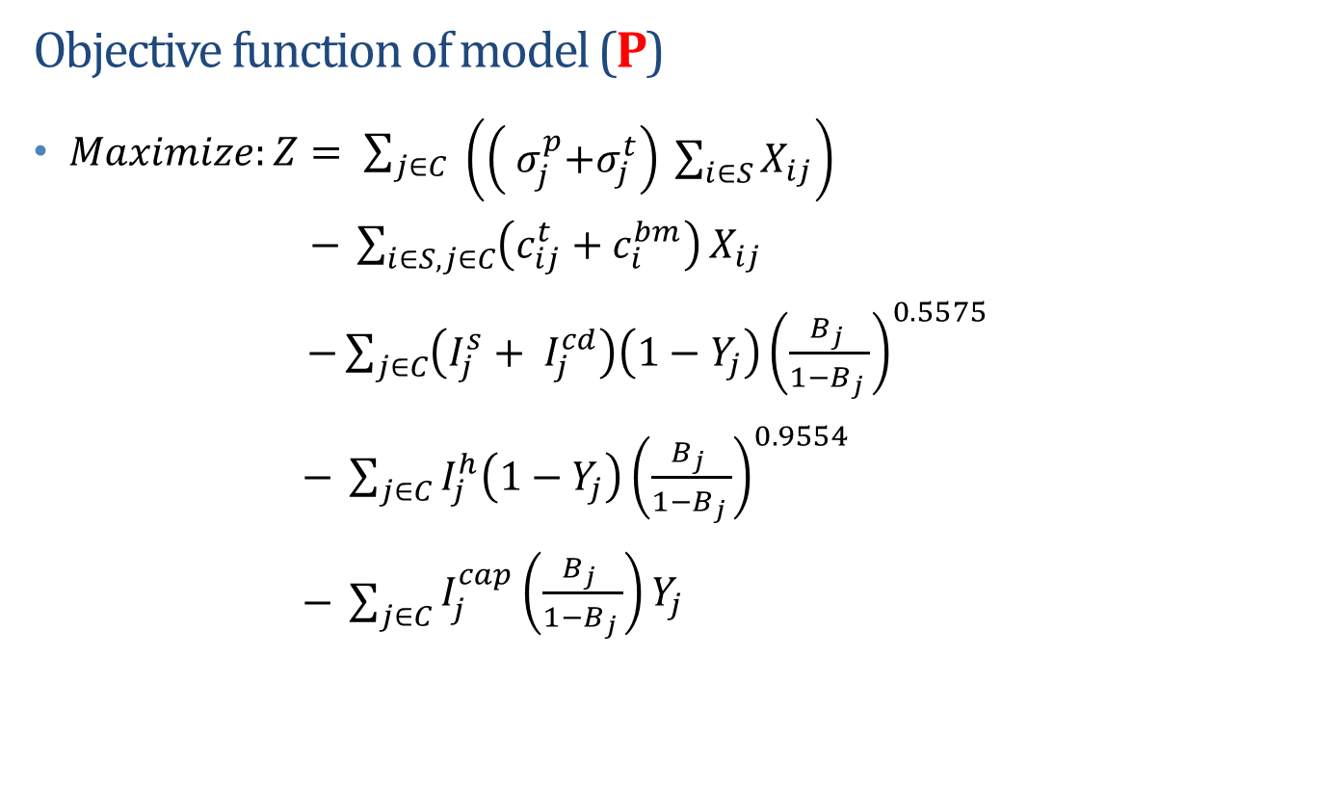
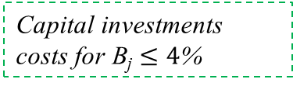
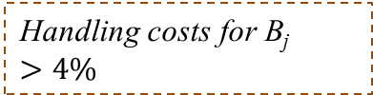
A Non-Linear Optimization Model
Objective function of model (P)
$Maximize:Z= \sum_{j∈C}{\begin{aligned} \\ \left(\left({ σ}_{j}^{p}+σ_{j}^{t}\right) \sum_{i∈S}{X_{ij}}\right)\end{aligned}}$
$− \sum_{i∈S,j∈C}{\left(c_{ij}^{t}+c_{i}^{bm}\right)}X_{ij}$
$−\sum_{j∈C}{\left(I_{j}^{s}+ I_{j}^{cd}\right)\left(1−Y_{j}\right){\left(\frac{B_{j} }{1−B_{j} }\right)}^{0.5575}}$
$− \sum_{j∈C}{I_{j}^{h}\left(1−Y_{j}\right){\left(\frac{B_{j} }{1−B_{j} }\right)}^{0.9554}}$
$− \sum_{j∈C}{\begin{aligned}I_{j}^{cap}\left(\frac{B_{j} }{1−B_{j} }\right)Y_{j} \\ \end{aligned}}$
Savings due to coal displacement and PTC
Biomass procurement and transportation costs
Storage and compressor- drier costs for B_{j} $>4$%
Handling costs for B_{j} $>4\%$
Capital investments costs for B_{j} $≤4$%

Slide 12
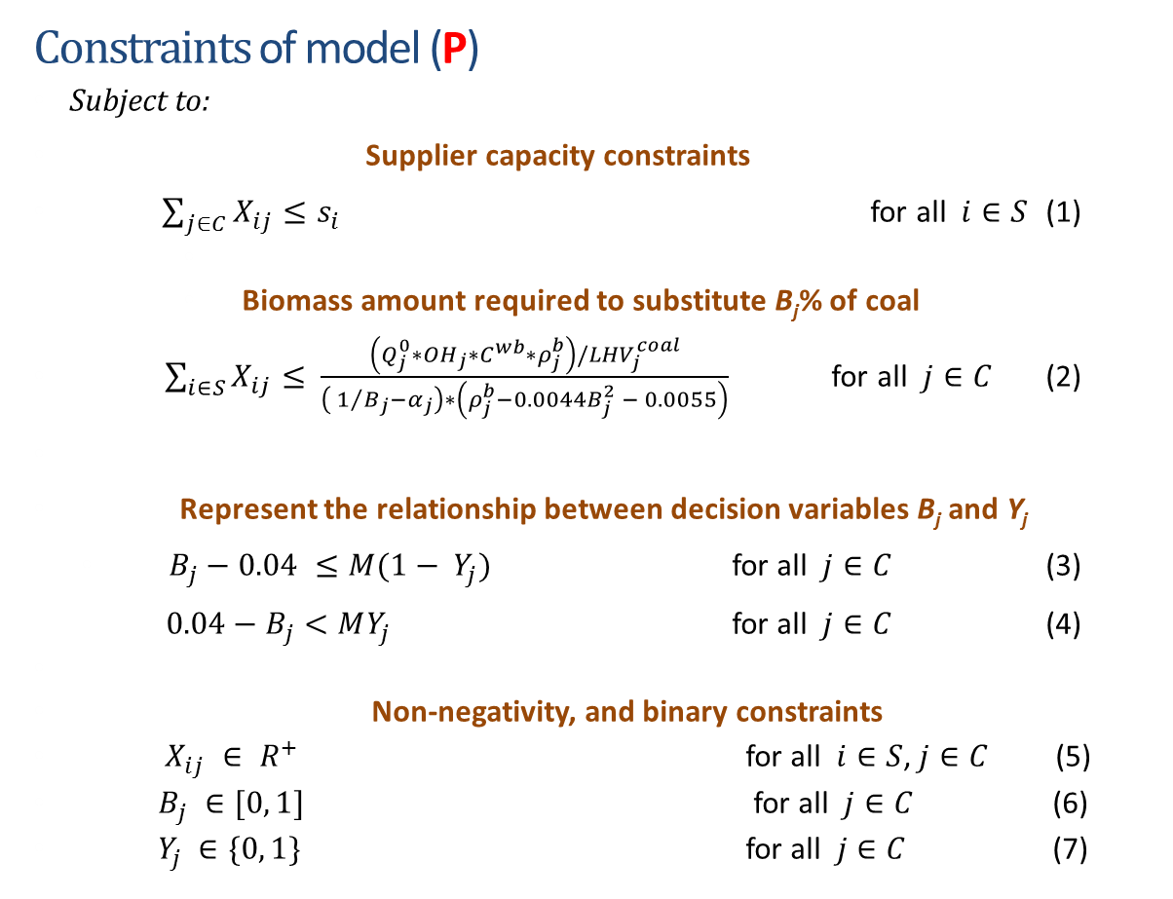
A Non-Linear Optimization Model
Constraints of model (P)
Subject to:
Supplier capacity constraints
$\sum_{j∈C}{X_{ij}}≤s_{i}$ for all $i∈S$ (1)
      Biomass amount required to substitute B_{j}% of coal
$\sum_{i∈S}{X_{ij}}≤$ $\frac{\left({Q_{j}^{0}∗OH}_{j}∗C^{wb}{∗ρ}_{j}^{b}\right)/{LHV}_{j}^{coal}}{\left( 1/{B_{j}}−α_{j}\right)∗\left(ρ_{j}^{b}−0.0044B_{j}^{2} − 0.0055\right)}$ for all $j∈C$ (2)
Represent the relationship between decision variables B_{j} and Y_{j}
  $B_{j}−0.04 ≤M(1− Y_{j})$ for all $j∈C$ (3)
$0.04−B_{j}<MY_{j}$ for all $j∈C$ (4)
Non-negativity, and binary constraints
$X_{ij} ∈ R^{+}$ for all $i∈S$, $j∈C$ (5)
$B_{j} ∈[0, 1]$ for all $j∈C$ (6)
$Y_{j} ∈\{0, 1\}$ for all $j∈C$ (7)

Slide 13
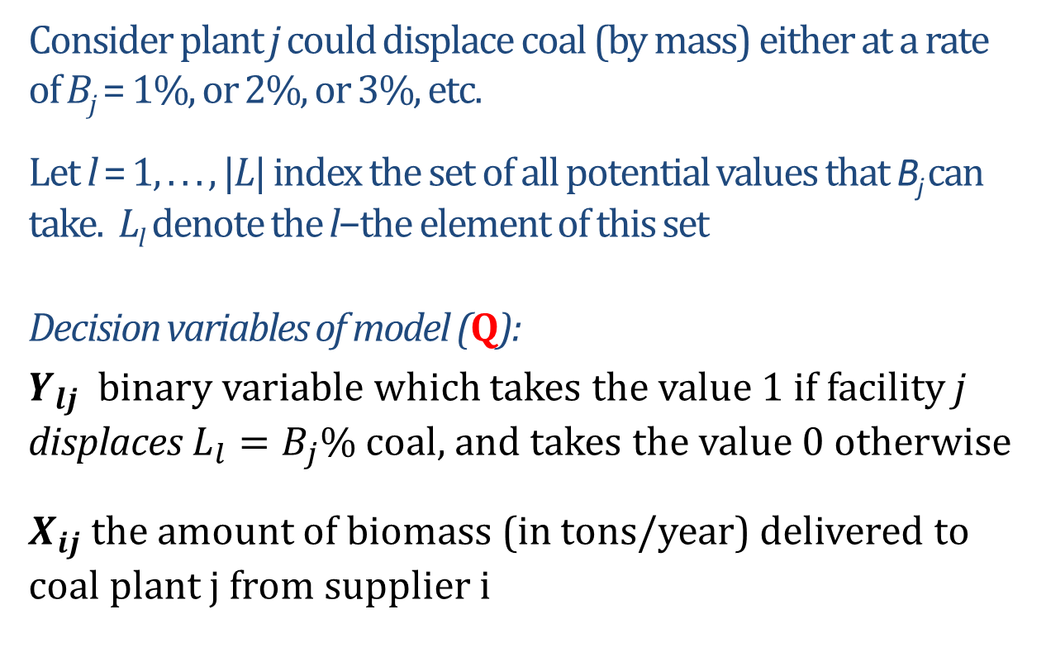
A Linear MIP Model – (Q)
Consider plant j could displace coal (by mass) either at a rate of B_{j} = 1%, or 2%, or 3%, etc.
Let l = 1, . . . , |L| index the set of all potential values that B_{j} can take. L_{l} denote the l−the element of this set
Decision variables of model (Q):
$Y_{lj}$ binary variable which takes the value 1 if facility j displaces $L_{l}=B_{j}\%$ coal, and takes the value 0 otherwise
    $X_{ij}$ the amount of biomass (in tons/year) delivered to coal plant j from supplier i

Slide 14
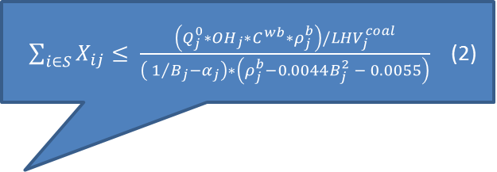
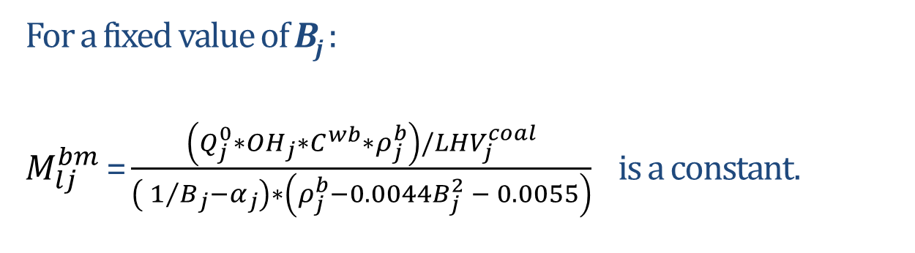
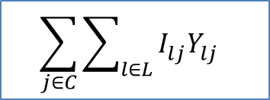
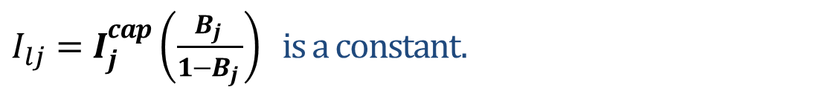
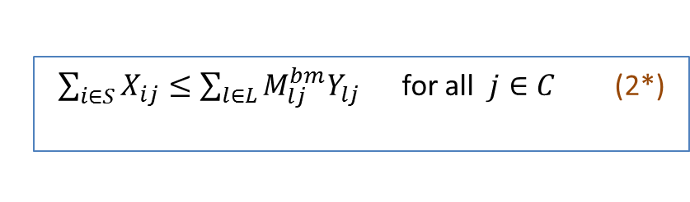
A Linear MIP Model– (Q)
$\sum_{i∈S}{X_{ij}}≤$ $\frac{\left({Q_{j}^{0}∗OH}_{j}∗C^{wb}{∗ρ}_{j}^{b}\right)/{LHV}_{j}^{coal}}{\left( 1/{B_{j}}−α_{j}\right)∗\left(ρ_{j}^{b}−0.0044B_{j}^{2} − 0.0055\right)}$ (2)
For a fixed value of B_{j} :
$M_{lj}^{bm}$ = $\frac{\left({Q_{j}^{0}∗OH}_{j}∗C^{wb}{∗ρ}_{j}^{b}\right)/{LHV}_{j}^{coal}}{\left( 1/{B_{j}}−α_{j}\right)∗\left(ρ_{j}^{b}−0.0044B_{j}^{2} − 0.0055\right)}$ is a constant.
$\sum_{i∈S}{X_{ij}}≤\sum_{l∈L}{M_{lj}^{bm}Y_{lj}}$for all $j∈C$ (2*)
    $I_{lj}^{}=I_{j}^{cap}\left(\frac{B_{j} }{1−B_{j} }\right)$ is a constant.
$$\sum_{j∈C}{\sum_{l∈L}{I_{lj}^{}Y_{lj}^{}} }$$

Slide 15
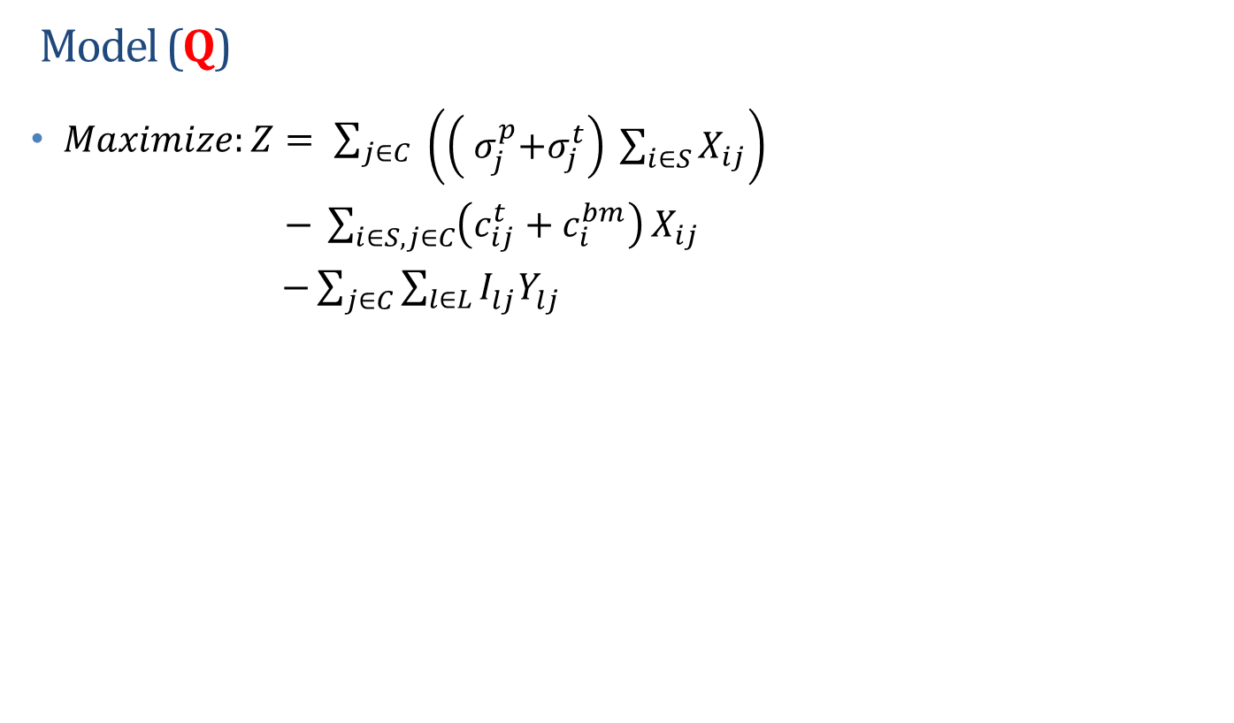
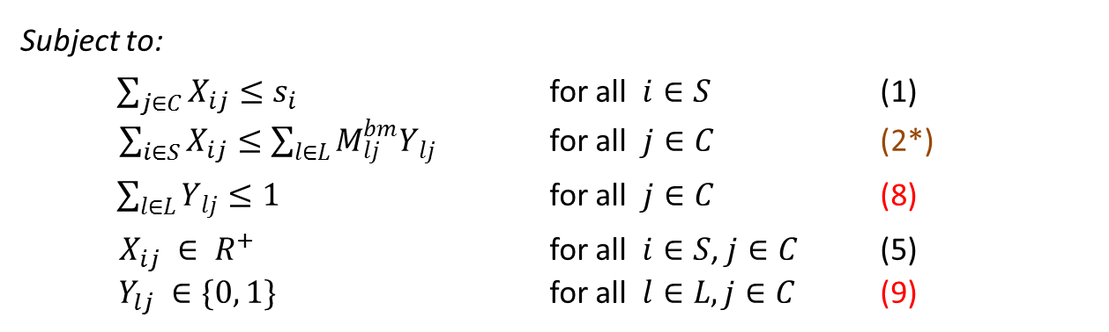
A Linear MIP Model – (Q)
Model (Q)
$Maximize:Z= \sum_{j∈C}{\begin{aligned} \\ \left(\left({ σ}_{j}^{p}+σ_{j}^{t}\right) \sum_{i∈S}{X_{ij}}\right)\end{aligned}}$
$− \sum_{i∈S,j∈C}{\left(c_{ij}^{t}+c_{i}^{bm}\right)}X_{ij}$
$−\sum_{j∈C}{\sum_{l∈L}{I_{lj}^{}Y_{lj}^{}} }$
Savings due to coal displacement and PTC
Biomass procurement and transportation costs
Investment costs
Subject to:
$\sum_{j∈C}{X_{ij}}≤s_{i}$ for all $i∈S$ (1)
$\sum_{i∈S}{X_{ij}}≤\sum_{l∈L}{M_{lj}^{bm}Y_{lj}}$ for all $j∈C$ (2*)
$\sum_{l∈L}{Y_{lj}}≤1$ for all $j∈C$ (8)
$X_{ij} ∈ R^{+}$ for all $i∈S$, $j∈C$ (5)
$Y_{lj} ∈\{0, 1\}$ for all $l∈L,j∈C$ (9)

Slide 16
Properties of Model (Q)
Proposition:
A solution to problem (Q) is feasible for the non-linear problem (P); and the objective function value of (Q) is a lower bound for problem (P).
Note: A feasible solution of (P) is non necessary feasible for (Q).
Theorem:
As |L| goes to infinity, an optimal solution to problem (Q) is optimal to (P) with probability 1.

Slide 17
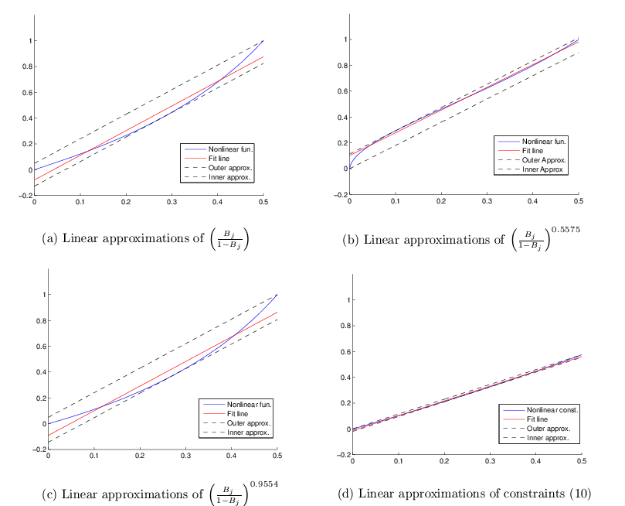
A Linear MIP Model – (LA)

Slide 18
Linear Approximations of (P)
A summary of linear approximation problems developed:
Problem (LA^{u}) - Obj. function - Inner approximation Constraints - Inner approximation
Problem (LAº) - Obj. function - Outer approximation Constraints - Inner approximation
Problem (LA^{f}) - Obj. function - Fit approximation Constraints - Inner approximation
Corollary: Solutions to problems (LA^{u}), (LAº), and (LA^{f}) are feasible for problem (P).

Slide 19
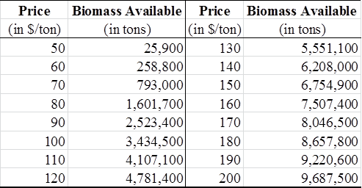
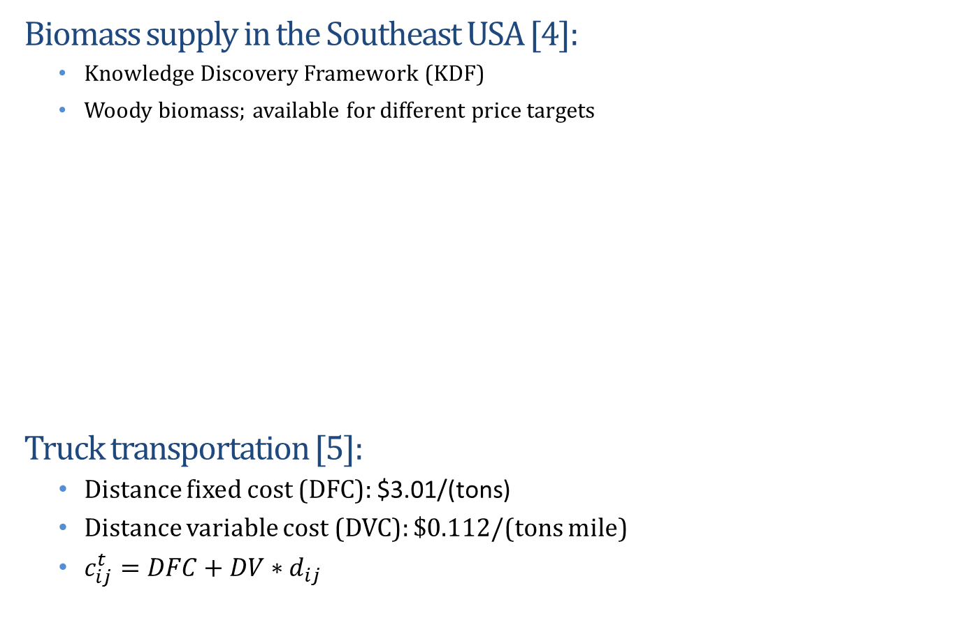
A Case Study
Biomass supply in the Southeast USA [4]:
  Knowledge Discovery Framework (KDF)
  Woody biomass; available for different price targets
Truck transportation [5]:
  Distance fixed cost (DFC): $3.01/(tons)
  Distance variable cost (DVC): $0.112/(tons mile)
  $c_{ij}^{t}=DFC+DV∗d_{ij}$

Slide 20
A Case Study
Coal plants data [6]:
  National Energy Technology Laboratory
  Power plants of capacity greater than 1MW
Plant Name | Primary Fuel | Fuel Type | Nameplate Capacity (MW) | Capacity Factor
Red Hills | COAL | Lignite coal | 514 | 0.7213
Henderson | COAL | Bituminous coal | 59 | 0.1078
R D Morrow | COAL | Bituminous coal | 400 | 0.7281
Victor J Daniel Jr | COAL | Bituminous coal | 2,229 | 0.4986
Jack Watson | COAL | Bituminous coal | 1,216 | 0.3544
State | BM Available (in tons) | Nr. Of Coal Plants
AL | 5,004,000 | 11
AR | 4,505,800 | 4
FL | 2,878,500 | 15
GA | 6,892,500 | 14
LA | 5,044,100 | 4
MS | 5,772,200 | 5
NC | 5,755,400 | 25
SC | 3,666,300 | 16
TN | 2,872,500 | 10
Product | LHV (BTU/Ton)
Woody biomass | 16,811,000
Bituminous coal | 22,460,600
Lignite coal | 19,536,300

Slide 21
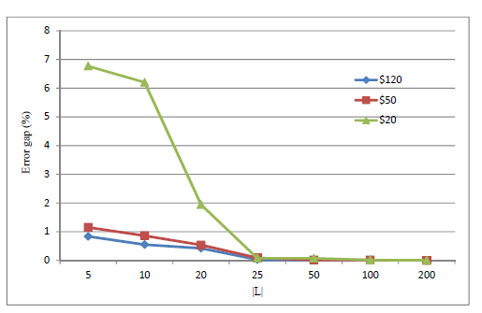
Numerical Results: Model (Q)
Solved using GAMS and BONMIN, GUROBI on a personal computer with data from Alabama.
  Average Running Times
  Increasing the size of |L| impacts the quality of the solutions found from formulation (Q).
 | Solution time (CPU sec)
|L| | (P) | (Q)
 | 297
5 |  | 4.2
10 |  | 3.9
20 |  | 4.7
25 |  | 4.3
50 |  | 4.8
100 |  | 5.2
200 |  | 7.2
Relationship between the size of set |L| and the quality of solutions of LP formulation.

Slide 22
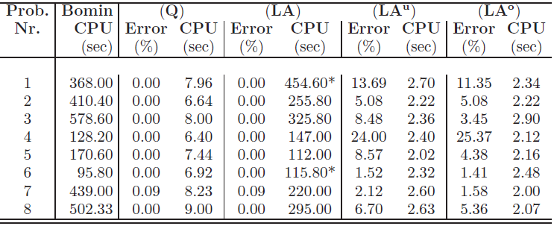
Numerical Results: Small sized problems
Problem parameters
Problem | Parameter
1 | Low biomass supply
2 | High biomass supply
3 | Low biomass cost
4 | High biomass cost
Problem | Parameter
5 | Low coal price
6 | High coal price
7 | Low transp. cost
8 | High transp. cost
Summary of results
*The quality of these solutions is better than solutions from Bomin.

Slide 23
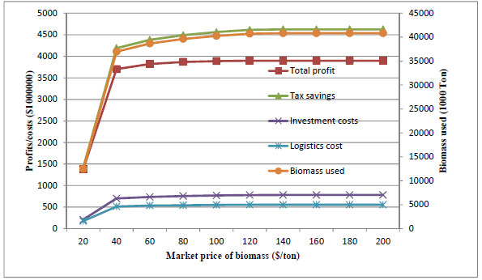
Numerical Results
  Increasing the target price of biomass for a fixed PTC of 1.1cents /kwh :
    Market price ≤ $65/ton:
      Profits increase since savings from PTC are greater than the additional costs from investment and transportation
      Renewable electricity production increases.
    Market price > $65/ton:
      Renewable electricity production remains constant.
Relationship between biomass price, investment costs, logistics costs, profits, biomass use.

Slide 24
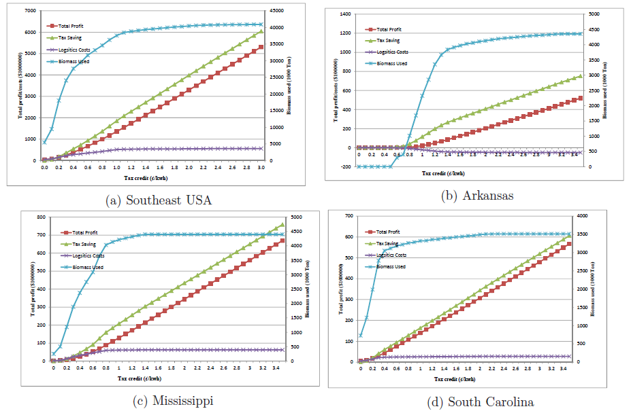
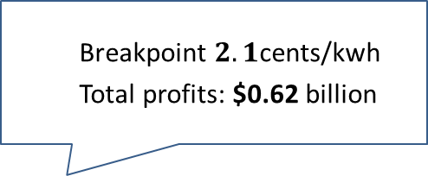

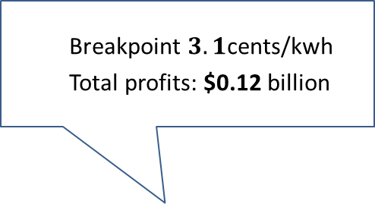

Numerical Results: Profits vs Tax Credit
    Breakpoint $3.1$cents/kwh
    Total profits: $0.12 billion
    Breakpoint $2.2$ cents/kwh
    Total profits: $6.25 billion
    Breakpoint $2.1$cents/kwh
    Total profits: $0.62 billion
    Breakpoint $1.2$cents/kwh
    Total profits: $0.7 billion
The impact of tax credits on profits and biomass usage for biomass target price of $100/ton

Slide 25
Summary of Findings
  Tax credits necessary to increase the production of the renewable energy.
    A PTC equal to 0 does not encourage renewable electricity production.
    A PTC greater than 2cents/kwh has only marginal impacts in increasing renewable energy.
  Tax credit should not be “one size fits all”. PTC could be a function of the amount of renewable electricity produced.
    Instead tax credits could be a function of plant capacity, or percentage of coal displaced, etc.
  There is a need for comprehensive tax credit schemes to encourage renewable electricity production and reduce GHG emissions.
    States that have the resources to transform biomass into renewable energy rip the benefits of PTC. Biomass transportation across state borders impacts GHG emissions.

Slide 26
Current Research
  Investigate the impact of tax schemes on renewable electricity production:
    Tax rate as a function of percentage of coal displaced
    Tax rate as a function of plant capacity
    Tax rate as a function of biomass available in the region
Tax rate
nα
….
2α
1.1 (cents/kwh)
α
B 2 B 3 B
X
Tax Credits ($)
B 2 B 3 B
X
Notes:
As

Slide 27
Current Research
  Consider supply chains that span larger regions. In this case the in-bound supply chain will have a hub-and-spoke structure.
  Develop models which optimize costs and the social impacts of co-firing:
    Use a bi-level optimization model:
      Outer optimization: Decision makers at the federal level that identify a PTC structure
      Inner optimization: Coal plants that decide on the amount of coal to displace.
      The goal is to a PTC which optimizes the social benefits without sacrificing power plants profits.

Slide 28
Questions?
Dr. Sandra D. Eksioglu seksiog@clemson.edu
Clemson University, SC

Slide 29
References
  [1] De, S., M. Assadi. 2009. Impact of cofring biomass with coal in power plants: A techno-economic assessment. Biomass and Bioenergy, Vol. 33, 283-293.
  [2] Sondreal, E.A., S.A. Benson, J.P. Hurley, M.D. Mann, J.H. Pavlish, M.L. Swanson. 2001. Review of advances in combustion technology and biomass cofring. Fuel Process Technology, 71 7-38.
  [3] Caputo, A.C., M. Palumbo, P.M. Pelagagge, F. Scacchia. 2005. Economics of biomass energy utilization in combustion and gasification plants: effects of logistic variables. Biomass and Bioenergy, Vol. 28, 35-51.
  [4] Knowledge discovery framework. US Department of Energy. https://bioenergykdf.net.
  [5] Searcy, E., P. Flynn, E. Ghafoori, A. Kumar. 2007. The relative cost of biomass energy transport. Applied Biochemistry and Biotechnology, Vol.137, 639-652.
  [6] National Energy Technology Laboratory. http://www.netl.doe.gov/energyanalyses/hold/technology.html.

Slide 30
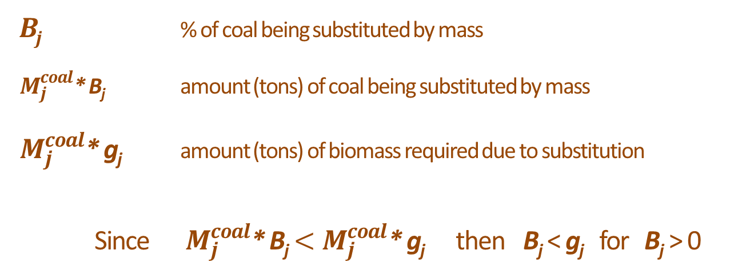
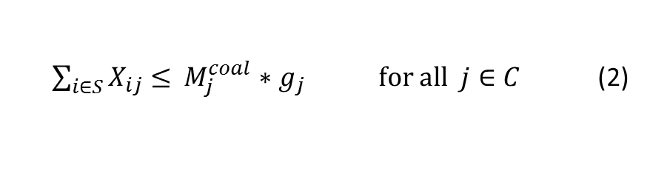
A Linear MIP Model – (LA)
Linearizing constraints (2):
g_{j}
$\sum_{i∈S}{X_{ij}}≤$ $M_{j}^{coal}\frac{ρ_{j}^{b}{∗B}_{j}}{\left( 1−α_{j}∗B_{j}\right)∗\left(ρ_{j}^{b}−0.0044B_{j}^{2} − 0.0055\right)}$ for all $j∈C$ (2)
$\sum_{i∈S}{X_{ij}}≤$ $M_{j}^{coal}{∗g}_{j}$ for all $j∈C$ (2)
B_{j} % of coal being substituted by mass
$M_{j}^{coal}$* B_{j} amount (tons) of coal being substituted by mass
$M_{j}^{coal}$* g_{j} amount (tons) of biomass required due to substitution
Since $M_{j}^{coal}$* B_{j} ${<M}_{j}^{coal}$* g_{j} then B_{j} < g_{j} for B_{j} > 0
Notes:
Gj- represents

Slide 31
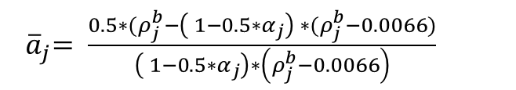

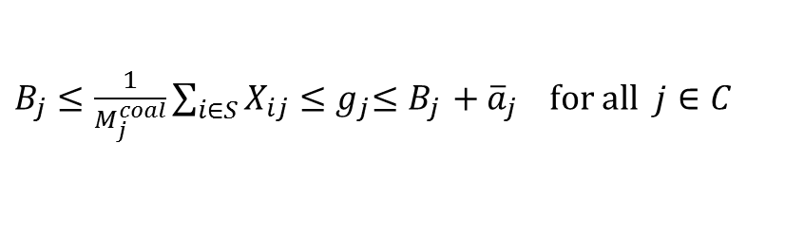
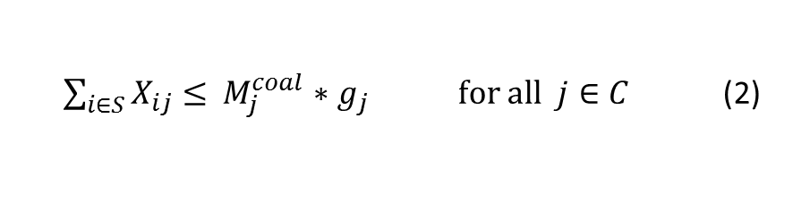
A Linear MIP Model – (LA)
Linearizing constraints (2):
$\sum_{i∈S}{X_{ij}}≤$ $M_{j}^{coal}{∗g}_{j}$ for all $j∈C$ (2)
Proposition:
$B_{j} ≤\frac{1}{M_{j}^{coal}}\sum_{i∈S}{X_{ij}}{≤g}_{j}{≤B}_{j}{+ \overline{a}}_{j}$for all $j∈C$
Relationship btw g_{j} and B_{j}
$${ \overline{a}}_{j}$$
Where,
${ \overline{a}}_{j}= \frac{0.5∗(ρ_{j}^{b}−\left( 1−{0.5∗α}_{j}\right) ∗(ρ_{j}^{b}−0.0066)}{\left( 1−{0.5∗α}_{j}\right)∗\left(ρ_{j}^{b}−0.0066\right)}$
Notes:
Gj- represents

Slide 32
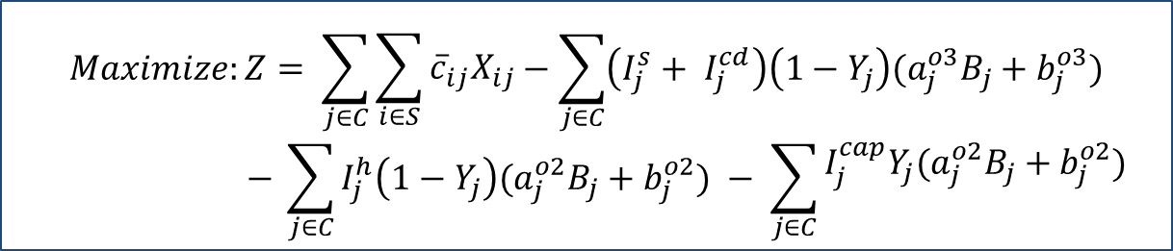
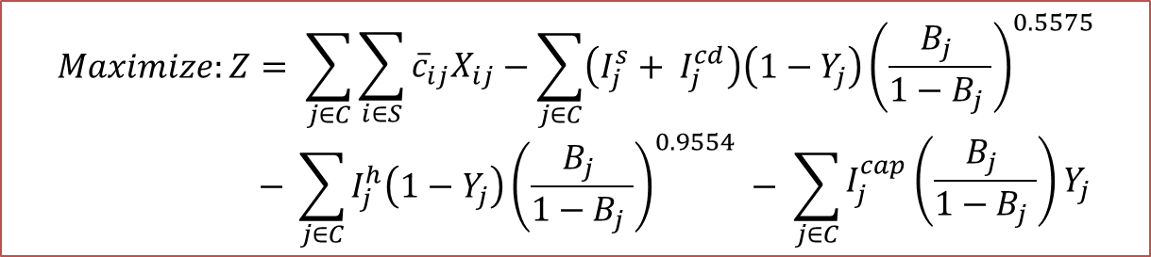
A Linear Approximation of the Objective Function
$$Maximize:Z= \sum_{j∈C}{\begin{aligned} \\ \sum_{i∈S}{{{\overline{c}}_{ij}X}_{ij}}\end{aligned}}−\sum_{j∈C}{\left(I_{j}^{s}+ I_{j}^{cd}\right)\left(1−Y_{j}\right){\left(\frac{B_{j} }{1−B_{j} }\right)}^{0.5575}}$$
$$− \sum_{j∈C}{I_{j}^{h}\left(1−Y_{j}\right){\left(\frac{B_{j} }{1−B_{j} }\right)}^{0.9554}} − \sum_{j∈C}{\begin{aligned}I_{j}^{cap}\left(\frac{B_{j} }{1−B_{j} }\right)Y_{j} \\ \end{aligned}}$$
Outer-approximation:
$$Maximize:Z= \sum_{j∈C}{\begin{aligned} \\ \sum_{i∈S}{{{\overline{c}}_{ij}X}_{ij}}\end{aligned}}−\sum_{j∈C}{\left(I_{j}^{s}+ I_{j}^{cd}\right)\left(1−Y_{j}\right)(a_{j}^{o3}B_{j}+b_{j}^{o3})}$$
$$− \sum_{j∈C}{I_{j}^{h}\left(1−Y_{j}\right)(a_{j}^{o2}B_{j}+b_{j}^{o2})} − \sum_{j∈C}{\begin{aligned}I_{j}^{cap}Y_{j}(a_{j}^{o2}B_{j}+b_{j}^{o2}) \\ \end{aligned}}$$

Slide 33
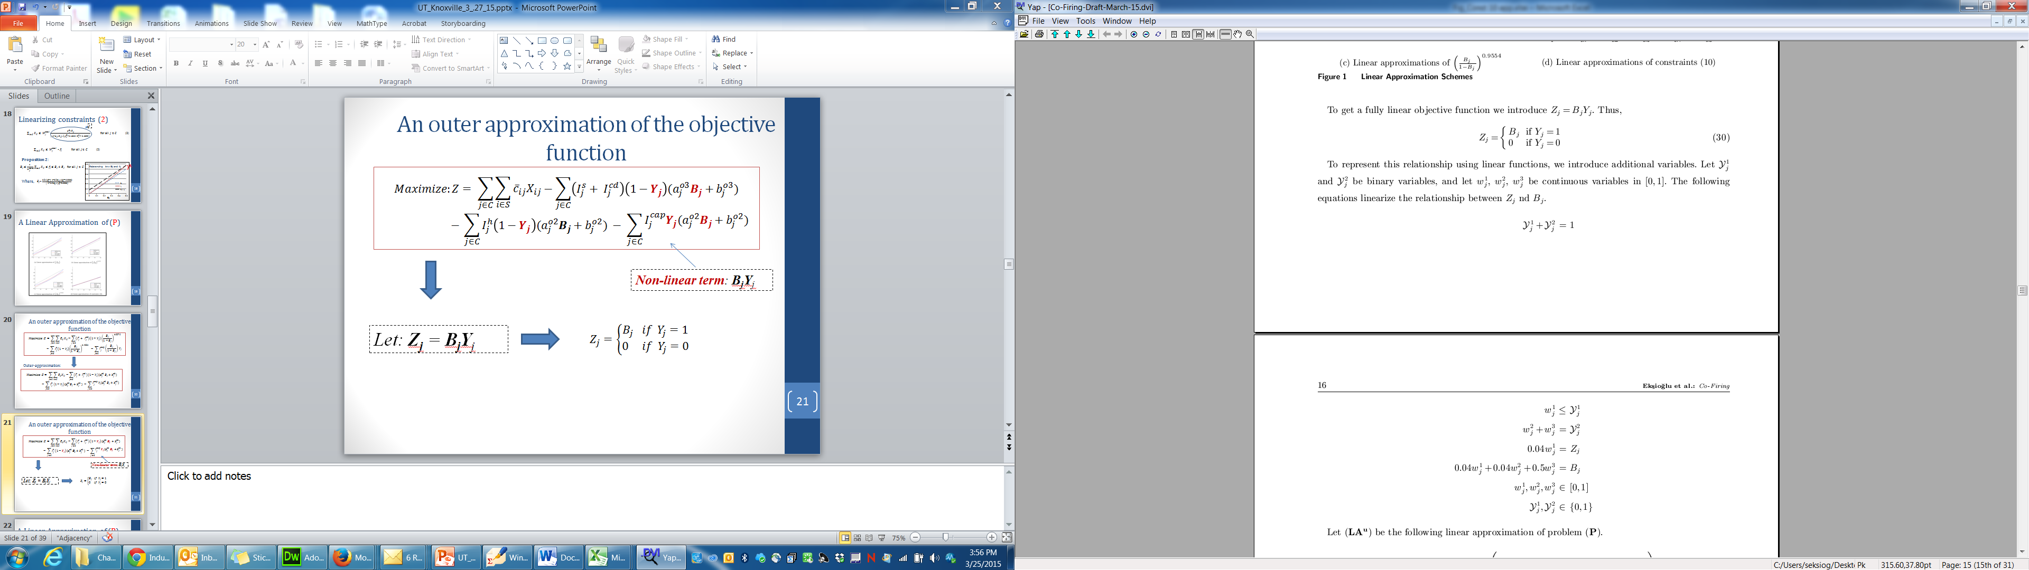
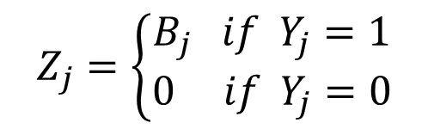
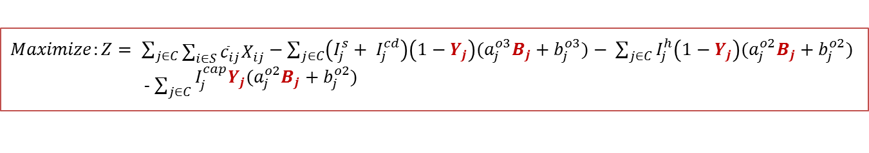
A Linear Approximation of the Objective Function
$Maximize:Z= \sum_{j∈C}{\begin{aligned} \\ \sum_{i∈S}{{{\overline{c}}_{ij}X}_{ij}}\end{aligned}}−\sum_{j∈C}{\left(I_{j}^{s}+ I_{j}^{cd}\right)\left(1−Y_{j}\right)(a_{j}^{o3}B_{j}+b_{j}^{o3})}$ $− \sum_{j∈C}{I_{j}^{h}\left(1−Y_{j}\right)(a_{j}^{o2}B_{j}+b_{j}^{o2})}$
- $\sum_{j∈C}{\begin{aligned}I_{j}^{cap}Y_{j}(a_{j}^{o2}B_{j}+b_{j}^{o2}) \\ \end{aligned}}$
Non-linear term: B_{j}Y_{j}
Let: Z_{j} = B_{j}Y_{j}
$$Z_{j}=\left\{\begin{aligned}B_{j} if{ Y}_{j}=1 \\ 0 if{ Y}_{j}=0\end{aligned}\right.$$

