Slide 1
About OMICS Group
OMICS Group International is an amalgamation of Open Access publications and worldwide international science conferences and events. Established in the year 2007 with the sole aim of making the information on Sciences and technology ‘Open Access’, OMICS Group publishes 400 online open access scholarly journals in all aspects of Science, Engineering, Management and Technology journals. OMICS Group has been instrumental in taking the knowledge on Science & technology to the doorsteps of ordinary men and women. Research Scholars, Students, Libraries, Educational Institutions, Research centers and the industry are main stakeholders that benefitted greatly from this knowledge dissemination. OMICS Group also organizes 300 International conferences annually across the globe, where knowledge transfer takes place through debates, round table discussions, poster presentations, workshops, symposia and exhibitions.

Slide 2
About OMICS Group Conferences
OMICS Group International is a pioneer and leading science event organizer, which publishes around 400 open access journals and conducts over 300 Medical, Clinical, Engineering, Life Sciences, Phrama scientific conferences all over the globe annually with the support of more than 1000 scientific associations and 30,000 editorial board members and 3.5 million followers to its credit.
OMICS Group has organized 500 conferences, workshops and national symposiums across the major cities including San Francisco, Las Vegas, San Antonio, Omaha, Orlando, Raleigh, Santa Clara, Chicago, Philadelphia, Baltimore, United Kingdom, Valencia, Dubai, Beijing, Hyderabad, Bengaluru and Mumbai.

Slide 3
Cleaner practices through optimization of resources and geoinformatics
By
Dr.Sampath kumar M.C
-Faculty, Environmental engineering Division,
B.M.S College of engineering, Bangalore, India.
email:sampathmc61@gmail.com

Slide 4
SCHEME OF PRESENTATION
1. ABSTRACT
2. STUDY AREA
3.CLEANER PRACTICES –CASE STUDIES
4.INTEGRATION OF GEOINFORMATICS
4. METHODOLOGY
-Laboratory Analysis
-Drastic Model Analysis
5. CONCLUSIONS

Slide 5
INTRODUCTION
Green Technology is the application of the environmental science to conserve the natural environment and resources, and to curb the negative impacts of human involvement.
The field of "green technology" encompasses a continuously evolving group of methods and materials, from techniques for generating energy to non-toxic cleaning products.

Slide 6
Applications of green technology:
Application of green technology includes recycling, waste water treatment, material efficiency, reduction of noise and solid waste management.
Goals of green technology:
Design efficiency
Energy efficiency
Material efficiency
Water efficiency
Waste reduction efficiency
Overall efficiency

Slide 7
OBJECTIVES
OBJECTIVE 1: Energy conservation at heat treatment shop
OBJECTIVE 2: Estimation of Water and chemical trend for surface treatment shop
OBJECTIVE 3: Ambient noise level monitoring (inside and outside the Bosch campus)

Slide 8
WORK DONE
OBJECTIVE 1:
Energy conservation at heat treatment shop
PROCESS:
Pre-Wash
Pre-Heat
Deep Freezing
Tempering
Shot Blasting
SQF
Post-Wash

Slide 9
WORK DONE CONTD.
ANALYSIS AND OBSERVATIONS:
Optimization of temperature of the alkali solution:
The temperature of the alkali solution was previously maintained at 80°C in alkali washers.
The temperature was reduced in decremental steps of 5° C at once and cleaning efficacy and energy consumption was monitored for one week for various components.
It is now finally optimized and fixed at 60 ° C
The cleaning of the components was monitored using an ultrasonic cleaning device.

Slide 10
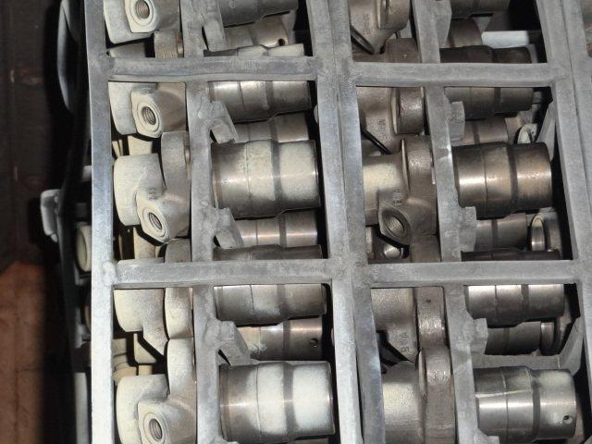
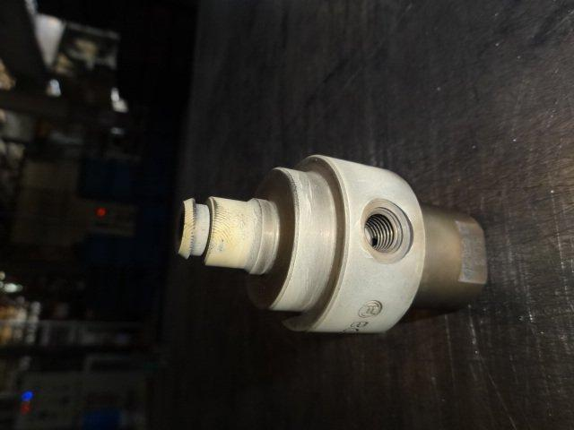
WORK DONE CONTD.

Slide 11
WORK DONE CONTD.
Analysis
Objective 1:
Table representing energy consumption by alkali washer at different temperatures:
TEMPERATURE | ENERGY CONSUMPTION (In kWh) | AVERAGE ENERGY CONSUMPTION (In kWh)
80° C | 716 -776 | 746
75° C | 590-625 | 607.5
70° C | 465-490 | 477.5
65° C | 325-360 | 342.5
60° C | 280-300 | 290

Slide 14
WORK DONE CONTD.
CALCULATIONS OF CO₂ EMISSION AND CARBON CREDITS:
Assuming power supply from thermal power plants from literature, for producing 1MWh of electricity - 0.95 tones of CO₂ is emitted. Based on this, CO₂ emissions for various power consuptions are calculated and tabulated below.
1 tone emission of CO₂ = 1 carbon credit.
Energy Production (In kWh) | CO₂ Emission in tones
1000kWh | 0.95
746kWh | 0.7087
607.5kWh | 0.57713
477.5kWh | 0.45363
342.5kWh | 0.32538
290kWh | 0.2755
465kWh | 0.44175

Slide 15
WORK DONE CONTD.
ECONOMICAL ASPECTS :
The economics has been estimated by two steps
Savings by reduction in energy consumption
By carbon credits
Savings by reduction in energy consumption:
By optimizing the temperature, the average energy savings is 456kWh/day/washer and a annual savings is 1,36,800kWh/washer.
Presently 1kWh of energy is supplied at Rs. 6 for commercial purpose.
Resulting in the savings of Rs.2,736/day/washer and Rs.8,20,800/annum/washer.

Slide 16
WORK DONE CONTD.
Savings by carbon credits:
The reduction in CO₂ emission by reduction of energy consumption by one washer is 132.5tones which is equal to 132.5 carbon credits.
If the optimized temperature is implemented in all the three washers, the reduction in CO₂ emission by reduction of energy consumption is 397.5tones which is equal to 397.5 carbon credits.
Presently 1carboncredit = $21($1 ≈ Rs.55).
The gain from carbon credit by one washer is Rs.7,287 annually.
The gain from carbon credit by three washer is Rs.21,862 annually.

Slide 17
RESULTS OBTAINED
BY OPTMIZATION
Reduction In
  Average energy consumption= 456kWh/washer/day=1,36,800kWh/washer/annum
  CO₂ emissions= 0.44tones/washer/day = 132tones/washer/annum
  There are 3 alkali washers, if this is implemented in all the 3 washers,
Reduction In
  Average energy consumption= 1368kWh/washer/day = 4,10,400kWh/annum.
  CO₂ emissions = 397.5tones /annum

Slide 18
RESULTS OBTAINED
This reduction leads to economic benefits, such as:
Reduction by energy consumption
  This results in the savings of Rs.2,736/day/washer resulting in a annual savings of Rs.8,20,800
  Presently there are 3 alkali washers and if the optimized temperature is implemented in all the 3, the resulting savings will be Rs.8,208/day and a annual savings of Rs.24,62,400
Carbon credits
  The gain from carbon credit by one washer is Rs.7,287 annually.
  The gain from carbon credit by three washer is Rs.21,862 annually.

Slide 19
Environmental management system
An Environmental Management System (EMS) is a set of processes and practices that enable an organization to reduce its environmental impacts and increase its operating efficiency.
An EMS is a voluntary management system for identifying, controlling and monitoring a facility’s activities, which have potential environmental impacts.
Case study in a Chemical Process Industry

Slide 20
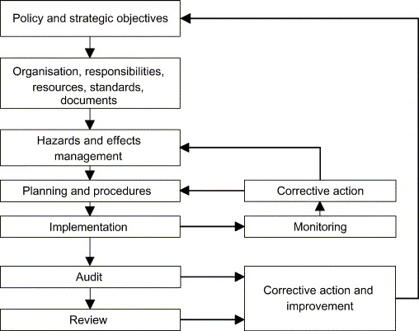
Basic elements of EMS

Slide 21
Aspect Impact analysis
ACTIVITY | ASPECT | IMPACT | LC | IPC | BC | SC | SE | PR | DN | SUM | S
waste water not meeting standard | land pollution & loss of resource | Y | Y | Y | Y | 3 | 3 | 2 | 1 | 9 | S
waste water discharged in storm drain | land pollution & groundwater contamination | Y | Y | Y | Y | 4 | 1 | 1 | 1 | 7 | S
S-significance

Slide 22
: Aspect Impact Analysis
Aspect impact analysis carried out for certain activities is the most effective mechanism for review and evaluation of significant environment impact.
By knowing the kind of activity and by giving the rating we can get to know if the activity is significant or not.
The periodic reviewing; or reviewing as and when there is any change in the process/activity or whenever a new process/activity is added or planned can bring the necessary awareness of the environmental impacts of those activities.

Slide 23
Impact is significant when any of the identified activity becomes:
Legal Concern (LC)
Interested Party Concern (IPC)
Business Concern (BC)
“Risk Priority Number (RPN) or Total Number” exceeds 10

Slide 24
Benefits of EMS
Cost savings;
Reduced risk;
Increased operational efficiency;
Positive external relations and public image;
Improved communication;
Greater employee stewardship;
Shared environmental solutions; and
Improved public relations.

Slide 25
Case study-Distillery
1. Wastewater quality assessment
Characterisation and statistical analysis of wastewater parameters for its compliance to the KSPCB prescribed standards by one sample T-Test.
Checking significance of values by independent T-test.
Simulation by a software module.
2. Solid waste management
To study the existing practises for managing the solid waste generated in the facility.
Simulation by software module to interpret the ash data and waste label generated.
Steps to eliminate the persisting problem or control measures for improvement which will help in better management of the generated solid waste.

Slide 26
3. Stack air quality assessment
Identifying the air pollution sources and control measures used by the facility walk through.
Collection of data using checklist which are prepared exclusively for the management of solid waste.
Analysing significance and correlation of parameters by using Statistical tools such as ANOVA and T-test.
Steps to eliminate the persisting problem or control measures for improvement which will help in improving air quality.
Extracting inferences, beneficial and meaningful to the industry.
4. Carbon Credits
Identifying projects in the company which can earn carbon credits
Description of the steps to acquire carbon credits through UNFCCC organization.
Cost comparison between paddy husk boiler and coal fired boiler.
Calculations of carbon credits which can be earned by Bio-methanation project in the company.

Slide 27
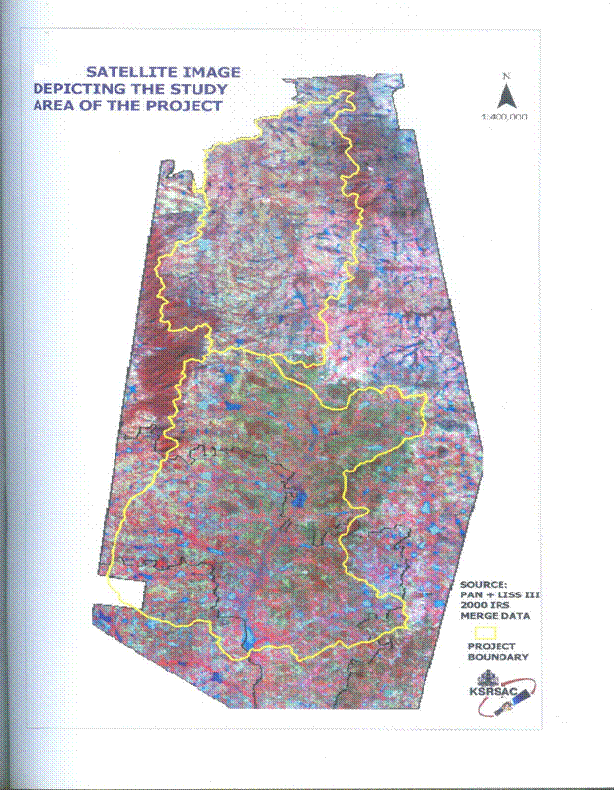

Slide 29
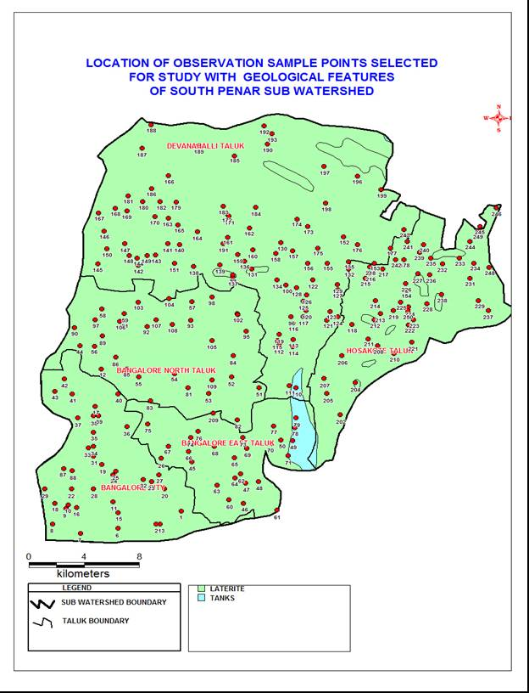

Slide 30
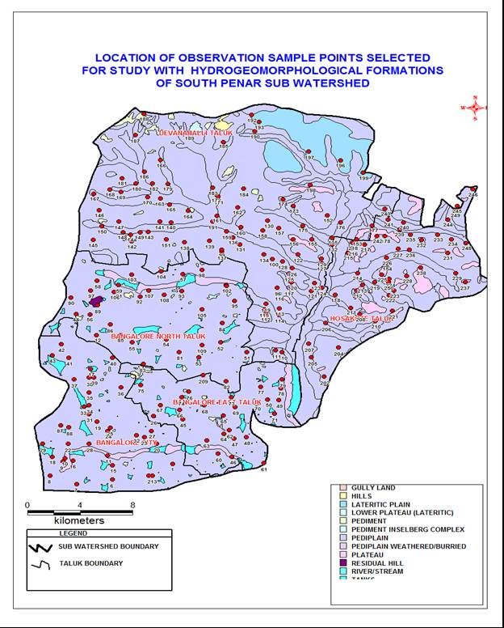

Slide 31
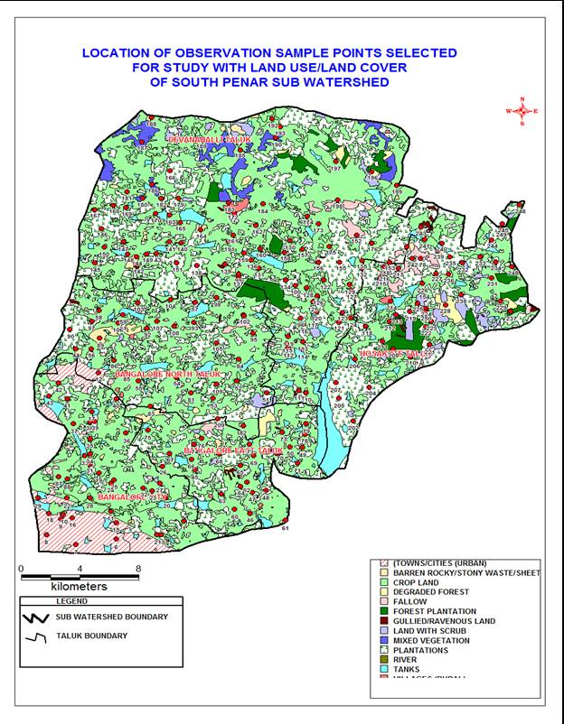

Slide 32
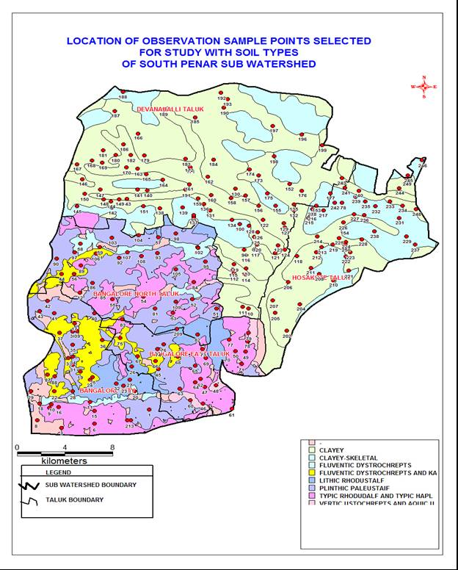

Slide 33
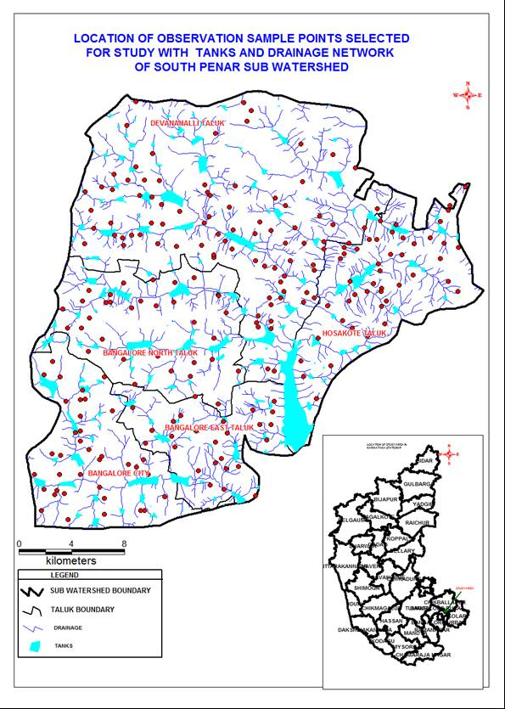

Slide 34
Laboratory studies
Based on the reconnaissance surveys selection of the area 70 groundwater stations (sampling stations) were selected
the study area of South Pennar sub-watershed having an area of 80 sq.kms
Analyzed for Heavy metals for iron, copper, cadmium, zinc, nickel and chromium

Slide 35
Table 2 indicates the permissible limits for drinking water (units in mg/l)
PARAMETER | PERMISSIBLE | PARAMETER | PERMISSIBLE
Iron | 0.3 | Nitrate | 45
Copper | 0.05 | fluorides | 1.00
Zinc | 5.00 | Total Hardness | 300
Nickel | 3.0 | Trichloroethylene | 0.04
Cadmium | 0.01 | Tetrachloroethylene | 0.04
Chromium | 0.05 | ethylenedibromide | 0.00004
(source: Bureau of Indian standards)

Slide 36
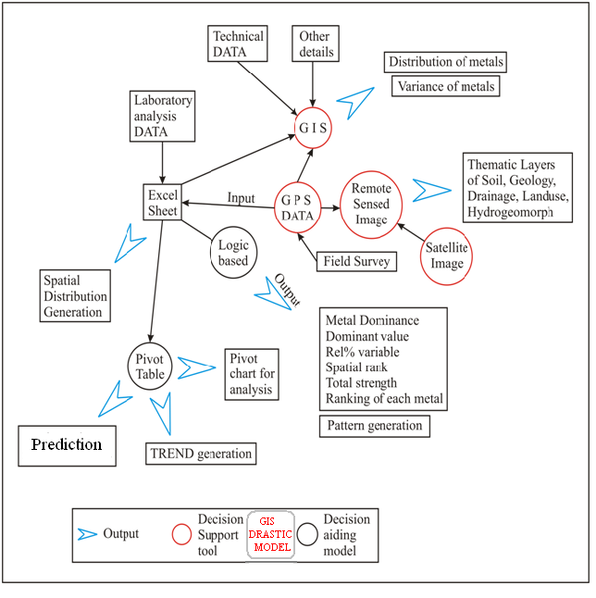

Slide 37
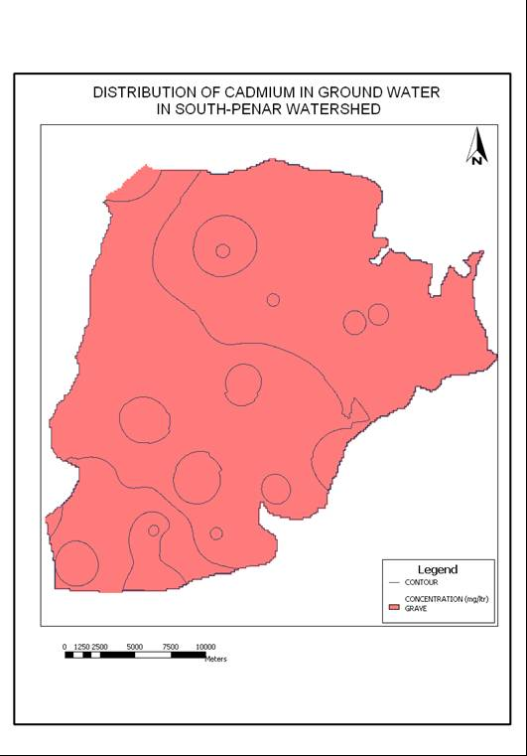

Slide 38
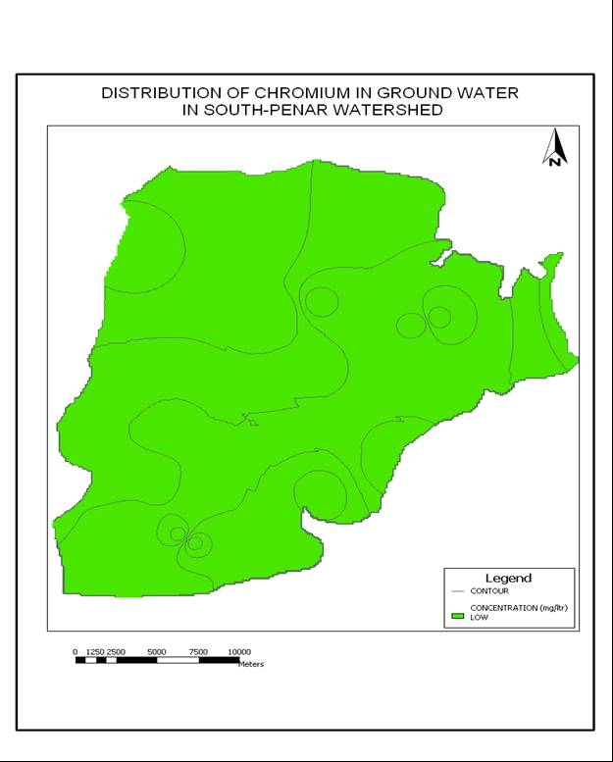

Slide 39
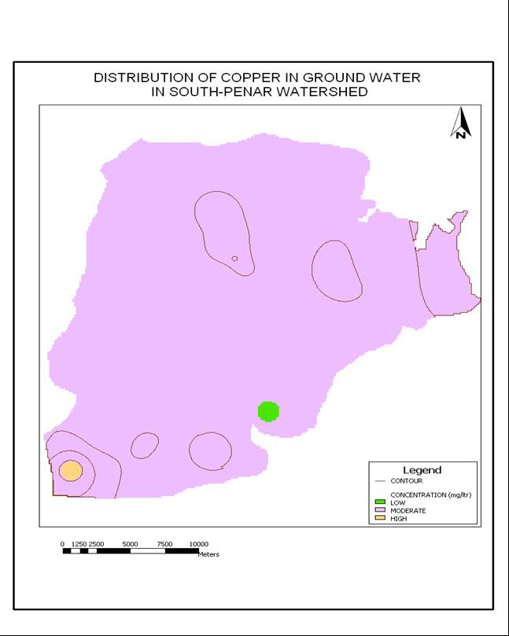

Slide 40
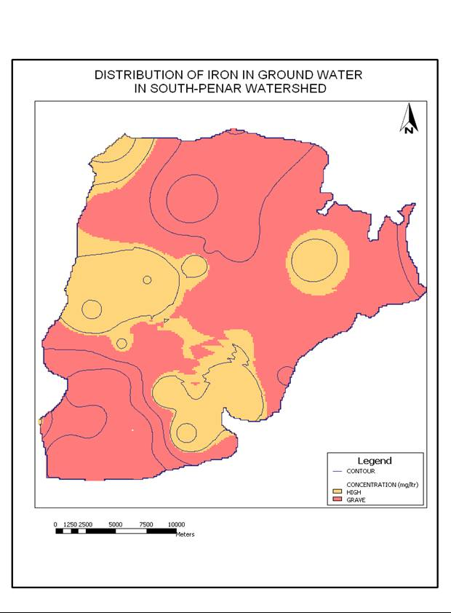

Slide 41
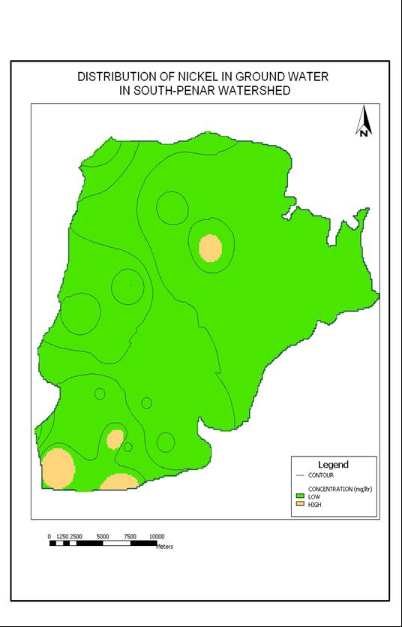

Slide 42
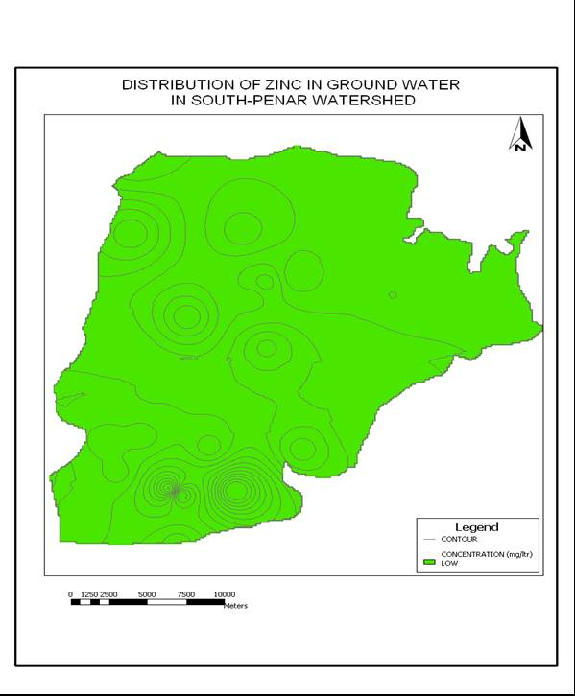

Slide 43


Slide 44
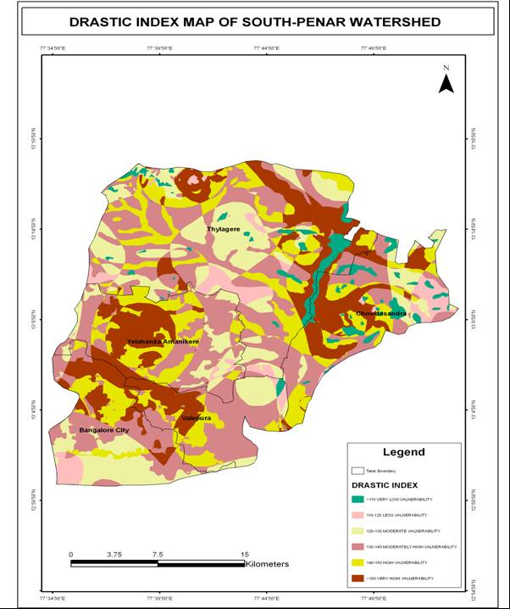

Slide 45
DRASTIC MODEL ANALYSIS
In the DRASTIC method, spatial data sets on
Depth to ground water
Recharge by rainfall
Aquifer type
Soil properties
Topography
Impact of the vadose zone and
Aquifer’s hydraulic Conductivity are combined

Slide 46
Area under vulnerability to groundwater pollution
Sl.no | Drastic index | vulnerability | Area(sq.kms) | Area (in %)
1 | <110 | Very low | 7.50 | 6.25
2 | 110-120 | low | 15.00 | 12.50
3 | 120-130 | moderate | 26.00 | 21.65
4 | 130-140 | Moderately high | 8.50 | 7.10
5 | 140-150 | high | 43.00 | 35.85
6 | >150 | Very high | 20.00 | 16.65

Slide 47
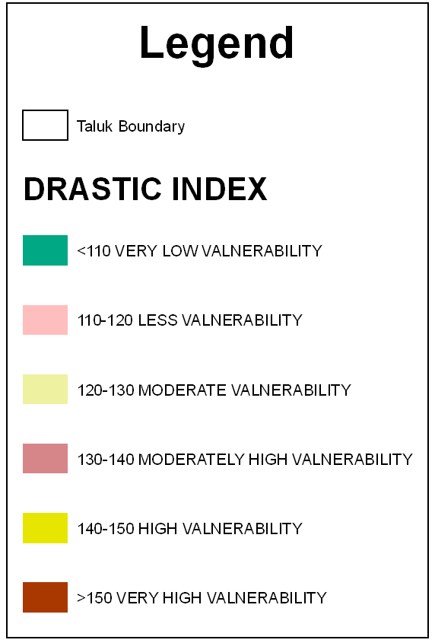

Slide 48
CONCLUSIONS
The analysis of the ground water samples for heavy metals are compared with Bureau of Indian Standards (BIS,10500) guidelines)
Iron content was found to be beyond the permissible limits at all the places (urban, semi urban and rural) areas (Fe < 0.3 mg/L)
Copper content was found to be beyond the permissible limits (Cu < 0.05mg/L) at most of the places except at some villages which varied with monsoon
Cadmium is well beyond the permissible limits (CD < 0.01 mg/L) at all the places.
Zinc was found to be well within the permissible limits at all the places in urban, semi urban and rural area (Zn < 5 )

Slide 49
Nickel was found to be well within the permissible limits at all the places in urban, semi urban and rural areas (Ni≤3mg/L). Chromium was absent in most of the places, even if present was well within the permissible limits (Cr ≤0.05 mg/L)
The results of this study shows that of the total 120 sq kms an area of about 22.50 sq.km is in the low vulnerable zone with a DRASTIC index range between 110and120,
About 35 sq.kms are in the moderately vulnerable zone with a DRASTIC index ranging between120-130,
About 43 sq.kms are in the high vulnerability zone with a DRASTIC index ranging between 140 and 150 and
About 20 sq.kms are in the very high vulnerability zone with a Drastic index of more than 150

Slide 50

Thank you
Thank you

Slide 51
Let Us Meet Again
We welcome you all to our future conferences of OMICS Group International
Please Visit:
http://materialsscience.conferenceseries.com/
Contact us at
materialsscience.conference@omicsgroup.us
materialsscience@omicsgroup.com

