Slide 1
Automating Farms Irrigation in
Saudi Arabia
Challenges of a Large-Scale System
Sami A. Alhasan

Slide 2
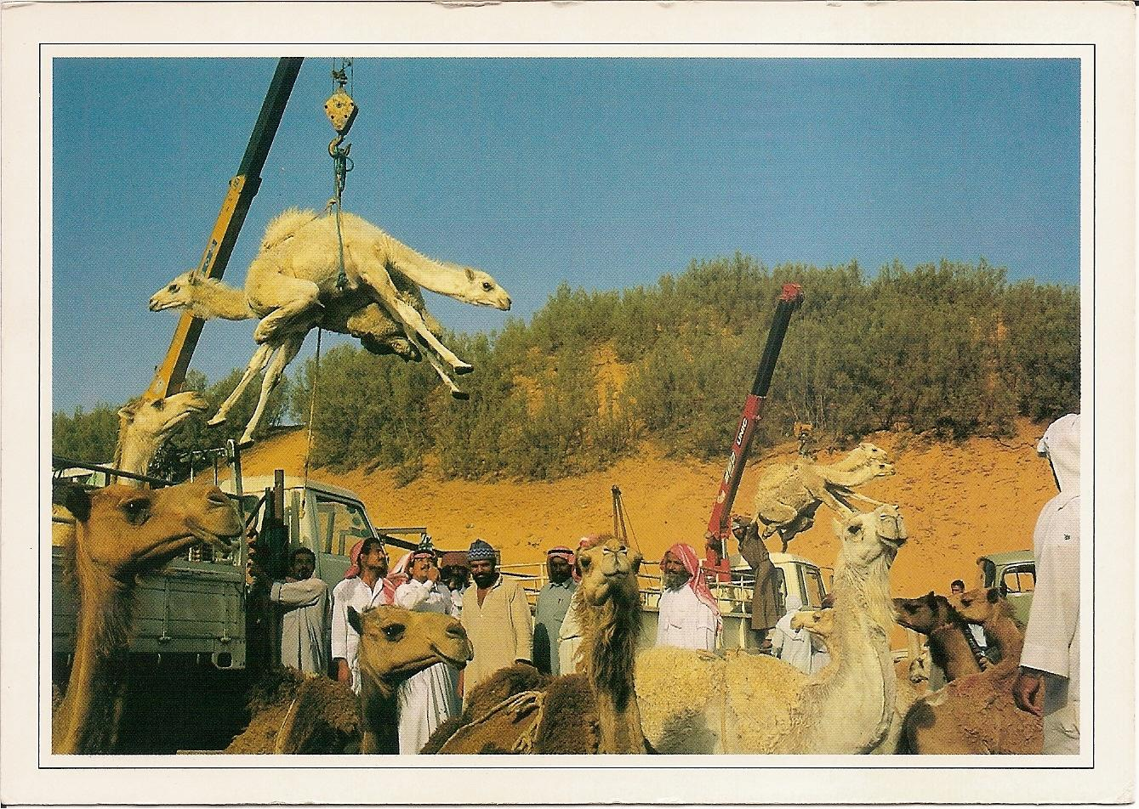
Welcome from Saudi Arabia

Slide 3
Who Am I?
Sami Alhasan from Saudi Arabia
Got MS and PhD from Georgia Tech 1999
Intelligent Control Systems (Fuzzy, NN, Genetic)
Worked on Intelligent Autonomous Areal Vehicles
Dean of Ahsa Tech College for four years
GM for Saudi Control Solutions Company
Academic Consultant for KFU University
GM for MISC Global Company

Slide 4
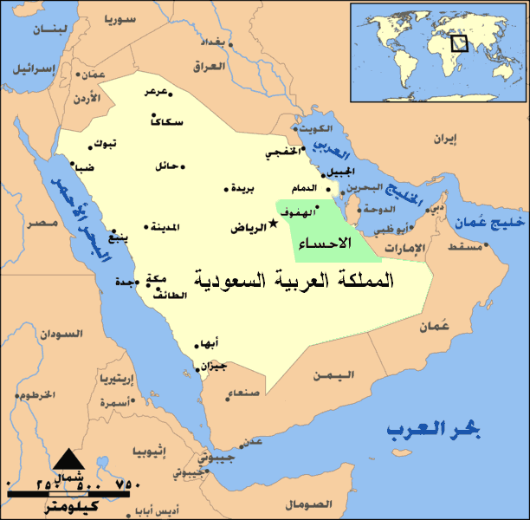
Saudi Arabia
Area = 2,150,000 km2
Population = 31 M
Main resource = Oil/Gas
Al Ahsa Region
Area = 534,000 km2
Population < 1,000,000

Slide 5
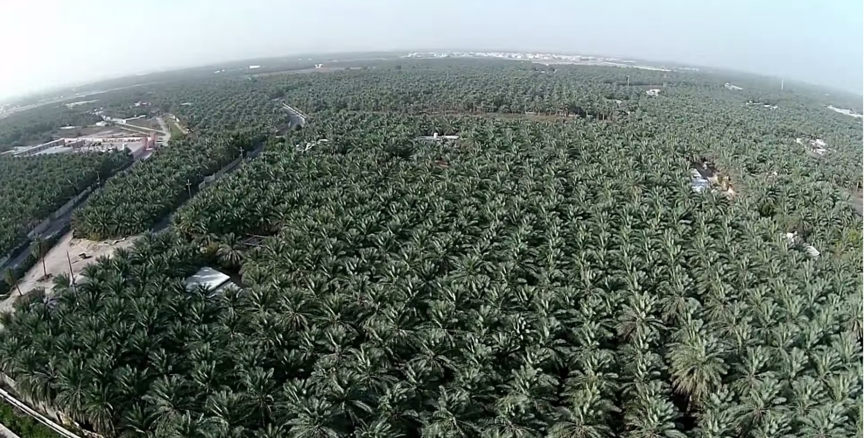
Al Ahsa Farms
~ 20% of 25 M palm trees in Al Ahsa (Sea of Palm Trees)

Slide 6
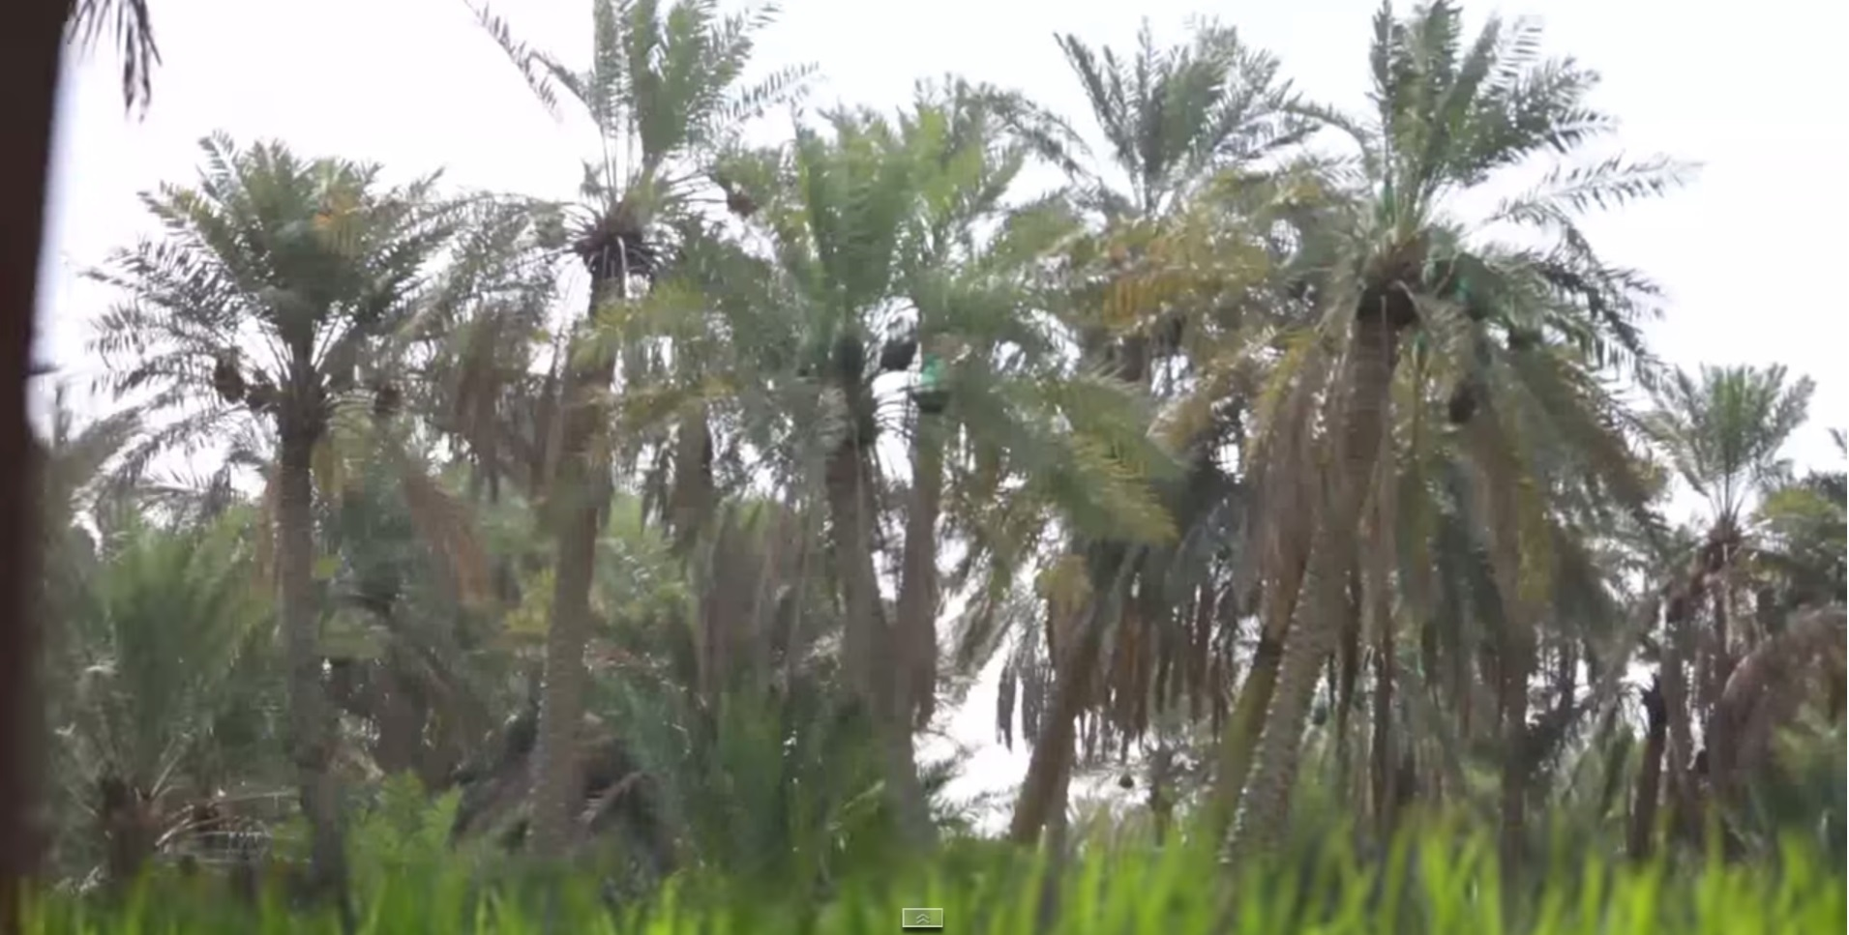
Al Ahsa Palm Trees

Slide 7
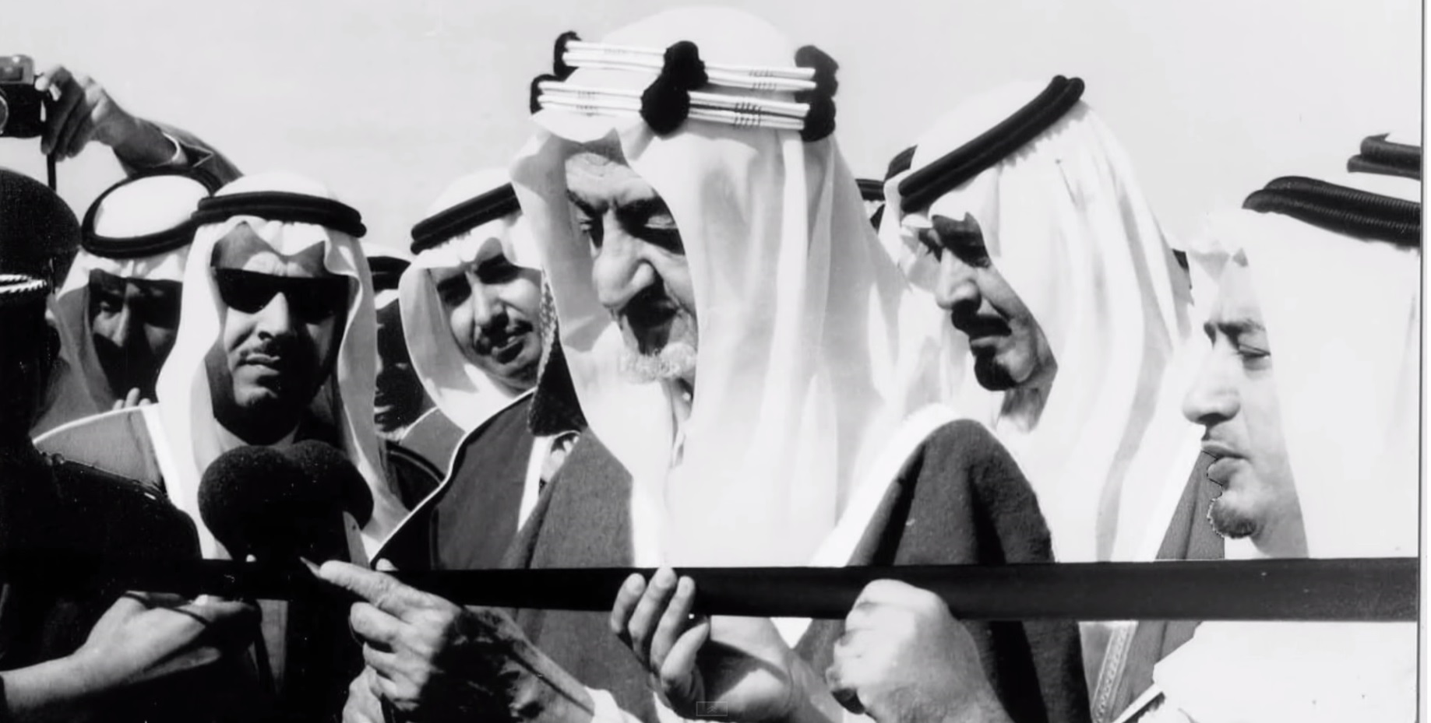
The 1972 Project
King Faisal launched the Irrigation Project in Al Ahsa

Slide 8
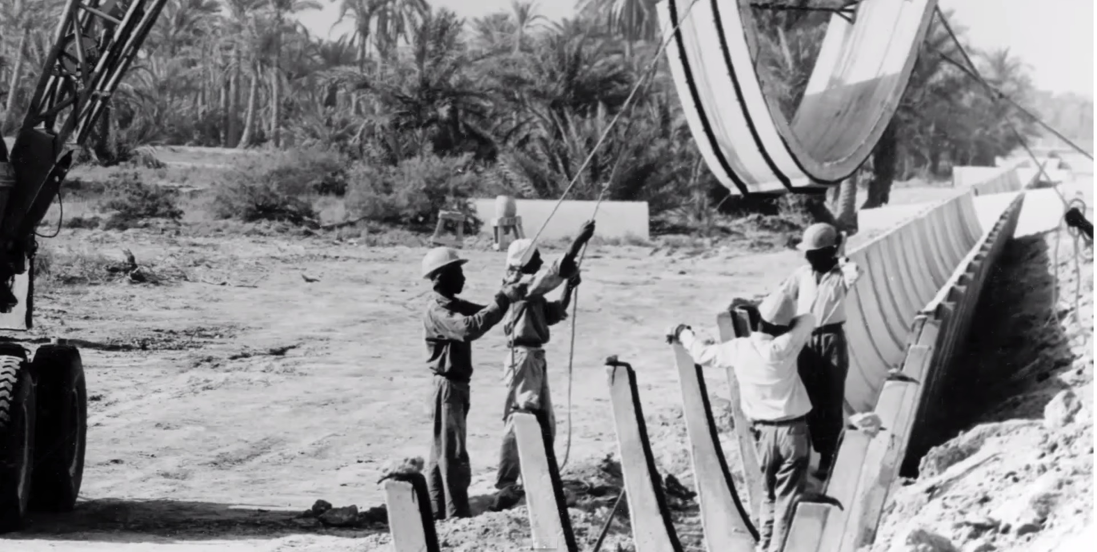
The 1972 Project

Slide 9
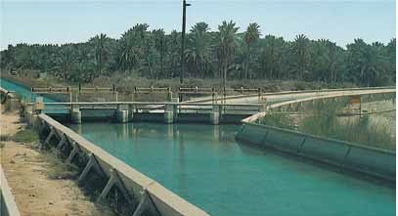
Open-Channel Irrigation
Open concrete channels of a total length = 1,500 km

Slide 10
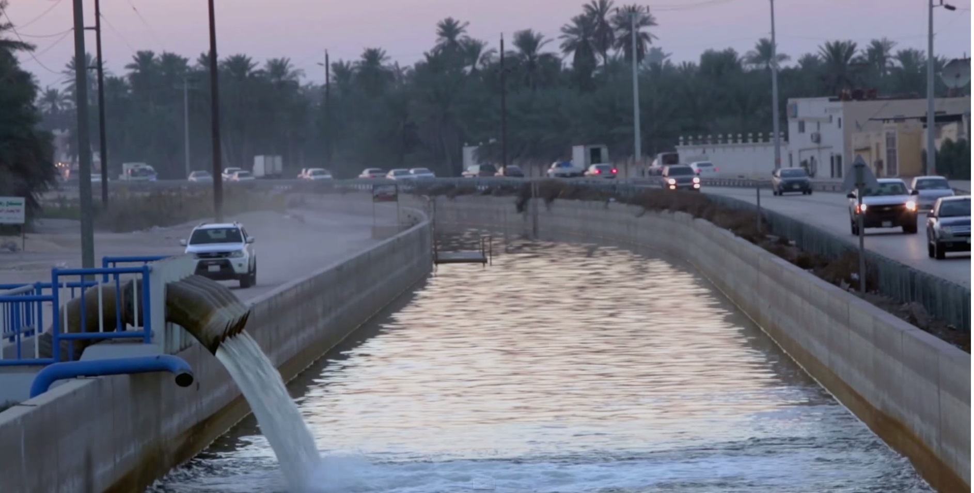
Main Irrigation Channels

Slide 11
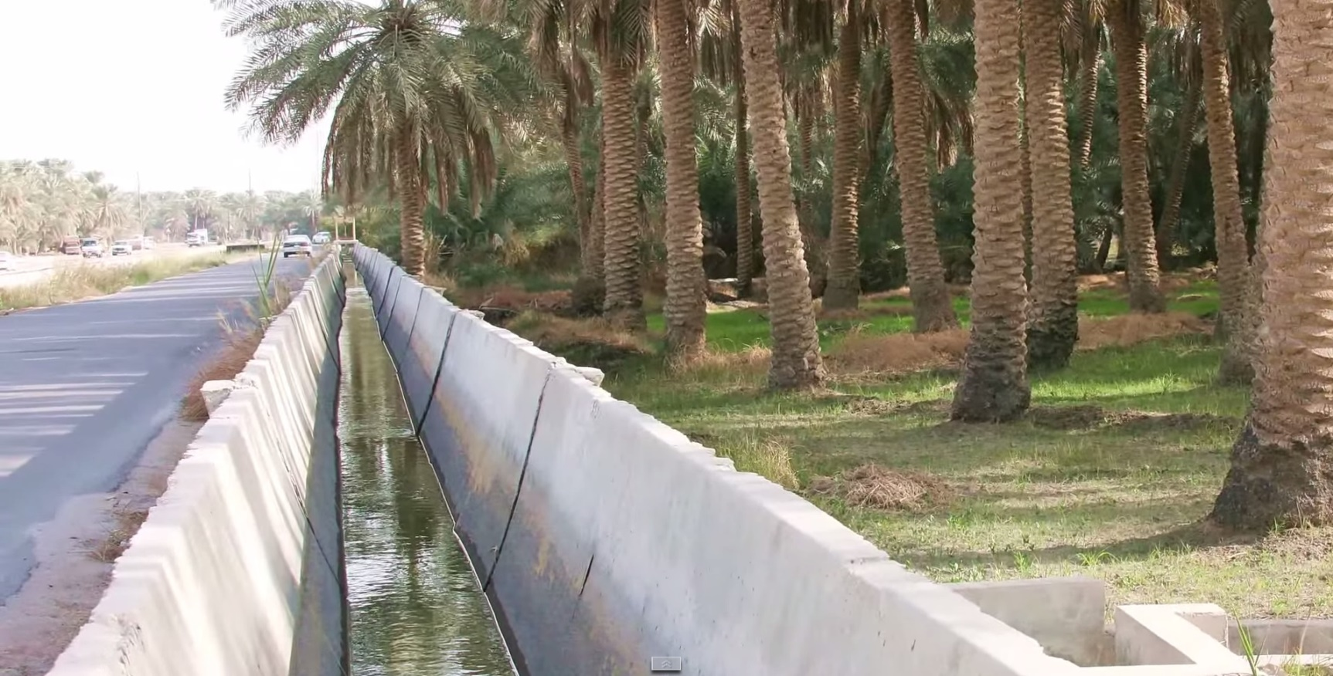
Branch Irrigation Channels

Slide 12
The Problem
Water wells were depleted
Water evaporates in open channels ( 40% )
Lots of water is wasted by
- Unmaintained channels
- Abuse of water resources

Slide 13
The Solution
A 293 M USD Project
Replace open channels with a pipeline network
Use recycled water for farm irrigation
Automate farm irrigation
Apply sprinkler irrigation in the farms

Slide 14
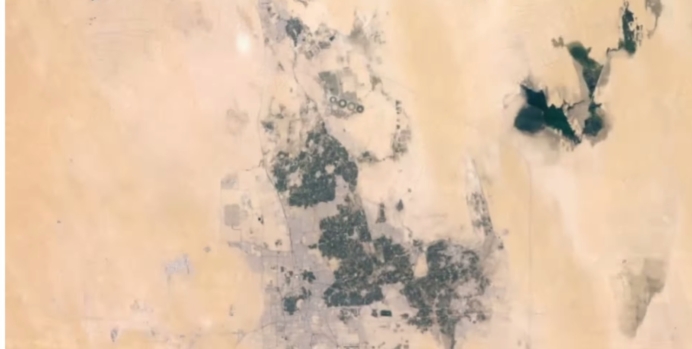
Al Ahsa Top View
Agricultural area in Al Ahsa = 80 km2 ( ~ 20% of Ahsa area)

Slide 15
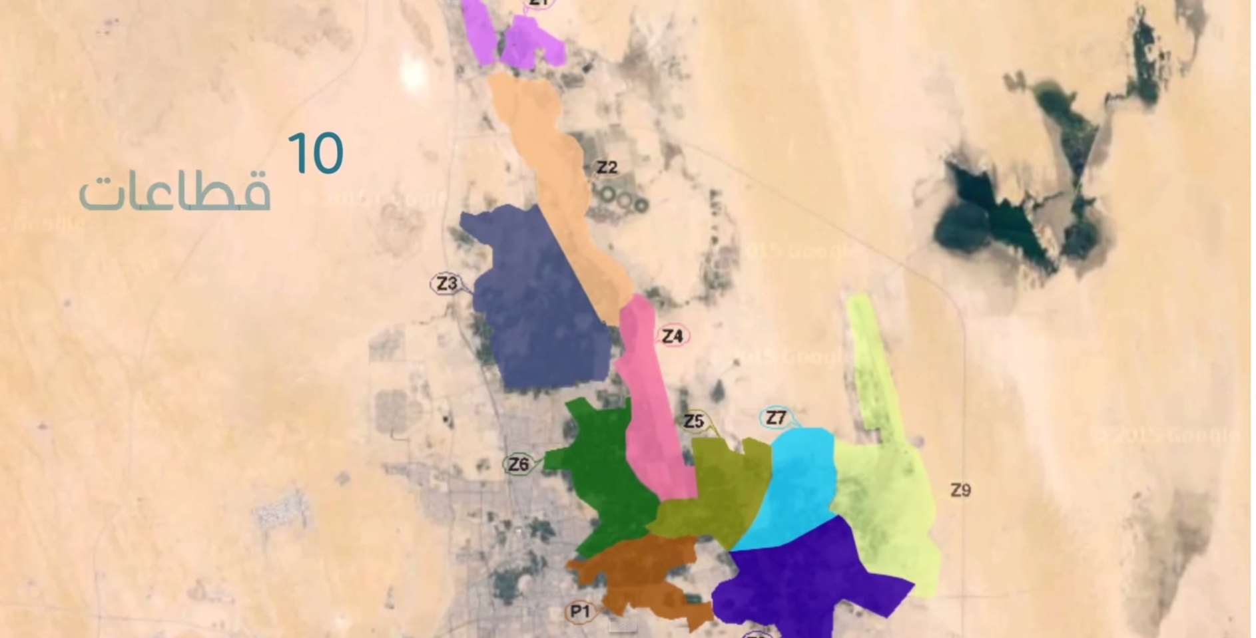
The 10 Farm Zones
Agricultural area with 24,570 farms divided to 10 zones

Slide 16
Design and Implementation
Each Zone → Water Reservoir/Tanks
Main Pumping Station
Valve-controlled pipeline network
Multi-level Zone Irrigation Control System
Zone controllers supervised by a Master Controller

Slide 17
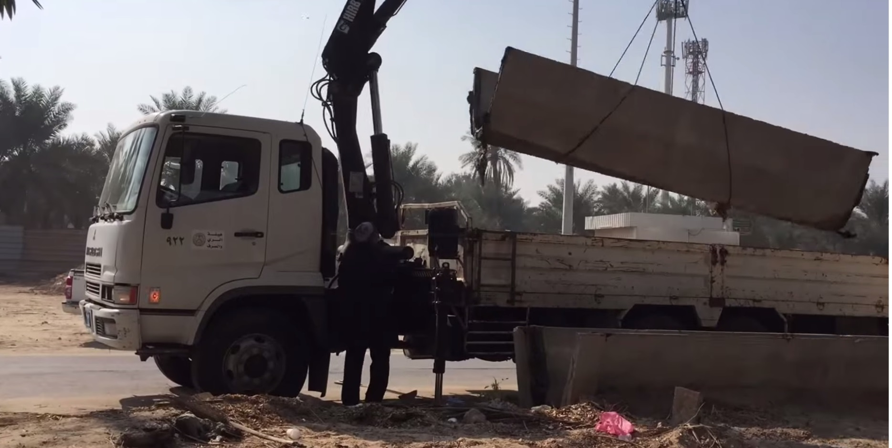
Removing the Open Channels

Slide 18
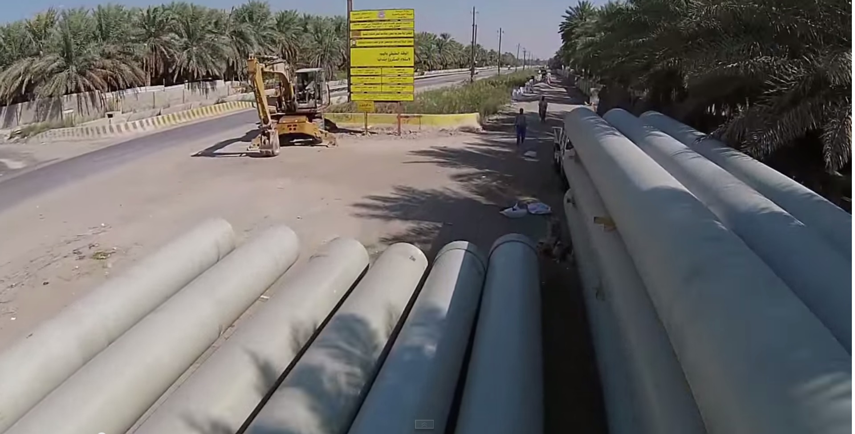
The Pipeline Network

Slide 19
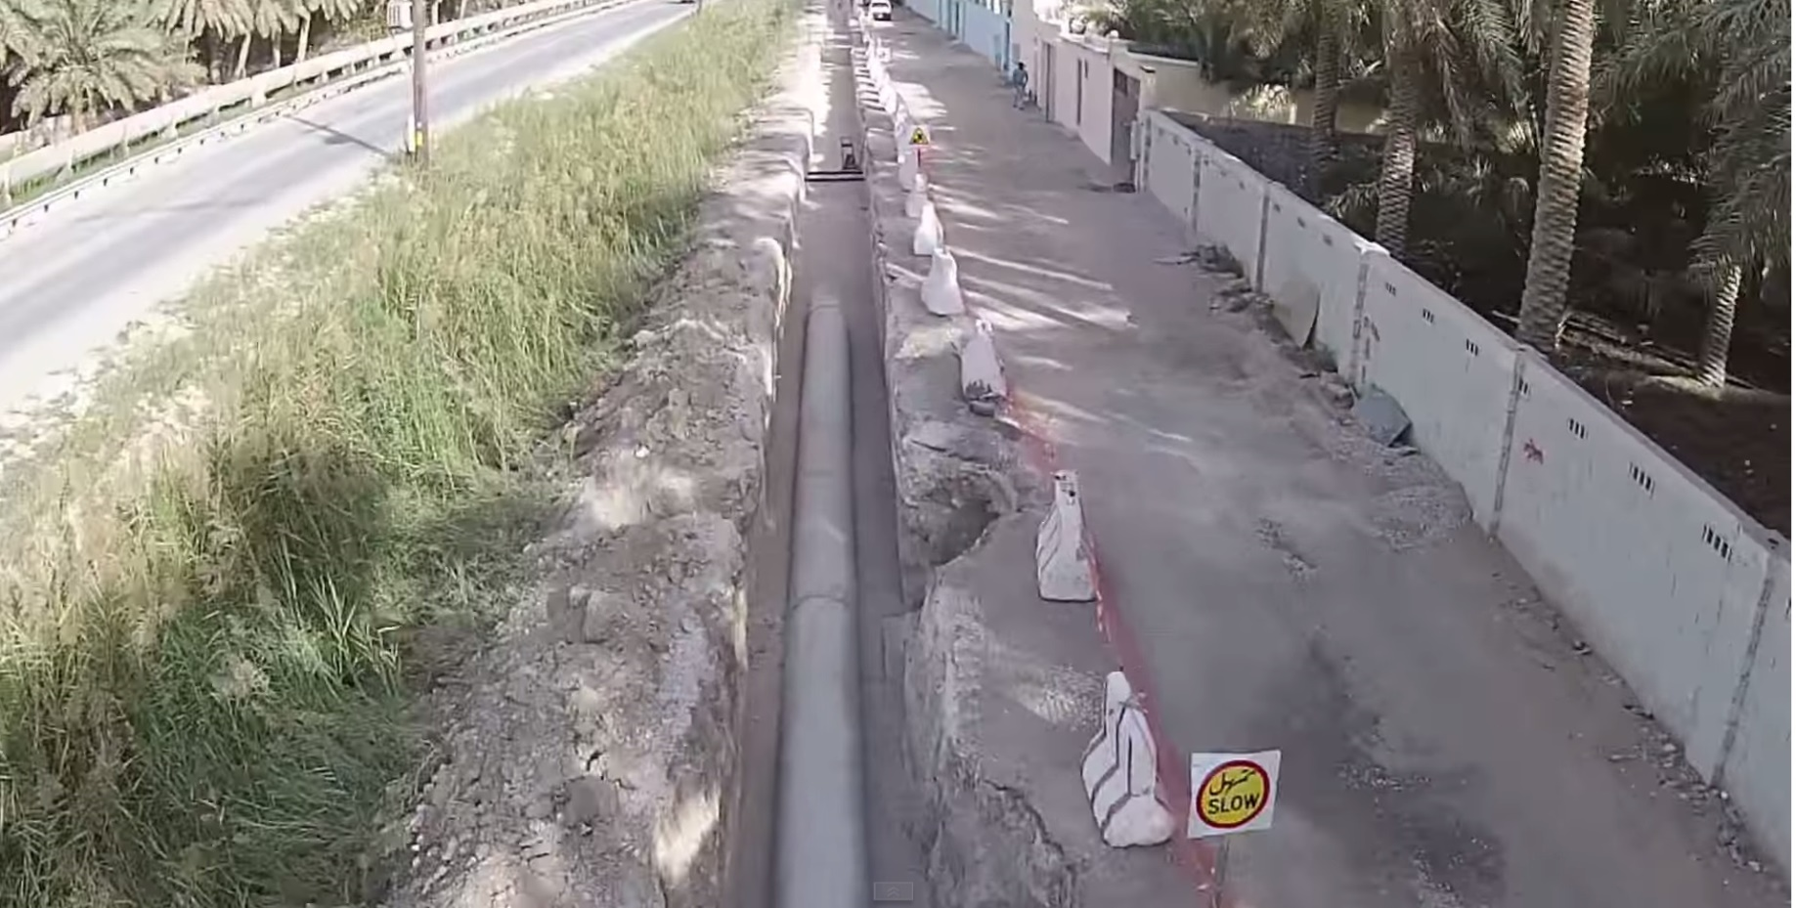
The Pipeline Network
Total length of the closed pipeline network is > 1,000 km

Slide 20
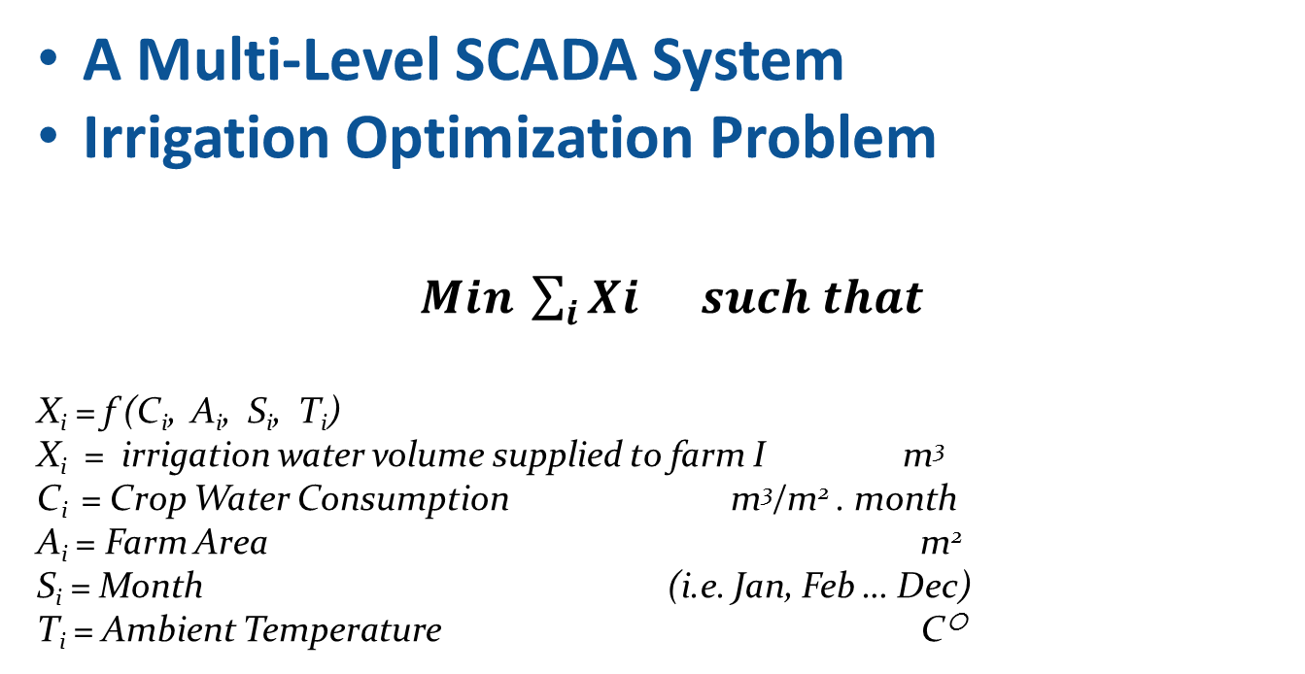
The Automated Irrigation System
A Multi-Level SCADA System
Irrigation Optimization Problem
$Min \sum_{i}{Xi} such that$
X_{i} = f (C_{i}, A_{i}, S_{i}, T_{i})
X_{i} = irrigation water volume supplied to farm I m³
C_{i} = Crop Water Consumption m³/m² . month
A_{i} = Farm Area m²
S_{i} = Month (i.e. Jan, Feb … Dec)
T_{i} = Ambient Temperature C○

Slide 21
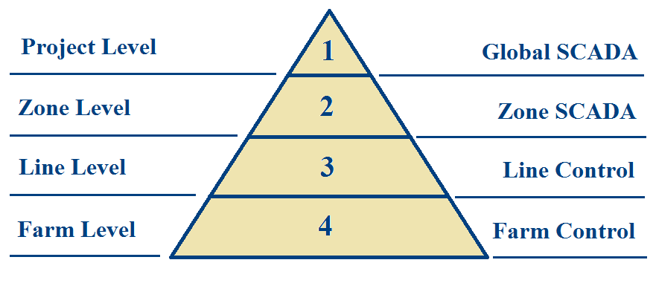
The Control System Hierarchy

Slide 22
What is the Project Status?
70% of the pipeline network finished
(still zones 1, 2 & 3 not finished)
Zone 6 finished and functional
- Area = 12 km2, with 3,508 Farms
- Project value = 43.7 M USD
- 100% Tertiary-recycled irrigation water
- 3-Level SCADA Control System

Slide 23
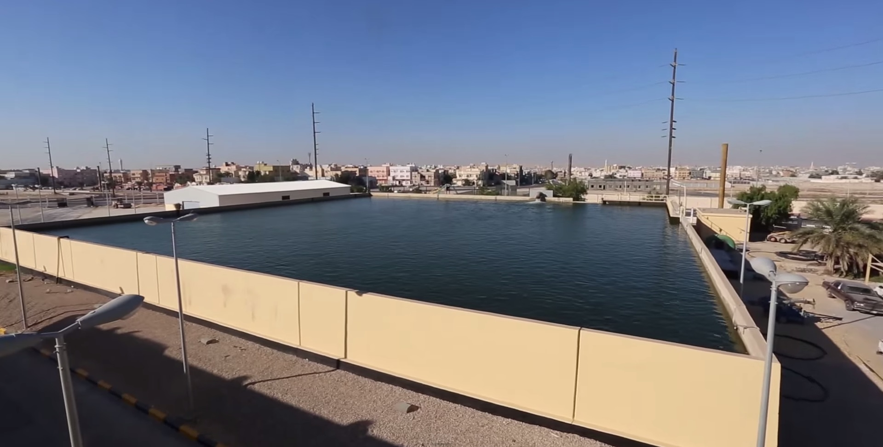
Zone 6 Reservoir

Slide 24
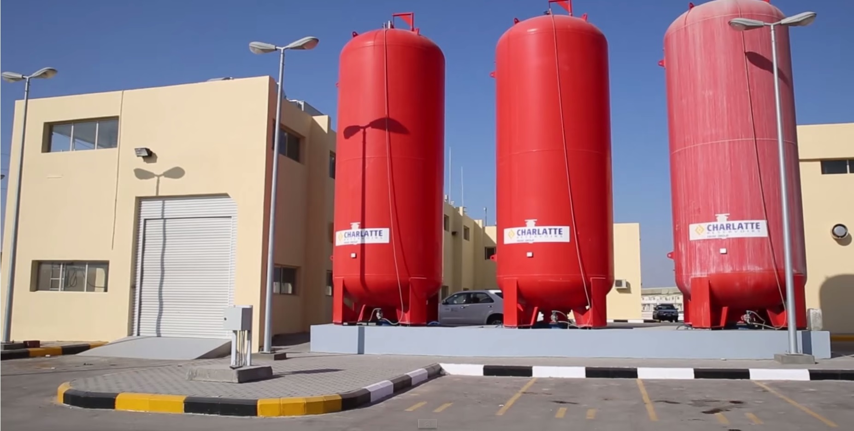
Zone 6 Tanks
15,000 m3 Irrigation Tanks

Slide 25
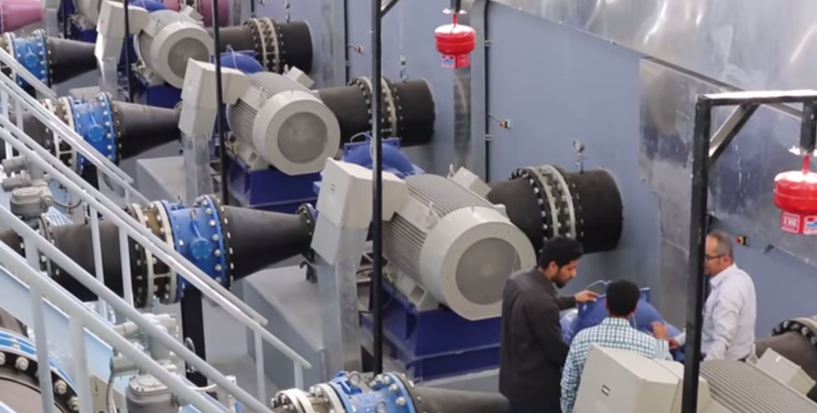
Zone 6 Pumping Station
6 MV pumps (4 Operating, 2 Standby) each = 500 L/sec

Slide 26
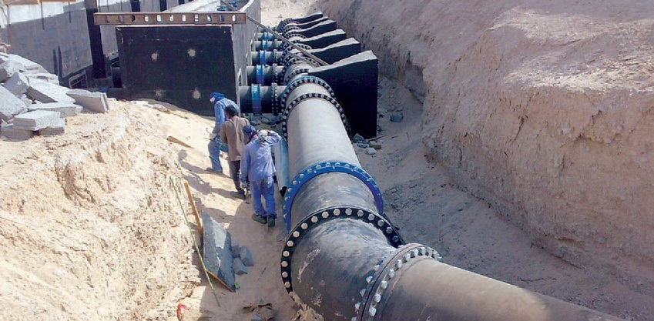
Zone 6 Main Pipeline

Slide 27
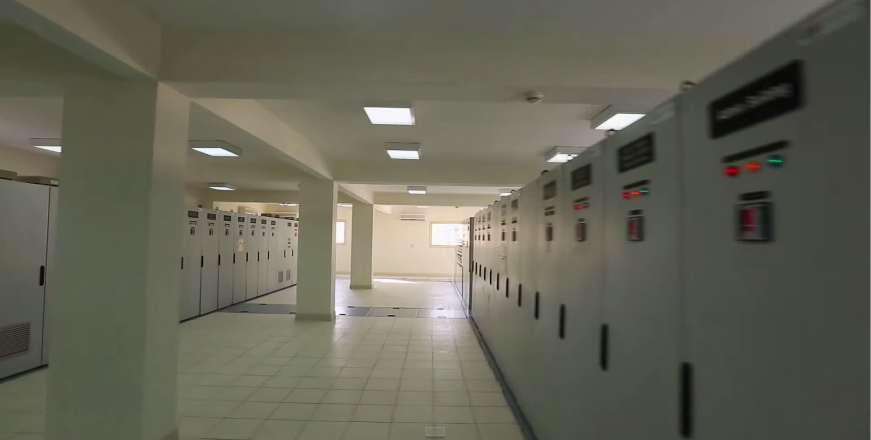
Zone 6 MCC Room

Slide 28
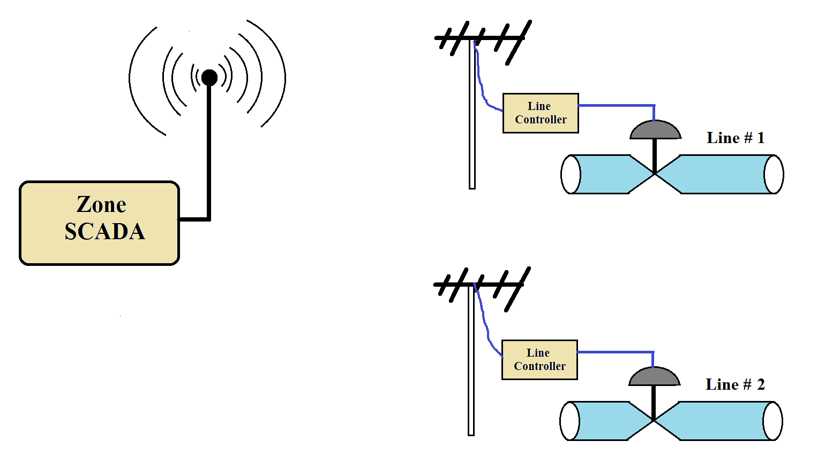
Zone 6 Control (levels 2 & 3)

Slide 29
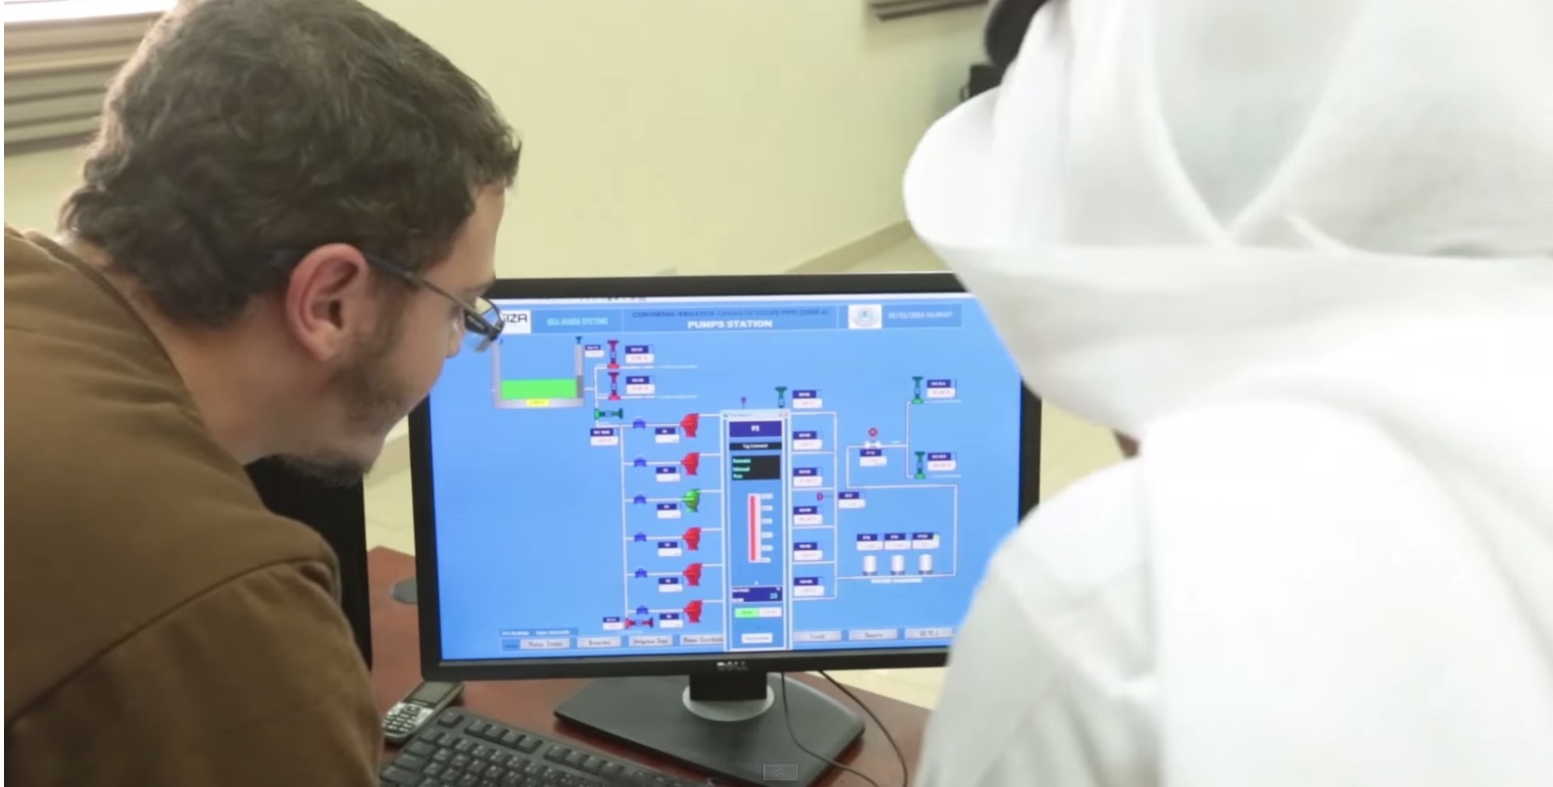
Zone 6 SCADA Software
SCADAPack from Schneider Electric

Slide 30
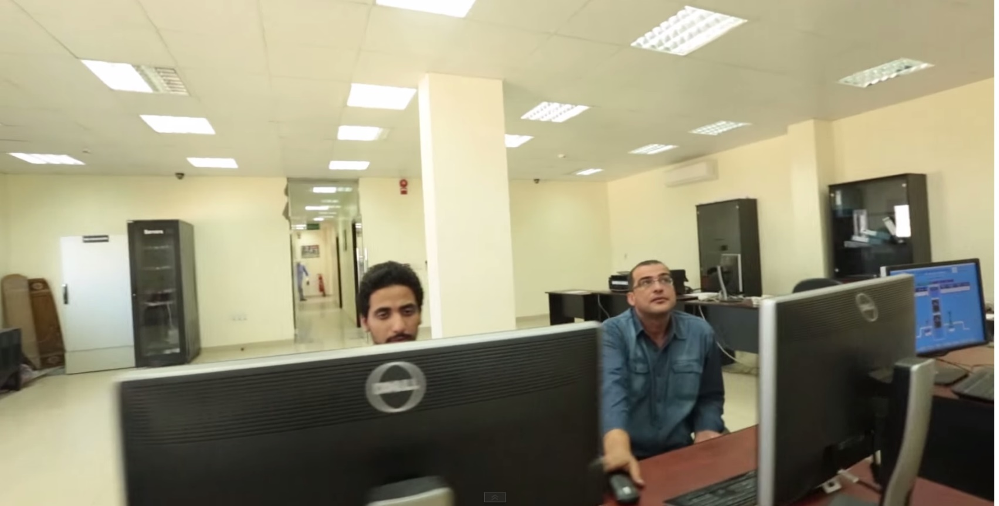
Zone 6 Control Room

Slide 31
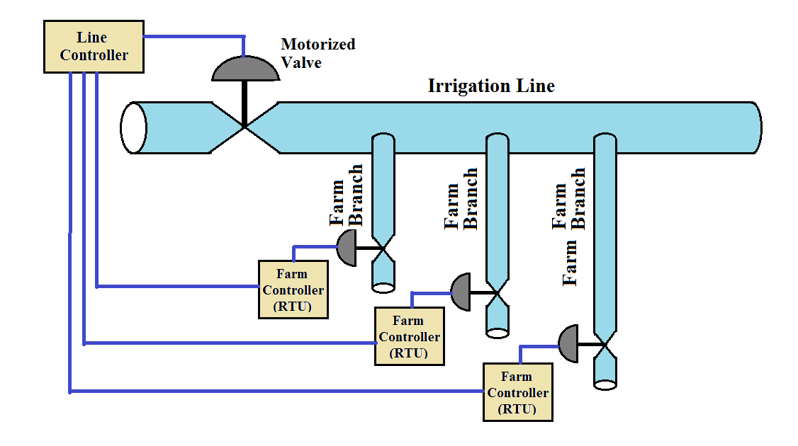
Zone 6 Control (levels 3 & 4)

Slide 32
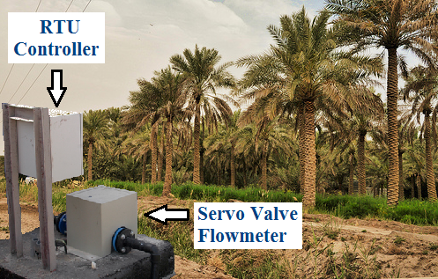
Farm Brach Control (Level 4)
RTU Twido PLC with Modbus Cable Communication

Slide 33
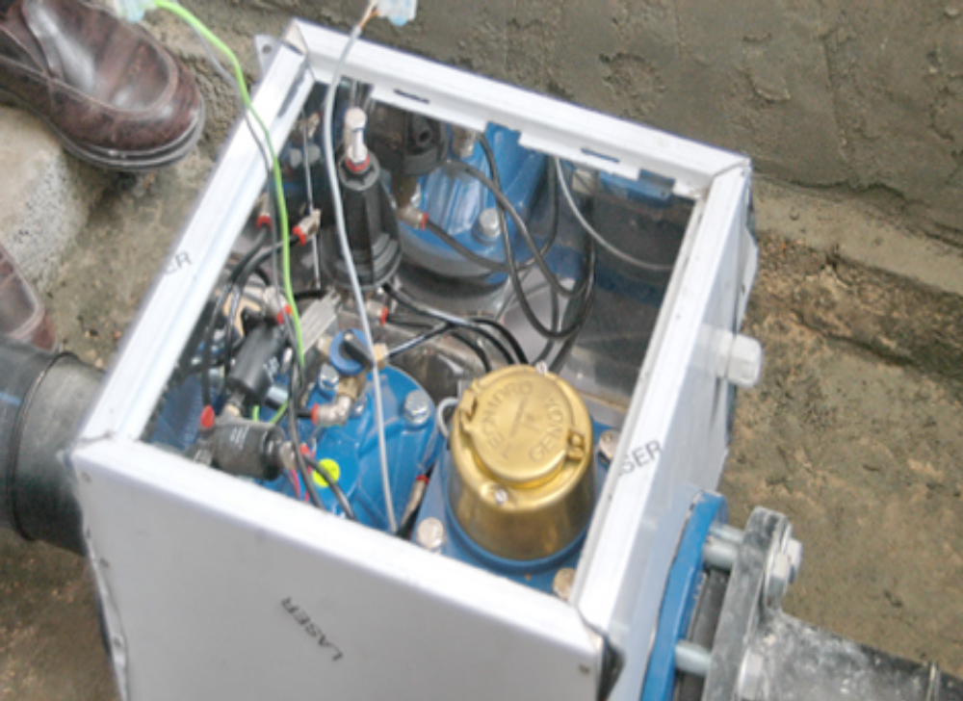
Farm Brach Servo Valve Box

Slide 34
Challenges
Operation:
* Automatic vs. Manual
Maintainability:
  * Maintain 25,000 farm RTUs
  * Unstructured agricultural environment
  * Spare Parts

Slide 35
Challenges
3. Expandability:
* New farms, farms expand, change crops
4. Technology:
  * Technology changes & becomes obsolete
  * Interface different technologies

Slide 36
Thank You
Sami A. Alhasan
+966 50 492 5915
salhasan@tvtc.gov.sa

