Slide 1


Research amongst Physical Therapists in the State of Kuwait: Participation, Perception, Attitude and Barriers
Presented by
Sameera Aljadi, PT, PhD
Assistant Professor
Faculty of Allied Health Sciences
Department of Physical Therapy
Kuwait University

Slide 2
Introduction

Slide 3
Research is necessary to advance the practice of physical therapy in order to assist physical therapists in the development and testing of knowledge unique to their practice, to help in the growth of their practice and to enhance the level of patient care.

Slide 4
Worldwide, several studies investigated the importance of research perception and attitudes towards research, participation levels, intentions and the barriers involved in research among physical therapists.
The literature showed that physical therapists have a positive attitude towards research and believe it would improve the image of the profession and consider research as being of vital importance to the profession.

Slide 5
The most commonly reported barriers to physical therapy research were:
  Lack of time
  Lack of funding
  High work load
  Unfamiliarity with research procedures & statistics

Slide 6
The objectives of this study were to investigate:
  The attitudes and perceptions toward research-related activities.
  Levels of engagement in research.
  The key barriers involved in participating in research amongst physical therapists in the State of Kuwait.

Slide 7
Methods

Slide 8
Subjects
A convenient sample of 200 selected PTs working in various governmental and private clinics received an invitation to participate in the study.

Slide 9
Questionnaire
The questionnaire used in the present study developed by Eckerling et al.
The questionnaire composed of four sections.
Section one collected demographic information including the participants’ age, gender, nationality, marital status and number of children, education degree, years of experience, area of specialty, work environment, patient load and contribution to research.

Slide 10
Questionnaire
Section two measured four research-related dimensions: 1)role of the participant in encouraging students and other colleagues to engage in research; 2)ability; 3)intent, and 4)engagement.
Each dimension included 4 statements addressing varied research-related activities (reading research articles to update knowledge, encouraging others to read, applying research findings to practice and initiating research projects).

Slide 11
Questionnaire
Section three, the participants graded the four research-related activities using a numerical grid rated from 1 to 7 (–3 to +3) relating to the four research-related dimensions.
A fifth dimension measured the overall attitudes toward research-related activities using a semantic differential scale with 4 bipolar adjectives on a 7-point scale for each of the four research-related activities.

Slide 12
Questionnaire
Section four, participants were asked to give their own opinion using a 5-point Likert scale regarding varied statements on work-related factors.
These included information regarding time available for reading research articles and time available for planning and conducting research during working hours.

Slide 13
Questionnaire
The participants were also asked whether research activities were encouraged by their superiors, colleagues and the management.
Statements regarding the ease of access to the electronic resources and research articles at the participants’ workplace were also assessed.

Slide 14
Questionnaire
Two open-ended questions were added to the original questionnaire.
The participants were asked to list the scientific journals that contain relevant physical therapy research and the journals the participants read on a regular basis.
The time taken to complete the questionnaire varied between 5 and 10 min.

Slide 15
Results

Slide 16
Of the 200 physical therapists to whom the questionnaires were given, 122 (61%) completed and returned the questionnaires.

Slide 17
Demographics
55 were males mean age 36.0 ± 9 years; 24–63 years and 67 females mean age 33.0 ± 8 years; 21–55 years.
68 (55.7%) of the participants were clinicians, 73 (59.8%) of the participants had less than 10 years of clinical experience with a mean of 10.1 ± 8.4 years.

Slide 18
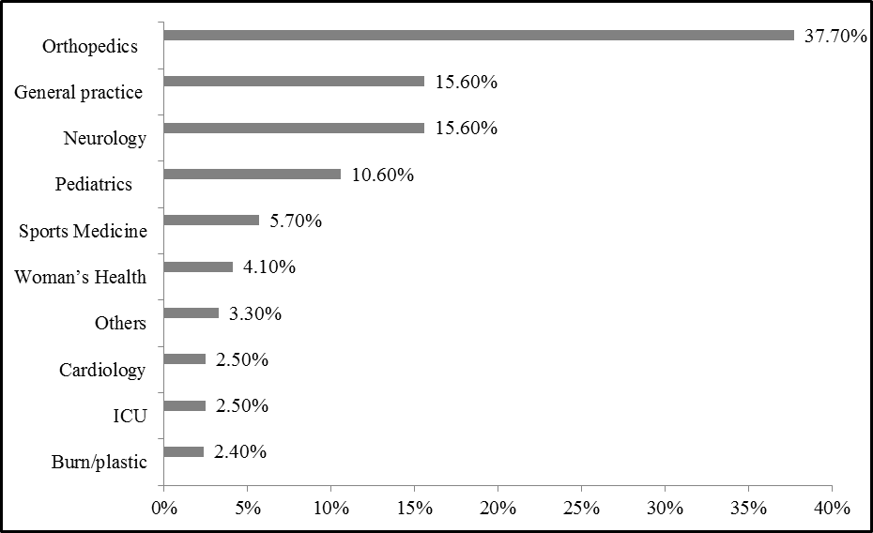
Area of specialty of the study participants.

Slide 19
In general, the attitude of the study participants towards research-related activities was positive.
The most positive attitudes identified were:
  The application of research findings to improve physical therapy practice.
  Reading research materials to update the participants’ knowledge.

Slide 20
The means for the four research-related activities were relatively similar
  Reading research: 1.34 ± 1.3
  Encouraging colleagues to read: 1.04 ± 1.3
  Applying research findings: 1.42 ± 1.2
  Initiating research: 1.29 ± 1.2

Slide 21
Medians, upper (q1) and lower (q3) quartiles for attitudes to research-related activities, means and standard deviations (SD) for index-attitudes scores
 | Interesting-Boring | Attractive-Repulsive | Easy-Difficult | Necessary-Unnecessary | *Index
 | Median (q₁, q₃) | Median (q₁, q₃) | Median (q₁, q₃) | Median (q₁, q₃) | Mean (SD)
Read Research | 2.0 (0.0, 3.0) | 1.0 (0.0, 3.0) | 1.0 (0.0, 2.0) | 3.0 (1.0, 3.0) | 1.34 (1.3)
Encourage colleagues to read | 1.0 (0.0, 3.0) | 1.0 (0.0, 2.0) | 0.0 (-1.0, 2.0) | 3.0 (0.0, 3.0) | 1.04 (1.3)
Apply research findings | 2.0 (1.0, 3.0) | 2.0 (0.0, 3.0) | 0.0 (0.0, 2.0) | 2.0 (0.0, 3.0) | 1.42 (1.2)
Initiate research | 2.0 (1.0, 3.0) | 2.0 (0.0, 3.0) | 0.0 (-1.0, 2.0) | 2.0 (1.0, 3.0) | 1.29 (1.2)

Slide 22
Role, Ability, Intent and Engagement in Research-Related Activities
In general, the participants’ responses ranged from ‘agree’ to ‘strongly agree’ that they have the responsibility, ability and intention to further update their knowledge through further reading and study.
Participants strongly agreed that they have a role and the ability to apply research findings to improve physical therapy practice.

Slide 23
Medians, upper and lower quartiles, means ± SD for role, ability, intent and engagement by research activity
 | Role |  | Ability |  | Intent |  | Engagement
 | Median (q₁, q₃) | Mean (SD) | Median (q₁, q₃) | Mean (SD) | Median (q₁, q₃) | Mean (SD) | Median (q₁, q₃) | Mean (SD)
Read Research to update knowledge | 5.0 (4.0, 5.0) | 4.55 (0.74) | 5.0 (4.0, 5.0) | 4.6 (0.55) | 5.0 (4.0, 5.0) | 4.41 (0.77) | 4.0 (4.0, 5.0) | 4.06 (0.96)
Encourage colleagues to read | 4.0 (4.0, 5.0) | 4.34 (0.77) | 4.0 (4.0, 5.0) | 4.31 (0.77) | 4.0 (4.0, 5.0) | 4.24 (0.75) | 4.0 (3.0, 5.0) | 3.92 (0.94)
Apply research findings | 5.0 (4.0, 5.0) | 4.43 (0.73) | 5.0 (4.0, 5.0) | 4.37 (0.76) | 4.0 (4.0, 5.0) | 4.33 (0.77) | 4.0 (3.0, 5.0) | 3.93 (0.97)
Initiate research | 4.0 (4.0, 5.0) | 4.13 (0.84) | 4.0 (4.0, 5.0) | 4.13 (0.85) | 4.0 (4.0, 5.0) | 4.16 (0.91) | 4.0 (3.0, 4.0) | 3.64 (1.0)

Slide 24
Role, Ability, Intent and Engagement in Research-Related Activities
There was a common belief that they possessed less of a role, less ability and intention, and that they were less engaged in initiating research and encouraging their colleagues to read.

Slide 25
Association of Research-Related Dimensions with Demographics
The level of education had a significant association with the intent to engage in research-related activities where baccalaureate degree holders intended to, and engaged in research-related activities .

Slide 26
Work Conditions and Association with
Engagement in Research-Related Activities
55 (45.1%) had set time aside to read research articles.
64 (52.5%) agreed that research-related activities were encouraged at their workplace by colleagues, superiors and the management.

Slide 27
Work Conditions and Association with
Engagement in Research-Related Activities
48 (39.3%) did not set time aside to plan and execute research during working hours.
41 (33.6%) had stated that they did not have time to take part in any research-related activities due to their high work load.
70 (57.4%) did not have access to electronic library resources and reading material at their workplace.

Slide 28
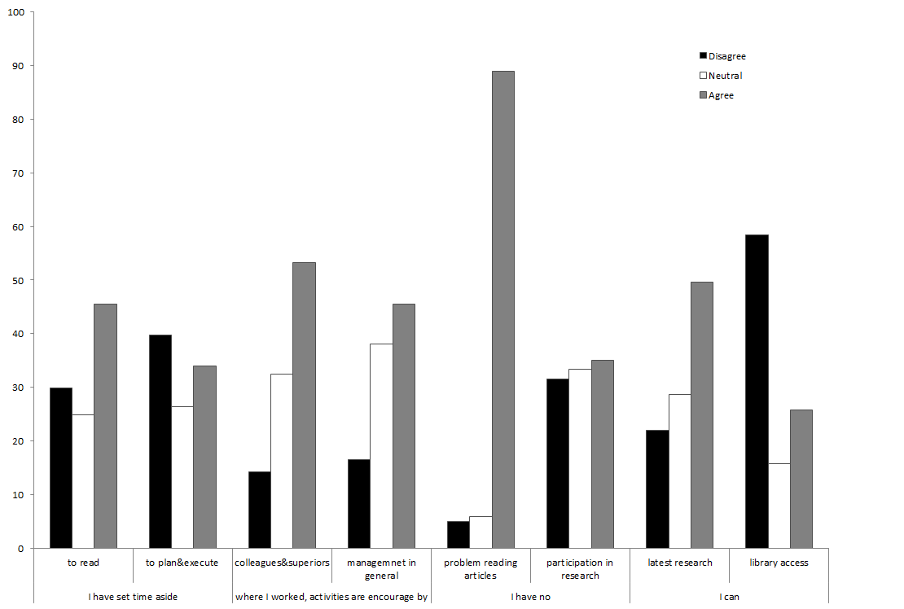
Work conditions and association with engagement in research-related activities.

Slide 29
Reading Relevant Scientific Articles
APTA journals were ranked first as the most-read journals followed by chartered society journals.

Slide 30
Discussion
Overall, physical therapists in this study had positive attitudes towards the application of research findings to their practice and towards reading physical therapy research to update their knowledge.
This is an indicator of a shift towards evidence-based practice.

Slide 31
Discussion
There was a common belief that they had less of a role, as well as a reduced ability, intention and level of engagement, in initiating research.
This could probably be due to work overload, lack of time and limited access to library resources; this was made evident by the low level of contribution to research.

Slide 32
Discussion
Physical therapists involved in this study did not perceive themselves to be competent in initiating research.
This could be attributed to a lack of skill in initiating and conducting their own research.
Methods for improving research skills need to be addressed and greater efforts should be made to enhance engagement in research.

Slide 33
Implications
The findings of this study could contribute to the development of PT curriculum in Kuwait University that should emphasize research and evidence-based practice.
We recommend the development of a system to stimulate engagement in research-related activities among physical therapists in Kuwait.

Slide 34
Conclusion
Physical therapists in Kuwait had a great sense of responsibility and a positive attitude towards research.

Slide 35
Conclusion
The key barriers to research identified in this study as reported by the participants were:
  Work load.
  Lack of time .
  Lack of research skills.
  Limited access to electronic library resources.

Slide 36
Thank you

