Slide 1

ONE STEP AHEAD – TO PREVENT MASTITIS IN DAIRY ANIMALS
Dr. Sameer Sawant,
Vice President, Asia Pacific & Indian Continent
IDD Juvelit Group (Sweden)

Slide 2
Mastitis
Bovine mastitis is very common in cows of both developed and developing countries. The prevalence of clinical and subclinical mastitis (SCM) varies from country to country.
Annual losses due to Mastitis in dairy is approximately USD 2 Billion USD in USA & more than 500 million USD in India, so you can imagine all over the world
Mastitis is ranked second after infertility as a main reason for culling cows. 20-50 % of dairy cows on farms are treated for udder infection every year.
Subclinical Mastitis is responsible for 70% of economic losses
The prevalence of mastitis by considering different risk factors like management practices, age, lactation, breed, season, quarters, and herd.

Slide 3
Mastitis
Inflammation of the mammary gland significantly reduces milk production in dairy cows. In response, to infections, white blood cells migrate to the mammary gland to help fight off invading organisms. These white cells also appear in milk and are measured as somatic cell counts (SCC). Determination of these counts in milk is therefore a reflection of the extent of infection in the four quarters of the udder.
For many years a relationship has been identified in dairy cows between increased somatic cell count of milk and reduction in milk volume by the cow.
Somatic cell count (ml) Reduction in Milk Volume
250,000 3%
400,000 5%
400,000 – 1,000,000 8-12%
More than 1,000,000 16-20%
In dairy cattle it is generally accepted that SCC greater than 200,000/ml indicate mammary gland inflammation.

Slide 4
Schedules
Data was collected from various regions of the state of India for a period of one year.
Data related to age, lactation & breed was recorded
Clinical Mastitis – changes in udder- redness, rise in temp,swelling,hardness, change in milk color, reduction in quality & quantity of milk
Test used SFMT ( Surf Field Mastitis Test)
Age of selected cows ranged from 3-13 years
Cows between 1st & 8 th lactation were selected
Breed wise prevalence of mastitis in cows - HF, Jersey, local breeds & ND
Four Seasons – Nov-Feb, March –May, June-Aug, Sept-October,
Quarter wise milk samples were collected
Herd wise – Organized & Un organized
Statistical analysis of the data was done

Slide 5
Age-Wise Prevalence of Bovine Mastitis
The highest prevalence of SCM was recorded in the age group of 7–10 years followed by the group of cows with age greater than 10 years and the least was recorded in the age group of 3–6 years.
The highest prevalence of clinical mastitis was recorded in the group of cows with age greater than 10 years followed by group of 7–10 years and the least was recorded in the age group of 3–6 years when tested with all three diagnostic tests.
The statistical analysis of data showed there was significant effect on age-wise prevalence of subclinical mastitis, whereas there was no significant effect on age-wise prevalence of clinical mastitis in the study area
Age.xlsx

Slide 6
Lactation-Wise Prevalence of Mastitis
The highest prevalence of SCM in cows detected by SFMT was in the 6th lactation period followed by the 5th, 2nd, 3rd, 1st, 4th, and 7th and the least was in the 8th lactation period.
The highest prevalence of clinical mastitis in cows detected by SFMT was in the 6th lactation followed by the 5th, 3rd, 4th, 1st, 7th, and 8th and the least was recorded in the 2nd lactation period.
The statistical studies showed there was significant effect on lactation-wise prevalence of SCM, whereas there was no significant effect on lactation-wise prevalence of clinical mastitis in the study area

Slide 7
Breed-Wise Prevalence of Bovine Mastitis
The highest prevalence of SCM and clinical mastitis in cows was in HF followed by Jersey, ND, and local breeds.
The statistical studies showed that there was no significant effect on breed-wise prevalence of subclinical mastitis & clinical mastitis when tested with SFMT
Breed.xlsx

Slide 8
Quarter-Wise Prevalence of Bovine Mastitis
The prevalence of SCM of cows indicated that highest incidence of bovine mastitis was in single quarter followed by two and four and the least was recorded in the three quarters.
The prevalence of clinical mastitis of cows detected by SFMT indicated that highest incidence of bovine mastitis was involved in two quarters followed by four and one and the least was recorded in the three quarters.

Slide 9
Herd-Wise Prevalence of Bovine Mastitis
The herd-wise prevalence of SCM and clinical mastitis of cows indicated that incidence of SCM and clinical mastitis in unorganized herds was more when compared with that of organized herds.
The statistical analysis of data showed there was significant effect on herd-wise prevalence of subclinical mastitis but there was no significant effect on herd-wise prevalence of clinical mastitis
Herd.xlsx

Slide 10
Season-Wise Prevalence of Bovine Mastitis
The season-wise prevalence of SCM and clinical mastitis in cows showed the highest prevalence was in monsoon followed by post-monsoon, winter, and summer seasons.
The statistical analysis of data indicates there was significant effect on season-wise prevalence of subclinical mastitis, whereas there was no significant effect on season-wise prevalence of clinical mastitis in the study area

Slide 11
Conclusion
In this study SFMT method used for the diagnosis of bovine mastitis. The age- and lactation-wise prevalence study indicates older age and cows with later part of lactation stage were more susceptible to bovine mastitis.
The breed-wise prevalence of bovine mastitis showed the exotic breeds like HF and Jersey were more prone to bovine mastitis than indigenous cows.
Season-wise study showed that cows are more sensitive to bovine mastitis during monsoon.
The quarter-wise prevalence of bovine mastitis indicated that preparation of teats and udder for milking is poorly practiced in this region, hence, preventive measures like washing of teats with clean water and drying completely before milking, dipping the teats with good sanitizing solution after milking as to be followed which not only helps to reduce infection of individual cow but also controls the spread of pathogenic bacteria to other animals and humans. The study also indicated that cows in organized herds are less exposed to the bovine mastitis.

Slide 12
Conclusion
The current analysis explored the fact that there exists a significant relationship between age of the cow and the subclinical mastitis but there is no significant association between age and clinical mastitis. Similarly significant association exists between lactation period of cow and subclinical mastitis but not showing in clinical mastitis. However there is no significant relationship between breed of the cow and subclinical mastitis
Season-wise prevalence analysis indicates that there is a strong association between seasons and the subclinical mastitis but no such association exists between season and the clinical mastitis. The study also indicated that cow herds and subclinical mastitis have high significant association whereas no major association was recorded between herds and clinical mastitis.

Slide 13
Conclusion
Considering the results of the current investigation it is concluded that subclinical mastitis is directly associated with age, management practices, lactation period, and environmental factors of the cow and clinical mastitis is more associated with the breed of the cow and environmental conditions.
The present study specifies that management practices, environment factors play a major role in both subclinical and clinical mastitis; therefore it is recommended to maintain hygienic conditions in the herds for controlling the bovine mastitis.

Slide 14
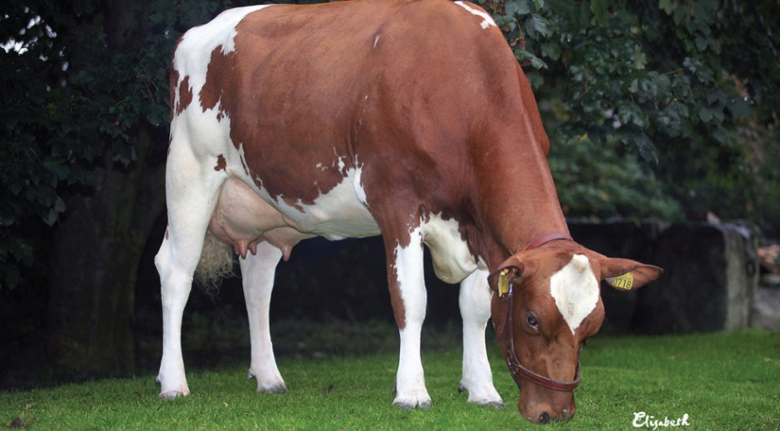
TO SUCCEED IN UDDER HEALTH WORK IN A COWHERD IS REQUIRED:
Involvement of owners and employees, where everyone takes 100 percent responsibility for the area.
Interest and perseverance in work practices designed to prevent disease.
Work towards the prevention of problems, not ’’ only ’’ antibiotic treatment without reflecting.
Good Feed management, Perfect drinking water quality, optimal milking routines.

Slide 15
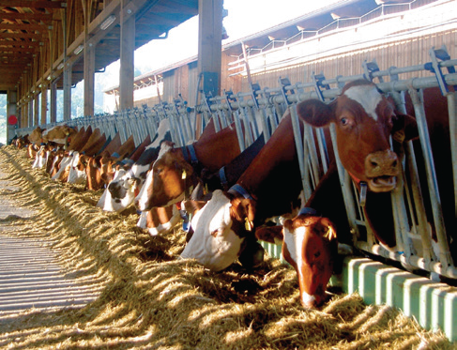
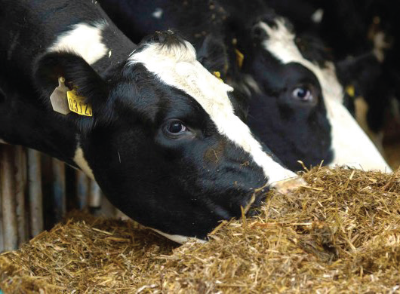
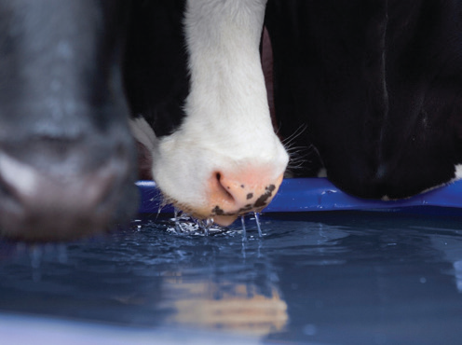
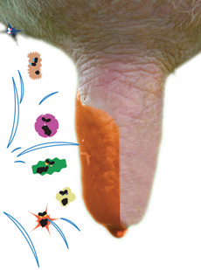
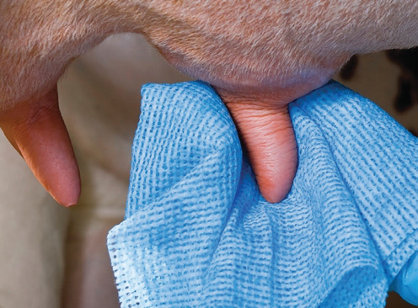
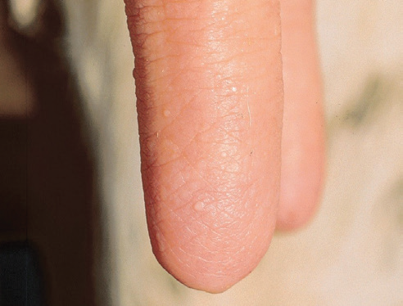
With perfect management routines around the animals, from Start To Finish - Created Perfect Udder health and milk quality.

Slide 16
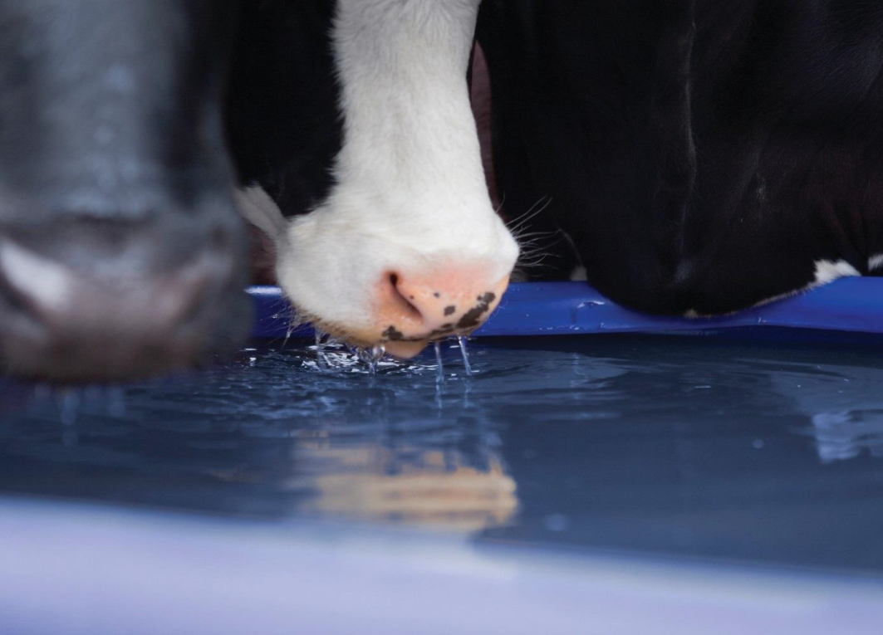
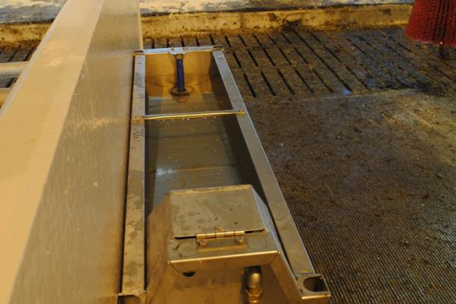
Disinfection of drinking water
Water quality is much important for: How healthy cows are. How perfect udder health cows have and how good milk quality they produce!
Have always full focus on the drinking water!

Slide 17
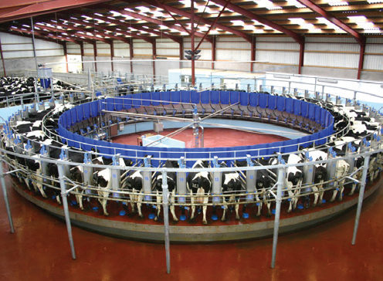
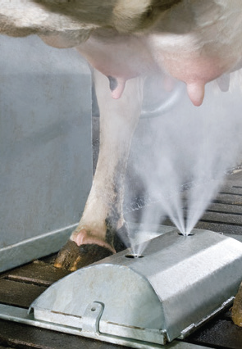

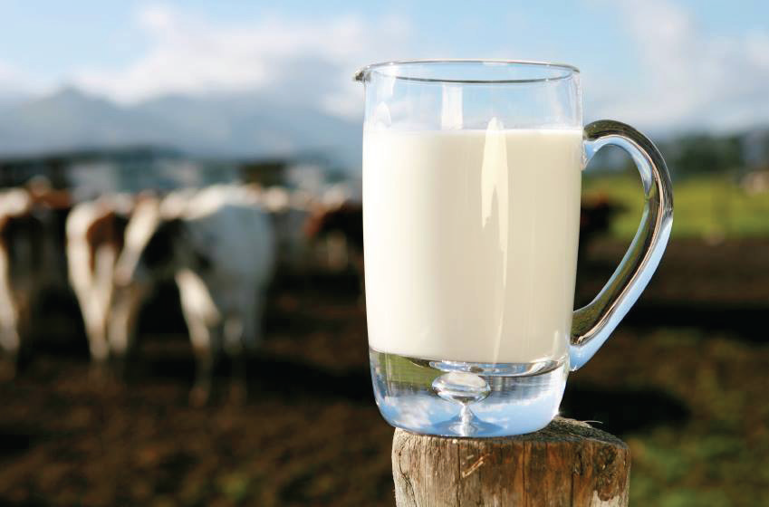
It is this that is the goal! A happy farmer family that create good profitability with fresh milk of the highest quality

Slide 18
MASTITIS IS NOT ALWAYS VISIBLE
Acute (visible) mastitis can best be described as the tip of the iceberg. The cow may be the one that’s been detected as a mastitis cow, but may be there are several cows that are Sub-clinically infected cows
VISIBLE SIGNS:
Mild Mastitis: Cloggy milk
Moderate Mastitis: Swollen udder
Severe Mastitis: Loss of appetite/fever
NO VISIBLE SIGNS:
Milk looks OK. Udder looks OK. Cow behaves normally
But the cow might still be infected which affects milk quality

Slide 19

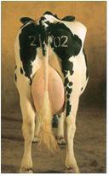
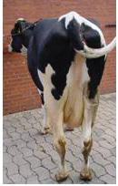

MASTITIS IS NOT ALWAYS VISIBLE
HEALTHY:
Mammary Epithelial Cells
MASTITIS:
<30% of secretion
(~no milk)
HEALTHY:
50 litres milk/day
MASTITIS:
MEC, Granulocytes

Slide 20
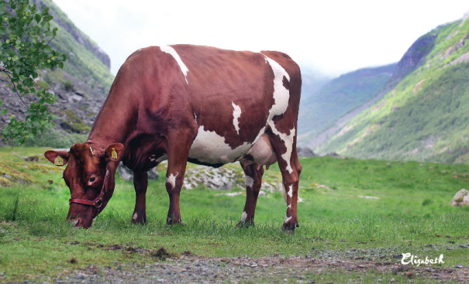
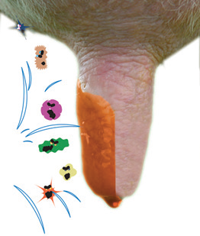
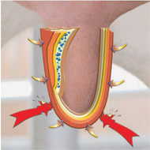
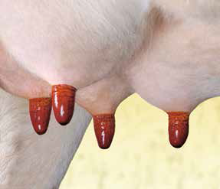
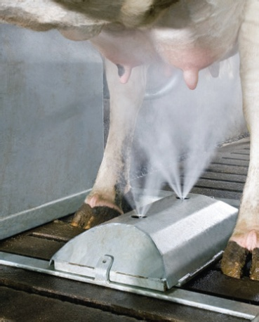
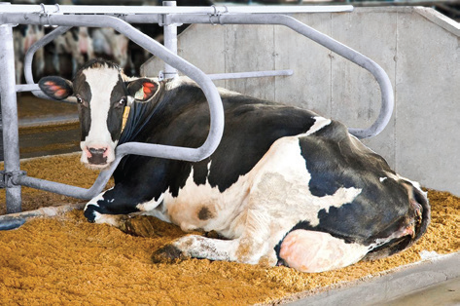
HOW TO PREVENT MASTITIS
“The key to prevent is to reduce the number of bacteria to which my teat ends are exposed”
Maintain good hygiene during milking

Slide 21
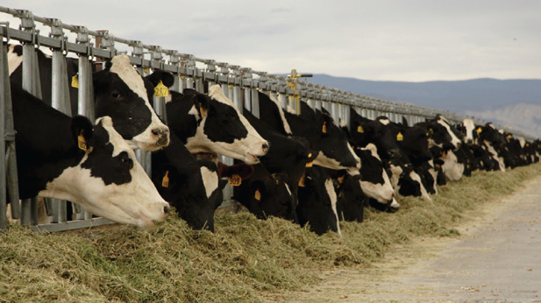
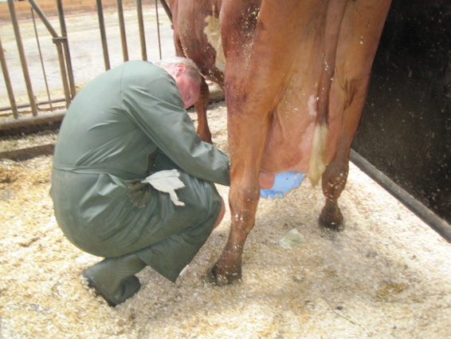
HOW TO PREVENT MASTITIS
Maintain good hygiene during milking. Disinfect all teats after every milking
Provide nutritious and healthy feed
Treat new and severe clinical cases of mastitis promptly and record data

Slide 22
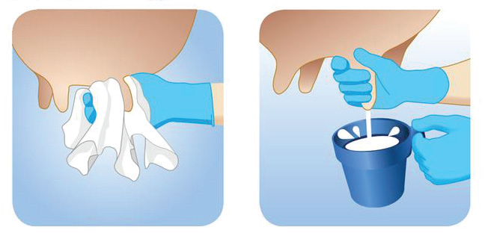
HOW TO PREVENT MASTITIS
Clean teats before milking
• Clean each teat
and teat end, preferably using a teat cleaning agent
• Always use disposable paper or udder cloths to
clean and carefully dry each teat
• Never use the same paper or cloths on more than one cow
Always pre-milk
• Never let milk run onto the floor when you pre-milk
• Strip 2–3 milk jets from each teat into an inspection vessel
• Examine the milk for flocculation, clumping or color changes
• Always separate abnormal milk
• Pre-milking stimulates milk let-down

Slide 23
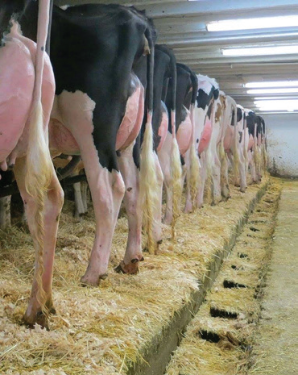
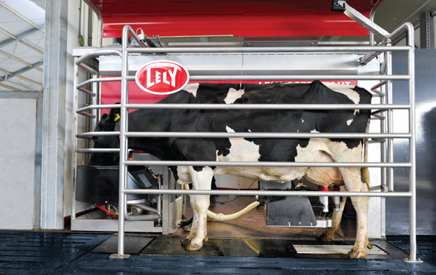
HOW TO PREVENT MASTITIS
Environment should be as clean and dry as possible
Keep equipment clean and functional

Slide 24
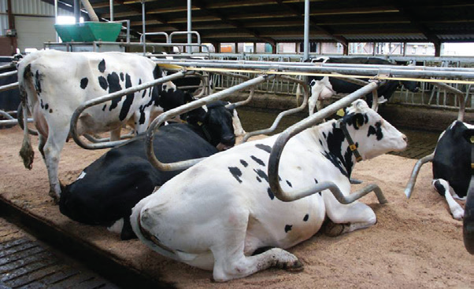
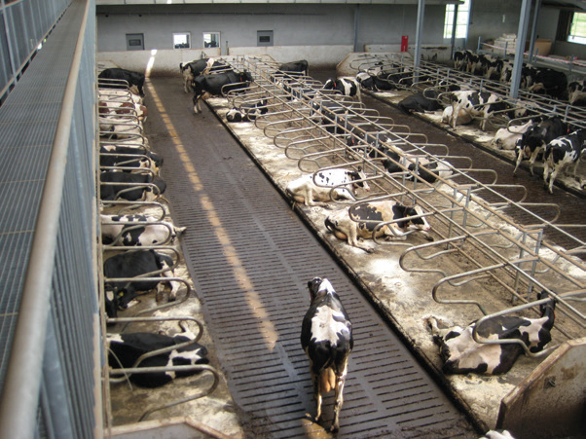
HOW TO PREVENT MASTITIS
Exchange bedding material every 48h
Don’t overstock the barn

Slide 25

HOW TO PREVENT MASTITIS
Choose appropriate cases
Separate healthy cows from infected ones

Slide 26
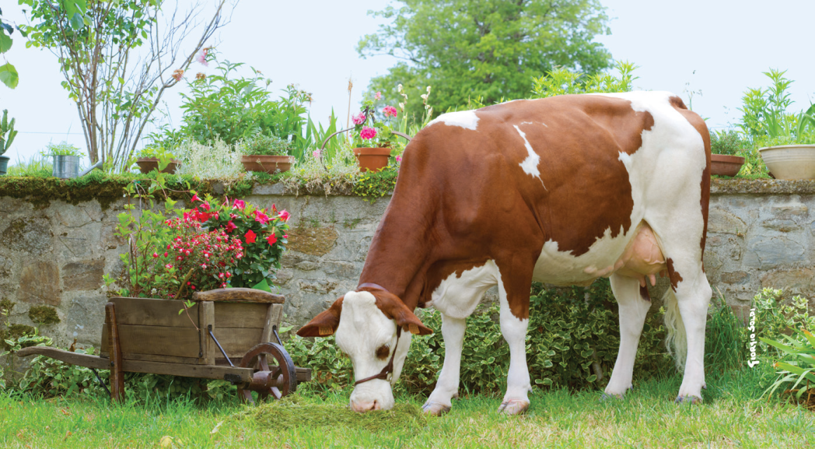
RESISTANCE TO ANTIBIOTICS IS A PROBLEM
The solution is not to increase the level of treatment but rather reduce
the need for antibiotics by closely monitoring cell count
Optimize use of antibiotics. Carefully select your treatment cases

Slide 27
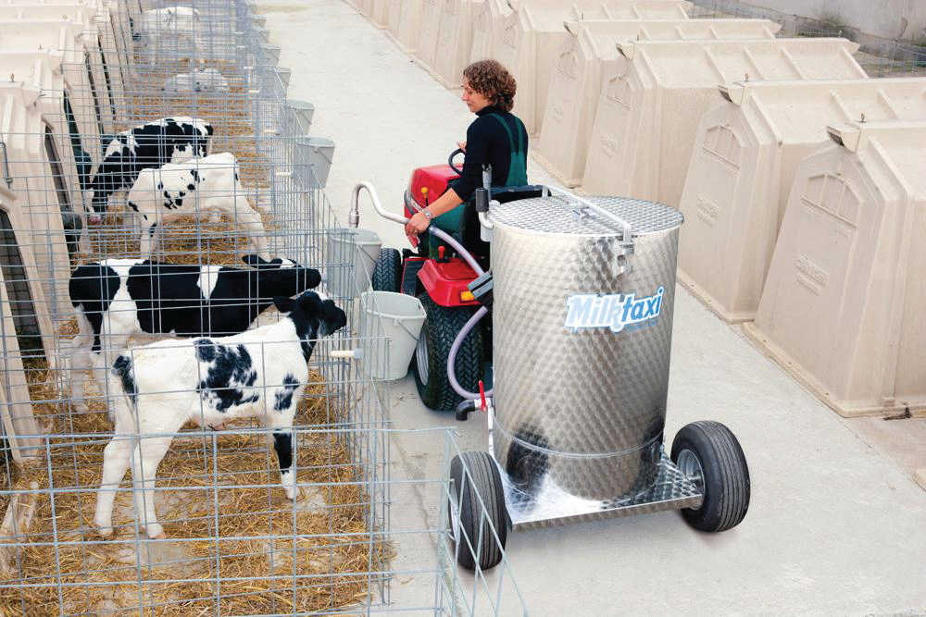
RESISTANCE TO ANTIBIOTICS IS A PROBLEM
Antibiotic treatment of mastitis is very costly and creates a lot of waste milk
“I don’t want to be fed with antibiotics if I don’t need them”

Slide 28
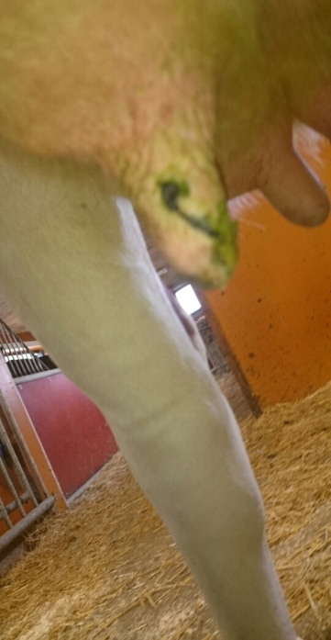
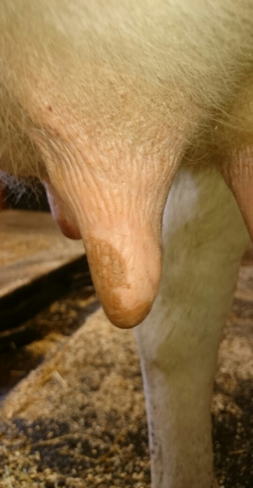
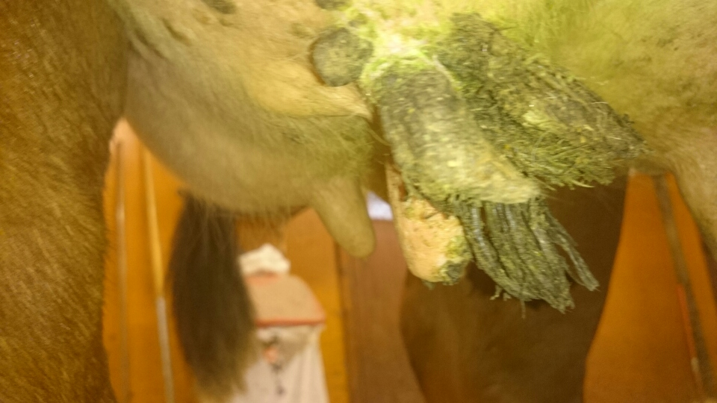
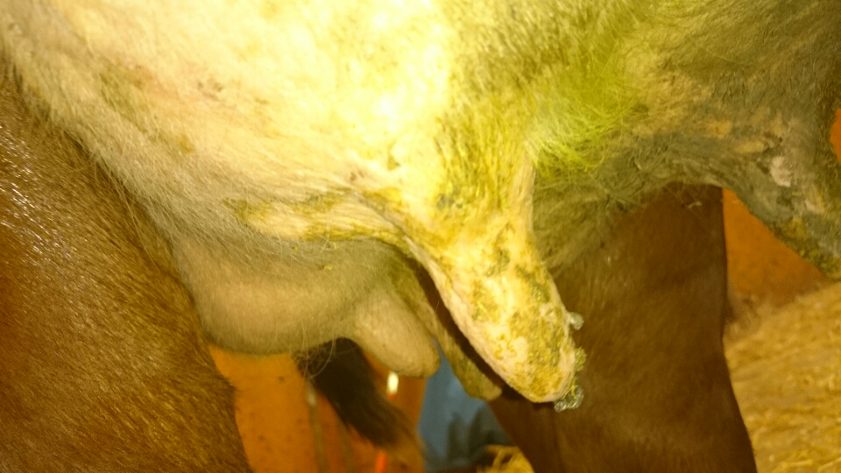
Examples of Right Treatment at Right time
This cow photo is from a difficult teat trampling that made the teat was very swollen and deeply forked. The first photo is taken a day after the teat trampling, this photo is from June 26, 2015. The second photo number 2 is taken August 14, 2015 on the same cow and same teat, The cow has only been sprayed with IDD Juvelit Micro teat Dip, No mastitis!!! and no high somatic cell counts as a result, we can hardly believe it's true the farm mangers comments as significant difference.
This is a Swedish milk cow that had extremely warts, the farm manager began to spray the IDD Juvelit Micro teat Dip on all cows on the farm included this infected cow with warts on June 1 2015.
Photo number 3 was taken June 1, 2015, photo number 4 is taken July 21, 2015. There is significant difference

Slide 29
PREVENTION IS BETTER THAN CURE
Increase efforts to identify the chronic cases of mastitis
This will save time and money and will ensure better milk quality
Make efforts to treat with right treatment at right time
Thanks to Mr. Johan Larsson,
Director –President,
IDD Juvelit Group

Slide 30
Thank you for your attention
We are committed towards
Healthy Animals –Good Udder Health-Quality Milk

