Slide 1
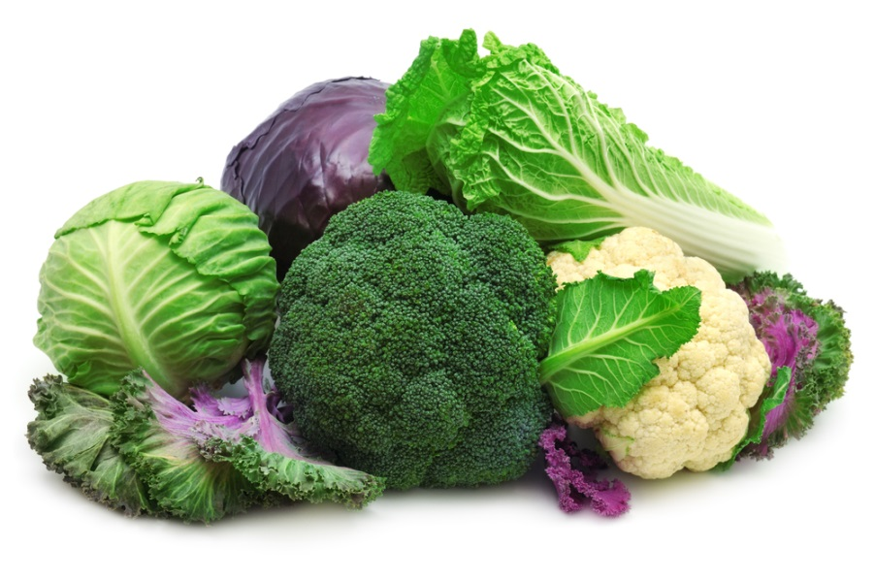

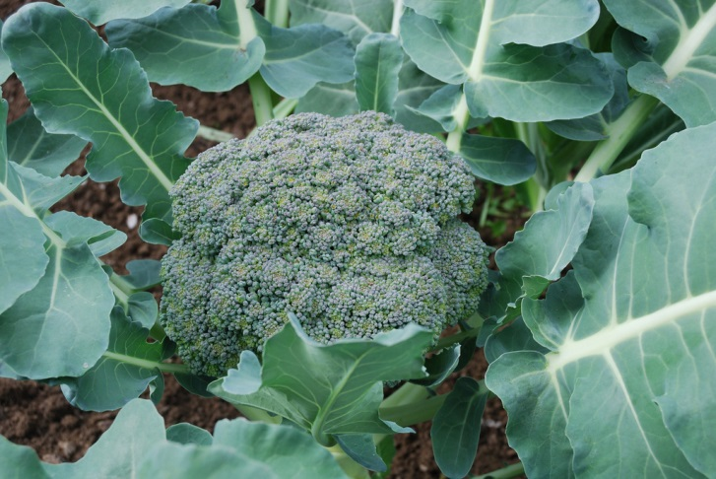
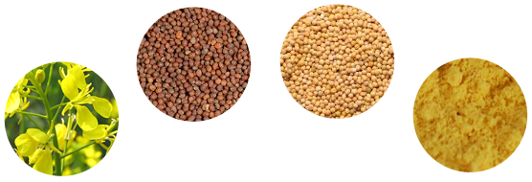
Novel approach to intensify the formation of the bioactive sulforaphane in cooked Brassica vegetables
Dr. Sameer Khalil Ghawi, University of Reading, UK
Notes:
Add some pictures, and work more in presentation such as size, colour…

Slide 2
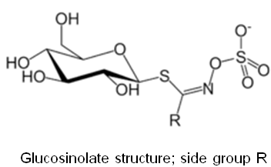
Glucosinolates-myrosinase system in Brassica vegetables
Glucosinolates (GLS), sulphur and nitrogen-rich products, are a group of secondary plant metabolites found in Brassica vegetables.
To date, over 120 different glucosinolates have been identified (Oerlemans et al., 2005), categraizing is based on the side group (Fahey, Zalcmann, & Talalay, 2001)
Myrosinase (thioglucoside glucohydrolase) : is a family of enzymes found in all glucosinolate containing plants

Slide 3
Glucosinolates-myrosinase system in Brassica vegetables
In plant tissues, myrosinase and glucosinolates are physically segregated in distinct compartments. This cellular segregation keeps glucosinolates stable.
Myrosinase catalyzes the hydrolysis of glucosinolates.
Upon tissues damage during handling or processing of Brassica vegetables, myrosinase comes into contact with glucosinolates and the hydrolysis initiates.
Hydrolysis releases glucose and different compounds depending on the side group of glucosinolates and the reaction conditions (pH, EPS, metallic ions).

Slide 4
Importance of the breakdown products
In addition to their nutritional value, Brassica vegetables are thought to have chemoprotective properties
Some of the hydrolysis compounds (e.g. indole and isothiocyanates) are claimed to be cancer-protective compounds.
Sulforaphane (isothiocyanate), derivative of 4-methylsulfinylbutyl glucosinolate (glucoraphanin), received a particular interest.
Moreover, recent studies showed sulforaphane to exhibit antimicrobial activity against a wide variety of bacterial and fungal pathogens.
Glucosinolates and the hydrolysis compounds contribute the distinct aromas and tastes in Brassica vegetables.

Slide 5
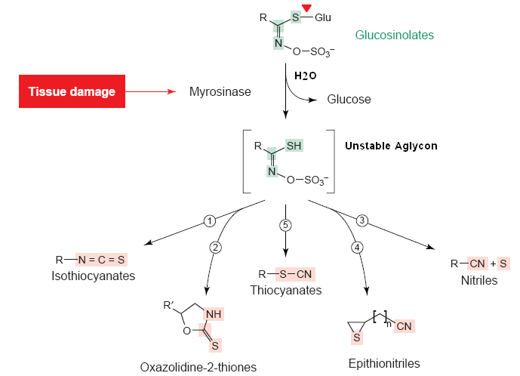
Glucosinolates-myrosinase system

Slide 6
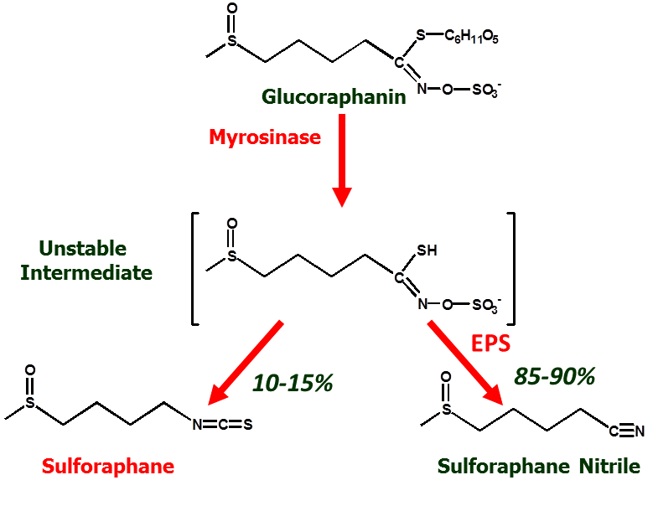
Glucoraphanin- myrosinase reaction

Slide 7
Thermal stability of glucosinolates-myrosinase system
Glucosinolates are thermally stable, and most of the decline in glucosinolates content after cooking is basically due to leaching into processing water.
On the other side, myrosinase is more likely to be inactivated after domestic cooking, and hence stop of the hydrolytic breakdown of glucosinolates.
This means consuming intact glucosinolates from cooked brassica.
Fortunately, glucosinolate hydrolysis may occur in the gastrointestinal tract under the action of the colonic microflora, however, the hydrolysis rate is much lower compared to hydrolysis resulting from the plant myrosinase (usually less than one third).

Slide 8
Study approach
During my PhD project, I utilized two approaches to enhance the formation of sulforaphane.
The first was by applying HPP which I am not talking about today.
The second approach:
Addition of low concentrations of Brassica condiments to cooked broccoli, has thermally inactive myrosinase, will reinitiate the hydrolysis reaction of glucoraphanin towards sulforaphane.
These sources will provide an intact myrosinase, and might be used as a condiments to improve palatability of Brassica vegetables.
Mustard seeds as was used as additive in this study:
Has higher thermal stability myrosinase.
does not contain ESP as previously reported.
Very widely used in diet.

Slide 9
Methods
Sample preparation
Cut about 4 Cm from top
Vacuum sealed (100g, LDPE)
Processed at different conditions (30 to 100 ⁰C; 4, 8 and 12 min)
Freezing in liquid nitrogen
lyophilization
Grinding and sieving
Broccoli powder, -20 ⁰C
analysis

Slide 10
Methods

Slide 11
Myrosinase thermal stability
The important condition, as source A might be added while or at the end of cooking
Mustard seeds
Broccoli
Domestic cooking we are completely loosing myrosinase activity, and hence stopping the enzymatic reaction

Slide 12
Thermal stability of glucoraphanin in broccoli (no enzymatic reaction, no leaching)
Glucoraphanin content in raw broccoli:10.3±0.21 μmol/g DW
□ 4 min; ▥ 8 min; ▨ 12 min

Slide 13
Effect of thermal processing on sulforaphane content in broccoli
(♦) 4 min; (■) 8 min; (▲) 12 min

Slide 14
Effect of thermal processing on sulforaphane nitrile content in broccoli
(♦) 4 min; (■) 8 min; (▲) 12 min

Slide 15
Sulforaphane content in cooked broccoli samples after adding mustard seed powder.
□ boiled broccoli, no mustard seeds; ▥ boiled broccoli with unprocessed MS, 1%
▨ boiled broccoli with unprocessed MS, 2%; ▧ boiled broccoli with processed MS (2%) for 5 min at 90 °C; ▤ boiled broccoli with processed MS (2%) for 5 min at 100 °C

Slide 16
Conclusions
In raw broccoli the predominant hydrolysis product of glucoraphanin is sulforaphane nitrile (more than 85%), due to the activity of epithiospecifier protein. However, mild cooking increases the conversion of glucoraphanin to sulforaphane, due to the inactivation of epithiospecifier protein while myrosinase is still partly active
Domestic cooking leads to myrosinase activation, while glucoraphanin is still stable.
Adding raw or slightly cooked mustard seeds to fully cooked broccoli provides a natural source of myrosinase enzyme needed to convert glucoraphanin to sulforaphane. This guarantees the conversion of all glucoraphanin to anticarcinogen sulforaphane, but not to sulforaphane nitrile which does not have antiarcinogenic properties.

Slide 17
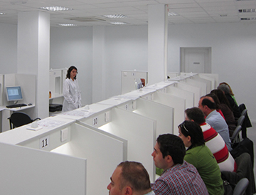
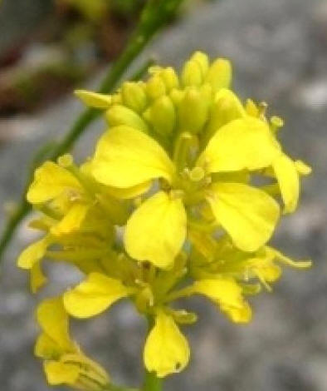
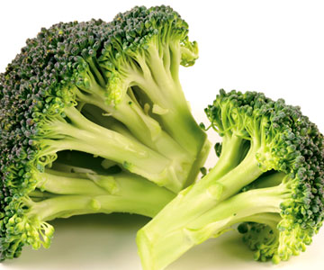
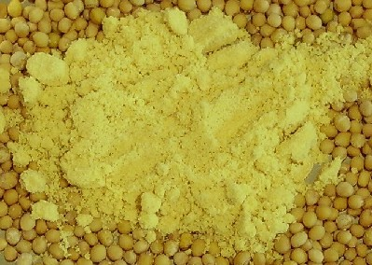
Sensory and consumer study
Gender | F/M (73.6%/26.4%)
Age | 18-30 years (43.3%) 31-45 years (40.3%) 45-65 years (19.4%)
Broccoli consumption | Less than once a month (9.7%) More than once a month (45.8%) More than once a week (44.4%)
Cooking methods used for broccoli (consumers selected all that applied) | Steamed (36.1%) Boiled (62.5%) Microwaved (26.4%) Stir-fried (55.6%) Grilled (4.2%) Raw (12.5%)

Slide 18
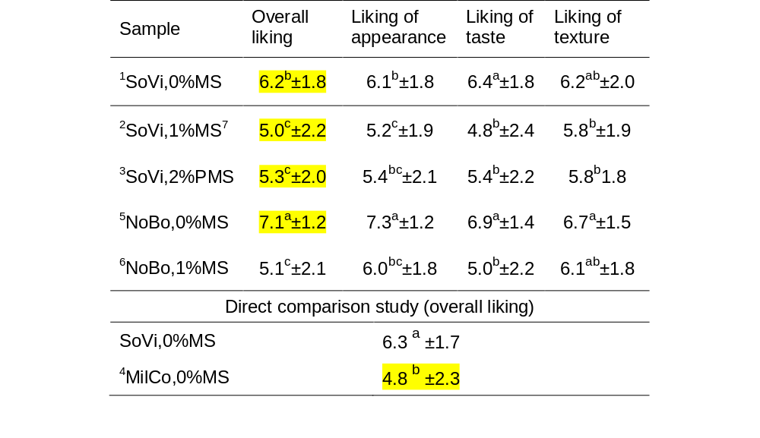
Consumer liking of six broccoli samples prepared by different methods
¹: Sous vide cooking (100 ºC, 12 min, 0%MS); ²: Sous vide cooking (100 ºC, 12 min, 1%MS) ; ³: Sous vide cooking (100 ºC, 12 min, 2%processed MS); ⁴: Mildly cooked, sous vide (70 ºC, 12 min, 0%MS); ⁵: Normal boiling (100 ºC, 7 min, 0%MS); ⁶: Normal boiling (100 ºC, 7 min, 1%MS); MS: Mustard seeds; different superscripts in the same column indicate significantly different means (P<0.05). Data are mean ± SD, n=72.

Slide 19
Liking of five clusters of consumers obtained from hierarchical cluster analysis
Cluster | ¹SoVi 0%MS | ²SoVi 1%MS⁷ | ³SoVi 2%PMS | ⁴MilCo 0%MS | ⁵NoBo 0%MS | ⁶NoBo 1%MS
1(13.9%) | 6.8ª±1.3 | 3.9^{b}±1.3 | 3.0^{b}±1.2 | 6.3ª±2.0 | 7.2ª±1.1 | 3.8^{b}±1.0
2(31.9%) | 6.1a^{b}±1.1 | 7.0ª±1.9 | 5.5^{b}±2.0 | 3.6^{c}±1.5 | 6.8^{ab}±1.9 | 6.7^{ab}±1.4
3(19.4%) | 5.1b^{c}±1.7 | 3.6^{c}±1.6 | 6.6a^{b}±2.4 | 6.8^{ab}±1.0 | 7.0ª±1.6 | 3.4^{c}±0.8
4(6.9%) | 6.0^{b}±0.5 | 6.6a^{b}±0.4 | 6.8a^{b}±0.7 | 7.8ª±1.7 | 7.0^{ab}±0.8 | 7.6^{ab}±0.7
5(27.7%) | 7.0ª±1.9 | 3.8b^{c}±2.1 | 5.1^{b}±0.9 | 3.1^{c}±1.8 | 7.6ª±1.4 | 4.5^{bc}±1.2
Overall liking | 6.2 | 5.1 | 5.3 | 4.8 | 7.1 | 5.1

Slide 20
Conclusions
Isothiocyanate formation in broccoli could be increased by employing low intensity cooking conditions which leaves myrosinase in its active form, or by the addition of a natural source of myrosinase to fully cooked broccoli.
Mild cooking option was not acceptable to consumers.
Addition of mustard seed powder as an active source of myrosinase, significantly changed sensory attributes of broccoli samples and affected consumer liking.
Despite the significant increase in pungency and burning sensation in samples with added mustard seeds, a considerable number of consumers (32%) liked it
More work should be done to assess the effect of adding other Brassica condiments (e.g. rocket, watercress and horseradish) on the sensory attributes and consumer acceptance of cooked Brassica vegetables. In addition, isothiocyanate bioavailability should be assessed after adding those condiments to cooked Brassica vegetables.

Slide 21


Aknowledments
Prof. Keshavan Niranjan
Dr. Lisa Methven

Slide 22
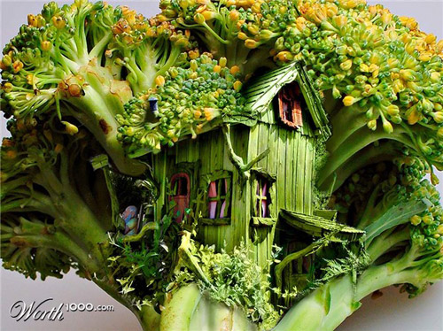
Please know how to eat me!
Mr Broccoli..
Thank you for your patience, questions

Slide 23
Introduction1

Slide 24
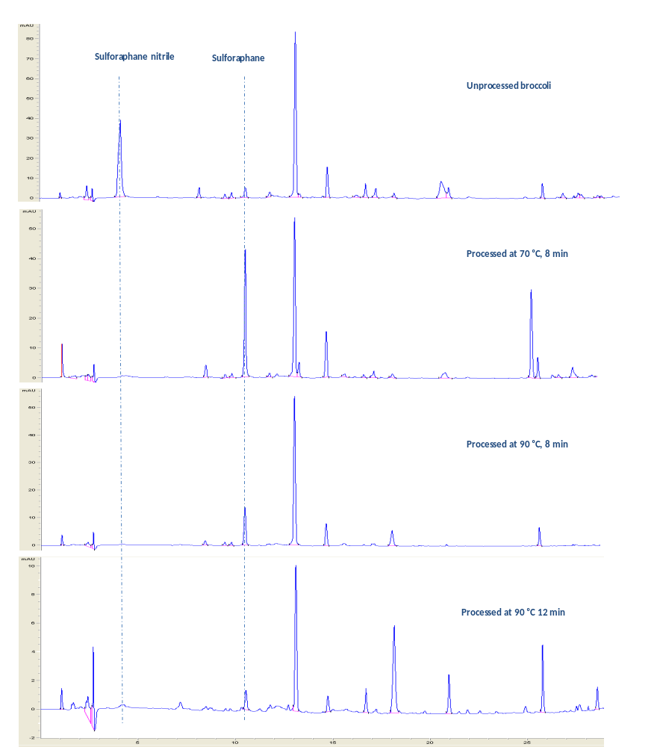
The change in sulforaphane and sulforaphane quantities during processing

Slide 25
Sensory characterisation
 | ¹SoVi 0%MS | ²SoVi 1%MS | ³SoVi 2%PMS | ⁴MilCo 0%MS | ⁵NoBo 0%MS | ⁶NoBo 1%MS | Significance (p value)
Green Colour (Florette) | 67.6 ^{ab} | 65.3 ^{ab} | 74.2 ª | 68.9 ^{ab} | 58.7 ^{b} | 60.4 ^{ab} | 0.02
Evenness of green colour | 52.6 ª | 55.7 ª | 62.5 ª | 61.8 ª | 55.3 ª | 55.0 ª | 0.38
Yellow (florets) | 23.2 ª | 17.8 ª | 16.3 ª | 12.1 ª | 18.4 ª | 19.1 ª | 0.54
Vibrancy | 43.0 ^{b} | 42.7 ^{b} | 48.4 ^{ab} | 62.3 ª | 61.5 ª | 57.7 ^{ab} | <.01
Firmness of texture | 41.8 ^{bc} | 35.7 ^{c} | 49.4 ^{b} | 89.4 ª | 49.6 ^{b} | 50.1 ^{b} | <.0001
Soggy | 31.3 ª | 35.8 ª | 23.1 ª | 5.8 ^{b} | 21.2 ^{ab} | 20.0 ^{ab} | <.0001
Boiled green vegetables odour | 57.0 ª | 52.0 ª | 47.3 ª | 46.7 ª | 44.9 ª | 43.4 ª | 0.37
Sulfur odour | 12.0 ª | 13.4 ª | 10.2 ª | 13.0 ª | 7.3 ª | 12.0 ª | 0.08
Pungent odour | 12.1 ^{ab} | 19.2 ^{ab} | 15.2 ^{ab} | 21.2 ª | 8.2 ^{b} | 15.1 ^{ab} | 0.01
Mustard odour | 0.3 ^{b} | 18.1 ª | 11.0 ª | 0.0 ^{b} | 0.0 ^{b} | 9.7 ^{ab} | <.0001
Earthy odour | 8.0 ª | 11.4 ª | 9.5 ª | 11.3 ª | 8.7 ª | 9.9 ª | 0.88
Green/grassy | 34.3 ^{ab} | 32.8 ^{ab} | 29.6 ^{ab} | 40.4 ª | 25.7 ^{b} | 29.7 ^{ab} | 0.07
Sweet odour | 12.7 ª | 9.8 ª | 12.0 ª | 16.1 ª | 13.7 ª | 11.8 ª | 0.37
Savoury odour | 8.5 ª | 12.9 ª | 10.1 ª | 9.7 ª | 7.8 ª | 10.8 ª | 0.38
Burnt odour | 3.0 ª | 0.6 ª | 0.8 ª | 0.3 ª | 1.6 ª | 0.7 ª | 0.18
Bitter taste | 14.2 ^{ab} | 22.6 ^{ab} | 26.5 ª | 18.9 ^{ab} | 10.5 ^{b} | 23.0 ^{ab} | 0.03
Sweet taste | 18.1 ª | 8.2 ^{b} | 9.7 ^{ab} | 17.2 ^{ab} | 18.7 ª | 9.7 ^{ab} | <.01
Umami taste | 10.3 ^{ab} | 12.9 ª | 11.2 ^{ab} | 10.3 ^{ab} | 7.3 ^{b} | 10.2 ^{ab} | 0.07
Sour taste | 3.3 ª | 4.7 ª | 4.0 ª | 2.2 ª | 2.0 ª | 3.1 ª | 0.32
Salty taste | 3.7 ^{ab} | 8.1 ª | 5.1 ^{ab} | 2.6 ^{b} | 2.4 ^{b} | 4.5 ^{ab} | 0.02
Metallic taste | 7.9 ^{ab} | 11.8 ª | 12.5 ª | 7.0 ^{ab} | 3.7 ^{b} | 12.5 ª | <.01
Boiled green vegetables flavour | 48.6 ª | 43.0 ª | 42.2 ª | 37.7 ª | 39.6 ª | 37.2 ª | 0.55
Sulfur flavour | 10.0 ª | 14.3 ª | 13.1 ª | 6.3 ª | 6.2 ª | 9.8 ª | 0.08
Pungent flavour | 9.6 ^{cd} | 27.9 ^{ab} | 37.1 ª | 12.6 ^{bcd} | 4.8 ^{d} | 25.1 ^{abc} | <.0001
Mustard flavour | 0.3 ^{b} | 41.8 ª | 43.2 ª | 0.0 ^{b} | 0.0 ^{b} | 36.7 ª | <.0001
Earthy flavour | 8.6 ª | 11.2 ª | 14.6 ª | 9.7 ª | 8.2 ª | 9.1 ª | 0.41
Green/grassy flavour | 30.6 ^{ab} | 29.3 ^{ab} | 27.2 ^{b} | 40.6 ª | 26.4 ^{b} | 25.7 ^{b} | 0.01
Savoury flavour | 11.3 ^{ab} | 14.8 ª | 12.9 ^{ab} | 6.7 ^{b} | 7.5 ^{b} | 10.8 ^{ab} | 0.01
Burnt flavour | 1.3 ª | 1.2 ª | 1.5 ª | 0.0 ª | 0.0 ª | 0.7 ª | 0.62
Stalk flavour | 11.4 ª | 13.7 ª | 8.7 ª | 18.0 ª | 11.1 ª | 14.3 ª | 0.36
Moist | 49.8 ª | 49.2 ª | 46.9 ª | 28.4 ^{b} | 48.3 ª | 51.6 ª | <.0001
Hard texture | 32.6 ^{b} | 25.7 ^{b} | 35.6 ^{b} | 80.6 ª | 37.6 ^{b} | 34.2 ^{b} | <.0001
Grainy/gritty | 0.4 ^{b} | 5.3 ^{ab} | 9.0 ª | 3.9 ^{ab} | 1.0 ^{ab} | 7.2 ^{ab} | 0.02
Burning sensation | 0.0 ^{c} | 41.6 ^{ab} | 51.4 ª | 0.0 ^{c} | 0.3 ^{c} | 35.2 ^{b} | <.0001
Stringy | 7.4 ^{b} | 4.3 ^{b} | 4.7 ^{b} | 22.9 ª | 8.1 ^{b} | 3.2 ^{b} | <.01
Burn/pungncy aftertaste | 2.6 ^{c} | 30.3 ^{b} | 46.5 ª | 1.9 ^{c} | 1.5 ^{c} | 24.7 ^{b} | <.0001
Bitter aftertaste | 7.4 ^{c} | 18.7 ª | 17.4 ^{ab} | 12.3 ^{abc} | 5.8 ^{c} | 8.2 ^{bc} | <.01
Sweet aftertaste | 9.6 ª | 3.8 ª | 5.1 ª | 7.5 ª | 8.4 ª | 3.2 ª | 0.03
Savoury aftertaste | 8.5 ª | 13.4 ª | 10.2 ª | 7.5 ª | 6.0 ª | 7.7 ª | 0.07
Earthy aftertaste | 6.0 ª | 7.3 ª | 7.7 ª | 11.1 ª | 4.7 ª | 7.7 ª | 0.34
Metallic aftertaste | 4.7^{c} | 13.6ª | 12.3^{ab} | 6.1^{bc} | 1.2^{c} | 10.2^{abc} | <.0001

