Slide 1
Greening The Pharmaceutical Industry To Afford Good Laboratory Practice
Presented By
Prof. Dr. Salwa Elmeligie
Faculty of Pharmacy, Cairo University

Slide 2

I am so glade to be here in this International Conference of GLP , GCP & GMP.

Slide 3

Who am I
Professor & Head of Pharmaceutical Organic Chemistry, Faculty of Pharmacy, Cairo University.
2. Trainer in Faculty and Leadership Development Center, Cairo University.
3. Reviewer for Higher Education Institutions, conducted by the
National Authority of Quality Assurance and Accreditation of Education, Egypt.
4. Evaluator at Project administration, Ministry of Higher Education, Egypt.
5. Consultant at missions and Cultural Affairs at the Ministry of Higher Education, Egypt.
Other Posts:
1. Director of Career Center, Faculty of Pharmacy, Cairo University.
2. Director of Quality Assurance Unit, Faculty of Pharmacy,
October 6 University.

Slide 4
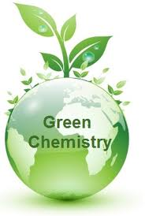

Slide 5
First, let’s consider chemistry’s benefits….
The chemical industries produce many products that
improve our lives and upon which we depend.

Slide 6
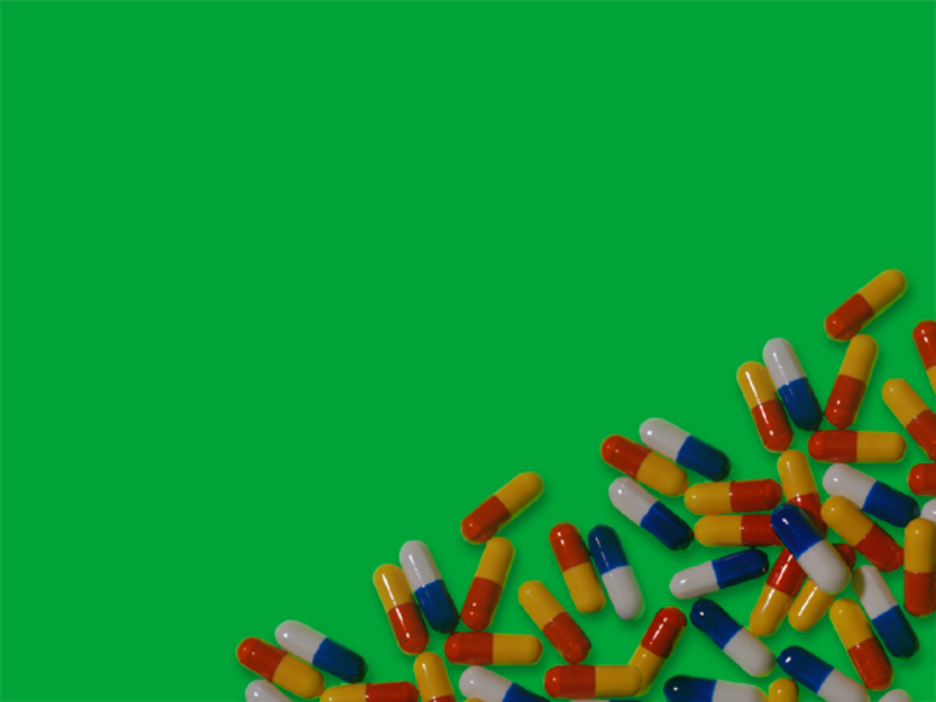
Benefits of chemical industries
Antibiotics and other medicines
Fertilizers, pesticides
Plastics
Nylon, rayon, polyester, and
other synthetic materials
Gasoline and other fuels
Water purification

Slide 7
“Better Things for Better Living Through Chemistry”
DuPont
Ibuprophen
Lipitor
Celebrex
Vioxx
Rogaine
Prozac
Viagra
Prilosec
Nylon
Dacron
Polystyrene
Acrylics
Teflon
Rayon
DNA
Recombinant
Technology
PCR
Notes:
Prilosec heartburn
Lipitor cholesterol
Rogaine hair loss
Celebrex, Vioxx arthritis

Slide 8
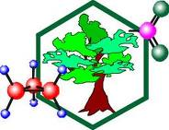
Green chemistry dates to the Pollution Prevention Act of 1990 which established a national US policy to prevent or reduce pollution at its source.
In 1993, the program was renamed "Green Chemistry" and expanded to include greener solvents and safer chemicals.

Slide 9
The 12 Principles of Green Chemistry
1- Prevention of wastes
It is better to prevent waste than to treat or clean up waste after it has been created.
2-Less Hazardous Chemical Synthesis
Wherever practicable, synthetic methods should be designed to use and generate substances that possess little or no toxicity to people or the environment.
.
3-Designing Safer Chemicals
Chemical products should be designed to effect their desired function while minimising their toxicity.

Slide 10
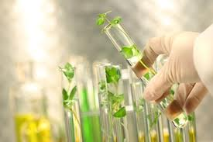
4- Safer Solvents and Auxiliaries
The use of auxiliary substances (e.g., solvents or separation
agents) should be made unnecessary whenever possible and
innocuous when used.

Slide 11
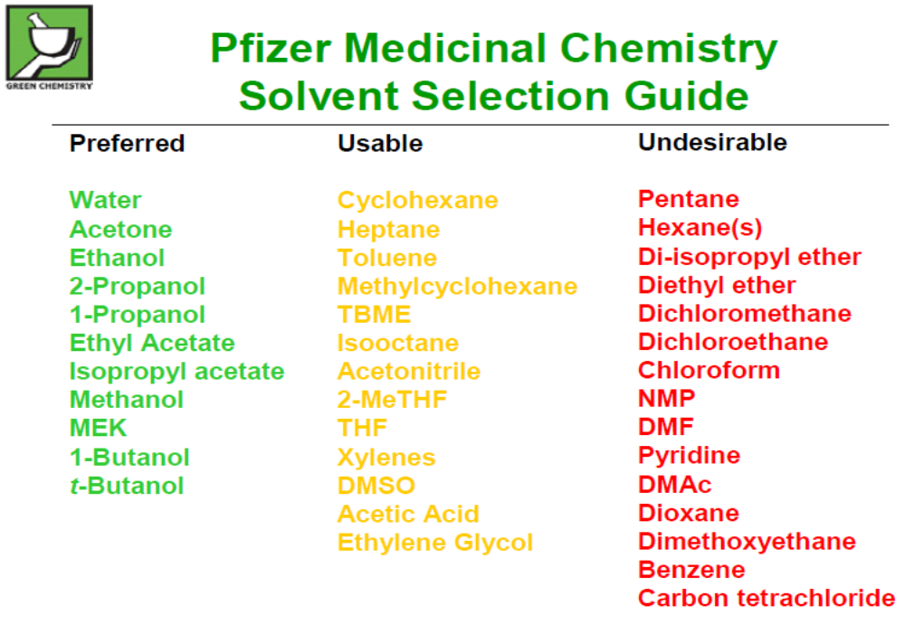

Slide 12
5- Design for Energy Efficiency
Energy requirements of chemical processes should be recognised
for their environmental and economic impacts and should be
minimised. If possible, synthetic methods should be conducted at
ambient temperature and pressure.
Energy sparing chemistry begins to use Microwave Chemistry in
order to increase energy efficiency.

Slide 13
Recently, microwave chemistry is the science of applying microwave irradiation to chemical reactions. Microwaves act as high frequency electric fields and will generally heat any material such as polar molecules in a solvent or conducting ions in a solid.

Slide 14
    6- Use of Renewable Feedstocks
      A raw material or feedstock should be renewable rather than
      depleting whenever technically and economically practicable.
    7- Reduce Derivatives
      Unnecessary derivatization (use of blocking groups
      protection/de-protection, and temporary modification of physical/chemical processes) should be minimised or avoided if possible, because such steps require additional reagents and can generate waste.
    8- Catalysis
      Catalytic reagents (as selective as possible) are superior to stoichiometric reagents.

Slide 15
9- Design for Degradation
      Chemical products should be designed so that at the end of their function they break down into innocuous degradation products and do not persist in the environment.
    10- Real-time Analysis for Pollution Prevention
      Analytical methodologies need to be further developed to allow for real-time, in-process monitoring and control prior to the formation of hazardous substances.

Slide 16
11- Atom Economy
    Synthetic methods should be designed to maximise the incorporation of all materials used in the process into the final product.
    12- Inherently Safer Chemistry for Accident Prevention Substances and the form of a substance used in a chemical process should be chosen to minimise the potential for chemical accidents, including releases, explosions, and fires.

Slide 17

Application

Slide 18
A Greener Synthesis of Ibuprofen Which Creates Less Waste and Fewer Byproducts

Slide 19
The traditional industrial synthesis of ibuprofen was
developed and patented by the Boots Company of England.
This synthesis is a six-step process and results in large
quantities of unwanted waste chemical byproducts that must
be disposed of or otherwise managed. Much of the waste that
is generated is a result of many of the atoms of the reactants
not being incorporated into the desired product (ibuprofen)
but into unwanted byproducts (poor atom economy/atom
utilization).

Slide 20
The BHC Company has developed and implemented a new
greener industrial synthesis of ibuprofen that is only three
steps. In this process, most of the atoms of the reactants are
incorporated into the desired product (ibuprofen). This results
in only small amounts of unwanted byproducts (very good
atom economy/atom utilization) thus lessening the need for
disposal and mediation of waste products.

Slide 23
Table 1 shows a calculation of the atom economy of the overall reaction.
Reagent |  | Used in ibuprofen |  | Unused in ibuprofen
Formula | M_{r} | Formula | M_{r} | Formula | M_{r}
C₁₀H₁₄ | 134 | C₁₀H₁₃ | 133 | H | 1
C₇H₆O₃ | 102 | C₂H₃ | 27 | C₂H₃O₃ | 75
C₄H₇ClO₂ | 122.5 | CH | 0 | C₃H₆ ClO₂ | 109.5
C₂H₅ONa | 68 |  | 0 | C₂H₅ONa | 68
H₃O | 19 |  | 0 | H₃O | 19
NH₃O | 33 |  |  | NH₃O | 33
H₄O₂ | 36 | HO₂ | 33 | H₃ | 3
Total |  | Ibuprofen |  | Waste products
C₂₀H₄₂NO₁₀ClNa | 514.5 | C₁₃H₁₈O₂ | 206 | C₇H₂₄ NO₈ClNa |  | 308.5

Slide 24
Green Chemistry: The BHC Company Synthesis of Ibuprofen—A Greener Synthesis of Ibuprofen.

Slide 25
Table 2 shows a calculation of the overall atom economy; it is 77% almost double that of the Boots’ synthesis .
Reagent |  | Used in ibuprofen |  | Unused in ibuprofen
Formula | M_{r} | Formula | M_{r} | Formula | M_{r}
C₁₀H₁₄ | 134 | C₁₀H₁₃ | 133 | H | 1
C₇H₆O₃ | 102 | C₂H₃O | 43 | C₂H₃O₂ | 59
H₂ | 2 | H₂ | 2 |  | 0
CO | 28 | CO | 0 |  | 0
Total |  | Ibuprofen |  | Waste products
C₁₅H₂₂O₄ | 266 | C₁₃H₁₈O₂ | 206 | C₂H₄ O₂ |  | 60

Slide 26
Conclusion

Slide 27
Good Laboratory Practice (GLP)
embodies a set of principles that provides a framework within
which laboratory studies are planned, performed, monitored,
reported and archived.
also, is concerned with preclinical development including
research laboratory: discovery & development of new
drugs/therapy.
Ridley, R., Handbook: good laboratory practice (GLP): quality practices for regulated non clinical research and development, Second edition, 2009, World Health Organization

Slide 28
Green Chemistry
embodies a set of principles that provides both a strategy for
developing safer products and the normative standards for
distinguishing desirable outcomes from less desirable ones.
affords a framework within which laboratory studies include greener
solvents and safer chemicals to prevent or reduce pollution at its
source.
also, is concerned with research laboratory for preclinical
development : discovery & development of new
drugs/therapy.

Slide 29
Indeed, greening the pharmaceutical industry
afford Good Laboratory Practice.

Slide 30
Recommendations

Slide 31
There are six key tools for designing greener chemicals/processes:
Alternative feedstocks/starting materials (raw materials).
Alternative reagents (substances in which other substances are dissolved).
Alternative solvents (substances in which other substances are dissolved).

Slide 32
Alternative product/target molecule (molecule on which
research is focused).
Alternative catalysts (reusable reagents that are not consumed
during the chemical reaction).
Finally, quality control (real – time measurements).

Slide 33
Chemists Must place a Major Focus on the Environmental
Consequences of Greening Pharmaceutical Products and the
Processes by which these Products are Made. We Must Consider
Our Chemical Ecological Footprint.

Slide 34
Green Chemistry is about turning a waste into a product and a cost into a profit, So it should be applied to afford Good Good Laboratory Practice.
Berekeley w. Cue, PhD, BWC Pharma Consulting, LLC, July 2009

Slide 35
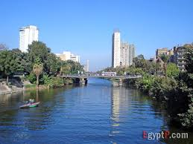

Slide 36


Slide 37


Slide 38
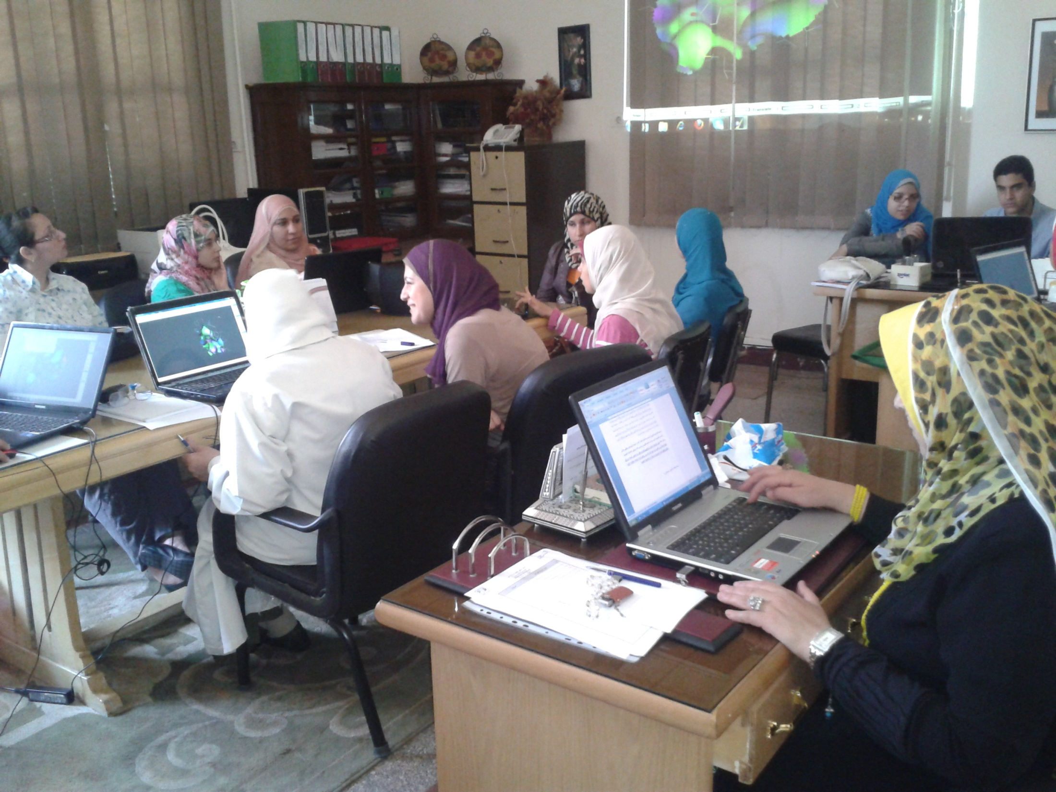

Slide 39



Slide 40


Slide 41


