Slide 1
The Role of Stereochemistry
in Pharmacy
Presented By
Prof. Dr. Salwa Elmeligie
Faculty of Pharmacy, Cairo University
Egypt

Slide 2

Who am I ?
Professor & Head of Pharmaceutical Organic Chemistry,
Faculty of Pharmacy, Cairo University.
2. Member of technical office at National Authority of Quality
Assurance and Accreditation of Education (NAQAAE), Egypt.
3. Trainer in Faculty and Leadership Development Center, Cairo University.
4. Evaluator at Project administration, Ministry of Higher Education, Egypt.
5. Consultant at missions and Cultural Affairs at the Ministry of Higher Education, Egypt.
6- Member of strategic plan committee, Faculty of Pharmacy, Cairo University.
Other Posts:
1. Reviewer for Higher Education Institutions, conducted by NAQAAE.
2. Member of Council of Faculty of Pharmacy, Cairo University.

Slide 3

I am pleased for my presence in one of international
conferences ‘’Pharma Middle East 2015’’.

Slide 4

Workshop in stereochemistry

Slide 5
Performance objectives
To highlight
  Introduction to stereochemistry.
  Stereochemistry.
  Enantiomers.
  Applications in pharmacy.

Slide 6
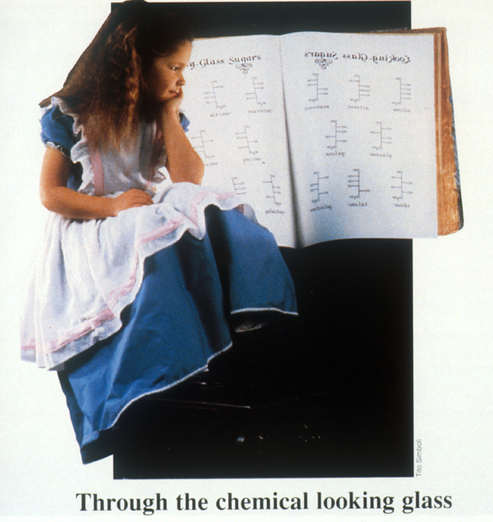

Slide 7
Introduction to stereochemistry
Isomerism

Slide 8
There are two types of isomers
Constitutional isomers
They have the same atoms, but they are joined differently.
Stereoisomers
They have the same atoms, they are joined the same way,
but the atoms are arranged differently in space.

Slide 9
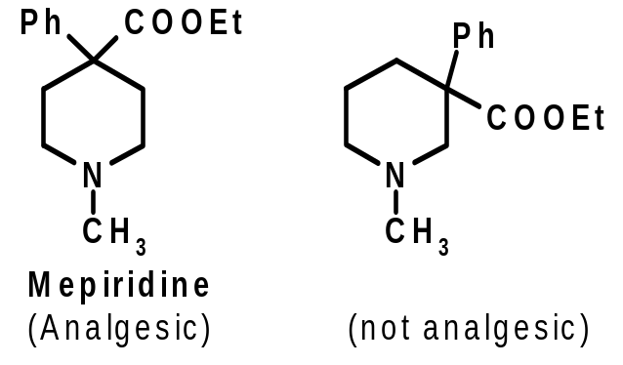
Constitutional isomers
Functional Group isomers
Same molecular formula, but different functional groups.
C
H
C
H
3
3
N
H
H
N
O
2
O
O
O
C
H
C
H
Positional isomers
2
3
3,4
-
MDA
phenacetin
(Psychoactive ) (analgesic)
Same molecular formula, same functional groups, but different positions of functional groups.

Slide 10
Stereoisomers
Before we proceed to stereoisomers, we should know
what is stereochemistry.

Slide 11
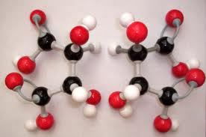
Stereochemistry

Slide 12
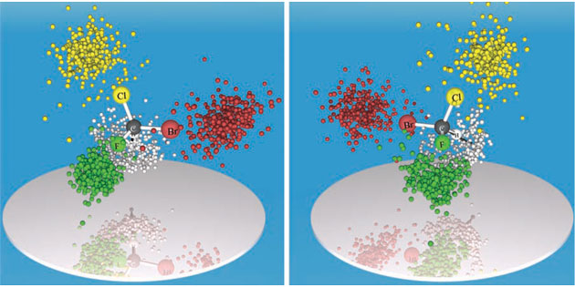
Stereochemistry is a unique science concerned with the study of how molecules are affected by the way their atoms are arranged in space. It is also known as 3D chemistry.

Slide 13
Types of stereoisomers
Geometrical isomers.
Optical active isomers.
  Enantiomers.
  Diastereomers.
  Atropisomers.

Slide 14
Types of stereoisomers
Geometrial isomers
They are molecules that are locked into their spatial positions with respect to one another due to a double bond or a ring structure. The isomers can not be interconvert through rotation around a single bond.
O
H
H
O
H
H
H
H
H
O
H
O
-
DEC
-
trans
cis
DEC
(Estrogenic) (non estrogenic)

Slide 15
Types of stereoisomers
Chiral or optically active isomers
Optical isomerism is characterized by compounds having the same structure but different configuration, and because of their molecular asymmetry these compounds are optically active or chiral.
So, chirality means molecular asymmetry i.e., the molecule present in two forms, which are not-superimposable on each other. Each is the mirror image of the other. This pair of compounds is known as a pair of enantiomers.

Slide 16
Why stereochemistry is important?
Because
The stereoisomers and chiral compounds lead to the development of drugs have the following:
The therapeutic advantages (reduction) in drug load and in possible adverse effects.
The isomers can help in understanding the mechanisms behind adverse effects and drug actions.
Improved specific action (introducing safer and effective drug alternatives of the new as well as existing drugs).
Improved pharmacokinetic and pharmacodynamic properties.
http://www.kimyasanal.com/yukle/cgq04lrtwb_1.pdf

Slide 17
Herein, we deal with important optical active isomers
Enantiomers

Slide 18
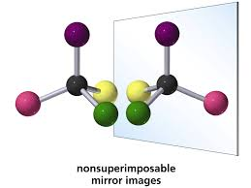

Slide 19
Racemic mixture
Is one that has equal amounts of left- and right
handed enantiomers of a chiral molecule.
An enantiomer can be named by the direction in which it
rotates the plane of polarized light. If it rotates the light
clockwise, that enantiomer is labeled (+). Its mirror-image is
labeled (−). The (+) and (−) isomers have also been
termed d- and l-, respectively (for dextrorotatory and
levorotatory).
https://en.wikipedia.org/wiki/Racemic_mixture

Slide 20
Demonstrations of the significance of stereochemistry was the thalidomide.
Thalidomide is a drug, first prepared in Germany. In 1957, prescribed for treating morning sickness in pregnant women. The drug however was discovered to cause deformation in babies.
It was discovered that one optical isomer of the drug was safe while the other had teratogenic effects. The (R) enantiomer of thalidomide is effective against morning sickness, while the (S) enantiomer is teratogenic, causing birth defects.
Singh K, Shakya P, Kumar A, S. Alok, Kamal M and Singh S.P. Int J Pharm Sci Res 2014; 5(11): 4644-59.

Slide 21
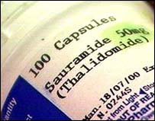
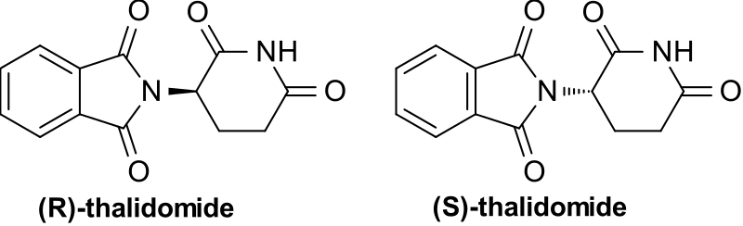
In the human body, thalidomide undergoes racemisation: even if only one of the two stereoisomers is ingested, the other one is produced.
Using stereochemistry was a driving force behind requiring strict testing of drugs before making them available to the public.
https://en.wikipedia.org/wiki/File:Thalidomide-racemate2DCSD.svg

Slide 22
One enantiomer may possess virtually all the
pharmacological activity while the other is inactive.
Both enantiomers may be pharmacologically active but have
qualitatively different therapeutic and toxic effects.

Slide 23
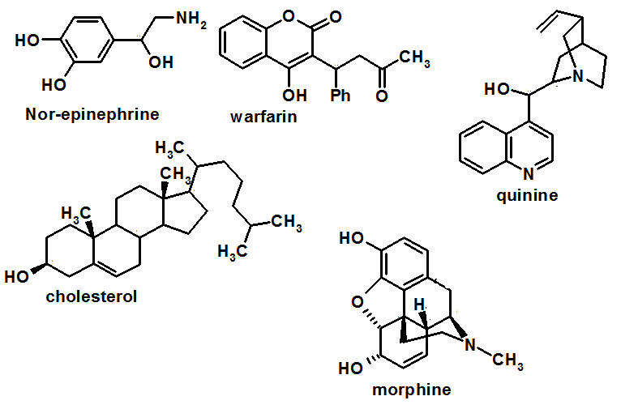
Activity
Identify chiral centers (carbon, nitrogen)

Slide 24
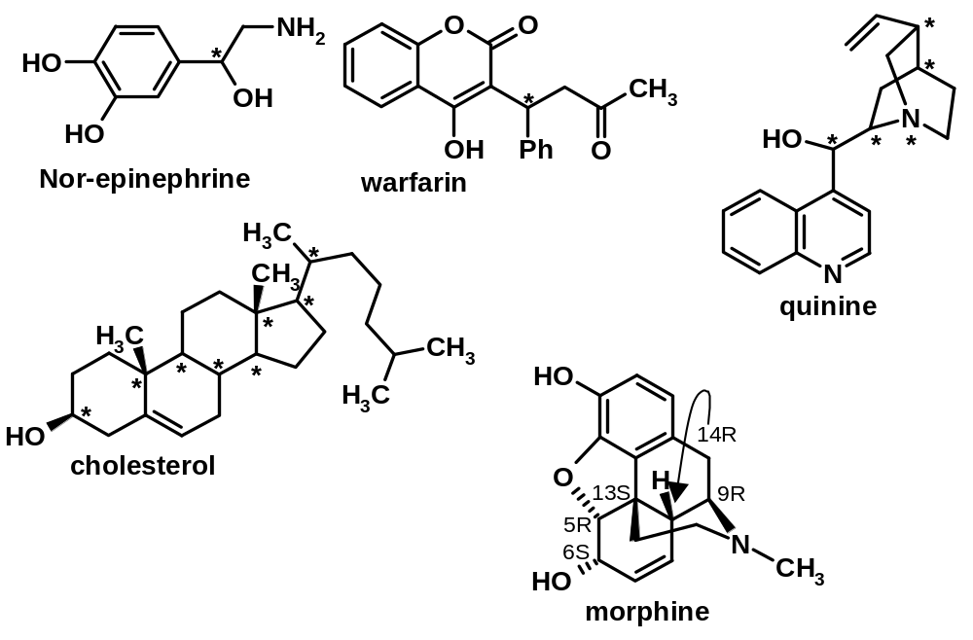
Answer

Slide 25
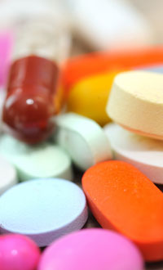
Applications in pharmacy

Slide 26
Chiral biological macromolecules
Proteins.
  Enzymes.
  Structural elements of membranes.
  Receptors.
Nucleic acids.
Chiral “building blocks” of L-amino acids and D carbohydrates.
Use of optically pure starting materials e.g
alkaloids, steroids and other natural products.
Drug Chirality : Past , Present & Future. Andrew J. Hutt. Department of Pharmacy, King’s College London.

Slide 27

Relationship of chirality with
drug properties

Slide 28
Approximately 25% of drugs are marketed as either racemates or mixtures of diastereoisomers.
Such stereoisomers frequently differ in terms of their biological activity and pharmacokinetic profiles and the use of such mixtures may contribute to the adverse effects of the drug particularly if they are associated with the inactive or less active isomer.
In recent years drug stereochemistry has become a significant issue for both the pharmaceutical industry and the regulatory authorities.
Singh K, Shakya P, Kumar A, S. Alok, Kamal M and Singh S.P. Int J Pharm Sci Res 2014; 5(11): 4644-59.

Slide 29
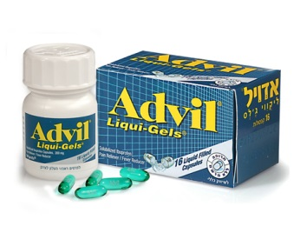
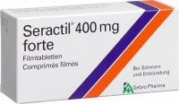
1- Potency
The S- form of the ibuprofen is active but R- form is inactive, however the drug is either racemic (Advil)® or pure S- form(seractil) ®.
http://www.researchgate.net/publication/263849614_Pharmacological_Significance_of_Stereoisomerism

Slide 30
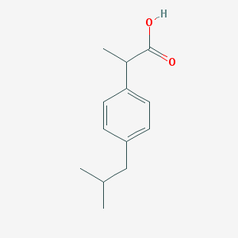
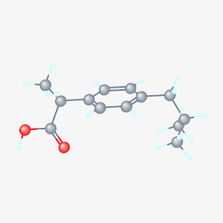
Structure
2D Structure
3D Conformer

Slide 31
Enantiomers of Ibuprofen

Slide 32
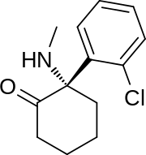
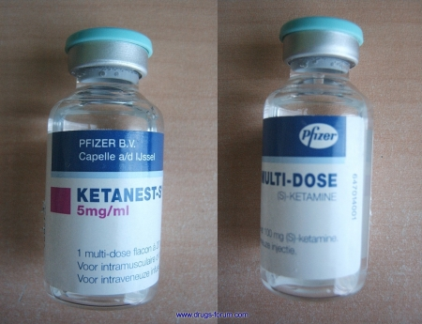
Also,
S- ketamine is potent anasthetics while R- ketamine is hallucinogenic in nature.
S - Ketamine
https://en.wikipedia.org/wiki/Esketamine

Slide 33

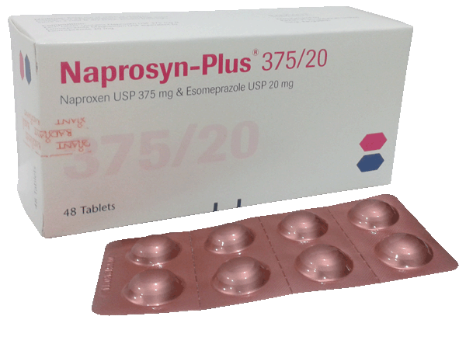
2- Therapeutic and adverse effects
R- Naproxane is used to treat arthralgic while S-Naproxane is teratogenic.
R-Naproxane
http://www.chemicalbook.com/ChemicalProductProperty_EN_CB2753351.htm

Slide 34
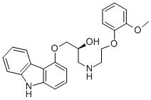
3- Efficacy
S- Carvediol is 100 times more potent as blocker than R-carvediol.
S-Carvediol
http://www.chemicalbook.com/ChemicalProductProperty_EN_CB2190419.htm

Slide 35
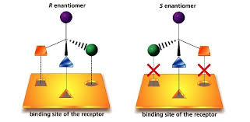
Pharmacodynamic differences resulting out of enantiomers
Because living systems are themselves chiral, each of the enantiomers of a chiral drug can behave very differently
in vivo. In other words, the R- enantiomer of a drug will not necessarily behave the same as the S-enantiomer of the same drug when taken by a patient.
J. McConathy and M.J.Owens, J Clin Psychiatry 2003, 5 (2)

Slide 36
Stereoselectivity of pharmacokinetic processes
Absorption - active transport.
Distribution - active/selective uptake, protein binding,
selective tissues distribution.
Metabolism.
Excretion.
Vauqelin G, Charlton SJ. , Br. J. Pharmacol. 161 (3): 488–508, 2012\

Slide 37
1-Absorption
Absorption can exhibit stereoselctevity, giving rise to the possibility of competitive interaction between enantiomers.
http://www.chinaphar.com/1671-4083/23/385.pdf

Slide 38
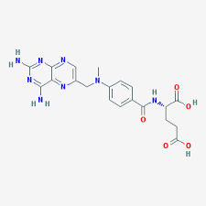
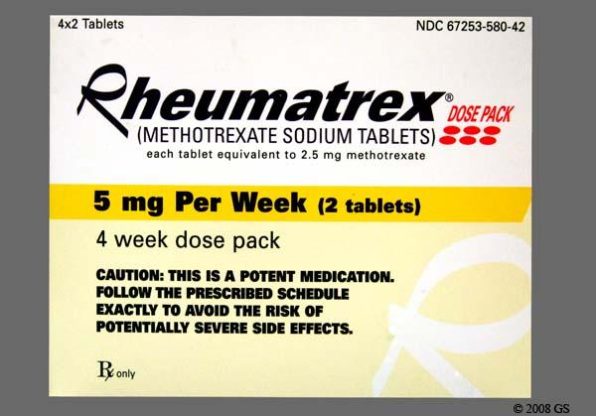
Example
L-Methotrexate (Brand name: Trexall,Rhematrex®) is better absorbed than its isomer D-Methotrexate .
L- Methotrexate
http://www.goodrx.com/rheumatrex/images#imgModal

Slide 39
2-Distribution
Stereoselectivity in drug distribution may occur as a result of binding to either plasma or tissue proteins or transport via specific tissue uptake and storage mechanisms. It is noteworthy that stereoselectivity in binding may vary for different proteins.
Singh K, Shakya P, Kumar A, S. Alok, Kamal M and Singh S.P. Int J Pharm Sci Res 2014; 5(11): 4644-59.

Slide 40


Example
The protein binding of propranolol to acid glycoprotein (AGP) is stereoselective for the S-enantiomer, whereas binding to human serum albumin ( HAS) favours R-propranolol.
S- form
R- form
http://www.tocris.com/dispprod.php?ItemId=1821#.VhmwZd_t2kq

Slide 41
3-Metabolism
In drug metabolism, stereo differentiation is the rule rather than the exception and stereoselectivity in metabolism is probably responsible for the majority of the differences .
Singh K, Shakya P, Kumar A, S. Alok, Kamal M and Singh S.P. Int J Pharm Sci Res 2014; 5(11): 4644-59.

Slide 42
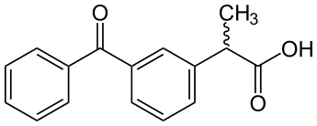
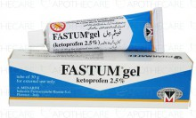
Example
Chiral inversion
One stereoisomer is metabolically converted into its enantiomer with no other alteration in structure.
The 2-arylpropionic acid (2-APAs) nonsteroidal anti-inflammatory drugs (NSAIDs), e.g., Ibuprofen, ketoprofen( Brand name: fastum gel®)
http://en.chembase.cn/molecule-148572.html

Slide 43
4-Renal Excretion
Stereo selectivity in renal clearance may arise for those
agents that undergo active tubular secretion. Interactions
between enantiomers may occur such that their excretion
differs following administration as single enantiomers
versus the racemate.
Singh K, Shakya P, Kumar A, S. Alok, Kamal M and Singh S.P. Int J Pharm Sci Res 2014; 5(11): 4644-59.

Slide 44
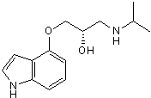
Example
The tubular secretion of the S-pindolol being 30% greater
than that of R- enantiomer.
S- form
Chirality in Drug Design and Development, Indra K. Reddy‏،Reza Mehvar‏, 2004

Slide 45
US - FDA’s policy statement
The guidelines strongly encourage the development of single isomers and discourage stereoisomeric (e.g., racemic) mixtures.
Approval could not be granted for a drug containing more than one isomer unless the pharmacokinetic and pharmacodynamic properties of each could be described and more importantly, justified.
Chirality 1992;338-40; http://www.fda.gov/cder/guidance/stereo.htm.

Slide 46
FDA
FDA
The Agency is impressed by the possibility that the use of single enantiomers may be advantageous:
By permitting better patient control, simplifying dose-response relationships.
By reducing the extent of interpatient variation in drug response.
Drug Chirality : Past , Present & Future. Andrew J. Hutt. Department of Pharmacy, King’s College London.

Slide 47
FDA
Efforts to develop pure drug enantiomers to
Separate unwanted pharmacodynamic side effects from toxic effects if these occur due to enantiomer.
Improve therapeutic index potentially.
Reduce the potential drug interactions.
Avoid enantiomer-enantiomer drug interactions.
Avoid bioinversion.
Monitor therapeutic drug of the stereochemically pure active enantiomer easily.
http://www.researchgate.net/publication/263849614_Pharmacological_Significance_of_Stereoisomerism

Slide 48
Conclusion
The field of stereoisomers and enantiomers is very essential to have a good knowledge about.
Stereochemistry should be applied on understanding the needs of pharmaceutical industries that have an important role to achieve potent efficiency.
It provides a pathway to good pharmaceutical products with not only many good pharmacokinetic and pharmacodynamic properties, but also minimum side effects and good therapeutic action.

Slide 49

Recommendations
Today & Tomorrow’s way of Treatment

Slide 50
  Stereochemistry in drug action should gain greater attention in medical practice and a basic knowledge of the subject will be necessary for physicians to make informed decisions regarding the use of single enantiomer drugs.
In future, more stereochemically pure drug agents will become clinically available and pharmacists will be relied upon for their knowledge and expertise in this area.

Slide 51


