Slide 1
Role of Good Laboratory Practice (GLP) in Good Clinical Practice (GCP)
Presented By
Prof. Dr. Salwa Elmeligie
Faculty of Pharmacy, Cairo University

Slide 2

I am so glade to be here in this International Conference of GLP , GCP & GMP
I hope you find a new knowledge of GLP and GCP

Slide 3

Who am I
Professor & Head of Pharmaceutical Organic Chemistry, Faculty of Pharmacy, Cairo University.
2. Trainer in Faculty and Leadership Development Center, Cairo University.
3. Reviewer for Higher Education Institutions, conducted by the
National Authority of Quality Assurance and Accreditation of Education, Egypt.
4. Evaluator at Project administration, Ministry of Higher Education, Egypt.
5. Consultant at missions and Cultural Affairs at the Ministry of Higher Education, Egypt.
Other Posts:
1. Director of Career Center, Faculty of Pharmacy, Cairo University.
2. Director of Quality Assurance Unit, Faculty of Pharmacy,
October 6 University.

Slide 4
Performance objectives
Highlight
  GLP.
  GCP based on ICH.
  The comparison between GLP & GCP in some aspects.
  The role of GLP to achieve GCP.

Slide 5
Drug development process
Basic Research
Clinical Trials
Disease Recovery
Drug Recovery
Preclinical Development
Manufacturing
Not regulated
GLP
GCP
Study Based
GMP
Process Based
Ridley, R., The Process of New Drug Discovery and Development, Second Edition, 2006, World Health Organization

Slide 6
Role of laboratories in medicine
Research Laboratory
Discovery & development of new
Drugs/therapy
Fundamental research/mechanisms of diseases
Medical Testing Laboratory
Patient care
Clinical drug trial
Manufacturing
Post clinical trials, bulk drugs, cell-based therapy,
Plasma products, medical device

Slide 7
Role of laboratories in
drug development
Stage I Stage 2 Stage 3 Stage 4
Discovery of
active
substance
Non – clinical
study
on SAFETY
testing
on drugs
Studies in
human /
Clinical Trials
Post approval
Clinical Trials
Manufacturing
Time line approximately 10 yrs
Ridley, R., Handbook: good laboratory practice (GLP): quality practices for regulated non clinical research and development, Second edition, 2009, World Health Organization

Slide 8
Classical drug development process
4 well-defined stages
Discovery of potential new drug products.
Not covered by a regulatory standard.
Stage I
Ridley, R., Handbook: good laboratory practice (GLP): quality practices for regulated non clinical research and development, Second edition, 2009, World Health Organization

Slide 9
Non-clinical, not in human.
Safety Testing.
GLP Principles specific for this stage :
toxicology.
mutagenicity.
safety .
pharmacology.
pharmacokinetics.
bioavailability.
Stage II
Ridley, R., Handbook: good laboratory practice (GLP): quality practices for regulated non clinical research and development, Second edition, 2009, World Health Organization

Slide 10
Clinical Studies, in human.
GCP is the basis for quality standards, ethical conduct and regulatory compliance
(Standard :ISO).
Phase I ( tolerance of test drugs, define human pharmacokinetics) to Phase II ( dose-effect relationship) and Phase III (full-scale, often multi-centre clinical efficacy trials in patients).
Stage III
Ridley, R., Handbook: good laboratory practice (GLP): quality practices for regulated non clinical research and development, Second edition, 2009, World Health Organization

Slide 11
Post-approval.
Drug registered , available on market.
Any subsequent clinical trials (Phase IV) must comply with GCP (Standard :ISO).
Stage IV
Ridley, R., Handbook: good laboratory practice (GLP): quality practices for regulated non clinical research and development, Second edition, 2009, World Health Organization

Slide 12
Role of laboratories in clinical trials
-Medical testing laboratories
Pre Study During Study End of Study
Screening.
Enrolment:
inclusion
criteria exclusion.
Verify effects of drug
clinical efficacy.
Monitoring of adverse
effects safety.
Clinical efficacy.
Data analysis.
Verification.

Slide 13
Good Laboratory Practice
GLP
Regulatory Authorities responsible for registering and controlling pharmaceuticals request :
laboratory to demonstrate data in registration package for a new chemical/drugs has been gathered using ‘good laboratory practice’ .
organization be certified (or accredited) for ‘GLP’.
Organizations (researchers and medical laboratories) often claimed that they are working under ‘GLP’.
Clients of laboratories often request that their work be done using ‘good laboratory practice’.
Weinberg, S., Good Laboratory Practice Regulations Third Edition, 2003, Marcel Dekker, Inc.

Slide 14

Definition:
GLP embodies a set of principles that provides a framework within which laboratory studies are planned, performed, monitored, reported and archived.
GLP is Food and Drug Administration (FDA) regulation that believes that implementation of a GLP quality system would avoid a risk-based approach, reduce regulatory burden and encourage science-based technology.
Ridely, R., Good laboratory practice training manual for the trainer: a tool for training and promoting
good laboratory practice (GLP) concepts in disease endemic countries, Second edition., 2008, World Health Organization

Slide 15
Formal concept of GLP
GLP is sometimes confused with the standards of laboratory safety like wearing safety goggles.
GLPs are not guidelines, they have the force of law.
The term ‘Good Laboratory Practice’ has a SPECIFIC meaning when applied to non-clinical environmental health and safety studies.

Slide 16
The principles of GLP in general
Concerned with how we organize our laboratories and how we organize our studies.
Addresses responsibilities for managing people, facilities and equipment for good science.
Concerned with how we plan, perform and report our experiments and studies.
Importantly it does not interfere with the ability of scientists to make scientific decision.
Weinberg, S., Good Laboratory Practice Regulations Third Edition, 2003, Marcel Dekker, Inc.

Slide 17
GLP standards
GLP standards include:
International Organization for Standardization (ISO)
The Organization for Economic Co-operation and Development (OECD )Principles of Good Laboratory Practice which:
Define and describe a quality system concerned with the organizational processes and conditions under which a non-clinical health and environmental safety study is conducted.
Ridely, R., Good laboratory practice training manual for the trainer: a tool for training and promoting good laboratory practice (GLP) concepts in disease endemic countries, Second edition., 2008, World Health Organization

Slide 18
Fundamental points of GLP
OECD afforded fundamental points of GLP which applied in whatever industry targeted, stresses the importance of the following main points.
Resources : Organization, personnel, facilities, equipments.
Rules : Protocols, concept of Study Director , Standard Operating Procedures (SOP).
GLP regs > Protocol > SOPs
GLP regs supercede the protocol and the SOPs
Characterization : Test items, test systems.
Documentation : Raw data, final report, archives.
Quality Assurance : Independence from study conduct.
Ridely, R., Good laboratory practice training manual for the trainer: a tool for training and promoting good laboratory practice (GLP) concepts in disease endemic countries, Second edition., 2008, World Health Organization

Slide 19
GLP in the OECD principles
‘A quality system concerned with the organizational process and the conditions under which non-clinical health and environmental studies are planned, performed, monitored, recorded, archived and reported.’
It does not concern with the technical validity of the studies.
Ridely, R., Good laboratory practice training manual for the trainer: a tool for training and promoting good laboratory practice (GLP) concepts in disease endemic countries, Second edition., 2008, World Health Organization

Slide 20

Now we will go to GCP

Slide 21
Clinical Practice Trials
Phase I
Phase II
Phase III
Phase IV
Phase V
  Checking for safety
  10-20 healthy volunteers
  Unexpected side effects may occurs
  Checking for efficacy
  ~ 200 samples
  How good is the intervention
  If not good, normally detect here
  Checking effectiveness
  ~ 1000s samples
  Looking for rare side effect
  Test long term safety
  Real patients
  Involve untested group of people
  Translational research
  Research
  on data
  collected
Cone, Ms., Guidelines for good clinical practice (GCP) for trials on pharmaceutical products,1995, WHO

Slide 22
Prior to an actual set of guidelines to follow for GCP, clinical
studies were dangerous and could result in serious disease, or
possibly death.
So, the formation of the
International Conference on Harmonization (ICH) led to the creation
of the Consolidated Guidance on GCP.

Slide 23
Good Clinical Practice
GCP
A standard for designing, conducting, recording and
reporting of studies involving human subjects.
Public assurance that the rights, safety and well-being
of trial subjects are protected.
Lisa de Blieck, MPA CCRC Clinical Trials Coordination Center, Good Clinical Practice

Slide 24
Good Clinical Practice
Designing
Reporting
Conducting
Clinical Trials or Studies
Analysis
Monitoring
Recording

Slide 25
Under GCP, FDA requires that people be informed:
    The study involves research of an unproven drug, the purpose
    of the research.
    The duration that the participant will be expected to
    participate in the study.
    The nature and the transparency in the study .
    Possible risks/benefits to the participant.
    Participation is voluntary and that participants can quit the
    study at any time without penalty or loss of benefits to which
    they are otherwise entitled.

Slide 26

ICH-GCP

Slide 27
International Conference on Harmonisation (ICH)
ICH was initiated on April 1990, in a meeting hosted by European
Federation of Pharmaceutical Industries Associations (EFPIA).
In 1997 – ICH GCP became law in some countries.
GCP also, is protected through existing ICH-GCP Guidelines with
co-sponsors (voting right); European Commission, European
Federation of Pharmaceutical Industries Associations (EFPIA),
Japanese Ministry of Health, Labour and Welfare (JMHLW), Japan
Pharmaceutical Manufacturers Association (JPMA), Pharmaceutical
Research and Manufacturers of America (PhRMA) and FDA.
Code of Federal Regulations and ICH Guidelines
– www.clinicalresearchresources.com/books/bookstore.html

Slide 28
Aims of ICH
Unify registration requirements for new products
Reduce medicinal product development costs: more economical use of animal, human and material resources.
Accelerate medicinal product licensing times: avoid repeat testing in different regions.
Increases patent protection times through reducing delay in licensing times.
Code of Federal Regulations and ICH Guidelines
– www.clinicalresearchresources.com/books/bookstore.html

Slide 29

Principles of ICH-GCP

Slide 30
Principles of ICH-GCP
Conduct trials according to GCP
Clinical trials should be conducted in accordance with the ethical principles that have their origin in the Declaration of Helsinki, and that are consistent with GCP and the applicable regulatory requirement(s).
2. Weigh risks vs. benefits
Before a trial is initiated, foreseeable risks and inconveniences should be weighed against the anticipated benefit for the individual trial subject and society. A trial should be initiated and continued only if the anticipated benefits justify the risks.
Guidance for Industry E6 Good Clinical Practice: Consolidated Guidance, April 1996, ICH

Slide 31
3. To exceed subjects wellbeing over the science
The rights, safety, and well-being of the trial subjects are the most important considerations and should prevail over interests of science and society.
4 . Have adequate information to justify trial
The available nonclinical and clinical information on an investigational product should be adequate to support the proposed clinical trial.
Guidance for Industry E6 Good Clinical Practice: Consolidated Guidance, April 1996, ICH

Slide 32
5 . Write a sound protocol
Clinical trials should be scientifically sound, and described in a clear, detailed protocol.
6. Receive IRB/IEC approval
A trial should be conducted in compliance with the protocol that has received prior institutional review board (IRB)/independent ethics committee (IEC) approval/favourable opinion.
Guidance for Industry E6 Good Clinical Practice: Consolidated Guidance, April 1996, ICH

Slide 33
7. Use qualified physicians
The medical care given to, and medical decisions made on behalf of, subjects should always be the responsibility of a qualified physician or, when appropriate, of a qualified dentist.
8. Use qualified & trained support staff
Each individual involved in conducting a trial should be qualified by education, training, and experience to perform his or her respective task(s).
Guidance for Industry E6 Good Clinical Practice: Consolidated Guidance, April 1996, ICH

Slide 34
9 . Obtain informed consent
Freely given informed consent should be obtained from every subject prior to clinical trial participation.
10. Record information appropriately
All clinical trial information should be recorded, handled, and stored in a way that allows its accurate reporting, interpretation and verification.
Guidance for Industry E6 Good Clinical Practice: Consolidated Guidance, April 1996, ICH

Slide 35
11. Protect data
The confidentiality of records that could identify subjects should be protected, respecting the privacy and confidentiality rules in accordance with the applicable regulatory requirement(s).
12. Handle investigational products appropriately
Investigational products should be manufactured, handled, and stored in accordance with applicable good manufacturing practice (GMP). They should be used in accordance with the approved protocol.
13. Ensure Quality
Systems with procedures that assure the quality of every aspect of the trial should be implemented.
Guidance for Industry E6 Good Clinical Practice: Consolidated Guidance, April 1996, ICH

Slide 36
Comparison between GLP & GCP
Function | GLP | GCP
Ownership | Facility Management | The Sponsor has the responsibility for the SOP system
Main responsibility for the activity | Study Director | Principal Investigator
Responsibilities for “Production” | Principal Investigator | Pharmacist
Quality | Quality Assurance QA does not approve SOPs QA reviews SOPs for GLP compliance only | Monitor/ Quality Assurance
Archive | Archivist | Archivist

Slide 37
The role of GLP in GCP
Role of laboratories in Clinical Trials including medical testing laboratories must meet the needs of all patients and the clinical personnel responsible for the care of those patients.
Such services include arrangements for requisition, patient preparation, patient identification, collection of samples, transportation, storage , processing and examination of clinical samples together with subsequent validation interpretation reporting and advice, in addition to safety and ethics in medical laboratory work.

Slide 38
If research in Laboratory practice concern with quality, reliability and integrity of studies, reporting of verifiable conclusions and the traceability of data and for non-clinical safety studies,
It will ensure product safety and efficacy under GLP for non-clinical studies and Patient care & clinical studies under GCP and will ensure that the produced results will be valid, reliable, accurate and reproducible.

Slide 39

Applications

Slide 40
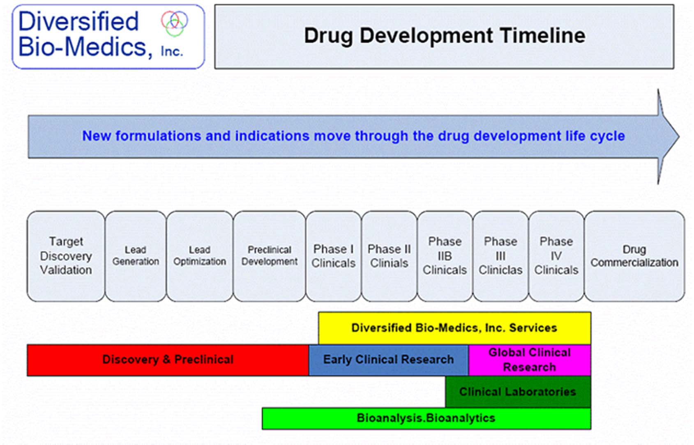

Slide 41
Diversified Bio-Medics, Inc., a development stage company 2003
at USA , focuses on providing bio-manufacturing and laboratory
services to biotechnology and biopharmaceutical industries to
provide manufacturing material for clinical trials, as well as
manufacturing services including validation, license application, &
packaging. It also plans to develop and manufacture drugs, such as
monoclonal antibodies, enzymes, interferon, ………………….etc.

Slide 42

Development of Combretastatin A4 Phosphate
(CA4P)
Two decades ago, combretastatins (CA1-4), as natural antimitotic agents, were isolated from the bark of the South African tree Combretum caffrum.
Pettit, G.; Singh, S.; Boyd, M.; Hamel, E.; Pettit, R.; Schmidt, J. and Hogan, F.; J. Med. Chem., 38, 1666 (1995).

Slide 43
An Example Of A Drug Development Life Cycle
Discovery of
Combretastatin A4
and the prodrug disodium phosphate
Preclinical development including plasma
and urine samples
Phase I started in 1998
PhaseII clinical trials
Now, CA4P is currently in
Phase III
to evaluate the safety
and efficacy
standards
Discovery & Preclinical
GLP
Early Clinical Research
GCP
X., Wang, et al, Journal of Chromatography B, 877 (2009) 3813–3821
H., Yang, et al, Bioorganic & Medicinal Chemistry 20 (2012) 903–909

Slide 44
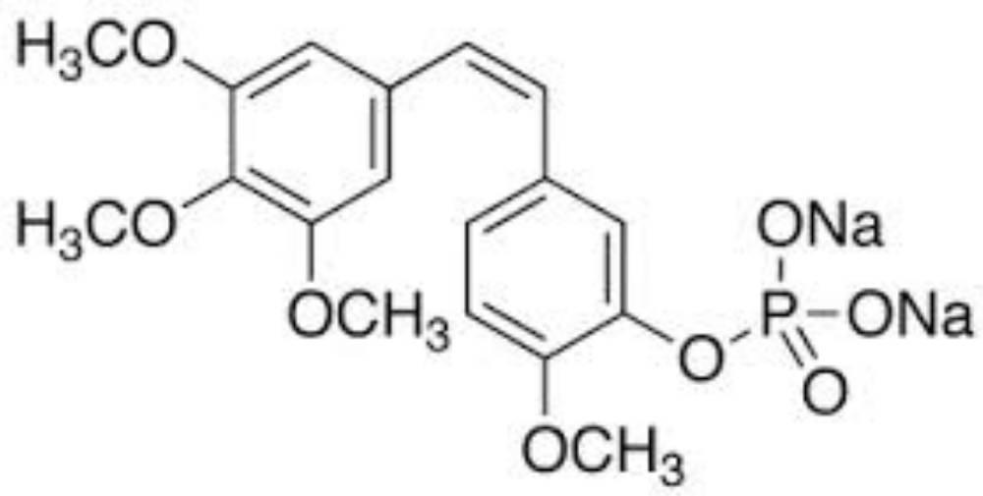
CA4P

Slide 45

This many people working for a year to make
this much drug!

Slide 46
Conclusion
Indeed, applying GLP built on understanding the needs of pharmaceutical industry and laboratories have an important role in clinical trials to achieve GCP.

Slide 47
Recommendations
Should be started with GLP with accurate laboratory practice.
Calibrate equipment to standard form , therefore giving right measurements.
Correct/accurate accounts of the actual lab study.
Adequate test systems.
Provide assurance of the safety of the newly developed compounds.
Focus on the protection of human rights in clinical trials.
Provide standards on how clinical trials should be conducted.
Define the roles and responsibilities of clinical sponsors, clinical research investigators, Clinical Research Associates, and monitors.

Slide 48


