Slide 1
Revolutionising the World of Dental hygienists
Sally Bing

Slide 2
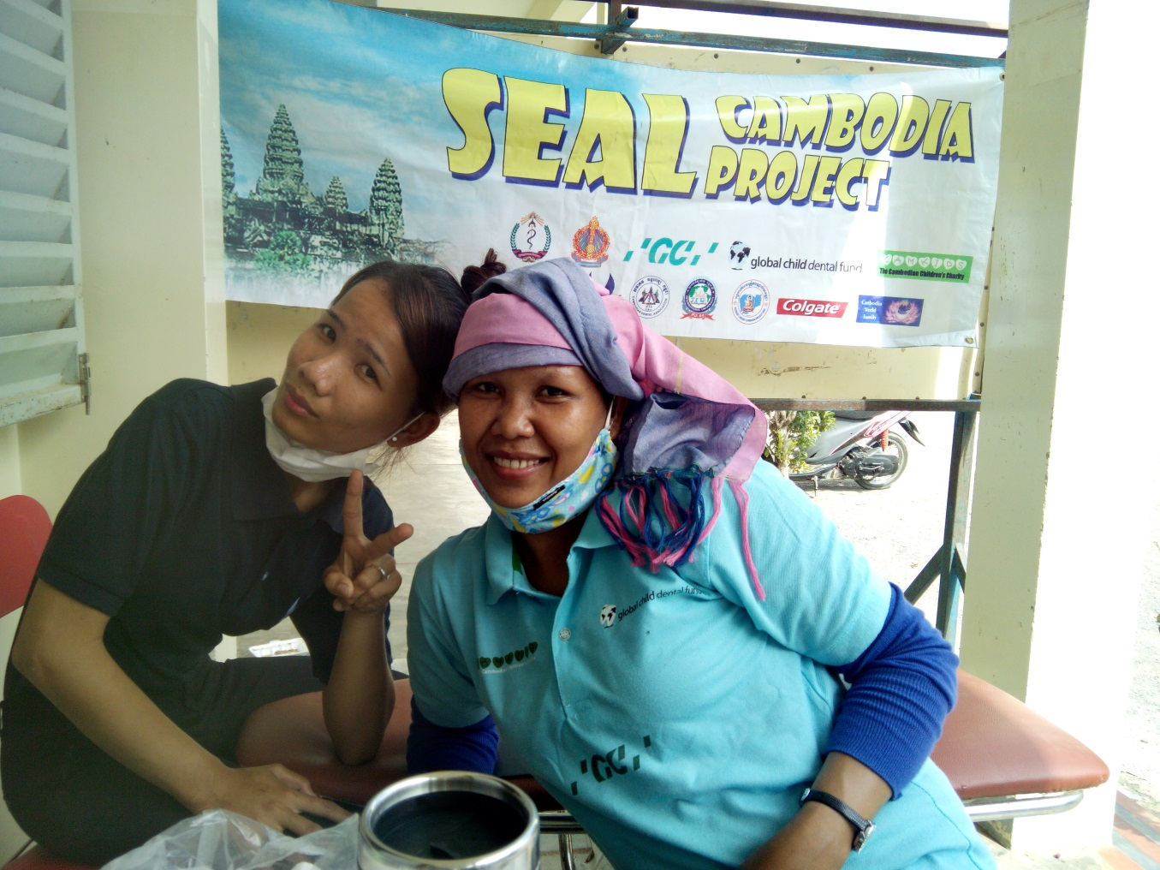
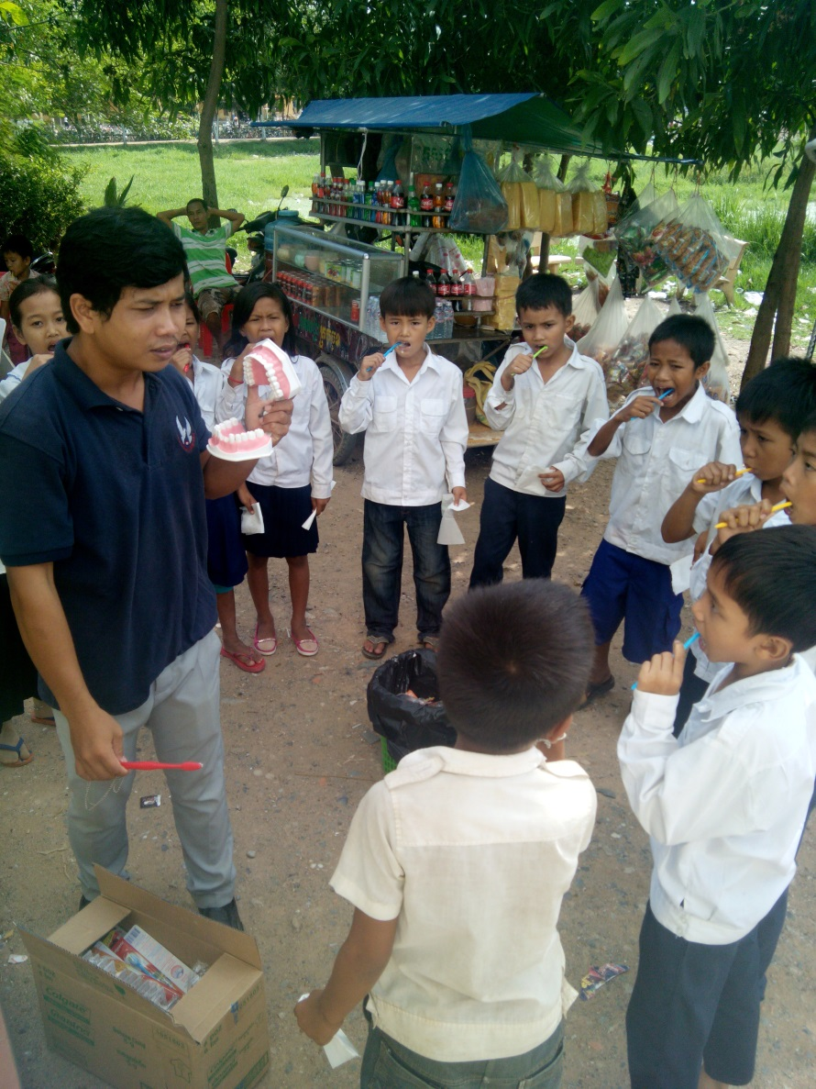

Slide 3
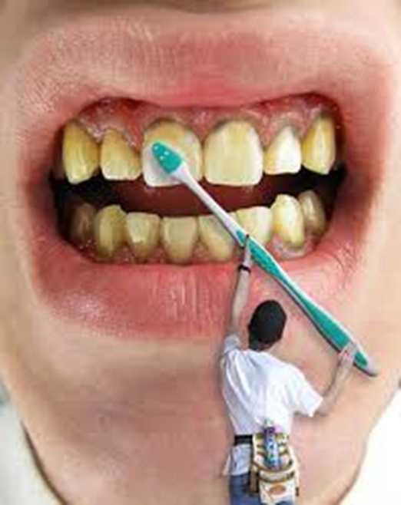
Dental Hygienists are…

Slide 4
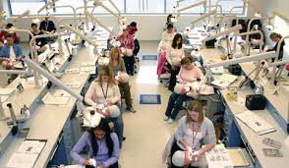
At School

Slide 5
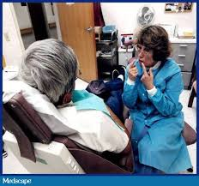
The Real World

Slide 6

Reality Check

Slide 7
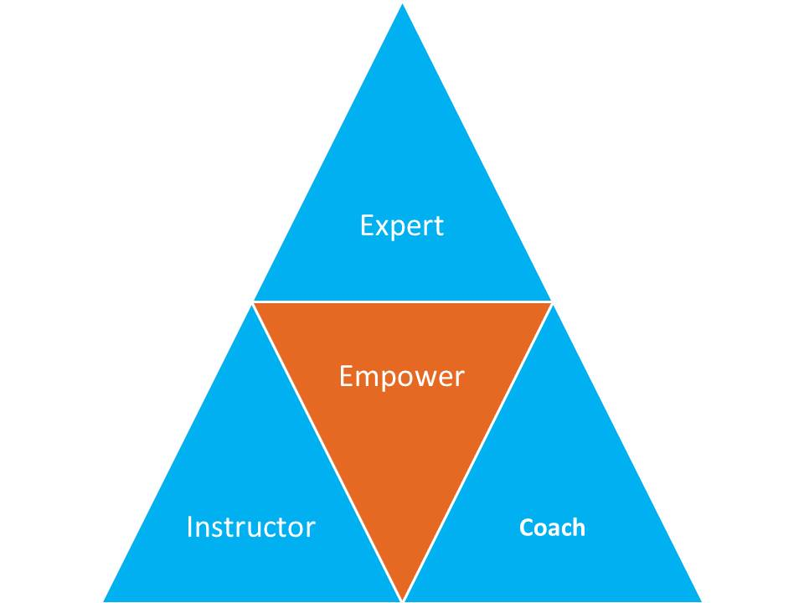
Complete the Puzzle

Slide 8

Complete the Puzzle – Be a Coach
Build a Relationship
Be a True Listener
Inspire

Slide 9
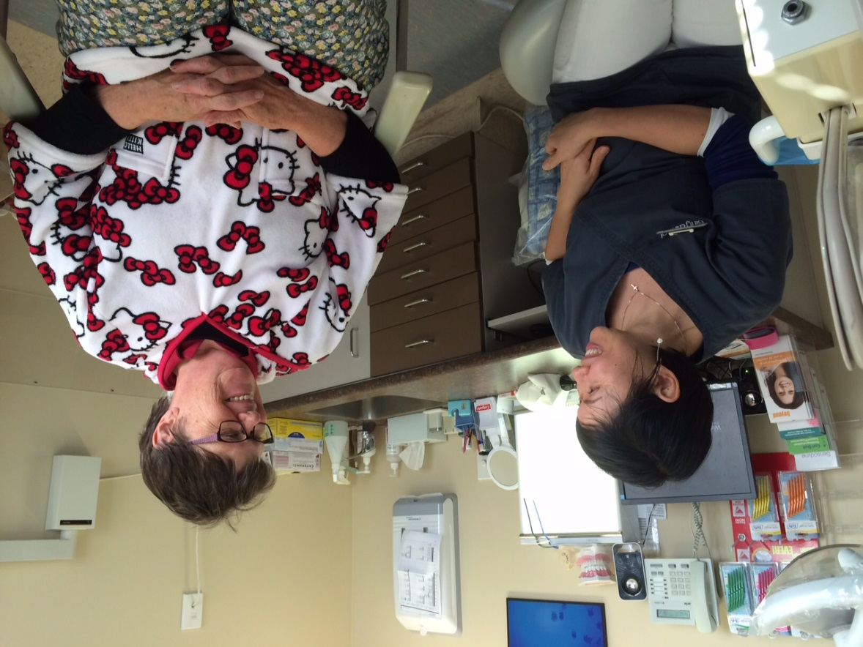
Build a RElationship

Slide 10
Be a True Listener
“The moment you
thought of a
solution,
you are not listening”
- N D Walsch

Slide 11
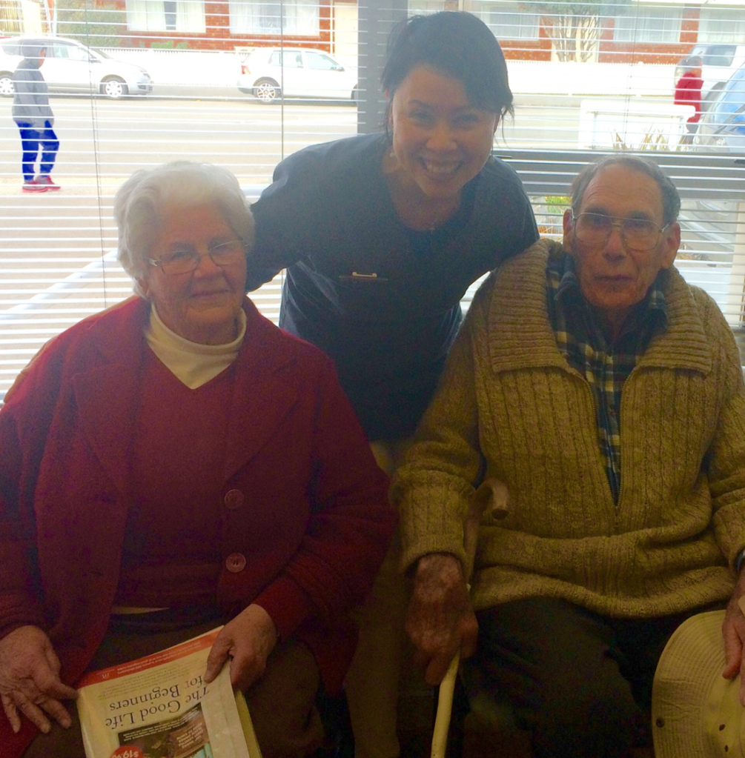
Inspire

Slide 12
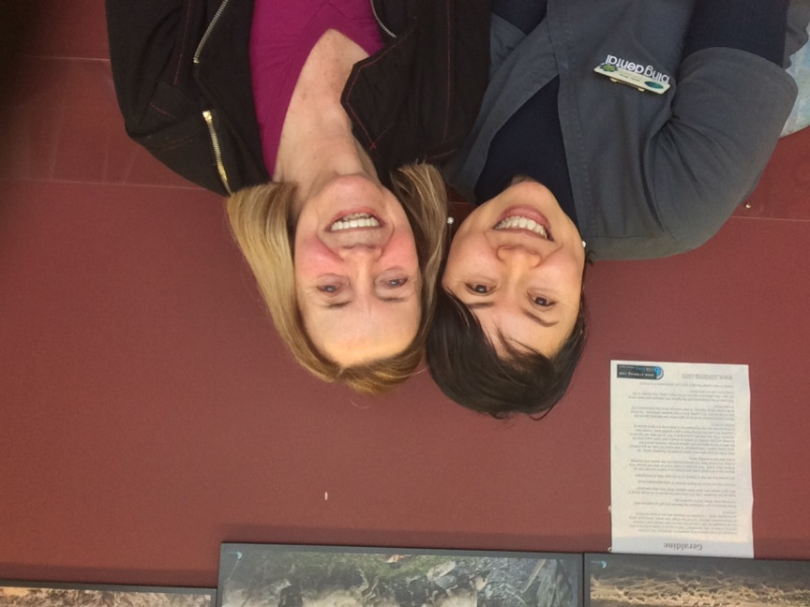
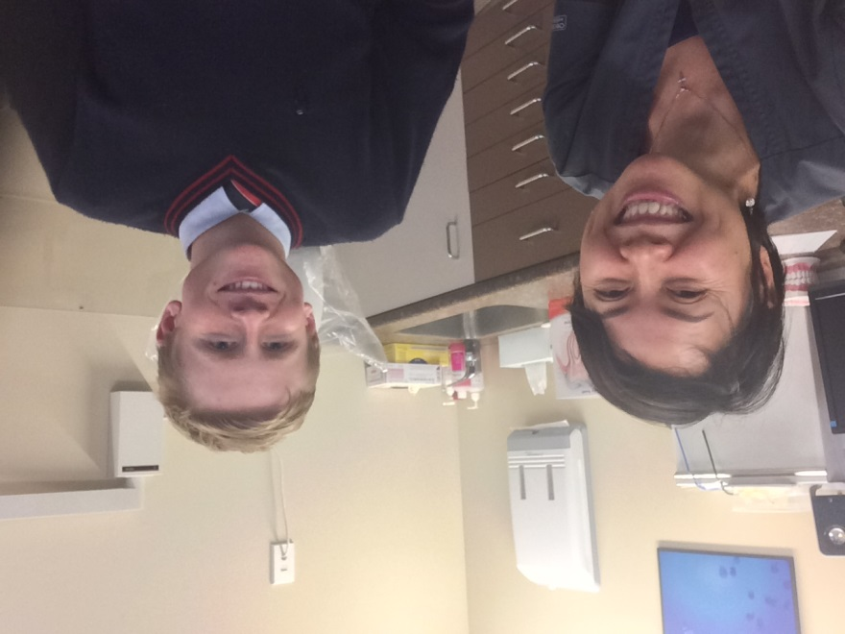
REsult
Active Maintenance
Low Cancellation
Motivated Clients
High Job Satisfaction

Slide 13
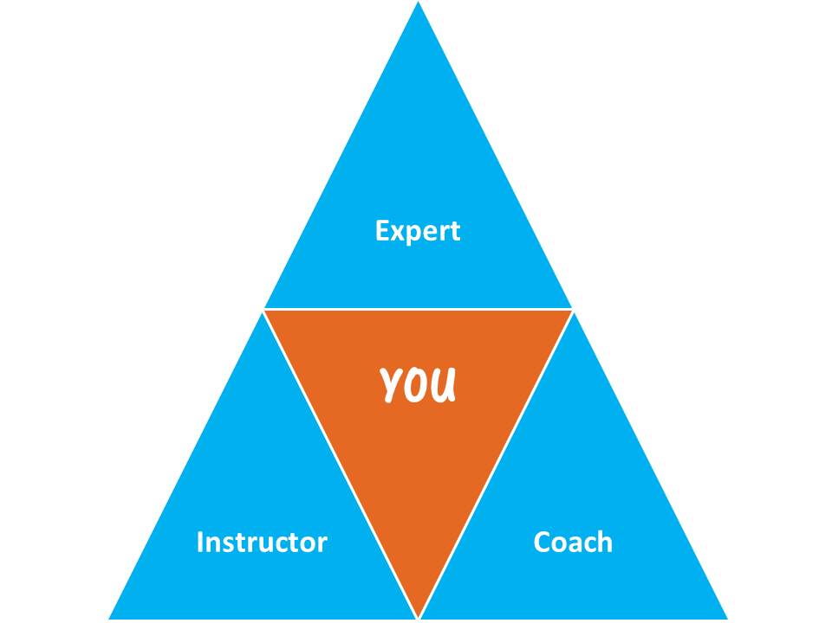
Complete Your Puzzle

Slide 14
Revolutionising the World of Dental hygienists
Sally Bing

