Slide 1
Postoperative Pain Management and Delirium
Sakura Kinjo, MD
Department of Anesthesia and Perioperative Care
University of California, San Francisco

Slide 2

Disclosures
No disclosures

Slide 3
Objectives
Discuss the relationship between postoperative delirium (POD) and pain management:
Common pain medications, pain management strategies used for the acute postoperative period (opioids, multimodal analgesia).
Regional anesthesia (epidural, peripheral nerve blocks).

Slide 4
Postoperative Delirium (POD)
Definition: acute state of confusion with alterations in attention and consciousness.
Incidence: 15-53%
POD can result in prolonged hospital stays, increased risk of post-discharge mortality, cognitive decline, functional dependence.

Slide 5
Postoperative Cognitive Decline/Dysfunction (POCD)
Cognitive dysfunction in various neuropsychological domains (e.g, memory, executive function)
Etiology is unknown.
May last a few days to weeks, sometimes months.
Extension of POD or subsyndromal POD?
Patient who is not delirious can present POCD.
Notes:
POD and POCD, Two can not be totally separated.

Slide 6
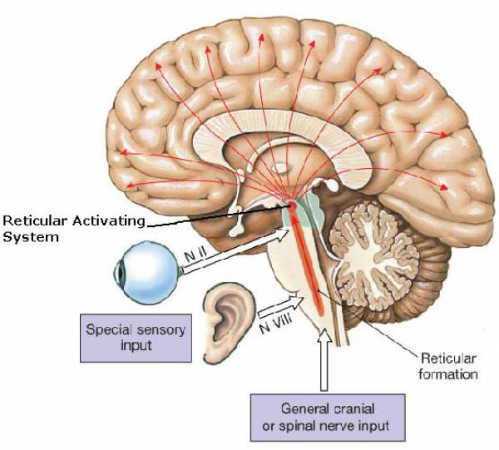
Pathophysiology of Delirium-
Reticular Activating System

Slide 7
Risk Factors of Delirium
Multifactorial syndrome influenced by:
1. Predisposing factors (Baseline patient risk factors)
(e.g., age, sensory, cognitive impairment, depression, alcoholism)
2. Precipitating factors
(e.g., drugs, infection, fluid-electrolyte disorder, hypoxia)
Notes:
1. Patient vulnerability, 2. exposure to precipitating factors (

Slide 8
Potential Surgical Factors of Delirium
Type of surgery (cardiac, orthopedic)
Length of surgery
Blood loss/blood transfusion
Neuroinflammation

Slide 9
Anesthetic Factors on Cognition
Type of Anesthesia (general vs. regional)
Williams-Russo. JAMA 1995 ---POD, POCD was measured 1 week and 6months after surgery. POD: GA vs. regional (9.4% vs. 12% p=0.5)
Rasmussen. Acta Anaesthesiol Scand 2003--- POCD was measured 7days, and 3months after surgery.
The incidence of POCD was greater with GA (19.7% vs. 12.5%, P=0.06) on 7days after surgery. but no difference in 3 months.
Notes:
We wonder epidural is better than GA for cognition. But data is not convincing, or evidence is limited. W-R: 262 pts, TKR, Rasumussen: 438 pts, non-cardiac surgery. Regional more protective.

Slide 10
Pain and POD
Pain, and pain management strategies are important factors related to the development of POD.
Age>70
Moderate to severe pain in preop
Increase pain baseline vs. postoperative day 1
Patient Controlled Analgesia (PCA) use (vs. oral pain medications).
Vaurio. Anesth and Analg, 2008
Notes:
Poorly controlled postoperative pain has been identfied as precipitating factor. Effective pain management strategies to reduce incidence of POD are still far from being elucidated.

Slide 11
Evolution of Pain Management
Past
Opioids
Neuroiaxial
(epidural, spinal)
Present
Peripheral Nerve Blocks
Multimodal Analgesia
Future
Newer Peripheral Nerve blocks

Slide 12
Opioids
Oral pain medications used as the sole means of postoperative pain control decreased risk of delirium in comparison to IV-PCA.
Meperidine…the anticholinergic property of its metabolite, normeperidine may contribute to delirium.
Notes:
According to the available data, which opioid analgesics increase the risk of OD, except for meperidine, is not conclusive.

Slide 13
Epidural Analgesia
Typically, a combination of local anesthetics with a low dose of opioid is widely used.
IV-PCA vs. Epidural: Epidural with better pain control, there is still a lack of evidence to decrease the incidence of POD.

Slide 14
Epidural-New Mode of Programming
PIB (programmed intermittent bolus)
(e.g., 5ml, q 30min)
Clinical research and practice has shown that bolus volume and delivery pressure can increase the spread of fluids in the epidural space compared to continuous infusion.

Slide 15


Continuous Infusion vs. PIB
Notes:
Continuous infusions result in the medication staying one place. Intermittent boluses allow the medication to spread laterally

Slide 16
Prevention of Delirium
Dexmedetomidine sedation, multicomponent interventions and antipsychotics were useful in preventing POD.
Zhang. Clinical Care, 2013
Notes:
Precedex. Zhang (china), 38 RCT with intervention ranging from perioperative managements to pharmacological, psychologica or multicomponent interventions.

Slide 17
Multi-Component Delirium Intervention
Pain management is a key element in multi-component therapy.
Hip fracture program degreased the incidence of delirium (Pedersen. J Am Geriatr soc, 2008)
Conventional group vs. Interventional group
(9.2% vs. 2.8%, p=0.006)
Regimen: femoral nerve catheter, acetaminophen, ibuprofen
THA, or TKA in a fast track set-up. No patients developed POD (Krenk. BJA, 2012)
Regimen: paracetamol, gabapentin, tramadol, celecoxib, ibuprofen, oxycodone, morphine.
Notes:
Krenk, 225 pts,

Slide 18
Multimodal Analgesia
Has been proposed as a way to decrease opioid consumption and opioid related adverse events.
NSAIDS /COX-2 inhibitors
NMDA antagonists (ketamine)
Gabapentinoids (gabapentin, pregabalin)
Acetaminophen
Notes:
It is still unclear whether ketamine is associated with incidence of POD as a multimodal postoperative analgesic.

Slide 19
Spine Surgery Protocol
Gas: Limit to 0.3 MAC or less
Propofol: 50 – 150 mcg/kg/min
Fentanyl: 0 – 5 mcg/kg/hr
Lidocaine: 1.5 or 2.0 mg/kg/hr
Ketamine: 2 – 5 mcg/kg/min
Magnesium Sulfate: 8 mg/kg/hr
Dexmedetomidine: 0.1 – 0.3 mcg/kg/hr
Notes:
MEP

Slide 20
Can Peripheral Nerve Blocks Mitigate or Prevent Delirium?
Fascia Iliaca Block
“Fascia Iliaca block significantly prevented delirium occurrence in intermediate-risk patients”.
Mouzopoulos. J Orthopaed Traumatol, 2009

Slide 21
Femoral Nerve Block
Femoral nerve block reduces the incidence of POD.
Kinjo. BMC Anesthesiology,2012
Notes:
85pts who under went TKR. 25% vs. 61%, P=0.002. No significant difference btwn the groups with respect to pain level or the amount of IV opioid use.

Slide 22
Newer Peripheral Nerve Blocks
Adductor Canal Block----knee, foot
Transverse Abdominal Plane (TAP) block----abdominal
Paravertebral Block----breast, thoracic
PEC blocks----breast
Notes:
Advanced quality of ultrasound machines enable us to do a different type of blocks.

Slide 23
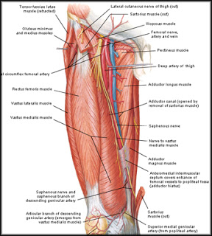
Adductor Canal Block
Advantages: less quadriceps weakness than femoral nerve block. Thus decreases the risk of fall, able to ambulate which facilitates physical therapy.

Slide 24
Total Knee Replacement Protocol
Preop: Adductor Canal Catheter (bolus given)
Plus
 | Preop | Postop
Acetaminophen | 1000 mg | 1000 mg TID
Gabapentin | 600 mg | 300mg TID
Celecoxib | 400 mg | 200mg BID
Notes:
UCSF

Slide 25
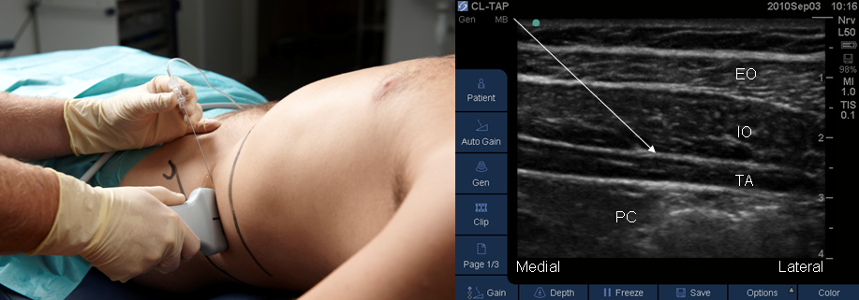
Transverse Abdominis Plane (TAP) Block
Notes:
Part of GYN, colorectal protocol.

Slide 26
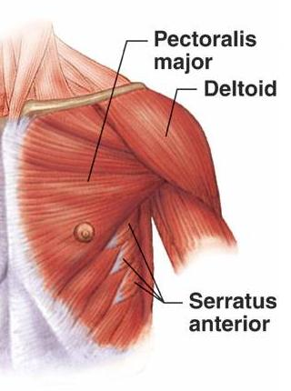
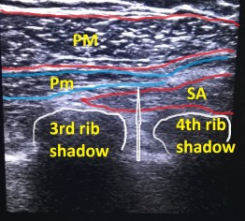
PEC Blocks

Slide 27
Summary
Poorly controlled postoperative pain is a risk factor for POD.
Limited data suggest multimodal analgesia strategies that minimize the use of opioids have a beneficial effect on POD.
The newer pain management techniques may help in reducing the incidence of POD.

Slide 28

Thank you
Sakura.Kinjo@ucsf.edu

