Slide 1


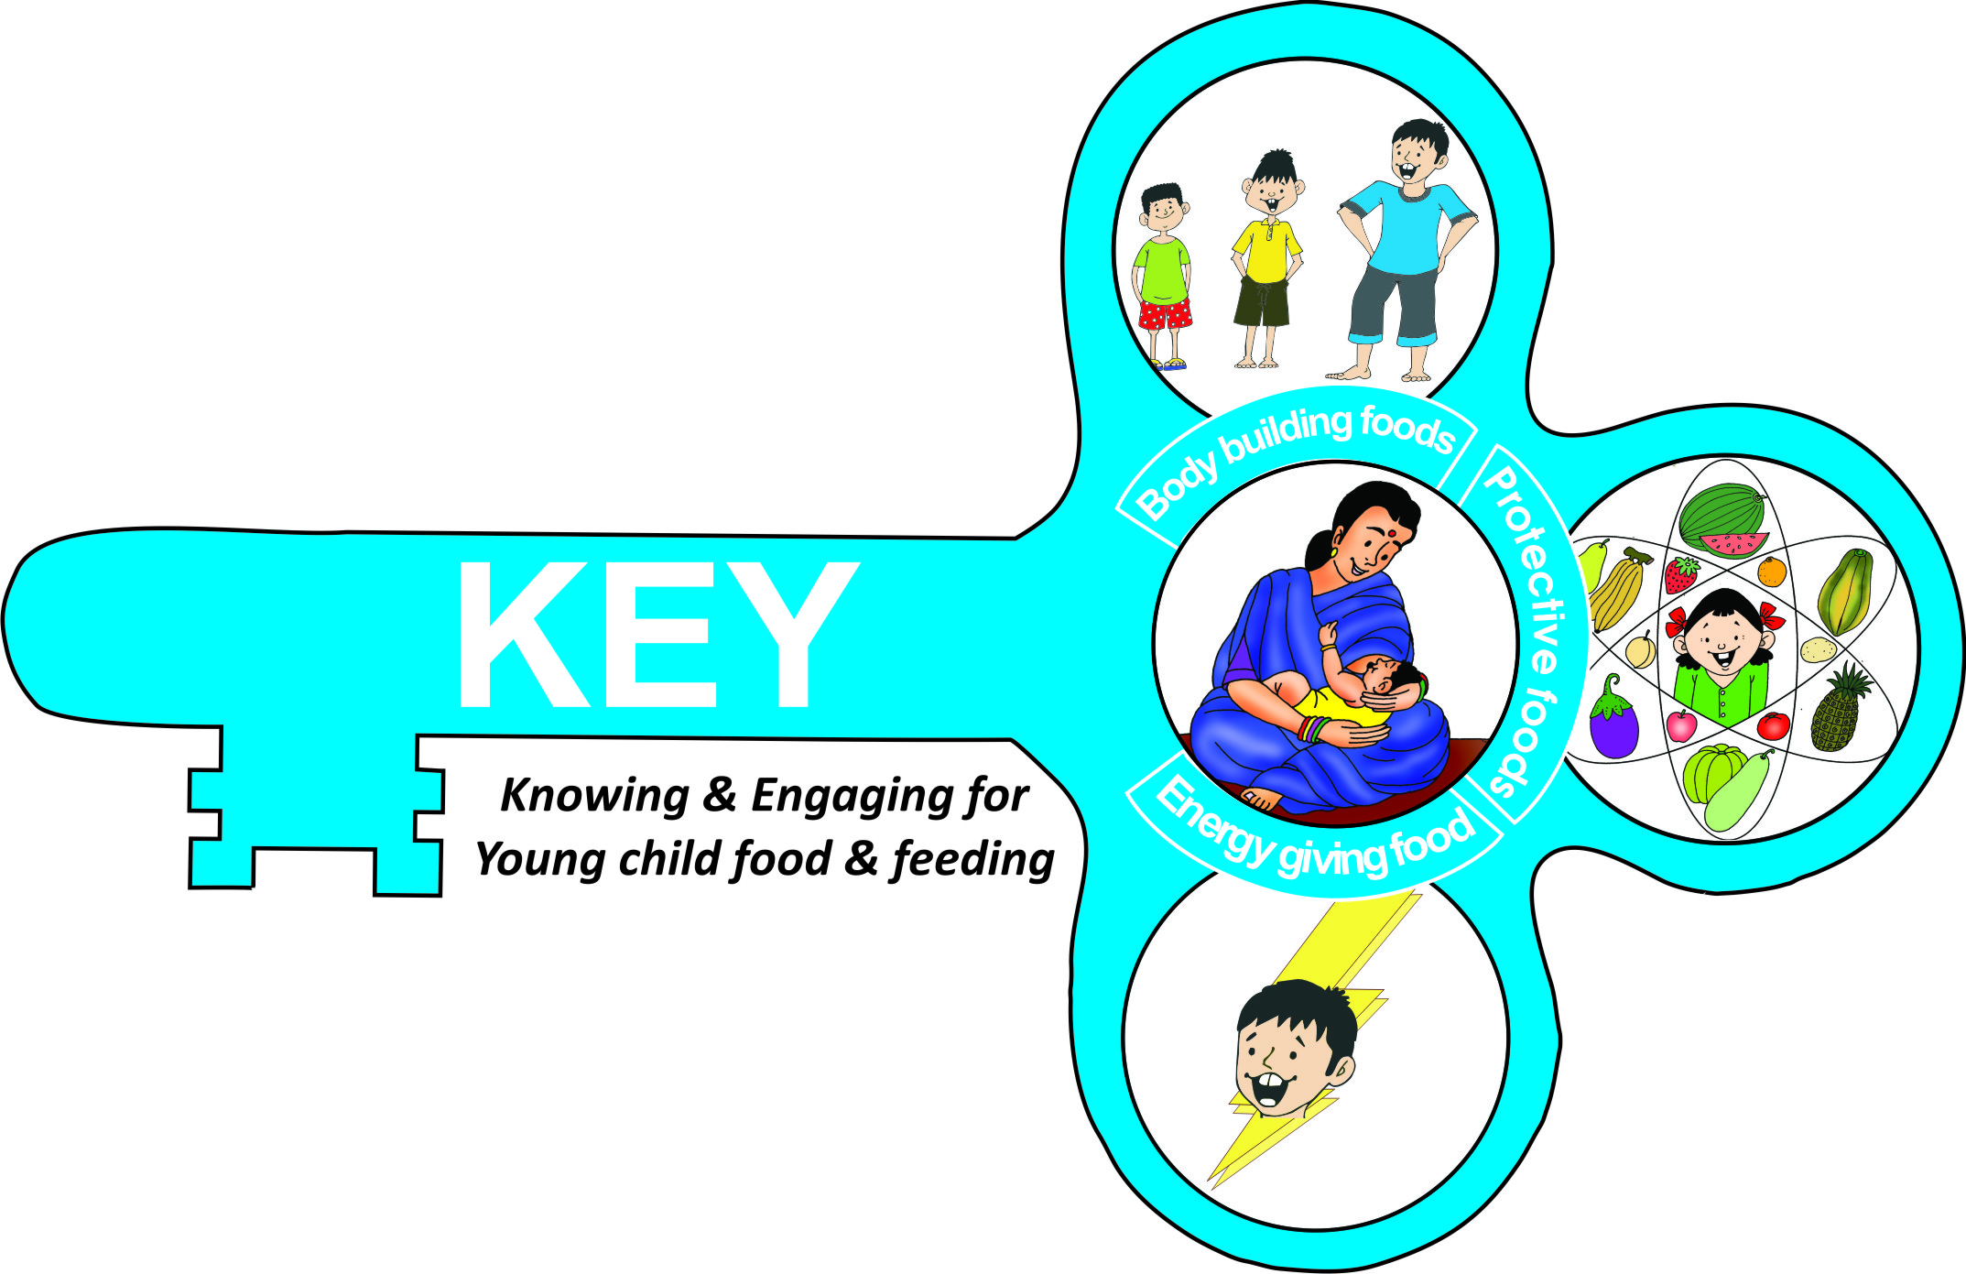
RAPID DIET ASSESSMENT TOOL: Demystifying IYCF assessments- Extrapolation of education/ learning initiative
A Cross-Sectional study of HOSHIARPUR (PUNJAB) Block
Dr. Smriti Pahwa, Abhinav Motheram, Remy Hans, Prabhsimran, Vajinder Thakur, Sakshi Dudeja

Slide 2
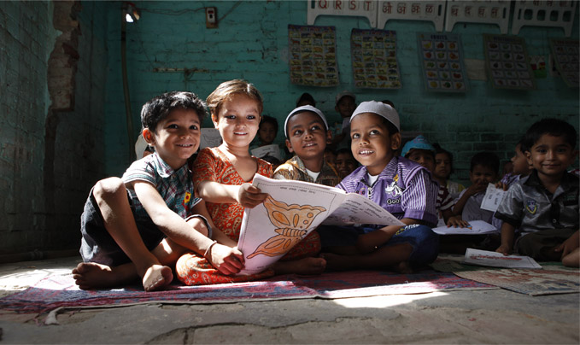
Pratham Education Foundation
Pratham Education foundation was established in 1995 in Mumbai and has grown in both scope and geographical coverage since then.
India’s largest non government organization.
An innovative learning organization created to improve the quality of education.
Run various programs reaching 7.7 million children across the country*.
*http://www.pratham.org/
Notes:
Pratham: parent organisation.Focus on quality education and ensure that children not only attend school but even prospers. Aim is to support government programs and not to replace them.

Slide 3
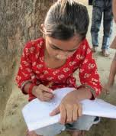
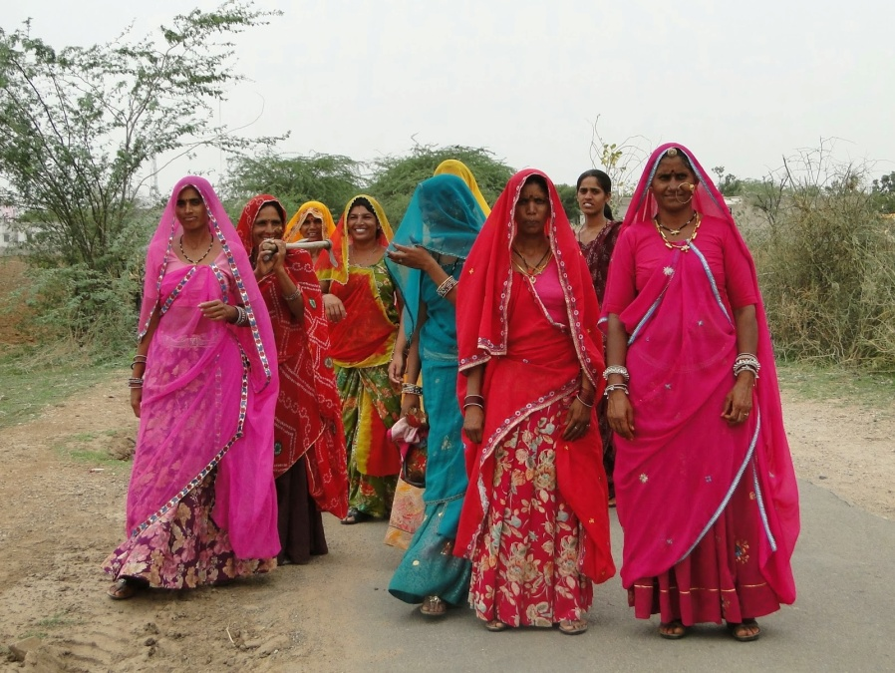
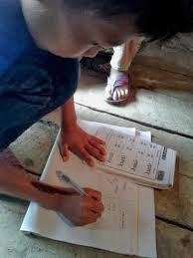
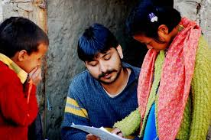

Slide 4

ASER (Annual Survey of Education Report)
ASER Centre was established in 2005.
The largest non-governmental household survey conducted in rural India.
ASER surveys have been involving more than 25,000 volunteers and covering over 700,000 children in 15,000 villages each year.
Tracks children’s ability to read and do basic arithmetic involving local organizations and institutions in every rural district in the country.
Has become an important resource for the education policies of both Central and State governments.
Notes:
Aser believes when ordinary people are empowered with knowledge, they can bring about extraordinary change. When they learn to measure what affects their lives, they communicate with each other in villages, states and take steps to resolve them.
700,000 children in age group 3-16 years across the country

Slide 5
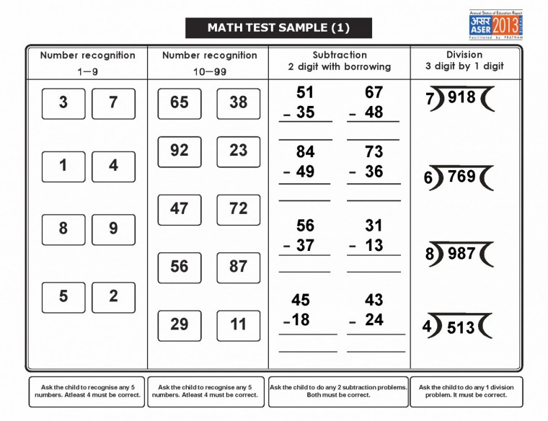
ASER Testing tool for Arithmetic

Slide 6
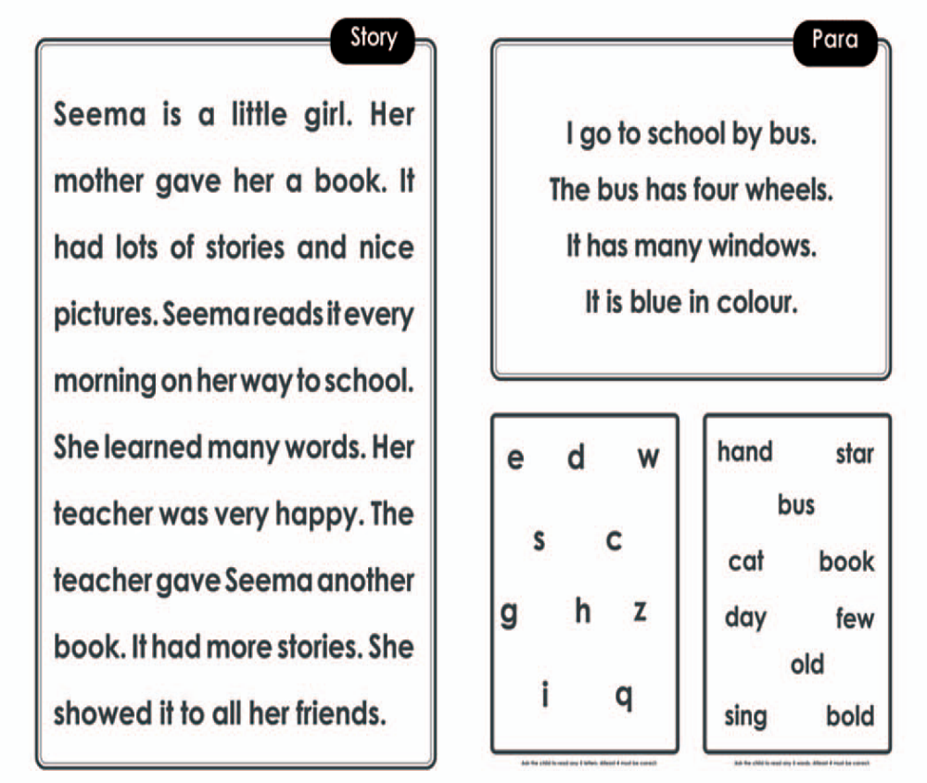
ASER Testing tool for Language
Notes:
Relating it to the applicability of tool used to do this survey. Highlighting the simplicity of the tool and how it can be used by local volunteers.

Slide 7
IYCF: FEW FACTS
Sound Infant and young Child Feeding (IYCF) practices are known to improve child’s growth, survival and intellectual development.
There is a policy push in India to unpack age appropriate complementary feeding so that the same can be better understood and adopted at community level.
An innovation was hatched extrapolating ASER/Pratham approach for large scale assessment and community participation approach in education for assessing IYCF and other domains involving National Service Scheme (NSS) students.

Slide 8
K.E.Y (Knowing and Engaging for Young child food and feeding)
An ECD-Nutrition curriculum to train frontline workers/volunteers to work with caregivers of very young children (less than 3 years) on nutrition, health and overall development.
Simple, measurable and actionable indicators have been identified to enable volunteers and caregivers to monitor Young child food and feeding practices, growth and overall health and development.

Slide 9
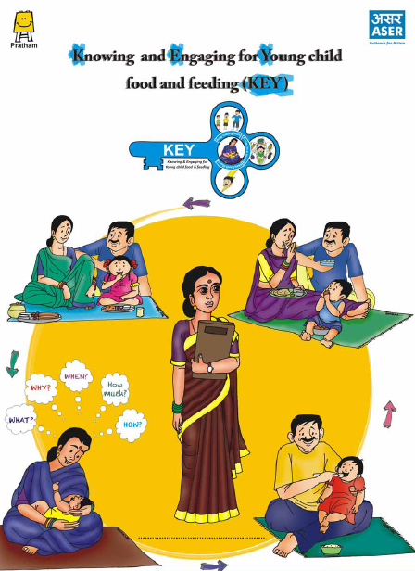
ECD Nutrition curriculum comprises of:
Main K.E.Y module
Supporting modules- Growth monitoring, Immunization, Diarrhoea, Water, hygiene and sanitation

Slide 10
Rapid diet assessment tool developed
Based on ASER philosophy of community involvement, simple assessment and understandable evidence
Rapid Diet Assessment tool:
A rapid diet assessment tool was developed.
An attempt to involve common people/ with not necessary technical background to unpack the age appropriate complementary feeding.
A possible interface for common people to look at IYCF, analyze and assess gaps for possible action
Reference period: 24 hour

Slide 11
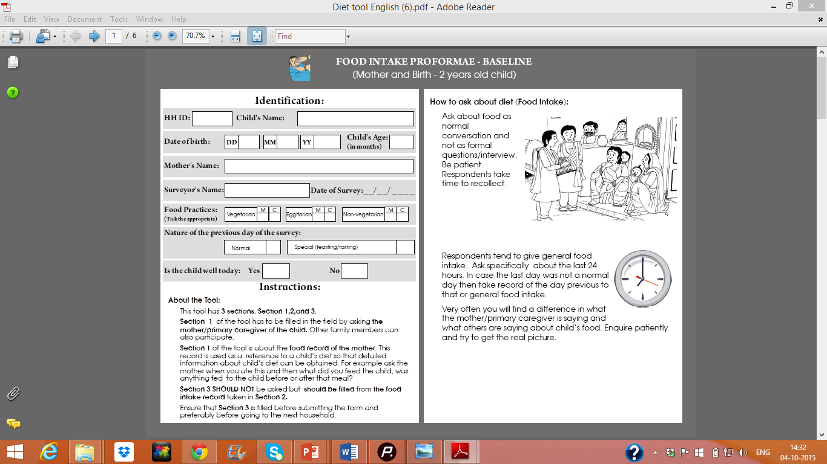
Rapid diet assessment tool

Slide 12
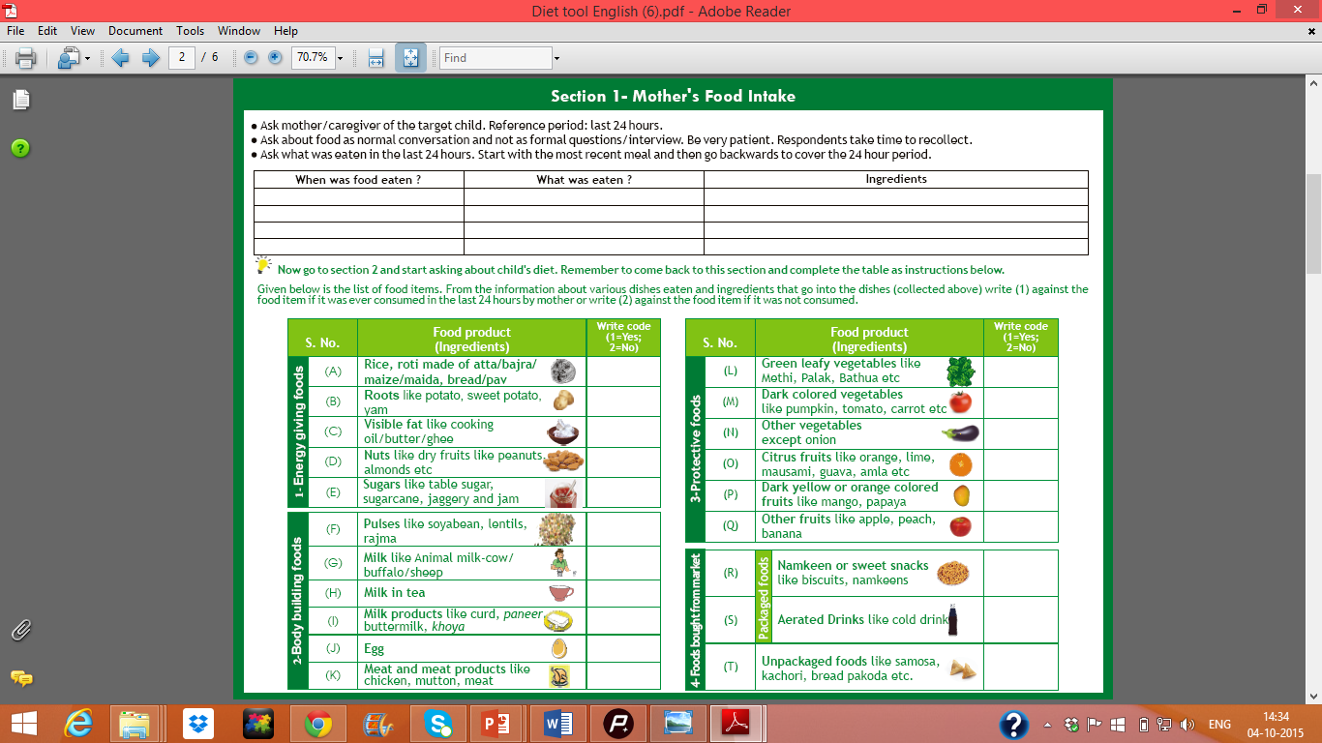
Rapid diet assessment tool

Slide 13
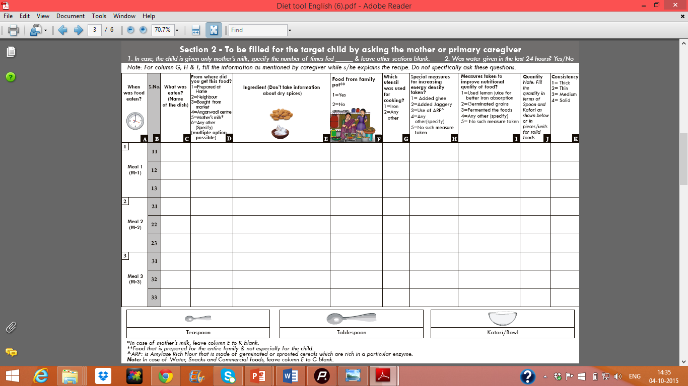
Rapid diet assessment tool

Slide 14
Training Process:
60 NSS students got Training on KEY in a workshop mode. First two days, information was given to them to build their capacities on allied topics followed by field exposure
To understand field realities, students got involved in doing the survey in 40 villages of Hoshiarpur Block.
Simple Rapid Diet assessment tool and a questionnaire was used to gauge information in order to understand the local perceptions, existing knowledge and practices in the community.
Desk check of all the forms was done.

Slide 15
METHODOLOGY:
40 villages were randomly sampled of Hoshiarpur II block using probability proportional to size (PPS) sampling technique.
Villages selected were as per the Census 2011 village list.
List of less than 2 year old children was obtained from Anganwadi centres.
16 households were covered from each village in order to give us a total targeted sample of 640 households to create a block report card of Hoshiarpur block.

Slide 16
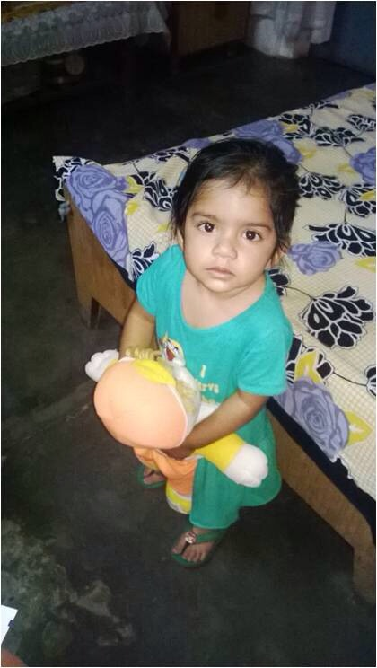
FINDINGS:

Slide 18
Educational Qualification

Slide 19
Employment Status

Slide 21
Infant and Young Child Feeding Practices

Slide 22
Distribution of children according to exclusive breastfeeding and other than mother milk (<= 6 months)
Age | Exclusive breastfeeding |  | Other than Mother milk
 | n | % | n | %
<=6 (N=139) | 108 | 77.1 | 31 | 22.3

Slide 23
Distribution of children according to exclusive breastfeeding and other than mother milk (6 months above)
Age | Exclusive breastfeeding |  | Other than Mother milk
 | n | % | n | %
7 – 8 months (N=71) | 19 | 26.8 | 52 | 73.2
9 – 11 months (N=100) | 16 | 16.0 | 84 | 84.0
>= 12 months (N=290) | 13 | 4.5 | 277 | 95.5
Total (N=461) | 48 | 33.8 | 413 | 89.6

Slide 25
Number of time additional feed was given according to the adherence to the guidelines
Category | Guidelines | Meeting guidelines |  | Not meeting guidelines
 |  | Total | % | Total | %
7 – 8 months (N=71) | >=3 feeds | 52 | 73.2 | 19 | 26.8
9 – 11 months (N=100) | >=4 feeds | 81 | 81.0 | 19 | 19.0
>= 12 months (N=290) | >=4 feeds | 260 | 89.7 | 30 | 10.3
Total (N=461) |  | 393 | 85.2 | 68 | 14.8

Slide 27
Dietary Diversification
Notes:
Consumption of protective foods and how it is related to micro nutrient deficiencies and hidden hunger

Slide 28
Meal consistency for children above 6 months
>6 Month Child (Meal items consistency)
Consistency | No of meal | %
Thick | 172 | 6.3
Thin | 1063 | 38.9
Medium | 485 | 17.7
Solid | 1016 | 37.1
Total | 2736 | 100.0

Slide 29
Measures taken to improve energy density of >6 month child meal
 | 7-8 months | 9-11 months | >=12 months | Total | %
Added Ghee | 12 | 31 | 120 | 163 | 35.3
Added Jaggery | 0 | 0 | 0 | 0 | 0
Use of ARF | 0 | 0 | 0 | 0 | 0
Any other | 0 | 0 | 0 | 0 | 0
Total |  |  |  | 163
Notes:
A child needs high nutrient density food because requirements are very high and requirements are given per kg child’s wt and a child’s weight gets doubled in 6 months.

Slide 30
Measures taken to improve nutritional quality of food
 | 7-8 months | 9-11 months | >=12 months | Total | %
Cooked in Iron utensils | 17 | 42 | 191 | 250 | 54.2
Used lemon juice for better iron absorption | 1 | 0 | 3 | 4 | 0.8
Germinated grains | 0 | 0 | 0 | 0 | 0.0
Fermented the foods | 0 | 0 | 0 | 0 | 0.0
Any other | 0 | 0 | 0 | 0 | 0.0
No such measure taken | 0 | 0 | 0 | 0 | 0.0
Notes:
Start with other measures and iron utensil is coming coz of common practice of using iron tawa for making roti

Slide 31
Other Domains

Slide 32
GROWTH MONITORING
If yes, why do you think regular weighing of children is important?
 | n | %
It helps in weight gain of the child | 128 | 21.2
To monitor child's growth | 395 | 65.4
Doctor has asked to do so | 22 | 3.6
Any other | 14 | 2.3
Don't know | 39 | 6.5
Not responded | 6 | 1.0
Do you have the growth chart of your child?
 | n | %
Yes | 460 | 76.2
No | 140 | 23.2
Not responded | 4 | 0.7
Total | 604
According to you, how often should a child be weighed?
 | n | %
Every month | 324 | 53.6
Once every three months | 54 | 8.9
No specific time | 64 | 10.6
At the time of immunization | 83 | 13.7
Any other | 16 | 2.6
Don't know | 55 | 9.1
Not responded | 8 | 1.3

Slide 33
Do you think regular weighing of a child is important
 | n | %
Yes | 552 | 91.4
No | 51 | 8.4
Not responded | 1 | 0.2
If the weight was not measured, what is the reason? (n=338)
 | n | %
AWW was not present | 17 | 5.0
Weighing machine was not available at AWC | 13 | 3.8
Lack of information about child's weighing | 93 | 27.5
Lack of time | 158 | 46.7
Any other | 40 | 11.8
Not responded | 17 | 5.0
Total | 338

Slide 34
Practice
Have you got your child weighed this month?
 | n | %
Yes | 264 | 43.7
No | 338 | 56.0
Not responded | 2 | 0.3
Total | 604

Slide 35
Diarrhoea
When your child had Diarrhea last, what did you do ?
 | n | %
Gave ORS | 46 | 22,4
Gave home made sugar and salt solution | 8 | 3,9
Gave home made fluids | 9 | 4,3
Took child to trained health worker | 105 | 51,2
Mother's milk | 14 | 6,8
Any other | 23 | 11,2
Total | 205
When child has diarrhoea, should there be any changes in the food and drink intake pattern of the child?
 | n | %
Increased food intake | 27 | 4,5
Increased fluid intake | 49 | 8,1
Did not change anything | 114 | 18,9
Stopped feeding mother's milk | 5 | 0,8
Decreased food and fluid intake | 42 | 7,0
Not Responded | 367 | 60,8
Total | 604

Slide 36
Do you know how to prepare ORS solution?
 | n | %
Explained Fully | 46 | 7.6
Explained partially | 364 | 60.3
Don't know | 169 | 28.0
Not Responded | 21 | 4.1
Total | 600

Slide 37
IMMUNISATION
Do you think immunization is important
 | n | %
Yes | 598 | 99.0
No | 5 | 0.8
Not responded | 1 | 0,2
If yes, why is immunization important?
 | n | %
Protect from diseases | 572 | 94.7
Everybody says so | 8 | 1.3
Family members asked to | 7 | 1.2
AWW told so | 18 | 3.0
Neighbours do it | 0 | 0.0
Don't know | 9 | 1.5
Any other | 3 | 0.5

Slide 38
Do you have your child's immunization card?
 | n | %
Yes | 554 | 91.7
No | 48 | 7.9
Not Responded | 2 | 0.3
Total | 604
If yes, vaccination status (for children >=12 months)
 | n | %
Total immunization (n=290) | 229 | 79.0

Slide 39
CONCLUSION:
Majority of the households have access to facilities but they have very little knowledge about right practices that need to be followed for development of a child
. It seems to be not so much of a problem of access but a problem of awareness.
we should be emphasizing more on making stakeholders than making beneficiaries.
Easy assessments instruments like the one used here might have a potential to demystify young child food and feeding by involving ordinary people in assessments and understanding the gaps to propel action.

Slide 40
Acknowledgements
Rayat Bahra Institute of Management, Hoshiarpur
Vajinder, Punjab state head, Pratham Pujab Team
Capacity Building Unit, ASER Centre

Slide 41
THANK YOU!

Slide 42
No. of children given different food groups
 |  | Energy Giving |  |  |  |  |  | Body Building |  |  |  |  |  |  |  | Protective Foods
 |  | Cereals & Millets | Roots & Tubers | Sugars | Fats & Oils | Nuts | Energy Giving | Pulses | Milk from animals | Milk in tea | Milk & Milk products | Egg | Meat | Body Building | Mother's milk | Green leafy vegetables | Dark colored fruits | Other vegetables | Citrus fruits | Dark colored fruits | Other fruits | Protective food
7-8 months (N=71) | 71 | 42 | 8 | 23 | 1 | 33 | 51 | 12 | 35 | 4 | 13 | 0 | 0 | 47 | 59 | 0 | 3 | 14 | 2 | 0 | 3 | 17
 | % | 59,2 | 11,3 | 32,4 | 1,4 | 46,5 | 71,8 | 16,9 | 49,3 | 5,6 | 18,3 | 0,0 | 0,0 | 66,2 | 83,1 | 0,0 | 4,2 | 19,7 | 2,8 | 0,0 | 4,2 | 23,9
9-11 months (N=100) | 100 | 69 | 15 | 53 | 0 | 50 | 81 | 39 | 57 | 7 | 26 | 0 | 1 | 72 | 78 | 1 | 34 | 45 | 2 | 3 | 15 | 56
 | % | 69,0 | 15,0 | 53,0 | 0,0 | 50,0 | 81,0 | 39,0 | 57,0 | 7,0 | 26,0 | 0,0 | 1,0 | 72,0 | 78,0 | 1,0 | 34,0 | 45,0 | 2,0 | 3,0 | 15,0 | 56,0
>= 12 months (N=290) | 290 | 262 | 84 | 225 | 1 | 202 | 275 | 131 | 194 | 44 | 129 | 2 | 0 | 263 | 168 | 8 | 139 | 195 | 7 | 16 | 41 | 215
 | % | 90,3 | 29,0 | 77,6 | 0,3 | 69,7 | 94,8 | 45,2 | 66,9 | 15,2 | 44,5 | 0,7 | 0,0 | 90,7 | 57,9 | 2,8 | 47,9 | 67,2 | 2,4 | 5,5 | 14,1 | 74,1
Total (N=461) | 461 | 373 | 107 | 301 | 2 | 285 | 407 | 182 | 286 | 55 | 168 | 2 | 1 | 382 | 305 | 9 | 176 | 254 | 11 | 19 | 59 | 288
 | % | 80,9 | 23,2 | 65,3 | 0,4 | 61,8 | 88,3 | 39,5 | 62,0 | 11,9 | 36,4 | 0,4 | 0,2 | 82,9 | 66,2 | 2,0 | 38,2 | 55,1 | 2,4 | 4,1 | 12,8 | 62,5

Slide 43
Measures taken to improve energy density of >6 month child meal
 | 7-8 months | 9-11 months | >=12 months | Total | %
Added Ghee | 12 | 31 | 120 | 163 | 35,3
Added Jaggery | 0 | 0 | 0 | 0 | 0,0
Use of ARF | 0 | 0 | 0 | 0 | 0,0
Any other | 0 | 0 | 0 | 0 | 0,0
Nothing | 0 | 0 | 0 | 0 | 0,0
Total |  |  |  | 163

