Slide 1
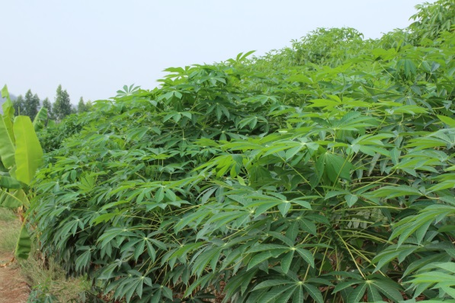
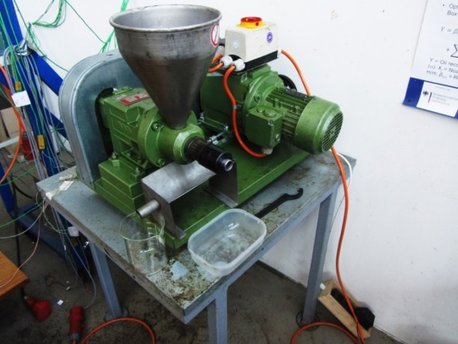
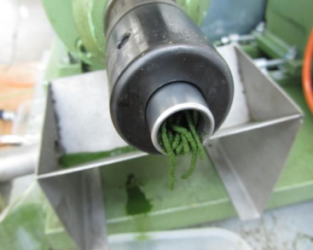
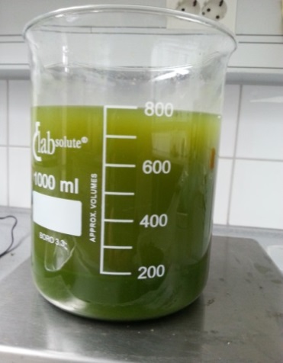
Optimization and computational evaluation of mechanical juice extraction from cassava leaves
Dr. Sajid Latif
Sebastian Romuli
Prof. Dr. Joachim Müller

Slide 2
Some facts about cassava
Widely grown in tropical and subtropical countries
226 million tons estimated production in 2006 (FAO, 2008)
Grown in 105 countries and ranks as world's fourth most important crop
A staple food for nearly one billion people
Mainly grown for starchy roots
However, the stem, leaves and petioles of cassava are also edible and are widely used as food in Africa
The Congolese call cassava leaves “old man’s meat”
In some places, usually left in the field after cropping the roots

Slide 3
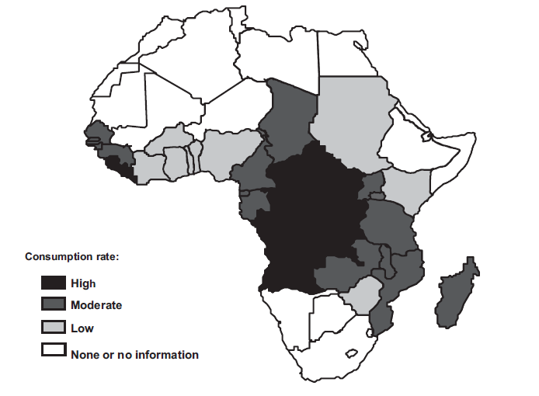
Consumption of cassava leaves in Africa
Ufuan Achidi, A., Ajayi, O. A., Bokanga, M., & Maziya-Dixon, B. (2005). The use of cassava
leaves as food in Africa. Ecology of Food and Nutrition, 44, 423-435.

Slide 4
Consumption of cassava leaves
Country | Consumption level | Dish name
Angola | Frequently | Kizaka, Ngwada
Botswana | Eaten
Brazil | As food supplement to combat malnutrition | Multimistura
Burundi | Eaten as spinach
Cameroon | Highly appreciated by the people of Yaounde 30 to 100g/day | nkwen, Gweri
Central African Republic | Eaten as spinach | pondu, sakasaka
Congo | Preferred vegetables, 40 to 170g/day | pondu, sakasaka, matamba, and sombe
Democratic Republic of Congo (DRC) | 500g/day
Gabon | Eaten as spinach
Indonesia | Eaten as vegetable | Daun Singkong, Daun ubi tumbuk
Liberia (Mano river counties of West Africa) | Eaten regularly accompaniment to rice | Pondo, sakasaka
Madagascar | Eaten throughout the country | ravitoto, ravinmahogo, and ambazaha
Malawi |  | chigwada
Malaysia | One of the traditional vegetable | Masak lemak pucuk ubi
Mali |  | Banankou boulou nan
Mozambique (Rural and north-east) | Eaten almost daily as side dish | Chigwada, mathapa
Nigeria | One of the twelve eaten as vegetable
Philippines southern part of Mindanao | Widely used as vegetable | Ginataang cassava leaves
Rwanda | Eaten as spinach | Isombe
Sierra Leone and Guinea | Eaten regularly accompaniment to rice, eaten as vegetable | Cassada leaves, Mafe haako bantare
Sri Lanka (Monaragala) | 35-100 g/day | Malluma
Tanzania | Eaten as vegetable | Kisanby, kisamvu
Zaire | Important part of the peasant meal, eaten as vegetable 500g per person | Mpondu, pondu, sakasaka
Zambia | Frequently | Kizaka, Ngwada
Zimbabwe | Eaten

Slide 5
Nutritional aspects of cassava leaves
High content of crude protein (17.7-38.1% dry weight) depending on the cultivar and climatic conditions
High content of vitamins, B1, B2, C, carotenoids and minerals
Total essential amino acid in cassava leaf protein is similar to
  Hen's egg
  Greater than spinach leaf, soybean, oat and rice grain
High essential amino acids as compared with the FAO recommended pattern

Slide 6
Antinutritional aspects of cassava leaves
Reduce nutrient bioavailability
  Phytate
  Trypsin inhibitor
  Fiber
  Nitrate
  Oxalate
  Polyphenols
  Saponins
Varies depending on the maturity status, climate condition and variety of cassava

Slide 7
Toxic aspects of cassava leaves
Cyanogenic glycosides: the most toxic compound
Three forms of cyanogens i.e.
  Cyanogenic glucoside (95% linamarin and 5% lotaustralin)
  Cyanohydrins
  Free cyanide
>100 ppm total cyanide (fresh weight basis): highly poisonous
Must be detoxified to less than 10 ppm (proposed by WHO)
Young leaves and newly germinated seedlings contain the highest concentration of cyanogens
Leaves have 5 to 20 times more cyanogenic potential than roots
However, leaves have 200 times more linamarase activity than roots

Slide 8
Sustainable future protein
Insufficient good nutritional protein: the most serious problem
Cassava leaves can be utilized to reduce this problem
Leaves are abundant and the yield per hectare per year of leaf protein can be at least four times higher than that of seed protein
However, direct consumption of leaves is strongly limited because of;
High content of fiber
Toxic substances
Antinutritional factors
Low digestibility and
Bad taste
It is possible to use this protein as human food if;
Leaf material is processed to eliminate these limiting factors

Slide 9
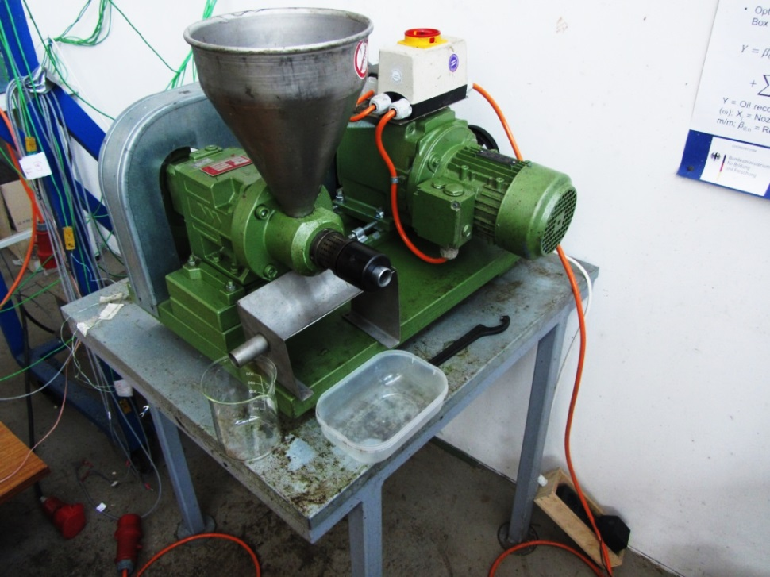
Material and methods
Oil press CA59G
Factory: IBG Monforts Oekotec GmbH & Co.KG
Capacity: 3-5 kg/h
El. power: 1,1 kW
Weight: 80 kg
Different diameter (2 – 6 mm)
Notes:
Half kg also possible, maybe different nozzle diameter picture

Slide 10
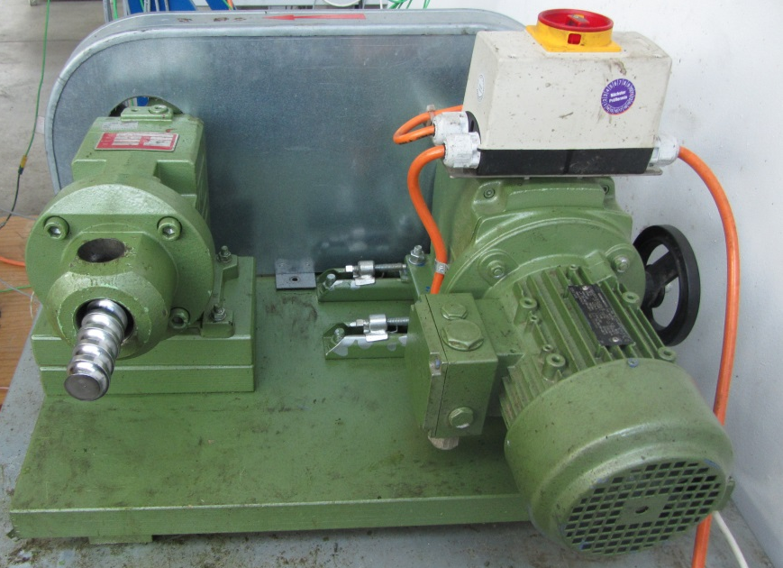
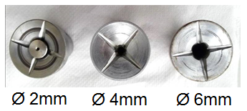
Influencing variables
Level | Screw speed, ω_{s} (rpm) | Nozzle diameter, Ø_{N} (mm)
Low | 18 | 4
Middle | 28 | 5
High | 40 | 6

Slide 11
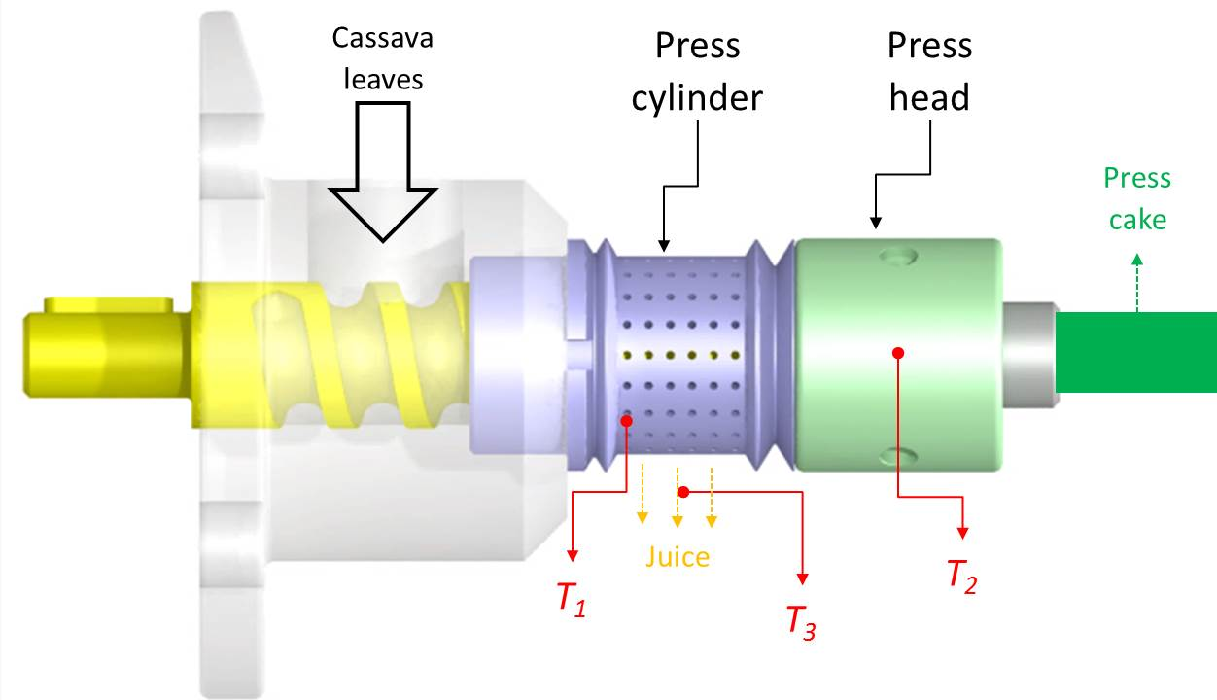
Temperature measurement
Temperature measurement of press cylinder (T₁), press head (T₂), and juice (T₃)

Slide 12
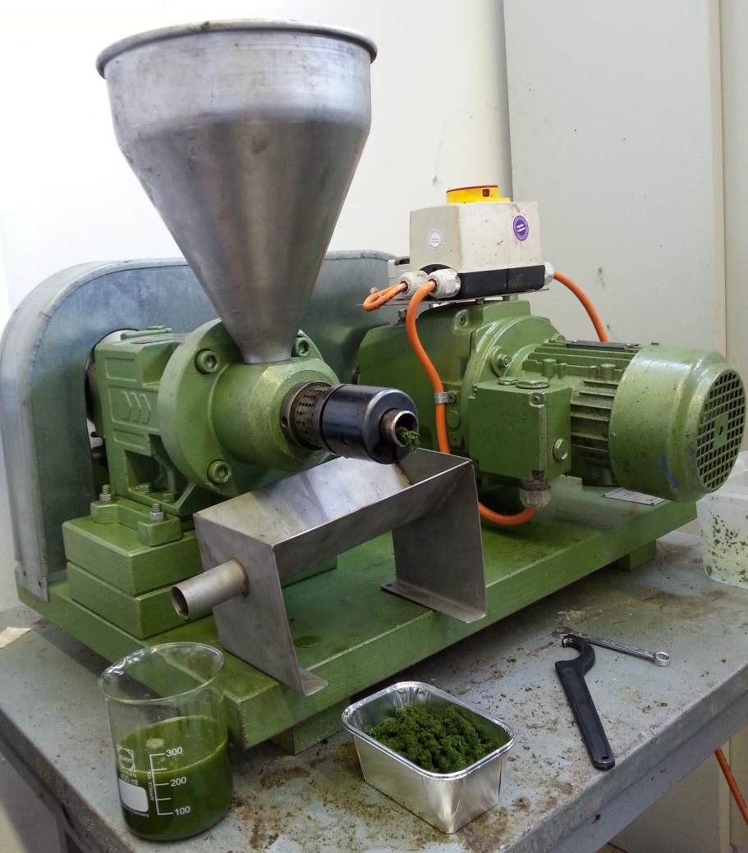
Cassava leaf pressing

Slide 13
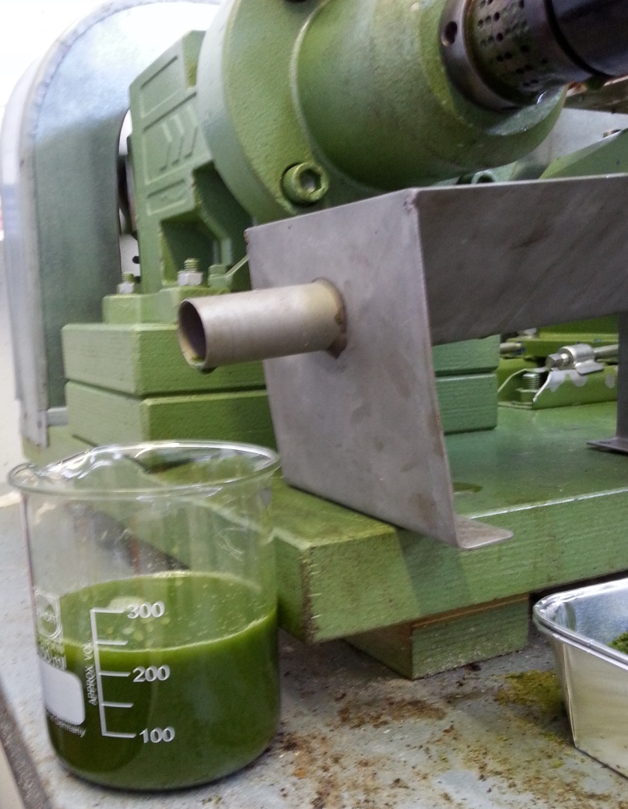
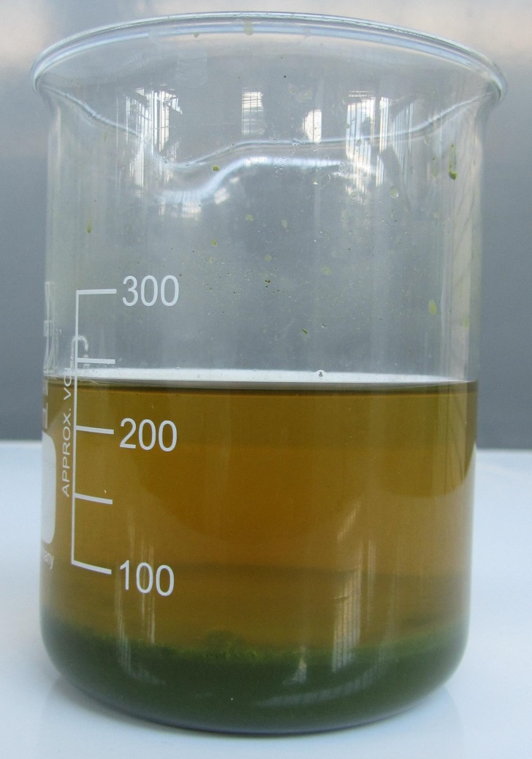
Cassava leaf juice sedimentation

Slide 14
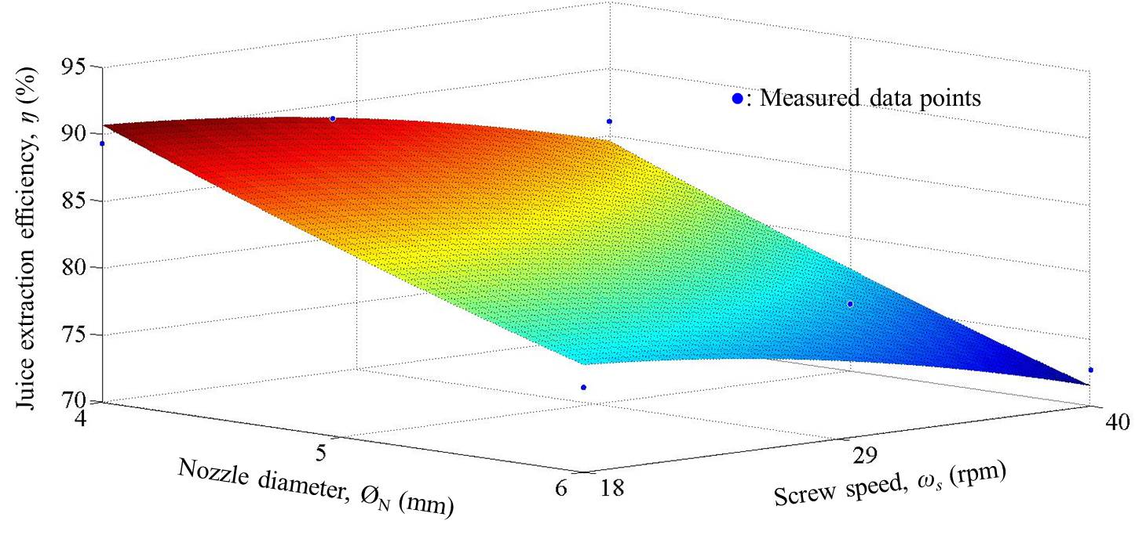
Extraction efficiency affected by nozzle diameter and screw press speed

Slide 15
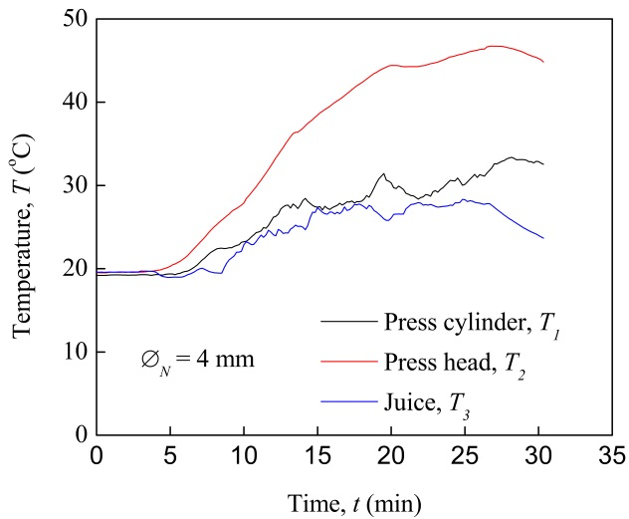
Temperature measurement at 18 rpm for 4mm nozzle diameter

Slide 16
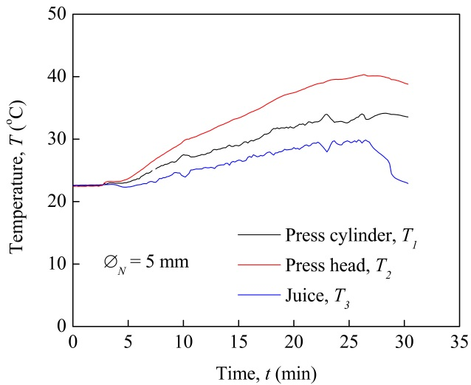
Temperature measurement at 18 rpm for 5mm nozzle diameter

Slide 17
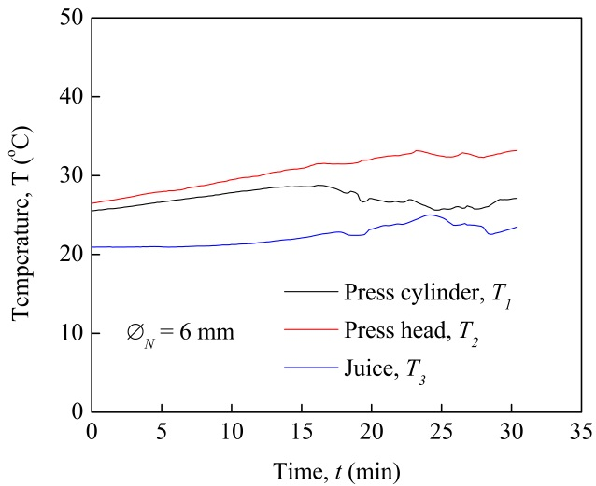
Temperature measurement at 18 rpm for 6mm nozzle diameter

Slide 18
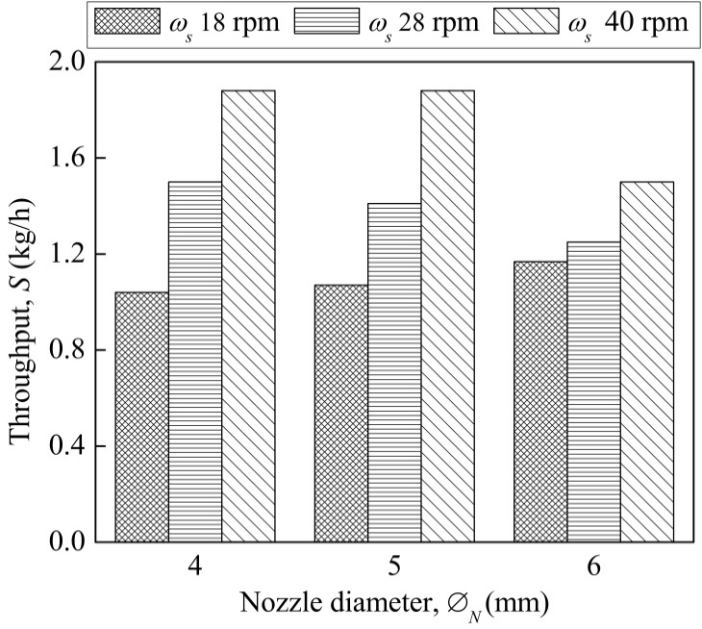
Throughput at different nozzle diameters and screw speed

Slide 19
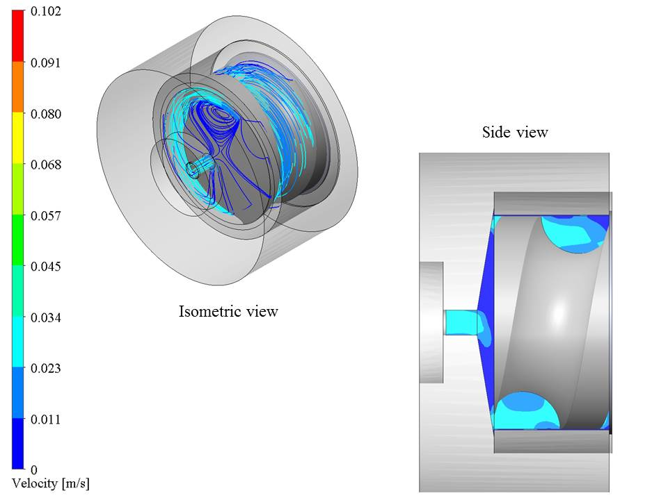
Simulation of velocity (side view) and flow trajectories (isometric view) in press head under optimized condition

Slide 20
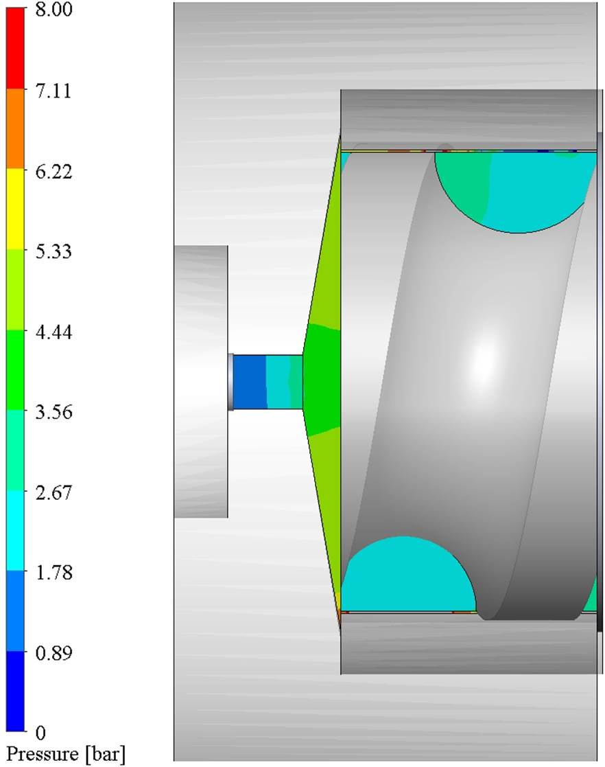
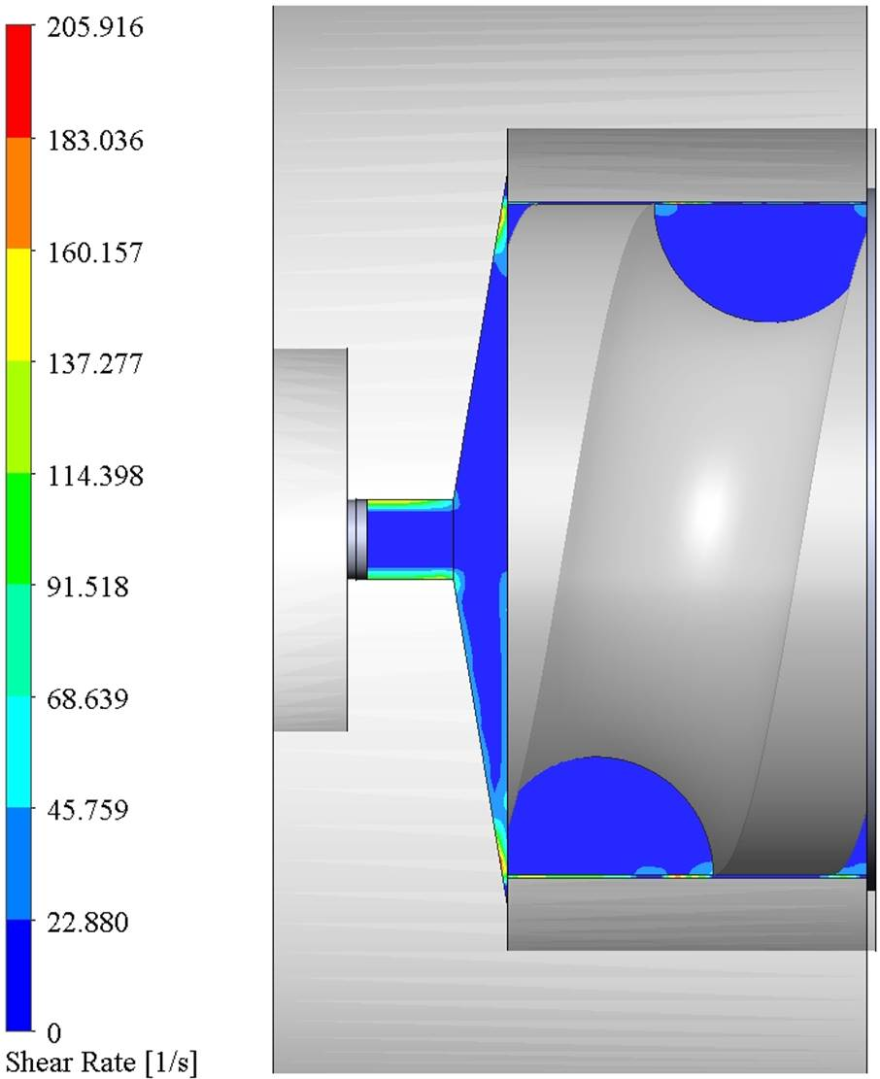
Computational pressure (left) and shear rate (right) in press head at 18 rpm screw press, and 4 mm nozzle size

Slide 21
Conclusions
Cassava leaves pressing was optimized using the screw press speed and the nozzle diameter
Lower motor speed and the lower nozzle diameter leads to a higher extraction efficiency
A low temperature of the press head under optimum conditions may suggest not to have a negative effect on the protein present in the juice as well as in the press cake
Flow simulation of cassava leaf considered as non-Newtonian fluid seems capable of simulating the leafy material during pressing
High rotational speed leads to high velocity of material, but not throughput
Improvement in geometry parameters such as pitch diameter, and bore holes of press cylinder can be made, in order to increase cassava juice extraction

Slide 22


Acknowledgements
This work was financially supported by the German Federal Ministry of Education and Research (BMBF) with funds from the German Federal Ministry for Economic Cooperation and Development (BMZ) as part of the GlobE program through project BiomassWeb – Improving food security in Africa through increased system productivity of biomass-based value webs.

Slide 23
Thanks for your attention!

Slide 24
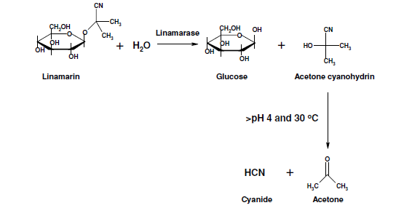
Breakdown linamarin
Linamarin: major cyanogenic glucoside
Linamarase catalyzes linamarin hydrolysis to glucose and acetone cyanohydrin
While hydroxynitrile lyase catalyses cyanohydrins hydrolysis to hydrogen cyanide (HCN) and a ketone
Hence cause serious illness or death of the consumers

