Slide 1


Stratigraphic Study of the Surface from Middle to Upper Eocene Dammam Formation, United Arab Emirates
Khouya, S., Sheikh, F., Almuntaser, A., Aljabri, M.,
Abdelghany, O. and Abu Saima, M.
United Arab Emirates University

Slide 2
Outline
Preface
Introduction
Geologic Background
Methodology
  Field Work
  Lab Analysis
Results
Conclusion & Recommendations
Acknowledgment

Slide 3
Preface
This presentation is a part of research project entitled “Stratigraphic study of the surface Middle to Upper Eocene Dammam Formation, United Arab Emirates” done by undergraduate students:
(Said Khouya, Falah Sheikh, Ali Almuntaser and Miyra Aljabri)
Supported by SURE Grants, UAEU
Supervised by:
(Dr. Osman Abdelghany and Dr. Mahmoud Abu Saima)

Slide 4
Introduction
The Dammam Formation was originally described from the Dammam Dome in Saudi Arabia.
It is widely exposed throughout large areas of southern Iraq, Kuwait, Saudi Arabia, Qatar, UAE and Oman. It is exposed in various localities throughout the UAE.
The Dammam Formation consists of a sequence of shallow water shelf carbonates interbedded with marls.

Slide 5
Objectives
The objectives of the study is to do a Lithostratigraphic and biostratigraphic correlation to the assigned outcrops,
To recognize features to examine Dammam Fm. as groundwater aquifer and as a petroleum reservoir.

Slide 6
Geologic Background
Jabal Hafit Localities (Al Ain)
Jabal Hafit has the most complete sequence for studying Eocene and Oligocene rocks in the UAE. Lays southeast of Al Ain city. Jabal Hafit contains exposed sequence of Rus Fm., Dammam Fm. and Asmari Fm.
Al Faya Range Mt’s. (Al Faya)
Belongs to a group of regional ridges formed by the folding of the Upper Cretaceous to Lower Tertiary sedimentary rocks exposed along the western margin of the Northern Oman Mountains.

Slide 7
Study Area

Slide 8
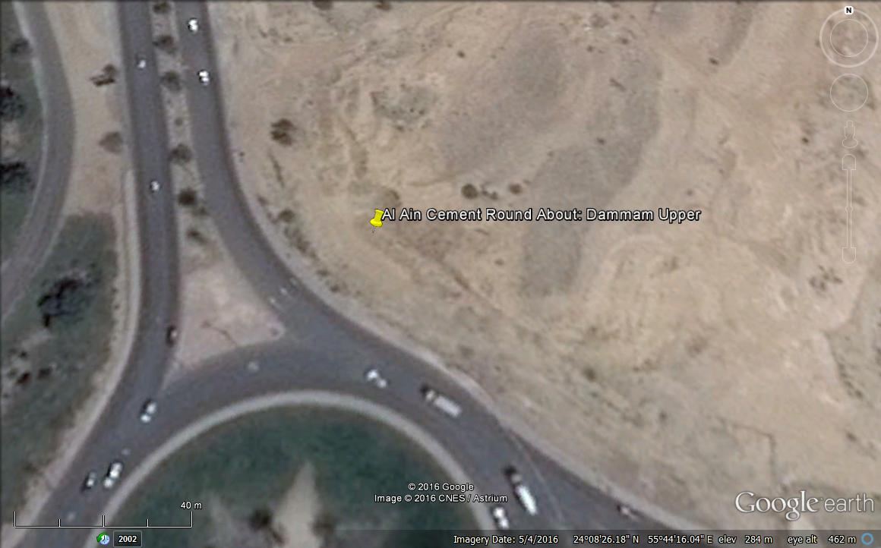
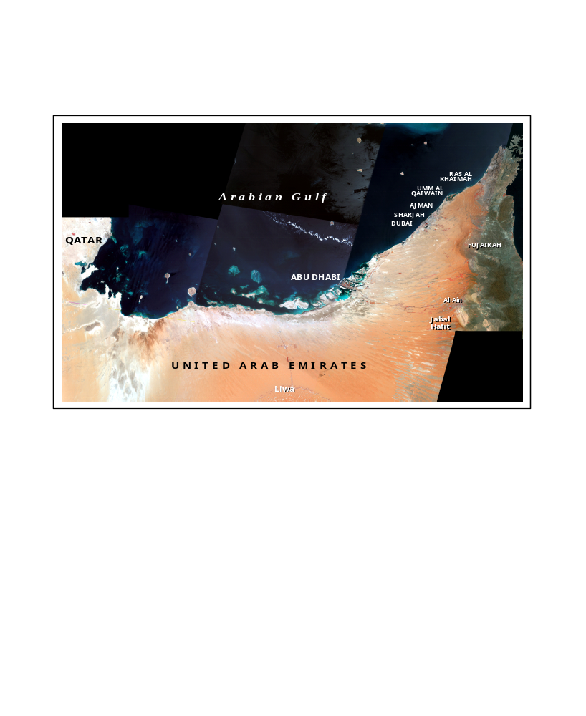
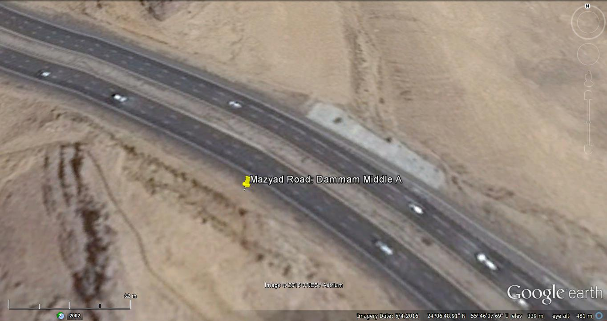
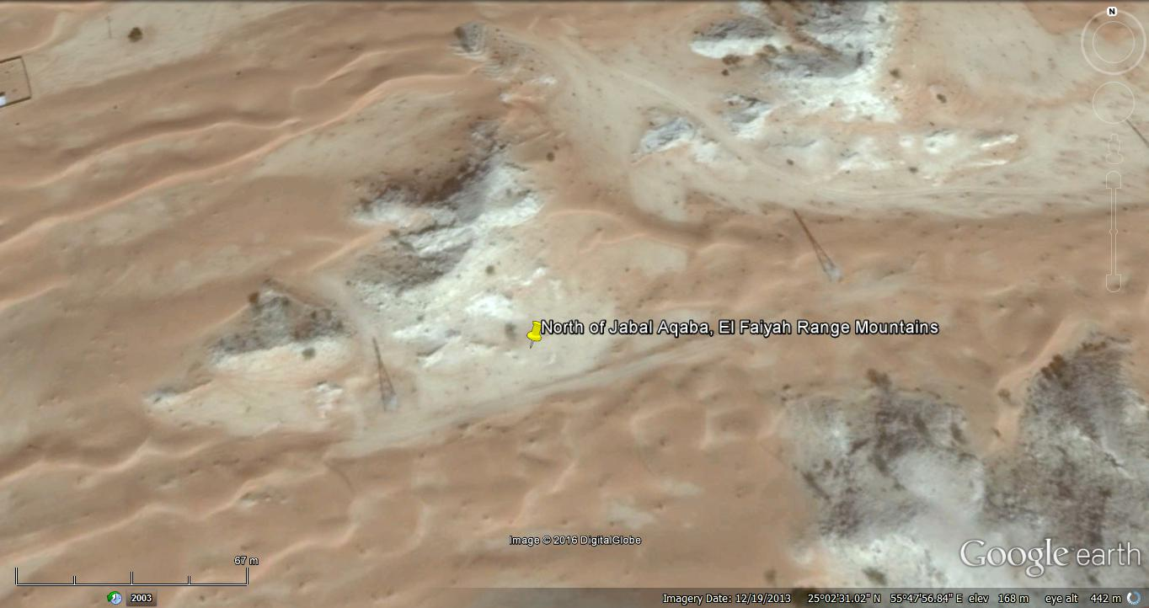
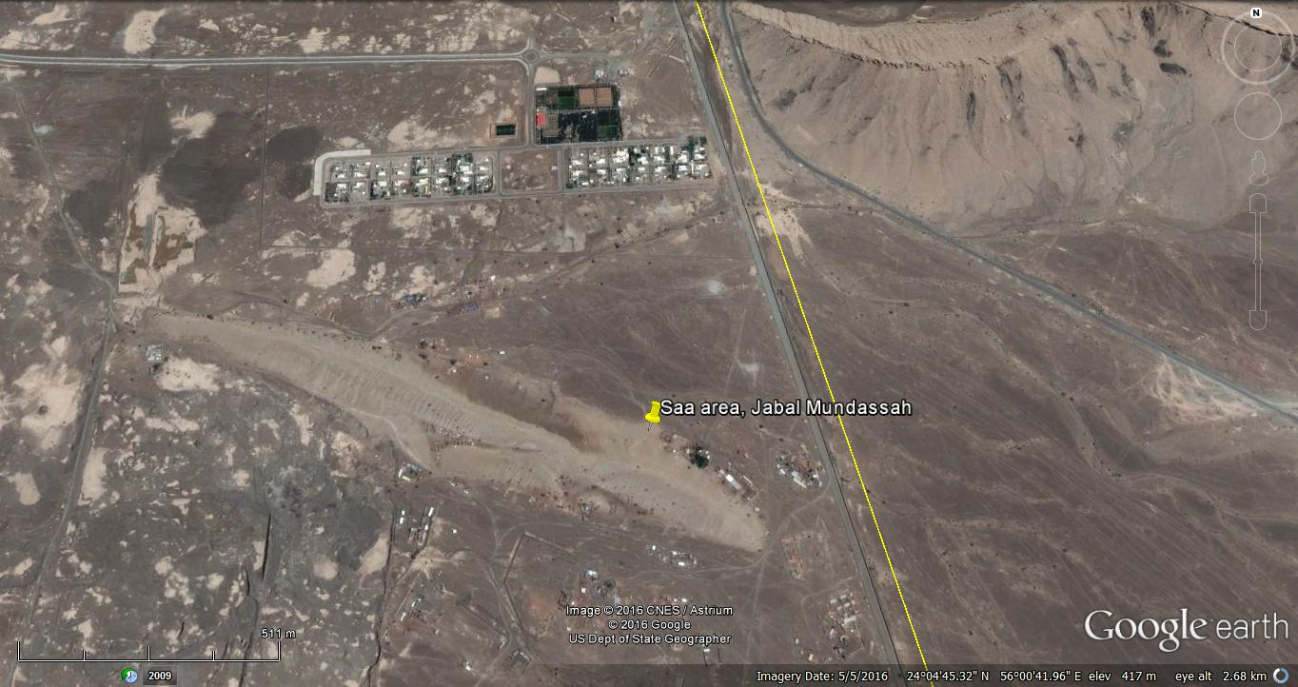
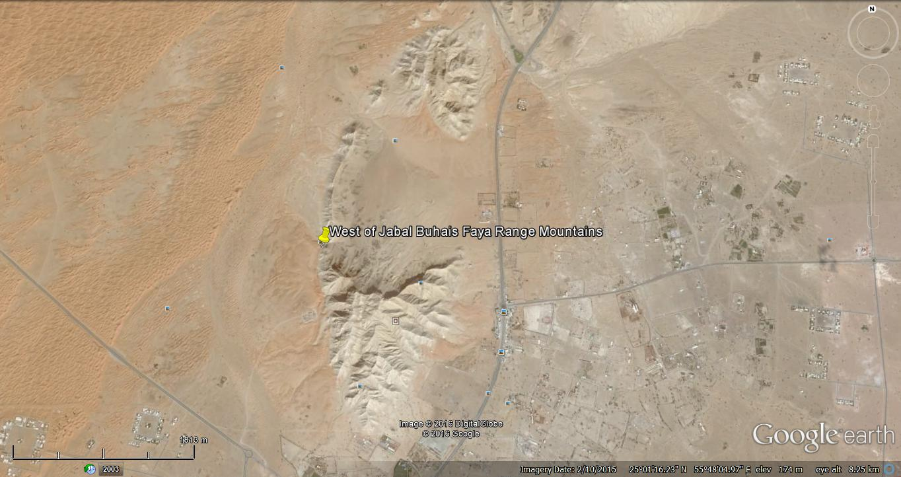
Cement RA, J. Hafit, Al Ain
J. Hafit Area, Al Ain
Jebal
El Faiyah
J. Malaqet
J. Buhays (North), Al Faya
J. Mundassah
Study area
J. Mundassah, Al Ain
J. Buhays (West), Al Faya

Slide 9
Methodology

Slide 10
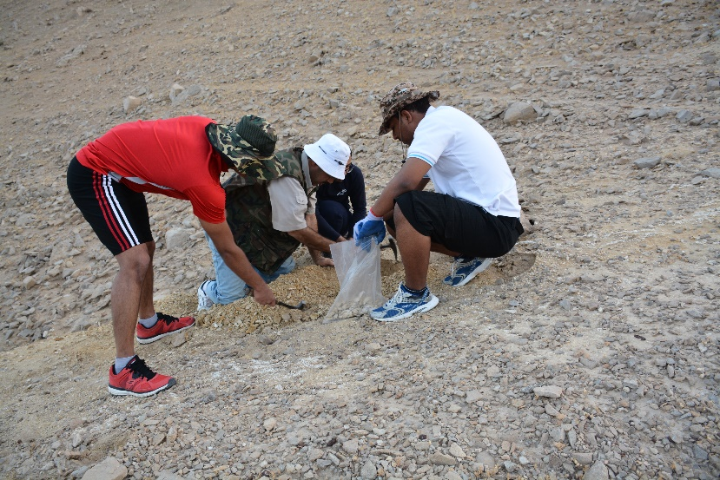
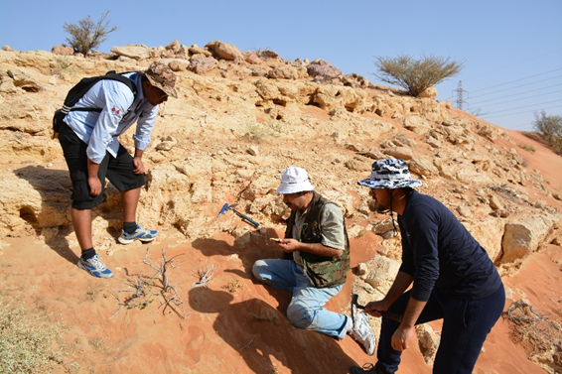
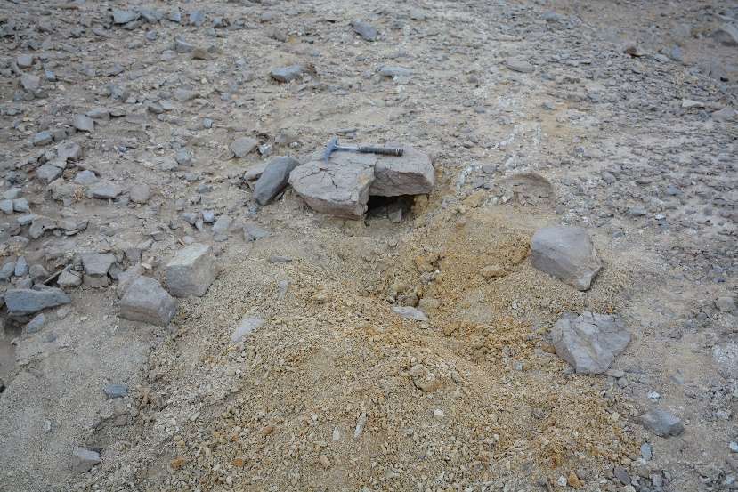
Field Work
20 rock samples were collected from the selected localities of Dammam Fm. in Al Ain (J. Hafit, J. Malaqet & Mundassah) and Al Faya Range Mt’s. (J. Buhays & J. Al Aqabah) alongside some Benthic fossils like (Asterocyclina pentagonalis, Discocyclina sp. and Nummulites sp.) precisely located by GPS coordinates.

Slide 11
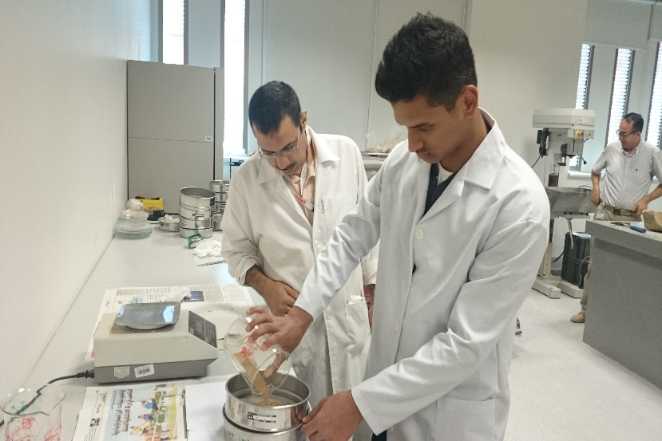
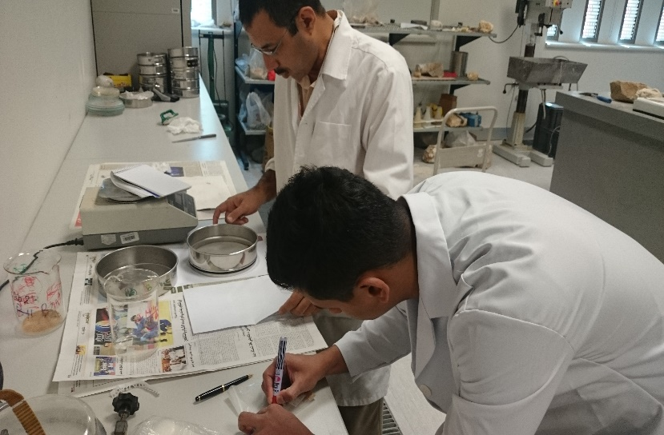
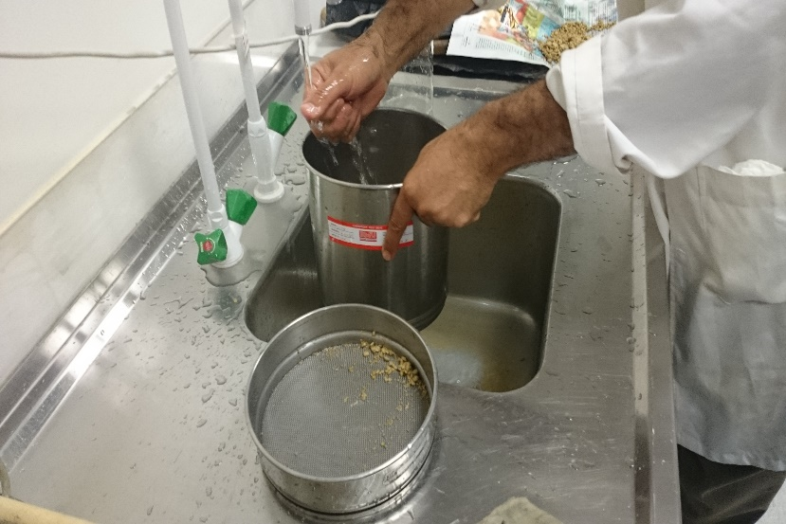
Lab Analysis (Sample Preparation)
The collected rock samples were crushed and grinded for washing to eliminate the unwanted grain sizes, using standard techniques for the extraction
of microfossils.
The residual coarse sized grains were examined to check if any Benthic fossils are present to be cleaned and placed together with the previously collected Benthic fossils from the field

Slide 12
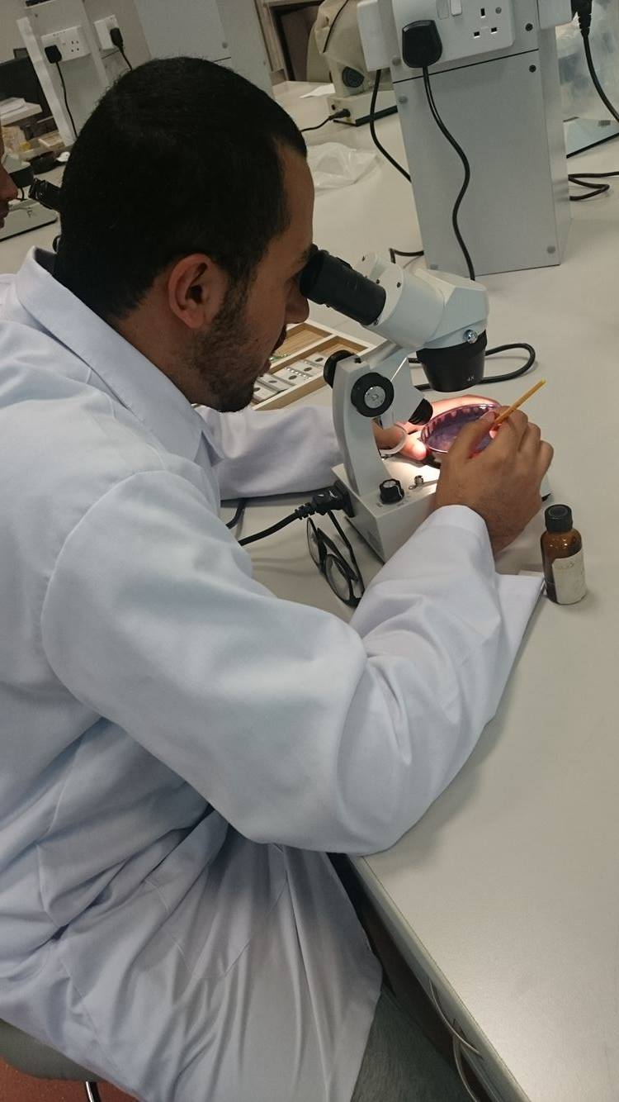
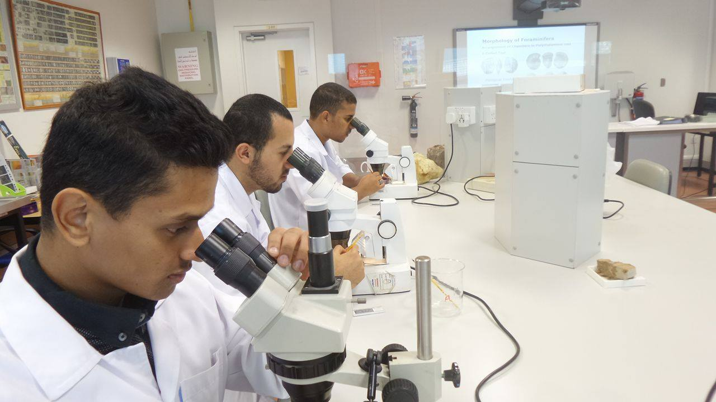
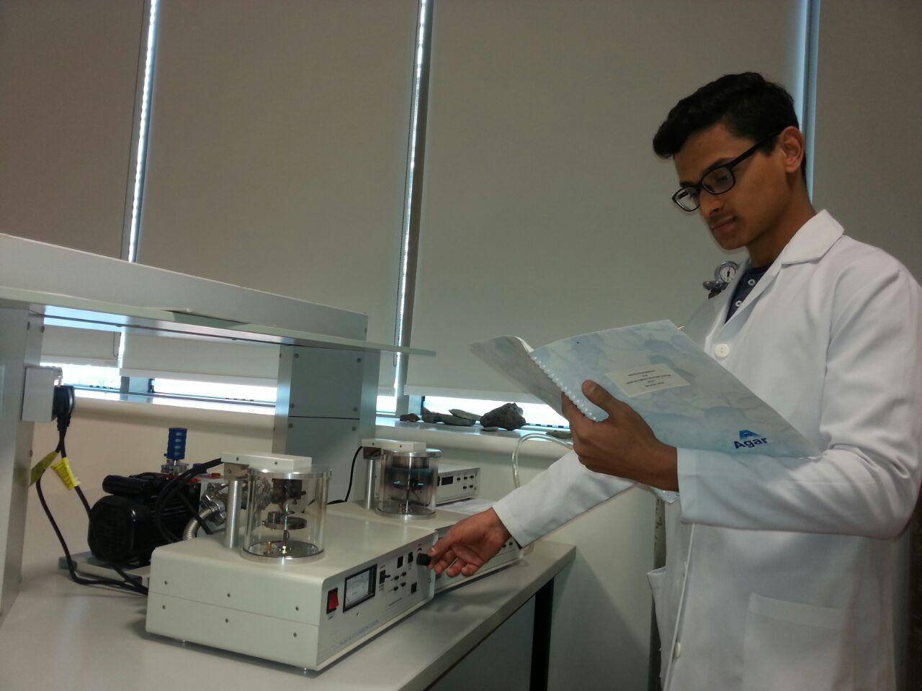
Lab Analysis (Fossils Picking)
Macro-fossils were easily collected however, micro-fossils required sample processing in order to liberate them from rock samples. For this purpose,
some washed crushed rock samples were
dispersed on a brass tray under a binocular microscope. Identified index fossils were collected for SEM imaging followed by assessment of the fossils for age determination. The picked fossils were prepared for SEM to image them.

Slide 13
Results

Slide 14
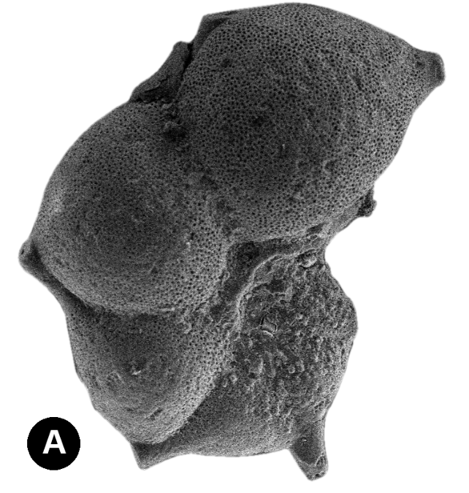
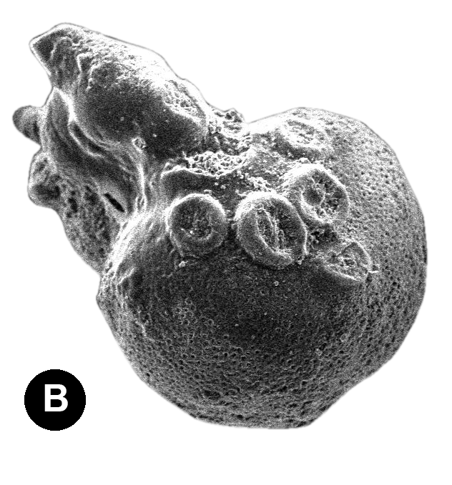
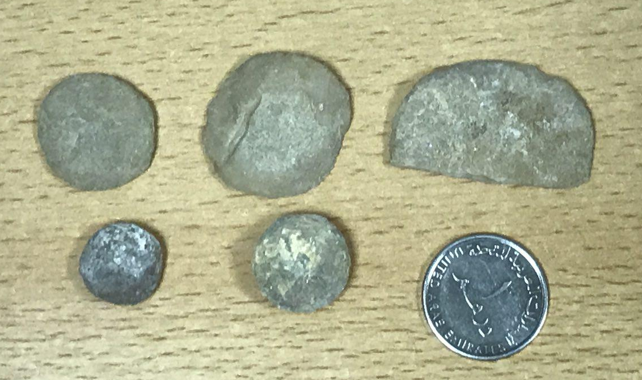
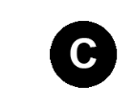
Age Determination
Based on the identified Hantkenina longispina (A) Cribrohantkenina inflata (B), and larger foraminifera Nummulites sp. (C) the Dammam Formation was deposited within the Middle to Upper Eocene.
2 cm

Slide 15
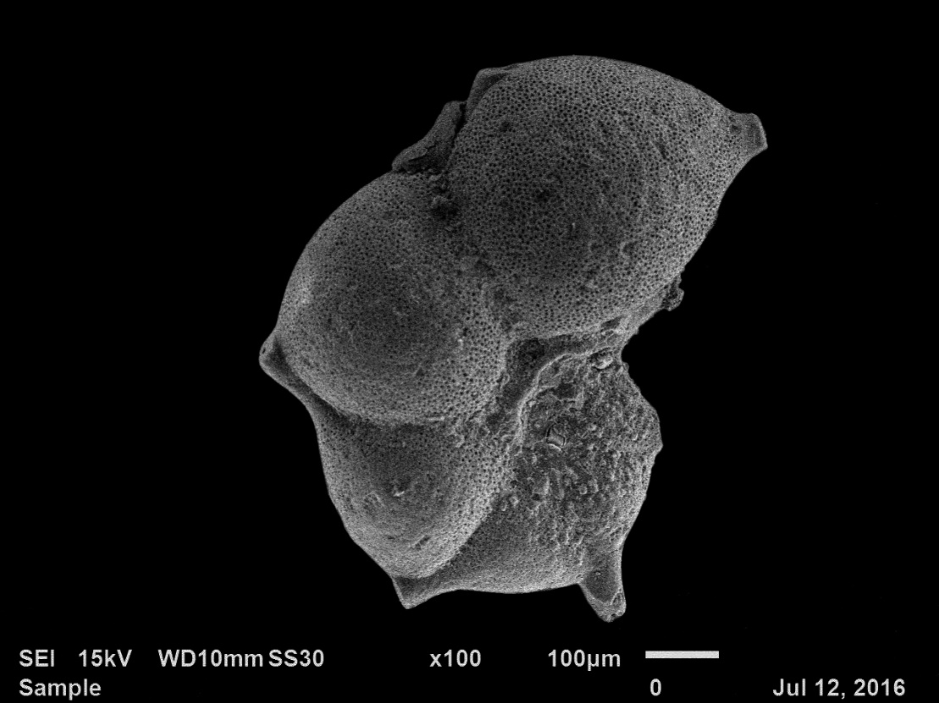
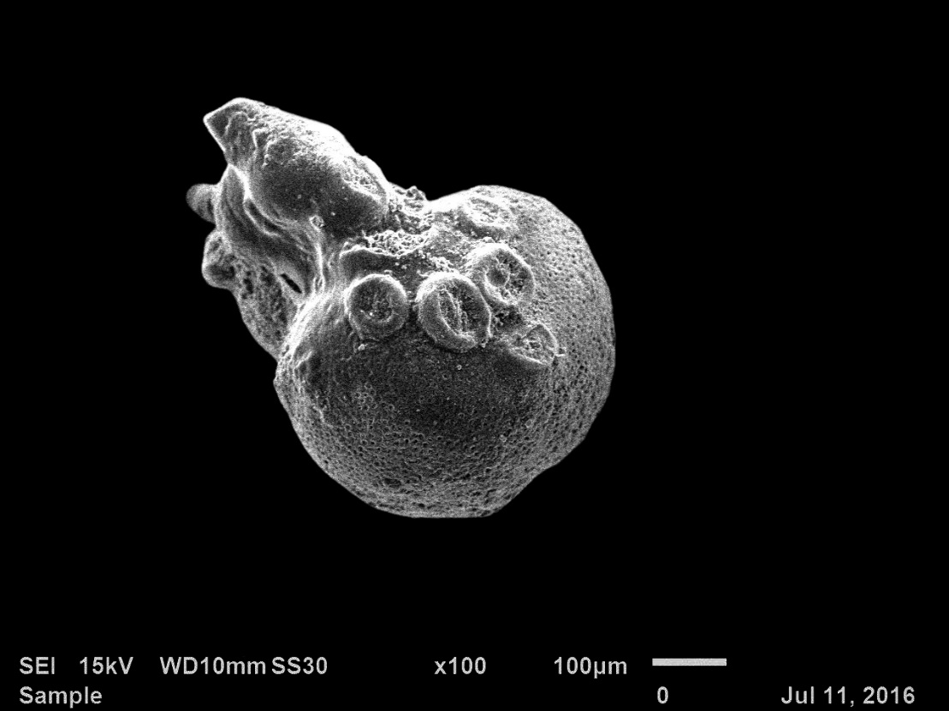
Hantkenina longispina
Middle to Late Eocene
Cribrohantkenina inflate
Late Eocene

Slide 16
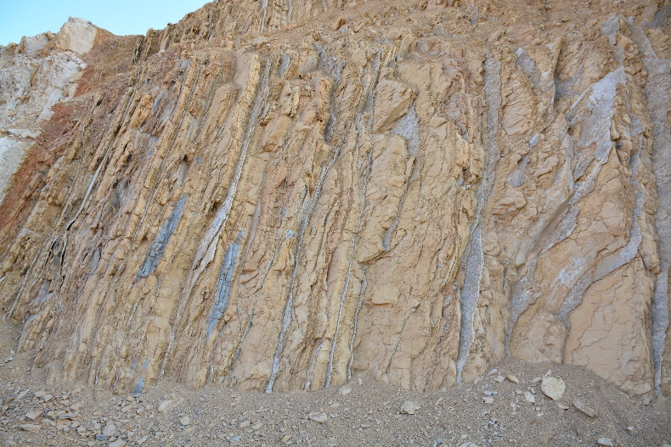
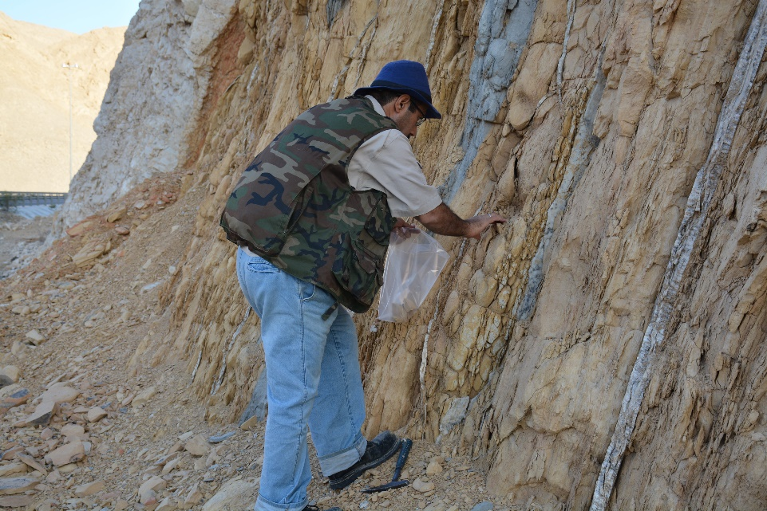
Paleo-environment
Nearly Vertical Beds
Limestone Layers interbedded with Marl, with lots of Gypsum veins through them
Areas with numerous amount of Nummulites followed by a break in the distribution, followed back by a swarm of Nummulites.
Various sizes of Nummulites concentrated in certain areas.

Slide 17
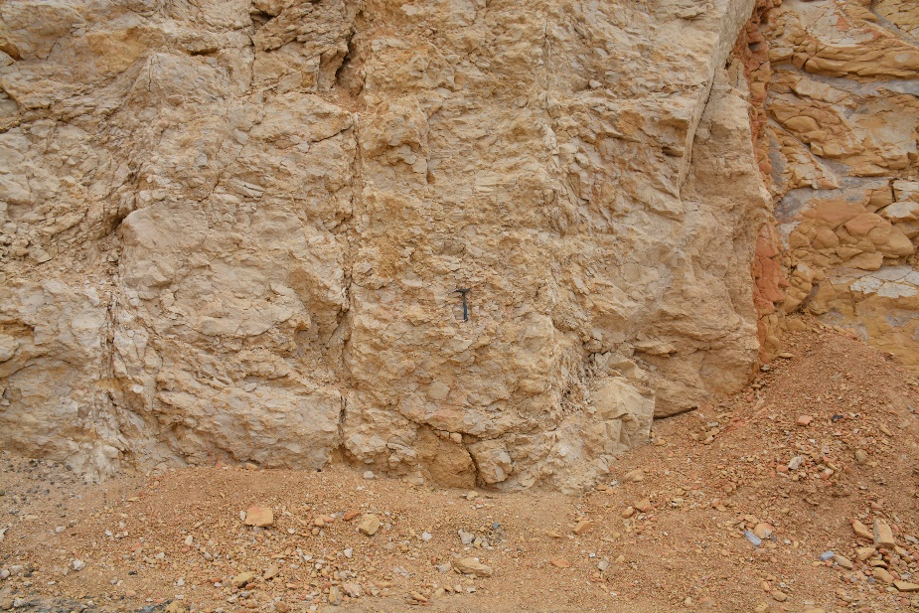
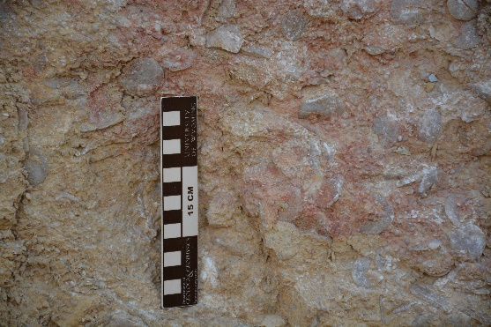
Paleo-environment
Exposed Limestone Breccia at the end of the Jabal Hafit outcrop
Concentration of molluscs, calcareous algae and colonial corals, shows that Dammam Fm. was deposited in a marine inner shelf environments.

Slide 18
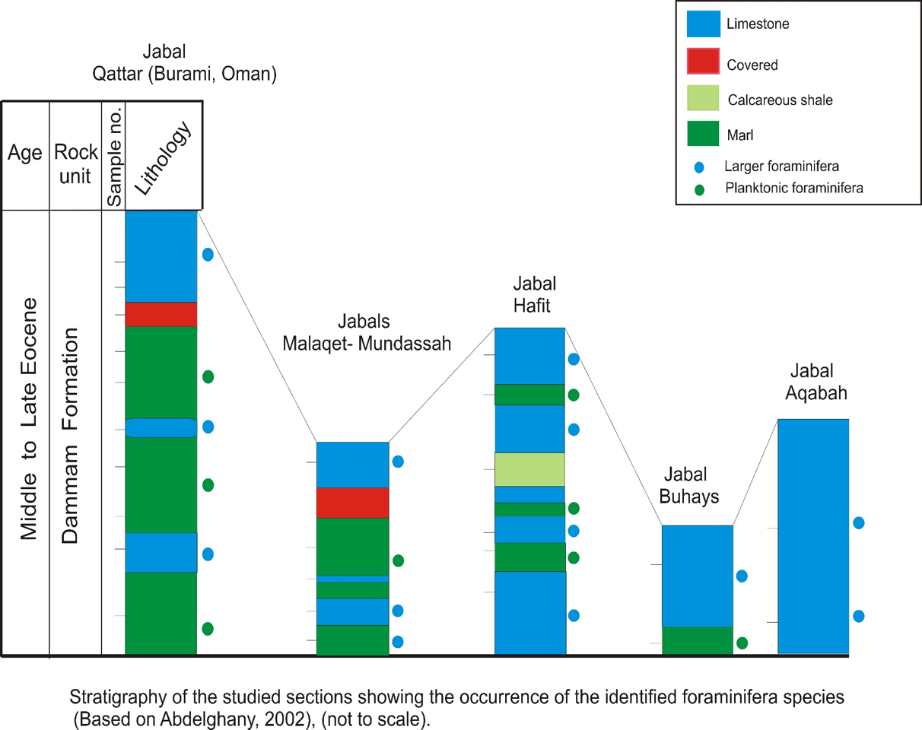

Slide 19
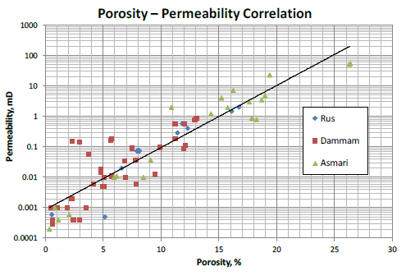
As Groundwater Aquifer & Petroleum Reservoir
Past Studies Prove Dammam Fm. to Have relatively Moderate Porosity
Dammam Fm. Shows good secondary Porosity due to the processes of diageneses such as chemical dissolution
a grey dolomitic limestone from this formation, at Jabal Mundassah, was found to contain conspicuous cavities (2-3 cm in diameter and 4 cm depth)
Petrophysical Study of UAE Carbonates
Anita Bhagat1, and Carl Sondergeld August 27, 2012, AAPG

Slide 20
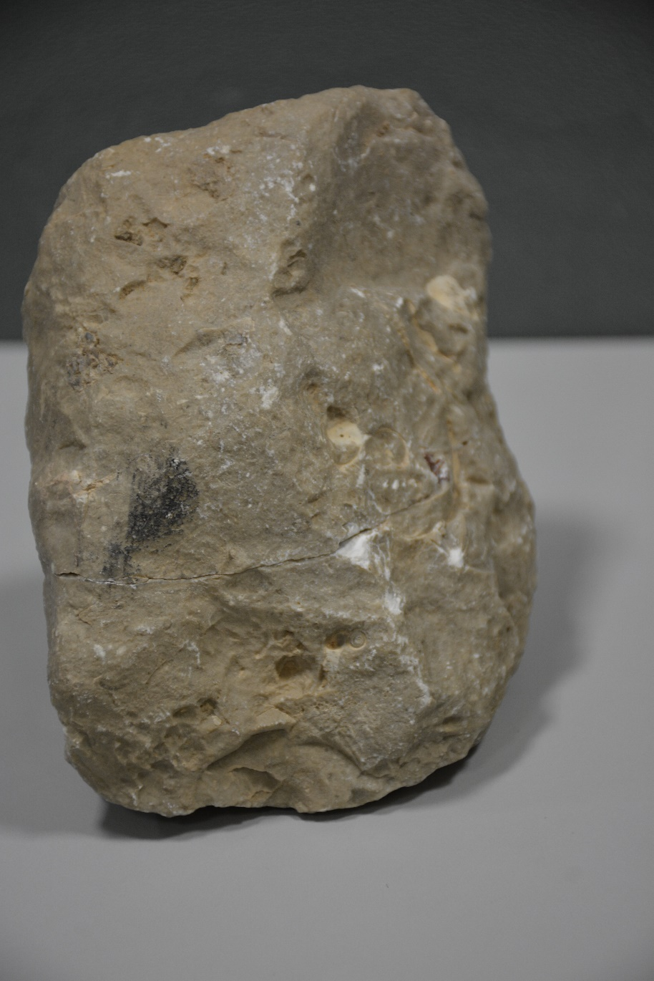
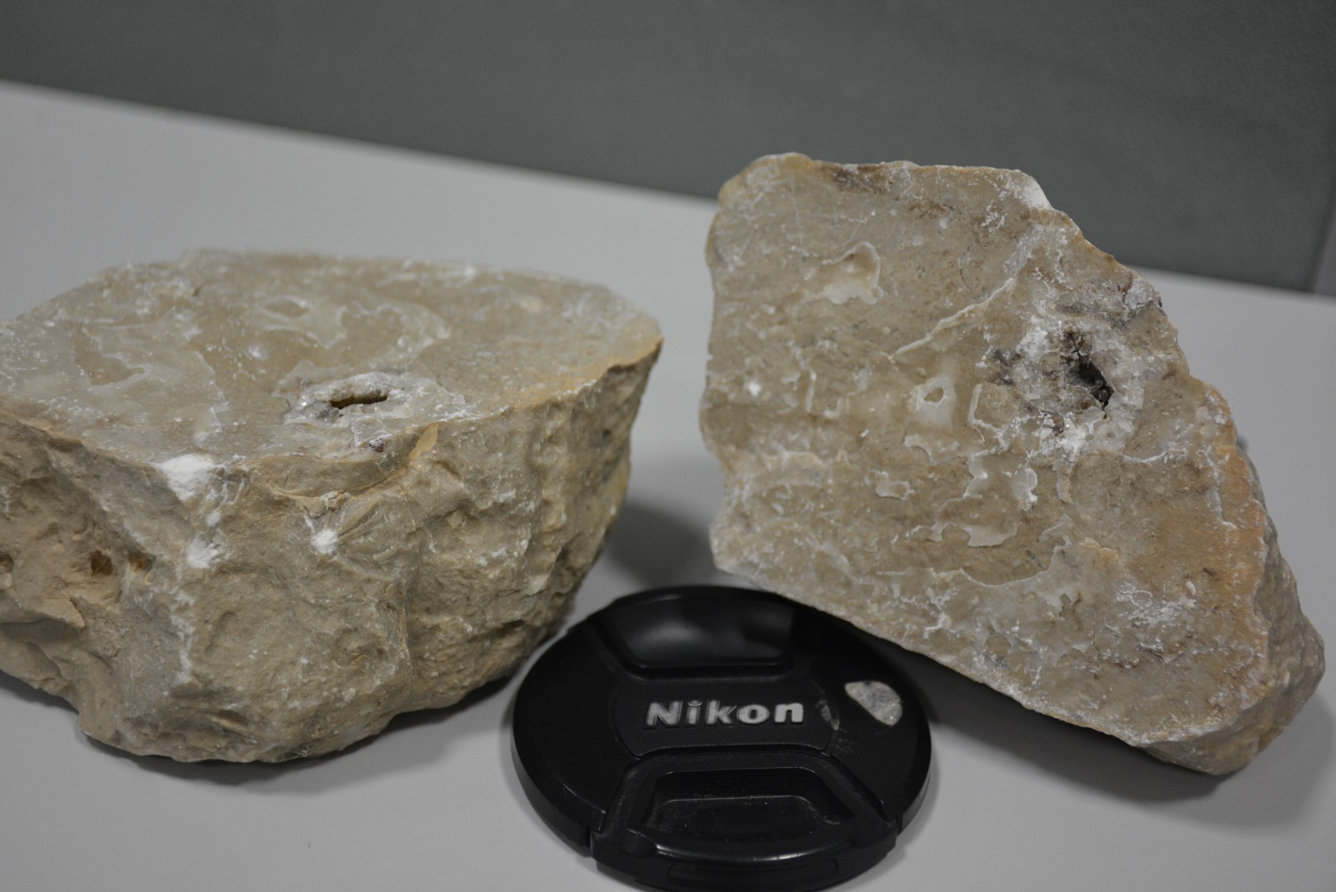
grey dolomitic limestone with cavity

Slide 21
Conclusion
Micro-sized and Large forams were recovered alongside large benthic (Asterocyclina pentagonalis)
The Fossils occurrences indicate deposition in a warm shallow marine inner shelf environment.
The cavities found demonstrate a diagenetic aspect of porosity enhancement in carbonate rocks. These cavities may also grow and interconnect to affect the permeability of the carbonate rocks.
The age for the Dammam in the study area is found to be Middle to Late Eocene.

Slide 22
Recommendations
More Detailed study supported by deep analysis to the same localities
Expanding the study to more Dammam Fm. Localities around the country and neighbor countries
Detailed petrophysical Analysis to Dammam Fm.’s Different Lithological Unites to prove porosity results
Subjecting more collected fossils (e.g. Nummulites Sp. and Asterocyclina pentagonalis) to thin sections and laboratory studies, for possibility of discovering new species within the formation

Slide 23
Acknowledgment
Special Thanks goes to:
UAEU Research Affairs (SURE Grants) for funding this Research
Geology Department, UAEU, for providing facilities
Dr. Osman Abdelghany and Dr. Mahmoud Abu Saima for supervising the research work, and Prof. Hasan Arman for accompanying us in all field trips.

Slide 24



