Slide 1

The Role of Electronic Health Records in Structuring Handoff Communication and Maintaining Situation Awareness among Nurses during Handoff
Presented by: Said Alghenaimi,
RN-MSN, M.Ed-Tech, PhD
Notes:
Good evening ladies and gentlemen.
Thank you … for the
In the next few minutes, I will be presenting my dissertstation study entitled …

Slide 2

What is Handoff?

Slide 3

Handoff
The transfer of professional responsibility and accountability for some or all aspects of care for a patient, or group of patients, to another person or professional on a temporary or permanent basis.
          (Australian Commission on Safety & Quality, 2010)
Notes:
The Australian Commission on Safety and Quality in Health Care defined handoff as
In the context of my study, I have focused on the handoff that takes place among nurses between shifts

Slide 4

Situation awareness
A common understanding of patient’s condition that enable the nurse to assume patient care effectively
Results of diagnostic tests
Treatments
Current condition
Pending procedures
Present and past history
Anticipated changes

Slide 5

Handoff interchangeable Terms
Change-of-shift report
Handover
Endorsement
Notes:
Handoff is also interchangeably used in literature with Handover, change of shift report, and the finding of my study added another term “endorsement” referring to the handoff that takes place between shift

Slide 6
Statement of Problem
Studies in Western countries have shown that communication gaps during handoff greatly increase the risk to patient safety
80% of serious medical errors in the United States are attributed to breakdown in communication during handoff .
Notes:
Poor handoffs have been repeatedly recognized to be potentially dangerous for patient safety and lead to adverse events.
For instance, the Joint Commission in 2010 For instance, estimated 80 % of serious medical errors in the United States to breakdown in communication during handoff

Slide 7
Cont. Statement of Problem
It is not known how nurses in Oman utilize the EHRs to facilitate consistent information exchange during handoff in the absence of handoff policy.
Al-Shifa 3 Plus
Notes:
As a step to eliminate the information gaps during handoff, the ministry health of Oman introduced an house EHR and the mandated on paperless documentations system in Oman. Despite all of these steps the nurses continue using verbal reports and relying on non-digital cognitive artifacts to maintain team’s distributed cognition surrounding nursing handoff.
It is not known how nurses in Oman utilize the EHRs to facilitate consistent information exchange during handoff in the absence of handoff policy that structures the information need to be included in a handoff report.

Slide 8
Aims of the study
Assess the nurses’ satisfaction with the usefulness and ease of use of the EHR (Al-Shifa).
Explore the content and the context of nursing handoff in Oman.
Identifies the artifacts that the nurses use during handoff.
Explore the strengths and weaknesses of the EHR in supporting quality handoff report.
Notes:
This study addressed four aims:
Assess the nurses’ satisfaction with the usefulness and ease of use of the electronic health records in structuring handoff communication and promoting effective and efficient transition of patient care during handoff.
Explore the content and the context of handoff practice in Oman.
Identify the artifacts that the nurses use to construct situation awareness about the patients’ condition in order to ensure continuity of care and the delivery of quality handoff reports.
Identify the strengths and the weaknesses of the electronic health records in supporting quality handoff report.

Slide 9
RQ1. How satisfied are nurses with the usefulness and ease of use of the EHR in structuring handoff communication and promoting effective and efficient transition of patient care during handoff?
Notes:
The first phase of this study address the first RQ that geared toward assessing the nurses satisfaction with …..

Slide 10
RQ2. What is the content and the context of nursing handoff in Oman?
Notes:
The second phase of this study, addressed the following three RQs.

Slide 11
RQ3. What artifacts the nurses in Oman use to convey information between shifts? how these artifacts are integrated into the handoff reports?
Notes:
The second phase of this study, addressed the following three RQs.

Slide 12
RQ4. What are the strengths and the weaknesses of the EHR (Alshifa) in supporting quality nursing handoff?
Notes:
The second phase of this study, addressed the following three RQs.

Slide 13
Methodology
Notes:
A mixed-method, quantitative and qualitative approach was used to study the nurses’ acceptance of the electronic health records in structuring handoff communication, and to explore the handoff practices in Oman and the artifacts that the nurses use to construct situation awareness.

Slide 14

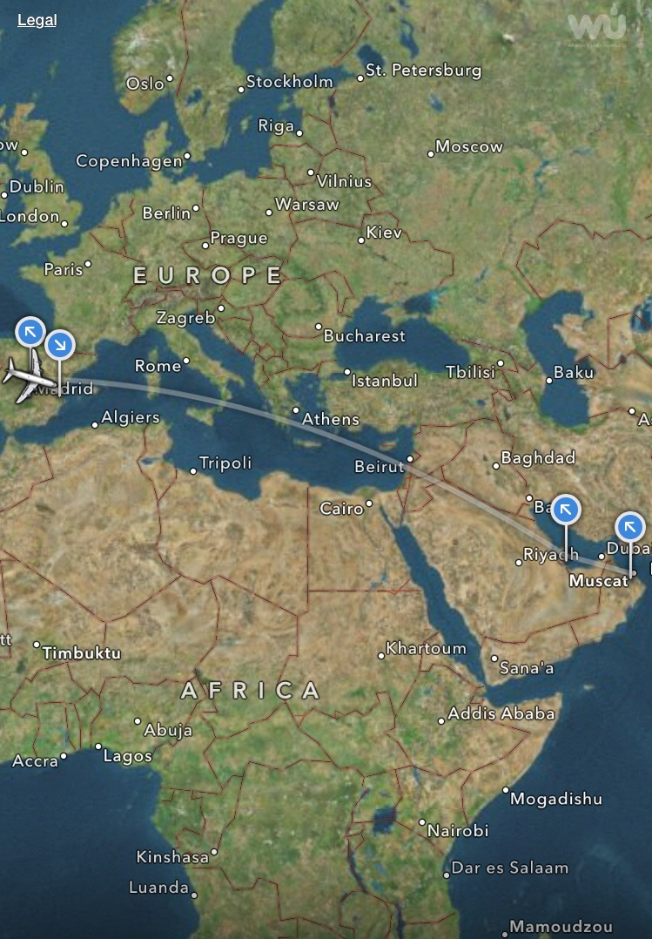
Setting
Took place at the Royal Hospital, a tertiary-teaching hospital located in Muscat, the capital of the Sultanate of Oman
Middle-Eastern country, with population of 3.6 million, of which 42.2% are non-nationals
Offer free health coverage for citizens and non-citizen working at the government sectors.

Slide 15
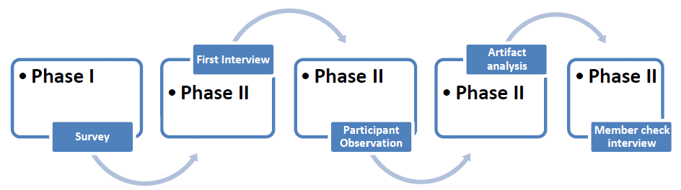
Research Design
A mixed-method, quantitative & qualitative approaches
(N= 157)
(20-handoff )
(N= 14)
(N= 14)
Notes:
A mixed-method, quantitative and qualitative approach was used to study the nurses’ acceptance of the electronic health records in structuring handoff communication, and to explore the handoff practices in Oman and the artifacts that the nurses use to construct situation awareness.
During Phase I, a self-administered survey questionnaire was used to assess the nurses’ perception about the usefulness and the ease of use of electronic health records during handoff, and to obtain preliminary information about the practice of nursing handoff in Oman.
Out of the 259 nurses who met the inclusion criteria, 167 responded to the survey. Ten of those surveys contained no data, which were then deleted, yielding (N= 157, 60.6 %) response rate.
During Phase II, exploratory approach will be used to collect in-depth qualitative data surrounding nursing handoff.
A convenient sample of 14 nurses was randomly selected for semi-structured interview from a pool of 20 nurses who self-selected to participate in the second phase of the study. Saturation point was reached at the 14th participant.
The participants were interviewed twice, the first interview took place before the observations.
A semi-structure interview guide was used to guide was used to elicit in-depth information about the:
Typical nursing handoff.
Al-Shifa use before, during, and after handoff.
Artifacts the nurses use to communicate and exchange information during handoff.
Features or functionalities in Al-Shifa that are helpful for nurses during handoff.
Features that are missing from Al-Shifa that maybe helpful for nurses during handoff.
Suggested changes in the handoff process and practice.
Suggested changes in the design of Al-Shifa to promote effective and efficient transfer of patient information during handoff
20 nursing handoffs were randomly observed between October 2011 and January 2012, Involving 162 nurses during which 382 patients were handed-off.
The observation took place at the MM1, MSW, FSW and Nephrology Units that covered all the three shifts: morning, afternoon and night, including holidays and weekends.
Predefined observation checklist, adapted from the SBAR handoff communication format, was used to guide the researcher to identify, categorize, and cluster the information communicated during nursing handoff.
During handoff observation, I stayed unobtrusive in the corner of the room and reassured the nurses that I am not collecting staff names nor the patients identifiers.
To capture the activities surrounding handoff the researcher arrived an hour before the shift and stay an hour after shift. This enabled me to observes the nurses use of these artifacts, particularly the EHR.
Artifact analysis was done for the tools that the nurses reported using during handoff. Pictures of these artifacts were taken, which were then deidentified and analyzed for content.
Member check interview with all the 14 nurses. They were given a printed transcript that is coded and deidentified. They were asked to read it, comment on it and clarify any missing information. They were also asked to disregard any information that the research may have misinterpreted during the interview and the observation.

Slide 16
Survey Questionnaire
1) Perceived usefulness (PU) and the Perceived ease of use (PEU) of the EHR during handoff
2) Process and practice of nursing handoff,
3) Perceived quality of nursing handoff,
4) Design of the EHR ,
5) Nurses’ demographic information.
Notes:
Consisted of 44 close-ended questions

Slide 17
data collection procedure
300 survey questionnaires were handed to the Education and Training Department at the Royal Hospital
Flyers explaining the scope, aims and the procedures of the study were also posted at the respective units
Notes:
300 survey questionnaires along with a cover letter explaining the scope, aims, and procedures of the study were handed to the Education and Training Department at the Royal Hospital

Slide 18
Cont. data collection procedure
Participants were given one month to complete the survey, Sept 26, 2011 to Oct 27, 2011
Participants were instructed to dropped-off completed surveys at the Education & Training Department
60.6 % response rate was yielded (n=157 of the target population 259)

Slide 19


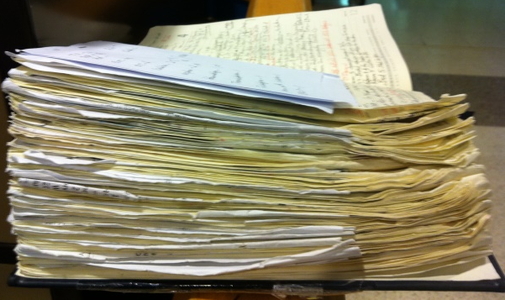
Qualitative data collection procedure
Variety of data collection methods were used to collect in-depth information surrounding nursing handoff
Semi-structured interviews
Participant observation
Artifact analysis

Slide 20
Semi-structured interviews
14 nurses was randomly selected from a pool of 20 nurses who self-selected to participate in Phase II
Each participant was interviewed twice.
Interviews took place in a private room and were recorded using a digital voice recorder

Slide 21
Cont. Semi-structured interviews
Interview guide was used to provide a consistent framework pertaining to handoff processes & practices
Interviews were transcribed within two weeks of the interview, & a member-check interview with the participants was conducted to confirm the findings and interpretations
Notes:
member-check interview with the participants was scheduled as a step to confirm the findings and interpretations drawn from the first interview and the observations

Slide 22

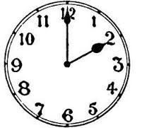

Participant observation
20-handoff reports were observed involving 162 nurses & 382 patients
Before
During
After
Notes:
To gain a holistic picture about the key events and activities taking place surrounding nursing handoff, the researcher arrived on the ward one hour prior to the arrival of the incoming shift, attended the handoff report and observed one or two members of the incoming shift an hour after they received the handoff report

Slide 23


Data analysis
IBM SPSS version 19 was used to analyze descriptive and frequency statistics
+
NVivo was used to organize and analyze Qualitative data

Slide 24
Major Findings

Slide 25
RQ1. assessed the nurses’ satisfaction with the PU & EOU of the EHR in structuring handoff communication & promoting effective and efficient transition of patient care during handoff
Notes:
RQ1. Assessed the nurses’ satisfaction with the usefulness and ease of use of the electronic health records in structuring handoff communication and promoting effective and efficient transition of patient care during handoff (P50) Pearson rank correlation was used to test for significance correlation among the constructs of the study.
Nurses’ acceptance of the EHRs as easy to use contributes to their usage during handoff and to their perceived usefulness of Al-Shifa.
As the perceived usefulness of the electronic health records increases, the likelihood of using them during handoff increases.

Slide 26
Demographic characteristics of the survey respondents (N =157)
Variables | Frequency | Percent
Gender Male Female | 16 141 | 10.2 89.8
Nationality Omani Non-Omani | 71 86 | 45.2 54.8
Level of Education Basic Nursing Diploma Post-Basic Diploma Bachelor of Science in nursing | 119 18 20 | 75.8 11.5 12.7
Studied handoff in nursing program Yes No | 126 31 | 80.3 19.7
Received in-service training on nursing handoff Yes No | 68 89 | 43.3 56.7

Slide 27
RQ1 Results
The nurses had positive perceptions about the PU and the PEU of the EHR in structuring handoff communication and promoting effective and efficient transition of patient care during handoff as evidenced by significant correlations
Notes:
Spearman's Rank Order correlation was used to test the correlation among the study variables

Slide 28
RQ 2. Explored the content and the context of nursing handoff in Oman

Slide 29

Research question 2
The nurses worked three shifts a day, with 30 minutes shift interlapse allocated for handoff.
Followed a “Block system” duty roster, where a team of nurses work with the same nurses for 2 to 3 months
All Handoffs took place in a private room
All handoff report were delivered on one-to-group
Notes:
The nurses work three shifts a day: morning & afternoon 7 hours shift and night shift 11:30 hours.
A 30-minute shift interlapse time between shifts is allocated for handoff reports.
The nurses follow a “block system” duty roster, where a team of nurses stays in the same rotation for two to three months. The nurses work the same shits and take off at the same time, this way during handoff all the team members have the same level of background information about the patients admitted in the unit.
The nurses deliver the handoff reports on one-to-group basis away from the patient.

Slide 30
Cont. Research question 2
None of the participants reported having a written handoff policy
None of the participants used the SBAR handoff communication format
Information communicated during handoff stratified into two main categories: “Unit Routines” and “Patient care-related information.”
Notes:
None of the 20 nurses interviewed reported having a written handoff policy. This conclusion is also supported by 71.3 % (N =112) of the survey respondents believed there is no handoff policy that determined the information should be included in the handoff report.
None of the nurses participated in this study was found to use the SBAR (Situation, Background, Assessment, and Recommendation) handoff communication format.
The information communicated during handoff could be further stratified into two main categories:
Unit routines: included administrative information essential to coordinate work at the nursing unit such as staffing concerns, bedding, supplies, maintenance, and messages that need to be communicated to all nurses working at the unit.
2. Patient-care related information including patient’s condition, treatments, procedures, discharge plan etc.

Slide 31
Cont. Research question 2
Length of the handoff report varied across shifts and units, ranging from 17 minutes to 90 minutes per shift.
Factors determine the length of the handoff report :
  number of patients admitted in the unit,
  the severity of patient condition,
  whether the nurses took care of the patient recently or not.
Notes:
20 nursing handoffs were observed involving 162 nurses & 382 patients
Duration of the handoff report varied across shifts and units; ranging from 17 to 90 minutes per shift, with an average of 2.07 minutes per patient.
This variation attributed to: absence of written policy or guidelines that standardize the information communicated during the handoff reports, the total patients admitted in the unit, the severity of patient condition, and whether the nurses took care of the patient recently or not.

Slide 32
RQ3. Explored the digital and non-digital artifacts the nurses used to convey information between shifts

Slide 33
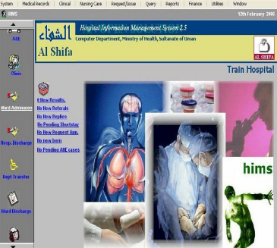
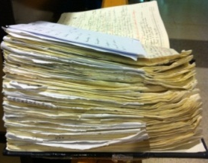
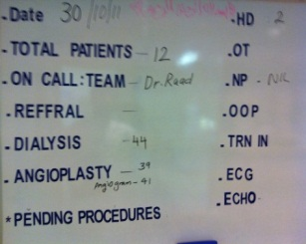
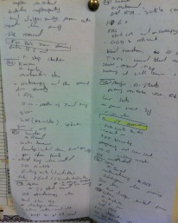
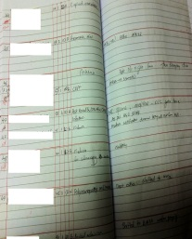
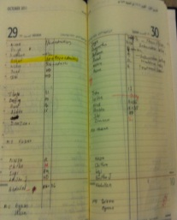
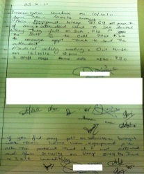
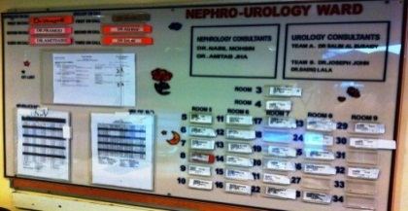
Research question 3
Notes:
The primary focus of this study was to explore the role of electronic health records in structuring handoff communication and maintaining situation awareness among nurses during handoff. However, the findings of the interviews and the field observations, revealed that the nurses use variety of non-digital artifacts to supplement the information documented in Al-Shifa as a means to maintain situation awareness throughout the nursing handoff.
Non-digital artifacts were mostly used to coordinate patients’ care and collaborate with the multidisciplinary teams as a step to provide a holistic care and to ensure the continuity of care.
Whiteboard (Whiteboard acts as a means to communicate and coordinate patients’ care among the health care professionals such as pending procedures ECG, EEG,CT, physical therapy etc. Promotes situation awareness among the nurses and the rest of the medical and the paramedical professionals. Used to summarize the total patient, total new admissions, total emergency and elective surgeries posted for the day, the names and pagers of the on-call doctors)
Rounds’ book (communicate and coordinate patient care among the doctors during the rounds)
Staff communication book (unit in-charge to communicate important messages concerning the nursing practice or to disseminate new circulars received from the nursing administration to all the nurses working at the unit across all shifts)
Bulletin board (communicate important information across shifts, such as the names and the pagers of the on-call doctors, and the patient’s directory. Dynamic non-digital artifact that promoted the distributed cognition among the nurses, the medical team members, and the paramedical team members across all shifts)
Staff assignment diary (Communicate & coordinate nurse-patient assignments, provide a means to track nurse-patient assignments and helps ensure the continuity of a patient’s care. Nurses assume up-to six patients admitted in a cubicle.)
Piece of paper known in lit. “Cheat-Sheet” (write key-information they received during the handoff report, served as to-do list, which reminded the nurses about the things they needed to accomplish throughout the shift, write important information they need to enter into the Al-Shifa, such as the values of vital signs, results of blood sugar tests, the total intake)
In-charge communication book (communicate important messages between the unit in-charge and the in-charges nurses of all shifts, served as a means for communicating “clerical jobs” across all the shifts such as new admissions, patients transfer in or out, items that need to be ordered from the pharmacy, store etc.)

Slide 34
RQ4. Assessed the strengths and the shortcomings of the EHR (Alshifa) in supporting quality nursing handoff

Slide 35
RQ4 Strengths of Al-Shifa
  All the interviewed nurses (N =14) perceived Al-Shifa to be primary artifact they use to facilitate electronic documentation, promote effective and accurate communication among the nurses during the transition of care
  Reading directly from the EHR during handoff minimized the reliance on nurses’ internal cognition
  system highlighted the abnormal laboratory values in different colors
  system “flags” allergies the patient has as well as any hospital born infections
Notes:
EHR use during handoff increased accessibility to patients’ medical records, which enabled the nurses to view the patient’s entire medical records and to deliver accurate and up-to-date clinical information about the patient
Reading directly from the EHR during handoff minimized the reliance on nurses’ internal cognition, which was formerly reported to be a leading factor for incomplete information or loss of information across the transitions of care (2003; Matic, et al., 2010; Olson, 2008).
The ability of the system to present the abnormal lab result using a preset color scheme enables the nurses to distinguish abnormal lab results thereby decreased their mental load
AlShifa provides “system flags” corresponding to the allergies the patient has, as well as any hospital born infections, so nurses can easily see it and report to the next shift

Slide 36
Cont. RQ4 Weakness of Al-Shifa
  90.4 % (N = 142) suggested having a specific module within the EHR designated for handoff communication:-
    enable the nurses to import up-to-date patient’s information directly from the EHR
    provide a structured format that standardize the content of the shift report.
    enable the nurses to add personalized remarks for each patient.

Slide 37
Limitations
Findings are somewhat limited because of the exploratory nature of the study as well as the non-probability sampling method employed.
Notes:
In spite of having a large number of nurses recruited from the same hospital, it could have been ideal to conduct the study in at least two or three hospitals that use Al-Shifa. This will produce variability in the demographic characteristics of the participants as well as may fulfill the normality assumption needed to conduct parametric tests. In addition, this may increase the generalizability of the study findings.

Slide 38
Recommendations for Further Study
A study should be conducted regarding the integration of aspects of the SBAR tool into the EHRs interface.
A study should be conducted to examine the role of EHR in structuring handoff report and ensuring the continuity of care during patient’s transfer.
Notes:
Given the fact that the SBAR has been reported to be the most popularly adapted handoff communication methods in the U.S., no study to date has integrated aspects of the SBAR tool into the electronic health records interface. Therefore a study should be conducted regarding the integration of aspects of the SBAR tool into the EHRs interface.
This study focused on the handoff that takes place between shifts. However, in clinical practice, another important handoff that takes place when the patient is moved from one unit to another within the same hospital. Thus, another potential study might consider exploring the role of electronic health records in structuring handoff report and ensuring the continuity of care during patient’s transfer.

Slide 39
Cont.… Recommendations for Further Study
A study should be conducted to examine the use of EHR at the point of care and the extent of patient involvement during handoff and its impact on the accuracy of the information exchanged during handoff and the overall quality of the handoff reports.
Notes:
All the handoffs observed in this study, involving 382 patients, took place away from the bedside. However, the current trend in western countries that handoff should be done at the bedside, involving the patient or family members. Thus, future research needs to further examine the use of electronic health records at the point of care and the extent of patient involvement during handoff and its impact on the accuracy of the information exchanged during handoff and the overall quality of the handoff reports.

Slide 40
Question or Comments

Slide 41


Slide 42
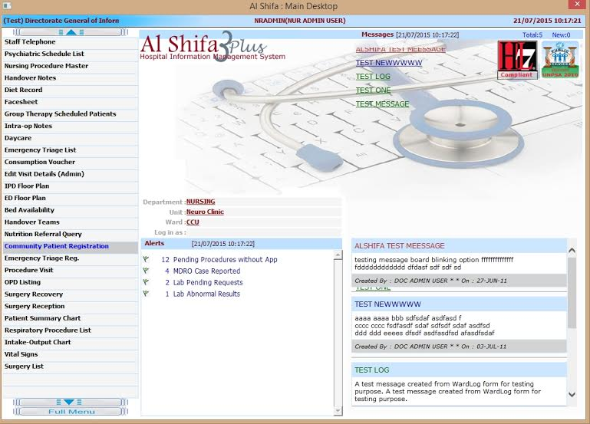
Back

