Slide 1

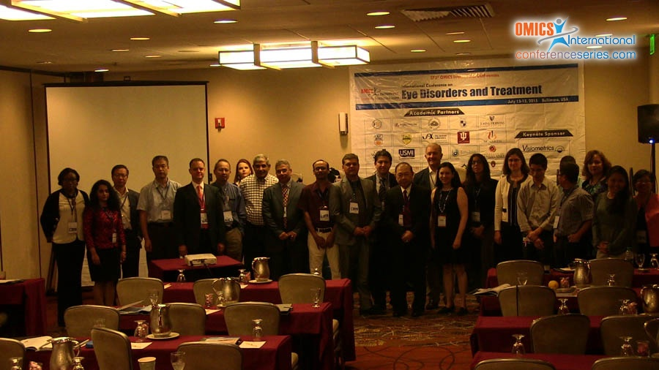

Eye-2015
Baltimore, USA
July13 - 15 2015
Saffar Mansoor

Slide 2
Protecting Retinal Cells Against
Cigarette Smoke Components
Saffar Mansoor^{1, 2}, M. Cristina Kenney ²
¹Case Western Reserve University, Cleveland, USA
²Gavin Herbert Eye Institute, School of Medicine, University of California, Irvine, USA

Slide 3
Age-related Macular Degeneration (AMD)
& Cigarette Smoking - Background
Age-related macular degeneration (AMD), is the leading cause of permanent vision loss in the elderly population worldwide.
The prevalence of this disease is expected to increase in the coming years as people live longer.
There are different forms of AMD:
  (1) Wet or neovascular form: In wet AMD, choroidal neovascularization (CNV) develops, which causes hemorrhage, swelling, and macular scarring resulting in severe visual loss;
  (2) Dry AMD results from atrophy of retinal pigment epithelium (RPE) and photoreceptors that can decrease central vision over time.

Slide 4
Age-related Macular Degeneration (AMD)
& Cigarette Smoking
Risk Factors for AMD
Include smoking, higher body mass index (BMI), nutrition, genetics & race.
Among these, cigarette smoking is one of the strongest factors associated with developing the most severe forms of AMD.
Current smokers have a 45% chance of developing early AMD and exhibit enhanced disease progression compared to nonsmokers.
White Caucasians are more at risk than Asian or Afro-Americans.

Slide 5
Cigarette Smoke Components (CSC)
Cigarette smoke contains more than 4000 toxic agents.
Acrolein, benzo[e]pyrene (B(e)P), 2-ethyl pyrine (2-EP), nicotine, and hydroquinone (HQ), Chrysene (Chry), & Catechol (Cat) are some prominent cigarette smoke components (CSC).
Table 1 showed CSC delivered per cigarette.

Slide 6
Table 1: Quantity of Cigarette Smoke
Components (CSC) in a Cigarette

Slide 7
Effects of CSCs on Retinal Cells
Several studies have reported adverse effects of CSC on various cell types:
  Retinal pigment epithelial (RPE) cells
  Retinal neurosensory (R28) cells
  Human microvascular endothelial (HMVEC) cells
  Müller cells & other glial cells of the retina
The mechanisms of CSC-induced toxicity on these cells include :
  Oxidative stress, mitochondrial dysfunction, apoptosis, and necrosis.

Slide 8
Effects of CSCs on Retinal & Vascular Cells
B(e)P [Benzo(e)Pyrene]: It is polycyclic aromatic hydrocarbon (PAH) formed by incomplete combustion of carbon from organic materials. B(e)P randomly inserts into DNA & causes mutagenic, teratogenic, & carcinogenic effects.
Chrysene (Chry): It is one of the most toxic PAH found in smoke. It causes formation of DNA adduct & has mutagenic, carcinogenic, & genotoxic effects.
HQ (Hydroquinone) is the most abundant quinine present in cigarette tar. High levels of HQ are detected in plasma & urine of smokers. It causes hepatotoxic & nephrotoxic properties of HQ.

Slide 9
2-EP (2-Ethyl Pyridine): Pyridines are prominent components of smoke & one of its most toxic derivative is 2-EP. It depresses antioxidant activity of cells, catalyzes fatty acid peroxides that disrupt vascular permeability & poisons enzyme systems.
Catechol (Cat): It is a toxic component of smoke, causeing lipid peroxidation, oxidation of protein, & genotoxic effects.
Nicotine (Nico): It affects release of vascular endothelial factor (VEGF) & enhances neovascularization, including the wet form of AMD.
Acrolein (Acro): It has a high hazard index & causes oxidative stress by reacting with sulfhydryl group.

Slide 10
Design of Experiments
  Cells were cultured & incubated at 37ºC till confluent.
  Then treated with one of the CSC agents for 24 hours.
  The following assays were performed:
    Cell Viability (CV) - determined using trypan blue dye exclusion test. It is based on principal that live cells possess intact cell membrane that exclude dyes, where as dead cell do not.
    Caspase activation – measures later stages of apoptosis using the FLICA kits. The apoptosis was quantified as the level of fluorescence. Non-apoptotic cells appeared unstained, whereas cells undergoing apoptosis fluorescent brightly.

Slide 11
Design of Experiments (con’t)
    Reactive oxygen species (ROS) - were measured with fluorescent dye and the ratios of emission/excitation were calculated.
    Lactate dehydogenase (LDH) – is a test for cytotoxicity and a marker of cell death.
    Mitochondrial membrane potential – loss of the mitochondrial membrane potential is a hallmark of early apoptosis. The JC-1 kit has a dye that fluoresces red (R) in mitochondria of live cells. In dead cells, the mitochondrial membrane collapses, & the dye remains in cytoplasm where it fluoresces green (G). The R/G fluorescence is higher in healthy cells.

Slide 12
Design of Experiments (con’t)
    Autophagy – is measured by the levels of the autophagy-related protein marker, LC3-II (microtubule-associated protein1 light chain 3) using the Western blot method. During cellular stress, autophagy is increased.
    ATP levels - a marker for cell viability. Cellular ATP levels declined rapidly when cells die due to either necrosis or apoptosis. ATP was quantified using an ATP detection kit.

Slide 13
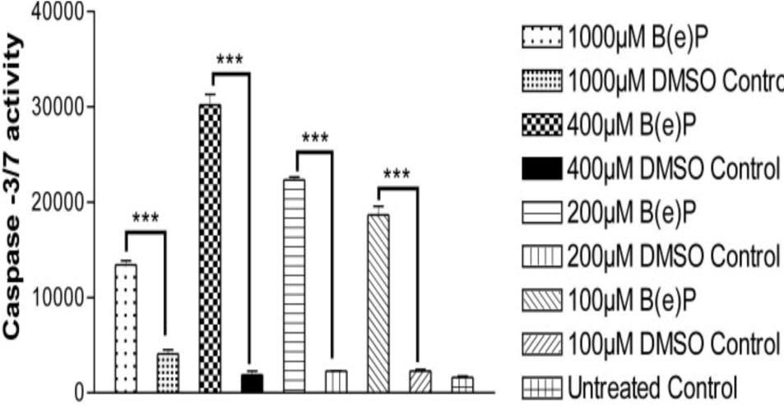
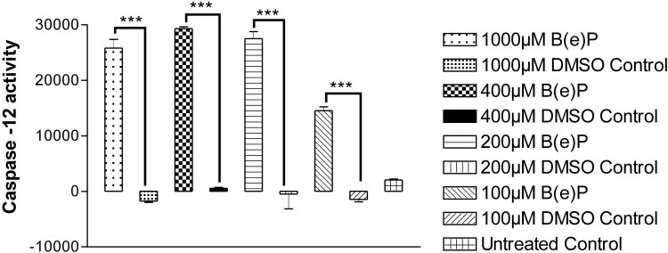
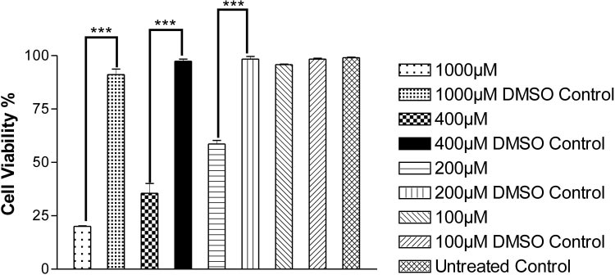
Toxicity of B(e)P on RPE Cells
(1) Human RPE cells were culture 24 hrs in the presence of different doses of B(e)P. The culture were then measured for cell viability & activation of different caspases.
Caspase-3/7 Activity
Caspase-12 Activity
Cell Viability Assay
Conclusion: B(e)P induced apoptosis by multiple caspases pathways & caused cell death in RPE cells (Sharma et al, IOVS Nov 2008).

Slide 14
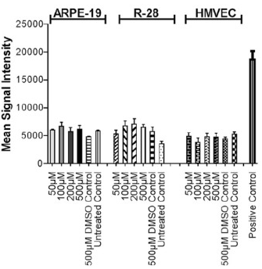
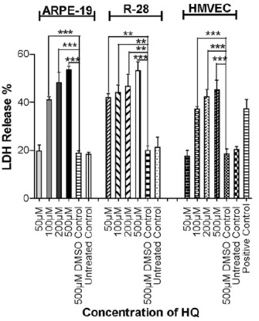
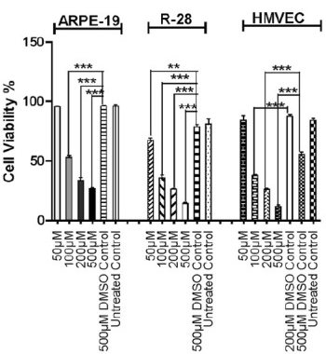
(2) The RPE cells were treated with different conc of HQ & analyzed for apoptosis, cell viability, & non-apoptosis pathways.
Caspase-3/7 Activity
LDH Release Assay
Cell Viability Assay
Conclusion: HQ caused cell death to RPE cells by non-apoptotic pathways (Sharma et al IJO 2013).

Slide 15
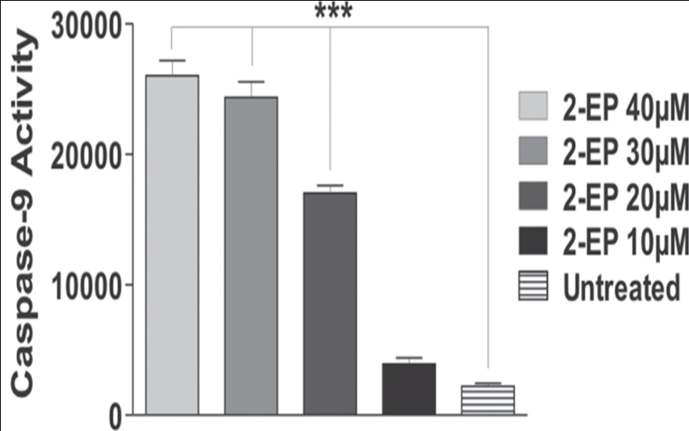
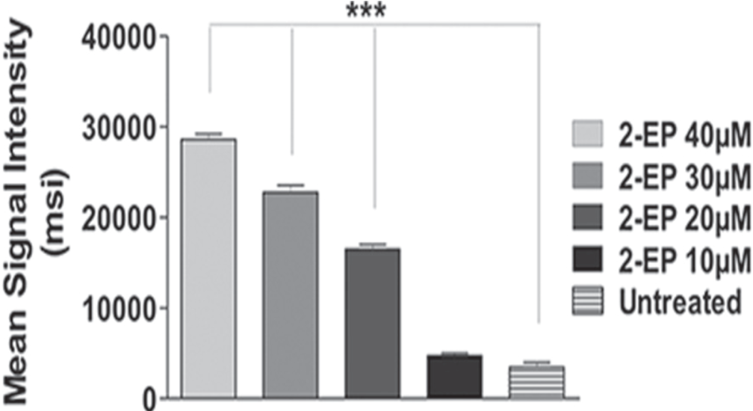
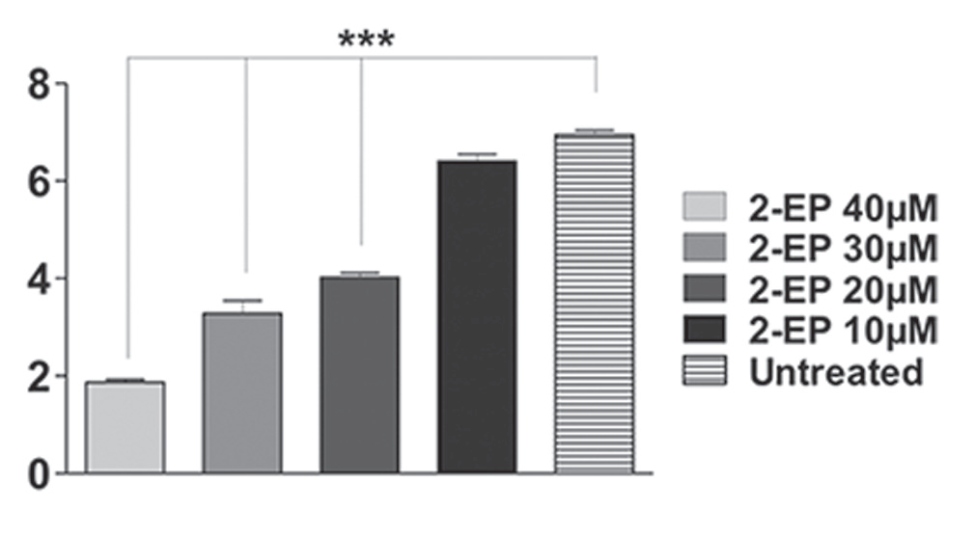
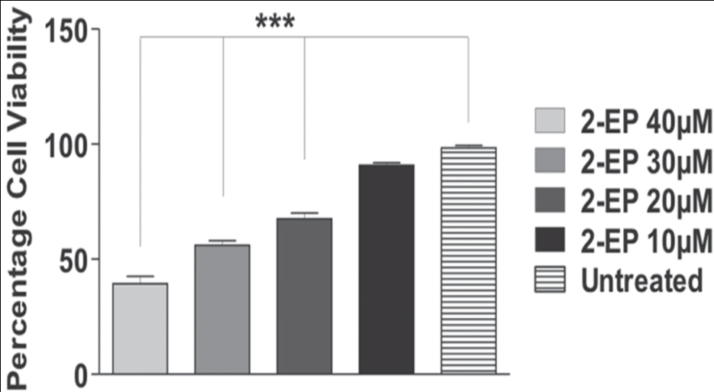
(3) RPE cells were exposed to varying doses of 2-EP & quantified for apoptosis, oxidative stress & mitochondrial dysfunction.
Caspase-9 Activity
ROS/RNS Level
Mitochondrial Membrane Potential Assay
Cell Viability Assay
Conclusion: 2-EP induced caspase-dependent apoptosis, oxidative stress & mitochondrial dysfunction in human RPE cells(Mansoor et al IJO 2014).

Slide 16
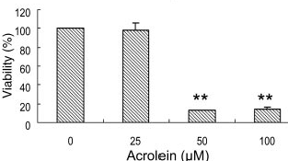
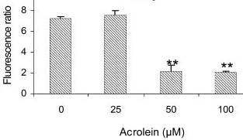
(4) RPE cells were cultured with different conc of Acrolein and cell viability & mitochondrial toxicity were measured (Jia et al ARVO 2007).
Mitochondrial Membrane Potential Assay
Cell Viability Assay
Conclusion: Acrolein caused dose-dependent decrease of mitochondrial membrane potential, & loss of cell viability in RPE cells.

Slide 17
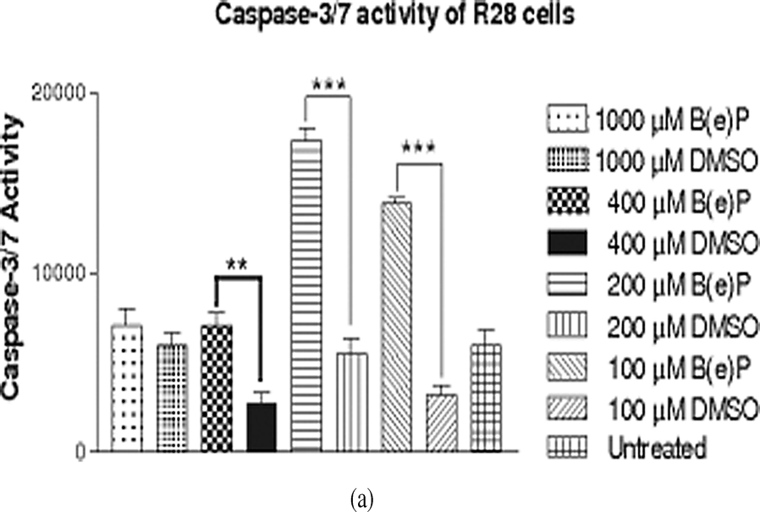
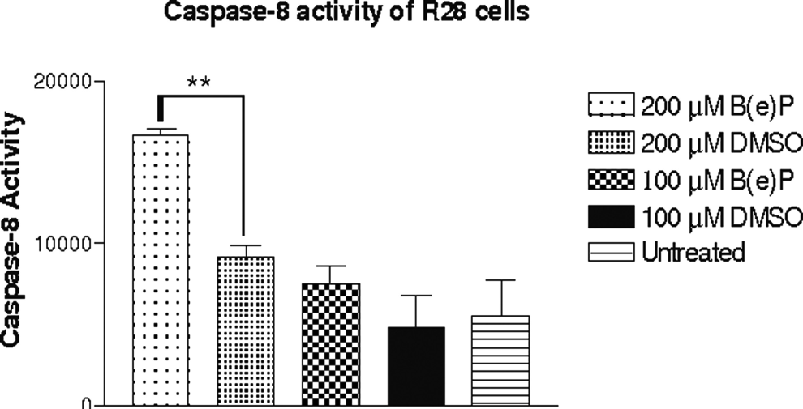
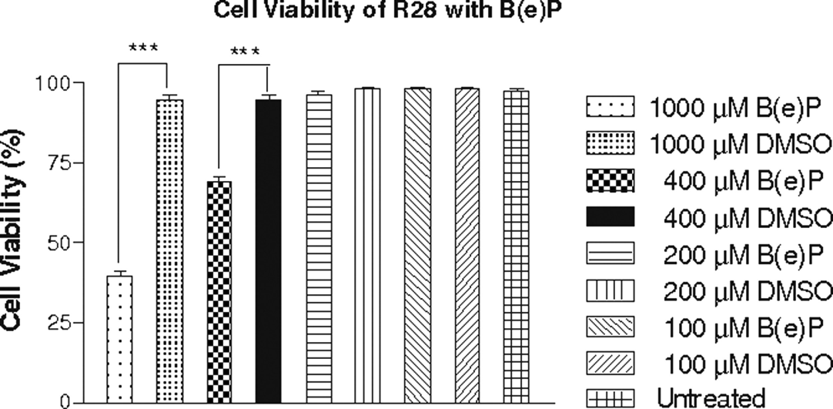
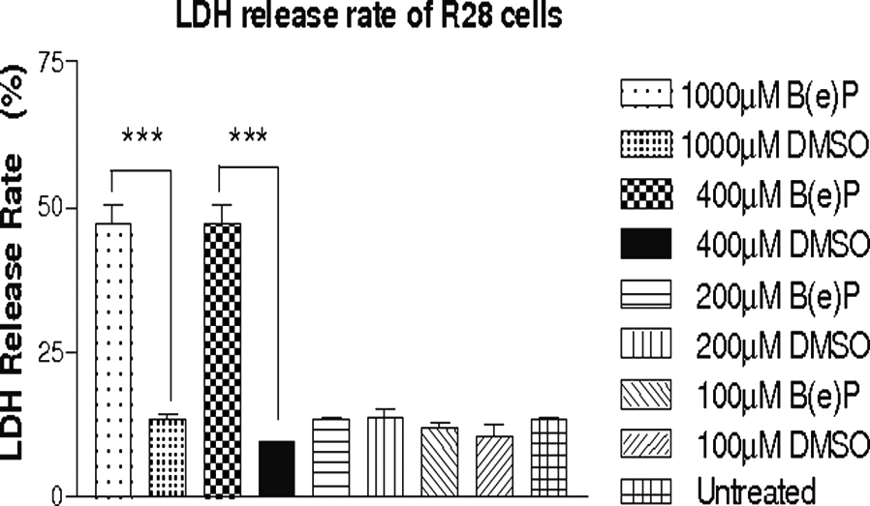
Toxicity of B(e)P on R28 Cells
(1) R28 cells were treated with different doses of B(e)P for 24 hrs & then analyzed for cell viability, caspase activity, & necrotic pathways (Patil et al Curr Eye Res 34, 2009).
Conclusion: B(e)P induced apoptotic (<200uM) & necrotic (>200uM) cell death to R28 cells.

Slide 18
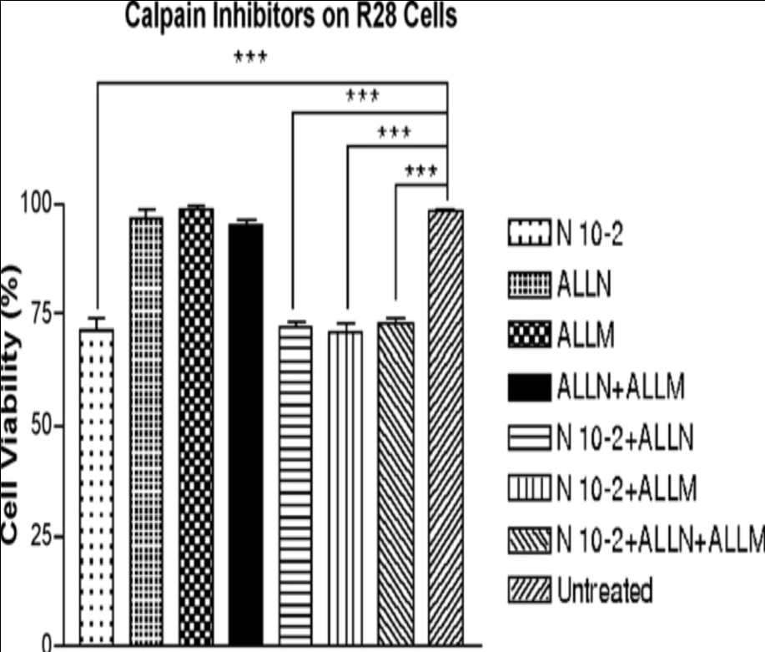
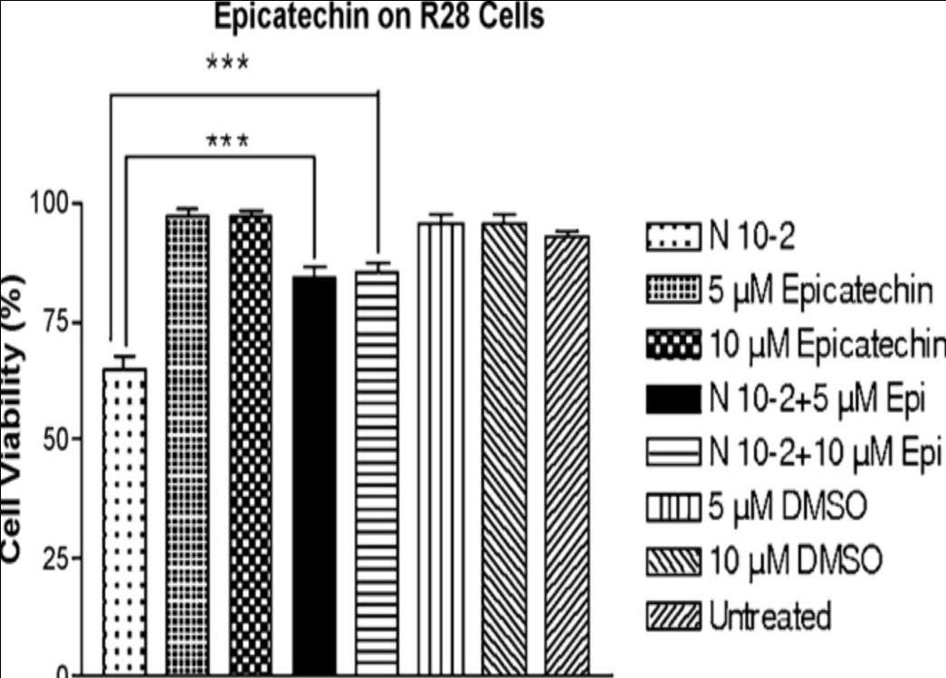
Toxicity of Nicotine on R28 Cells
(2) R28 cells were pre-treated with calpain inhibitors or epicatechin & then cultured for 24 hrs with nicotine (N 10-2μM). Cells were analyzed for cell viability & involvement of non-caspase & non-calpain pathways (Patil et al Tox 2008).
Conclusion: Nicotine effects to R28 cells were through oxidant mechanisms that are non-caspase and non-calpain dependent.

Slide 19
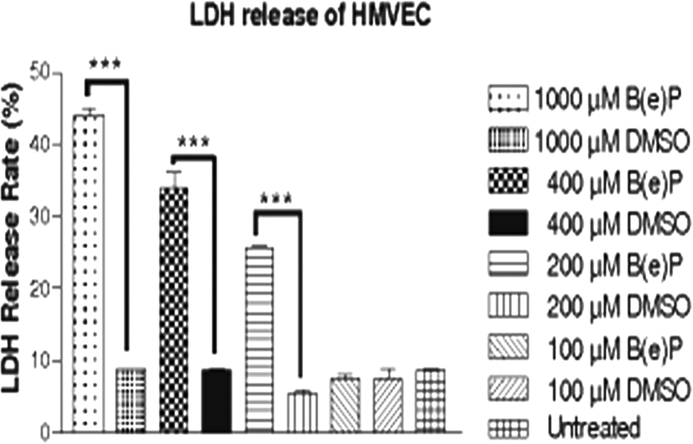
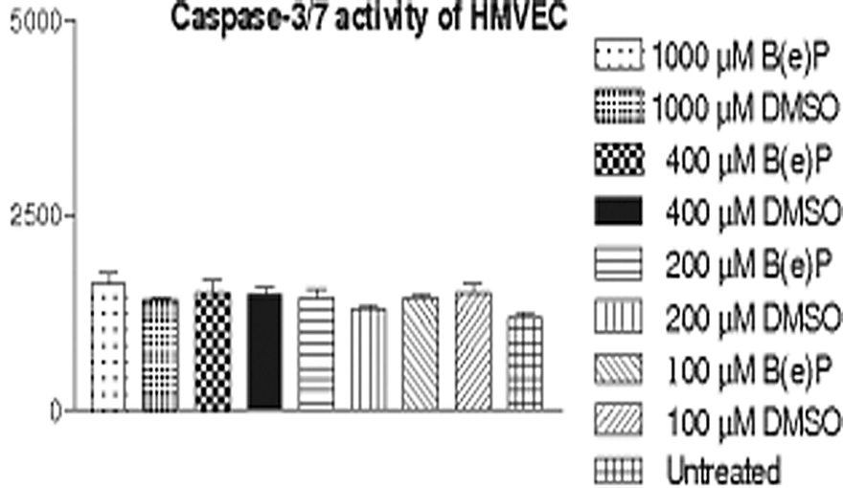
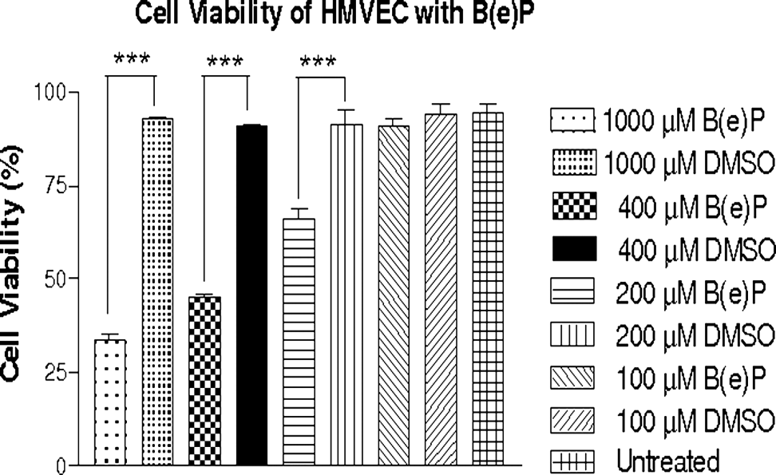
Toxicity of B(e)P on HMVEC cells
HMVEC were cultured 24 hrs with different doses of B(e)P & were then analyzed for cell death, caspase 3/7 activation, & necrosis pathways (Patil et al Curr Eye Res 34, 2009)
Conclusion: B(e)P induced HMVEC cell death is via non-caspase-dependent necrosis pathways.

Slide 20
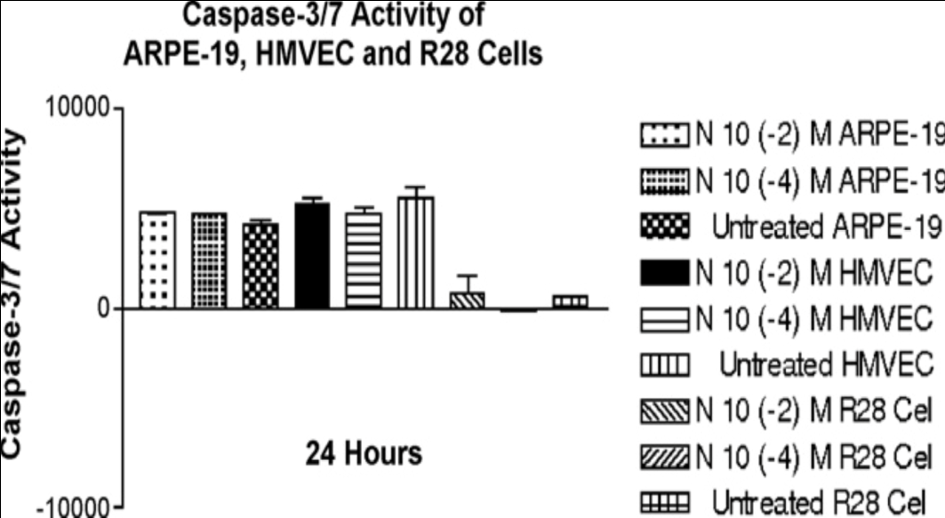
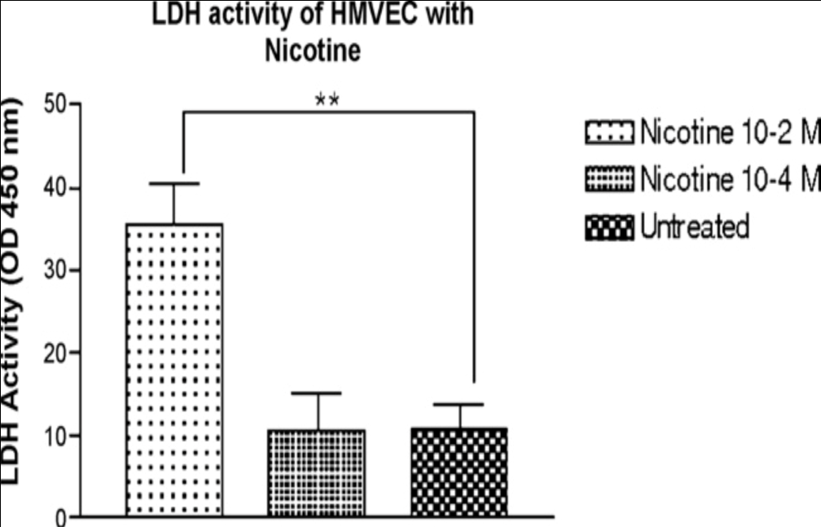
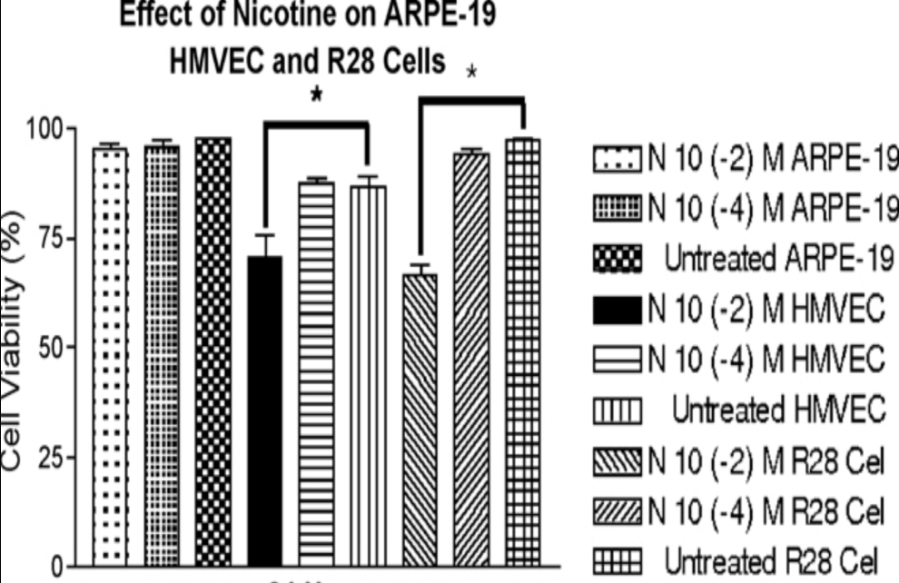
Toxicity of Nicotine on HMVEC cells
HMVEC were cultured 24 hrs with different doses of nicotine & were then analyzed for cell death, caspase 3/7, & necrosis pathways (Patil et al Tox 2008).
Conclusion: Nicotine causes
toxicity to HMVEC via necrosis

Slide 21
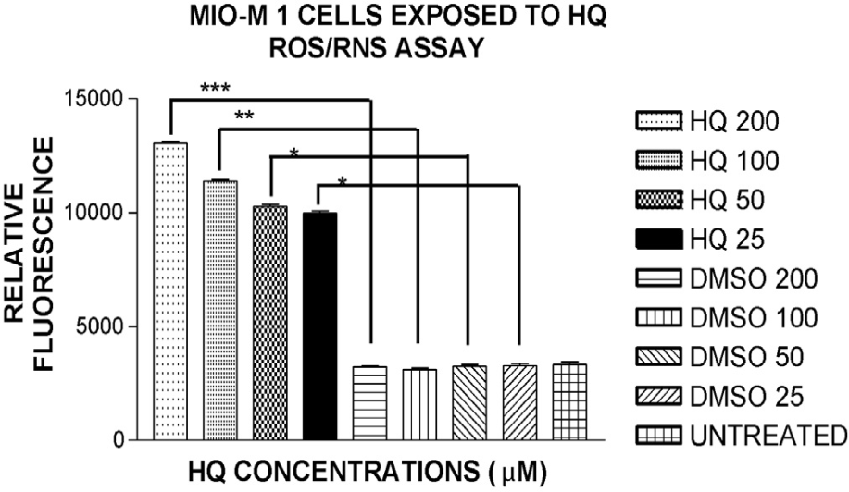
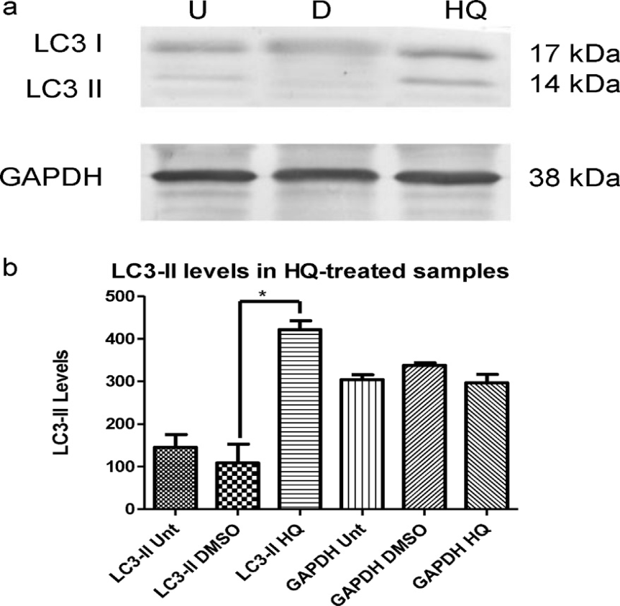
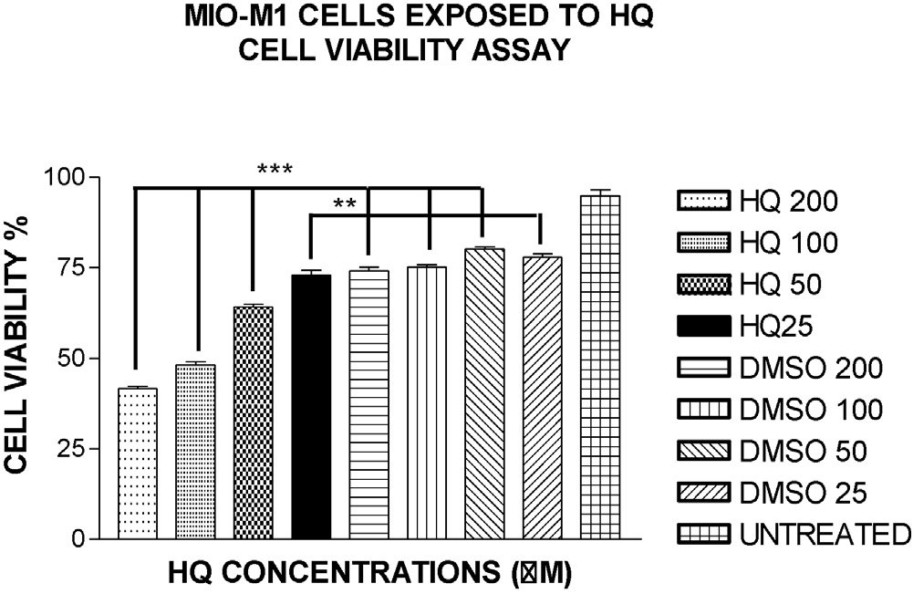
Toxicity of HQ on Müller Cells
Müller cells were exposed to HQ for 24 hrs & then analyzed for oxidative, mitochondrial, & autophagic pathways (Ramirez et al NeuroTox 2013).
Conclusion: HQ damaged Müller cells through oxidative, mitochondrial, and autophagic pathways.

Slide 22
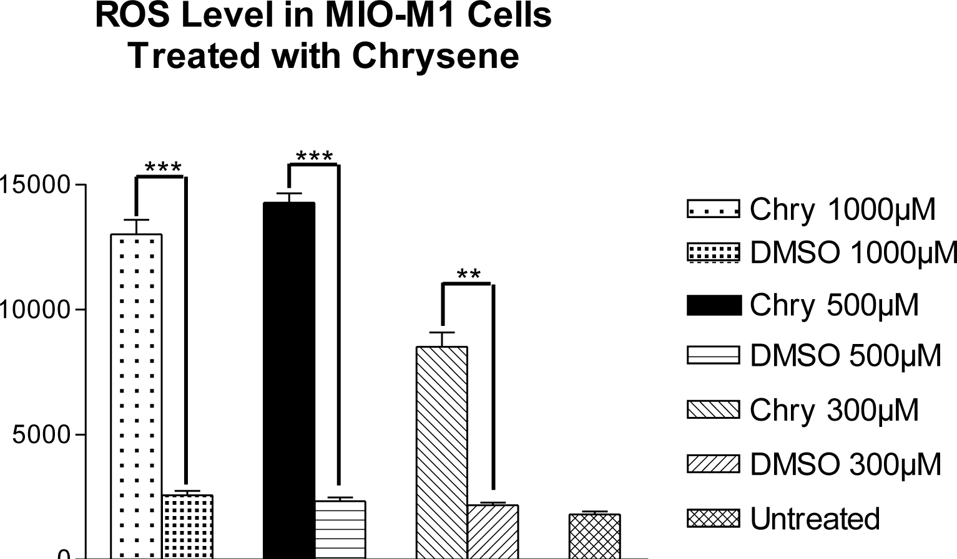
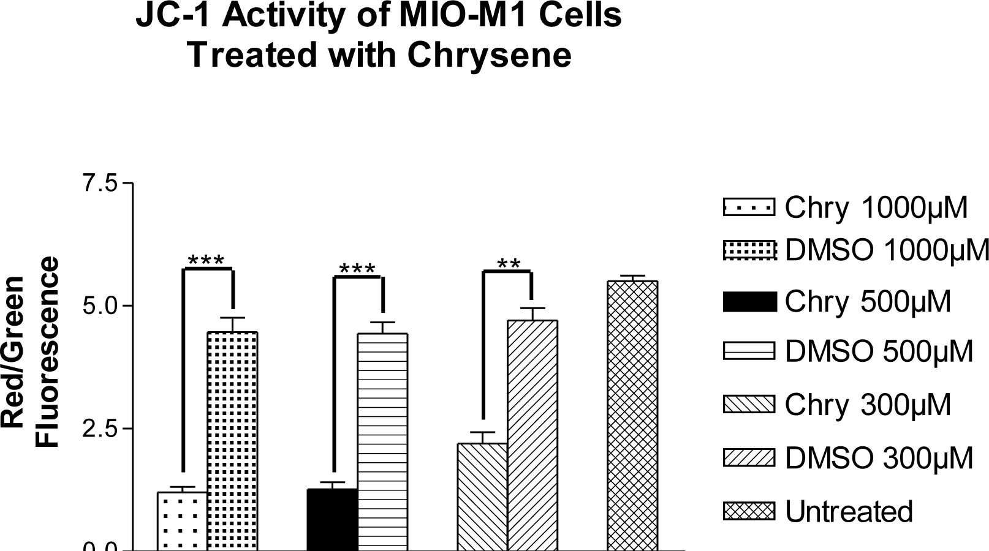
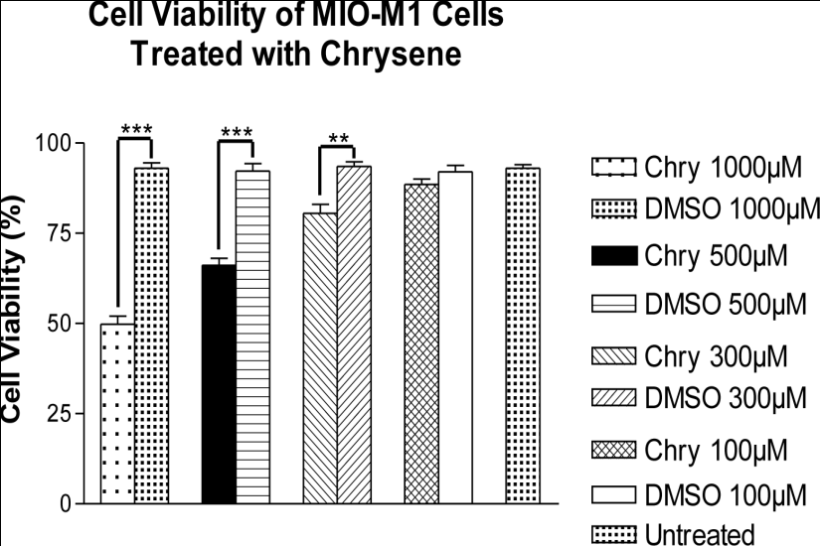
Toxicity of Chrysene on Müller Cells
Müller cells were exposed to chrysene for 24 hrs & then analyzed for cell viability, oxidative, & mitochondrial pathways (Mansoor et al Mol Vis 2013).
Conclusion: Chrysene causes oxidative stress & mitochondrial dysfunction of Müller cells.

Slide 23
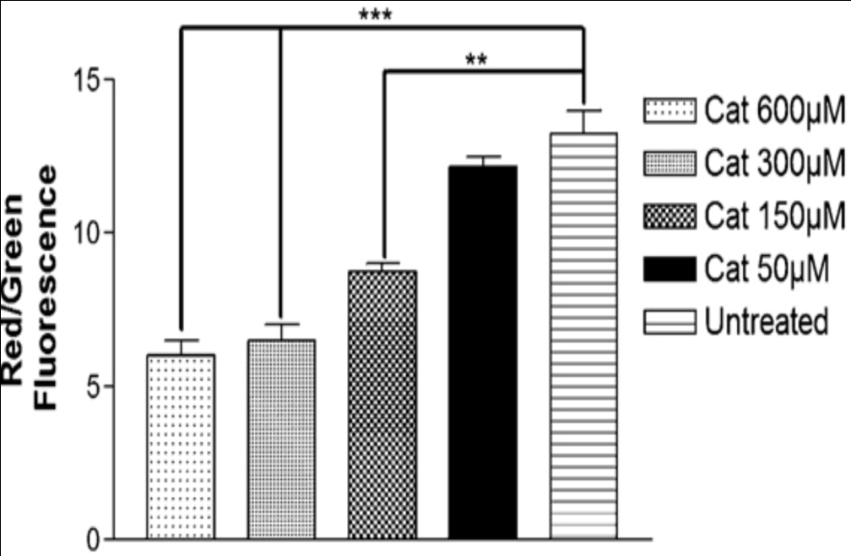
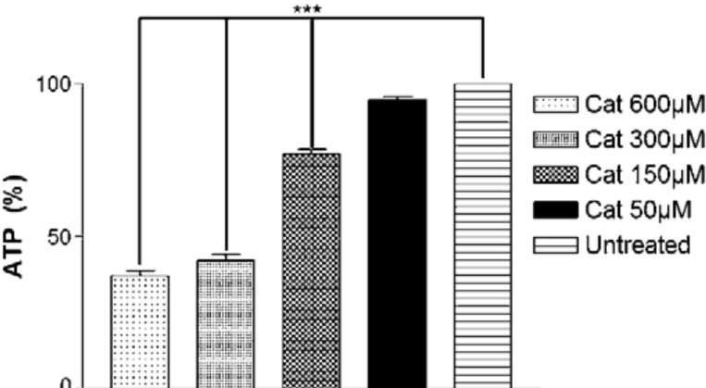
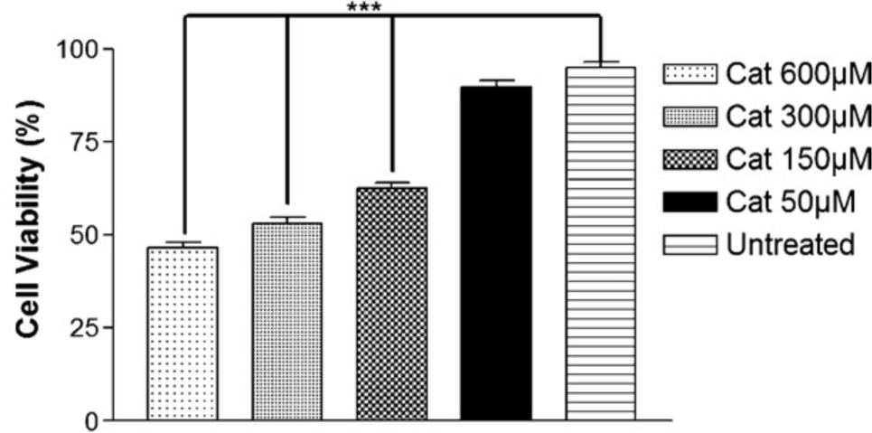
Toxicity of Catechol on Müller Cells
Müller cells were exposed to catechol for 24 hrs & then analyzed for cell viability, mitochondrial dysfunction (Mansoor et al Tox 2010).
JC-1Assay
ATP Level Assay
Cell Viability Assay
Conclusion: Catechol diminished cell viability of Müller cells via mitochondrial dysfunction.

Slide 24
Table 2: Summary of Mechanisms of CSC
Toxicity to Retinal Cells
RPE Cells
R28 Cells
BeP
2EP
Acro
Nico
HQ
BeP
Caspases
Necrosis
Oxidative
Mit Dysfu
Necrosis
Apoptosis
Necrosis
Non-Caspase
Non-Calpain
CV
CV
CV
CV
CV
CV
Abbreviations: BeP; Benzo-e-pyrene, HQ; Hydroquinone, 2EP; 2-Ethyl pyridine, Acro; Acrolein, Nico; Nicotine,, Mit Dysfu; Mitochondrial dysfunction; CV; Cell viability

Slide 25
Table 2: Summary of Mechanism of CSC Toxicity to Retinal Cells (continued)
HMVEC
Müller Cells
HQ
Chry
Cat
BeP
Nico
Non-Caspase
Necrosis
Necrosis
Non-Caspase
Mito Dysfu
Autophagy
Oxidative
Mito Dysfu
Mito Dysfu
CV
CV
CV
CV
CV
Abbreviations: BeP; Benzo-e-pyrene, HQ; Hydroquinone, Nico; Nicotine, Chry; Chrysene, Cat; Catechol, Mit Dysfu; Mitochondrial dysfunction; CV; Cell viability

Slide 26
Conclusion for These Experiments
The previous slides showed different CSCs that caused damage to the retinal and vascular cells.
We then wanted to determine if we could identify a medication or drug that would protect the cells.
In these experiments the cells were pre-treated with various inhibitors and then exposed for 24 hrs to CSC.

Slide 27
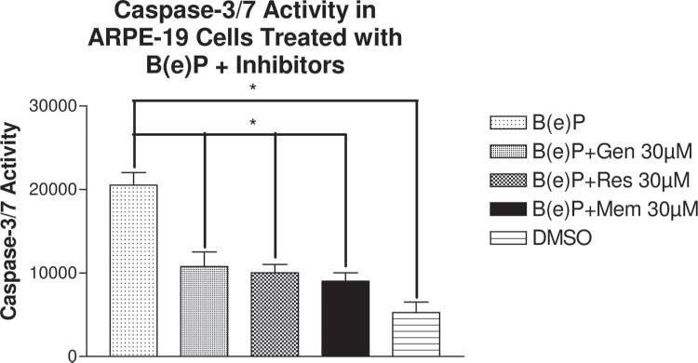
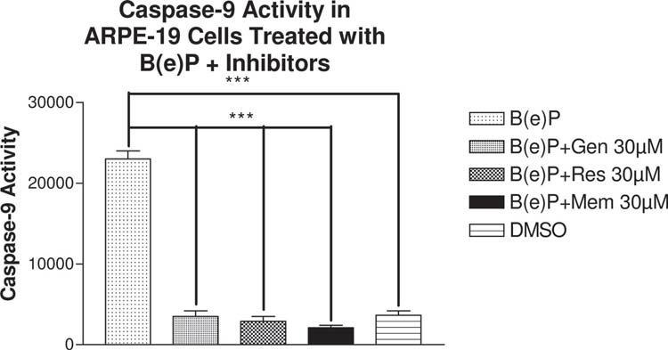
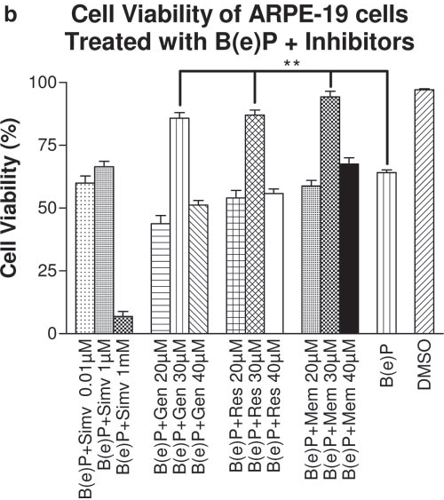
Preventing RPE Cell Damage against B(e)P
RPE cells were pretreated with genestein (Gen), resveratrol (Res), memantine (Mem) & then cultured for 24 hrs with B(e)P. Cells were analyzed for cell viability & caspase pathways.
.
Conclusion: Genestein, resveratrol, memantine reversed apoptosis & loss of cell viability in B(e)P treated RPE cells (Mansoor et al IOVS 2010).

Slide 28
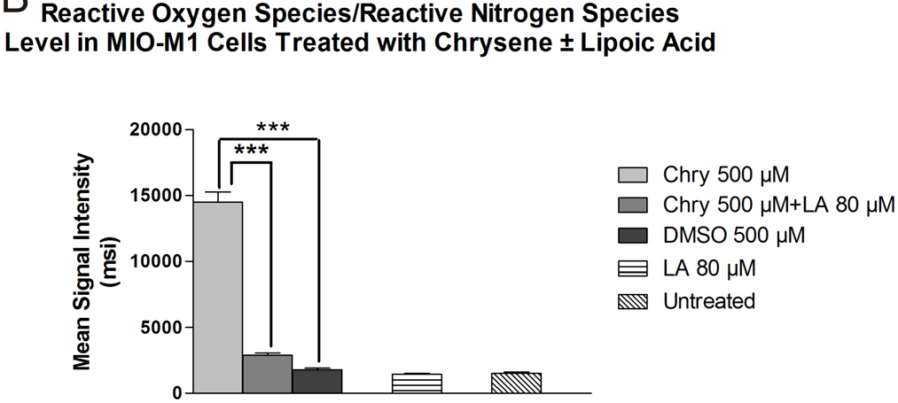
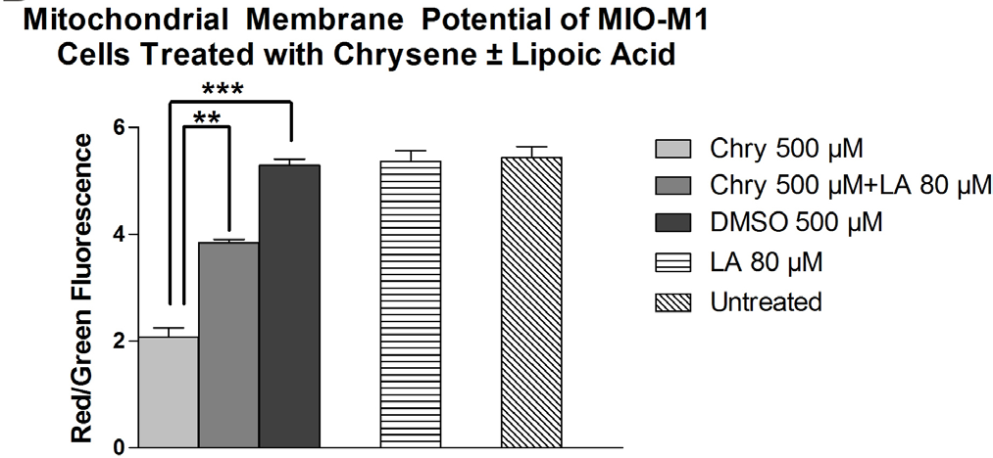
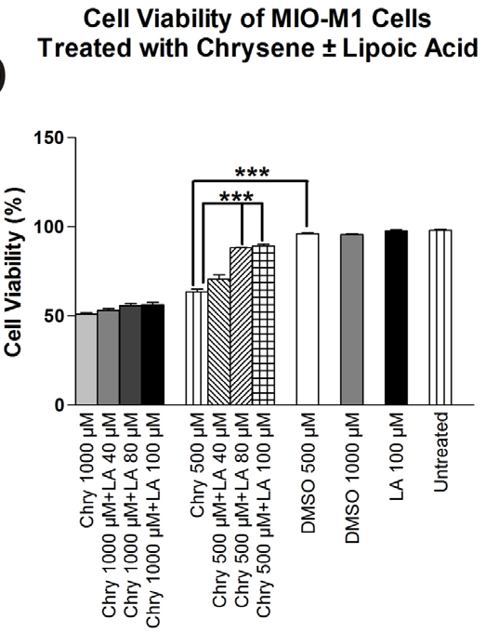
Preventing Müller Cell Toxicity Against Chrysene
Müller cells were pretreated with Lipoic acid (LA) & then cultured for 24 hrs with chrysene. Cells were analyzed for cell viability, ROS & mitochondrial membrane potential (Mansoor et al Mol Vis 2013).
Conclusion: LA treatment decreased ROS/RNS level, increased mitochondrial
potential, & reversed loss of cell viability in chrysene treated Müller cells.

Slide 29
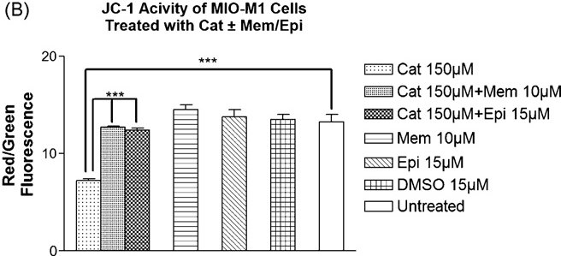
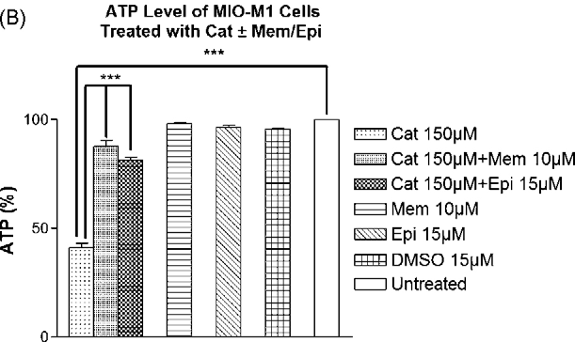
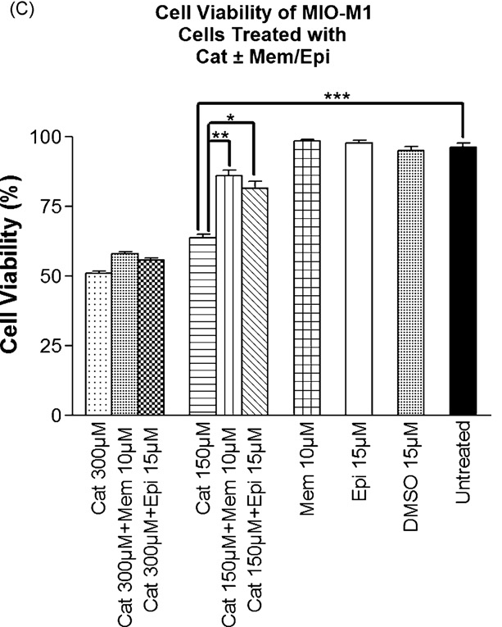
Reversing Müller Cell Toxicity Against Catechol
Müller cells were pretreated with Memantine or Epicatechin & then cultured for 24 hrs with catechol. Cells were analyzed for cell viability, & mitochondrial function (Mansoor et al Tox 2010).
Conclusion: Memantine & Epicatechin treatments increased mitochondrial function & reversed loss of cell viability in catechol treated Müller cells.

Slide 30
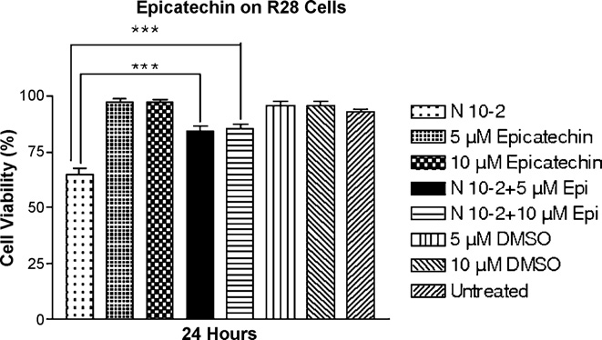
Reversing R28 Cell Toxicity Against Nicotine
The R28 cell were pretreated with epicatechin & then cultured 24 hrs with nicotine. Cells were analyzed for cell viability (Patil et al Tox 2008).
Conclusion: Epicatechin treatment partially reversed R28 toxicity induced by nicotine.

Slide 31
Table 3: Summary of Different
Mechanisms of Cellular Protection
RPE Cells
R28 Cells
Gen/Res/Mem
Lipoic acid
Epi
BeP
Acro
Nico
Multi Capase
Mito Func
Non-Caspase
Non-caplain
CV
CV
CV
Abbreviations: Gen; Genestein; Res; Resveratrol; Mem; Memantine, Epi; Epicatechin, BeP; Benzo-e-pyrene, Acro; Acrolein, Nico; Nicotine, Mito Fun; Mitochondrial function, CV; Cell viability

Slide 32
Table 3: Summary of Different
Mechanisms of Cellular Protection (continued).
Müller Cells
Lipoic acid
Mem
Epi
Chry
Cat
Mito Fun
Oxidative
Mito Fun
CV
CV
Abbreviations: Mem; Memantine, Epi; Epicatechin, Chry; Chrysene, Cat; Catechol, Mito Fun; Mitochondrial function, CV; Cell viability

Slide 33
Conclusions
Smoking is a major risk factor for developing AMD.
Cigarette smoke components (CSC) are harmful to retinal cells.
Different retinal cells respond differently to the CSCs.
  Some undergo caspase-dependent apoptosis, while others are damage via autophagy or necrosis.
  This suggests that a single agent may not provide general protection against CSCs and that combinations of drugs might be needed.
Using our retinal cell culture models, we have identified specific cyto-protecting agents that are protective against the toxic effects of the CSC.
This information can be used for future studies and clinical trials to identify beneficial, cyto-protective agents against harmful smoking components.

Slide 34
Acknowledgements
Discovery Eye Foundation,
Henry L. Guenther Foundation,
The Iris & B. Gerald Cantor Foundation
Polly & Michael Smith Foundation,
Lincy Foundation

Slide 35

Meet the eminent gathering once again at
Eye-2016
Miami, USA
September 26-28, 2016
Eye– 2016
Website: eye.conferenceseries.com

