Slide 1
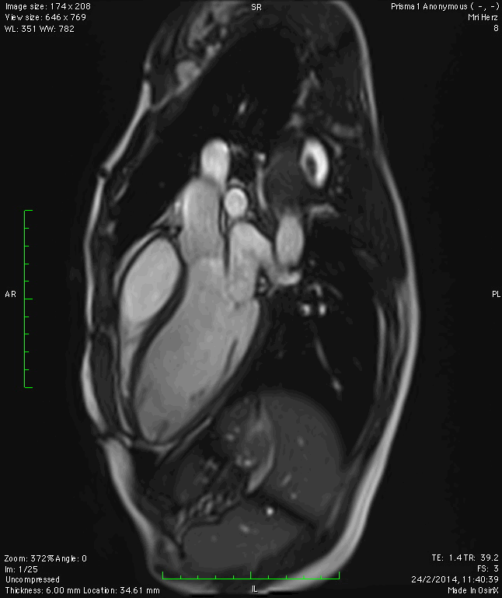

The Value of Stress MRI in Evaluation of Myocardial Ischemia
Dr. Saeed Al Sayari, MBBS, EBCR, MBA
Department of Radiology and Nuclear Medicine
Mafraq Hospital, Abu Dhabi
United Arab Emirates

Slide 2
Introduction
Ischemic heart disease (IHD) is the leading cause of death worldwide.
7 million deaths reported in 2008.
The burden of IHD has shifted from high-income countries to other parts of the world.
Early detection and management of IHD is vital in decreasing mortality.
Notes:
According to WHO report on Ischemic Heart Disease..
… to other parts of the world, like India ..
We all know that early detection…

Slide 3
Diagnostic Tests
ECG
Invasive Coronary Angiography (ICA)
Echocardiography (Echo)
Coronary CT Angiography (CTA)
Single photon emission computed tomography (SPECT)
Cardiac positron emission tomography (PET)
Cardiac MRI (CMR)
Notes:
Here are some diagnostic tests that are used for workup of suspected IHD.
ECG is a simple, safe and widely available test, but with low sensitivity (45-50%).
Invasive coronary angiography, as the name implies is an invasive procedure, but allows intervention along with diagnosis.
Stress Echocardiography: has a sensitivity and specificity of 80-88%, but is highly operator dependent and it’s difficult in patients with poor acoustic window, with morbid obesity or COPD.
CTA has a very high negative predictive value, but limited by radiation exposure, poor quality in patients with arrhythmias or high heart rates.
Stress SPECT has higher sensitivity compared to Echo, but limitations include radiation exposure, high costs, long acquisition protocols, and reduced sensitivity if patients have triple artery disease.
PET is much better than SPECT in all aspects, but it’s not easily available and very expensive.
CMR on the other hand is more widely available, but again with high costs, limited expertise, and difficult in patients with arrhythmias.

Slide 4
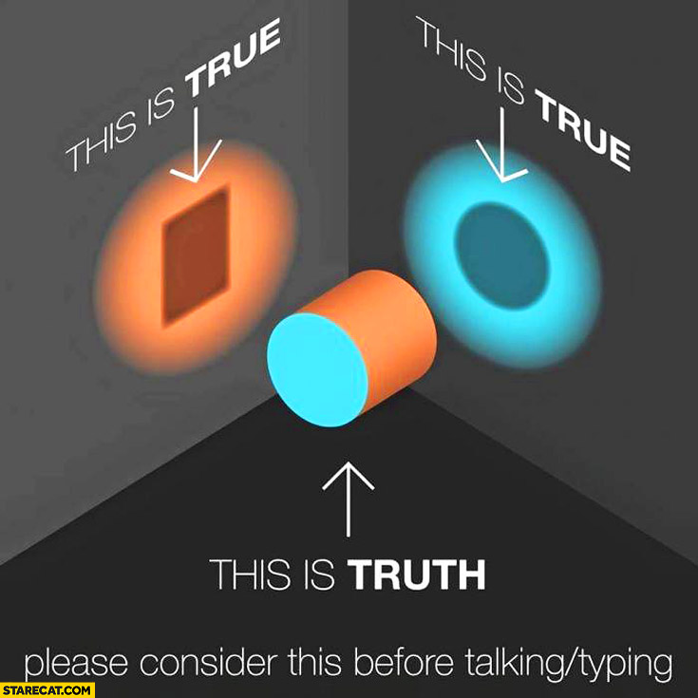
Complement - Not Compete
Notes:
Keep in mind that tests do not compete against each other. Different examinations always add new information that help in seeing the whole picture.

Slide 5
Test Selection
Ask yourself 3 questions:
  1. What is the clinical pre-test probability (PTP)?
  2. Can the patient exercise?
  3. Does the patient suffer from conditions that limit or contraindicate the use of any of the modalities?
Stress imaging test (echo, CMR, SPECT, PET) if:
Intermediate risk of IHD (PTP: 15-85%)
Known stenosis of unknown significance
AND
Bad ECG
Cannot exercise
Notes:
How do we select the proper test?

Slide 6
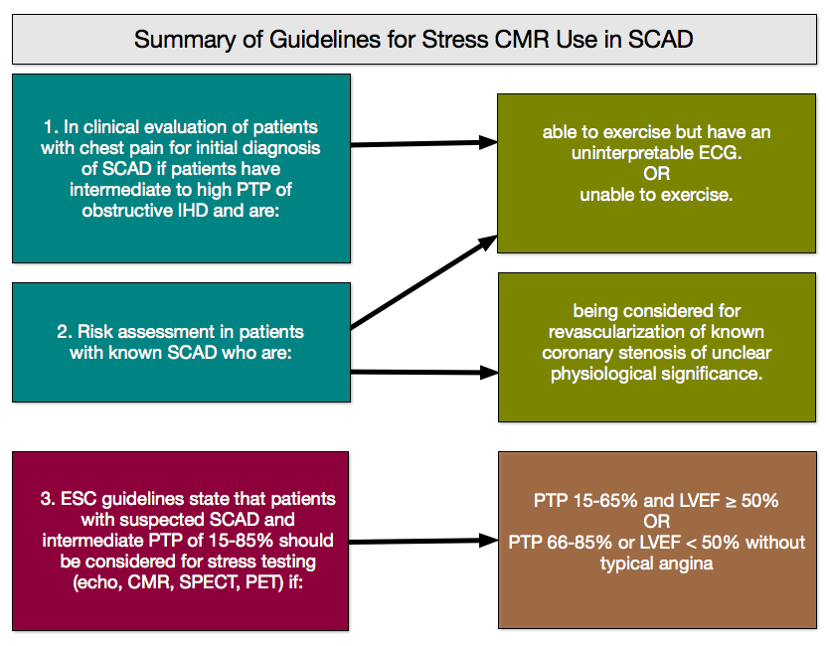
Notes:
Boxes 1 and 2 show the North American guidelines and box number 3 shows the European guidelines for use of stress imaging tests (echo, CMR, SPECT or PET) in patients with stable coronary artery disease (SCAD).
In summary, a patient needs a stress imaging test if he or she has an intermediate risk of IHD and can not exercise or has a bad ECG. OR a patient has a known coronary stenosis of unknown significance, can not exercise or has a bad ECG.

Slide 7
Advantages of CMR
Non-invasive modality.
No radiation exposure.
Provides additional information regarding cardiac morphology, function, detection of scar tissue and hence prognostic value.
Detection of thrombus and microvascular obstruction that are not detected by most of the other modalities.
Detection and quantification of valve diseases if present.
Notes:
Since my presentation is about CMR, let’s discuss its advantages.

Slide 8
(Potential) Uses of CMR
In the emergency department (ED)
Differential diagnosis of chest pain
Diagnosis of complications post myocardial infarction
Assessment of complications due to or after interventions
Prediction of myocardial recovery
Detection of inducible ischemia in patients with known IHD
Differentiating ischemic from non-ischemic heart failure
Risk stratification

Slide 9
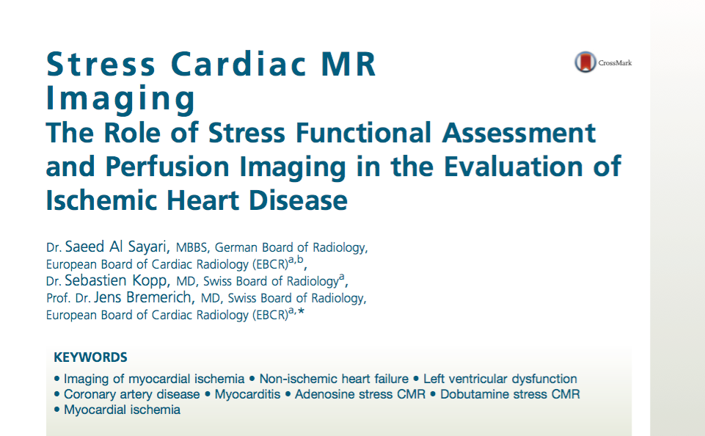
alsayari@outlook.com
Notes:
This presentation is prepared from this article that was published this year. If you want it, just send me an email and I will email it to you…

Slide 10
(Potential) Uses of CMR
In the emergency department (ED)
Differential diagnosis of chest pain
Diagnosis of complications post myocardial infarction
Assessment of complications due to or after interventions
Prediction of myocardial recovery
Detection of inducible ischemia in patients with known IHD
Differentiating ischemic from non-ischemic heart failure
Risk stratification

Slide 11
In the Emergency Department
In a multicentric study in the USA, 10,689 patients presented to ED with acute chest pain, data collected over 7months.
23% (2,459 patients) had true Acute Cardiac Ischemia (ACI) (36% acute MI, 64% unstable angina) | 77% (8,230 patients) did not have Acute Cardiac Ischemia
94% admitted, 6% discharged | 59% admitted, 41% discharged
At this rate of discharge, the estimated number of missed ACI is more than 11,000 patients/year in the USA with potential dire consequences | At this rate of admission, the estimated number of unnecessary admissions is more than 3.6 million patients/year in the USA, with huge financial burden
Pope JH, Aufderheide TP, Ruthazer R, et al. Missed diagnoses of acute cardiac ischemia in the emergency department. New England J Med 2000;342(16): 1163–70.

Slide 12
In the Emergency Department
Patients with acute ST elevation MI (STEMI) need reperfusion therapy ASAP; CMR is not for these patients.
Kwong, evaluated 161 patients who presented to ED with acute chest pain, but no signs of ST-elevation on ECG. All patients had a resting CMR examination.
Concluded that resting CMR imaging is suitable for triage of patients with chest pain in the ED, especially those with enzyme-negative unstable angina.
Other studies suggested the use of CMR after resolution of chest pain to aid in risk stratification.
Kwong RY, Schussheim AE, Rekhraj S, et al. Detecting acute coronary syndrome in the emergency department with cardiac magnetic resonance imaging. Circulation 2003.
Notes:
We should keep in mind that clinical judgment plays a major role in ordering any imaging test. CMR is not different.

Slide 13
Protocol and Findings in Acute MI
Protocol:
  LV function module
  Myocardial edema module (T2W)
  First-pass myocardial perfusion in rest (+/- in stress)
  Late (+/- early) gadolinium enhancement.
With T2W imaging (myocardial edema), area at risk (AAR) can be measured:
  Includes both reversible and irreversible myocardial injury.
With LGE:
  Irreversible injury (scar) is measured.
Salvageable myocardium = AAR - LGE

Slide 14



-
=
Salvageable Myocardium
Edema – Scar =
Notes:
Here is a graphical representation of the concept of salvageable myocardium.

Slide 15
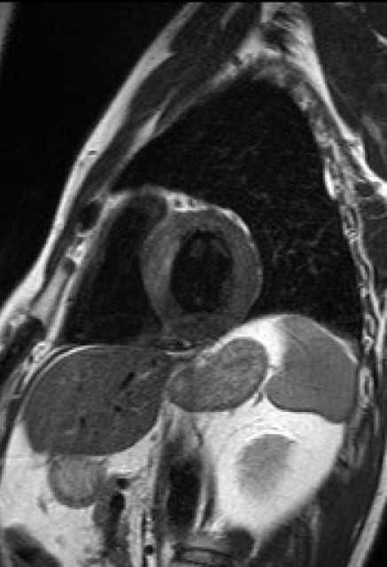
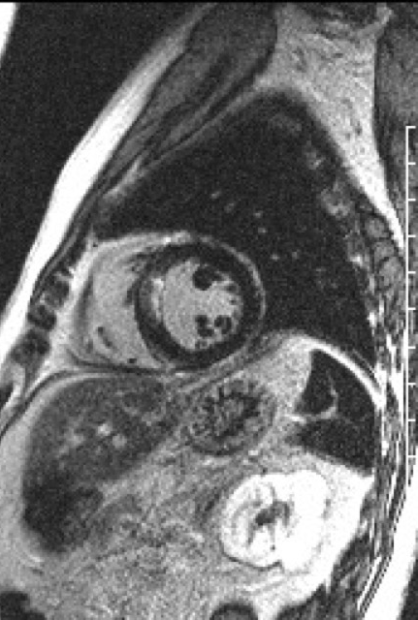
Myocardial edema
Subendocardial Scar
Acute myocardial infarction in the
anteroseptal region

Slide 16
(Potential) Uses of CMR
In the emergency department (ED)
Differential diagnosis of chest pain
Diagnosis of complications post myocardial infarction
Assessment of complications due to or after interventions
Prediction of myocardial recovery
Detection of inducible ischemia in patients with known IHD
Differentiating ischemic from non-ischemic heart failure
Risk stratification

Slide 17
Most important causes of chest pain from CMR point of view
Acute myocarditis
Acute myocardial ischemia
Takotsubo cardiomyopathy
Acute pericarditis
Dilated cardiomyopathy (DCM)
Hypertrophic cardiomyopathy (HCM)
Pulmonary embolism
Aortic dissection
Notes:
MRI can aid in detection of these pathologies and it’s of a great value especially in diagnosis of myocarditis, Takotsubo, DCM and HCM. Let’s see some of these pathologies.

Slide 18
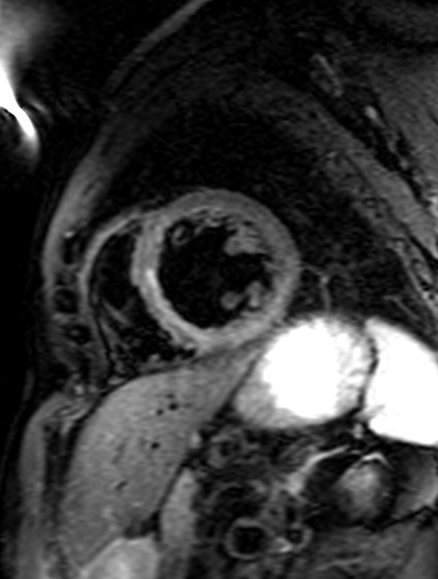
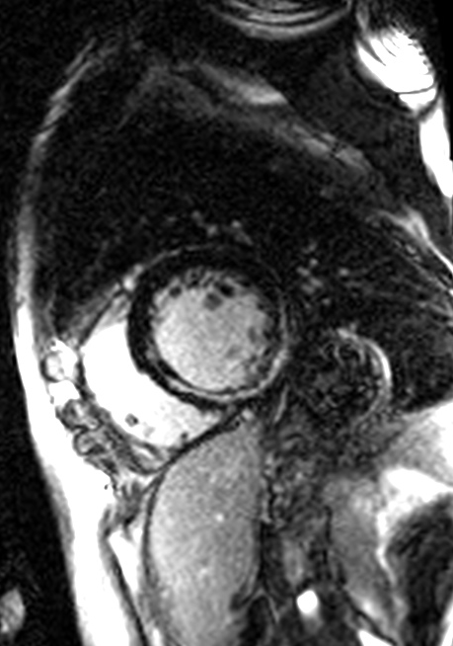
48 y/o male, presented to ED with acute chest pain and high troponin levels
T2W
LGE
Notes:
A myocardial infarction was suspected, and the patient underwent an invasive coronary angiography, which was normal. Next day, CMR was done.
Here you can see a hyperintense area in the infero-septal region in T2W image indicating myocardial edema, which also shows midmyocardial late-enhancement, suggesting myocarditis.

Slide 19
53 y/o female, presented to ED with suspected ACS and high troponin.
Notes:
Coronary angio was normal. Myocarditis was suspected. CMR revealed Takotsubo cardiomyopathy with typical apical and midventricular ballooning and absent LGE.

Slide 20
(Potential) Uses of CMR
In the emergency department (ED)
Differential diagnosis of chest pain
Diagnosis of complications post myocardial infarction
Assessment of complications due to or after interventions
Prediction of myocardial recovery
Detection of inducible ischemia in patients with known IHD
Differentiating ischemic from non-ischemic heart failure
Risk stratification

Slide 21
Post MI Complications
Ventricular aneurysm.
Ventricular free wall rupture.
Rupture of the interventricular septum.
Rupture of the papillary muscle.
Formation of LV mural thrombus.
Notes:
The only pathology that I encountered from this list is the last one.

Slide 22
Ischemic dilatation of the LV with apical thrombus.
Key feature: No contrast medium uptake in late enhancement images with high TI of 600 ms.

Slide 23
(Potential) Uses of CMR
In the emergency department (ED)
Differential diagnosis of chest pain
Diagnosis of complications post myocardial infarction
Assessment of complications due to or after interventions
Prediction of myocardial recovery
Detection of inducible ischemia in patients with known IHD
Differentiating ischemic from non-ischemic heart failure
Risk stratification

Slide 24
Complications due to or after Interventions
These include:
  Coronary dissection
  Side-branch occlusion
  Plaque embolization
A strong correlation was found between increasing troponin levels at 24hrs post intervention and areas of new myocardial LGE.

Slide 25
(Potential) Uses of CMR
In the emergency department (ED)
Differential diagnosis of chest pain
Diagnosis of complications post myocardial infarction
Assessment of complications due to or after interventions
Prediction of myocardial recovery
Detection of inducible ischemia in patients with known IHD
Differentiating ischemic from non-ischemic heart failure
Risk stratification

Slide 26
Viable myocardium?
“The extent of infarction in each segment determines the likelihood of functional recovery post-revascularization”. (Kim et al. 2000)
In clinical practice, we use 50% cutoff to define “potential” viability.
% Wall thickness infarction | Likelihood of functional recovery
1-25 | 60%
26-50 | 40%
51-75 | 10%
>75 | Almost nil
Notes:
This is one of the most important uses of CMR. CMR has the ability to reveal myocardial segments that are likely to recover after an intervention.
Here is the data from a paper published in year 2000, concluding that:

Slide 27
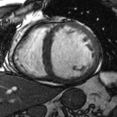
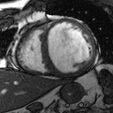
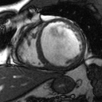
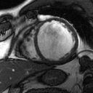
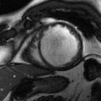
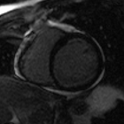
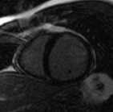
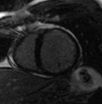
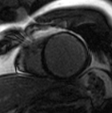
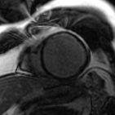
Upper row: severe hypo- to akinesia in multiple segments
Lower row: subendocardial scars, <50% transmurality
→ Viable myocardium → Intervention

Slide 28
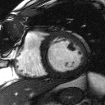
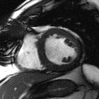
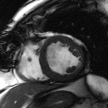
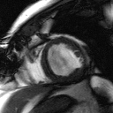
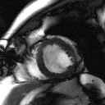
Upper row: pre-intervention
Lower row: post-intervention
Significant improvement in function.

Slide 29
(Potential) Uses of CMR
In the emergency department (ED)
Differential diagnosis of chest pain
Diagnosis of complications post myocardial infarction
Assessment of complications due to or after interventions
Prediction of myocardial recovery
Detection of inducible ischemia in patients with known IHD
Differentiating ischemic from non-ischemic heart failure
Risk stratification

Slide 30
Types of Stress CMR
Pharmacological stress testing with catecholamines:
  Dobutamine (+/- Atropine) Stress CMR
    Positive inotropic and chronotropic effect → increased cardiac workload → increased myocardial oxygen demand
Pharmacological stress testing with vasodilators:
  Adenosine perfusion stress CMR
  Regadenoson perfusion stress CMR
    Both cause primary coronary vasodilatation → used for assessment of coronary flow reserve

Slide 31
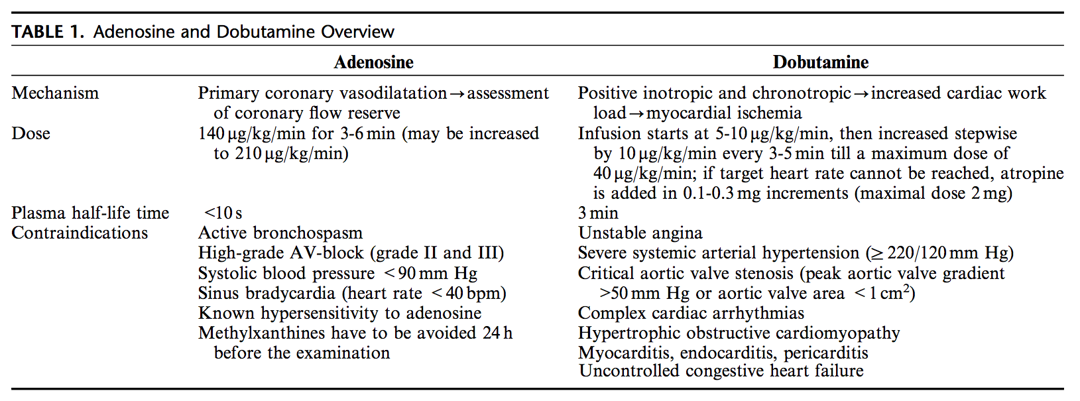
Adenosine vs. Dobutamine
Nadine Kawel-Boehm, Jens Bremerich. Magnetic Resonance Stress Imaging of Myocardial Perfusion and Wall Motion. J Thorac Imaging, Vol. 29, no. 1, January 2014.
In our practice, Adenosine perfusion MRI is preferred to Dobutamine stress MRI due to its higher safety profile.

Slide 32
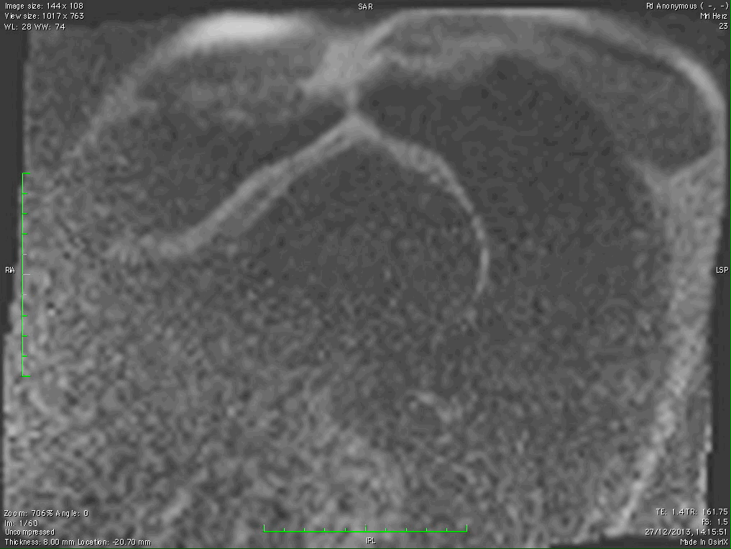
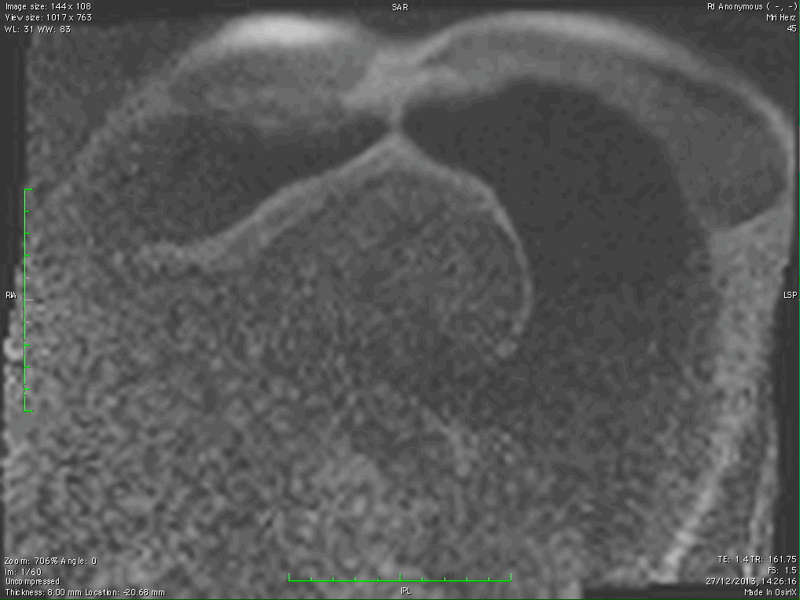
Perfusion in Stress
Perfusion in Rest
Notes:
Here is an example of an Adenosine stress test, as you can notice, on the left side the image shows a subendocardial perfusion defect in the interventricular septum in stress which is not present in rest suggesting stress inducible ischemia.

Slide 33
(Potential) Uses of CMR
In the emergency department (ED)
Differential diagnosis of chest pain
Diagnosis of complications post myocardial infarction
Assessment of complications due to or after interventions
Prediction of myocardial recovery
Detection of inducible ischemia in patients with known IHD
Differentiating ischemic from non-ischemic heart failure
Risk stratification

Slide 34
Ischemic vs. Non-ischemic Heart Failure
Both ischemic and non-ischemic cardiomyopathy can cause LV dysfunction, dilatation, and heart failure.
Identification is important due to different therapeutic approach (interventional vs. medical).
The pattern of LGE plays a major role in distinguishing ischemic from non-ischemic cardiomyopathy.
  LGE in IHD: subendocardial to transmural, correlates to coronary distribution.
  LGE in DCM: midmyocardial, most commonly in the mid-interventricular septum.

Slide 35
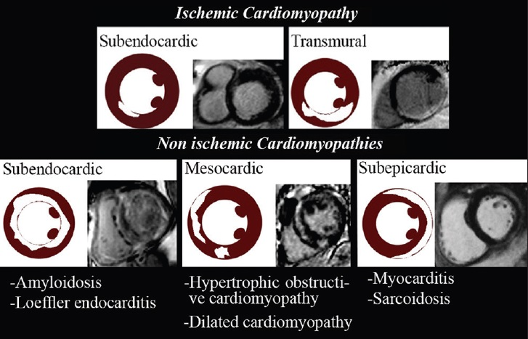
Olivas‑Chacon et al, Magnetic Resonance Imaging of Non-ischemic Cardiomyopathies: A Pictorial Essay. Journal of Clinical Imaging Science, Vol. 5, Issue 2, Apr-Jun 2015.
Notes:
Upper images show patterns of late enhancement in ischemic cardiomyopathy. Lower images with non-ischemic cardiomyopathies.

Slide 36
Transmural & subendocardial
LGE in LAD territory.
Mid-myocardial LGE→ DCM

Slide 37
(Potential) Uses of CMR
In the emergency department (ED)
Differential diagnosis of chest pain
Diagnosis of complications post myocardial infarction
Assessment of complications due to or after interventions
Prediction of myocardial recovery
Detection of inducible ischemia in patients with known IHD
Differentiating ischemic from non-ischemic heart failure
Risk stratification

Slide 38
Risk Stratification
Patients who had:
  Stress inducible perfusion defect
  LGE
  → > 3-fold association with cardiac death or acute MI.
Patients without a perfusion defect or LGE had a 98.1% negative annual event rate for death or MI.
Steel K, Broderick R, Gandla V, et al. Complementary prognostic values of stress myocardial perfusion and late gadolinium enhancement imaging by cardiac magnetic resonance in patients with known or suspected coronary artery disease. Circulation 2009;120(14):1390–400.
Notes:
Sometimes we do a stress CMR in pre-operative patients although there are not clear-cut guidelines for this use.

Slide 39
(Potential) Uses of CMR
In the emergency department (ED)
Differential diagnosis of chest pain
Diagnosis of complications post myocardial infarction
Assessment of complications due to or after interventions
Prediction of myocardial recovery
Detection of inducible ischemia in patients with known IHD
Differentiating ischemic from non-ischemic heart failure
Risk stratification

Slide 40

Take Home Message
Cardiac MRI is a powerful tool for the diagnosis of ischemic heart disease.
It can reveal additional or different pathologies and aid in differential diagnosis of chest pain.
It can guide therapy and predict prognosis.
Unfortunately, it’s underutilized mostly due to lack of knowledge of referring physicians or lack of CMR experts.

Slide 41

THANK YOU!
alsayari@outlook.com

