Slide 1
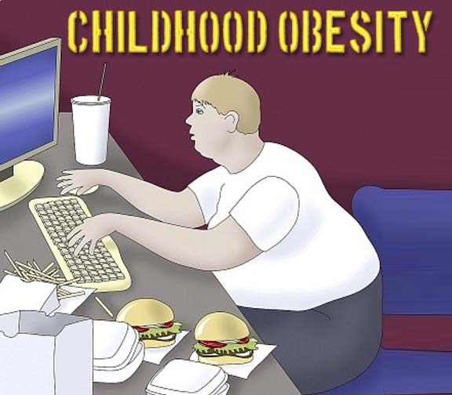

Risk factors of overweight and obesity in childhood and adolescence in South Asian countries: a systematic review of the evidence
SABUJ KANTI MISTRY
Research and Evaluation Division
BRAC, Bangladesh

Slide 2
Background
Obesity invaded heavily among south Asian children and adolescents, particularly of India
Obesity prevalence increased among children from 9.8% to 11.7% between 2006 to 2009 in India
This is ‘beyond expectation’, as under-nutrition has always been the concern, posing a dual burden of malnutrition
Reflects a ‘nutritional transition’, also happening in other developing countries
Obesity in childhood often runs into adulthood and act as a potent risk factor of several chronic diseases

Slide 3
Objective and Rationale
Individual studies do not provide sufficient evidence on their own to warrant appropriate action
This review systematically synthesizes the factors of overweight and obesity among children and adolescents in South Asian countries to inform policy, practice and future research

Slide 4
Methods
Study Design: Systematic Literature Review
Searched databases included: PubMed, PubMed central, EMBASE, MEDLINE, BioMed central, Directory of Open Access Journals (DOAJ) and the electronic libraries of the authors’ institutions
Text words and MeSH terms were used such as ‘obesity’, ‘childhood’, ‘overweight’, ‘determinants’, ‘factors’, ‘risk factors’, ‘South Asian countries’, ‘India’, ‘Pakistan’, ‘Nepal’, ‘Bangladesh’, ‘Sri Lanka’, ‘Bhutan’, ‘Maldives’ etc.
Boolean search was done using ‘AND’, ‘OR’ and ‘NOT’ to unite and filter the search terms

Slide 5
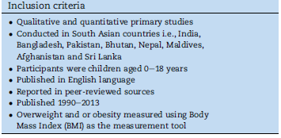
Methods (Cont.)
Study Selection: Firstly based on title and abstract; then against some preset inclusion criteria
Quality appraisal of the selected studies done by Effective Public Health Practice Project (EPHPP) guidelines

Slide 6
Findings

Slide 7
Title and abstracts searched and assessed (n = 1287)
Excluded n = 967
Insufficient available information to accomplish assessment n = 4
Full text retrieved and evaluated for eligibility (n = 316)
Excluded n = 288
Study design/comment/ editorial/letter n = 132
Background/discussion n = 38
Grey literature n = 29
Child age ≥ 18 years n = 24
Child age unclear n = 5
Studies carried outside South Asian countries n = 49
Not using BMI to measure overweight/obesity n = 8
Duplicate publication n = 3
Studies identified through contacting expert n = 1
Studies identified through screening bibliography
n = 4
Language not English n = 6
Articles meeting study selection criteria (n = 27)
Excluded n = 16
No clearly defined comparison group n = 11
No correlation value between comparison groups n = 5
Articles included in the review n = 11
Figure 3: Flow diagram of study selection

Slide 8
Findings..
Studies were done in India (7), followed by Pakistan (3) and Bangladesh (1); between 2000 and 2013
Nine uses cross-sectional design, others case-control
Prevalence of overweight ranged from 3.1% to 19.7% and obesity ranged between 1.2% to 14.5%
Though not statistically significant obesity prevalence is higher among boys than girls

Slide 9
Findings..
Lack of physical activities positively associated with overweight and obesity in childhood and adolescence
Regular exercise for 30 minutes/day as a protective factor against overweight/obesity
Long hours (2-4h/d) of TV watching/video games is a potent risk factor (OR: 5.4-7.3)
Frequent consumption of fast food/junk food has a significant positive correlation with risk of overweight and obesity in childhood and adolescence

Slide 10
Findings..
Participants with at least one overweight parent were nearly three times more likely to become overweight or obese
Obese children were nearly 50 times more likely to have a family history of obesity
Four of six studies reported a significant positive association between higher SES and higher overweight/obesity prevalence among chilgren

Slide 11
Conclusion
There is increasing burden of obesity and overweight among children and adolescents in South Asia
Unhealthy energy-rich foods and sedentary lifestyle contribute to increasing prevalence of childhood and adolescent overweight and obesity
Important for planners, policymakers, academics and researchers in public health and health policy at national, regional, and international levels

Slide 12
Recommendations
Need for a cross-sectoral approach involving interventions at various levels such as home, school and the community
Require nationally representative data to inform concerted action to tackle the issue
In-depth understanding of the associated cultural, social and environmental factors, including drivers for causative dietary and behavioural factors through qualitative studies
Focused intervention to tackle the problem

Slide 13
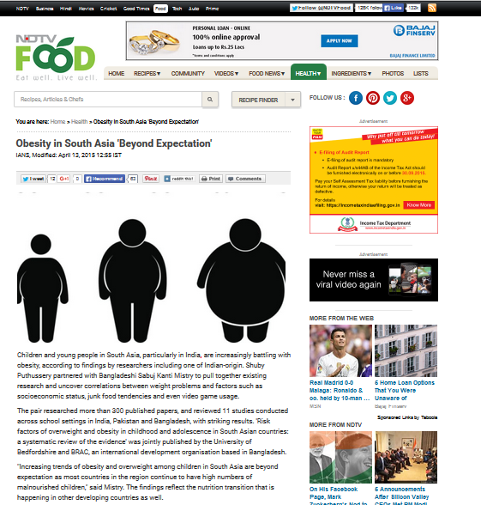

Slide 14
Thank You

