Slide 1
Cataractogenesis
Can Cataract be delayed or reversed?
Dr S. V. Eswaran
UNESCO-DBT Regional Centre for Biotechnology, Faridabad, Haryana
e mail: samba.eswaran@rcb.res.in

Slide 2
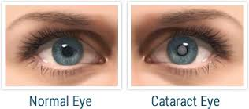
I. Is Cataract a disease of old age?
Age related nuclear cataract; congenital cataract

Slide 3
II. What triggers onset of cataract?
The human eye lens contains water soluble, heat stable and fully transparent proteins.
Oxidation, dehydration, formylation, fragmentation, misfolding, aggregation could make these proteins insoluble
& making the lens cloudy, translucent and then finally opaque

Slide 4
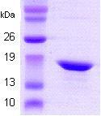
III. α-A Crysatllin
The most abundant protein in the eye lens and plays a critical role in cataractogenesis.
It has a chaeperoning role and holds a ‘misfolded’ protein until it refolds to its original state. (“Holdase function”)
MDVTIQHPWF KRTLGPFYPS RLFDQFFGEG LFEYDLLPFL
SSTISPYYRQ SLFRTVLDSG ISEVRSDRDK FVIFLDVKHF SPEDLTVKVQ DDFVEIHGKH NERQDDHGYI SREFHRRYL PSNVDQSALS CSLSADGMLT FCGPKIQTGL DATHAERAIP VSREEKPTSA PSS

Slide 5
IV. The alternative kynurenine pathway

Slide 6
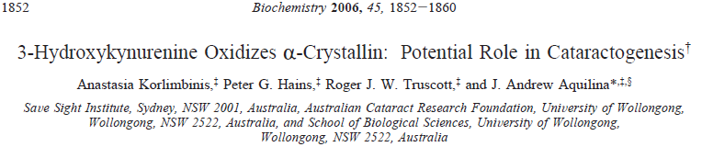
3-Hydroxykynurenine + Crystallin
Hydrogen peroxide, H₂O₂ is produced in the human eye and is implicated in cataractogenesis
2006

Slide 7
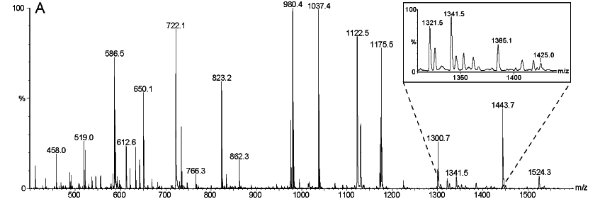
3OHKyn modified αA-crystallin, purified by HPLC, was digested with trypsin, and the resulting peptide mixture was analyzed directly by nanoESI-MS. The abundant (M+2H)²⁺ ion at m/z 722.1 and the abundant (M + H)⁺ ion at m/z 1443.7 corresponded to the Ac-MDIAIQHPWFK peptide, the first 11 residues of αA-crystallin, in which the Met had been oxidized to M_{ox}.

Slide 8
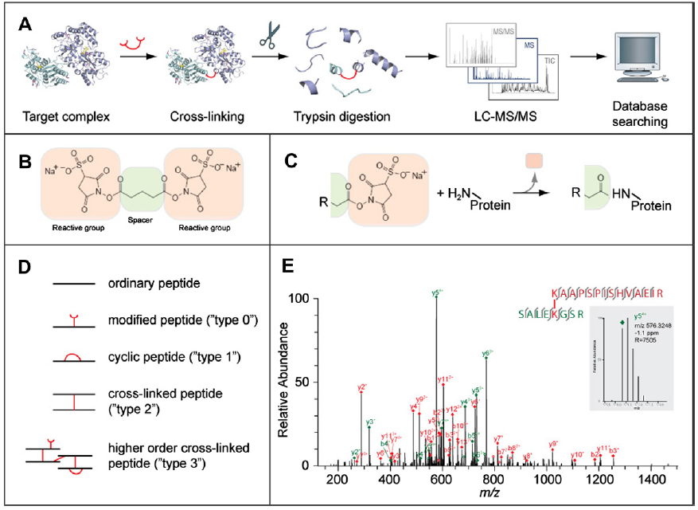
V. The beginning of a beautiful friendship: Cross-linking/mass spectrometry –bioinformatics for modeling of proteins and multi-protein complexes
Juri Rappsilber, Edinburgh, UK, Journal of Structural Biology 173 (2011) 530–540

Slide 9
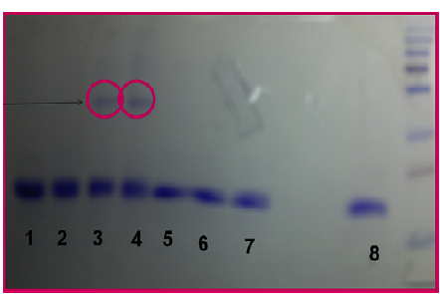
New Reagents For Proteomics
Hypothesis: 3-hydroxyanthranilic acid (3-HAA) could also be involved in Cataractogenesis
SDS-PAGE, excision of the ‘dimeric’ band, trypsin digestion, MALDI-MS, MS/MS & use of bioinformatics tools.

Slide 10
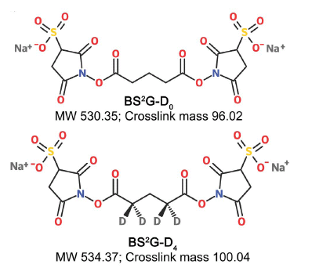
α-A WT Crystallin and αA-G98R
“Crosslinking of wild type α-A WT Crystallin and αA-G98R mutant has been compared using a homobifunctional crosslinker-mass spectrometry (MALDI-MS, MS/ MS) & bioinformatics. A single difference in subunit-subunit interaction sites has been detected between the αA-G98R mutant and the wild type, which leads to a conformational change, making the mutant protein more prone to aggregation”
R., Kannan, et al, PLOS ONE, 8, ,1-9 (2013)

Slide 11
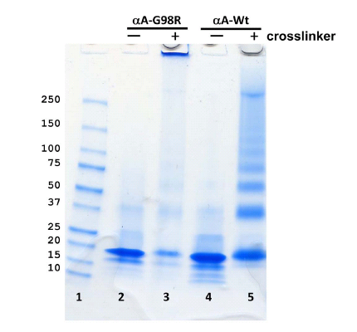
Lane 3: Crosslinked under the same conditions
αA-G98R forms higher order complexes that do not enter the gel
Lane 5:
Dimers, trimers & Oligomers
SDS-PAGE analysis of crosslinked products

Slide 12
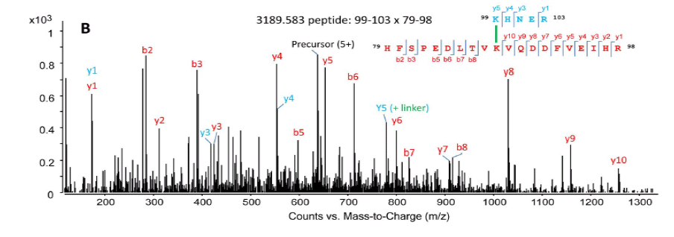
LC MS , MS/MS analysis of a crosslinked αA-G98R peptide
Two peptide fragments 99-103 & 79-98 crosslinked at Lys88 & Lys 99

Slide 13
Crosslinking studies reveal that the inter-subunit crosslinking is clustered in the K88region in αA WT and in the K99 region of the mutant αA-G98R.
K99 is solvent exposed in αA WT and is not proximal to any other amino group as has been shown using DTSSP crosslinker.
No inter-subunit interactions involving K99 in αA WT were observed but such inter-subunit interactions in the K99 region were observed in mutant G98R protein, making it more prone to aggregation and cataract formation.

Slide 14
In conclusion, the results reveal a new, previously unknown interaction site between G98R subunits. The difference in the cross-linking pattern between the aA-WT and G98R Crystallin, likely reflects
the different oligomerization of the proteins due to altered subunit interaction regions. Our studies demonstrate the use of chemical cross-linking and mass spectrometry as a tool for expanding our understanding
of the interactions and conformational changes in mutant proteins that contribute to their aggregation.

Slide 15
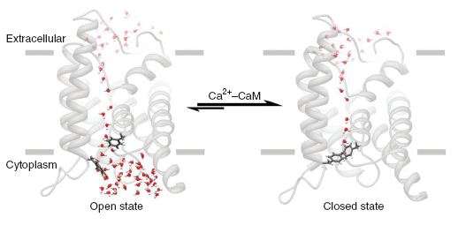
VI. The role of Aquaporin 0 in Cataract
Calcium binding controls opening/ closing of the water channel, creating osmotic pressure, forcing water into the eye lens, leading to cataract.
AQPO shown as grey ribbons
Water molecules as red
Tyr 149 and Phe 75 as scale models
S. L. Reichow et al
Nature Str . Mol. Biol. 20 (9) 1086, (2013)

Slide 16
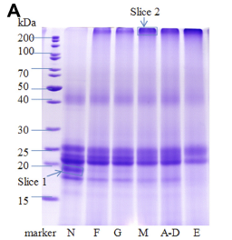
VII. Age Related Nuclear Cataract -ARNC
“Proteomic analysis of Age -Related Nuclear Cataracts (ARNC) and Normal Lens Nuclei” is associated with formation of high-molecular weight aggregates in ARNC lens nuclei.
S. Su et al, Investigative Opthamology & Visual Sci., 52., 4182-4191, (2015)
Normal lens (N) and Cataractous lenses

Slide 17
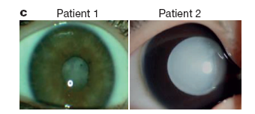
VIII. Can cataract be delayed or reversed?
Color foto of Patient 1’s right eye in the first pedigree (IV-1) with a total cataract
Patient 2’s right eye in the same pedigree (IV-3) with a cataract

Slide 18
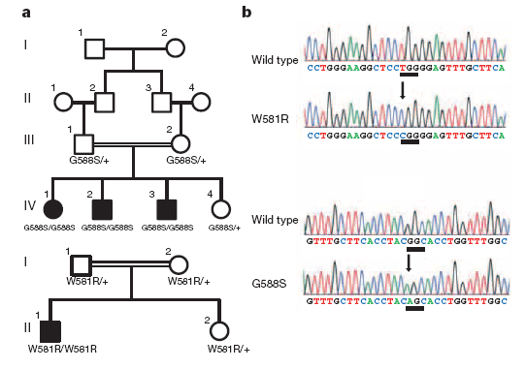
a Pedigrees of affected families and cataract phenotype
Squares and circles indicate males and females, resp.
b DNA sequencing data and an unaffected individual and an affected child (II-1) with a
homozygous W581R mutation; DNA sequencing data and an unaffected
individual and an affected child (IV-1) with a homozygous G588S mutation.
The underlined sequence indicates the nucleic acid change.

Slide 19
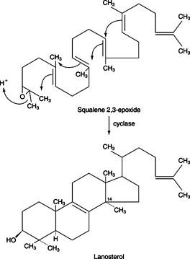
Lanosterol delays & reverses Cataract in rabbits and dogs
Studies on congenital cataract on two patients have shown that two mutations (W581R and G588S) in the highly conserved region for lanosterol synthase, leads to increased aggregation of the mutant protein. Lanosterol delays and reverses such cataract in rabbits and dogs. Can this result be extended to man?

Slide 20
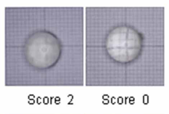
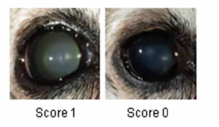
Rabbit and Dog’s eyes before and after treatment; Nature, 2015
L. Zhao et al, Nature 523, 607-611, (2015).

