Slide 1


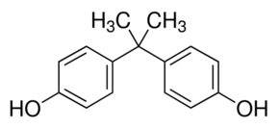


Abrogation of BPA-induced Cell Proliferation Via GPR30/Ras/PI3K/Akt Pathway by DIM in the Mammary Gland of Sprague-Dawley Rats
14.04.2017
8th World Congress on Toxicology and Pharmacology
April 13-15, 2017, Dubai, UAE
S. THILAGAVATHI, Ph.D. Graduate,
Department of Biochemistry & Biotechnology,
Faculty of Science, Annamalai University,
Tamilnadu, India

Slide 2
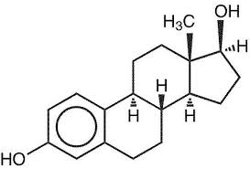
Bisphenol- A (BPA)
Sources
Food Containers
Water Bottles
Water Pipes
Electronics
Dental Sealants
Baby toys
A common environmental endocrine disruptor
Used as a xenoestrogen product of epoxy resins, polycarbonate plastics, & flame retardants
Absorbed in GIT, metabolized in liver, and excreted in urine
Mimics & structurally resembles 17-β-estradiol (E2)
Binding affinity - 1,000-2,000 times lower than that of E2
Binds & activates both cytosolic ERα & membrane-bound GPR30
Binds to GPR30 (membrane-bound ER) & activates various signaling kinases including MAPK
Estrogen
BPA
Notes:
Bisphenol-A, a common environmental endocrine disruptor, is used as a xenoestrogen product of epoxy resins, polycarbonate plastics, & flame retardants.
It is mainly found in food containers, water bottles, water pipes, electronics, dental sealants, baby toys.
Upon heating in water, polycarbonate plastics are hydrolyzed to BPA which gets absorbed in GIT, metabolized in liver, and excreted in urine.
Most of the BPA entering our body gets excreted, but a few fractions of it, in case of heavy ingestion, enters circulation and travels to various sex organs.
BPA mimics natural estrogen due to structural resemblance and binds to estrogen receptors & to some extent EGFR in cells of sex organs.
Binding affinity of BPA towards ER is 1000-2000 times lower than E2.
BPA binds & activates both cytosolic & membrane-bound ER.
Upon binding, membrane-bound ER (GPR30), BPA activates various kinases leading to the activation of PI3K/Akt & MAPK signaling which are involved in cell proliferation.

Slide 3
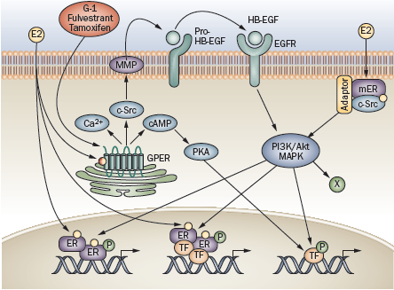
Estrogen Signaling
Notes:
Endogenous estrogen is known to bind all three known ERs, ER-α, ER-β and GPER.
Estrogen activates nuclear ERs inducing receptor dimerization and binding of receptor dimers to the promoters of target genes.
Alternatively, activated ERs modulate the function of other classes of TFs through protein–protein interactions.
Subpopulations of ERs at the plasma membrane activated by E2 interact with adaptor proteins (adaptor) and signaling molecules such as c‑Src, which mediates rapid signaling via PI3K–Akt and MAPK pathways.
E2 also activates GPER which is predominantly localized intracellularly.
GPER activation stimulates cAMP production, calcium mobilization and c‑Src, which activates MMPs.
These MMPs cleave pro‑HB‑EGF, releasing free HB‑EGF that transactivates EGFR, which in turn activates MAPK and PI3K–Akt pathways that can induce additional effects regulating gene transcription.
E2-mediated transcriptional regulation may involve phosphorylation of ER or other TFs that may directly interact with ER, or bind independently of ER within the promoters of target genes.

Slide 4
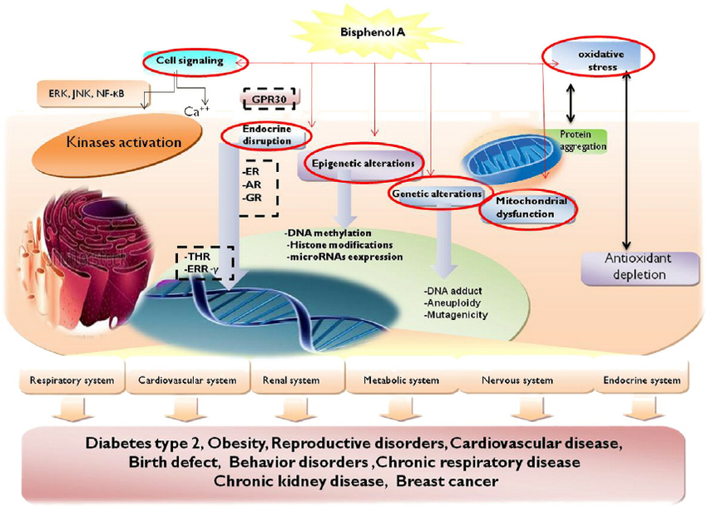
Effects of BPA on Human Health
Notes:
Upon binding & activating ER, BPA activates various signaling kinases and causes oxidative stress and genetic & epigenetic alterations all leading to pathogenesis of many diseases including diabetes, obesity, CVD, behavioral disorders, reproductive disorders, cancer.

Slide 5


3, 3-Diindolylmethane [DIM]
Derived from acid condensation of indole-3-carbinol
Sources – Cruciferous vegetables
Promotes estrogen metabolism by increasing the formation of 2-α hydroxy estrogen metabolites
Pharmacological Properties
Anti-angiogenic activity
Anti-estrogenic property
Anti-oxidant activity
Anti-cancer activity
Anti-inflammatory activity
Notes:
Diindolylmethane (DIM) is a plant indole found in cruciferous vegetables such as broccoli, brussels sprouts, cabbage, cauliflower, and kale.
DIM is a stable derivative of indole-3-carbinol.
It promotes estrogen metabolism by increasing the formation of 2-α hydroxy estrogen metabolites.
It has potential estrogen-modulating and anti-neoplastic activity.
DIM also has antioxidant, anti-estrogenic, anti-inflammatory, and anti-angiogenic activities.

Slide 6
OBJECTIVE
To explore the protective effect of DIM against BPA induced cell proliferation via GPR30/PI3K/Akt pathway in the mammary gland of Sprague-Dawley rats
Notes:
The aim of our study was To explore the protective effect of DIM against BPA induced cell proliferation via GPR30/PI3K/Akt pathway in the mammary gland of Sprague-Dawley rats

Slide 7
Experimental Design
  6-7 weeks old female Sprague-Dawley rats (100-120 g)
  Ethical and animal housing: IAEC, RMMC&H, Annamalai University
  Duration - 12 weeks
    Group – I Control (Corn oil)
    Group – II BPA (10 µg/kg/bw)
    Group – III DIM (5 mg/kg/bw)
    Group – IV BPA+DIM (10 µg + 5 mg/kg/bw)
  Proteins analysed: GPR30, Src, Ras, PI3K, Akt, ER-α, & PCNA
  Immunoblotting & immunohistochemistry
Notes:
For this purpose, we used 6-7 weeks old female Sprague-Dawley rats weighing 100-120 g
Animals were divided into four groups each consisting 6 rats
G-1 served as vehicle control receiving only basal diet with corn oil, whereas G-2 & 3 received BPA (10 µg/kg/bw) and DIM (5 mg/kg/bw) respectively
G-4 received both BPA & DIM
Study protocol was approved by institute animal ethics committee of au
At the end of 12 weeks, animals were sacrificed by cervical dislocation & blood & mammary tissues were collected and stored
We analysed the expression of ER-α and various pts involved in cell proliferation using imunoblotting & immunohistochemistry.

Slide 8
Effect of DIM on expression of GPR30, Src, Ras, PI3K and Akt in mammary tissues of control and BPA-treated rats
Notes:
BPA treatment up-regulated the expression of GPR30, Src, Ras, PI3K, and Akt in mammary tissues of experimental rats.
Administration of DIM along with BPA abrogated this up-regulation to near normal.

Slide 9
Effect of DIM on expression of PCNA in mammary tissues of control and BPA-treated rats
Notes:
In addition, PCNA expression was also found to be up-regulated confirming cell proliferation in mammary tissues.

Slide 10
Effect of DIM on expression of ER-α in mammary tissues of control and BPA-treated rats
Notes:
On the other hand, expression of ER-α remained unchanged suggesting that BPA acted mainly via GPR30 not via ER-α.

Slide 11
Discussion
Notes:
Treatment of BPA promoted cell proliferation via GPR30/Src/Ras/PI3K/Akt axis.
Administration of DIM along with BPA abrogated this effect.

Slide 12
Acknowledgements
We gratefully acknowledge University Grants Commission (UGC), Govt. of India, for funding the project and providing financial support in the form of project assistant.

Slide 13

Thank you

