Slide 1

DR. S. S. AMRITPHALE
Chief Scientist Head-Materials from Waste & Interdisciplinary Studies
CSIR-Advanced Materials and Processes Research Institute (AMPRI)
India
Email: ssamritphalerrl@yahoo.co.in
Mobile:+91-9425302575

Slide 2
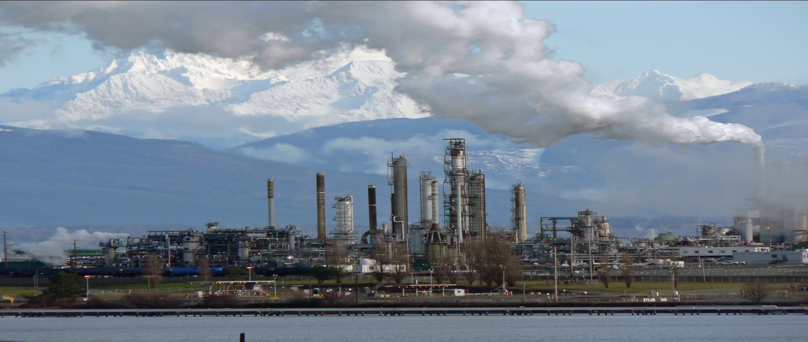
FUNCTIONALLY DESIGNED ADVANCED
CERAMIC MATERIAL FOR ADDRESSING OIL SPILLAGE : FIELD DEMONSTRATION.

Slide 3
Petroleum stands for Rock Oil.The word comes from the Greek word ‘petra’ (meaning rock) and the latin word ‘oleum’ (meaning ‘oil’).
Petroleum or crude oil is a naturally occurring, toxic, flammable liquid consisting of a complex mixture of hydrocarbons of various molecular weights and other organic compounds that are found in geologic formations beneath the earth's surface.
Petroleum is recovered mostly through oil drilling.
It is refined and separated, most easily by boiling point , into a large number of consumer products, from gasoline and kerosene to asphalt and chemical reagents used to make plastics and pharmaceuticals.

Slide 4
New materials from "Industrial and agricultural wastes" for Advancement of Petrochemical Industry.
THE OIL WELL INDUSTRY HAS THREE MAJOR AREAS OF OPERATION:
1. Oil well cementing materials.
2. Drilling mud materials.
3.Issue of "wastes generated in oil well industry

Slide 5
OIL WELL CEMENTING MATERIALS
The well is created by drilling a hole 12 cm to 1 meter (5 in to 40 in) in diameter into the earth with a drilling rig that rotates a drill string with a bit attached.
After the hole is drilled, sections of steel pipe (casing), slightly smaller in diameter than the borehole, are placed in the hole.
Cement may be placed between the outside of the casing and the borehole.
The casing provides structural integrity to the newly drilled wellbore, in addition to isolating potentially dangerous high pressure zones from each other and from the surface.
Conventional materials comprise:
- Conventional Ordinary Portland cement (OPC)
- Conventional Geopolymer cement (CGC) C)

Slide 6
An emerging New material ( ALSAGC) developed by CSIR-AMPRI, Bhopal, India
ALSAGC is Advanced Ligno- Silico -Alminous Geopolymeric Cement.
Significant features of ALSAGC:
a) Obviates the need of external materials required in conventional geopolymer cement e.g. LIGNIN BASED COMPOUNDS.
b) ALSAGC posses 25 % increased Compressive and flexural strength compare to CGC.
c) Homogenous matrix.

Slide 7
DRILLING MUD MATERIAL(DMM)
-Liquid drilling fluid is often called drilling mud.
-The main functions of drilling mud include providing hydrostatic pressure to prevent formation fluids from entering into the well bore, keeping the drill bit cool and clean during drilling, carrying out drill cuttings, and suspending the drill cuttings while drilling is paused and when the drilling assembly is brought in and out of the hole.
-The drilling fluid used for a particular job is selected to avoid formation damage and to limit corrosion.
-The three main categories of drilling fluids are water-based muds (which can be dispersed and non-dispersed), non-aqueous muds, usually called oil-based mud and gaseous drilling fluid, in which a wide range of gases can be used.

Slide 8
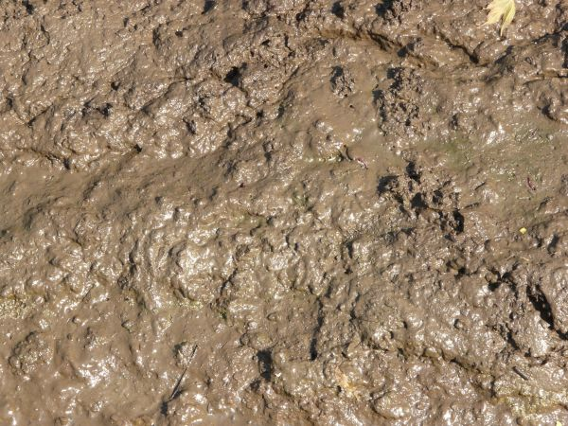
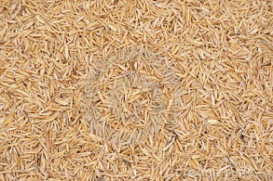
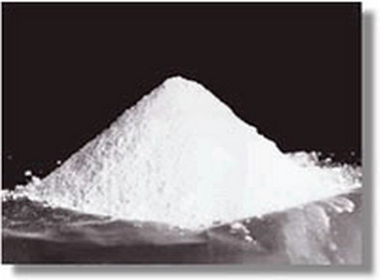
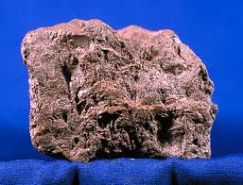
Conventional Drilling Mud Materials include:
MUD
RICE HUSK
BARITE (BARIUM SULPHATE)
HEMATITE

Slide 9
Innovation by CSIR-AMPRI, Bhopal An emerging New material - Advanced "Magnetic" Drilling Mud Material
( AMDMM) developed by CSIR-AMPRI, Bhopal
Raw materials for developing (ALSAGC) –
1. Fly Ash from Thermal power plants.
2. Rice Husk from Agricultural industry.
3. Brine Sludge from Chloral Alkali Industry.
4.Red Mud from Aluminum Production industry.

Slide 10
SIGNIFICANT FEATURES OF AMDMM:
It Obviates the need of external materials required in conventional Drilling mud material namely I) Barite, ii ) Hematite and Rice Husk.
AMDMM enables controlling rheology of the drilling mud by an additional features and parameter i.e. Magnetic properties of drilling mud.
AMDMM has a Homogenous matrix.
Converts wastes - in to resources materials i.e. Brine sludge, Red mud and Rice husk.

Slide 11
WASTE GENERATED IN OIL WELL INDUSTRY.
Petrochemical plants generate solid wastes and sludge some which are hazardous in nature due to toxic organics and heavy metals (e.g. spent caustic).
Proper facilities should be provided for handling and storage of hazardous wastes.
For final disposal , recycling/reuse should be given priority.
For incinerable wastes, properly designed incinerators should be installed and non-incinerable hazardous wastes should be disposed in secured landfill (TSDF)

Slide 12
PRESENTLY THE POLLUTION LOADS IN OIL INDUSRTY IS FROM :
A. Barite waste from drilling mud
B. Waste water
C. Organic compounds

Slide 13
SOLUTION PROPOSED FOR UTILIZING THE WASTE FROM OIL WELL
A. Barite waste from drilling mud can be uses as resource material for making - Advanced radiation Shielding materials. ( Expertise of CSIR-AMPRI, Bhopal A patent In USA)
B. Waste water
C. Organic compounds .
B & C can be treated using Geopolymeric Materials (expertise of CSIR-AMPRI, Bhopal)

Slide 14
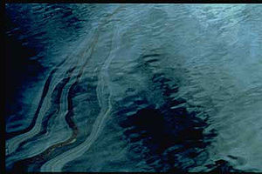
PROBLEM OF OIL SPILLAGE
Its one of the most important problem ,having following harmful effects-
Oil spill pollution, a severe environmental problem, which persists in marine environment or in inland water across the world, has grown to an alarming magnitude with increased levels of oil production and transport.
Oil spilled by damaged tankers, pipelines or offshore oil rigs coats everything it touches and becomes an unwelcome but long-term part of every ecosystem it enters.
Developments in petrochemical industry warrants increased oil supply carried through pipelines and ships from places where it is found to the most convenient sites for refineries and chemical manufacturing plants.

Slide 15
Material for addressing Oil Spillage :
New approach towards the search for new materials is inevitable to target removal of oil from marine and off shore oil spillage problem.
The very basis of these new material, are magnetic, high surface area and environmental friendly.
The material is of huge industrial, environmental and scientific applications.
The materials processing at sub-micron or nano level will be essential for the new technology.

Slide 16

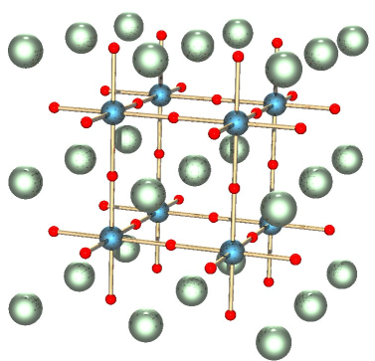
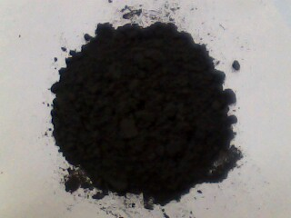
Red Mud Derived Magnetic Iron Titanium Silicate Mineral Composite
for Addressing Oil Spillage Issues
Concept
Structure
Properties
Practical Issues
Probable Solutions
Future Directions
AMPRI’s Ceramic powder
)

Slide 17
Concept of Developed Material
The development of advanced ceramic material with tailored properties like surface area which is suitable for removal of oil from marine and off shore oil spillage.
Red mud (aluminium industry waste) will be used to get iron titanium silicate mineral compositions.
The developed material with varying density and compositions will be used for removal of oil from marine and off shore oil spillage.
The composition developed will be devoid of any hazardous elements like lead, chromium, arsenic etc, makes the material environment friendly. Developed materials are not yet mature enough to demand immediate industry attention.
I had be working on the basic aspects of materials synthesis and characterization.
I have enough reasons to believe that developed advanced functional ceramic can be helpful to solve the materialistic problems of oil spillage.

Slide 18
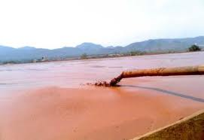

Raw Material for Functionally Deigned Ceramic Material
Red mud is the waste generated during Aluminum production from bauxite. 1.0–1.6 tonnes of red mud is generated per tonne of alumina.
It is estimated that over 66 million tonnes is impounded annually in the world.
Disposal of red mud tailing costs industry US$ 3 per tonnes of alumina production.
Redmud is used for making inexpensive and efficient adsorbent for removal of cadmium, zinc and Arsenic, fluoride, lead, chromium from aqueous solutions has also been reported recently.

Slide 19
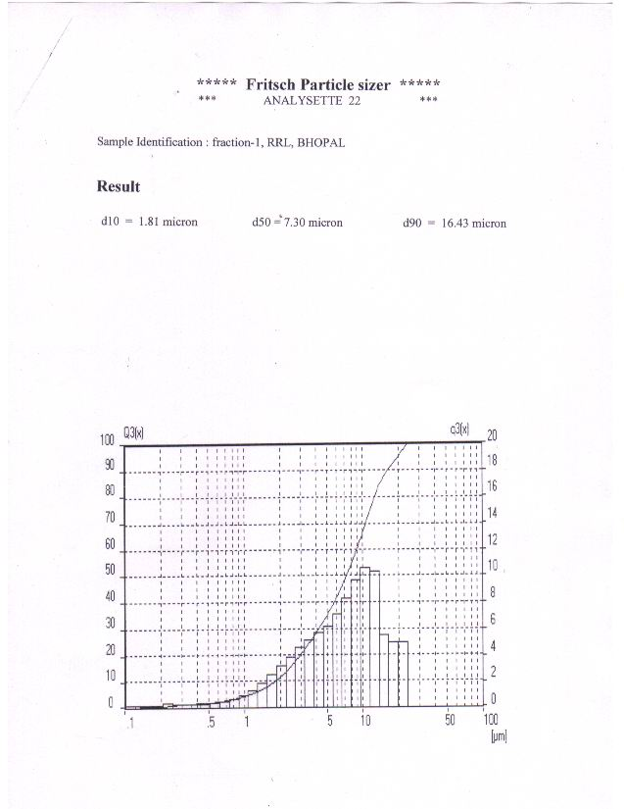
Properties of Resource Material for Designed Ceramic
Fe₂O₃ - 31.88 %
TiO₂ - 21.20 %
Al₂O₃ - 20.10 %
SiO₂ - 8.50 %
CaO - 2.99 %
Na₂O - 6.00%.
LOI - 10.0%.
Raw Red Mud Sample
Average Particle Size : 16.43 μm
Red Mud obtained from Hindustan Aluminum Company (HINDALCO) Renukoot, India

Slide 20
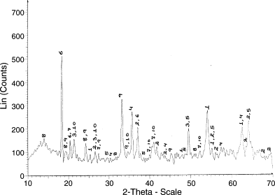
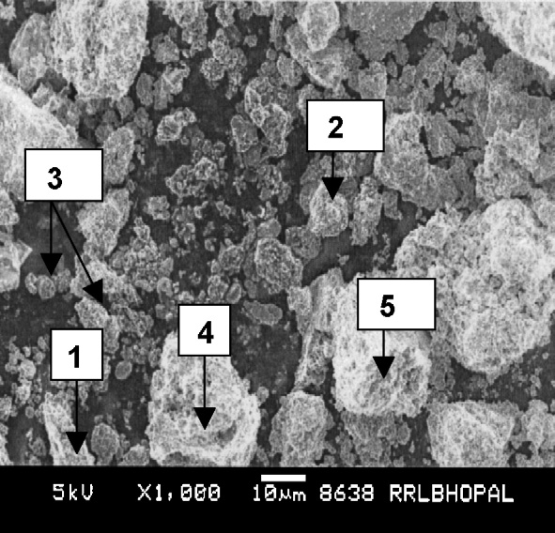
Mineralogical Composition & Surface Profile of Resource Material
Mineralogical Phases in Red Mud Sample:
1. Anatase 2. Rutile
3. Quartz 4. Hematite
5. Bohmite 6. Gibbsite
7. Bayerite 8. Na₅Al₃CSi₃O₁₅
9. Cancrinite, 10. Chantalite
X-ray powder diffraction analysis of red mud exhibited presence of a diverse mineralogical phases and compounds which act as a source materials for obtaining varieties desired phases.
SEM of red mud (scattered morphology):
  Tetragonal - Anatase
  Tetragonal - Rutile
  Hematite Spherical
  Hexagonal Cancrinite
(5) Orthorhombic - Boehmite.
The scanning electron microphotographs exhibiting
microstructure of red mud.
Red Mud obtained from Hindustan Aluminum Company (HINDALCO) Renukoot, India

Slide 21
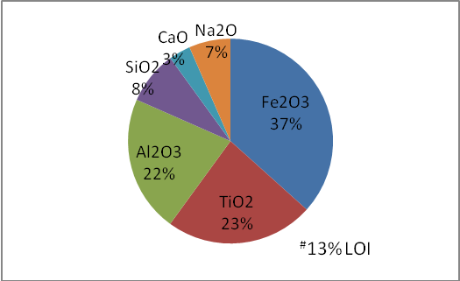
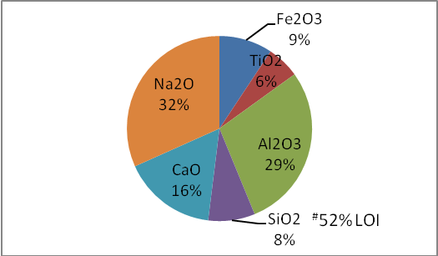
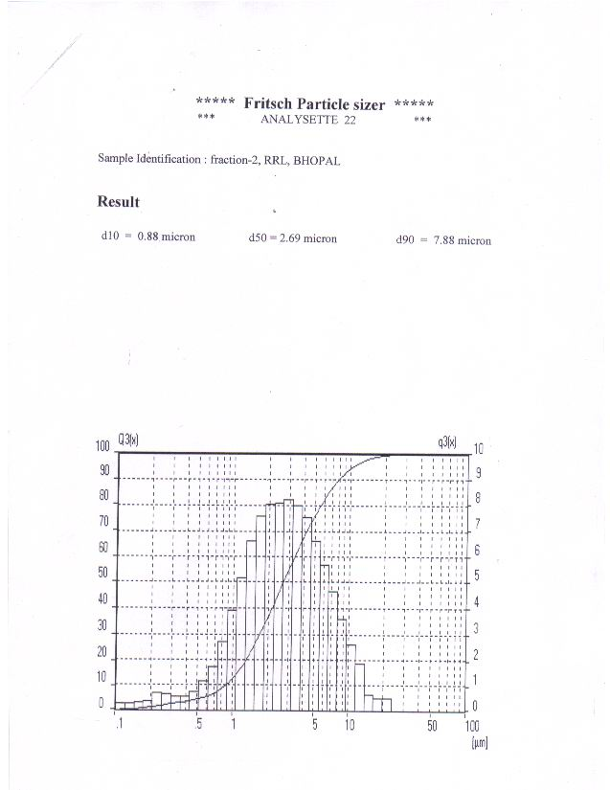
Properties of Functionally Deigned Ceramic for Addressing Oil Spillage Issue
Raw Red Mud Sample
Average Particle Size : 16.43 μm
Raw Red Mud Sample
Average Particle Size : 7.88 μm

Slide 22
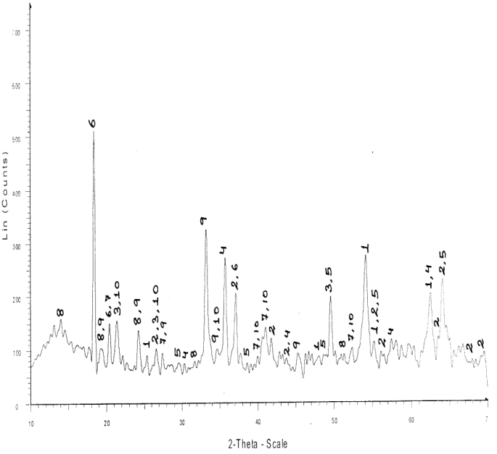
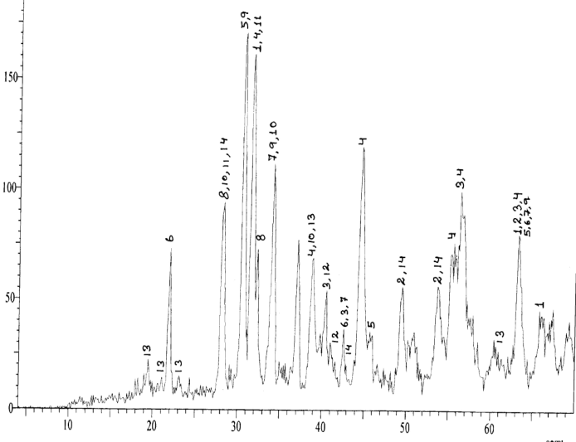
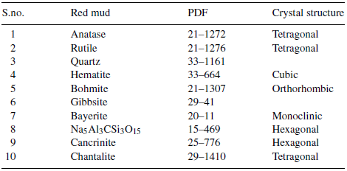
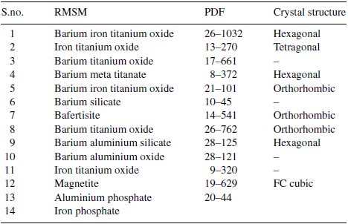
Mineralogical Composition & Surface Profile Compression
Red mud Sample 1 (Ceramic Route)

Slide 23
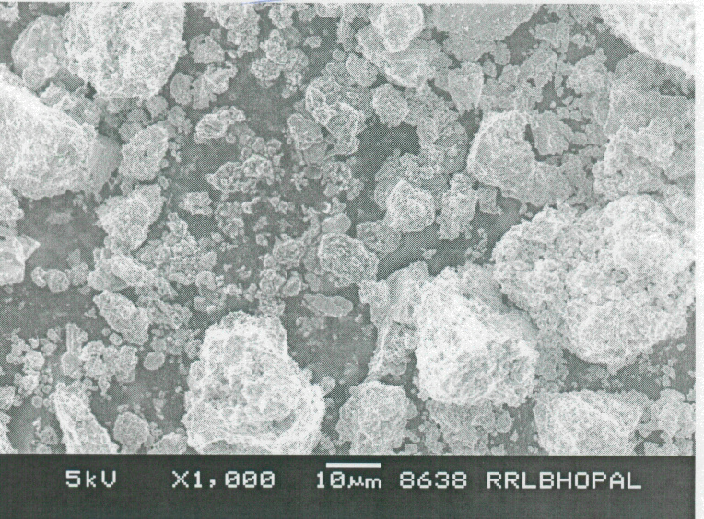
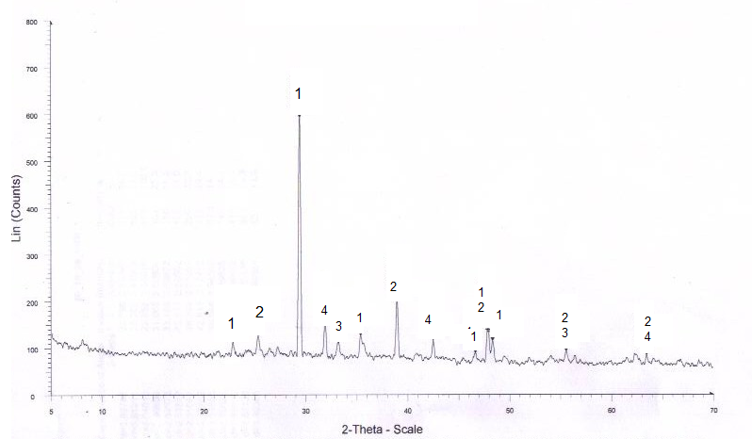
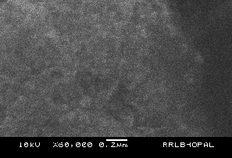
Development of Functional Ceramic by Spray Pyrolysis Technique
Mineralogical Phases in
Red Mud Sample:
1. Anatase 2. Rutile
3. Quartz 4. Hematite
5. Bohmite 6. Gibbsite
7. Bayerite 8. Na₅Al₃CSi₃O₁₅
9. Cancrinite, 10. Chantalite
Mineralogical Phases in
Sample 2 for oil spillage issue:
1. Calcite 2. Anatase
3. Hematite 4. Cancrinite,

Slide 24
Significant Features of Designed Ceramic for Addressing Oil Spillage Issue
Tailored properties and oil removal by sorption (adsorption & absorption both)
a) Low density (1.2 gm/cc)
b) High Porosity for oil sorption
c) Magnetic in nature for removal of oil loaded material from liquid surface.
d) High temperature stability.
Oil removal from both solid and liquid surfaces.
Geomimic origin: Iron Titanium Silica based material.
Non toxic, Non hazardous and Environment friendly
due to devoid of any hazardous elements.
Non explosive, non corrosive and fire resistant.
Material can be recovered and reused again.
Mechanization of the processes is in progress.

Slide 25

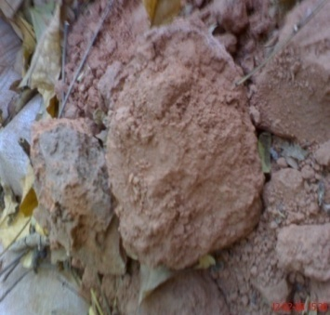
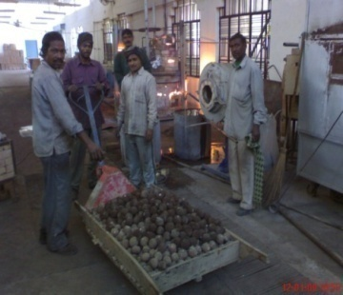
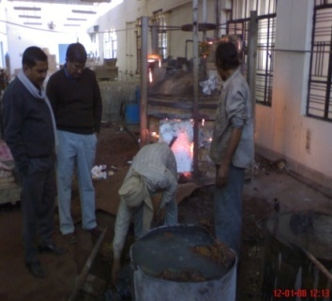
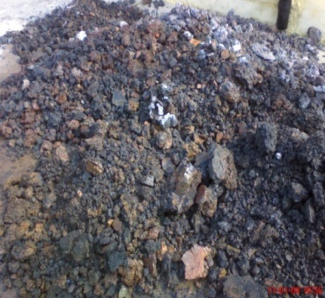
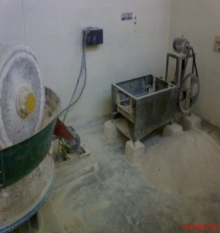
Up scaling of Developed Material for Commercial Viabilities Studies
Lab Scale development to Semi Pilot Plant Level: Processing of 3 Tons of Red mud
9 Tons Red Mud Collected
from HINDALCO, Renukoot to AMPRI, Bhopal
Ceramic Powders Synthesis using the facilities of
CDGI, Firozabad, India
Activities at CDGI under guidance of AMPRI, Bhopal India
1. Grinding of Red Mud Lumps to Red mud Powders
2. Formulation & making balls of Red Mud Powders
3. Heat Treatment of Red Mud balls at 13000C
4. Grinding of multiphase shielding material (range 100 to 200 mesh )
AMPRI’s Ceramic powder

Slide 26
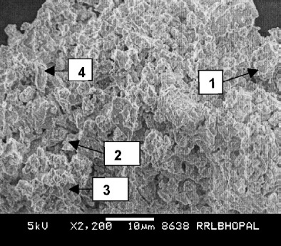
Surface Profile Compression
SEM of red mud (Scattered Morphology):
  Tetragonal - Anatase
  Tetragonal - Rutile
  Hematite Spherical
  Hexagonal Cancrinite
(5) Orthorhombic - Boehmite.
The scanning electron microphotographs exhibiting
microstructure of red mud.
SEM of red mud (Modified Porosity):
  Hexagonal – Barium Iron Titanium Oxide
  Cubic - Magnetite
  Orthorhombic -Befertisite
The microphotographs of advanced ceramic sample clearly show the modified and continues porosity with integrated morphological characteristics.

Slide 27
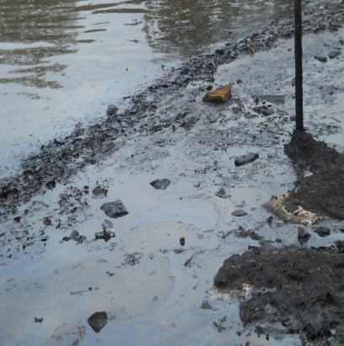
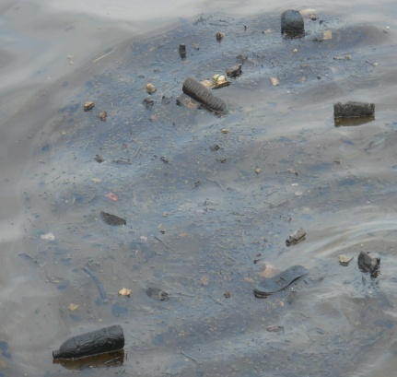
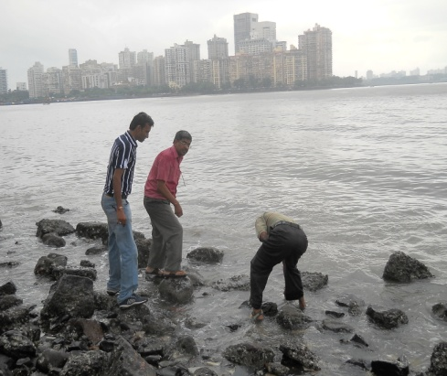
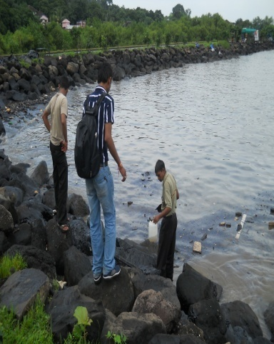
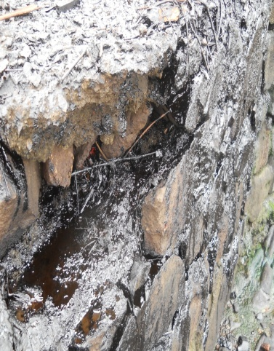
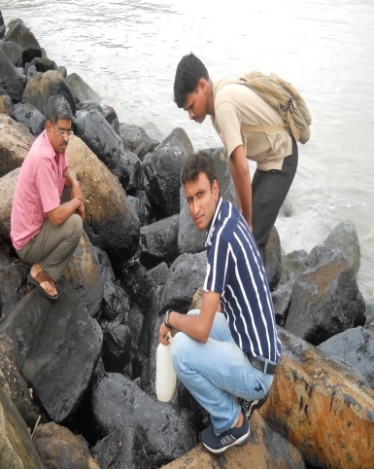
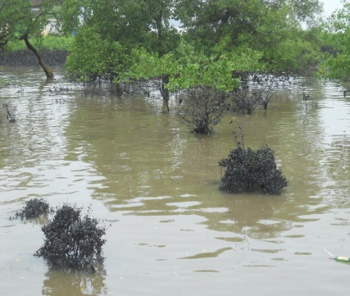
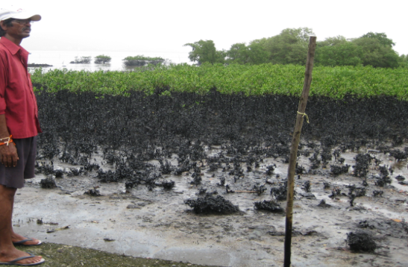
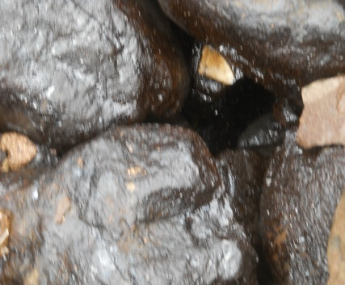
Affected areas near Mumbai sea shore:
Floating oil at Elephanta Cave sea shore
Oils Rocks at Sea Shore of Elephanta Cave sea shore and Marine Derive, Mumbai
Oil on Mangroves and Sand at PDP, Mumbai on

Slide 28
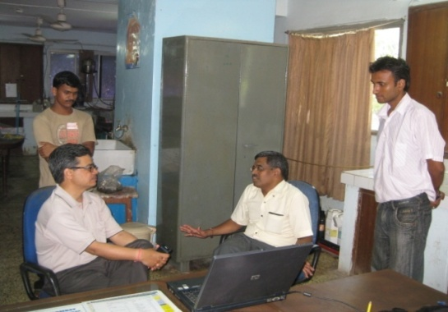
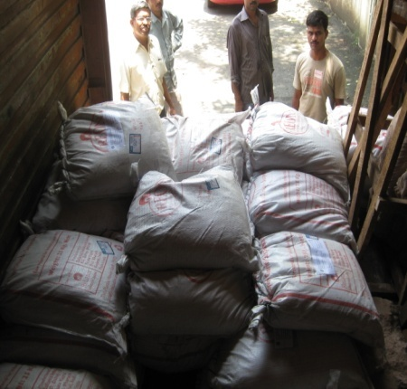
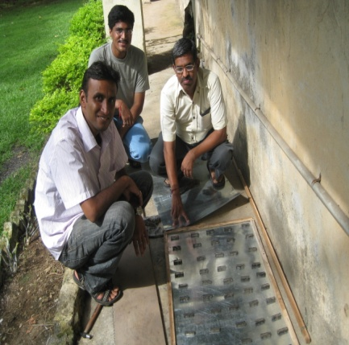
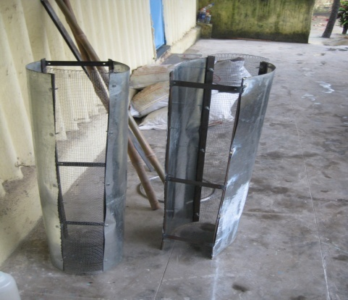
Targeting : Mumbai Oil Spill removal of floating oil and oils on sea shore rocks
Operation Performed on:
1. Floating oil on the sea water at Elephanta Cave sea shore.
2. Oil layer on Rocks at Elephanta Cave sea side rocks and Marine drive, Mumbai.
3. Sand samples at PDP, Mumbai
Dr. R. Kumar, NEERI, Mumbai Zone and
Dr. Amritphale regarding oil removal operation
Two Tons of AMPRI material send to NEERI Mumbai Zone.
Fabrication of demo apparatus for removal of floating oil manually .

Slide 29


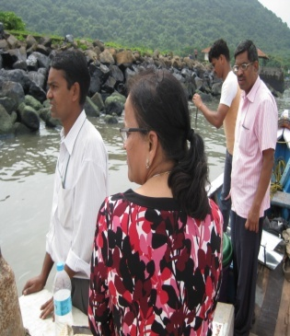
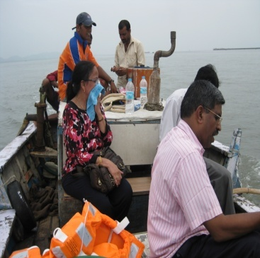
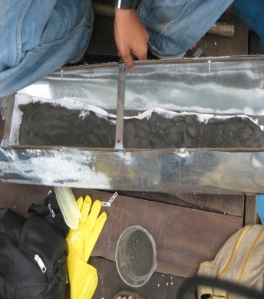
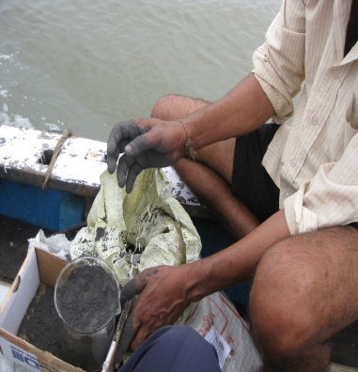
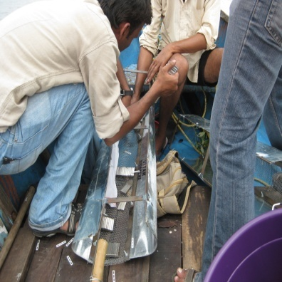
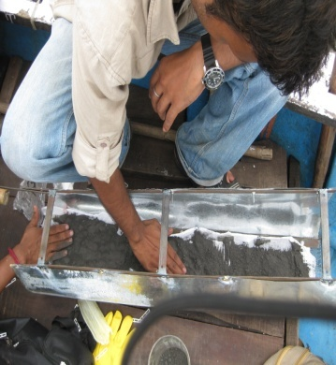
Targeting : Mumbai Oil Spill removal of floating oil and oils on sea shore rocks
During 26th Aug. to 28th Aug. 2010, Elephanta Cave sea shore and Marine drive, Mumbai
AMPRI and NEERI team at removal of oil at Mumbai sea shore
Removal of floating oil using AMPRI’ developed material

Slide 30
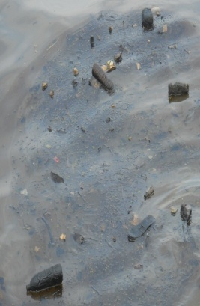

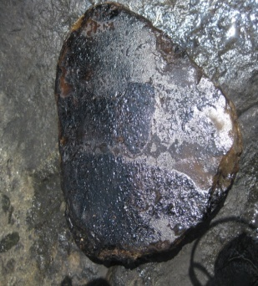
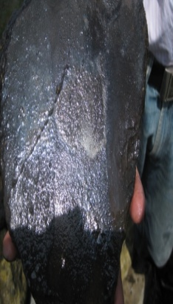



Analysis of Mumbai Spill removal of floating oil and oils on sea shore rocks
Initial and Final Site: Floating oil removal from Sea and Sea Rock
Analysis of samples at AMPRI

Slide 31



Due to severe Draw backs of Ordinary Portland cement Conventional Geopolymer Cement Concrete (CGC) emerged as possible solution

Slide 32

Conventional Geopolymeric Materials Used for Cementing Oil Wells
Geopolymer cement
Pumpable geopolymer formulation comprising:
an alumino silicate source,
a carrier fluid, activator,
boron containing compound, lignosulfate, sodium gluconate, sodium glucoheptonate, tartaric acid and phosphorus containing compound, or a mixture of them as retarder
Lithium or potassium compound as accelerator
cenospheres, sodium- calcium-borosilicate glass, and silica-alumina microspheres as Lightweight particle .
Manganese tetraoxide, iron oxide (hematite), barium sulfate (barite), silica and iron/titanium oxide (ilmenite) as heavy particle .
Water-immiscible oil-based phase.
Microwave Incinerated Rice Husk Ash (MIRHA) geopolymer

Slide 33
Portland cement
Geopolymeric cement
5CaCO₃+2SiO₂
3CaO.SiO₂+2CaO. SiO₂+5CO₂
Al₂O₃+SiO₂ in raw material
20-90ºC
+alkali silicate solution
1450ºC
Clinker Phases
-Si-O-Al-O-
non curing
Hydration ( curing with water
C-S-H + Ca(OH)₂
Alumino silicate 3D framework
Characteristics of OPC Compared with Conventional Geopolymer

Slide 34


Davidovits model of geopolymer structure
Barossa model of geopolymer structure
Amorphous (gel like), partially amorphous or crystalline
Network configurated of SiO₄ and AlO₄ tetrahedrons united together by oxygen bridges

Slide 35




Geopolymers (earthly originated inorganic polymeric materials)
New family of synthetic aluminosilicate materials Mimicking synthesis of natural volcanic Zeolitised rocks
Macromolecules linked by covalent bonds having – Si-O-M-O- backbone, Where M denotes principally aluminium and other Metals such as iron
Geopolymeric structure
showing Al-O-Si bonds
Three basic forms of geopolymer
Polymeric structures from polymerization of monomers

Slide 36

Formation of Geopolymer
Binding Material
Metakolin
Clay
Slag
Fly Ash
Alkaline Activator
NaOH/ KOH
Sodium Water Glass
Potassium Water Glass-
------
+ Water
Mixing
Binder
Setting
Geopolymer

Slide 37
Advantages of Geopolymeric Materials Used for Cementing Oil Wells
Economical in production
Sustainable in reducing waste products
Consumes less energy
doesn't undergo chemical attacks
durable
resistive in acidic environments
can be used in CO₂-rich environments.
High Strength
Excellent volume stability
Anti-corrosive
Can be used in marine environment
Possess higher strength compared to OPC.
Controllable thickening and/or the setting times of suspension.
Emits approximately 90% less CO₂ and requires 50% less energy in production due to its low process temperature compared to OPC.
The cost of geopolymer concrete manufacture is 10-30% less than that
of OPC concrete

Slide 38
Word of appreciation by father of geopolymers
Video clipping

Slide 39


Rice Husk
Fly Ash
INNOVATION BY CSIR-AMPRI, BHOPAL
Development of curing free , Multifunctional, Ecofriendly, NEW Novel Hybrid Advanced Ligno - Silco -Aluminous geopolymeric Cementitious Material (ALSAGC)

Slide 40


Mechanism of the Process
Raw material number 1. Fly Ash
Precursors
From
Fly Ash
Typical Chemical Analysis of Fly Ash
Raw material number 2. Rice Husk
Raw material number 3. Sodium hydroxide
-OH moieties of organic precursors
Novel Penta coordinated silicon complexes
Conventional Tetrahedral silicon complexes
In-situ Synthesis of sodium silicate
OCH₂
M⁺
CH₂O
CH₂O
OCH₂
Si
Si
CH₂O
OCH₂
CH₂O
OCH₂
OCH₂
-----n
CH₂O

Slide 41
Plausible Chemical Reactions
I. Sodium Hydroxide + Lignin in Rice husk
Sodium lignate (Binder)
II . Sodium Hydroxide+ Silica from Rice Husk and Silica and Alumina from Fly ash and Red Mud Sodium silicate precursor
(Necessary for making inorganic matrix)

Slide 42

Novel Patented* Concept of CSIR-AMPRI, Bhopal for Advanced
Ligno-Silico-Aluminous (LSA) Materials
(* India (2301 DEL 2012) and USA (13 / 949585) .
Conventional Geopolymeric Material
Advanced LSA Material
-OH moieties of organic precursors
CH₂O
OCH₂
M⁺
CH₂O
OCH₂
Versus
Si
Si
CH₂O
OCH₂
CH₂O
OCH₂
OCH₂
Conventional Tetrahedral silicon complexes
Novel Penta coordinated silicon complexes
-----n
CH₂O
Advanced LSA Material enables improved Engineering Properties
e.g. workability, compressive strength etc.
Know-How transferred to M/s JSPL, Raigarh and demonstration
completed successfully.

Slide 43

²⁹Si NMR Studies
Conventional geopolymeric material: ²⁹Si NMR of conventionally developed geopolymeric material indicated NMR Signals at δ-82 ppm due to tetracoordinated geometry and signals at δ -92, δ -96 and δ -109 ppm indicated pentacoordinated geometry around silicon atom.
Advanced hybrid organic- inorganic Geopolymeric material: ²⁹Si NMR at δ -90 ppm, δ -96 ppm and at δ -109 ppm indicated pentacoordinated geometry around silicon.
Absence of NMR signals at δ -82 ppm, indicates absence of tetracoordinated geometry around silicon atom.
Conclusion of ²⁹Si NMR Studies:
Thus complete transformation of tetracoordinated silicon to pentacoordinated silicon is confirmed in presence of alkali and organic molecules from rice husk in hybrid inorganic organic geopolymer.
The bond length increases up to 5 % in pentacoordination which imparts improved flexibility , reactivity and thus functionality in hybrid inorganic organic geopolymer.
Presence of organic as well as inorganic linkages in IR studies further confirmed the participation of molecules from Rice husk.
.

Slide 44


²⁷Al NMR Studies
²⁷Al NMR of Conventional geopolymer
²⁷Al NMR of hybrid inorganic organic geopolymer
Conclusion: The presence of ²⁷Al NMR signal at 55 ppm which is characteristic of geopolymer formation is found in both conventional geopolymer as well as in hybrid inorganic-organic geopolymer and thus confirmed the formation of geopolymeric material.

Slide 45
XRD Studies
XRD pattern of Conventional geopolymeric material
XRD pattern of Hybrid inorganic organic geopolymeric material
Conclusion: The XRD studies confirmed the simultaneous presence of inorganic phases namely Cancrisilite ,Herschelite, sodium aluminium silicate, quartz, mullite, hematite and organic phases namely native cellulose, α D-glucose and sucrose leading to the formation of Hybrid inorganic organic geopolymeric material.

Slide 46

FESEM Studies
The absence of organic molecules in conventional geopolymeric material restricts size of particles as low as 36.7 nm only
FESEM -conventional geopolymeric materials
The presence of organic molecules in hybrid inorganic-organic geopolymeric material helps in obtaining size of particles as low as 26.7 nm
Conclusion: The lesser nanosize obtained in hybrid inorganic organic materials helps in continuous growth of silicon- aluminium oxygen polymeric chains which increases amorphous nature and densifies the matrix leading to homogeneous, strong and flexible matrix with improved properties.
FESEM-Hybrid inorganic-organic geopolymeric material

Slide 47



EDX spectra of hybrid inorganic-organic
geopolymeric material
Element | Weight% | Atomic%
C K | 88.16 | 91.96
O K | 9.90 | 7.75
Al K | 0.22 | 0.10
Si K | 0.20 | 0.09
Au M | 1.52 | 0.10
Totals | 100.00
Example
Element | Weight% | Atomic%
C K | 88.16 | 91.96
O K | 9.90 | 7.75
Al K | 0.22 | 0.10
Si K | 0.20 | 0.09
Au M | 1.52 | 0.10
Totals | 100.00
Conclusion: The elemental analysis by EDX indicates presence of both carbon from organic molecules and Al and Si from fly ash, confirming the Hybrid nature of the geopolymeric material.

Slide 48


IR Studies
Transmittance %
Transmittance %
Wavenumber cm⁻¹
Wavenumber cm⁻¹
IR spectra of conventional geopolymeric material
IR spectra of hybrid inorganic-organic geopolymeric material
Conclusion: Thus additional peaks due to organic molecules are observed in IR spectra of Hybrid inorganic organic geopolymer in addition to inorganic phases observed in conventional geopolymerS. Thus confirming the participation of organic molecules from rice husk in presence of alkali during Geopolymerisation.

Slide 49
Superior Properties and comparison of Developed Advanced Ligno - Silco -Aluminous geopolymeric Materials.
1-Containing Hybrid Organic-Inorganic Matrix
2-Better Workability
3-Less Brittle Nature
4UniformHomogeneos Matrix
5-Better Compressive strength
6-Enhanced Oil Recovery due
to Lignin in Rice Husk
Engineering Properties As per IS : 516-1999
Properties | Advanced Geopolymeric Materials | Conventional Geopolymeric Materials
Compressive Strength | 20- 30 MPa | 16-25 Mpa
Flexural Strength | 2 - 4 MPa | 1-2 Mpa
Density | 2300 - 2500 Kg/m³ | 1850-2100 Kg/m³

Slide 50

Applications
Advanced Ligno-Silico-Aluminous Materials
Low Tech
Medium Tech
High Tech
Strategic
Green concrete
Irrigation channels
Fire Proof Blocks
Heat insulating
panels
Cement Free
advanced
reinforced
green
concrete
Paver Blocks
Alkali Activated
Inorganic Path
(Roads)
Aerospace
Automotive
Industries
Biomedical
applications
OIL WELL INDUSTRY
DESIGN MIX of
shielding concrete
shielding materials
based on nano
materials
On-site and In-situ
chemical
encapsulation of
Radioactive wastes

Slide 51

Normality NaOH
LIGNO-SILICO ALUMINOUS ALKALINE LIQUID AS DRILLING FLUID
The LSA can be used as oil well drilling fluid.
By taking constant quantity of rice husk and heating it with different known Normality of NaOH solution , the viscosity of filtrate has been measured at constant temperature and similar concentration of the filtrate .
Time in seconds
The graph obtained proved that with the increase in the concentration of NaOH , the time taken for complete flow of filtrate also increases i.e viscosity increases.
The developed material can be used as good drilling mud as it should have high viscosity to carry cuttings to the surface and suspends weighting agents in the mud

Slide 52
2- UTILIZATION OF SEA SAND AND SEA WATER FOR MAKING LIGNO- SILICO- ALUMINOUS MATERIAL FOR APPLICATION IN OIL WELL CEMENTING

Slide 53





Novelty of the Work:
Sea sand and sea water cannot be used in making Conventional Cement Concrete
Ligno- Silico- Aluminous Material can be made using sea sand and
sea water.
2. Precious saving of river sand and fresh water.
3. Environment friendly, addresses global warming.
4. Water curing free.
5. Can be used for oil well cementing
Engineering Properties:
Methodology Adopted:
Compressive Strength (MPa)
7-DAYS 28-DAYS
Puri Sea Sand/Sea Water
21.7 – 24.2 28.5 – 30.6
Mumbai Sea Sand
15.5-18.0 19.2 – 24.4
Collection of Sea Sand & Sea Water at Puri Beach
Evaluation of other properties as per IS in progress
Sample Preparation using Sea Sand and Sea Water

Slide 54
Rice Husk
3-UTILIZATION OF LSA FOR MAKING : PANELS MANMADE ON SITE
Fly Ash

Slide 55











Studies carried Out on
Advanced Ligno-Silico-Aluminous Materials
at CSIR-AMPRI
Panels: Manmade on Site
Cube
(15 cms x 15cms
x 15 cms)
On-site Manual Preparation of Panels
Panel
1 x 1 feet
Irrigation
Channel
Prefabricated Partition Panels- By Mechanization
I I
-(-Si -O- Si - O-)n
I I
O O
I I
-(-Si -O- Al - O-)n
I I
Mechanical Mixing Mechanical Pressing
Panel 2 x 2 feet

Slide 56




Properties of Advanced, Ligno- Silico- Aluminous (LSA) Cementitious Heat Insulating Panels/ Blocks
Mouldable
Machineable
Block For Acoustic Property
Block, 1 x 1 feet
Block, 10 x 10 cms
Panel , 2 x 2 feet
Properties-Obtained
Properties- Targeted
Property | Value
Density (Kg/m³) | 1200-2500
Compressive Strength (MPa) | 20-35
Flexural Strength (MPa) | 3-4
Water Absorption (%) | 5-8
Machinability | Possible
Mouldability | Possible
Property | Value
Density ((Kg/m³) (IS 2185-1978 Part I and II) | 900-2900
Compressive Strength (MPa) (IS 2185 1978 Part II) | 30-40
Flexural Strength (MPa) ( IS 516 -1959) | 5-7
Water Absorption (%) (IS 2185-1978 Part I and II) | <40
Thermal Conductivity (W/m deg K) (50 mm to 75 mm) (BS4370-Part 2) | 0.21-0.22
Fire Reistance (100 mm) (IS 3809-1995) | 4h
* Patent being filed

Slide 57

4-Development of Advanced Cement Free Green Concrete

Slide 58

Mechanism of the Process
Precursors From Fly Ash
Chemical Analysis of Fly Ash
Binder
Alkaline Activators: NaOH
Advanced Green Concrete

Slide 59




Mixing of raw materials
Pouring of slurry of raw materials in of sample cubes
Raw material filled
in sample cubes
Prepared sample cubes

Slide 60





Reinforced Green Concrete Beam of Dimensions 6’’X6’’X12’
Green Concrete Base Slab Dimensions 3.0’X3.0’
Developed at CSIR-AMPRI
Green Concrete Cubes
Green Concrete Cubes Compressive Strength Testing

Slide 61
6.5 FEET
6.5 FEET
6.5 FEET
8 FEET
2.5 FEET
6.5 FEET
4.5 FEET
4.5 FEET
3 Dimensional View of Structure being Constructed at CSIR-AMPRI

Slide 62






Demonstration of Cast in-Situ Cement Free Reinforced Green Concrete Structure at CSIR-AMPRI Premises
Various Stages of Construction Activities
Slab Construction
Side Views of Structure

Slide 63





Wonder Material for the Next decade
Cement Free Concrete
1. Development of Cement Free Concrete and its Demonstration in
Reinforced Green Concrete Structure at CSIR-AMPRI
Raw Materials
I I
-(-Si -O- Si - O-)n
I I
O O
I I
-(-Si -O- Al - O-)n
I I
Fly Ash
Coarse and Fine Aggregates
Standard Cube
(15 x 15 x 15 cms)
Cement Free Concrete Mix
Engineering Properties
As per IS : 516-1999
Compressive Strength | 15-30 MPa
Flexural Strength | 2-3 MPa
Density | 2200-2400 Kg/m³
The developed binder (90% fly ash) replaces the conventional cement
Cement Free Concrete Structure Demonstrated at CSIR-AMPRI
(Dimensions 4.5 Feet X 4.5 Feet X 8.0 Feet)

Slide 64



From Era of Instant Foods to Instant Green Building Materials using Heat Treatment
Heating in conventional hot air system at 60⁰C for 24 hours
28 minutes in microwave at 200
watt power
28 days at ambient temperature
Sample cubes
7.06 cm x 7.06 cm x 7.06 cm
Achieving Compressive Strength of 33 Mpa)
(IS :4031-1999)

Slide 65

Photograph of Know-How Transfer to M/s JSPL Raigarh on 11th May 2013 for Making Cement Free Green Concrete

Slide 66



5- Demonstration of Cement free Concrete Road
Demonstration of Cement free Concrete Road at CSIR-AMPRI Campus on 19-20 June 2014.
Length: 34 meter | Density :2400 Kg/m³
Width: 3.75 meter | Compressive Strength: 35 MPa
Thickness: 150 mm | Flexural Strength: 4 Mpa

Slide 67
PATENT
TITLE | COUNTRY | NUMBER
“A novel process for making Advanced hybrid Geopolymeric functional materials” | India and USA | (India (2301 DEL 2012) and USA (13 / 949585) .
S.S. Amritphale, Deepti Mishra, R.K. Chouhan, Manish Mudgal, Mohd. Akram Khan, Swati Lahiri, Navin Chandra, B.K. Mishra

Slide 68
KNOW HOW-TRANSFER
TITLE | DATE OF TRANSFER | ORGANIZATION/ INDUSTRY | TOTAL FEES REALIZED
Know How- for Making Fly Ash Based Cementitious Materials Useful for Making Cement Free Concrete of Varying Grades, depending on the characteristics of fly ashes and aggregates for non- structural applications | 11th May 2013 | JSPL, Raigarh | Rs. 15 Lakhs
S.S. Amritphale, Deepti Mishra, R.K. Chouhan, Manish Mudgal, Mohd. Akram Khan, Swati Lahiri, Navin Chandra, B.K. Mishra

Slide 69
Filing a patent entitled ‘A novel process for making “ tailored precursor materials” in a solid powder form, useful for further broadening the application spectrum of the conventional Geopolymeric system.
Sudhir Sitaram Amritphale, Manish Mudgal, Ramesh Kumar Chouhan, Deepti Mishra, Navin Chandra, Filed in PCT in December 2013 (156 DEL 2014).

Slide 70
CSIR-AMPRI,India :Welcomes Collaborative Researcher and Entrepreneur
1-Cordial invitation for collaborative Research work to scaling and development of new material with Team of CSIR- AMPRI, Bhopal, M.P. India.
2- Entrepreneurs for developed Know-How.
3- Let us utilize Complementary and Synergistic Expertise
for "Exponential Growth" of Petro chemistry &
Chemical Engineering.

Slide 71



Dr. S.S Amritphale,
Dr. Sarika Verma
Dr. Avneesh Anshul

Slide 72

THANKS

