Slide 1

Multi-criteria Decision-making for Purchasing Cell Phone using Machine Learning Approach
Presented by
Prof.Sachi Nandan Mohanty
IEEE,FIE,FIET
School of Computer Engineering,
KIIT University, India, Odisha, Bhubaneswar-751024

Slide 2
Outline
Introduction
Related works
Research Gap
Methodology
Results & Discussion
Conclusion
Future Research Work
References

Slide 3
Introduction
Decision making (DM) is the process of choosing suitable one among the alternatives.
In India as well as across the globe, the present scenario has become more complicated due to tough competition among mobile phone manufacturing companies.
The majority of the mobile manufacturing companies focus on maximising their profits and to achieve this goal, they add new features when launch different versions.
Selection of appropriate mobile for the common people is a multi-criteria decision making problem.

Slide 4
Literature Survey
SL NO. | AUTHOR | PAPERS | METHODOLOGY
1. | G. Zayaraz,S. Vijayalakshi, V. Vijayalakshmi, Febuary 2012 | Multi criteria Decision Analysis for the Evaluation of Software Architectures | MCDA method
2. | Zeshui Xu, December 2007 | Multiple-Attribute Group Decision Making with Different Formats of Preference Information on Attributes | Weighted Attribute Information
3. | F.Losavio, L.Chirinos, N. Levy, A.Ramdane, March 2003 | Quality Characteristics of Software Architecture | ATAM analysis technique
4. | M. Stahlberg, C. Wohlin, L.Lundberg, M. Mattsson’ July 2002 | A Method for understanding Quality Attributes in Software Architecture Structure | Rational Unified Process, QASAR design method
5. | G. Zayaraz,S. Vijayalakshi, V. Vijayalakshmi, July 2009 | Evaluation of Software Architectures using Multi criteria Fuzzy Decision Making Technique | Fuzzy Inference System

Slide 5
Methodology
Sample profile
Characteristic | Descriptive Statistics | Male | Female | χ² | F
Gender Birth Place Urban Semi-urban Rural | N (%) N (%) | 110 (77.50) 68(54.20) 30(27.70) 12(18.10) | 90 (22.50) 47(42.2) 32(47.80) 11(10.00) | 121.00*** 13.42***
Age Years studied | M (SD) | 20.81(4.50) 14.99(3.06) | 23.61(3.97) 17.73(3.52) |  | 28.34*** 52.11***
Family size |  | 4.67(1.85) | 4.69(1.34) |  | 0.01
Income (in INR) |  | 466399(771448) | 530888(988621) |  | 0.42

Slide 6
Input Parameters
Measuring variable | Methods for data Collection
Cost | Questionnaire Survey
Battery Backup
Size (screen )
Weight
Rear Camera
Internal Memory
Operating System

Slide 7
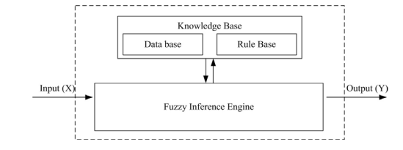
Fuzzy Rule Base System
Fig. 1. Schematic diagram of FRBS

Slide 8
A knowledge base (KB) and inference engine (IE) are two main components of FRBS.
The KB generally represents the problem to be solved in the form of fuzzy linguistic IF-THEN rules.
The IE is needed to obtain an output from the FRBS, when an input is specified.
1. Fuzzy linguistic variable and membership functions
Fuzzy linguistic approach provides a systematic way to represent linguistic variables in a natural evaluation procedure .

Slide 9
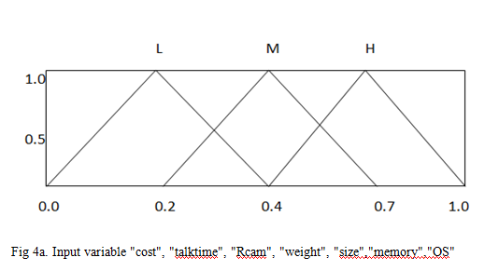
2 . Description of fuzzy input variables
The input fuzzy variables were V1 = {cost}, V2 = {Talk Time} and V3 = {Rear Camera }, V4 = {Size}, V5 = {Weight} ,V6 = {Memory}, V7 = {Operating System} and each of them was represented using three linguistic terms, such as low (L), medium (M), high (H)

Slide 10
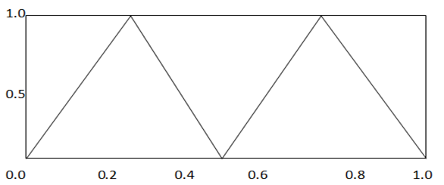
3. Description fuzzy output variable
Two linguistic terms, namely local and global were used to represent the output variable: V8 = {output}
Non Select
Select

Slide 11
Determining fuzzy rule base from input and output variables
Rules are the cores of the FRBS, which represent the relationship
between its inputs and output.
In the present problem, seven input variables were considered and each of them was represented using three linguistic terms.
In this study we have generated 344 fuzzy rules.
For instance, the first and last rules were as follows:
If V1 is L AND V2 is L AND V3 is L And V4 is L AND V5 is L AND V6 is M AND V7 is M THEN output is Not-Select .
If V1 is H AND V2 is L AND V3 is M AND V4 is H AND V5 is H AND V6 is M AND V7 is H THEN output is Select.

Slide 12
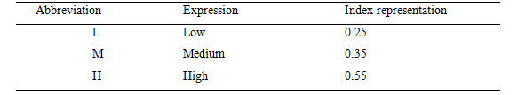
5. Fuzzy rule encoding
Seven input variables and each having three linguistic terms constitute 344 rules. Linguistic terms are represented with their index values, as given in Table

Slide 13
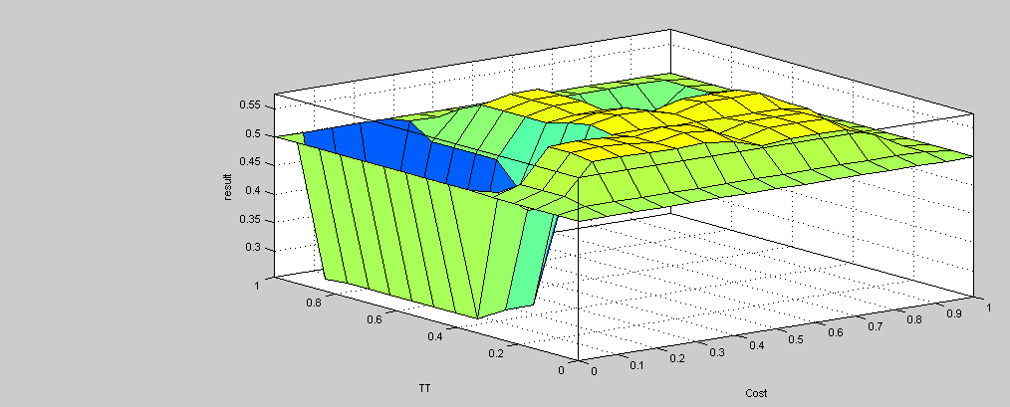
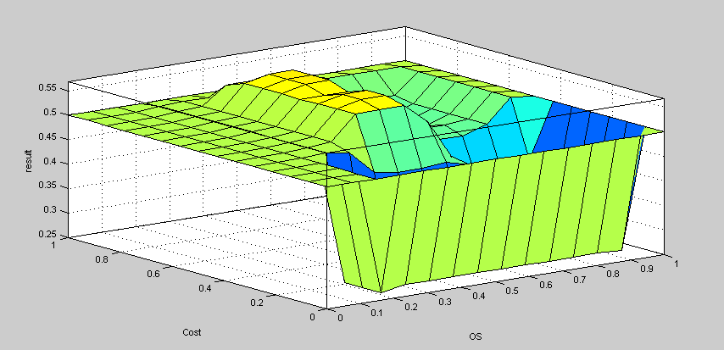
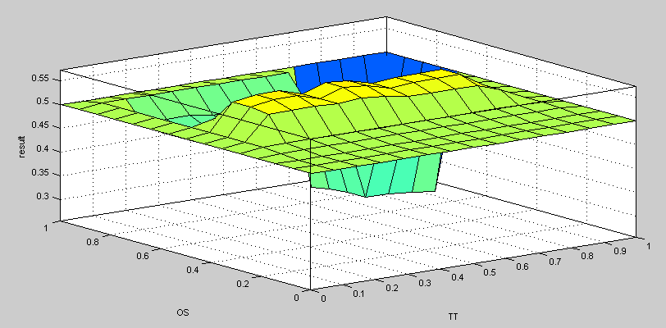
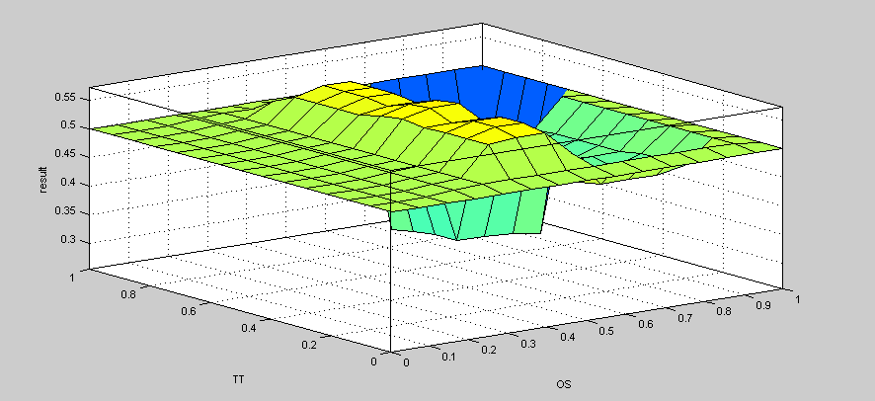
Results of FIS
Cost vs TT
OS vs Cost
TT vs OS
OS vs TT

Slide 14
Design and development of adaptive neuro-fuzzy system based on Mamdani approach
A neuro-fuzzy system works based on a fuzzy system, which is trained by a learning algorithm derived from neural network theory. In this study, a neuro-fuzzy system based on Mamdani approach was adopted, which is described below.
It consists of five layers:
Input layer
Fuzzification layer
AND implementing layer
Fuzzy inference layer
Defuzzification layer

Slide 15
A schematic view of the neuro-fuzzy system based on Mamdani approach

Slide 16
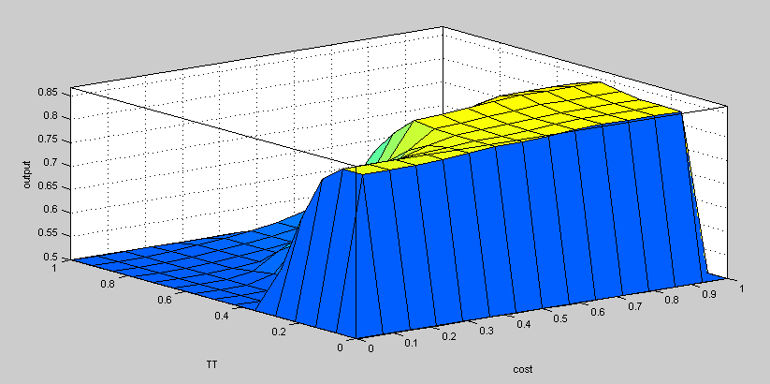
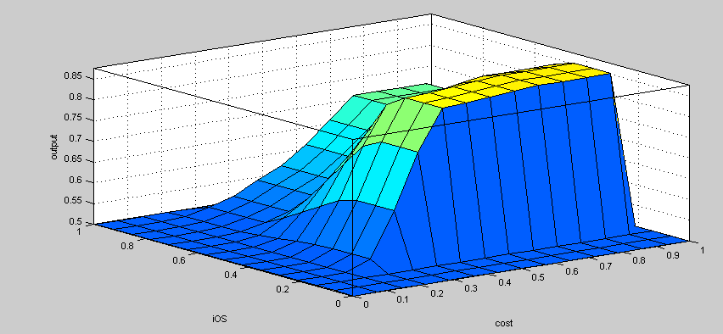
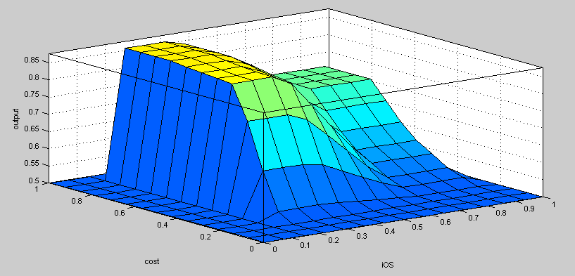
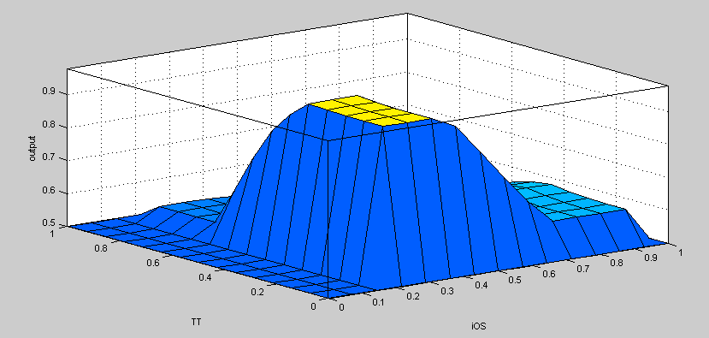
Results of neuro-fuzzy approach
Cost vs TT
Cost vs OS
OS vs Cost
OS vs TT

Slide 17
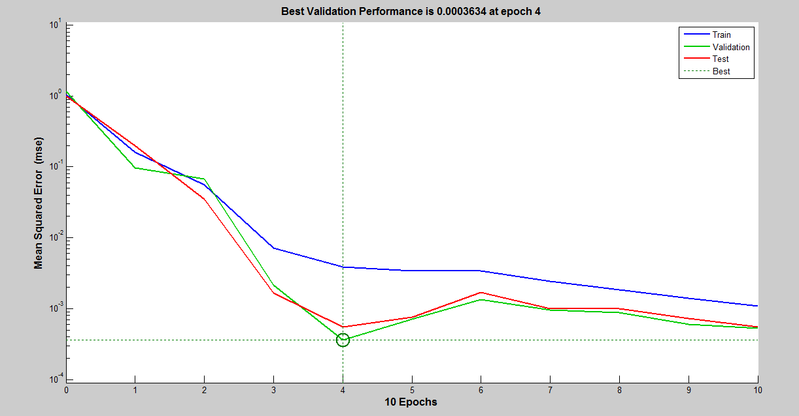
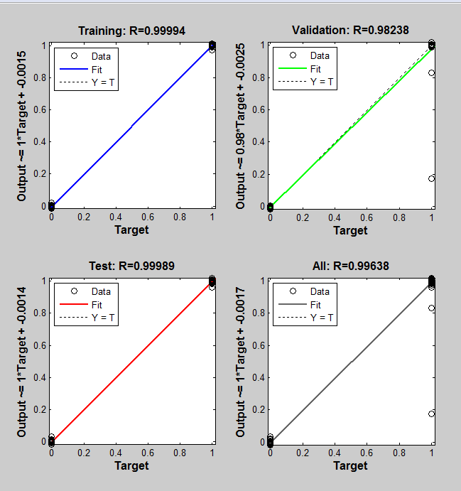
Results of ANN
Performance graph using ANN tool Regression graph using ANN tool

Slide 18
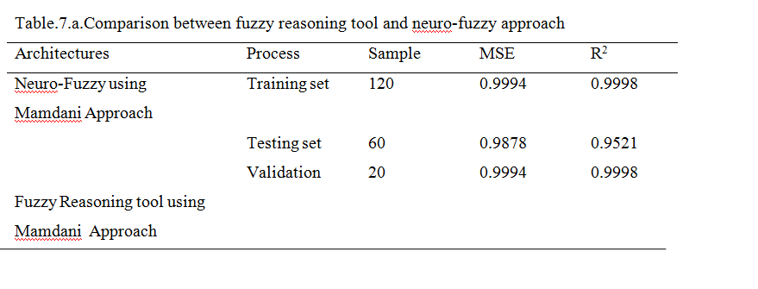

Slide 19
Conclusion
In this study, we have analysed the purchase of cell-phone on information processing during DM using fuzzy reasoning tool and neuro-fuzzy system developed based on Mamdani approach.
Focused upon a new view on fuzziness in information processing, both traditional fuzzy reasoning tool and neuro-fuzzy system developed based on Mamdani Approach were used in order to determine input-output relationships of this process.
We conclude that neuro-fuzzy approach showed better performance in predictions compared to that of the traditional fuzzy reasoning tool.

Slide 20
Future Research Work
Only seven input variables were consider as independent variables
Restricted age group considered in this study
Computational Complexity of the method may be reinvestigated in future study

Slide 21
Appendix
Input parameters | Output
COST | BB | RCAM | WT | SIZE | MEM | OS
L | L | L | L | L | M | M | NSELECT
L | L | L | L | L | M | H | SELECT
L | M | L | L | L | M | M | SELECT
L | M | L | L | L | M | H | SELECT
L | H | L | L | L | M | M | SELECT
L | H | L | L | L | M | H | SELECT
L | L | M | L | L | M | M | NSELECT
L | L | M | L | L | M | H | SELECT
L | L | H | L | L | M | M | NSELECT
L | L | H | L | L | M | H | SELECT

Slide 22
References
[1] Bayraktar, E., Tatoylu, E., Turkyilmaz,A., Delen, D., Zaim, S. 2012. Measuring the efficient of customer satisfaction and loyalty for mobile phone brand with DEA; Expert Systems with Applications.39: 99-106.
[2] Bevilacqua, M., Ciarapica, F.E., Giacchetta, G. A.2006. Fuzzy QFD approach to supplier selection journal of purchasing and supply management; Journal of purchasing and supply management. Vol.12: 14-27.
[3] Bhattacharya, A., Sarkar, B., 2007.Integrating AHP with QFD for robot selection under requirement perspective; International journal of production reaserch.vol. 43: No.17: 3671-3685.
[4] Chun, J., Sung, H.H., Hyunsuk, I., Park,Yongs S., 2011. A method for searching photos on mobile phone by using the fisheye view technique; International Journal of Industrial Ergonomics. 41: 280-288.
[5] Rajesh.G., Malliya, P., 2013.Supplier selection based on AHP QFD methodology; Procedia Engineering. Vol-64:1283-1292.

Slide 23
THANK YOU

