Slide 1
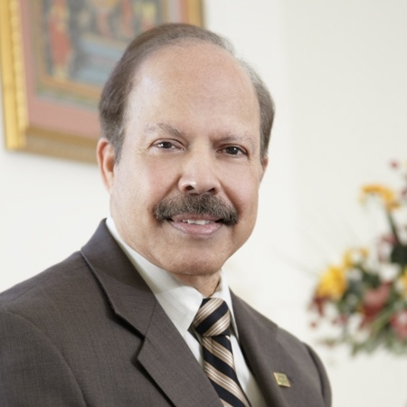
Dr. S. K. Dash
President & Director of Innovations
DD Innovations, Inc. (USA)
Chairman & Founder
UAS Laboratories, Inc (USA)
Any statements and/or claims made in this presentation have not been reviewed or approved by FDA.

Slide 2
About Dr. Dash
Ph.D. (Nutrition & Biochemistry), 1973
  South Dakota State University, Brookings
MS (Nutrition), 1970
  South Dakota State University, Brookings

Slide 3
About Dr. Dash
Former Director of Food and Drugs South Dakota State (USA)
Chairman National Probiotic Committee (USA)

Slide 4


About Dr. Dash
Served as Scientific Advisor & Vice-President of International Probiotics Association
Adjunct Professor at
  Minnesota State University
  South Dakota State University

Slide 5
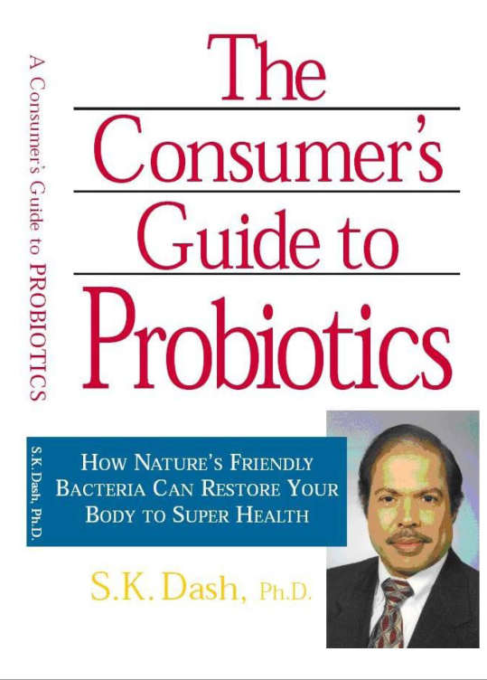
About Dr. Dash
Author of more than 40 Scientific Articles
Author of 4 books
Recipient of various National and International Awards

Slide 6
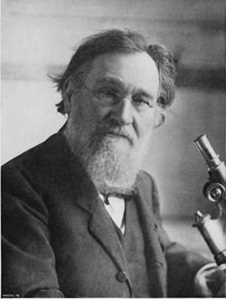
History Of Probiotics
Probiotics are not new. Probiotics have been used for a long time
The probiotic concept was postulated in early 20th century by Russian Scientist Eli Metchnikoff (Nobel Prize, 1908)

Slide 7
Probiotics as a Drug
While working as the Director of Food and Drug at South Dakota during 1973 to 1979, Dr. Dash found a probiotic product was licensed by the US Government (USDA) as a drug to treat E. coli infection (scour) in pigs.

Slide 8
Probiotics effective against infections
Further research by Dr. S. K. Dash revealed that probiotics were 97% effective against E. coli infection in pigs, a cure rate as effective as the antibiotic, Neomycin Sulfate.

Slide 9
Probiotic Industry lacked funds
Antibiotic industry had resources for research and marketing and prevailed.
Probiotic industry lacked funds to compete with antibiotics and lost the battle.

Slide 10
Probiotics regain its importance
Later Dr. S. K. Dash found that people were concerned about drug residues in meat, milk & eggs and antibiotic resistance and other side effects of the drugs.
Unlike antibiotics, probiotics had no harmful effects.

Slide 11
Probiotics regain its importance
People were looking for nutrition not prescription
He also realized that there were no high quality probiotics commercially available at that time

Slide 12
Continued…
Dr. Dash rediscovered and reintroduced probiotics in the USA in 1979.
He left the Food & Drug Director position in 1979 to establish UAS Laboratories in Minneapolis, Minnesota (USA)

Slide 13
Continue…
UAS Laboratories has been at the forefront of Probiotic Industry since 1979.
Dr. Dash commercially manufactured and introduced a strain of Lactobacillus acidophilus DDS®-1 which is backed by 40 years of University Research, US patent and trademark.

Slide 14
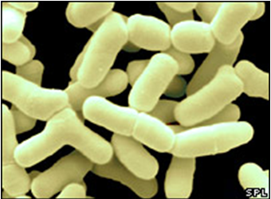
Definition of Probiotics
Probiotics are “Live microorganisms which when administered in adequate amounts confer a health benefit on the host” FAO/WHO

Slide 15
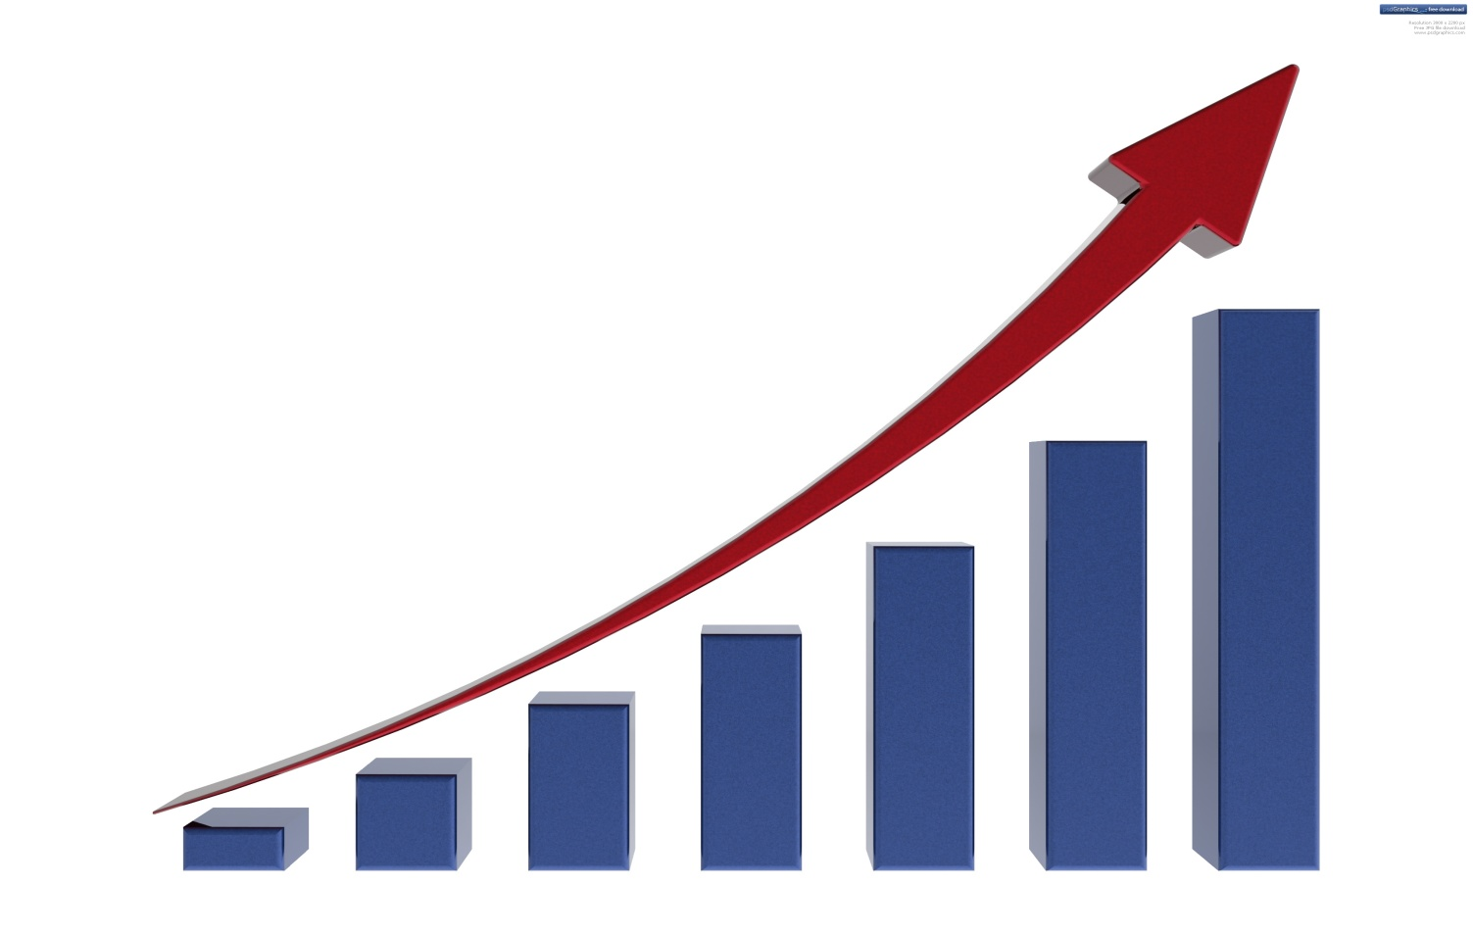
Probiotics are now top Selling Supplements in the world
Probiotics

Slide 16
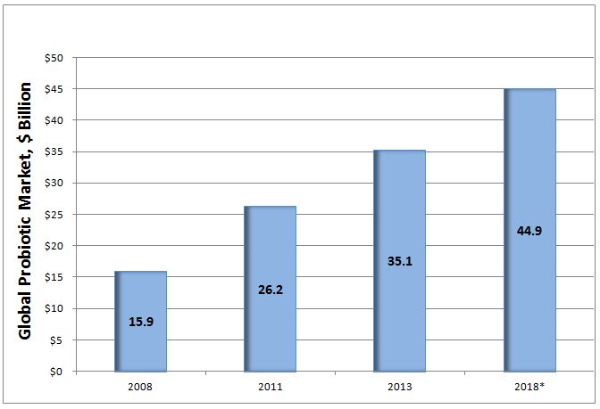
Global Probiotic Market
* Expected forecast
Source: Transparency Market Research titled “Probiotics Market (Dietary Supplements, Animal Feed, Foods & Beverages) - Global Industry Analysis, Market Size, Share, Trends, Analysis, Growth and Forecast, 2012 – 2018.

Slide 17
Probiotics and Major Market Segments
There are major three market segments of probiotics:
Ingredients
Food
Supplements

Slide 18
Probiotics and Major Market Segments
Food
  Yogurt products accounted for the largest share of sales, representing 36.6 %
Probiotic Supplement
  US supplements’ segment is the largest segment in the world
  Probiotics are sold as dietary supplements. Now we have two additional categories: Medical Foods and Drugs
Probiotic Ingredients
  Lactobacillus genus account for the largest share representing 61.9%

Slide 19
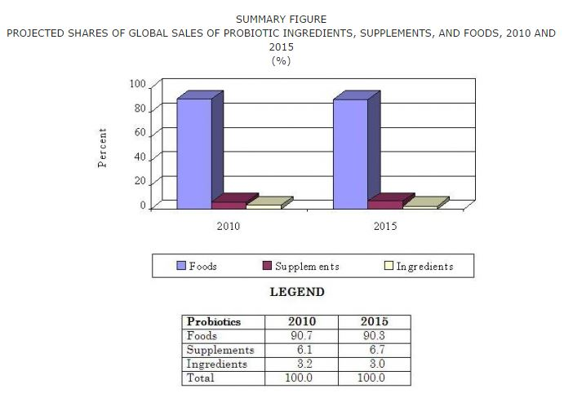
Global Probiotic Market by Segment
Source: BCC Research: The Probiotics Market: Ingredients, Supplements, Foods, June 2012
* Expected forecast

Slide 20
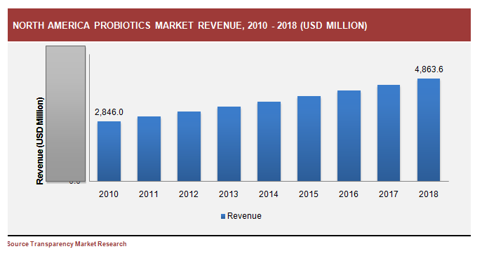
North American Probiotic Market

Slide 21

Why Probiotic Market is growing?
Major drivers for market growth
Increasing consumer awareness
Rising healthcare costs
Specific health benefits
Consumer interest towards preventive healthcare
Increasing population of baby boomers

Slide 22
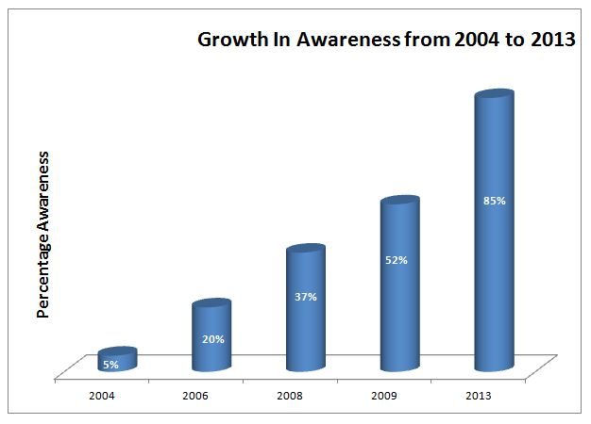
Increased Awareness of Probiotics
Less than 10% Consumers knew Probiotics 10 years ago
Now more than 85% Consumers know and most use probiotics
Source: Food product design.com

Slide 23

The name Probiotics doesn’t mean anything unless it is
Strain Specific
Dose Specific
Condition Specific
GRAS*
* Generally Recognized As Safe

Slide 24
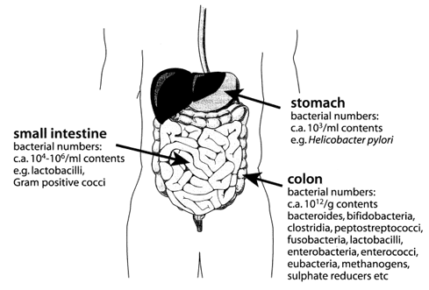
Human GI Tract showing approximate bacterial numbers

Slide 25
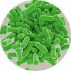
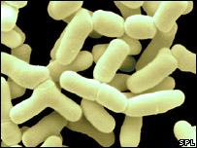
Types of Probiotic Strains
Lactobacillus acidophilus
Lactobacillus bulgaricus
Lactobacillus casei
Lactobacillus paracasei
Lactobacillus plantarum
Lactobacillus lactis
Bifidobacterium longum
Bifidobacterium infantis
Bifidobacterium bifidum
Streptococcus thermophilus
Saccharomyces boulardii
and others
Lactobacilli
Bifidobacteria

Slide 26
Lactobacillus acidophilus
Safe (GRAS) and effective
Boosts immune function
Aids digestion
Produce natural antibiotics to inhibit pathogens
Colonizes in the small intestine

Slide 27
Bifidobacterium bifidum
Bifidobacterium lactis
Bifidobacterium longum
Colonize in the large intestine
Modulates immune system
Safe (GRAS)

Slide 28
Fructooligosaccharides (FOS)
Indigestible carbohydrate which feeds beneficial bacteria
Promotes, stabilizes and enhances the proliferation of beneficial bacteria
Called “Synbiotics” when mixed with probiotics

Slide 29
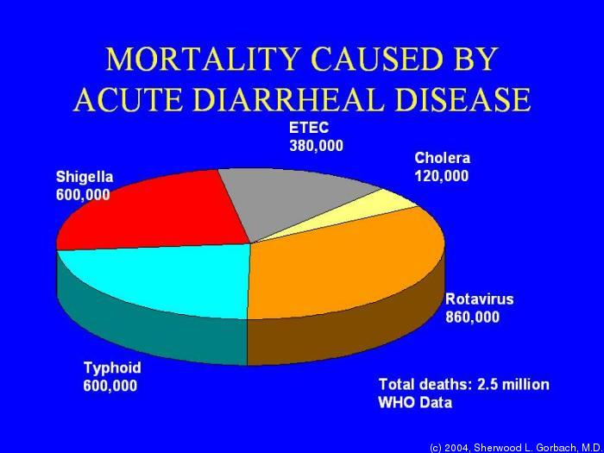
Medical Conditions Helped by Probiotics – Diarrhea
#1 cause of sickness and death worldwide
Diarrheal disease - #3 cause of sickness and death in US
Dysbiosis costs $107 billion/yr in direct health care costs
200 million sick days, 50 million ambulatory visits
16.9 lost school days, 10 million hospitalizations

Slide 30
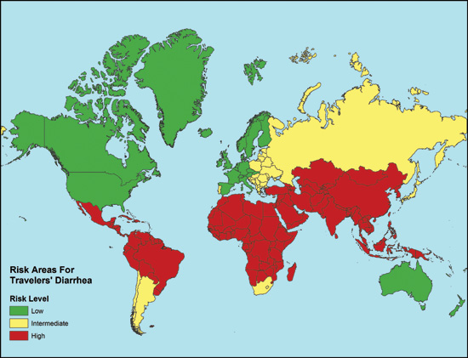
Medical Conditions Helped by Probiotics – Diarrhea (cont.)
Nearly 200,000 deaths per year, Diarrhea costs $4.7 billion per year
Traveler’s Diarrhea affects 30%-50% of 30 million U.S. travelers
80% of cases due to infectious agents
Source: USAF Public Health Info and Research

Slide 31
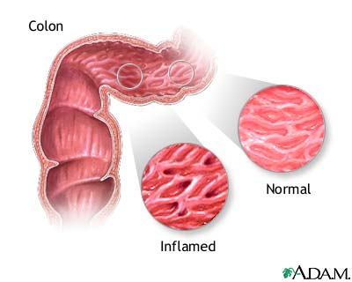
Inflammatory Bowel Diseases
1.4 million people in U.S. and 2.2 million in Europe
Crohn’s Disease $1.3 billion in annual healthcare costs
Ulcerative colitis: $868 million in annual healthcare costs
Source: NIH - NIDDK

Slide 32
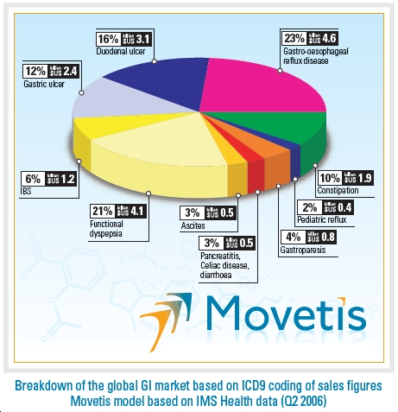
Digestive Disease
22 Million acute digestive conditions/year
Chronic Constipation – 6.3 million visits in 2004
Peptic Ulcer – $3.1 billion
Colorectal cancer - $9.5 billion
Source: NIH - NIDDK
Global Incidence of GI market IMS Health Data 2006
*old data

Slide 33
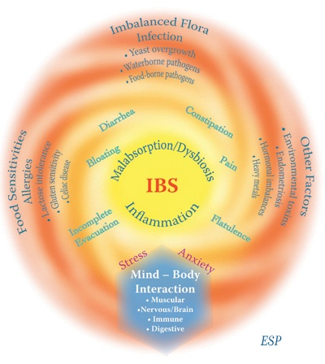
IBS
3 million hospital visits per year
$1 billion in total costs
Possible actions of probiotics
  Adherence prevents pathogens
  Enhanced barrier function
  Secretion of bacteriocins
  Acidification of colon
  Immune modulation
  Altered mucosal response to stress
  Inhibition of hypersensitivity
  Statistics source: NIH NIDDK

Slide 34
Probiotics for Other Digestive
Tract Conditions
Gingivitis and Thrush
Halitosis (Bad Breath)
Tooth Decay
Canker Sores
Colic
Food Allergies
Pancreatitis (acute)
Malabsorption

Slide 35
Probiotics for Non-digestive conditions
Candida Yeast Infections
Autism
Chronic Fatigue Syndrome
Urinary Tract Infections
Elevated Cholesterol and Blood Lipids
Allergies
Damage from Smoking
Cancer Prevention
Toxic Shock Syndrome
HIV Support
Eczema
Acne
Infections and Immune Function

Slide 36
Probiotics and Cancer
Lung, breast and prostate cancers are the most common
The next most likely is colon cancer (95,000/yr and rising) and rectal cancer (35,000/yr and rising)
Functional foods are an exciting hope for prevention and cure
Faecal bacterial enzyme activity is linked to cancer incidence
L. acidophilus and Bifidobacterium have shown positive anti-cancer effects.

Slide 37
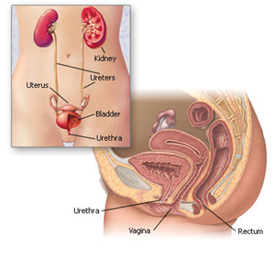
Probiotics and UTIs
Over 300 million cases
Most common cause – fecal bacteria
Most common treatment – antibiotics
Natural biofilms
  Antibiotics and spermicides alter microflora
  Lactobacilli inhibit many fecal organisms
  Production of hydrogen peroxide

Slide 38
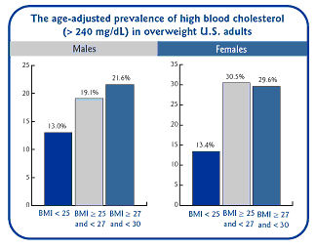
Probiotics and Cholesterol
British Journal of Nutrition finds L. acidophilus reduces cholesterol absorption
Annals of Nutrition and Metabolism found that L. acidophilus and B. lactis had cholesterol lowering effects in hypercholesterolemic subjects.

Slide 39
Role of L. acidophilus DDS-1 in various Health Conditions
Antibacterial Action
L. acidophilus DDS®-1 produced an antibacterial compound ‘acidophilin’ that demonstrates activity against
• Bacillus subtilis •Clostridium botulinum
• Clostridium perfringens • E. coli
• Proteus mirabilis • Salmonella enteritidis
•Salmonella typhimurium • Staphylococcus aureus
• Staphylococcus faecalis • and others

Slide 40
Antibacterial Studies
L. acidophilus DDS®-1 inhibits growth and adhesion of pathogens at vaginal and urethral mucosa.
Shows positive effects in the prevention of urinary tract infection.
Ref:
Tramer J. Inhibitory effect of L.acidophilus. Nature 1966;211:204-5.
Gerasimov SV. Probiotic prophylaxis in pediatric recurrent urinary tract infection. Clin Pediatr 2004;43:95-8

Slide 41
Effect on Candida albicans
L. acidophilus DDS®-1 produces hydrogen peroxide that helps in the inhibition of Candida albicans
Ref:
Senhert KW. Effect of DDS-acidophilus, A case study. 1989
Attaie R, Whalen PJ, Shahani KM, Amer MA Inhibition of growth of S. aureus during production of acidophilus yogurt. J Food Protect 1987;50:224-8

Slide 42
Anti allergic Studies
L. acidophilus DDS®-1 was demonstrated to be effective in controlling atopic dermatitis in preschool children, improving child`s and family quality of life, and reducing use of corticosteroid medications.
  Ref:
  Perdigon, G., de Macias, M.E., Alvarez, S., Oliver, G., and A.P. de Ruiz Holdago. 1988. Systemic augmentation of the immune response in mice by feeding fermented milks with Lactobacillus casei and Lactobacillus acidophilus DDS-1. Immunology. 63: 17-23.

Slide 43
Diarrheal Illness Studies
L.acidophilus DDS®-1, in combination with Lactobacillus casei, significantly reduced diarrheal duration and vomiting in children, aged 6-24 months, suffering from persistent diarrhea
  Ref:
  Gaon, D., Garcia, H., Winter, L., Rodriguez, N., Quintas, R., Gonzalez, S.N., and G. Oliver. 2003. Effect of Lactobacillus strains and Saccharomyces boulardii on persistent diarrhea in children. Medicina (B Aires). 63: 293-299.

Slide 44
Diarrheal Illness Studies
L. acidophilus DDS®-1 provided substantial protection against traveler’s diarrhea
  Ref:
  Senhert KW. Effect of DDS-acidophilus, A case study. 1989

Slide 45
Cholesterol Lowering Studies
L. acidophilus DDS®-1 demonstrated cholesterol lowering effects in a rat model.
Relative to control milk, milk fortified with 4 million L. acidophilus DDS®-1 cells per milliliter achieved significant reduction in cholesterol levels of the animals
Ref:
Sinha DK. Development of unfermented acidophilus milk and its properties. Ph.D. thesis, University of Nebraska, Lincoln, 1978

Slide 46
Anti Carcinogenic Studies
L. acidophilus DDS®-1 stimulated the production of immune components (interleukin-1α and tumor necrosis factor-α) that are known killers or inhibitors of tumor cells.
L. acidophilus DDS®-1 performed this function better than three other strains of L. acidophilus or Bifidobacterium bifidum.
Ref:
Lee H, Rangavajhyala N, Grandjean C, Shahani KM. Anticarcinogenic effect of Lactobacillus acidophilus on N-nitrosobis (2-oxopropyl) amine induced colon tumor in rats. J Appl Nutr 1996;48:59-66.
Rangavajhyala N, Shahani KM, Sridevi G, Srikumaran S. Nonlipopolysaccharide components of lactobacillus acidophilus stimulate the production in interleukin-1 alpha and tumor necrosis factor-alpha by murine macrophages. Nutr Cancer 1997;28:130-4

Slide 47
Immune Health Studies
L. acidophilus DDS®-1, fed via a fermented milk product, was demonstrated to increase phagocytic and lymphocytic activity, in mice
Ref:
Perdigon, G., de Macias, M.E., Alvarez, S., Oliver, G., and A.P. de Ruiz Holdago. 1988. Systemic augmentation of the immune response in mice by feeding fermented milks with Lactobacillus casei and Lactobacillus acidophilus DDS-1. Immunology. 63: 17-23

Slide 48
Other indications where Probiotics are used
Antibiotic associated Diarrhea
Rotavirus Diarrhea
Indigestion
Constipation
Inflammatory Bowel Syndrome

Slide 49
Other indications where Probiotics are used
Irritable Bowel Syndrome
Peptic and Duodenal Ulcer
Urinary Tract Infections (UTIs)
Bacterial Vaginosis
Lactose Intolerance

Slide 50

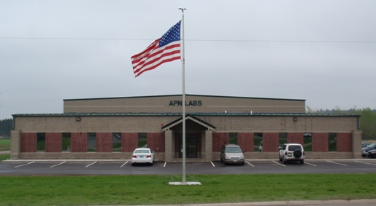
World class Manufacturing facilities

Slide 51
Doctors prefer to have Probiotic Formulations which:
Contain Super strain DDS®-1 L. acidophilus, or such other proven Probiotic strains
Non Dairy, Gluten free, Wheat free, Corn free, Non GMO
High Potency
Human Origin, adapts to the human body
Acid and Bile resistant (survives stomach acid)

Slide 52

Doctors prefer to have Probiotic Formulations which:
6. Produces Hydrogen Peroxide, Lactic
Acid & Natural antibiotics
7. Fortified with Prebiotics (It is Synbiotic)
8. Stable at room temperature for 2 years
9. Freeze dried and packaged with
Nitrogen to improve stability
10. Available in veggie capsules

Slide 53
Doctors prefer to have Probiotic Formulations which:
11. Helps maintain a Healthy flora
12. Generally Recognized as Safe
13. Backed by University Research, US Patent and Trademark
14. Listed in Physicians’ Desk Reference
15. America’s Favorite Probiotic Since 1979

Slide 54
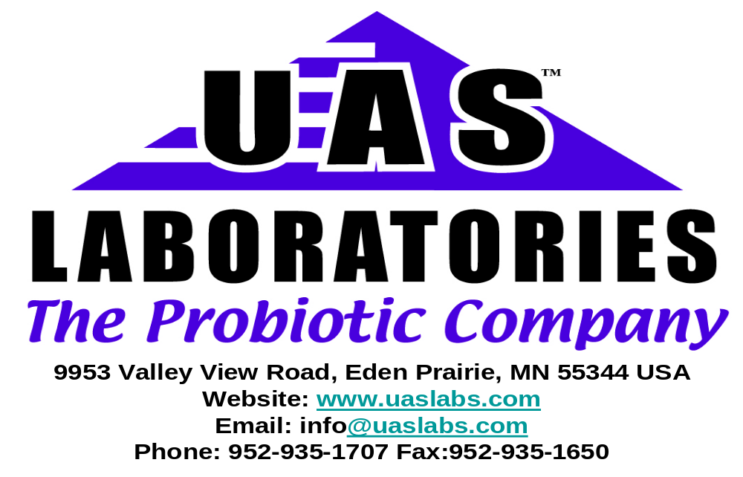
About
Established since 1979

Slide 55
UAS LABS
Credentials
Probiotic Pioneer since 1979
First to introduce QC standard CFU/gm, now used worldwide
First to introduce non dairy, gluten free, non GMO probiotics
First to introduce nitrogen packaging to enhance the stability
First to introduce acid & bile resistant probiotics
First to introduce the combination of probiotics with Prebiotics
First to use University of Wisconsin technology to improve probiotic Stability.

Slide 56


































UAS Labs serves in
over 55 Countries
United States
Australia
Brazil
Chile
Hong Kong
Israel
Japan
Mexico
Philippines
Germany
Kazakhstan
Singapore
Taiwan
United Kingdom
Austria
Canada
Finland
India
Italy
Ukraine
Bulgaria
Romania
Baltic Republic
New Zealand
Russia
South Africa
Trinidad & Tobago
Vietnam
Malaysia
Norway
Spain
Republic of Georgia
Bangladesh
Uzbekistan

Slide 57

What is New in USA
    Establishment of Probiotic Innovation Laboratory
    Establishment of Endowed Probiotic Professor
    At South Dakota State University, Brookings, South Dakota (USA)

Slide 58


NDA for Probiotic Drug
FDA designated their product as Fast Track product for recurrent C. diff infection

Slide 59
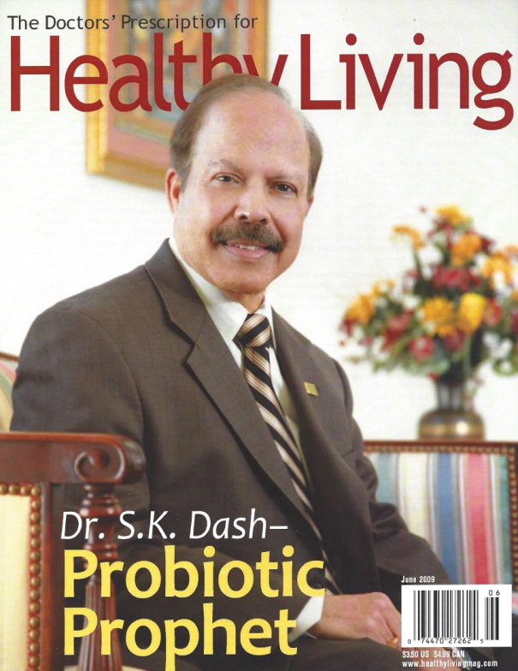
Achievements and Awards (2009)
Leading Consumer Magazine – Healthy Living honored Dr. Dash as “Probiotic Prophet”
The June issue of magazine has featured Dr. Dash and his many innovations, research and contribution to the growth of the probiotic sector and Philanthropy.

Slide 60
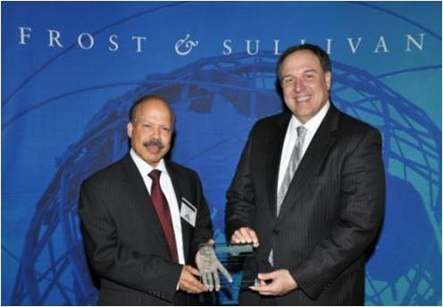
Frost & Sullivan Award for Probiotic Innovation

Slide 61

Honored by Minnesota State Senate for Outstanding Contribution to Probiotics

Slide 62
Dr. Dash Emphasis
“Probiotics are more important than multivitamins and should be taken daily" TM
      Dr. S.K. Dash
Since all probiotics are not the same, consumers should look for proven, well researched and documented probiotic supplements like DDS® Probiotics and such others.

Slide 63
Thank You!
For additional information
please contact drdash@ddinnovation.com

