Slide 1
About OMICS Group
OMICS Group is an amalgamation of Open Access publications and worldwide international science conferences and events. Established in the year 2007 with the sole aim of making the information on Sciences and technology ‘Open Access’, OMICS Group publishes 500 online open access scholarly journals in all aspects of Science, Engineering, Management and Technology journals. OMICS Group has been instrumental in taking the knowledge on Science & technology to the doorsteps of ordinary men and women. Research Scholars, Students, Libraries, Educational Institutions, Research centers and the industry are main stakeholders that benefitted greatly from this knowledge dissemination. OMICS Group also organizes 500 International conferences annually across the globe, where knowledge transfer takes place through debates, round table discussions, poster presentations, workshops, symposia and exhibitions.

Slide 2
About OMICS International Conferences
OMICS International is a pioneer and leading science event organizer, which publishes around 500 open access journals and conducts over 500 Medical, Clinical, Engineering, Life Sciences, Pharma scientific conferences all over the globe annually with the support of more than 1000 scientific associations and 30,000 editorial board members and 3.5 million followers to its credit.
OMICS Group has organized 500 conferences, workshops and national symposiums across the major cities including San Francisco, Las Vegas, San Antonio, Omaha, Orlando, Raleigh, Santa Clara, Chicago, Philadelphia, Baltimore, United Kingdom, Valencia, Dubai, Beijing, Hyderabad, Bengaluru and Mumbai.
.

Slide 3
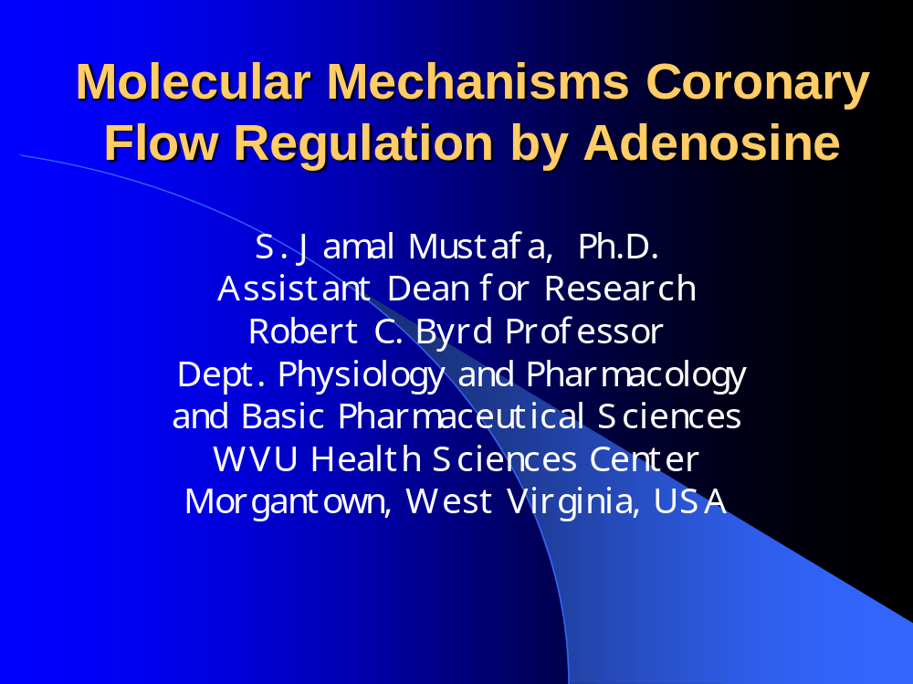


Slide 4
Clinical Applications
Adenocard® (Adenosine)-SVT
Adenoscan® (Adenosine)-myocardial perfusion imaging
Investigational Use: Treatment during PTCA (to reduce the myocardial reperfusion injury in patients with myocardial infarction.
  Better myocardial salvage and thus prevention of left ventricular remodeling, ejection fraction, decreased infarct size, and ST-segment elevation resolution.
  But not conclusive and needs larger clinical trials.

Slide 5
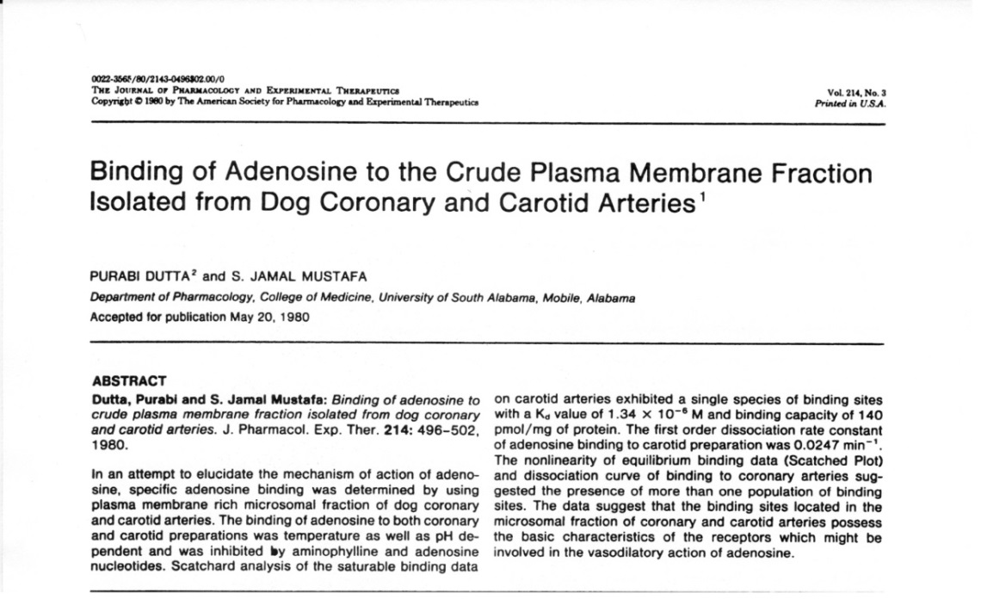
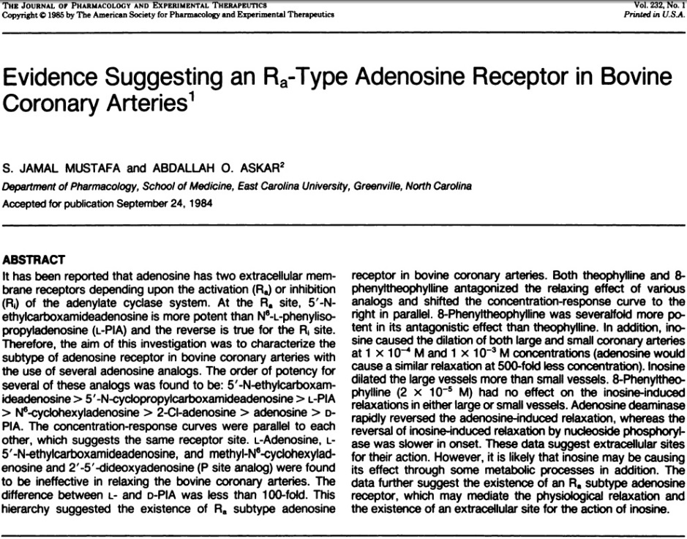
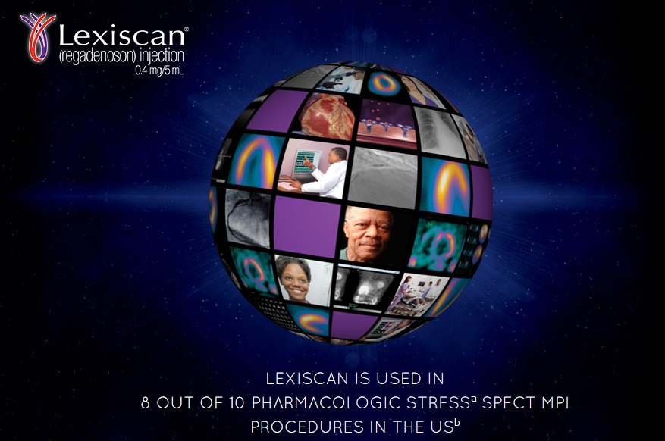
Lexiscan® (A_{2A} selective agonist, regadenoson):
approved (April, 2008) myocardial perfusion imaging based on our work for almost 30 years ago.

Slide 6
Adenosine Receptor Pharmacology
_______________________________________________________________________________________________________________________
Receptor Subtype A₁ A_{2A} A_{2B} A₃
Deduced molecular size
Amino acids 326 410‑412 332 320
Kilodaltons 36.7 46.2 36.4 36.6
G‑protein coupling Go, Gi Gs Gs Go, Gi
Agonist potency CCPA > CPA > NECA >> CGS 21680 ≥ NECA > NECA 2-Cl-IBMECA >>
CGS 21680 CV 1808 > R‑PIA > CPA Bay 60-6583 R-PIA= NECA >>
LUF5835ª CGS21680
Antagonists DPCPX, 8‑PST, CPT ZM 241385, SCH 58261, MRS-1754 MRS-1220,
CSC, KF 17837 MRS-1706 MRS-1191, PSB-1115 MRS-1523,
compound 16ª
CVT-6883
Clone designation M 69045 (rat) M 97370 (human) M 97759 (human) M 94152 (rat)
M 64299 (rat) X 14052 (dog) M 91466 (rat)
X 14051 (dog)
M 86261 (cow)
X 63592 (cow)
Distribution Brain, testis, adipose Striatum, olfactory Brain, heart, lung, Testis, brain, lung, tissue, heart, lung, tubercule, heart, blood mast cells, blood vessels mast cells, heart
mast cells vessels (including (including endothelial cells)
endothelial cells)
________________________________________________________________________________________________________________________
*'A novel adenosine receptor, tentatively designated A4, has been described on the basis of ['H]CV 1808 binding [Cornfield et al., 19921.
Several binding proteins for NECA that are unrelated to A2 receptors have been described (see Schwabe et al., [19921; Linden et al. 1993 for
further information on adenosine receptor clones). CPA, N6‑cyclopentyl adenosine; CCPA, 2‑chloro CPA; NECA, 5'N‑ethylcarboxamino aden‑
osine. Modified from ABBRACCHIO et.al DRUG DEVELOPMENT RESEARCH 28:207,1993
ª Beukers et al; Med Res Rev. 26:667-98, 2006.

Slide 7
ADENOSINE
ISCHEMIA
ADENOSINE
A₁
A_{2A}
A_{2B}
A₃
()
(++)
(+)
()
CORONARY VASODILATION
Heterogeneity of Adenosine Receptors in CBF
Huda

Slide 8
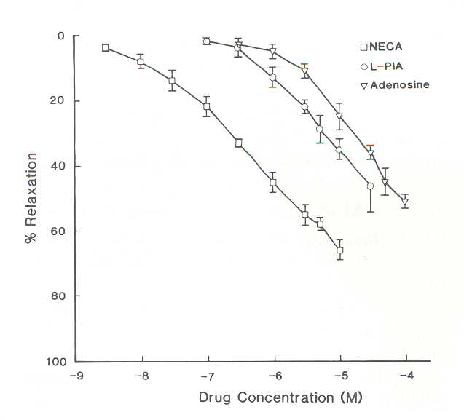
Ramagopal, Chitwood and Mustafa (European J. Pharmacology 151: 483, 1988)
Concentration-response curves for the relaxation of adenosine and its analogs in human coronary artery ring preparations pre-contracted with prostaglandin F_{2α} (10⁻⁶ M) in the presence of diltiazem (10⁻⁶ M). Each point represents the mean of six vascular rings from four human hearts ± S.E.M.

Slide 9
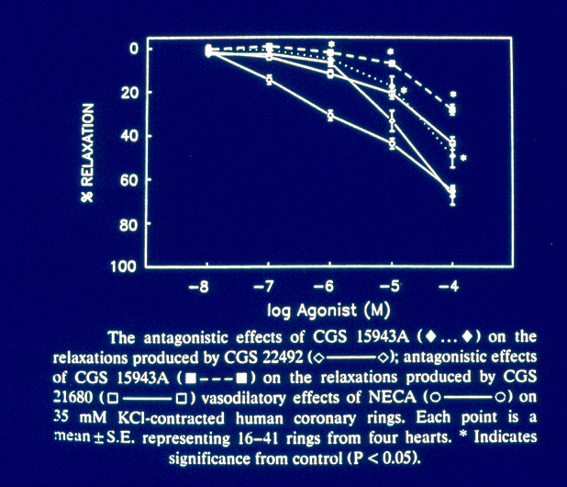
Mustafa et.al. (European J. Pharmacology 221: 243, 1992)

Slide 10
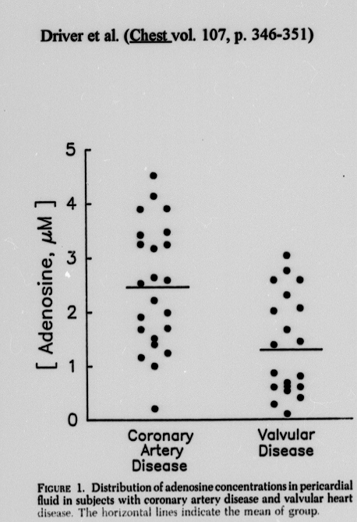
Driver et.al. Chest 107: 346-351, 1995

Slide 11
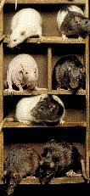
Dr. Morrison
Men to Mice
Advent of targeted gene modification
“Knockout”, “knockin”, transgenic models
among the most useful models for dissection of physiological pathways

Slide 12
Role of A₁ Adenosine Receptor in CBF Regulation
(using A₁ KO)

Slide 13
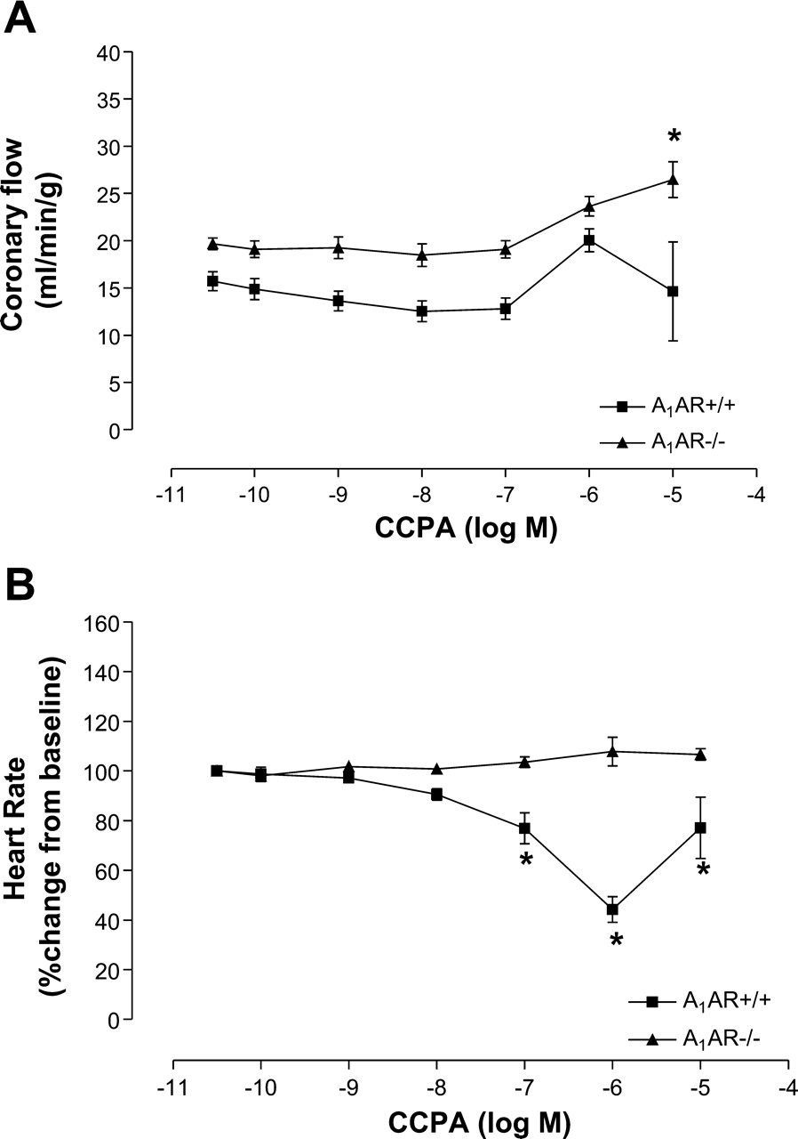
Concentration-response curves for 2-chloro-N6-cyclopentyladenosine (CCPA) on coronary flow (A) and heart rate (B) in isolated perfused hearts from A1AR+/+ and A1AR-/- mice
Tawfik, H. E. et al. Am J Physiol Heart Circ Physiol 291: H467-H472 2006.
Copyright ©2006 American Physiological Society

Slide 14
Role of A_{2A} Adenosine Receptor in CBF Regulation
(using A_{2A} KO)

Slide 15
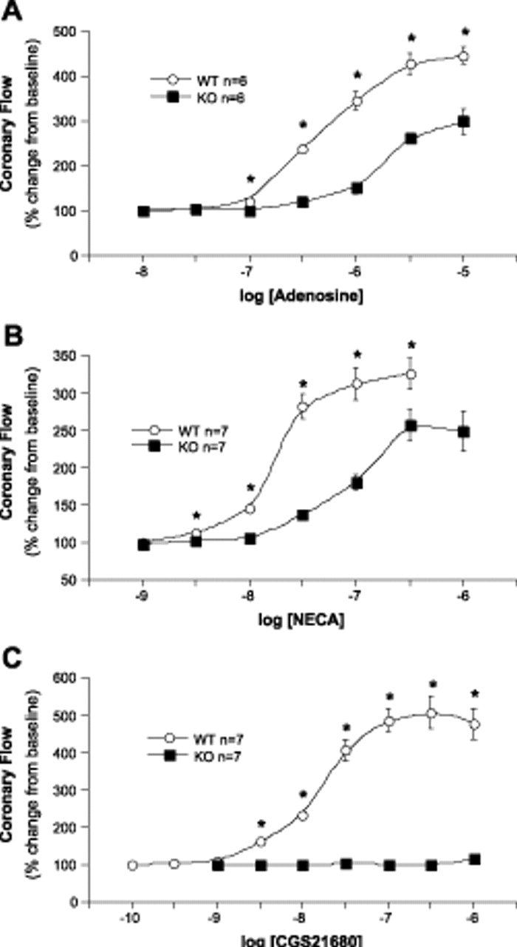
Concentration-response curves for coronary flow (expressed as percent change from baseline) for adenosine (A), NECA (B), and CGS-21680 (C) in isolated perfused mouse hearts.
Open circles represent wild-type (WT) hearts and closed squares represent A2AR KO . *Significant differences between WT and A2AKO groups, P < 0.05.
Support A_{2A} and possibly A_{2B} and
others?
R. Ray Morrison et al. Am J Physiol Heart Circ Physiol 2002;282:H437-H444
©2002 by American Physiological Society
Notes:
Concentration-response curves for coronary flow (expressed as percent change from baseline) for adenosine (A), NECA (B), and CGS-21680 (C) in isolated perfused mouse hearts. Open circles represent wild-type (WT) hearts and closed squares represent A2A receptor knockout (KO) hearts. Values are means ± SE. *Significant differences between WT and A2AKO groups, P < 0.05.

Slide 16
Role of A₃ Adenosine Receptor in CBF Regulation
(using A₃ KO)

Slide 17
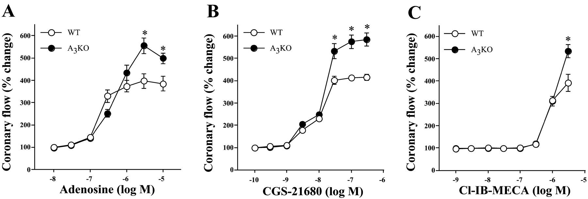
Concentration-dependent coronary vascular effects of adenosine (A), 2-[p-(2-carboxyethyl)]phenylethylamino-5′-N-ethylcarboxyamido-adenosine (CGS-21680) (B), and 2-chloro-N 6-(3-iodobenzyl)-adenosine-5′-N-methyluronamide (Cl-IB-MECA) (C) in isolated hearts.
CF response curves adenosine (A), CGS-21680 (B), and Cl-IB-MECA (C) in isolated hearts from WT and A3AR KO, negative role) mice. *P 0.05 vs. corresponding WT value.
M. A. Hassan Talukder et al. Am J Physiol Heart Circ Physiol 2002;282:H2183-H2189
©2002 by American Physiological Society
Notes:
Concentration-dependent coronary vascular effects of adenosine (A), 2-[p-(2-carboxyethyl)]phenylethylamino-5′-N-ethylcarboxyamido-adenosine (CGS-21680) (B), and 2-chloro-N 6-(3-iodobenzyl)-adenosine-5′-N-methyluronamide (Cl-IB-MECA) (C) in isolated hearts from both wild-type (WT) and A3 receptor knockout (A3KO) mice. Symbols represent means ± SE of 5–8 experiments. Concentration-response curve for coronary flow was constructed noncumulatively. y-Axis, changes in the coronary flow are expressed as %change from immediate baseline value that was assigned as 100%; x-axis, the molar concentration of agonists on a logarithmic scale. *P < 0.05 vs. corresponding WT value.

Slide 18
Role of A_{2B} Adenosine Receptor in Coronary Flow Regulation (using A_{2B} KO)

Slide 19
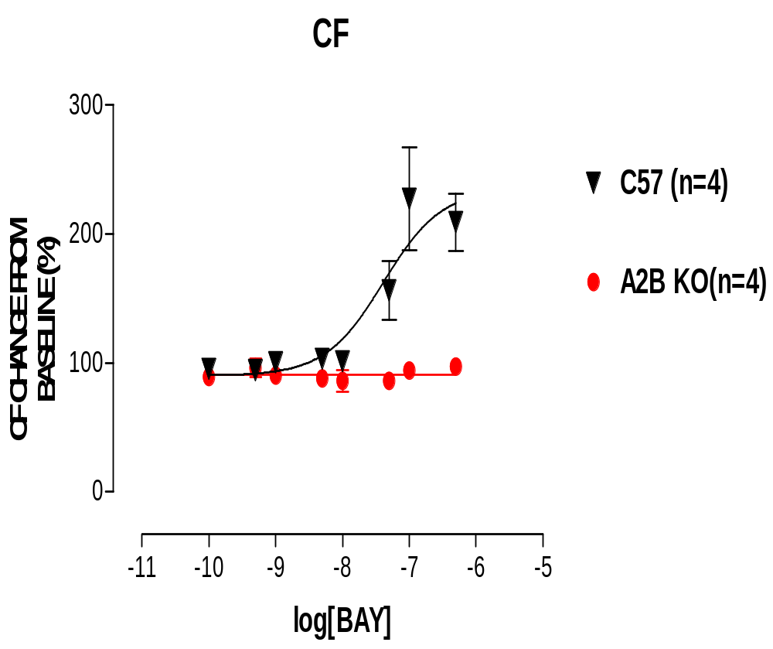
Effect of BAY 60-6583 (A_{2B} selective agonist) in Isolated Heart from A_{2B} KO and WT mice
Maryam Sharifi Sanjani et al. Am J Physiol Heart Circ Physiol. 301:H2322-H2333, 2011.

Slide 20
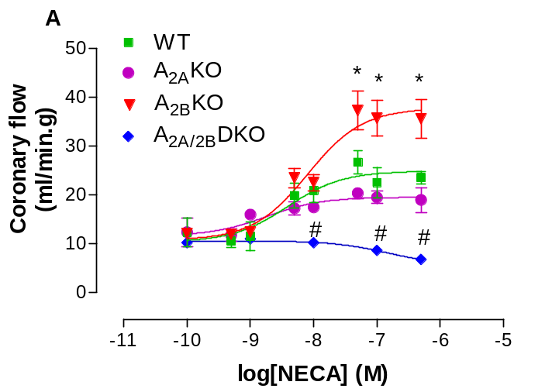
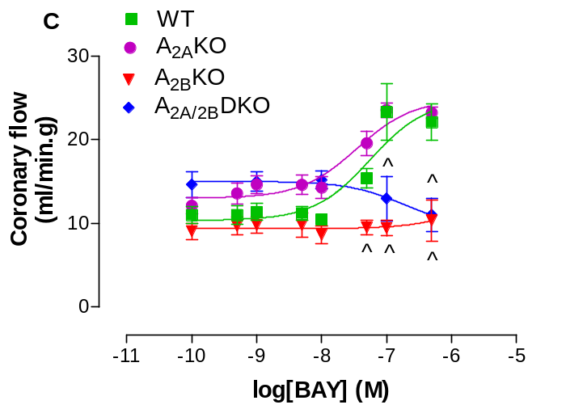
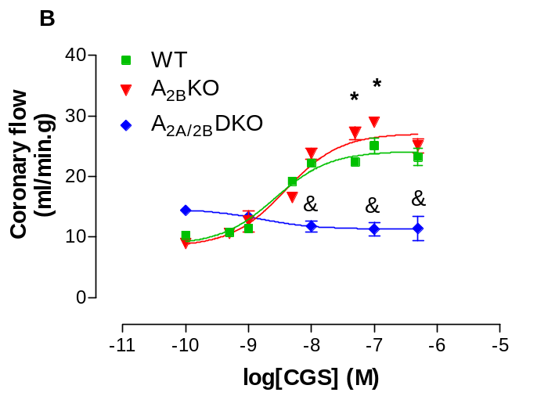
Role of A_{2A} and A_{2B}ARs in the regulation of coronary flow.
Values are means±S.E.M. *Significant difference compared to WT, A_{2A}KO, and A_{2A/2B}DKO, #Significant difference compared to WT, A_{2A}KO, and A_{2B}KO, ∞Significant difference compared to WT, A_{2A/2B}DKO, &Significant difference compared to WT, A_{2B}KO, ^Significant difference compared to WT, A_{2A}KO, p<0.05.
Maryam Sharifi Sanjani et al. Am J Physiol Heart Circ Physiol. 301:H2322-H2333, 2011.

Slide 21
Role of H₂O₂ in Adenosine Receptor-Mediated Increase in Coronary Flow Regulation (using AR KOs)

Slide 22
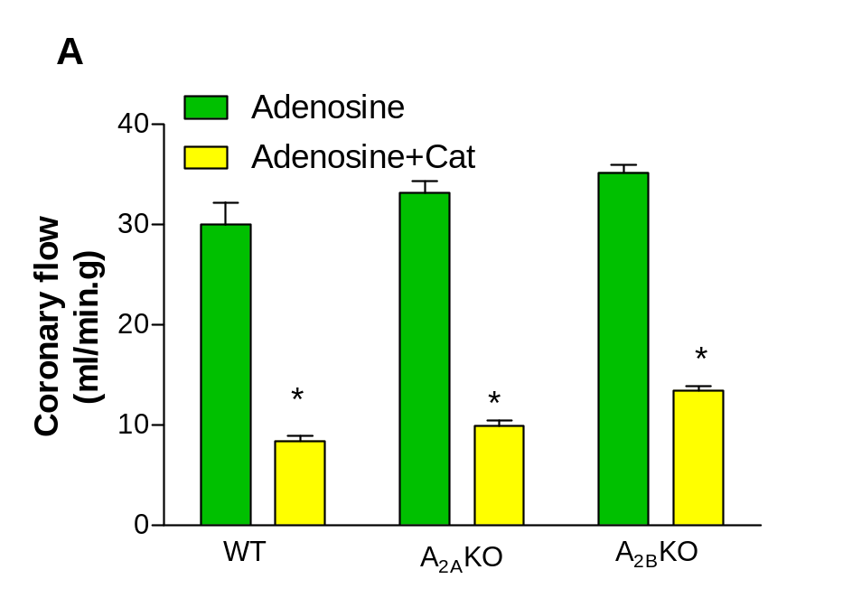
Involvement of H₂O₂ in A₂ adenosine receptors-mediated increase in coronary flow
Catalase (CAT)
H₂O₂ → H₂O+O₂.
Maryam Sharifi-Sanjani et al. Am J Physiol Heart Circ Physiol. 304:H1294-H1301, 2013.

Slide 23
Role of K⁺_{ATP} Channels in AR-Mediated Increase in Coronary Flow Regulation/Reactive Hyperemia (using AR KOs) through H₂O₂

Slide 24
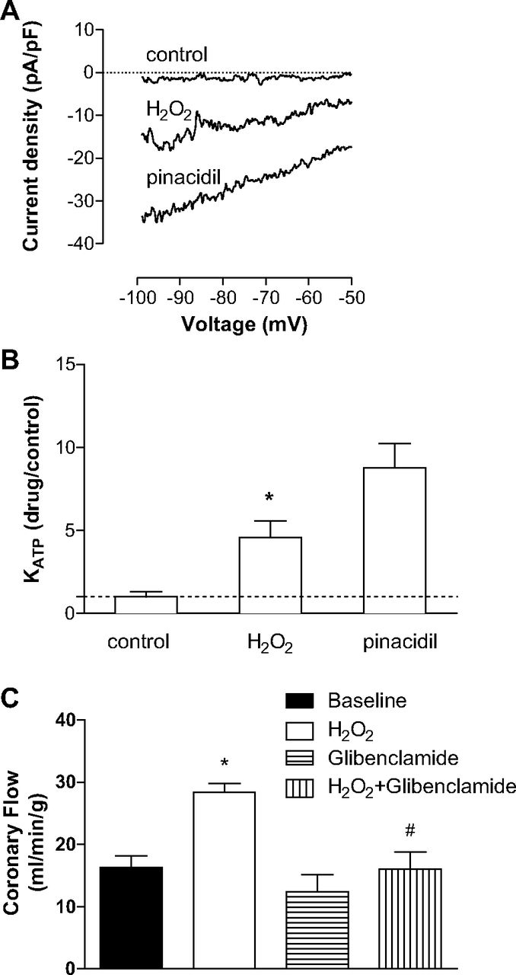
H2O2 activates KATP channels in smooth muscle cells.
Maryam Sharifi-Sanjani et al. Am J Physiol Heart Circ Physiol. 304:H1294-H1301, 2013.
©2013 by American Physiological Society
Notes:
H₂O₂ activates K_{ATP} channels in smooth muscle cells. A: representative trace showing effect of H₂O₂ (1 mM) to increase K_{ATP} current. B: group data (cells from n = 5 mice) illustrate effect of H₂O₂ on K_{ATP} current relative to pinacidil (10 μM). C: group data (n = 4) demonstrate the effect of glibenclamide (10 μM) on H₂O₂-mediated increase in coronary flow of WT hearts. * and # indicate P < 0.05 vs. WT and H₂O₂ effect, respectively.

Slide 25
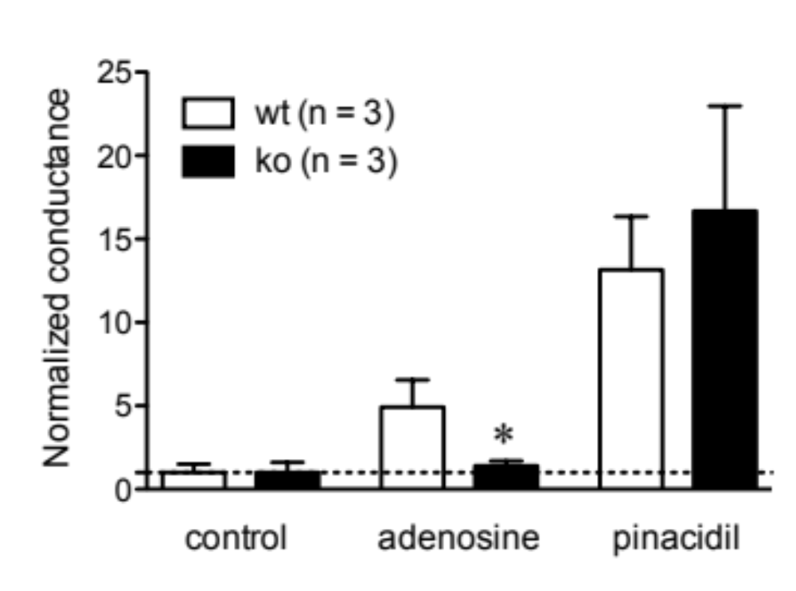
Adenosine induces opening of K_{ATP} channels in SMC through A₂ ARs (A_{2A/2B}DKO)
Collaborators: Dick GM and Asano C.

Slide 26
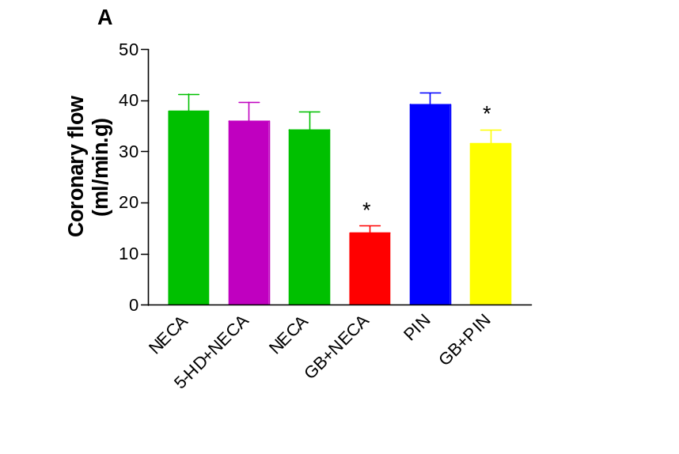
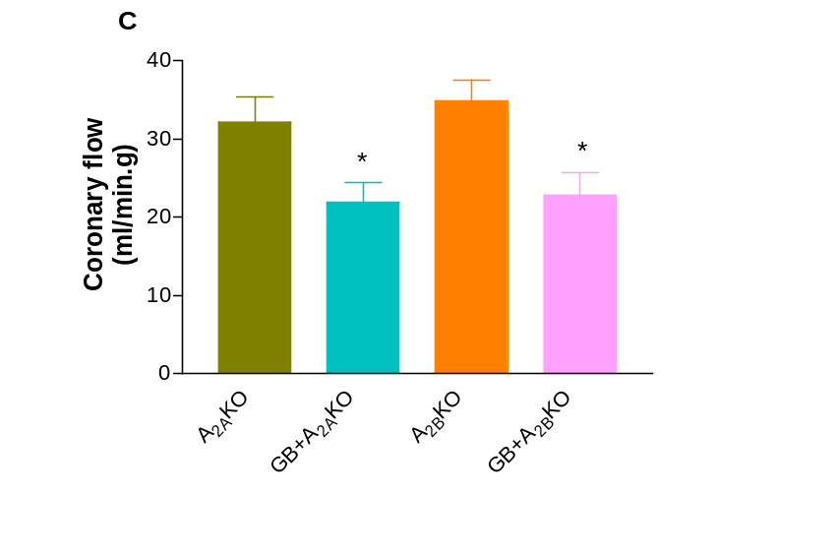
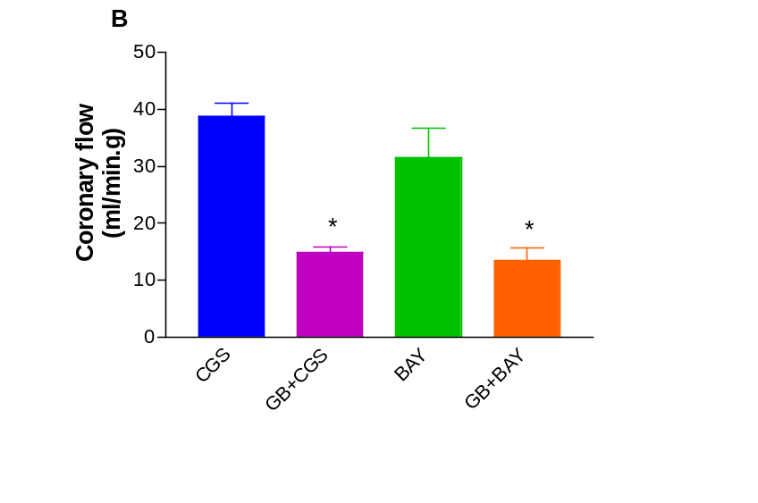
Effect of 5-HD and glibenclamide (GB) on NECA and pinacidil (A, PIN), CGS 21680/BAY (B)-mediated increase in CF in WT mice (B). Effect of GB on NECA-mediated increase in CF in A_{2A}KO and A_{2B}KO mice (C).Values are means±S.E.M. *Significant difference in drug-mediated effects in the presence of antagonist compared to their corresponding controls, p<0.05.
Involvement of non-mitochondrial K_{ATP} channels in A_{2A} and A_{2B}ARs-mediated increase in coronary flow.
Maryam Sharifi-Sanjani et al. Am J Physiol Heart Circ Physiol. 304:H1294-H1301, 2013.

Slide 27
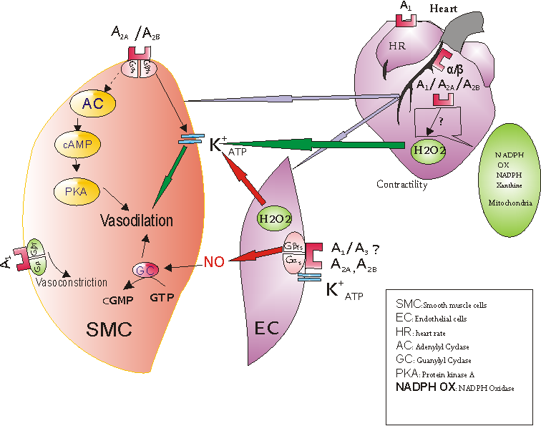

Slide 28
Acknowledgements
(Co-workers)
Current Graduate Students
Maryam Shariffi, M. S.
Ernest J. Young, B. S.
Swati Kunduri, M. S.
Past/Current Colleagues
Dovenia Ponnoth, Ph. D.
M. El-awady, Ph. D.
Huda Tawfik, M. D., Ph. D.
Bunyen Teng, Ph. D.
Ray Morrison, M. D.
Majd Sabouni, Ph. D.
Hasan Talukder, M. D., Ph. D.
Collaborators
Steve Tilley, M. D. (UNC)
Jurgen Schnermann, Ph. D. (NIH)
C. Ledent, Ph. D. (Belgium)
Greg Dick, Ph. D. (WVU)
Al Driver, M. D.
Supported by:
HL 027339, HL 094447, HL071802, T-32-HL090610

Slide 29


Slide 30
Thank you.

Slide 31

Thanks' for your kind attention!!!!!!

Slide 32
Let Us Meet Again
We welcome you all to our future conferences of OMICS International
Please Visit:
http://cardiology.conferenceseries.com
http://www.conferenceseries.com/
http://www.conferenceseries.com/clinical-research-conferences.php

