Slide 1
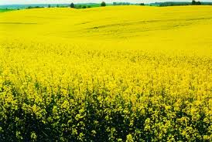

ANTIOXIDANT PROPERTIES OF RAPESEED CAN BE MODIFIED BY CULTIVATION AND BIOLOGICAL STRESS
R. Amarowicz
Institute of Animal Reproduction and Food Research of the Polish Academy of Sciences, Olsztyn, Poland
4th International Conference and Exhibition on Food Processing & Technology
London 10-12 August 2015

Slide 2
Chemical structure of phenolic acids

Slide 3
Sinapic acid
Sinapine
Glucopyranosyl sinapate

Slide 4
The major objective of the present study was to investigate the effect of cultivation (different level of fertilization) and action of pathogen fangus on the rapessed phenolic compounds present in the extract and their antioxidant properties.

Slide 5
Cultivars: California, Castilla, Nelson F1
Characteristic of the cultivation conditions
Fertilization | Control | Intensive | Spare
Phosphorus (Autumn) Potassium (Autumn) Nitrogen Autumn Spring I Spring II Total Sulphur (Spring) | 60 kg 120 kg 30 kg 120 kg 60 kg 210 kg 45 kg | 80 kg 150 kg 30 kg 120 kg 80 kg 230 kg 60 kg | 40 kg 60 kg 30 kg 120 kg 40 kg 190 kg -

Slide 6
Effect of pathogen:
Cultivar: Hybryda 1
Green house of the University of Warmia and Mazury
Cultivation in the vason (volum of 9 l). During the phase of budding plant plantation was inoculated with spores of fungal Alternaria brassica.
The seeds of stage of full maturity were analysed.

Slide 7
Extraction:
Phenolic compounds were extracted from the defatted seeds with 80% (v/v) aqueous methanol at 80º C for 15 min at a solid to solvent ratio of 1: 10 (w/v). Extraction was carried out in dark-colored flakes using a shaking water bath. The extraction was repeated twice more, supernatants combined and acetone evaporated under vacuum at 40 ºC in a rotary evaporator. The remaining water solution was lyophilised.
Chemical analysis:
Total phenolics (Folina – Ciocalteu’a phenol reagent)
Antiradical activity against DPPH radical (Yen i Chen, 1995)
Antiradical actiovity against ABTS cation radical (TEAC) (Re et al., 1999)
FRAP (Prior et al., 2005)
RP-HPLC

Slide 8
HPLC analysis of phenolic compounds
A Shimadzu HPLC system was employed:
LC-10ADVP pump
Controler SCL-10AVP
Photodiode array detector UV-VIS SPD-M10AVP,
Controler SCL-10AVP
Conditiones of separations:
Prepacked LUNA C8 column (5μm, 4.6 x 250 mm; Phenomenex)
A gradient: A - water-methanol (90:10; v/v) with 1.25% o-phosphoric acid, B - methanol with 0.1% o-phosphoric acid; linear gradient from 0 to 60% B for 50 min.
Flow rate – 1 ml/min; injection volume 20 μl; the detector was set at 330 nm.

Slide 9
Content of total phenolics in the extracts (mg/g)

Slide 10
TEAC of the extracts (mmol Trolox/g)

Slide 11
FRAP of the extracts (mmol Fe2+/g)

Slide 12
Antiradical activity of the extracts against DPPH radical

Slide 13
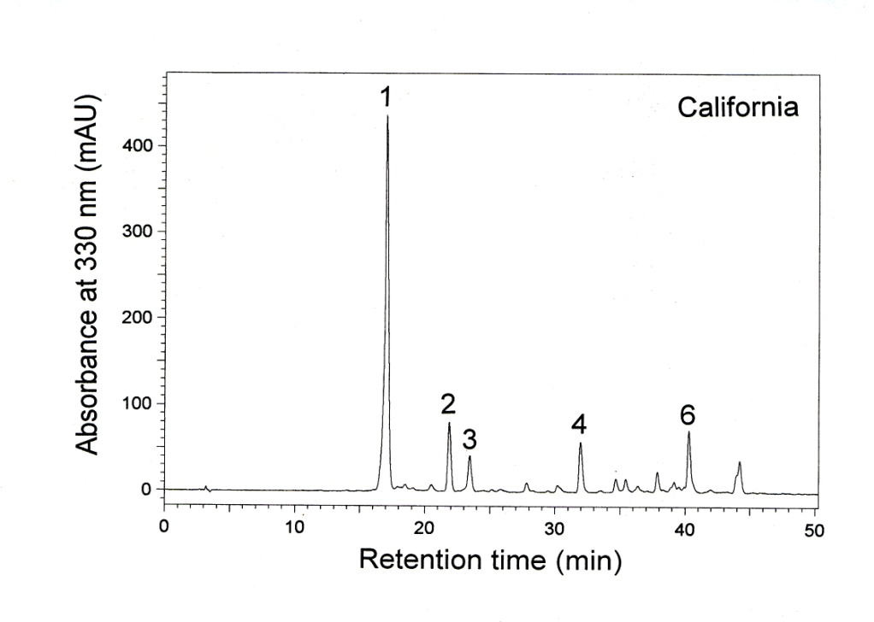
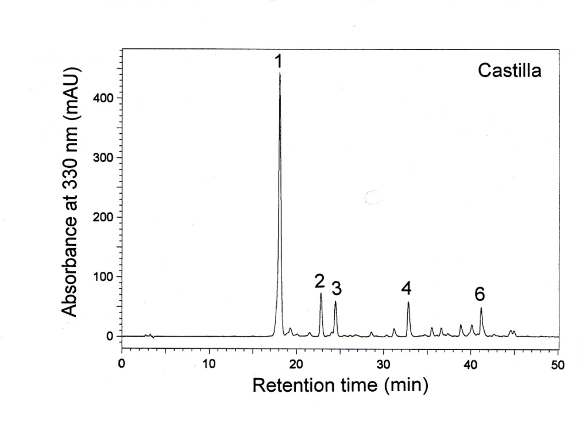
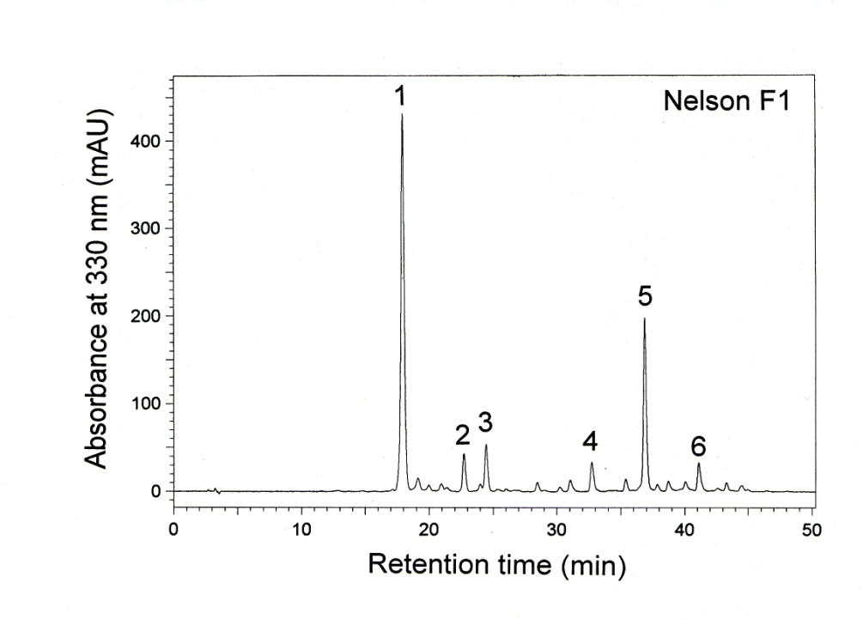
HPLC chromatograms of the extracts

Slide 14
Content of individual phenolic compounds in the extracts of California (mg/g)
Compound | Control | Intensive | Spare
1 2 3 4 5 6 | 80.1 ± 1.4 8.4 ± 0.3 5.6 ± 0.3 6.3 ± 0.4 - 8.5 ± 0.5 | 81.9 ± 5.1 7.7 ± 0.6 5.1 ± 0.2 6.2 ± 0.3 - 8.3 ± 0.2 | 76.2 ± 4.0 7.6 ± 0.6 5.1 ± 0.3 6.1 ± 0.3 - 7.6 ± 0.5

Slide 15
Content of individual phenolic compounds in the extracts of Castilla (mg/g)
Compound | Control | Intensive | Spare
1 2 3 4 5 6 | 76.3 ± 3.4 7.1 ± 0.9 5.9 ± 0.5 5.9 ± 0.7 - 6.0 ± 0.7 | 73.0 ± 5.6 7.1 ± 1.2 5.9 ± 1.0 5.2 ± 0.6 - 5.7 ± 0.2 | 70.1 ± 1.4 6.4 ± 0.2 5.4 ± 0.5 5.5 ± 0.1 - 6.4 ± 1.5

Slide 16
Content of individual phenolic compounds in the extracts of Nelson F1 (mg/g)
Compound | Control | Intensive | Spare
1 2 3 4 5 6 | 65.8 ± 3.0 4.0 ± 0.1 5.2 ± 0.1 3.8 ± 0.2 18.3 ± 0.5 3.8 ± 0.4 | 64.5 ± 3.3 2.5 ± 0.2 4.9 ± 0.2 3.9 ± 0.5 16.9 ± 1.0 3.2 ± 0.4 | 70.8 ± 5.3 3.1 ± 0.8 5.0 ± 0.6 4.4 ± 0.8 17.3 ± 0.9 3.5 ± 0.8

Slide 17
Content of total phenolics in the extracts and seeds
Inoculated

Slide 18
TEAC of the extracts and seeds
Inoculated

Slide 19
FRAP of the extracts and seeds

Slide 20
Antiradical activity of the extracts aginst DPPH radical

Slide 21
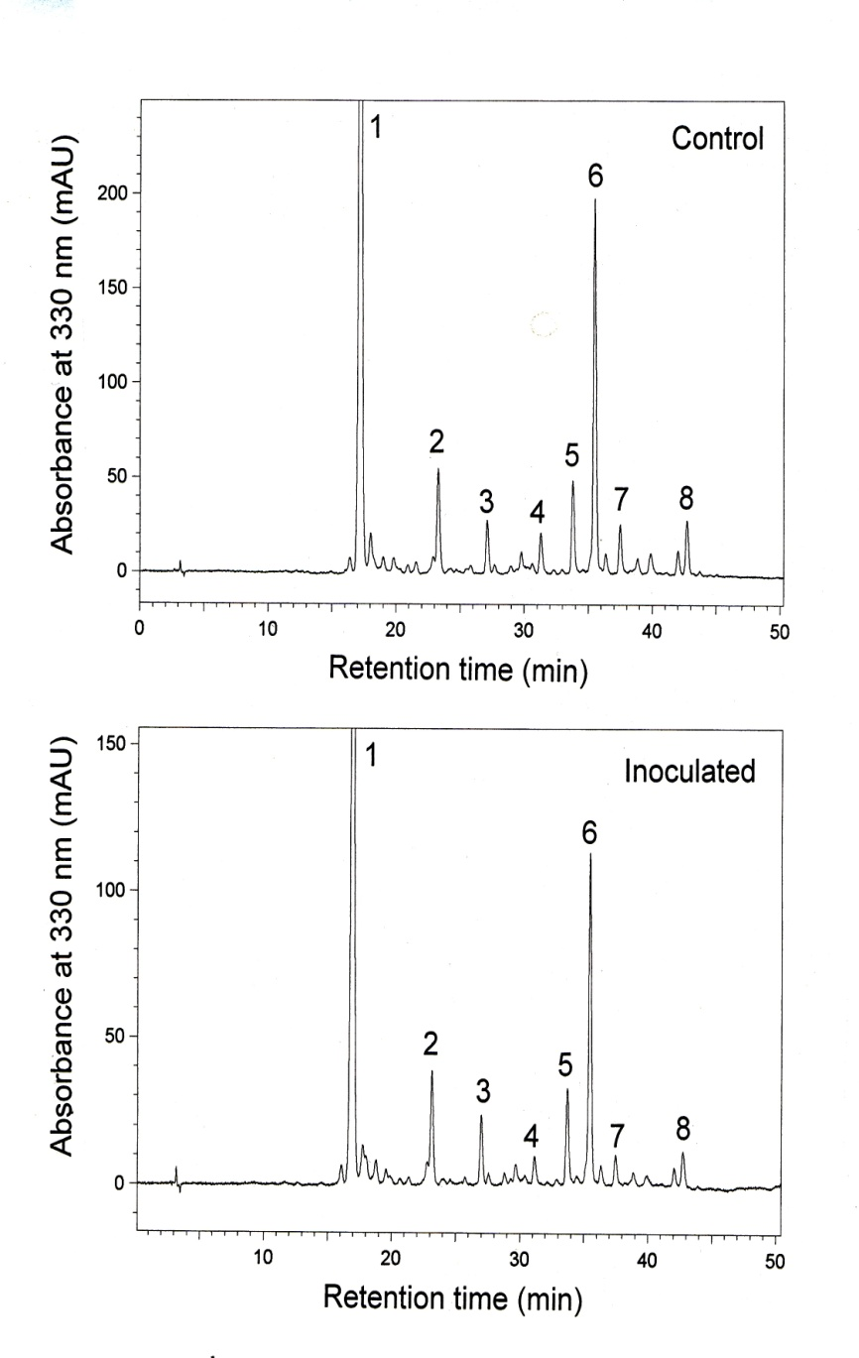
HPLC chromatograms of the extracts

Slide 22
Content of individual phenolic compounds in rapeseed extracts (mg/g of extract)
Compound | Control | Inoculated
1 (sinapine) 2 3 4 5 6 7 8 | 58.2 ± 2.2 3.3 ± 0.2 1.7 ± 0.2 1.6 ± 0.2 3.1 ± 0.2 11.2 ± 0.8 2.0 ± 0.1 2.1 ± 0.1 | 37.9 ± 1.8 2.3 ± 0.2 1.4 ± 0.1 0.7 ± 0.1 2.2 ± 0.1 7.0 ± 0.5 1.0 ± 0.1 1.1 ± 0.1

Slide 23
Content of individual phenolic compounds in rapeseeds (mg/g of defatted seeds)
Compound | Control | Inoculated
1 (sinapine) 2 3 4 5 6 7 8 | 8.49 ± 0.41 0.48 ± 0.03 0.25 ± 0.01 0.24 ± 0.01 0.45 ± 0.02 1.63 ± 0.05 0.29 ± 0.01 0.30 ± 0.01 | 8.00 ± 0.39 0.48 ± 0.03 0.29 ± 0.01 0.16 ± 0.01 0.46 ± 0.02 1.47 ± 0.05 0.21 ± 0.01 0.23 ± 0.01

Slide 24
Conclusions:
All the rapeseed extracts were characterized by the high content of phenolic compound (phenolic acids).
Strong antioxidant activities of the rapeseed extracts were observed and assayed using different chemical methods.
In the seeds of Nelson F1 we found sinapic acid derivative which was absent in the seeds of California and Castilla.
The weak effect of fertilization on the antioxidant properties was observed. However, it was different for the individual rapeseed cultivars and the chemical methods used for the measure the antioxidant activity.
In the extract of the seeds treated by Alternaria brassica the content of phenolic compounds as well as antioxidant activity were lower than in the extracts of the untreated seeds.

Slide 25

Thank you

