Slide 1

Effect of Gravity on Heat Feedback of Small-scale Pool Fires
5th World Congress on
Petrochemistry and Chemical Engineering
December 05-07, 2016 Phoenix, Arizona, USA
Ryo Takahashi*, Akihiko Ito, Hiroyuki Torikai
Graduate School of Science and Technology,
Hirosaki University
Notes:
Thank you, chairman.
Good morning everyone.
I’m Ryo Takahashi from Hirosaki University, JAPAN..
I’ll talk about Effect of Gravity on Heat Feedback of Small-scale Pool Fires.
それでは「液面燃焼の熱フィードバック量に及ぼす重力の影響」と題しまして、弘前大学大学院 高橋諒が発表します。

Slide 2
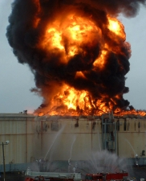
Oil tank fire
Japan is an earthquake country.
After occurrence of a huge earthquake,
an oil tank fire (large-scale pool fire) sometimes occurs due to the impact.
In order to prevent and suppress pool fires, it is necessary to clarify and understand
1) combustion character,
2) flame structure,
3) combustion mechanism.
Therefore, there are a lot of fundamental studies on pool fires.
Notes:
Japan is an earthquake country.
After occurrence of a huge earthquake,
an oil tank fire (large-scale pool fire) sometimes occurs due to the impact.
In order to prevent and suppress pool fires, it is necessary to clarify and understand 1) combustion character,
2) flame structure,
3) combustion mechanism.
Therefore, there are a lot of fundamental studies on pool fires.

Slide 3
Combustion mechanism of pool fire
Flame
Heat
Feedback
Fuel Vapor
Fuel
In order to sustain a stable pool fire, heat transfers from the combustion zone to the liquid fuel (heat feedback) is important .
The liquid fuel is evaporated due to the heat transferred from the flame to the liquid fuel and supplied to the flame.
Notes:
In order to sustain a stable pool fire, heat transfers from the combustion zone to the liquid fuel (heat feedback) is important .
The liquid fuel is evaporated due to the heat transferred from the flame to the liquid fuel and supplied to the flame.

Slide 4
Heat feedback mechanism
Flame
Heat
Feedback
Convection
Radiation
Fuel
Heat feedback is carried out by convective and radiative heat transfers.
The dominant heat transfer process in a pool fire depends on a scale.
Notes:
Heat feedback is carried out by ●convective and ●radiative heat transfers.
The dominant heat transfer process in a pool fire depends on a scale.

Slide 5
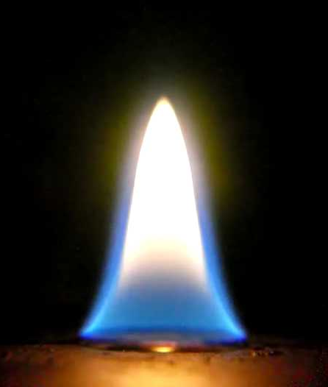
Scale effect on heat transfer mechanism
Scale:
Small
Large
1G
Combustion condition:
Heat transfer
Mechanism:
Laminar flame
Convective
heat transfer
Turbulent flame
Radiative
heat transfer
We have a lot of knowledge on a pool fire in a normal gravity environment.
Notes:
We have a lot of knowledge on a pool fire in a normal gravity environment.
For example, Combustion condition and heat transfer mechanism,

Slide 6
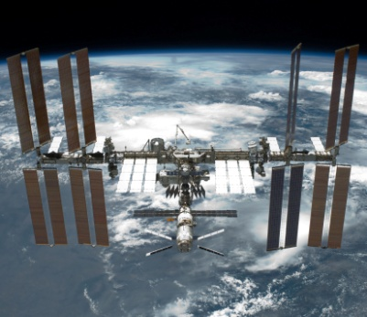
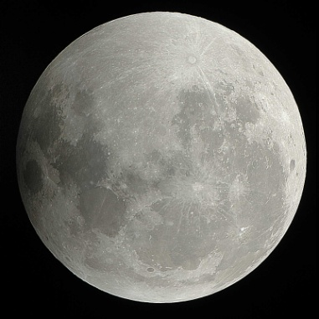
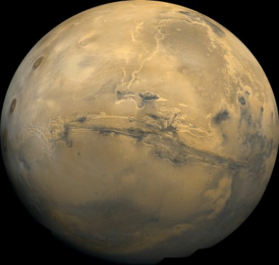
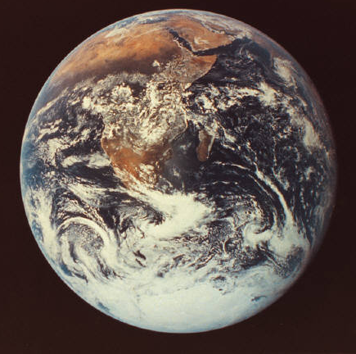
Space exploitation
Space
Moon
Mars
Earth
μG
0.17G
0.38G
1G
Microgravity
Environment
Partial Gravity Environment
Normal Gravity
Environment
Quoted from JAXA HP. (http://www.jaxa.jp/)
As space research and technology progress, activity range of human spreads to various gravity environments.
A fire in a spacecraft and station is also a greatly feared hazard.
Notes:
On the other hand,
As space research and technology progress, activity range of human spreads to various gravity environments.
A fire in a spacecraft and station is also a greatly feared hazard.

Slide 7
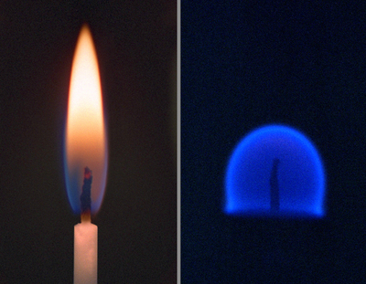
Gravity effect on heat transfer mechanism
Gravity level
Small scale
There is no buoyancy = no natural convection.
As a result, radiative heat transfer is dominant factors to sustain a combustion in a microgravity environment.
μG
Buoyancy-induced flows in combustion phenomena occur in a normal gravity.
As a result, conduction and convective heat transfer is a key factors to determine the flame characteristic.
1G
Notes:
In a microgravity environment,
There is no buoyancy = no natural convection.
As a result, radiative heat transfers is dominant factors to sustain a combustion
On the other hand,
Buoyancy-induced flows in combustion phenomena occur in a normal gravity.
As a result, convective heat transfer is a key factors to determine the flame characteristic.

Slide 8

Gravity-scale diagram
Gravity level
μG
Radiation
Partial gravity
1G
Convection
Radiation
Small
Large
Scale
The dominant heat transfer mechanism changes depending on a gravity level and a scale of a fire.
A partial gravity environment is important for planetary exploration.
Notes:
The dominant heat transfer mechanism changes depending on a gravity level and a scale of a fire.
●A partial gravity environment is important for planetary exploration.

Slide 9

Gravity-scale diagram
Gravity level
μG
Radiation
Partial gravity
1G
Convection
Radiation
Small
Large
Scale
There has been little combustion research in a partial gravity.
We have to clarify combustion characters, flame structure and combustion mechanism in partial gravity environment.
Notes:
There has been little combustion research in a partial gravity.
We have to clarify combustion characters, flame structure and combustion mechanism in partial gravity environment.

Slide 10
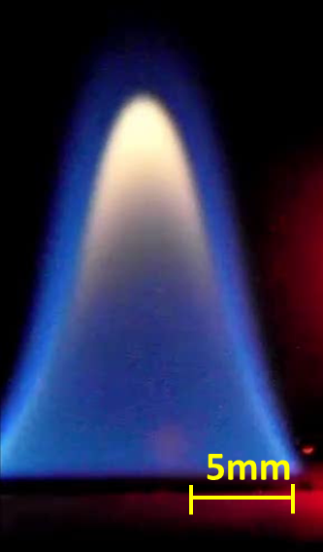
Our previous study
In order to understand the combustion characters in a partial gravity, we focused on a small-scale pool fire.
A small scale pool fire is the one of the basic models of liquid fuel combustion.
10mm
The flame shape, structure and so on, depends strongly on a natural convective flow field.
→Natural convection is caused by a buoyant force, which is determined by a gravity level.
Ethanol
Pan diameter 15mm
Which kind of heat transfer process is important in small scale pool fire in a partial gravity environment?
Notes:
In order to understand the combustion characters in a partial gravity, we focused on a small-scale pool fire
A small scale pool fire is the one of the basic models of liquid fuel combustion.
The flame shape, structure and so on, depends strongly on a natural convective flow field.
Which kind of heat transfer process is important in small scale pool fire in a partial gravity environment?

Slide 11
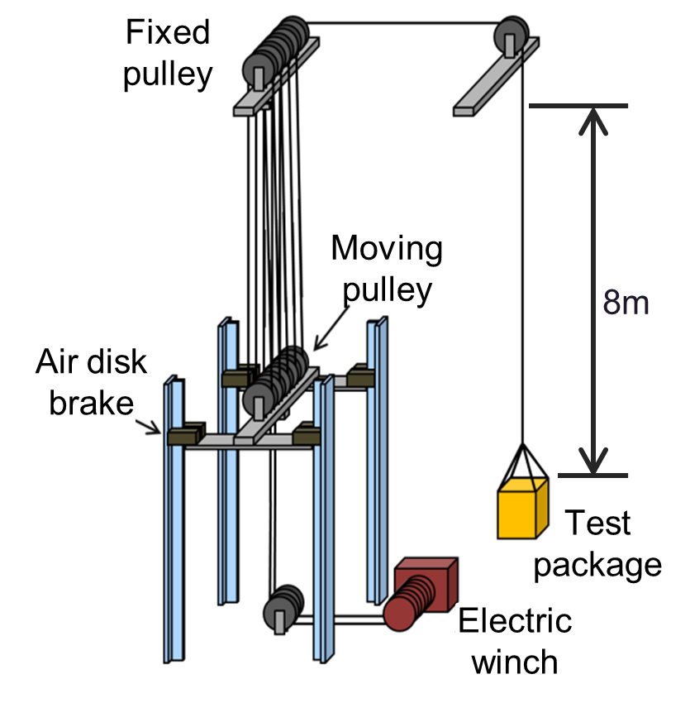
Drop tower to establish a partial gravity condition
We have built a drop tower in a campus of Hirosaki university.
The test package including an experimental setup falls 8m.
We can establish a partial gravity environment for about one second.
Notes:
This is a schematic drawing of Experimental facility Partial Gravity Drop Tower
It is constructed at Hirosaki University

Slide 12
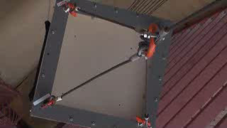
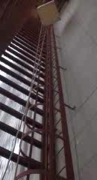
Drop tower to establish a partial gravity condition
We have built a drop tower in a campus of Hirosaki university.
The test package including an experimental setup falls 8m.
We can establish a partial gravity environment for about one second.
Notes:
The test package falls 8 meters
It’s kept the partial gravity environment for about one second

Slide 13
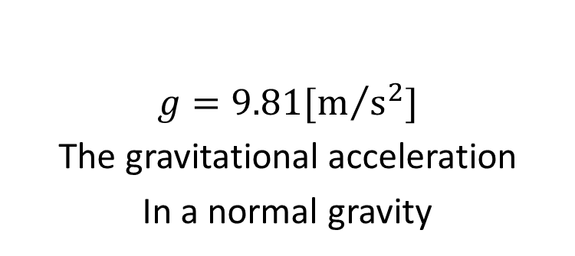
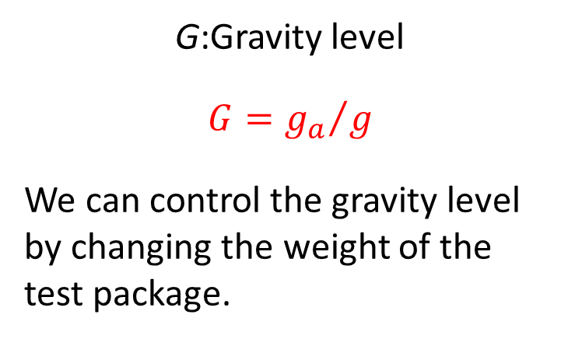
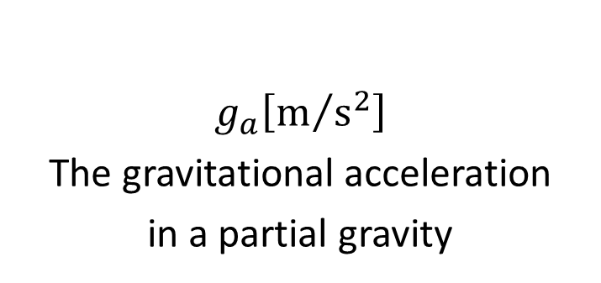
Drop tower to establish a partial gravity condition
G:Gravity level
$$G={g_{a}}/g$$
We can control the gravity level by changing the weight of the test package.
$$g_{a}\left[m/{s^{2}}\right]$$
The gravitational acceleration
in a partial gravity
$$g=9.81[m/{s^{2}}]$$
The gravitational acceleration
In a normal gravity
Notes:
The gravity level G [-], is defined as ga/g
We can change the gravity level by controlling the weight of the package

Slide 14
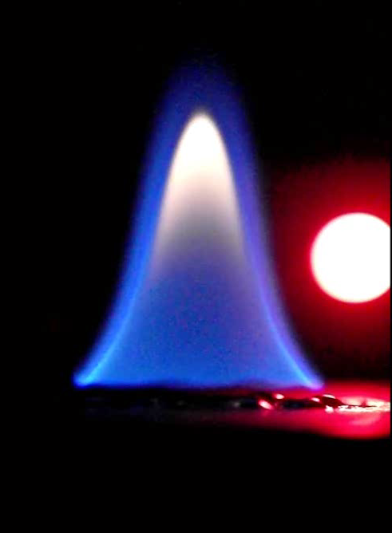
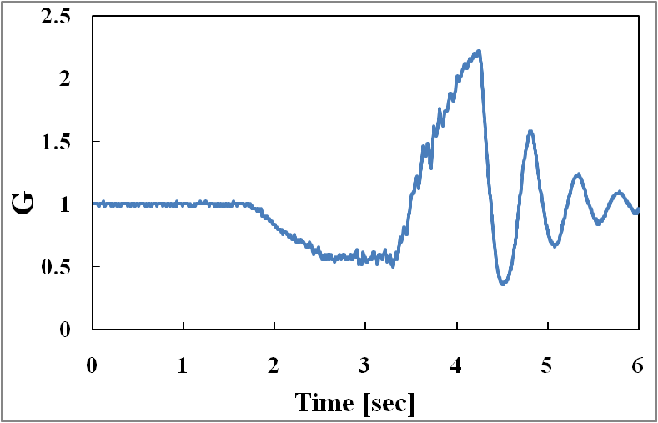
Flame in Partial gravity
0.9 s
G = 0.55
Fuel: Ethanol, Pan diameter: 15 mm
Playback speed：0.5x
This video shows the small scale pool fire in a partial gravity environment.
The flame shape changes right after the gravity level goes down.
Notes:
This video shows the small scale pool fire in a partial gravity environment.
And this figure shows the time variation of the gravity level
Please show the video
●When turn off the LED light , at the same time, test packcage start to fall.
Decreased gravity level
The flame shape changes right after the gravity level goes down.

Slide 15
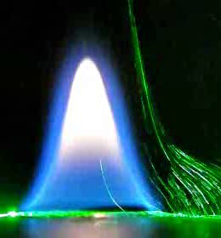
Flow visualization
In order to grasp the flow field in the partial gravity combustion, we have used PTLS method to visualize the stream lines.
Acetone
Pan diameter 15mm
When a gravity is reduced from 1 g to 0.55 g, all flow velocities induced by the combustion decreases .
The flame height also decreases.
Notes:
In order to grasp the flow field in the partial gravity combustion, we have used PTLS method to visualize the stream lines.
When a gravity is reduced from 1 g to 0.55 g, all flow velocities induced by the combustion decreases.
The flame height also decreases.

Slide 16
Question
Findings in our previous study
Small-scale pool fire under a partial gravity condition
・The flame height decreased
・The buoyancy induced flow velocity decreased
The decrease in the flame height may be caused by the reduction of amount of heat feedback from the flame to the liquid fuel.
Which kind of heat transfer process is dominant in the heat feedback mechanism in small scale pool fire under a partial gravity condition?
We focus on clarification of the heat transfer mechanism.
Notes:
Findings in our previous study is that.
The decrease in the flame height may be caused by the reduction of amount of heat feedback from the flame to the liquid fuel.
Which kind of heat transfer process is dominant in the heat feedback mechanism in small scale pool fire under a partial gravity condition?
We focus on clarification of the heat transfer mechanism.

Slide 17
Heat Transfer Mechanism of Pool Fire
Flame
Heat
Feedback
Evaporated
Fuel
Rim
Fuel
In order to grasp qualitatively the amount of the heat feedback and the heat transfer mechanism, we have to measure the temperature field in the pool fire.
Notes:
In order to grasp qualitatively the amount of the heat feedback and the heat transfer mechanism, we have to measure the temperature field in the pool fire.

Slide 18
Our objective
〇Experiments
The partial gravity experiment on a small-scale pool fire has been performed.
〇Measurements
A temperature measurement with a fine-wire thermocouple has been carried out.
The flame shape has been recorded with a high-speed camera.
〇Analyses
The amounts of heat feedbacks on both the convective and radiative heat transfers have been calculated from the temperature field and the flame shape.
Notes:
Experiments
The partial gravity experiment on a small-scale pool fire has been performed.
Measurements
A temperature measurement with a fine-wire thermocouple has been carried out.
The flame shape has been recorded with a high-speed camera.
Analyses
The amounts of heat feedbacks on both the conductive and radiative heat transfers have been calculated from the temperature field and the flame shape.

Slide 19
Our objective
From the experimental results, we clarify the dominant heat feedback mechanism in a small-scale pool fire under a partial gravity condition.
Notes:
From the experimental results, we clarify the dominant heat feedback mechanism in a small-scale pool fire under a partial gravity condition.

Slide 20
Experimental Apparatus & Method
Notes:
Now, describe the experimental apparatus and method
それでは、実験装置と方法について説明します。

Slide 21
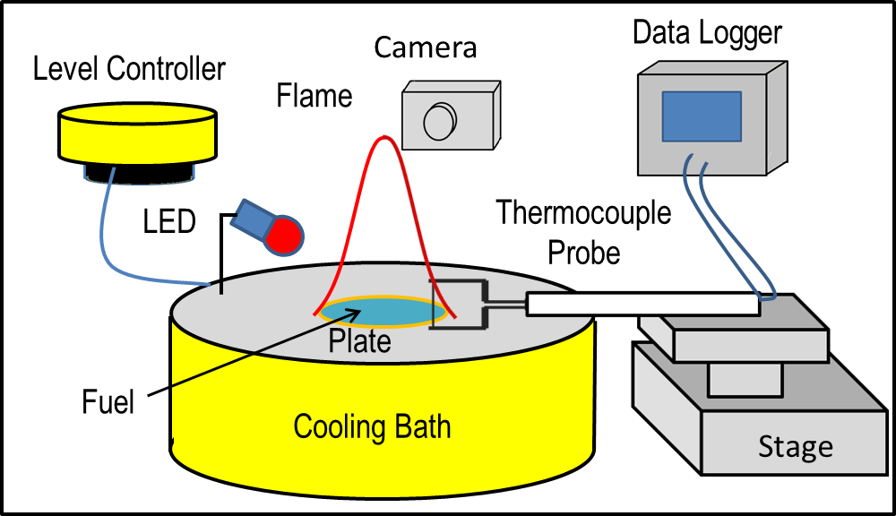
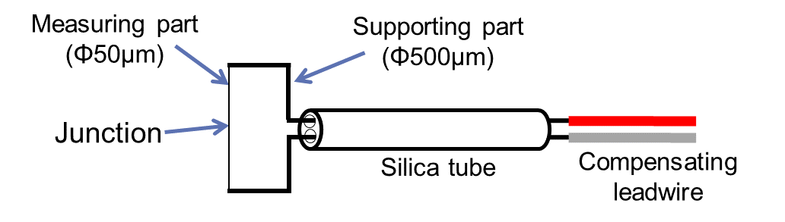
Experimental Apparatus
＜Overview＞
＜Thermocouple probe＞
R-type (Pt-PtRh13%)
Notes:
This figure shows a schematic of the experimental apparatus inside the test package, including the measuring system.
The fuel pan diameter is 15 mm.
The fuel level was kept at the upper rim of the pan using a level controller.
A digital camera (CASIO, EX-F1, 300fps) recorded the flame behavior of the pool fires.

Slide 22
Experimental Apparatus
＜Overview＞
＜Thermocouple probe＞
R-type (Pt-PtRh13%)
Notes:
This is an R-type thermocouple (TANAKA, Pt-PtRh13%) probe. it was used for temperature measurement.

Slide 23
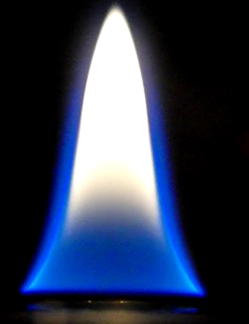
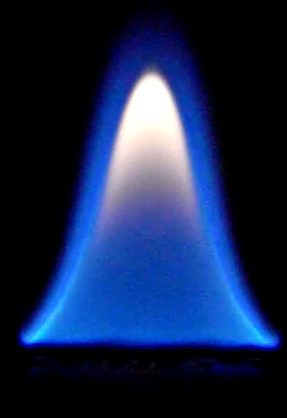
Fuel Type
Brightness:
Low
High
5mm
Ethanol
Acetone
To investigate effect of gravity on radiation, we used ethanol and acetone which have different amount of soot.
The two fuel types have different brightness.
Notes:
To investigate effect of gravity on radiation, we used ethanol and acetone which have different amount of soot.
The two fuel types have different brightness.

Slide 24
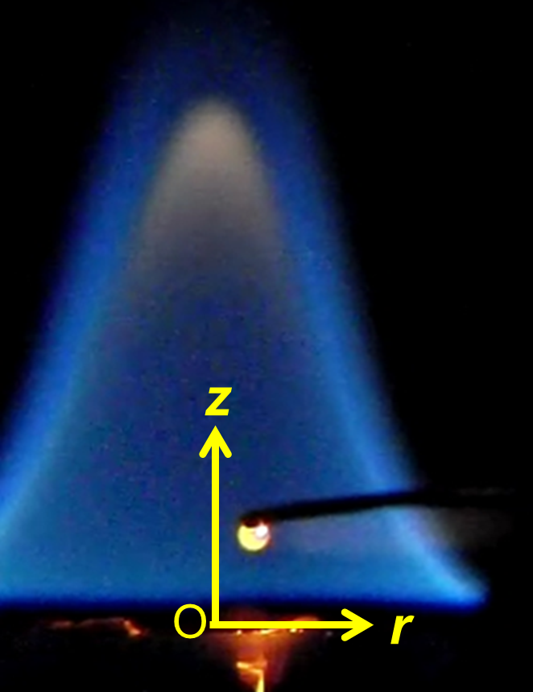
Experimental Condition
Fuel | Ethanol, Acetone
Pool diameter [mm] | 15
Gravity level G [-] | 1, 0.55
Thermocouple height z [mm] | 1-2
Sampling rate [s] | 0.1
Frame rate [fps] | 30
Exposure time [s] | 1/30
Pre-combustion time [s] | 60
Number of trials | 3
Thermocouple
Correction of thermocouple indication temperature had not done in this experiment
Notes:
The thermocouple position was defined by r [mm] and z [mm] as shown in this figure,
The origins of r and z are both the center of the fuel surface.

Slide 25
Experimental results
Notes:
Experimental results

Slide 26
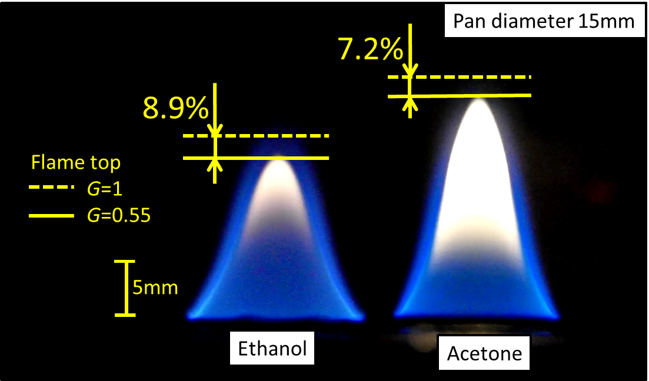
Decrease in Flame Height
Decreasing rate of flame height varies
depending on fuel species.
The flame height is decreased because of
decreasing of fuel evaporation.
Notes:
The acetone flame height was decreased 7.2%
To decrease rate of flame height depend on fuel species
So, it has possibility that the flame height may decrease by decreasing of fuel evaporation

Slide 27
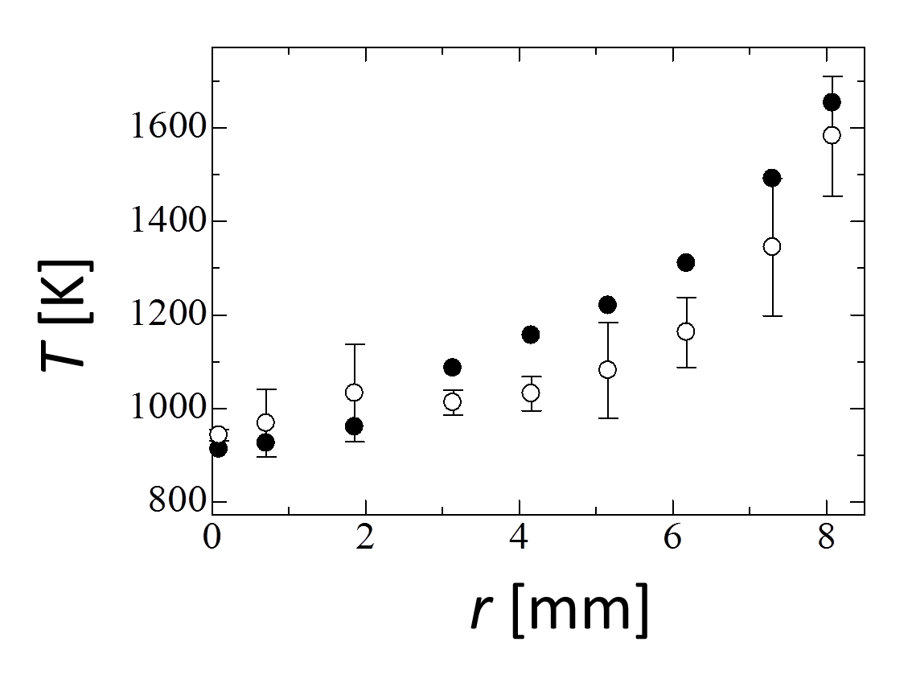
Experimental Results
Flame Sheet
● G=1
○ G=0.55
Flame
0
Rim
Pan
<Ethanol，z=2.3mm>
The average temperature is used as a representative temperature.
Notes:
This figure is the temperature distribution of ethanol fire
In this research, we assumed that the temperature distributions were axially symmetrical.
The average temperature, ethanol and acetone, are used as a representative temperature

Slide 28
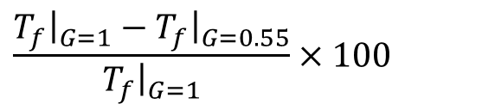
Representative Temperature
The average temperature
 | Ethanol | Acetone
G=1 | 1190 [K] | 1222 [K]
G=0.55 | 1128 [K] | 1188 [K]
Decreasing Rate | 5.2% | 2.8%
$$\frac{T_{f}{\left.​\right|}_{G=1}−T_{f}{\left.​\right|}_{G=0.55}}{T_{f}{\left.​\right|}_{G=1}}×100$$
Decreasing Rate of Flame Temperature
Flame height and representative temperature is different in
a partial gravity environment.
Calculate the amount of heat feedback from the flame temperature.
Notes:
This is an average value of the flame temperature
Decreasing Rate of Flame Temperature is defined as this
In ethanol, the ratio of the decrease in temperature at G = 0.55 compared with G = 1 is 5.2 %.
Acetone is 2.8%
We calculated the heat feedback amount from the flame temperature

Slide 29
Amount of Heat Feedback
Notes:
So we considered about the heat feedback amount
そこで燃料蒸発量を決定する要因である
熱フィードバック量について考えました

Slide 30
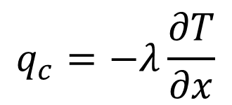
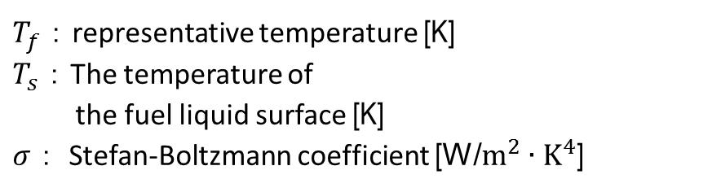
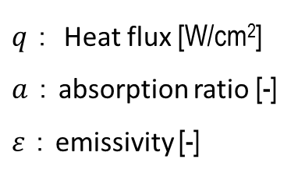
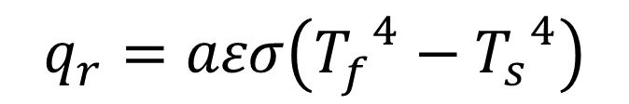
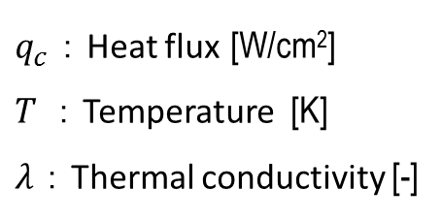
Equations of Heat Transfer
Convection
<Fourier's law>
$q_{c}$：Heat flux [W/cm²]
$T$：Temperature [K]
$λ$：Thermal conductivity [-]
$$q_{c}=−λ\frac{∂T}{∂x}$$
Radiation
<Stefan-Boltzmann law>
$$q_{r}=aεσ\left({T_{f}^{}}^{4}−{T_{s}}^{4}\right)$$
$q$： Heat flux [W/cm²]
$a$：absorption ratio [-]
$ε$：emissivity [-]
$T_{f}$：representative temperature [K]
$T_{s}$：The temperature of
the fuel liquid surface [K]
$σ$： Stefan-Boltzmann coefficient [W/$m^{2}∙K^{4}$]
Notes:
There are basic equations of heat transfer，Convection and Radiation
From Fourier's law, ●Convection depends on temperature gradient
From Stefan-Boltzmann law, ●radiation depends on temperature to the power of 4
Both we need to investigate flame temperature to understand heat feed back
これらの伝熱機構の基礎式を示します。
対流項はフーリエの法則・ニュートンの冷却則により、●温度勾配へ依存します。
一方、放射項はステファン・ボルツマンの法則より、●温度の4乗に依存します。
いずれにしても、これらの伝熱機構を検討するには、火炎周囲の温度測定が必要となります。

Slide 31
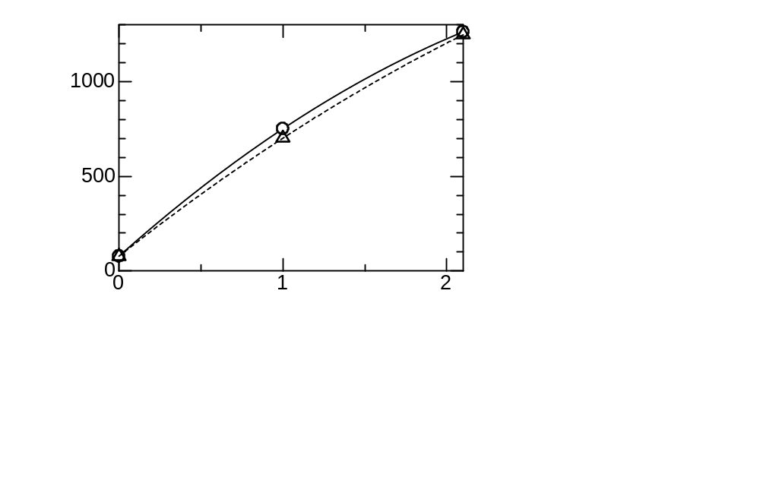
Calculation of Convective Heat Flux
Temperature gradient in the z direction
T [○C]
○: G=1
△: G=0.55
z [mm]
<Ethanol, r = 6.0 mm>
Temperature at z=0 is assumed boiling point at fuel surface.
In 0.55G, flame temperature decreased.
Notes:
First, I will explain Calculation method of Convective Heat Flux
This graph is temperature gradient in the z direction.
●Temperature at z=0 is assumed boiling point at fuel surface.
●In 0.55G, flame temperature decreased.

Slide 32
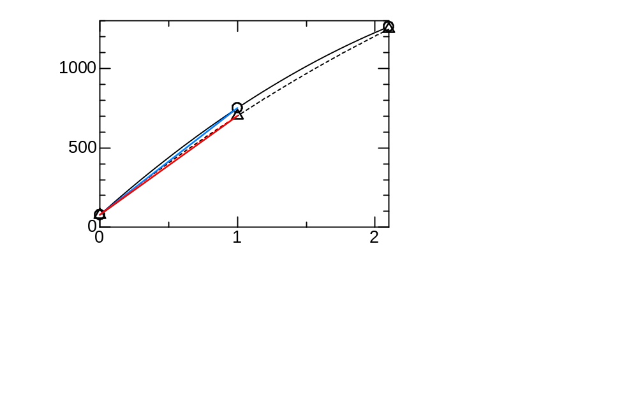
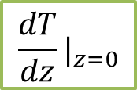
Calculation of Convective Heat Flux
Temperature gradient in the z direction
T [○C]
G=1
881.19
[K/mm]
○: G=1
△: G=0.55
G=0.55
819.56
[K/mm]
$$\frac{dT}{dz}|_{z=0}$$
z [mm]
<Ethanol, r = 6.0 mm>
Calculate temperature gradients at z = 0.
Temperature gradients decrease in 0.55G.
Notes:
We calculated temperature gradients at z = 0.
Temperature gradients decrease in 0.55G.

Slide 33
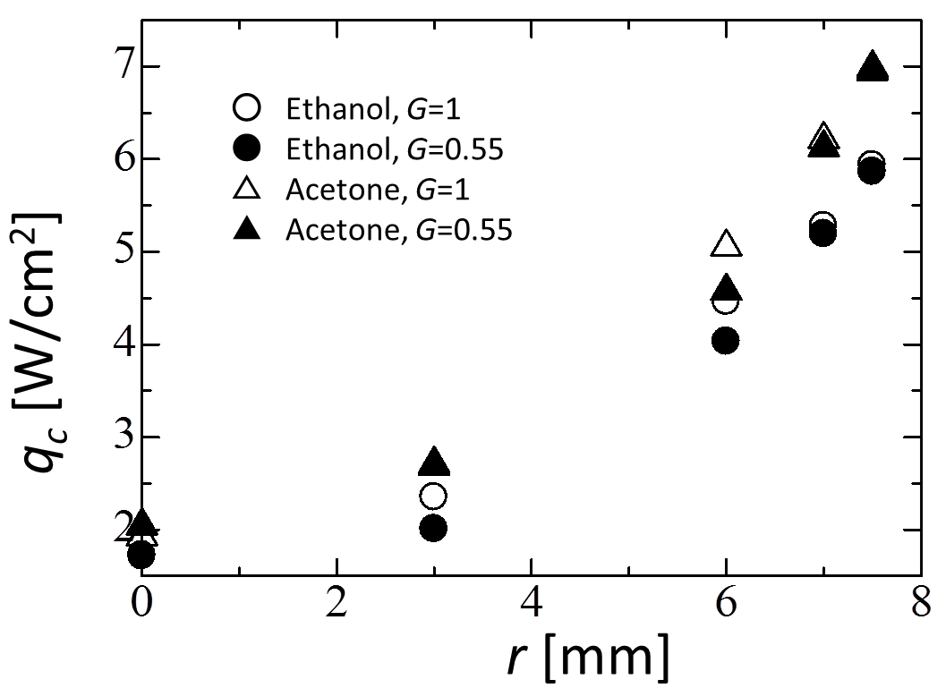
Distribution of Convective Heat Flux
Flame
0
Pan
Heat flux to the fuel surface decreases in 0.55G
Especially, qc at r = 6 mm decreases significantly.
Notes:
This graph is distribution of Convective Heat Flux
Heat flux to the fuel surface decreases in 0.55G.
●Especially, qc at r = 6 mm decreases significantly.

Slide 34
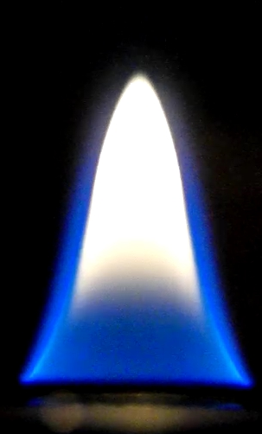
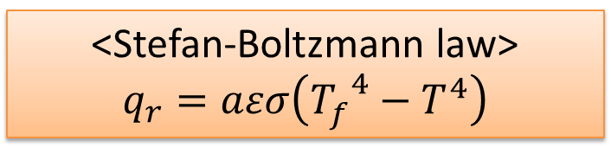

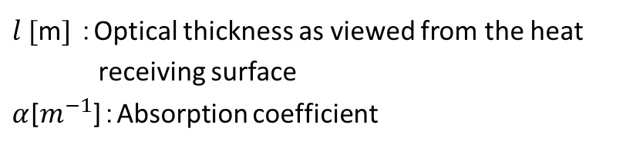


Calculation of Radiative Heat Flux
Acetone
<Stefan-Boltzmann law>
$$q_{r}=aεσ\left({T_{f}^{}}^{4}−T^{4}\right)$$
$ε=1−exp\left(αl\right)$
$$l$$
$l$ [m] ：Optical thickness as viewed from the heat
receiving surface
$α$[$m^{−1}$]：Absorption coefficient
To estimate emissivity , we used the “flame radiation absorption model”. Following this model, emissivity depends on 𝑙.
The $l$ was assumed as the straight distance from the heat receiving surface to the flame sheet.
Notes:
Next, I will explain Calculation method of radiative Heat Flux
To estimate emissivity, we used the “flame radiation absorption model”. Following this model, emissivity depends on 𝑙.
The 𝑙 was assumed as the straight distance from the heat receiving surface to the flame sheet.

Slide 35
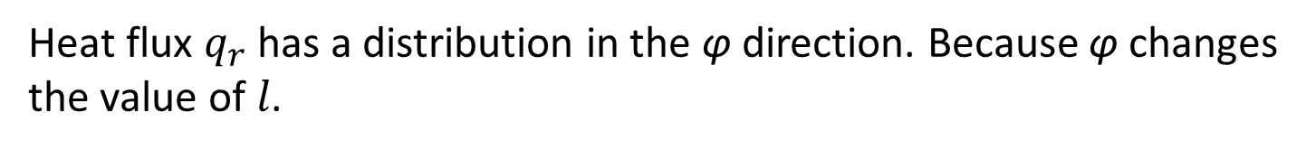
Calculation of Radiative Heat Flux
Acetone
<Stefan-Boltzmann law>
$$q_{r}=aεσ\left({T_{f}^{}}^{4}−T^{4}\right)$$
$ε=1−exp\left(αl\right)$
φ
$l$ [m] ：Optical thickness as viewed from the heat
receiving surface
$α$[$m^{−1}$]：Absorption coefficient
Heat flux $q_{r}$has a distribution in the φ direction. Because φ changes the value of 𝑙.
Therefore, we calculated the heat flux by each φ.
Notes:
We defined the angle φas shown in this figure.
Heat flux 𝑞_𝑟 has a distribution in the φ direction. Because φ changes the value of 𝑙.
Therefore, we calculated the heat flux by each φ.

Slide 36
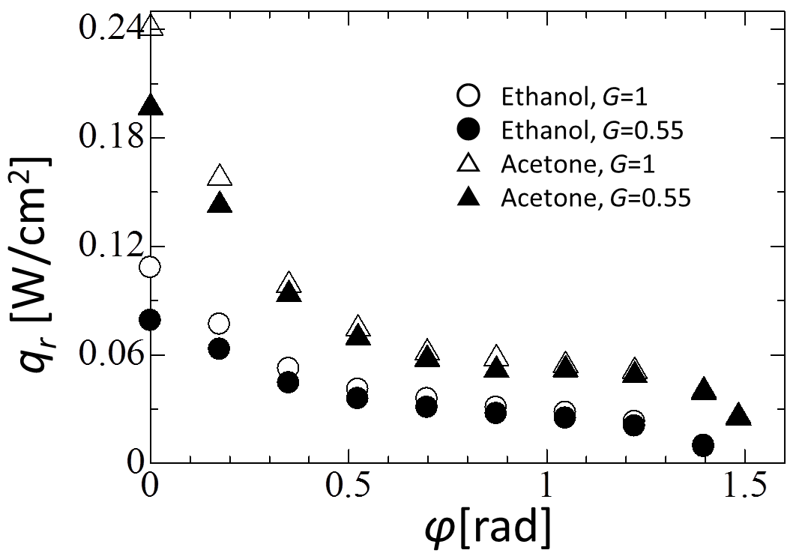
Distribution of Radiative Heat Flux
φ=0
Flame
φ=0.5
0
Pan
As gravity level increases, the heat flux decreases.
Notes:
This graph is distribution of radiative heat flux.
As gravity level increases, the heat flux decreases.

Slide 37

Distribution of Radiative Heat Flux
1G
Flame
0.55G
$$l$$
0
Pan
In φ =0, the heat flux decreased most in 0.55G.
Because the change of 𝑙 is the largest.
As φ increases, the heat flux came to little change.
Because the width of the flame does not change.
Notes:
In φ =0, the heat flux decreased most in 0.55G.
Because the change of 𝑙 is the largest.
●As φ increases, the heat flux came to little change.
Because the width of the flame does not change.

Slide 38
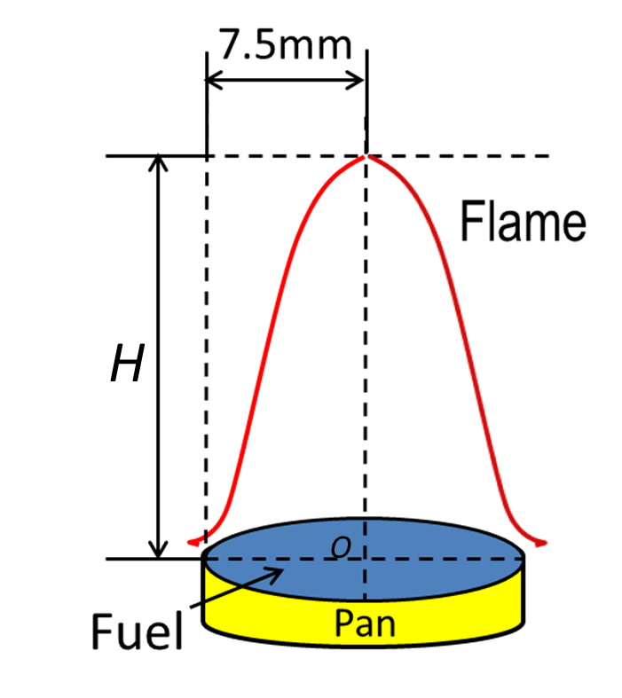
Calculation of Heat Feedback
Amount of
heat feedback
Heat flux
The amount of heat feedback was derived
by integrating the calculated heat flux.
Notes:
The amount of heat feedback was derived by integrating the calculated heat flux.

Slide 39
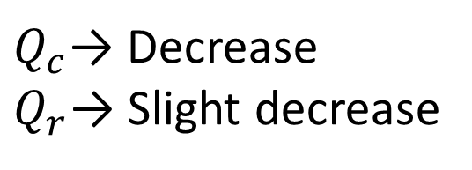
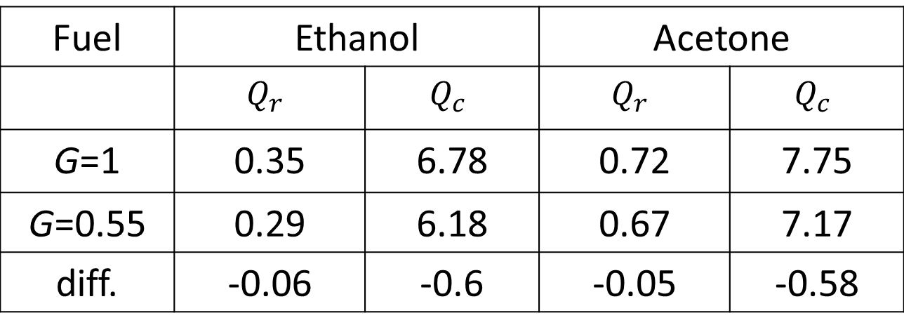
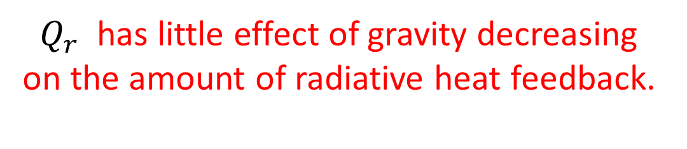
Calculation Result
Compare the amount of heat feedback of
the radiation with that of the conduction
Fuel | Ethanol |  | Acetone
 | $$Q_{r}$$ | $$Q_{c}$$ | $$Q_{r}$$ | $$Q_{c}$$
G=1 | 0.35 | 6.78 | 0.72 | 7.75
G=0.55 | 0.29 | 6.18 | 0.67 | 7.17
diff. | -0.06 | -0.6 | -0.05 | -0.58
[W]
$Q_{c}$→ Decrease
$Q_{r}$→ Slight decrease
$Q_{r}$ has little effect of gravity decreasing
on the amount of radiative heat feedback.
Notes:
Compare the amount of heat feedback of the radiation with that of the conduction
𝑄𝑐 decreased
𝑄𝑟 Slight decreased
So, 𝑄𝑟 has little effect of gravity decreasing on the amount of radiative heat feedback.

Slide 40
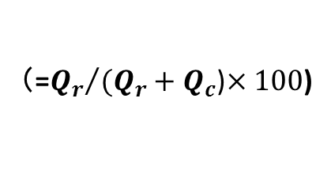
The Ratio of Radiative Heat Feedback
The ratio of amount of radiative heat feedback
Fuel | Ethanol | Acetone
G=１ | 4.91 % | 8.50 %
G=0.55 | 4.48 % | 8.55 %
（=${Q_{r}}/{(Q_{r}+Q_{c}}$)$×100$)
Acetone has larger proportion of the radiative heat feedback.
Decreasing rate of flame height
Ethanol | Acetone
8.9% | 7.2%
Acetone has small decreasing rate of flame height.
Notes:
This table is the ratio of amount of radiative heat feedback
Acetone has larger proportion of the radiative heat feedback.
On the other hands,
This is decreasing rate of flame height
Acetone has small decreasing rate of flame height.

Slide 41
Discussion
Notes:
So we considered about the heat feedback amount
そこで燃料蒸発量を決定する要因である
熱フィードバック量について考えました

Slide 42
Structure of The Pool Fire
Normal gravity environment
Gravity
Natural convective
flow
Flame
Heat Feedback
Fuel evaporation
Rim
Fuel
Occurrence of natural convection due to gravity.
Fuel evaporation due to heat feedback from the flame.
Notes:
In normal gravity environment,
●Major characteristics in the pool fire is occurrence of natural convection by gravity
●Natural convection transport fuel vapor, oxygen and combustion gas
Fuel vapor is burned and fuel receive heat feedback from the flame

Slide 43
Structure of The Pool Fire
Partial gravity environment
Gravity
Natural convective
flow
Flame
Heat Feedback
Fuel evaporation
Rim
Fuel
Decrease natural convection due to gravity
Notes:
In partial gravity environment,
Natural convection is decreased ●

Slide 44
Structure of The Pool Fire
Partial gravity environment
Gravity
Natural convective
flow
Flame
Heat Feedback
Fuel evaporation
Rim
Fuel
Decrease natural convection due to gravity
Amount of fuel vapor is decreased by decrease heat feedback
Notes:
And amount of Fuel vapor is decreased by decreasing heat feedback

Slide 45
Structure of The Pool Fire
Partial gravity environment
Gravity
Natural convective
flow
Flame
Heat Feedback
Fuel evaporation
Rim
Fuel
The radiative heat feed back is hardly affected by the gravity.
So, Flame height of acetone doesn’t relatively decreased.
Notes:
The radiative heat feedback is hardly affected by the gravity.
So, Flame height of acetone doesn’t relatively decreased.

Slide 46
Conclusion
We have performed the partial gravity experiment
to estimate the heat feedback of a small-scale pool fire
The amount of heat feed back decreases in partial gravity environment
2. Flame height is decreased due to that amount of
fuel vapor is decreased
3. The flame which has large proportion of the radiation
has little influence by gravity.
Notes:
We have performed the partial gravity experiment to estimate the heat feedback of a small-scale pool fire
The amount of heat feed back decreases in partial gravity environment
Flame height is decreased due to that amount of fuel vapor is decreased
The flame which has large proportion of the radiation has little influence by gravity.

Slide 47
Thank you for your kind attention

Slide 48
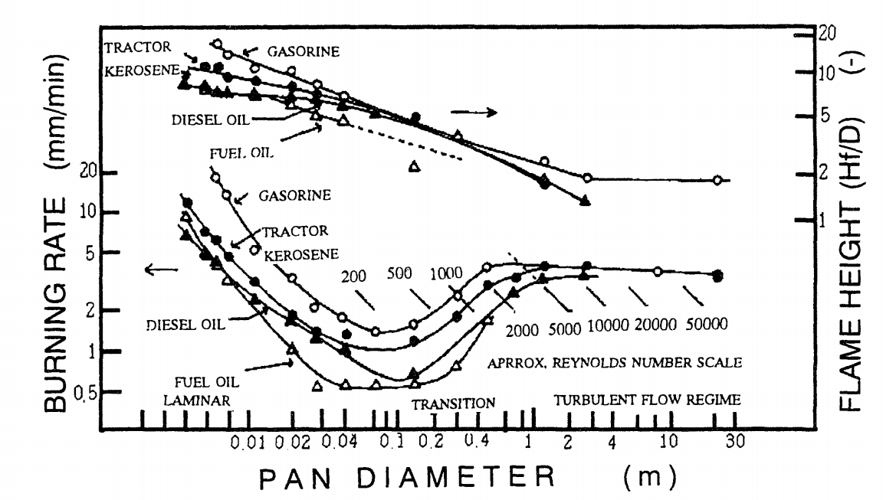
Heat feedback mechanism(仮)
As pool fire scale more lager, convective heat feedback decrease. And radiation become to be dominant.

Slide 49
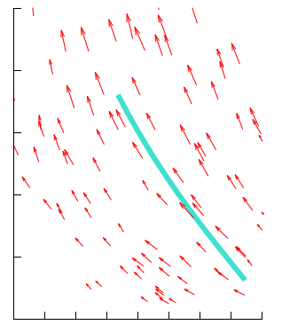
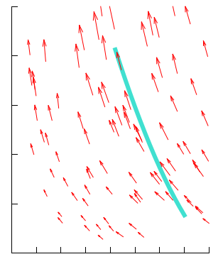
火炎基部流れ場ベクトル図
10
10
8
Flame
sheet
Flame
sheet
8
z [mm]
z [mm]
6
6
4
4
2
2
0
1
2
3
4
5
6
7
8
0
1
2
3
4
5
6
7
8
0.5 m/s
r [mm]
r [mm]
Rim
Rim
G = 0.5
G = 1
・ z の増加に伴い速度増加
・ 火炎面への空気流入
燃料槽上端から z = 5 mm

Slide 50
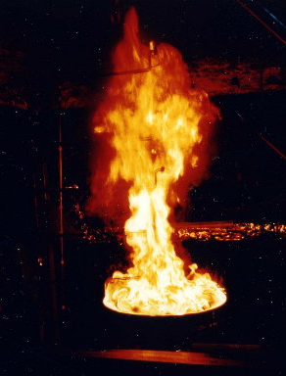
Pool Fire
In this study, we will discuss on small-scale pool flame.
Feedback of knowledge
Small-scale
Middle-scale
Large-scale
It is difficult to treat a large-scale pool fire experimentally.
By finding and using a scaling law, it is possible to grasp the burning characteristics of an actual scale fire from the experimental results of laboratory scale fire.
Notes:
In the fire research, it is desirable that we do the experiments with real scale.
But, handling of large-scale pool fire is dangerous and difficult.
Therefore, small-scale pool flame is targeted in this study.
We aim to apply the resulting knowledge to the real scale of the flame.
火災研究においては、実規模による研究を行うのが最も望ましいですが、大型プール火炎の取り扱いは危険かつ困難です。
そこで、●本研究では実験室で取り扱い可能な小型プール火炎を対象とし、●得られた知見を実規模の火炎に応用することを目標としています。

Slide 51
Pool Fire
The structure of the pool flame
Flame
Heat
Feedback
Radiation
Convection
Evaporated
Fuel
Fuel
Convection
Radiation
The heat feedback amount
The radiation is dominant in real scale fire
Notes:
There are two the heat feedback, Convection and Radiation.
Radiation is dominant in the real scale fire.
ここで熱フィードバック量には対流項と放射項の２種類があり、実規模火災では放射項が支配的となります

Slide 52
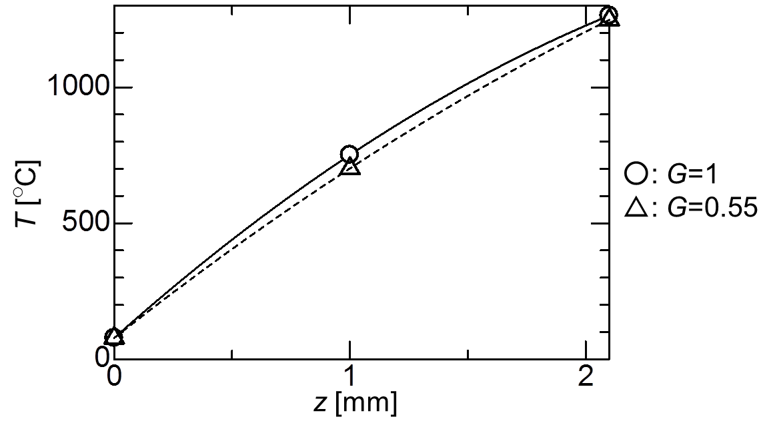
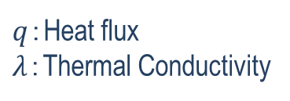


熱流束の算出 –Calculation of Heat Flux-
＜Fourier’s Law＞
$$q=−λ\frac{∂T}{∂z}$$
$q$：Heat flux
$λ$：Thermal Conductivity
$λ$is the thermal conductivity of air for the average temperature between z=0 and 1.
Notes:
続いて、フーリエの法則を用いて液面方向への熱流束を算出します。
本研究ではガスの流動による熱伝達を考慮せず、火炎内のガスの熱伝導のみで考えます。
●熱伝導率λには、z=0 と 1 との平均温度に対する空気の熱伝導率を使用します。
●そして、熱伝導率λと先程算出した温度勾配を乗じて、熱流束qを算出しました。

Slide 53

温度勾配 -Temperature Gradient-
T [○C]
G=1
881.19
[K/mm]
○: G=1
△: G=0.55
G=0.55
819.56
[K/mm]
$$\frac{dT}{dz}|_{z=0}$$
z [mm]
<Ethanol, r = 6.0 mm>
z = 0 における温度勾配を算出
Calculate temperature gradients at z = 0
低重力環境 → 温度勾配は低下
Temperature gradients decrease under partial gravity environment
Notes:
このz方向の温度分布から、●今度は液面 (z=0) における、液面方向への温度勾配を算出します。
低重力環境ではこちらに数値で示したように、●z=0における温度勾配dT/dzは低下していることがわかります。

