Slide 1
Maxilla’s Occlusal Plane –Tool for Orientation in Space?
A new Aspect concerning Temporomandibular Disorder (TMD)
Ruth Nebel, physician, Berlin, Germany
31.03.2016
7th Global dentists and Pediatric dentistry annual meeting 2016
Valencia, Spain
Notes:
Ladies and Gentlemen, my colleages,
Good afternoon.
Ist nice to see so many people from so many countries here.
My name is Ruth Nebel, I am a physician and I graduated in 2014 at the Charité in Berlin. Before that, I was working as a physiotherapist with people with chronic pain.
I would like to outline a problem in the understanding of occlusion. Occlusion has become a main parameter in dentistry and in the treatment of temporomandibular disorders. This is due to the assumption that occlusion is connected to posture.
An incorrect occlusion is thought to be able to cause changes in posture and pain.
But is this true?

Slide 2
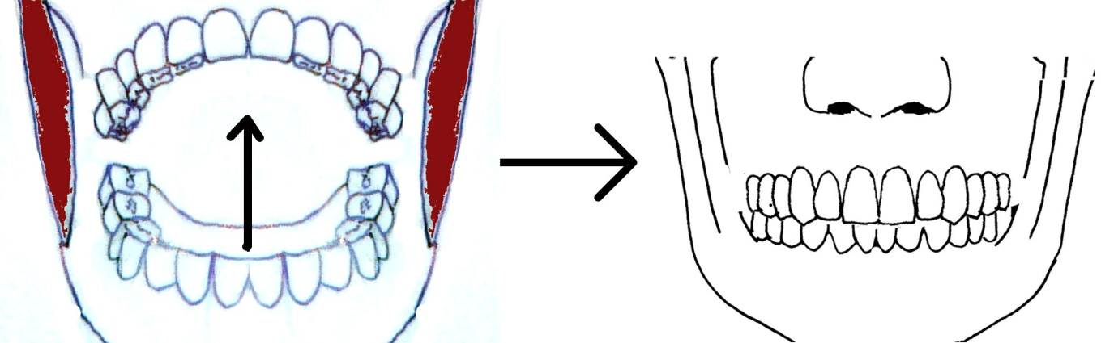
Occlusion as a stomatognath function
?
Tooth contacts : sensitive impulses
Vector: course of chewing muscles
Active movement
Happens < 1 h/day
„Muscular dysbalances“: a muscular problem
?
?
?
?
?
?
Notes:
Occlusion is a parameter of the stomatognath, the chewing system. Tooth contacts are thought to be sensitive stimuli that normally are guided to the central nervous system to be processed there.

Slide 3
„Classic view“: „Disorders are related to the chewing function (occlusion)“
active tooth contacts
Chewing
system
Receptor (periodontium)
Trigeminal
nerve
Afferent sensitive impulse
?
Efferent motor effect
Influence on local muscles
Musculo-
skeletal
system
?
myofascial chains
?
?
?
influence on muscles, change of posture,
arousal of pain
Notes:
The assumed stimulus-and-response-reaction from occlusion to posture had to cross systems. The initial afferent sensitive stimulus is assumed to be converted into an efferent motor impulse. Such has not been observed yet.
This transduction is assumed to be performed by myofascial chains. We will later on see by the reaction parameters, that this is not possible. Myofascial chains are too slow compared to the fast reaction.
Today, I am going to challenge occlusion. I hypothesize that occlusion is not the parameter that is connected to posture. Pursuing the wrong parameter means to miss the right one. What influences posture if not occlusion?
I hypothesize that teeth have a function in two different systems.

Slide 4
Teeth: Function in two different systems
Chewing system
Postural system
Notes:
In some hundred studies, the connection of occlusion to posture has been investigated . In the interventional studies, occlusion was changed by a wafer and afterwards, posture was re-evaluated. The results were contradictious, as you certainly know: one part of investigations recorded a change in posture, while the other part did not.
This does not speak for a clear connection. This speaks for an acting confounder that influences results.
I was having a look at the thickness of the wafers. The thickness of the wafers seemed to correlate with the results: Thick wafers (over 2 mm) produced a change in posture, while thin wafers did not.
So possibly it is the heights or the length of teeth that cause the change in posture.

Slide 5
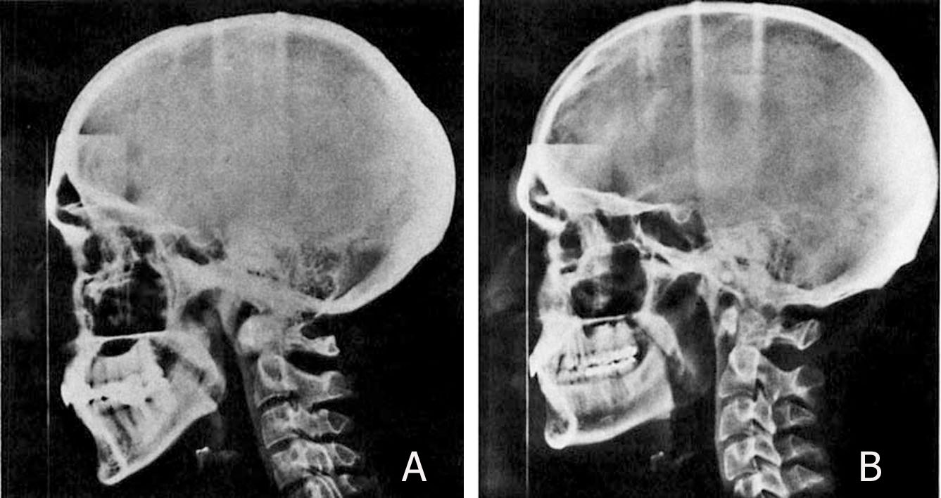
Craniofacial heights correlate to head posture (Solow; Tallgren)
Fig A: large anterior height
Head extension in relation to the spine
Fig B: large dorsal height
Head flexion in relation to the spine
Hypothesis: Head posture depends on heights, perhaps even on teeth height/ teeth length.
Notes:
An investigation from Solow and Tallgren found craniofacial heights correlating to head posture. These two radiographs have been taken in the natural head position, the self balance position. Fig A shows a large anterior height that correlates with a head extension in relation to the spine. Fig. B however shows a large dorsal height and correlates with a head flexion in relation to the cervical spine.
Another investigation, by Huggare, recorded a change in head posture in initially edentulous patients after they had been provided with a denture. Initially, most of the probands showed an NPH with and extended head posture. This improved towards a neutral posture with the denture.

Slide 6
Parameters of postural reaction
High speed
Direct connection
Unconscious
The bigger the stimulus, the larger the effect in posture)
Localisation of stimulus correlates with morphology of pattern in posture
counter-directed (tilt to the right, rotation to the left)
Notes:
I want to say a few words to body posture:
Body posture has got various influences. These may be individual aspects like sex, age, health state and mood. Further, there are common influences that are the same in all people. These are influences of the postural system.
The postural system adapts the individual to environmental conditions, like the gravitational direction. This is required to keep balance and to orientate in space. The function is set reactions. They appear in all people. Set reactions have a unique feature by which they may be detected: they show counter-directed components: head tilt to the right is combined with a rotation to the left.
Voluntary movements, like a look round have the rotation and the tilt to the same side.
Set reactions are: fast, unconscious, they directly connect impulse and reaction. The bigger the stimulus, the larger will be the extent of the set reaction.
Just have a look at set reactions that adapt body posture to the environment and to the force of gravity.

Slide 7
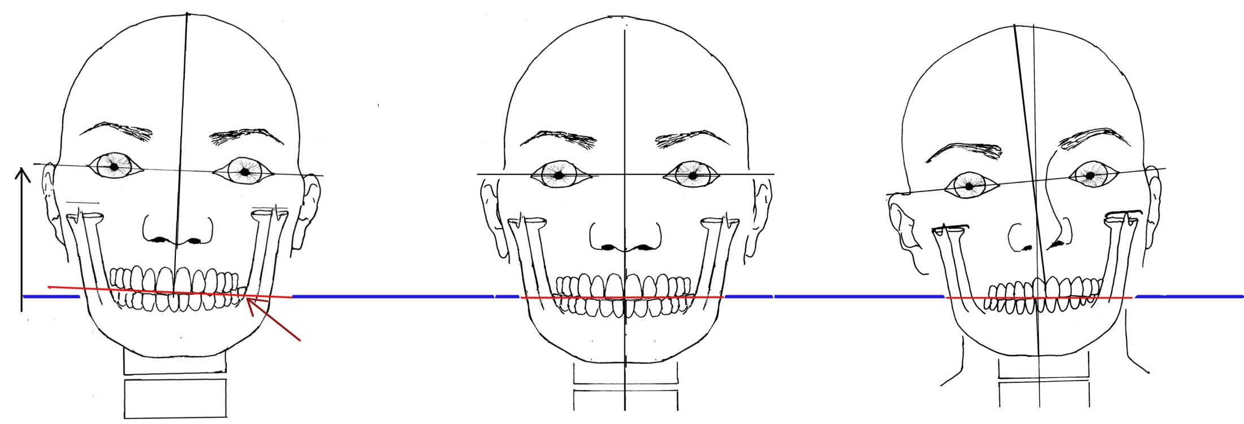
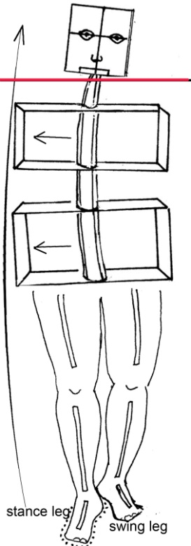
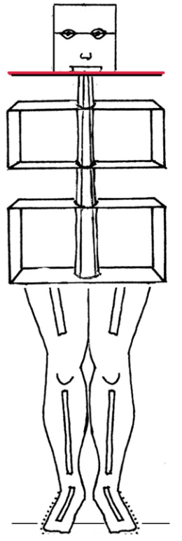
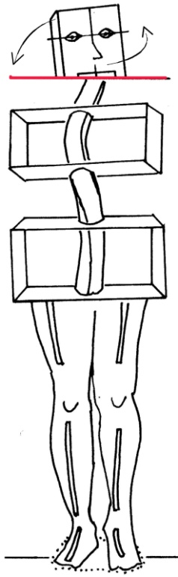
Centre position and set reactions:
Normal set reaction
Centre position
Non-phys. set reaction
V
True Horizontal
True Horizontal
Trigger:
external stimulus (stance leg)
Trigger:
dislocation of reference plane
Notes:
I am going to show you set reactions. Initially, you see my body axis upright, that means according to the gravitational direction. You see my supporting base where I am standing on: it is as large as my two feet and the area in between. My gravity-centre and the body axis is positioned right the middle of the supporting base.
Now, I am standing on one leg only, which has become the stance leg. The supporting base is reduced now to a third of the original size. the body sections pelvis and shoulder girdle are shifting above the supporting base under the right foot. They have to be aligned according to the gravitational direction and in balance . The whole body side above the stance leg lengthens up to the head. Head tilts to the side of the swing leg and rotates to the side of the stance leg.
This was a physiological set reaction.
Various investigations that looked after the connection between posture and occlusion. A heel lift was applied to one foot and then looked after a change in occlusion. It was not noticed that a physiological set reaction was being triggered. In the next slide, we will have a look at the interplay of teeth which is rather a postural performance than occlusion.
Now I am demonstrating a non-physiological set reaction by dislocating the reference plane: I am adding 3 mm of height to the left side of upper teeth.
Please take the frame for an objective relation of the head position or any other horizontal or vertical line.
You perhaps see my head tilt to the right side and rotate to the left side. The left shoulder rises.
This reaction does not depend on tooth contact, but is faster with tooth contact.
Various studies investigated the connection between occlusion and posture. They applied an asymmetric wafer and thereby triggered a non-physiologic set reaction.
The trigger is not external, but it is the dislocation of the body’s reference.
A system that adapts posture according to external goals, to gravitational force and spatial dimensions – can you imagine that this works without a reference? Should there be a reference within the body that turns spatially consistent during movement and orientation in space?
I hypothesize that the reference plane resides in the maxilla. During movement in space, not with gymnastics or while sleeping,l it is hypothesized to be positioned according the true horizontal and the movement direction.

Slide 8
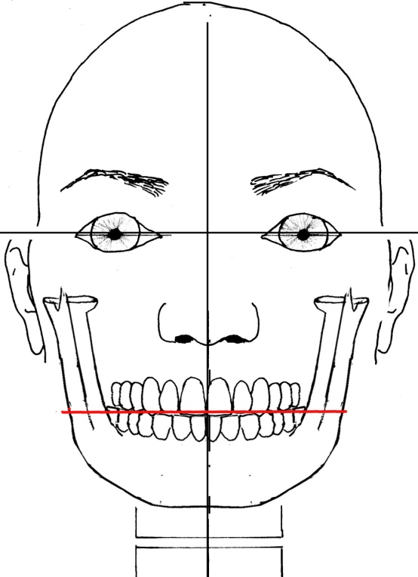
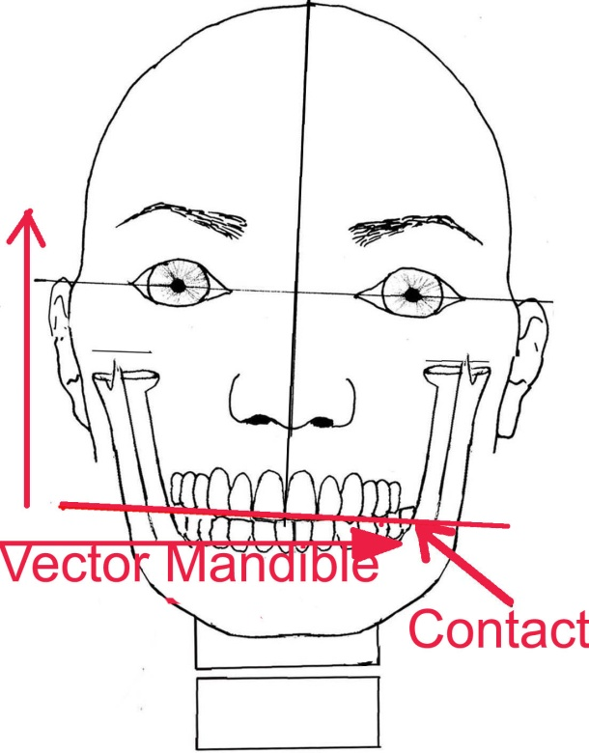
Tooth contacts: impulses about state of balance
tooth contacts:
horizontal
sensoric impulses
- done by inertia and passive sway of the mandible.
Set reaction
Lower teeth/ mandible:
supervises position of upper occlusal plane
sums up gravitational and individual vectors
Synopsis allows calculation of the state of balance in the CNS.
Notes:
We will have a closer look at the interplay of upper and lower teeth. The tooth contacts seem to represent the information about the state of balance.
Have a look at left figure: this is the posture of a man standing on two feet. The right figure shows this man during walking, in the stance phase on the right foot. The skull and upper teeth rise in the right side which is shown by the red line. Upper teeth diverge from the true horizontal. The mandible however, remains hanging along to gravity force, which is due to the inertia of a hanging object. Consequently, there will be a tooth contact in the lower side, the side of the swing leg.
This tooth contact probably indicates the limit of the upwards movement of skull and upper teeth. The upper teeth and the reference plane must not diverge from the true horizontal more than 3°, otherwise an acute loss of balance will follow.
By means of tooth contacts between upper and lower teeth, the postural sytem calculates the acceleration, the force and the direction of head and body. Hindering this afferences may be done by fixing the mandible. This was done to investigate the role of occlusion to posture. It was not noticed there, that the resulting poor balance was caused by hindering the postural afferences.
Classically, this is interpreted as an occlusal situation. I contradict to this and hypothesize that teeth serve as an indicator of the position of the true horizontal and the gravitational direction.

Slide 9
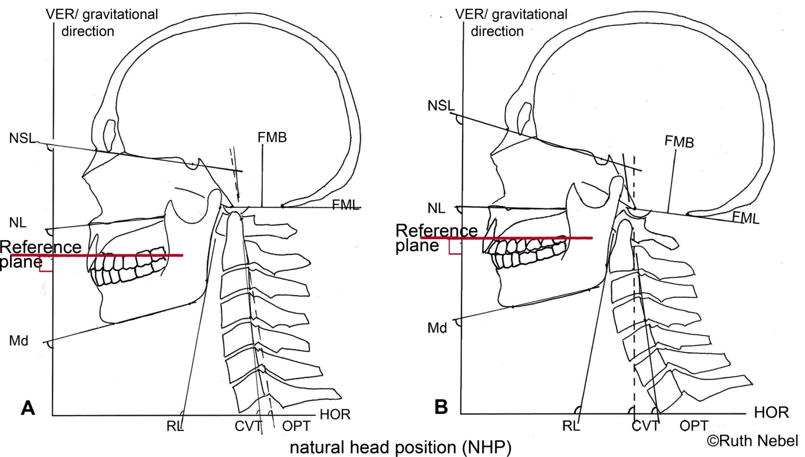
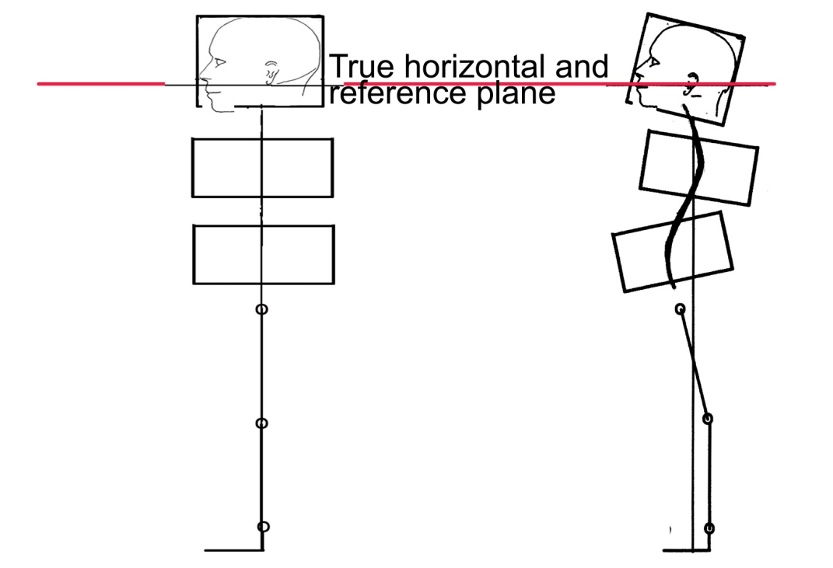
Set reactions in the sagittal plane
True horizontal and
reference plane
The reference plane is
positioned according the
true horizontal
Notes:
Please have a look at head and body posture in the sagittal plane.
Figure A above and below show a head posture with normal upper teeth and a normal body posture.
The red line marks the reference plane, which is according to the true horizontal.
In Fig. B above and below, the dorsal teeth length is reduced. The reference plane now ascends from frontal to dorsal relative to skull. Nevertheless, it is positioned according to the true horizontal.
Changes in teeth length may happen while manufacturing a prosthesis. They affect the Natural head posture and the body posture.
These patterns are suitable for diagnostics of disorders caused be wrong teeth height.

Slide 10
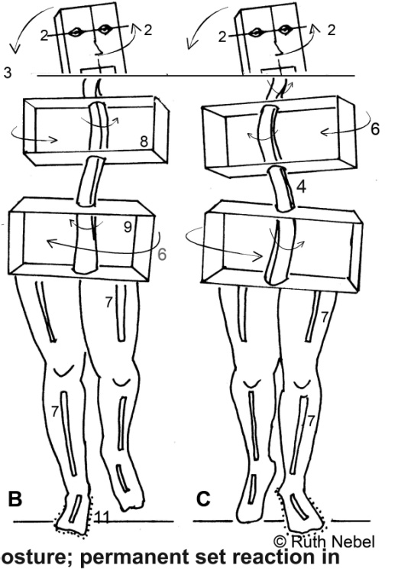
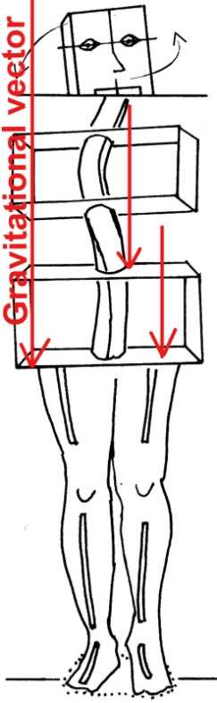
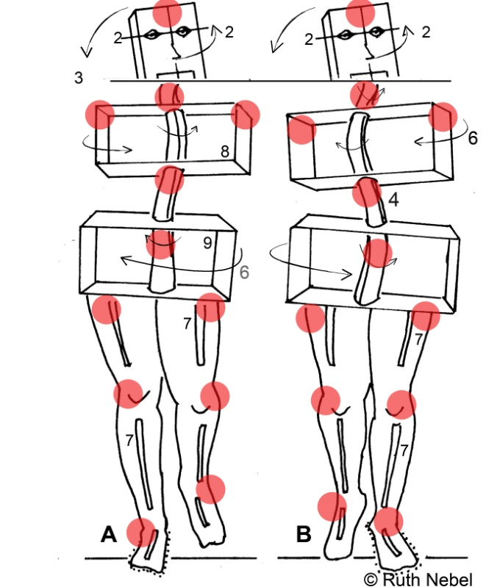
Shearing forces by set reactions- origin of severe pain?
3 D- adjustment to keep reference plane stable
In movement, the spine winds like a bottle screw
The gravitational force acts as a shearing force on the spine
Pain will arise after years
Notes:
In the frontal plane, we have tilts and rotations.
In motion, a set reaction due to a dislocated reference plane causes the spine wind around the gravitational direction. Further, the gravitational force does not act axially on the spine, but becomes a shearing force. Permanent incorrect load will damage joints, muscles, ligaments and bones over the years. The reference plane is kept consistent to space at the cost of the body, which tilts and rotates like a bottle screw in three dimensions.

Slide 11
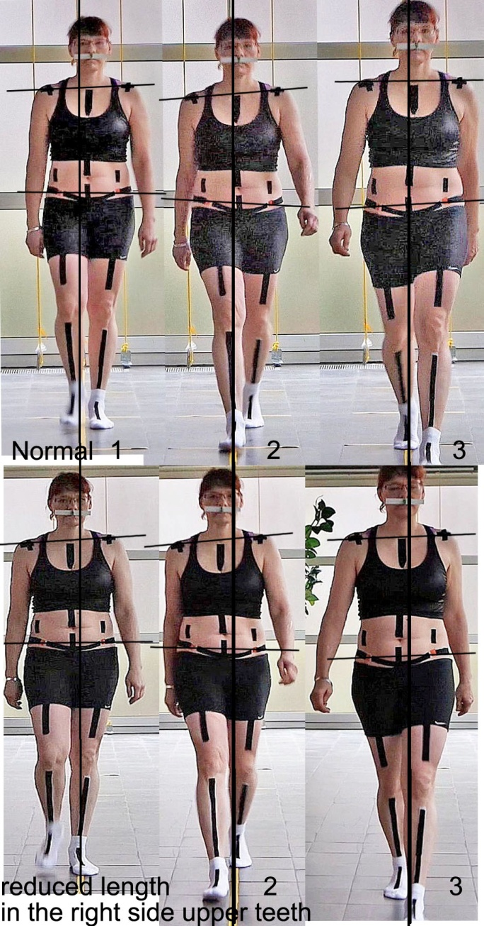
Reference plane spatial consistent?–
Test: Marking cross and change in teeth length
Trial 1: Reference plane cconsistent to space?
gait with normal teeth length.
Trial 2: How will the reference plane behave, if teeth length is reduced in the right hand side?
Notes:
A trial is required to check, if upper teeth are really consistent to the true horizontal. The marking cross is fixed to native upper teeth that represents the hypothetical consistent plane. Initially, it is adjusted to the true horizontal and the movement direction. The marking cross represents a plane of upper teeth Result: The marking cross respectively the searched plane, has proved to be spatially consistent. Besides the shoulder girdle and the pelvis, which are not consistent in space, the marking cross represented the only layer of the body that was consistent to space.
In a second trial, the wafer for the upper teeth is prepared asymmetrically: In the left hand side, it is added another 3 mm of thickness.
Results: The marking cross that has been adjusted according ton the true horizontal and the movement direction, now runs at an angle to the head. Its wings remain according to the true horizontal and the movement direction. Again, it is spatially consistent.”

Slide 12
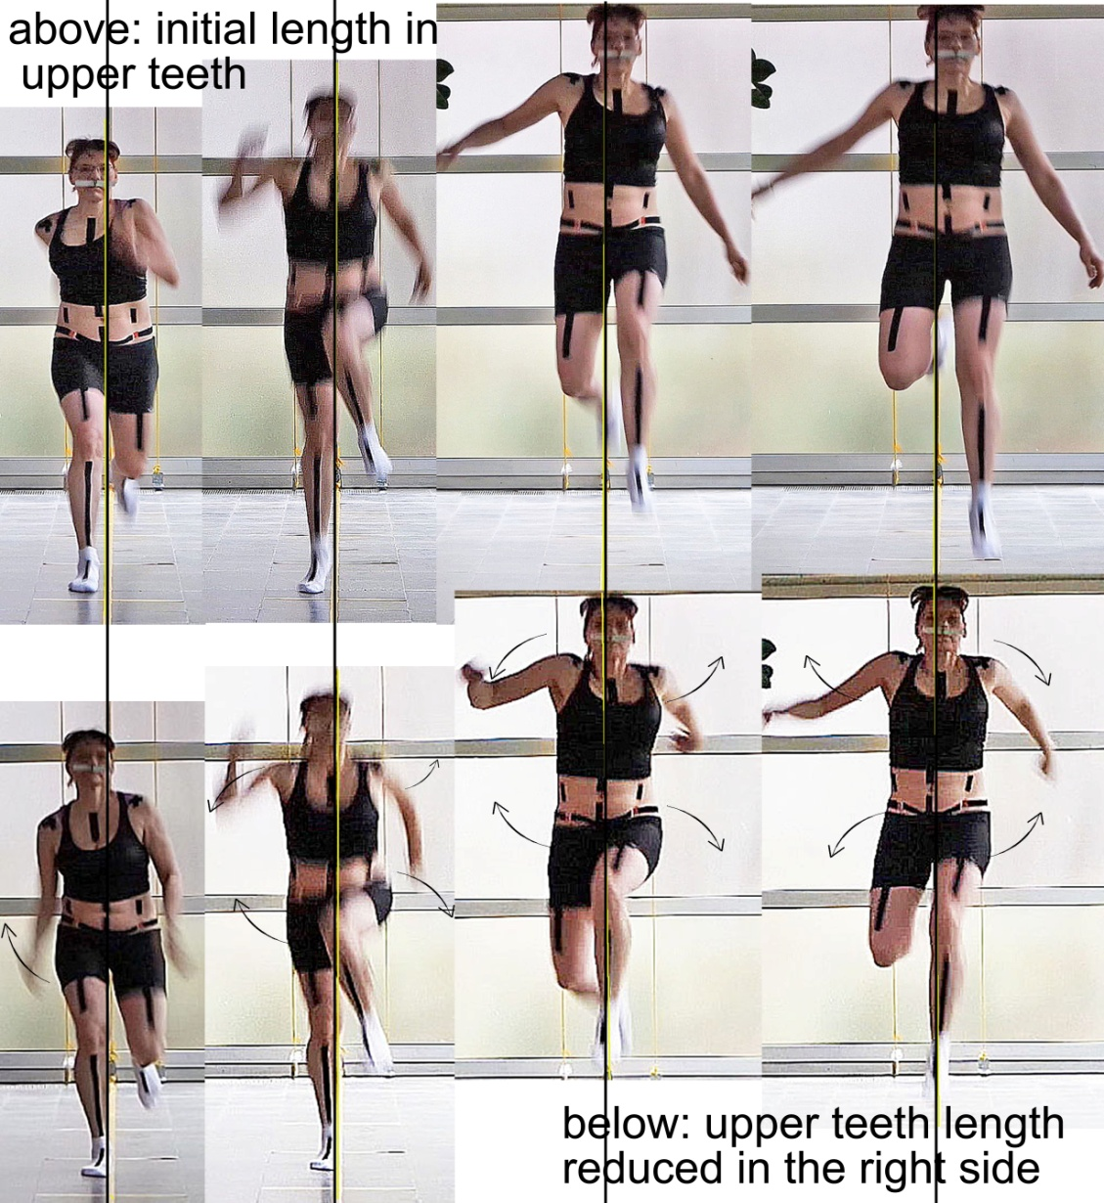
Reference plane: consistent in space - movements: altered
Movement aspects: Lengthening of stance side.
Axial loading.
Normal upper teeth length
Movement aspects:
Tilts and rotations in opposing directions.
Incorrect loading.
Reduced upper teeth length in the right side
Notes:
This trial was repeated in both the native (above) and the asymmetric version (below) in jumping. Results: Even in jumping, the marking cross stays nearly consistent in space. Correlating is a specific change in posture/ movements by non-physiologic set reactions.To keep the reference plane stable in space, the movement obviously is adjusted in every single phase of movement and in every fraction of a second
Hence, this has to be a fast reaction.
If we were going to test a new height to the patient’s teeth by a wafer - for how long do we have to wait for the reaction in posture?
3 weeks, three days or 3 minutes? We can re-evaluate the new height three minutes later and try the next version.

Slide 13
Integrating the postural aspects into practice
dental treatment , treatment of TMD and maxillary surgery probably suffer from the neglection of the postural function of teeth
Treatment should improve by integrating the postural aspects
requires teaching concerning set reactions
Requires modification of the dental equipment, e.g. the articulator.
Notes:
It seems probable that the weakness of dental treatment and the origin of TMD depend on the neglect of the postural function.
To provide relief, the postural aspects have to be integrated into practice. This requires the diagnostic evaluation of set reaction to decide how to improve the situation of the patient.
As this is not well-known, some teaching may be required.
Dental equipments needs an upgrade to show integrate theenvironmental and the postural situation.

Slide 14
Outlook:
An investigation (Vicon 3 D gait analysis with passive markers) is required. Please contact me.
Thanks to
Prof. Lothar Beyer
Dr. Ulrike Sauermann
Dr. Doris Bolk-Weischedel
Dorothee Nebel
Malene Firniss ruth.nebel@mail.de
Thank you for your attention.

