Slide 1

A Rational Approach to Identification of Wild Type Trans-sialidases for the Production of Human Milk Oligosaccharides
By Rune Thorbjørn Nordvang
BioEng
Institute for Chemical and Biochemical Engineering
Technical University of Denmark
Glycobiology World Congress
August 11th 2015
Philadelphia

Slide 2
Outline
Human Oligo Saccharides - structures and properties
The BioEng HMO production setup (for sialyllated HMOs)
In silico Trans-sialidase discovery
  Strategy development
  In silico results
In vitro verification
  Experimental
  In vitro results
Conclusions & Perspectives

Slide 3
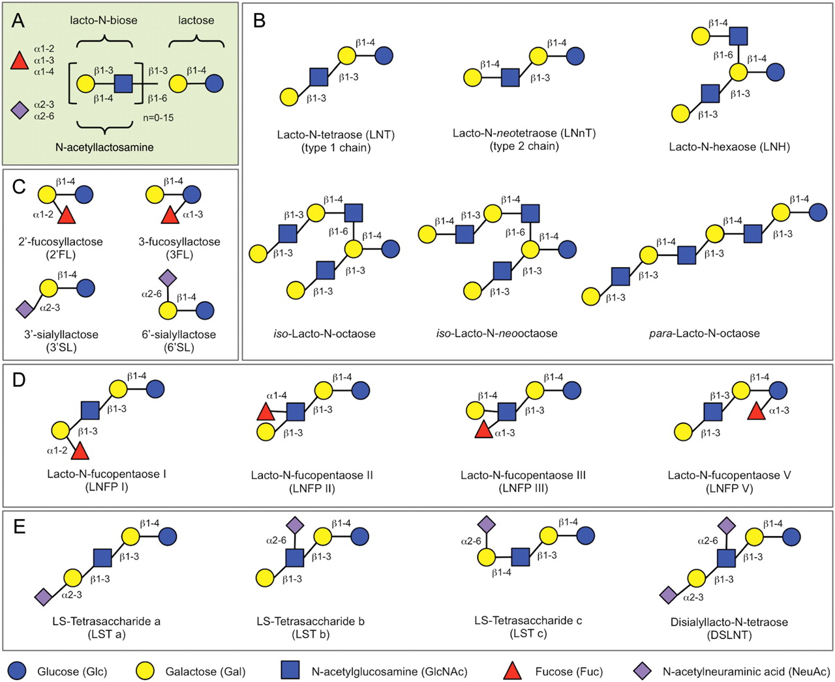

HMO blueprint and selected HMO structures
Bode L Glycobiology 2012;22:1147-1162
© The Author 2012. Published by Oxford University Press. All rights reserved. For permissions, please e-mail: journals.permissions@oup.com
Notes:
HMO blueprint and selected HMO structures. (A) HMOs follow a basic structural blueprint. (Monosaccharide key is shown at the bottom of the figure.) (B) Lactose can be fucosylated or sialylated in different linkages to generate trisaccharides. (C) Lactose can be elongated by addition of either lacto-N-biose (type I) or N-acetyllactosamine (type II) disaccharides. Addition of disaccharides to each other in the β1-3 linkage leads to linear chain elongation (para-HMO); a β1-6 linkage between two disaccharides introduces chain branching (iso-HMO). (D) Elongated type I or II chains can be fucosylated in different linkages to form a variety of structural isomers, some of which have Le blood group specificity (Figure 3). (E) The elongated chains can also be sialylated in different linkages to form structural isomers. Disialylated lacto-N-tetraose (bottom right) prevents NEC in neonatal rats.

Slide 4
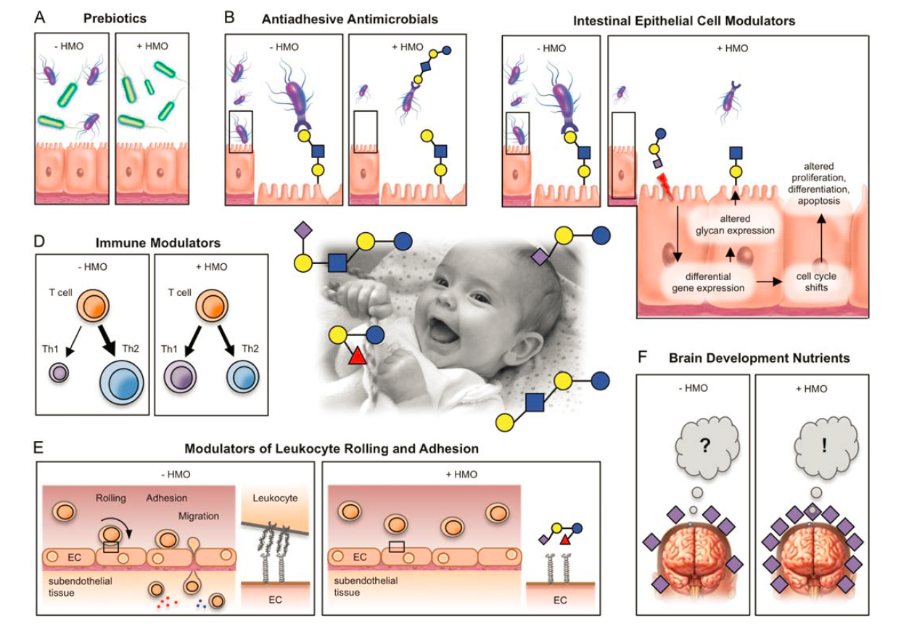
Enzyme-catalysed synthetic HMO production setup
Bode L Glycobiology 2012;22:1147-1162
© The Author 2012. Published by Oxford University Press. All rights reserved. For permissions, please e-mail: journals.permissions@oup.com
Notes:
HMO blueprint and selected HMO structures. (A) HMOs follow a basic structural blueprint. (Monosaccharide key is shown at the bottom of the figure.) (B) Lactose can be fucosylated or sialylated in different linkages to generate trisaccharides. (C) Lactose can be elongated by addition of either lacto-N-biose (type I) or N-acetyllactosamine (type II) disaccharides. Addition of disaccharides to each other in the β1-3 linkage leads to linear chain elongation (para-HMO); a β1-6 linkage between two disaccharides introduces chain branching (iso-HMO). (D) Elongated type I or II chains can be fucosylated in different linkages to form a variety of structural isomers, some of which have Le blood group specificity (Figure 3). (E) The elongated chains can also be sialylated in different linkages to form structural isomers. Disialylated lacto-N-tetraose (bottom right) prevents NEC in neonatal rats.

Slide 5
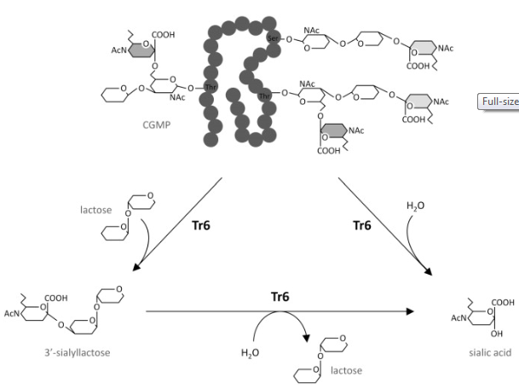
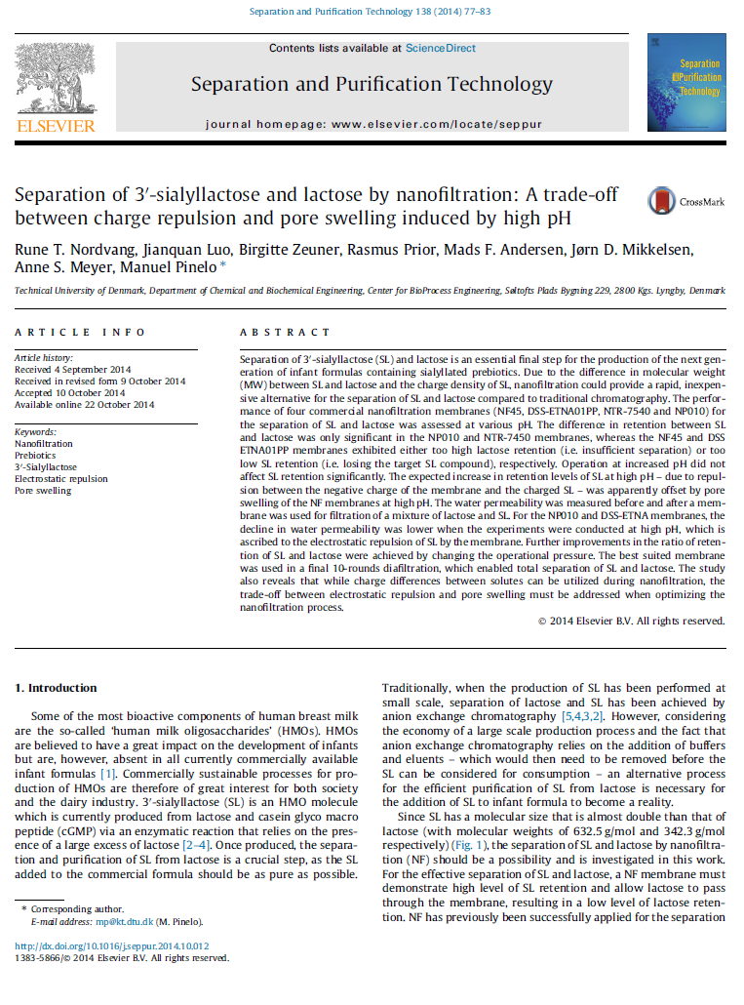
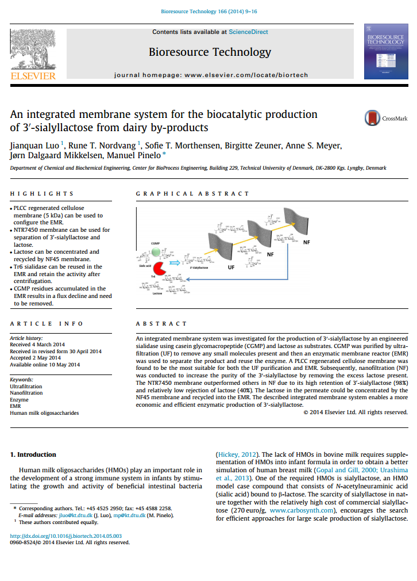
Enzyme-catalysed synthetic HMO production setup
cGMP
Enz.
Enz.
Enz.
Figure adapted from:
Zeuner B, et al. 2014 Enzyme and Microbial Technology 55:85-93

Slide 6
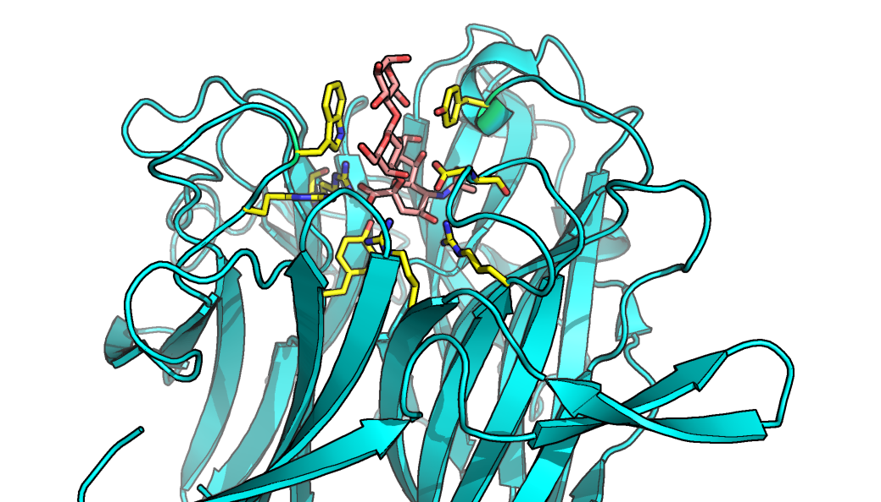
One native trans-sialidase is known
TcTS model based on Amaya M.F., et.al. (2004) Structure 12: 775–784

Slide 7
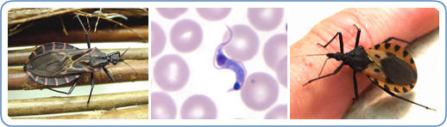
The trans-sialidase of Trypanosomas cruzi
TcTS model based on Amaya M.F., et.al. (2004) Structure 12: 775–784

Slide 8
The trans-sialidase of Trypanosomas cruzi
Not a sialyl-transferase
Virulence factor in a human pathogen
TcTS model based on Amaya M.F., et.al. (2004) Structure 12: 775–784

Slide 9
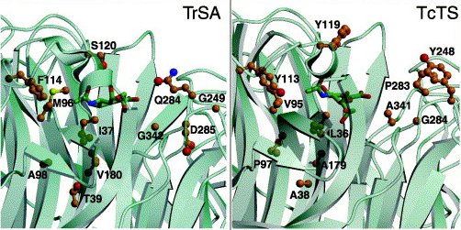
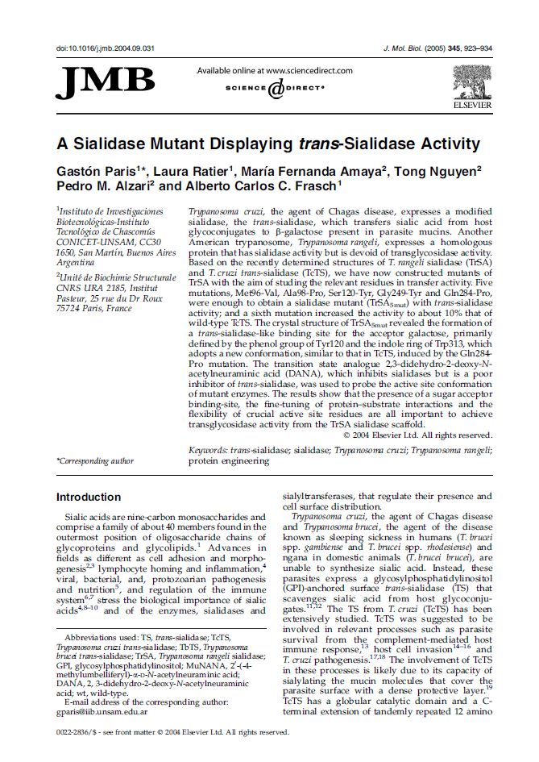
A quintuple mutant of it’s close cousin
from the non-pathogenic T. rangeli

Slide 10
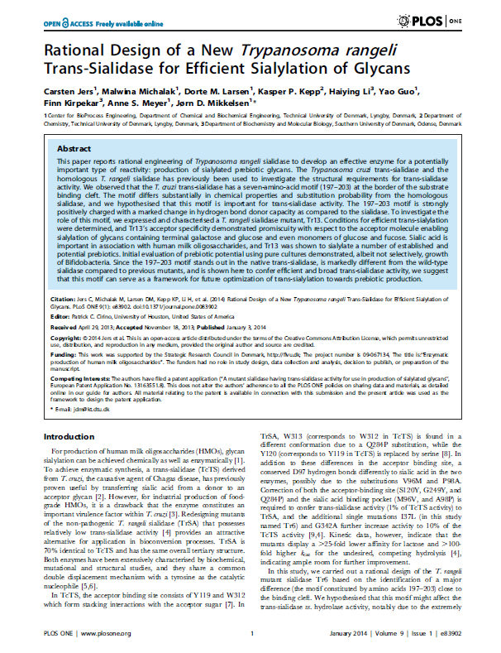
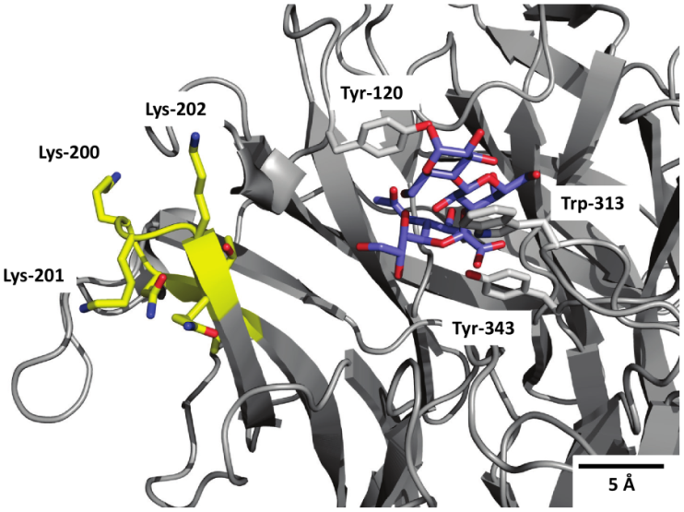
Tr13
Directed evolution

Slide 11
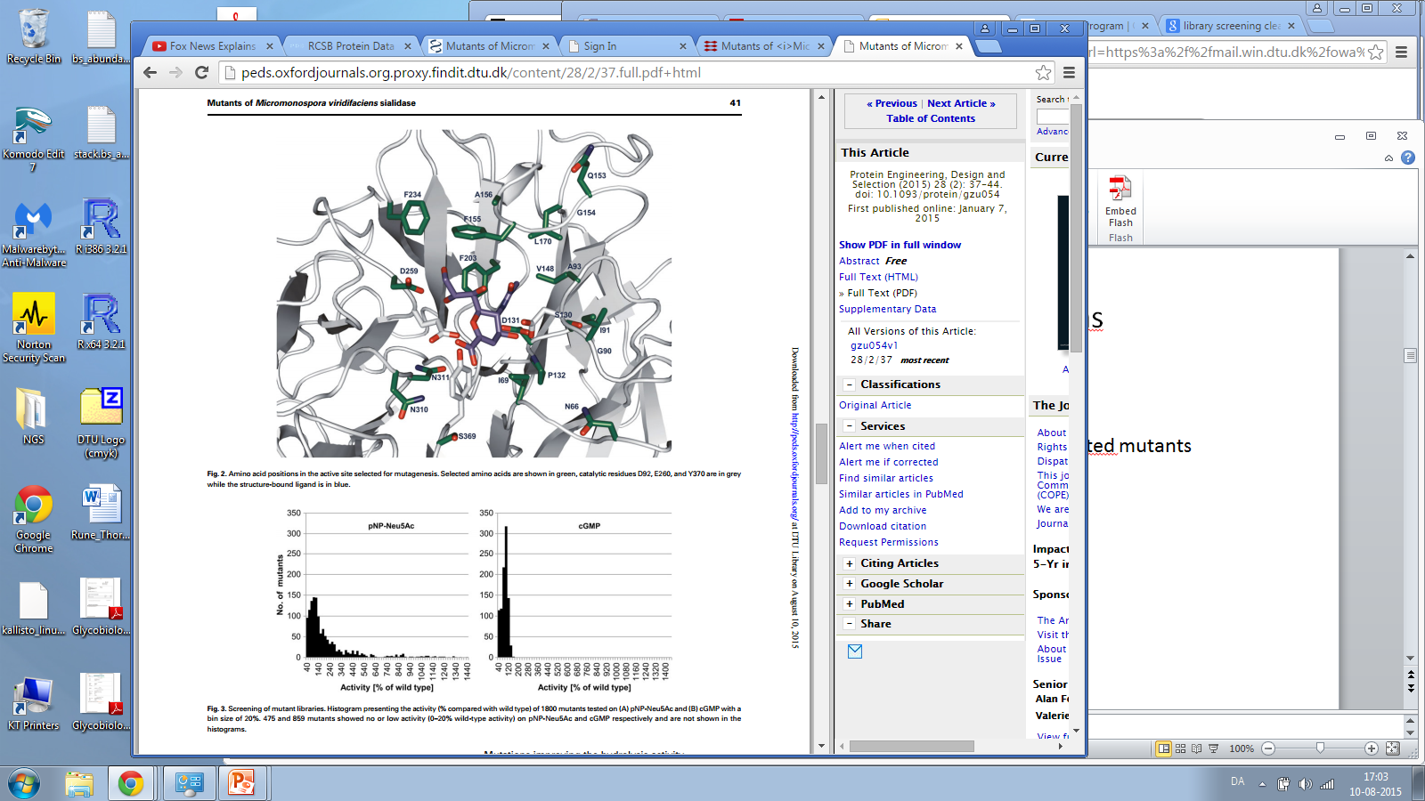
Compared to M. viridifaciens
Jers C, et al.
Oxford jour.
doi: 10.1093/
protein/gzu054
No trans-sialidase activity observed…
…From a pupulation of more than 200 constructed mutants

Slide 12
All avancements based on TcTS
New knowledge about trans-sialidases needed.
No trans-sialyllation screening assays.
Hard to find conserved AA when TcTS is the only trans-sialidase.
What to do?

Slide 13
Reaquaint with TcTS
Hydrophobic pocket
Conserved sialidase
active site
TcTS model based on Amaya M.F., et.al. (2004) Structure 12: 775–784

Slide 14
Enzyme identification strategy development
Hydrophobic pocket
Conserved sialidase
active site
TcTS model based on Amaya M.F., et.al. (2004) Structure 12: 775–784
Hypothesis 1: The family of sialidases is extremely conserved and it can be speculated that a trans-sialidase could have developed in parallel with the TcTS inferring an aromatic sandwich in a similar position as it is found in TcTS.

Slide 15
Enzyme identification strategy development
Hydrophobic pocket
Conserved sialidase
active site
TcTS model based on Amaya M.F., et.al. (2004) Structure 12: 775–784
Hypothesis 2: If hypothesis 1 is correct, sialidases with an aromatic sandwich above the active site
will be a good candidates for identifying sialidases with trans-activity.

Slide 16
Enzyme identification strategy development
Hydrophobic pocket
Conserved sialidase
active site
TcTS model based on Amaya M.F., et.al. (2004) Structure 12: 775–784
Search for motif: [W/Y/F-x-R-D-R]

Slide 17
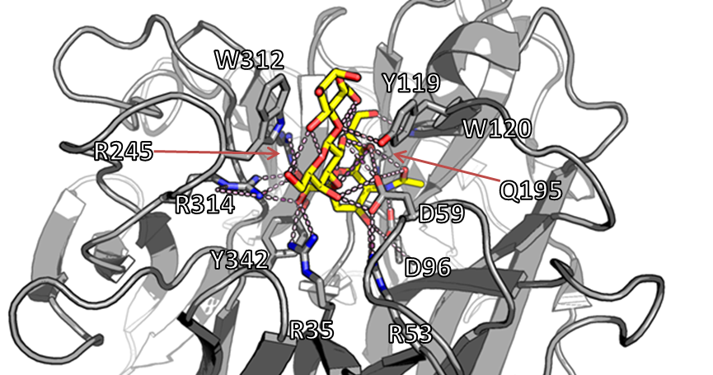
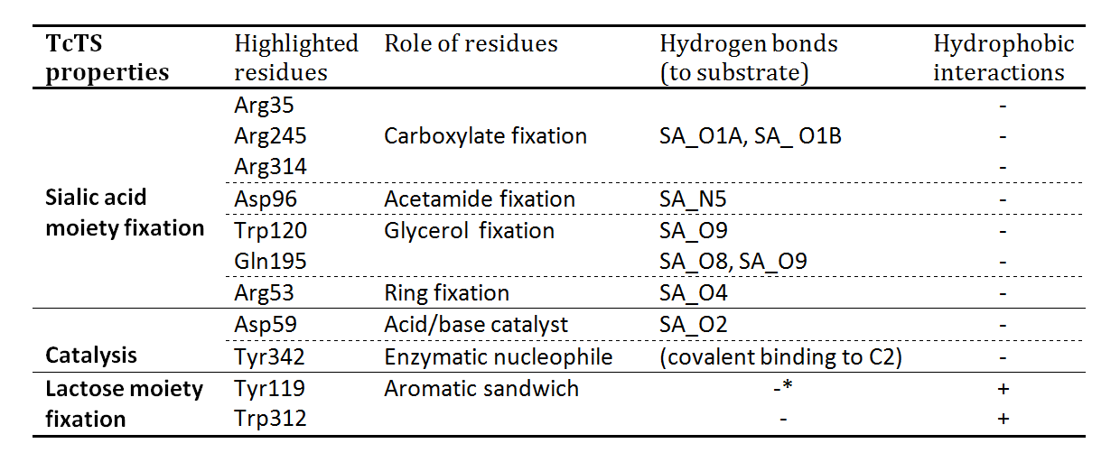
A closer look at the TcTS active site
TcTS model based on Amaya M.F., et.al. (2004) Structure 12: 775–784

Slide 18
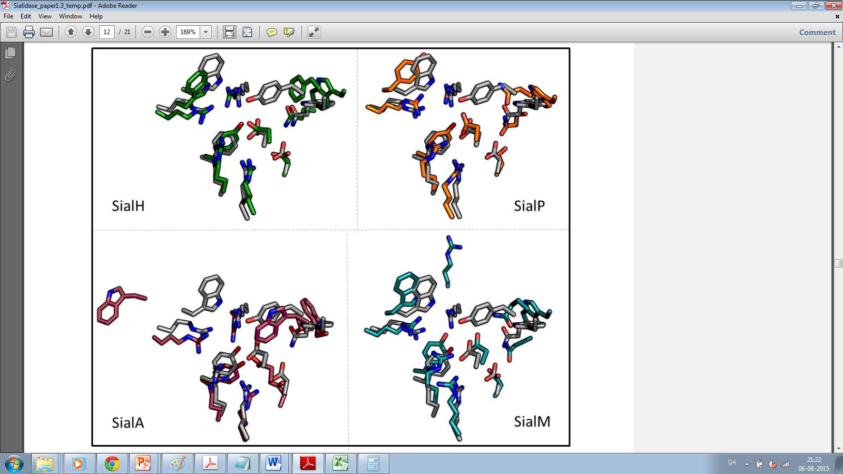
Candidate selection
3D homology moddeling using HHpred and CPHmodels
Alignment of active site residues
Visual inspection
Aligned active site residues for 1 of 15 candidate enzymes

Slide 19
4 candidates enzymes model and align well

Slide 20
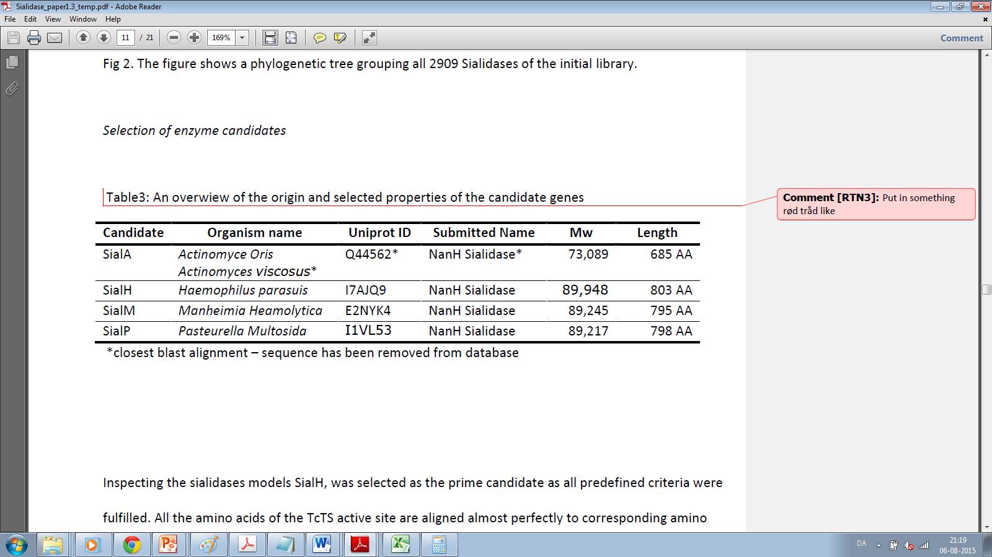
4 candidate enzymes selected for in vitro analysis

Slide 21
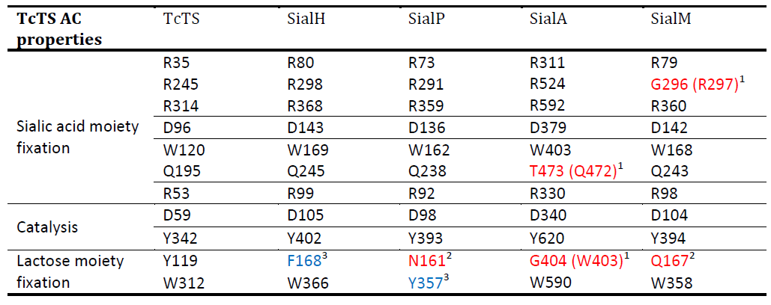
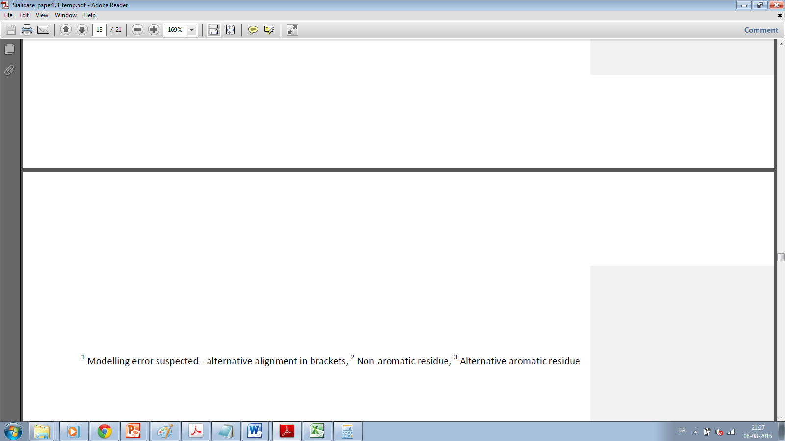
Candidate alignment overview

Slide 22
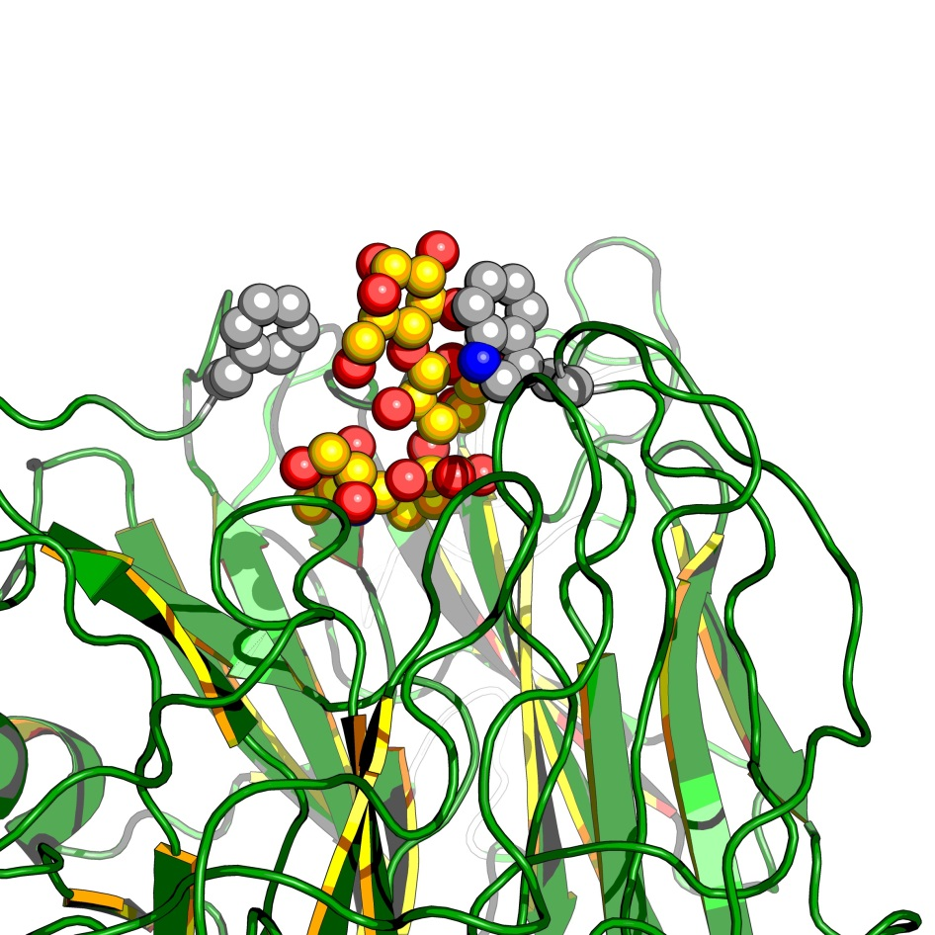
One candidate stands out

Slide 23
The remaining 3 candidates included
- Deep narrow binding pockets

Slide 24
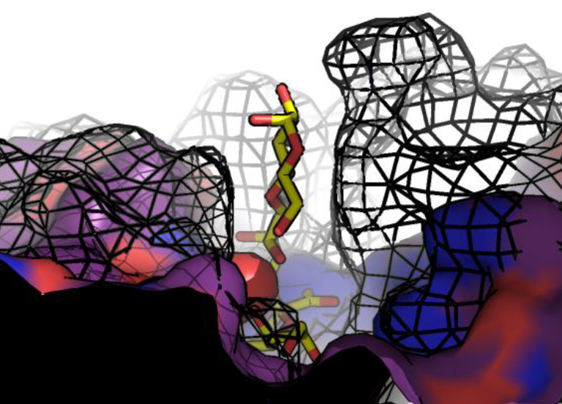
The remaining 3 candidates included
- Deep narrow binding pockets

Slide 25
Enzyme expression setup
Gene sequences synthesized (DNA2.0)
  With N-terminal His-taq
  T7 promotor expression system vector
Transformed into E. coli BL2 (DE3)
Overnight 30ᵒ C autoinduction expression
Enzyme recovery
  Sonication
  Äkta purification

Slide 26
Applying the candidate enzymes to the trans-sialidase setup
cGMP
Enz.
Enz.
Enz.
Figure adapted from:
Zeuner B, et al. 2014 Enzyme and Microbial Technology 55:85-93

Slide 27
Reaction conditions
Volume: 1ml (Eppendorf tubes)
Lactose: 100 g/L
cGMP: 40 g/L
Temperature: 30^{O}C (Thermo mixer)
pH: 6.4
Mixing: 700 rpm (Thermo mixer)
Reaction stop: Heat inactivation 10 min.
Reaction time: 2 hours
cGMP
Enz.
Enz.
Enz.
Figure adapted from:
Zeuner B, et al. 2014 Enzyme and Microbial Technology 55:85-93

Slide 28
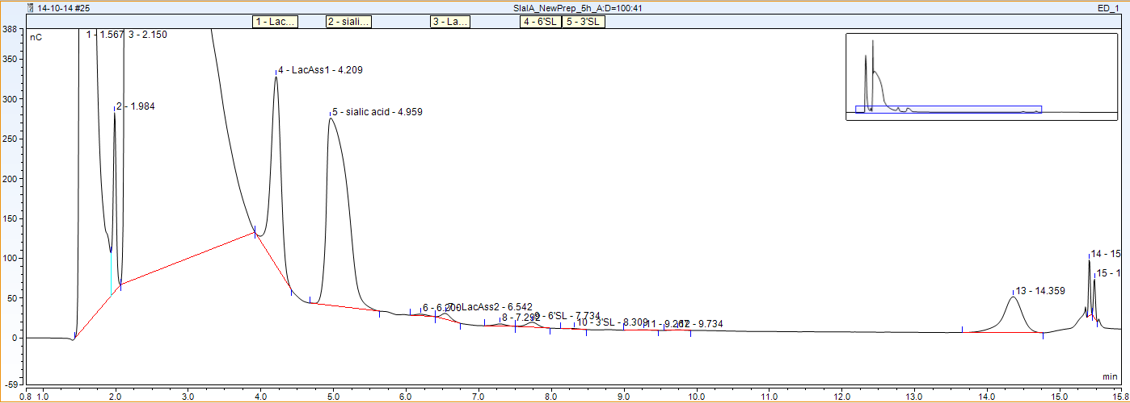
HPLC - Analysis
Sial A
Hydrolase/Sialidase
Type: HPAEC-PAD
Column: CarboPacTM PA100
Machine: ICS 3000
(Dionex Corp., Sunnyvale, CA)

Slide 29
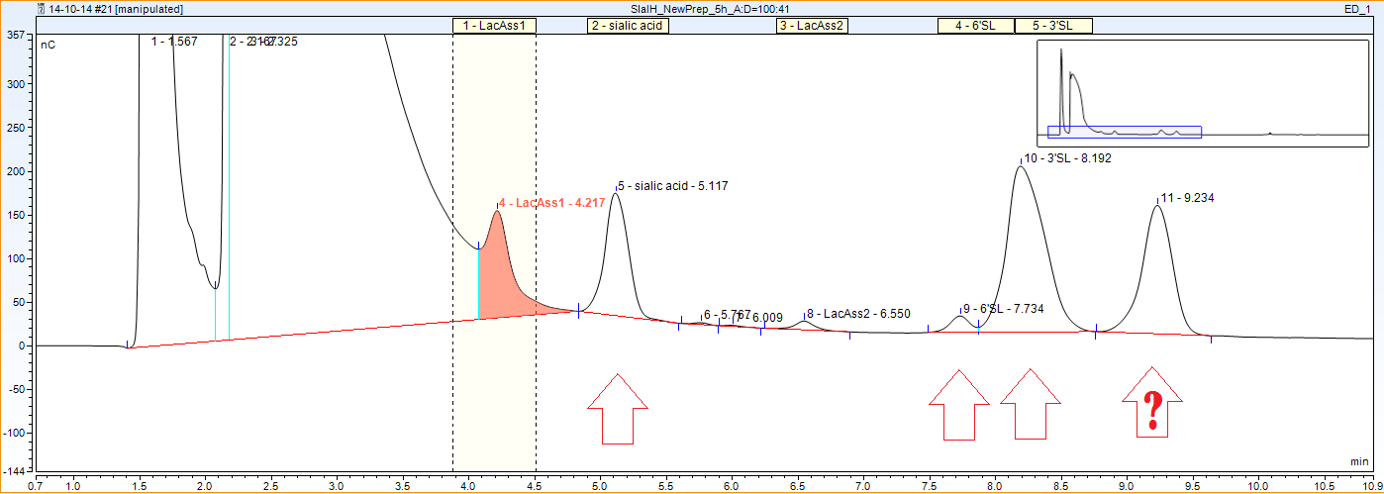
HPLC - Analysis
Sial A
Hydrolase/Sialidase
Sial H

Slide 30
HPLC - Analysis
Sial A
Hydrolase/Sialidase
Sialic acid
Sialyllactose
Sial H

Slide 31
HPLC - Analysis
Sial A
Hydrolase/Sialidase
Sialic acid
Sialyllactose
Sial H
Trans-activity!!!

Slide 32
HPLC - Analysis
Sial A
Sialic acid
Sialyllactose
Sial H
Mystery peak 2

Slide 33
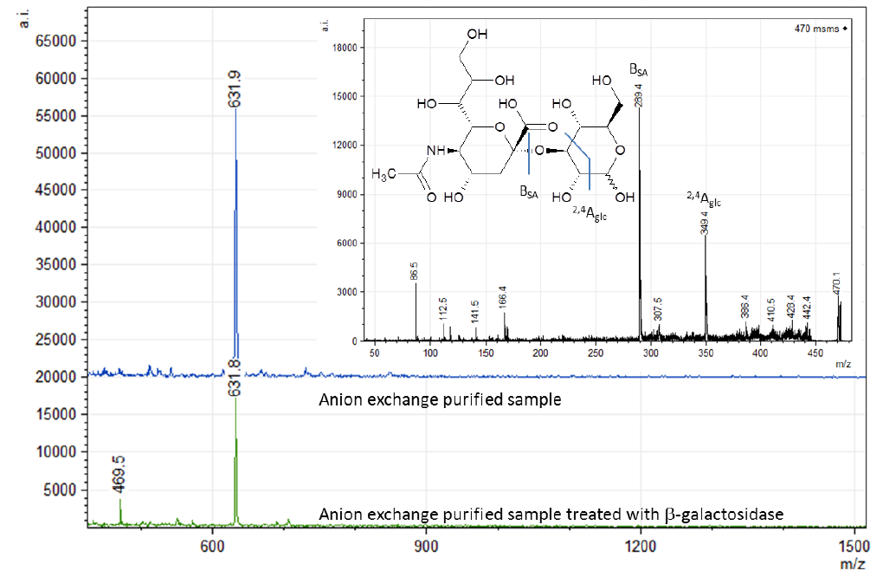
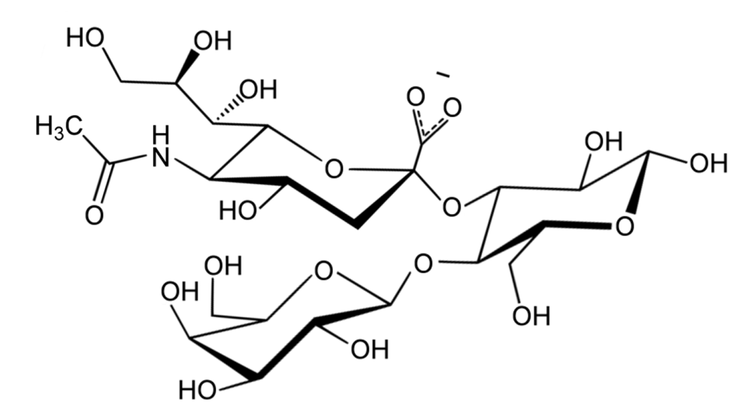
Product identification
MS and β-galactosidase treatment
3-sialyllactose
Confirmed by NMR

Slide 34
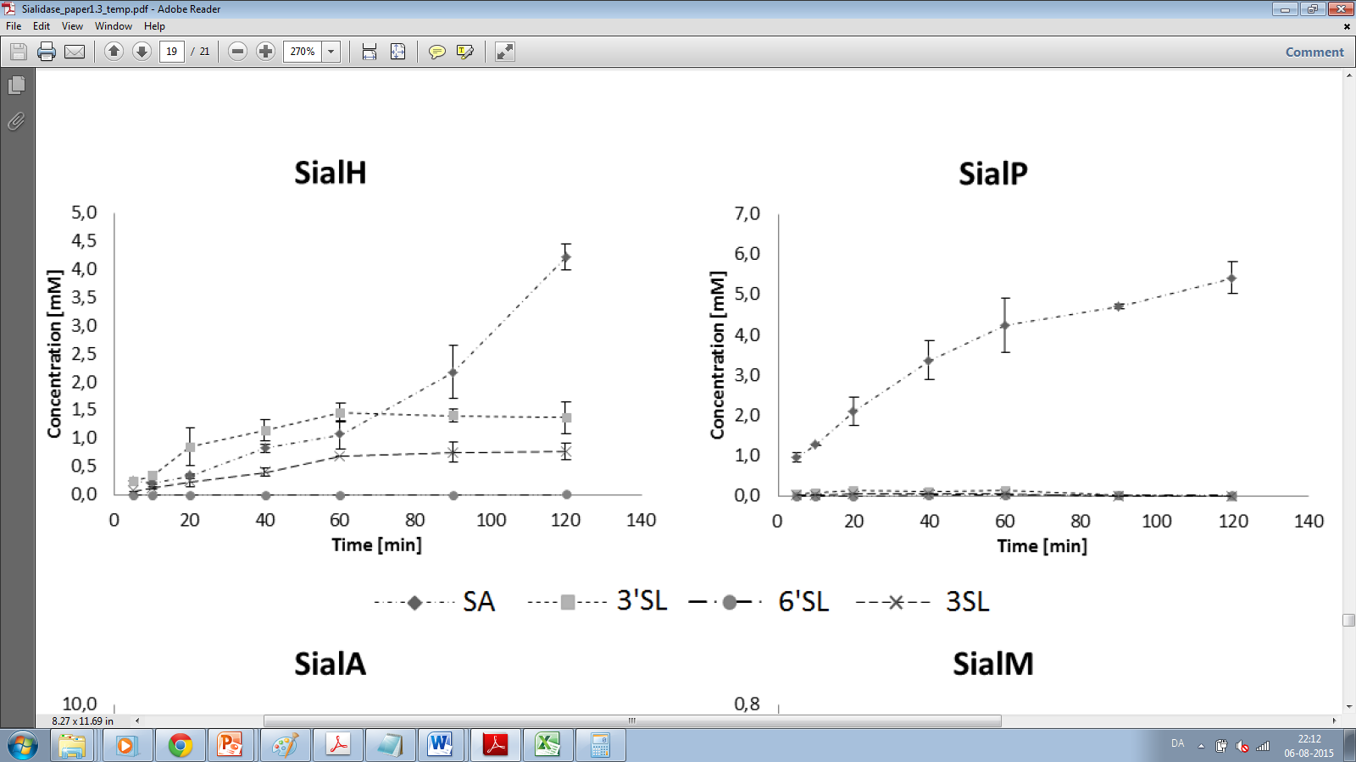
Time study SialH
SA
3’SL
3SL
6’SL
Products 3’SL and 3SL reaches levels of 1.5 mM and 0.9 mM respectively

Slide 35
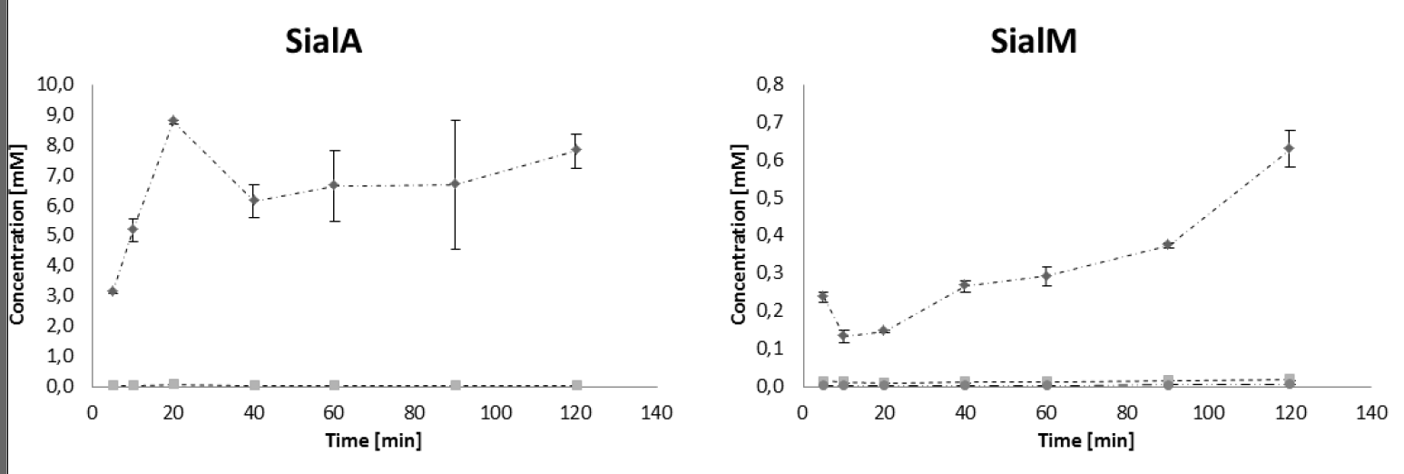
Time study (all candidates)
SA
SA
3’SL
3SL
6’SL
SA
SA

Slide 36
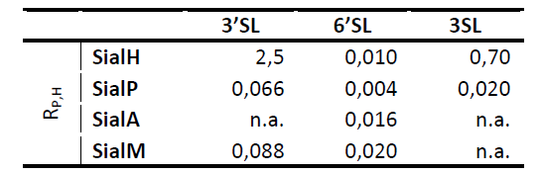
Time Study (all candidates)

Slide 37
Conclusion
”We give to you”

Slide 38


Conclusion
The trans-sialidase of Haemophilus parasuis (HpTS)

Slide 39
Conclusion
1
Novel trans-sialidase identified
From a database of 2909 sialidases
Identified by rational sequence analysis strategy
First confirmed bacterial trans-sialidase
Trans-sialidase of H. parasuis
Novel sialylation product identified
New type of 3-sialyllactose
4 candidates showed trans-activity
Although higher hydrolysis rates were observed
4
15
2909

Slide 40
Conclusion
<
1
Novel trans-sialidase identified
From a database of 2909 sialidases
Identified by rational sequence analysis strategy
First confirmed bacterial trans-sialidase
Trans-sialidase of H. parasuis
Novel sialylation product identified
New type of 3-sialyllactose
4 candidates showed trans-activity
Although higher hydrolysis rates were observed
4
Hypothesis 1: The family of sialidases is extremely conserved and it can be speculated that a trans-sialidase could have developed in parallel with the TcTS inferring an aromatic sandwich in a similar position as it is found in TcTS.
15
Hypothesis 2: If hypothesis 1 is correct, sialidases with an aromatic sandwich above the active site
will be a good candidates for identifying sialidases with trans-activity.
2909

Slide 41
Conclusion
<
1
Novel trans-sialidase identified
From a database of 2909 sialidases
Identified by rational sequence analysis strategy
First confirmed bacterial trans-sialidase
Trans-sialidase of H. parasuis
Novel sialylation product identified
New type of 3-sialyllactose
4 candidates showed trans-activity
Although higher hydrolysis rates were observed
4
Hypothesis 1: The family of sialidases is extremely conserved and it can be speculated that a trans-sialidase could have developed in parallel with the TcTS inferring an aromatic sandwich in a similar position as it is found in TcTS.
15
Hypothesis 2: If hypothesis 1 is correct, sialidases with an aromatic sandwich above the active site
will be a good candidates for identifying sialidases with trans-activity.
2909

Slide 42
Perspectives
Crystallography of HpTS
  Common traits between TcTS and HpTS
  Further improvement of Tr13?
  Identification of more native trans-sialidases
Identification of other trans-glycosidases
  ”Where can I find a sandwich ?”

Slide 43









Acknowledgements
Colleagues:
Arla Foods A.M.B.A for providing substrate for donating the trans-sialylation reaction substrates
(Supervisors)
Prof JD Mikkelsen Asst Prof M. Pinelo
PhD C. Jers PhD J. Holck PhD M. Lezyk
PhD C. Nyffenegger PhD B. Zeuner PhD Candidate S Jamek Prof AS Meyer

Slide 44
Questions please
Thank you for your attention

