Slide 1
Cementation of Aesthetic Resin Composite Indirect Restorations
Resin Cements
Dr. Rui Franco
27 July 2015

Slide 2
Introduction
Evolution in the adhesion of dental materials
Direct Restorations vs Indirect Restorations
Cement Importance in the Adhesion
Aesthetics importance from Society Point of View

Slide 3
Objectives
Resin Cements – State of the Art;
Cementing Technique in Indirect Composite Restoration:
  Polymerization type;
  Adhesive System.

Slide 4
Ideal Material
Ideal Material
Biocompatible
Mechanically stable
Minimally conductive thermally and electrically
Esthetic – identical to natural tooth
Easy to manipulate
Adherent
Tasteless and odorless
Cleanable and repairable
Cost-effective

Slide 5
Factors Influencing the Success of a Restoration
Patient Factors
Dentist Factors
Material Factors
Longevity Dental Restoration

Slide 6
Indirect Restorations
Recent developments in resin‐based composite resins have made it possible to fabricate esthetic indirect adhesive restorations
    No polymerization shrinkage;
    No inadequate degree of conversion.
Indirect restoration requires more dentin exposure than direct restoration and thus increases dentin sensitivity.
Zorba et al, 2009

Slide 7
With indirect restorations, all technical processing of the restoration, including polymerization, are performed externally.
However, it is still possible for polymerization stress to occur during the curing phase of the resin cement:
    marginal leakage
Zorba et al, 2009

Slide 8
An adequate polymerization of resin cement is crucial to acquire optimal physical and biological properties and clinical performance
Marginal adaptation influences the longevity of indirect restorations.
Medina et al, 2012

Slide 9
Case Review Study

Slide 10
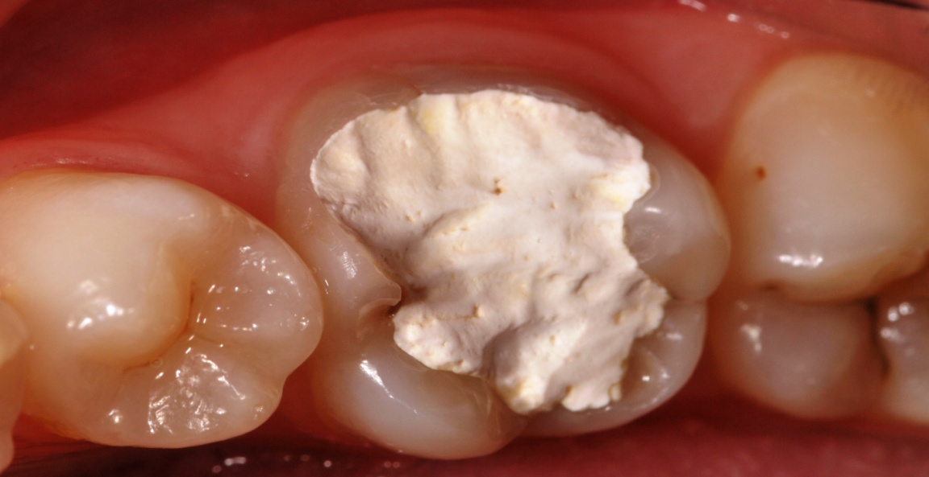
First Appointment
“I have a cavity” SIC

Slide 11
Rehabilitation Options
Direct Restoration;
Indirect Restoration:
Porcelain
Resin Composite
Metal
Metal-Porcelain
De demand of esthetically pleasing dental restorations has made the all-ceramic crown a popular option.
Zorba et al, 2009
Sakrana, 2013

Slide 12
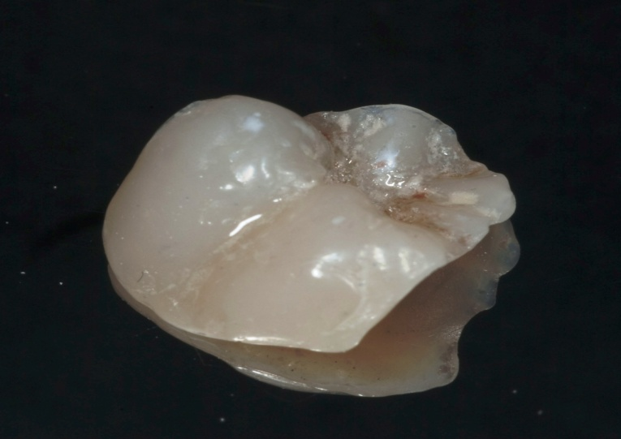
Indirect resin composite restoration – Preparing
Laboratory-processed indirect composite resin systems are an attractive esthetic alternative for intracoronal posterior restorations.
Cetin et al, 2009

Slide 13
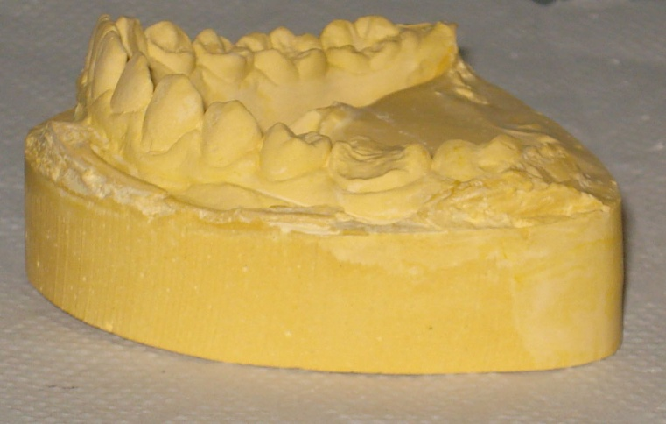
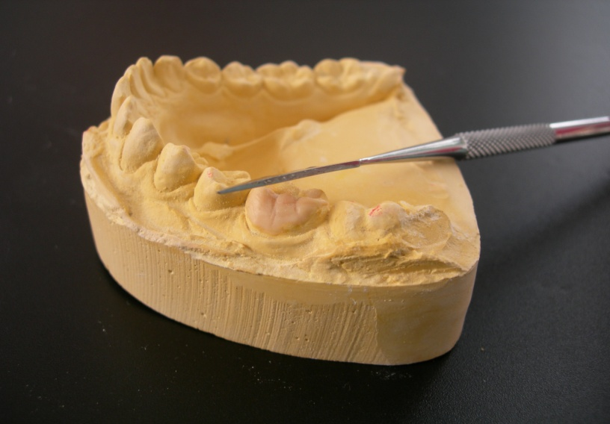
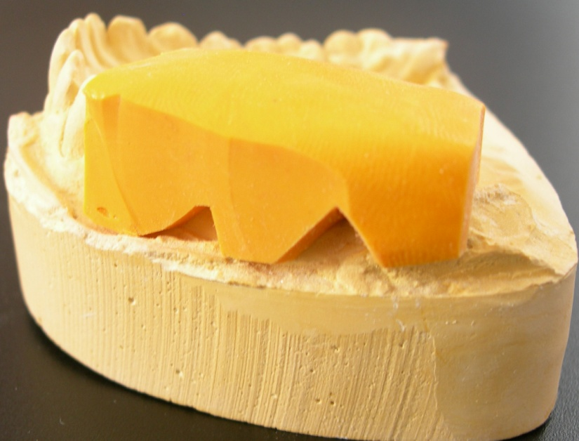
Study models,
Diagnostic wax up and silicone key

Slide 14
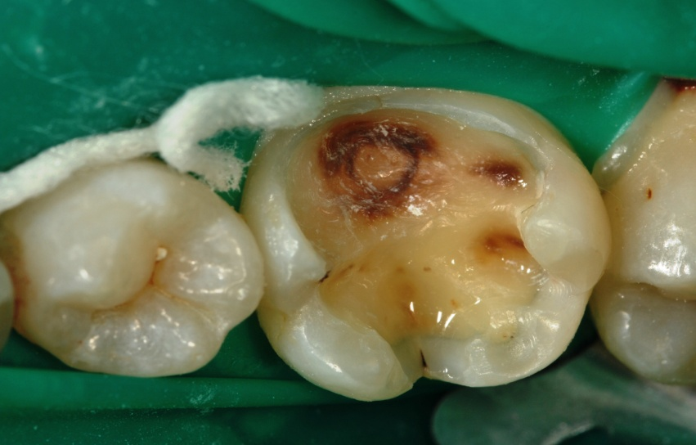
Cavity Evaluation

Slide 15
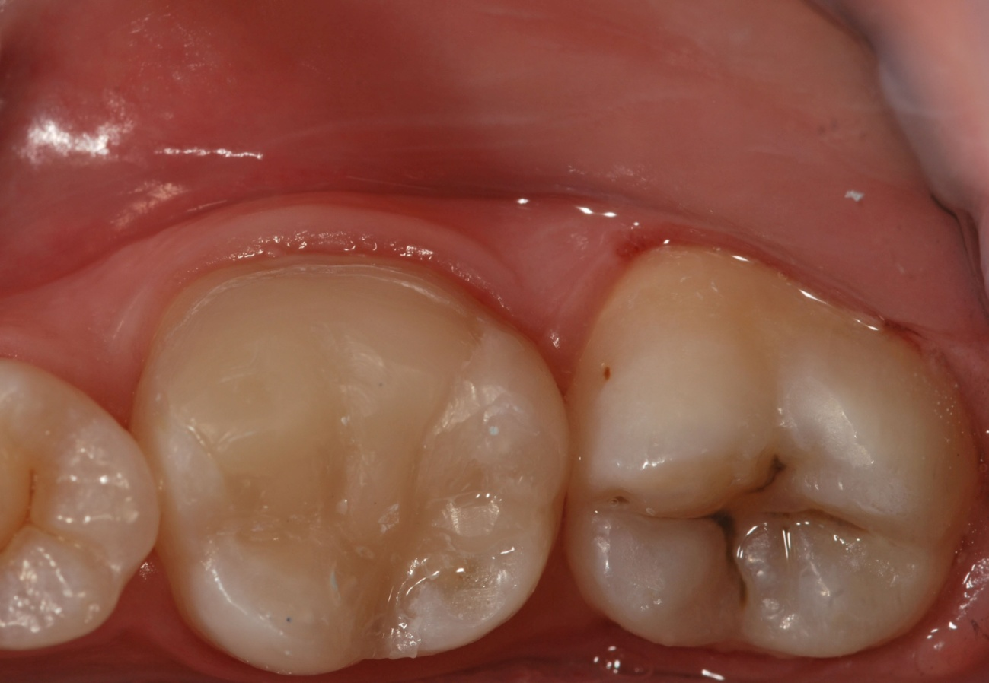
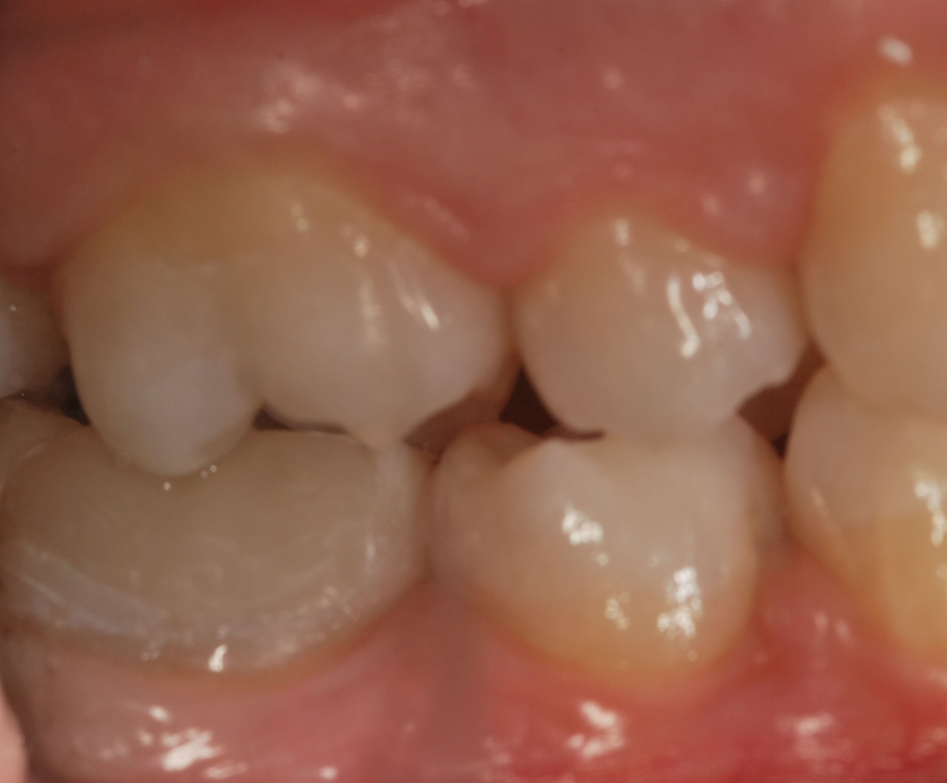
Temporary direct composite restoration
Filtek Z250® (3M ESPE – Minnesota, USA)
Extensively destroyed teeth are commonly restored with composite resin before cavity preparation for indirect restorations.
Dos Santos et al, 2014

Slide 16
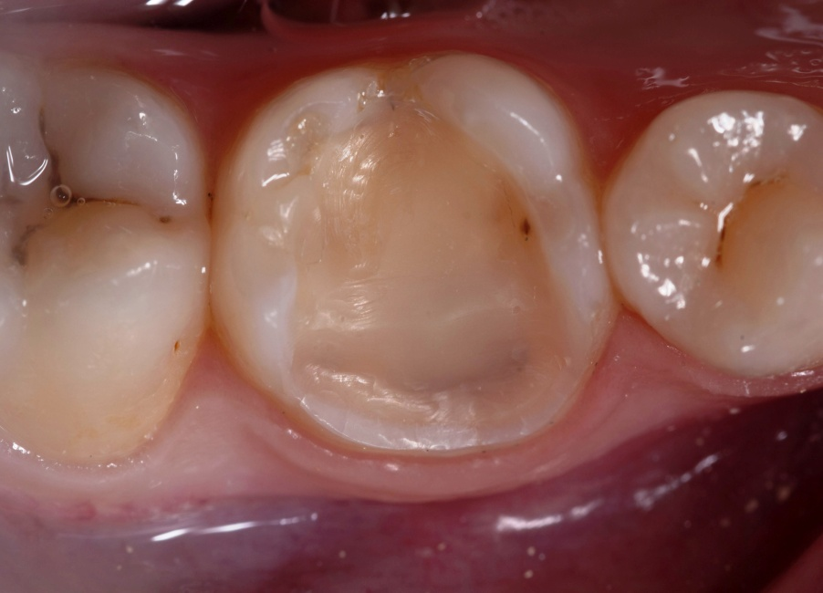
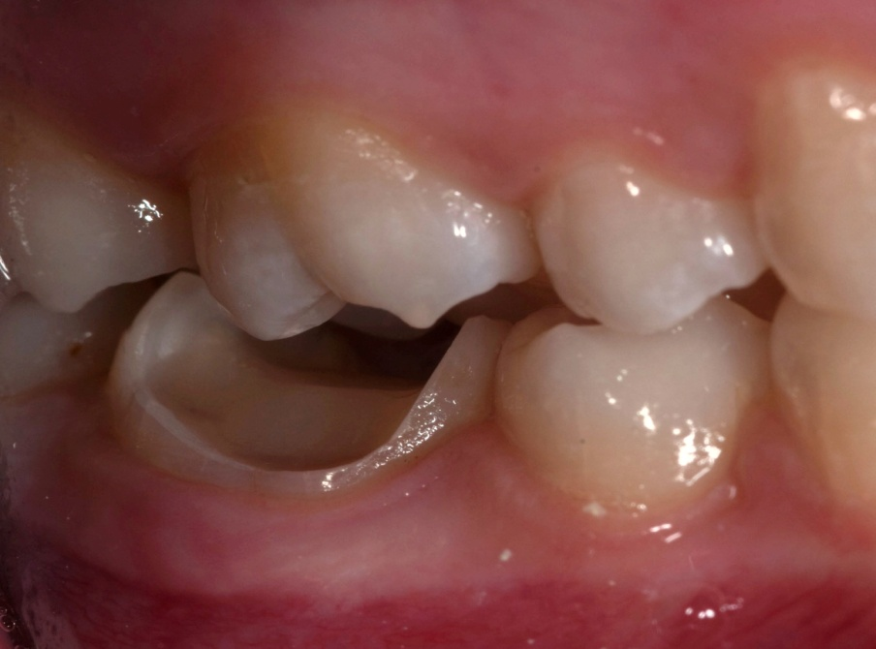
Tooth Preparation
Characteristics:
  Enamel margins
  Rounded Internal angles;
  Occlusal divergence.
Cetin et al, 2009

Slide 17
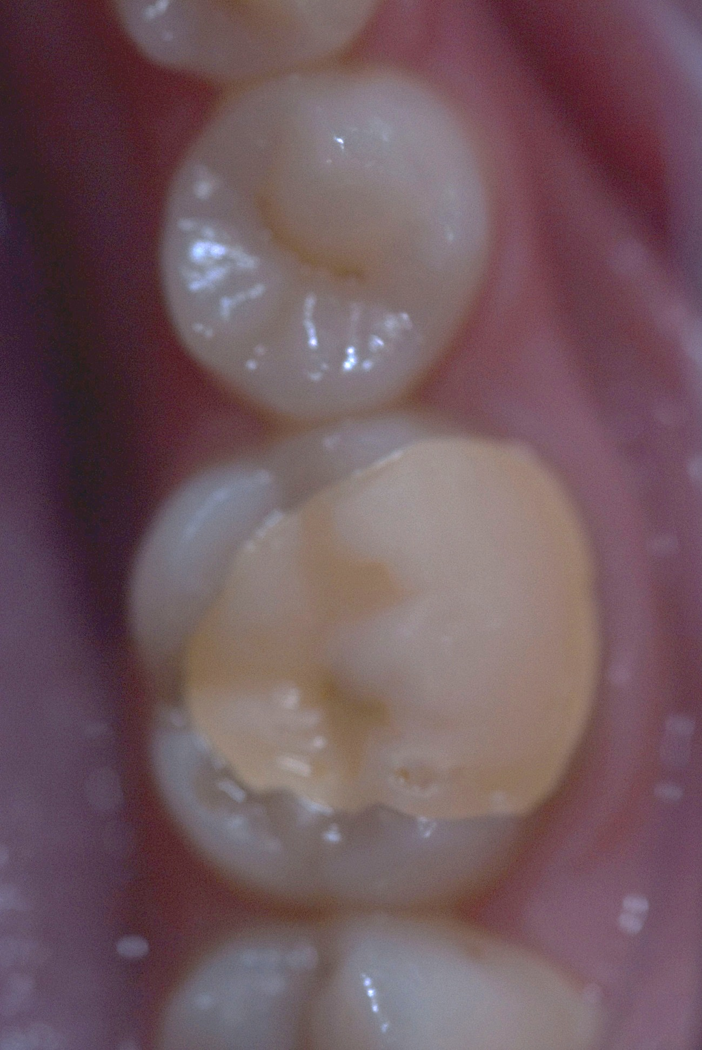
Temporary Acrylic Resin Restoration
Protemp® (3M ESPE – Seefeld, Germany)

Slide 18
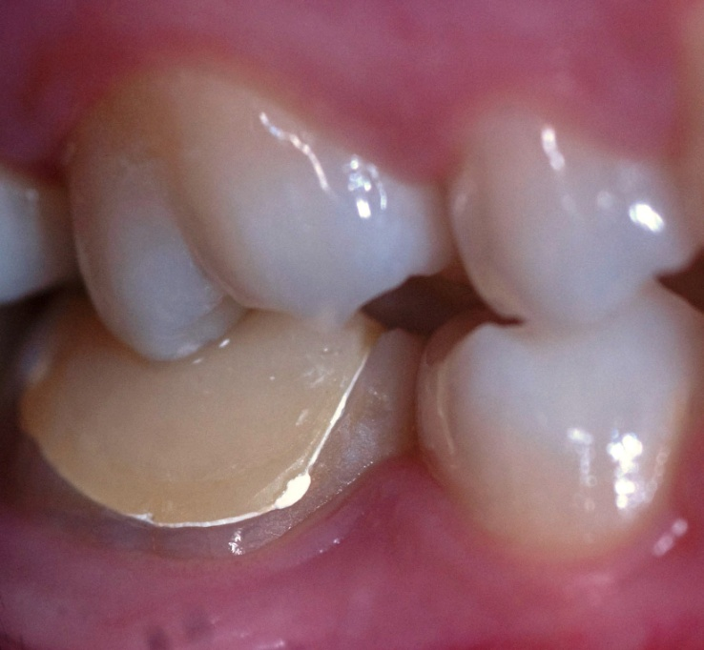
Cementing Temporary restoration
TempBond NE® (Kerr – California, USA)

Slide 19
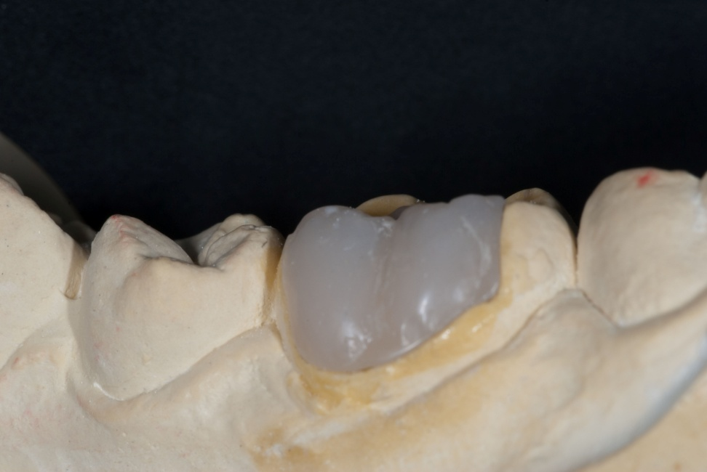
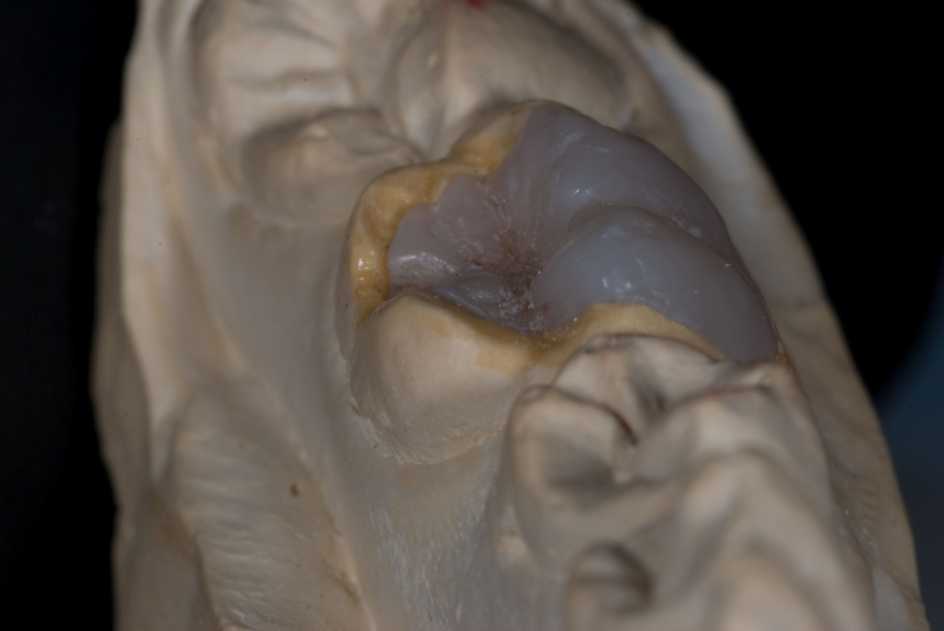
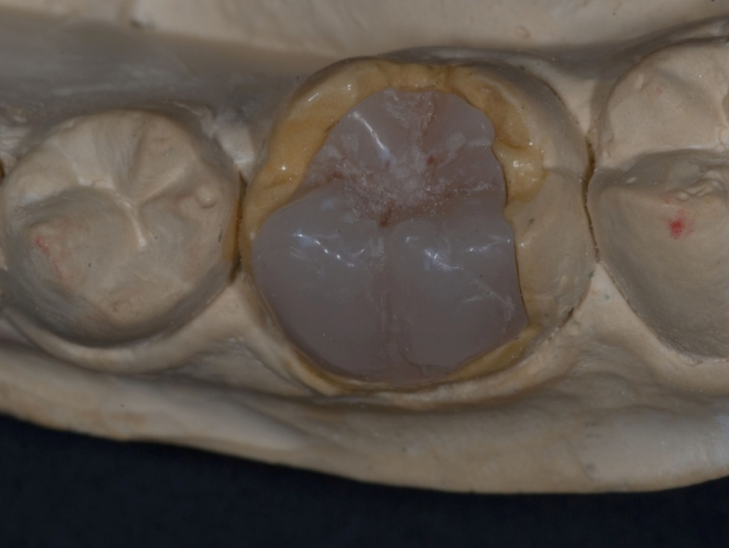
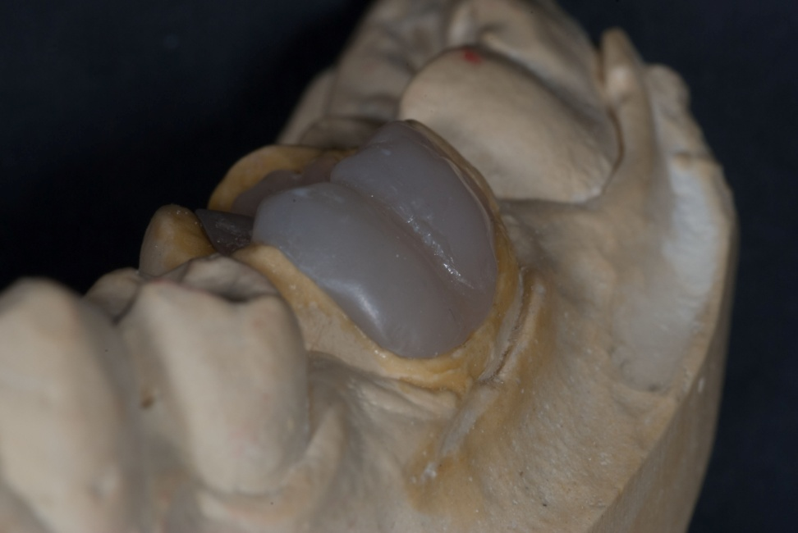
Laboratory execution
Microhybrid resin composite (Enamel Plus HFO® - Micerium-Avegno, Italy)

Slide 20
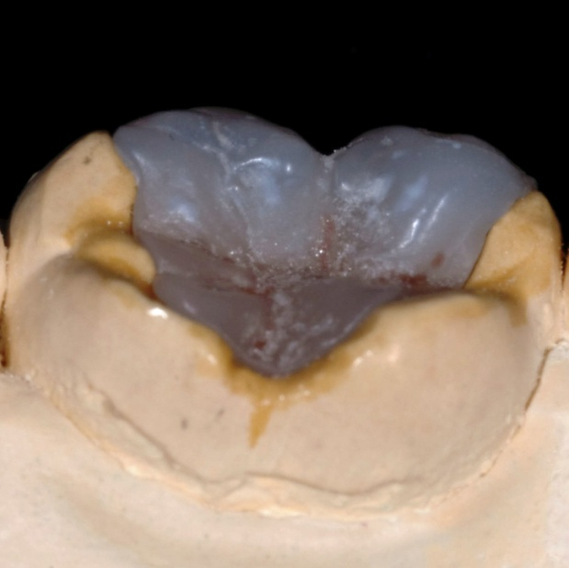
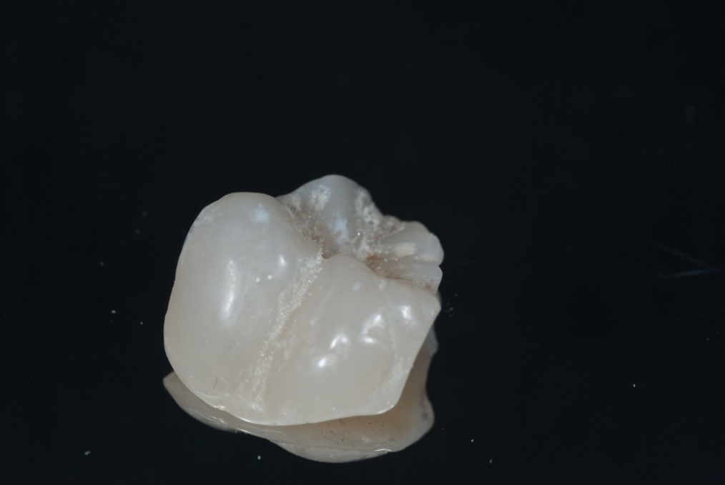
Resin Characterization
brown and white pigments from Enamel Plus HFO® (Micerium-Avegno, Italy)

Slide 21
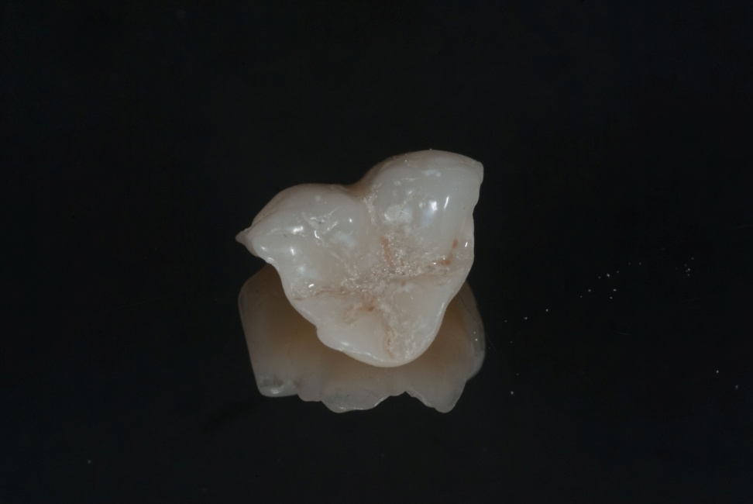
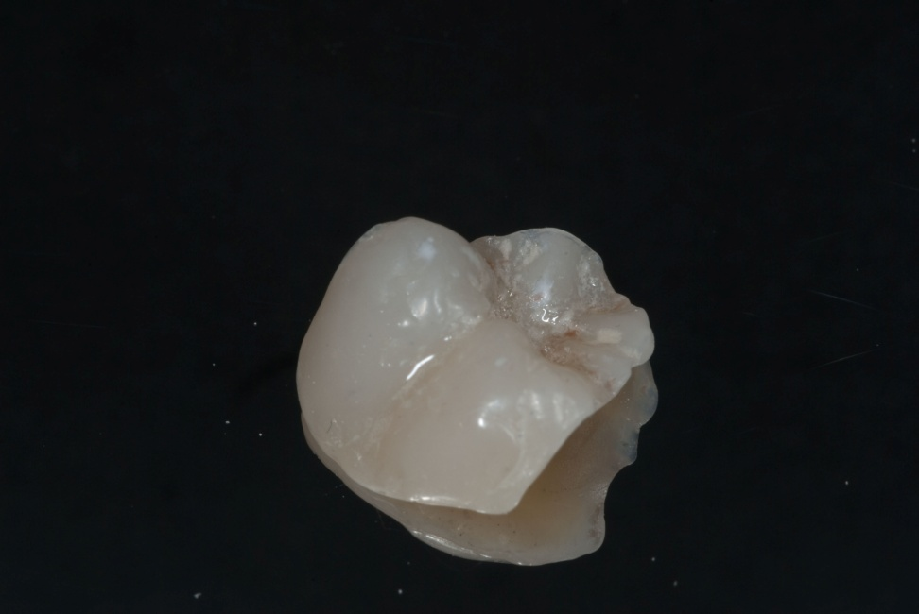
Polishing
Sof-Lex discs® (3M ESPE Dental Division - Minnesota, USA).

Slide 22
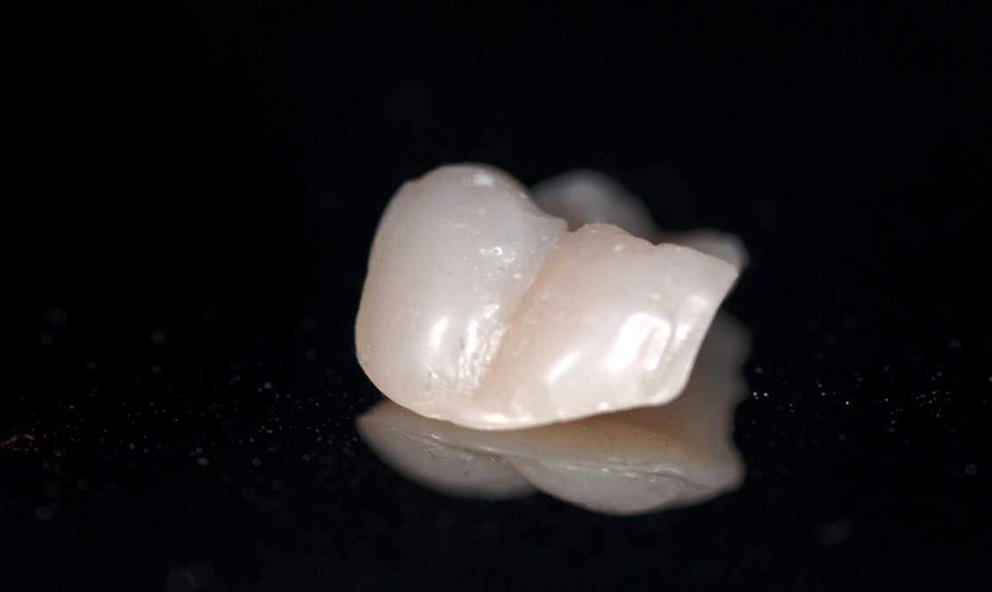
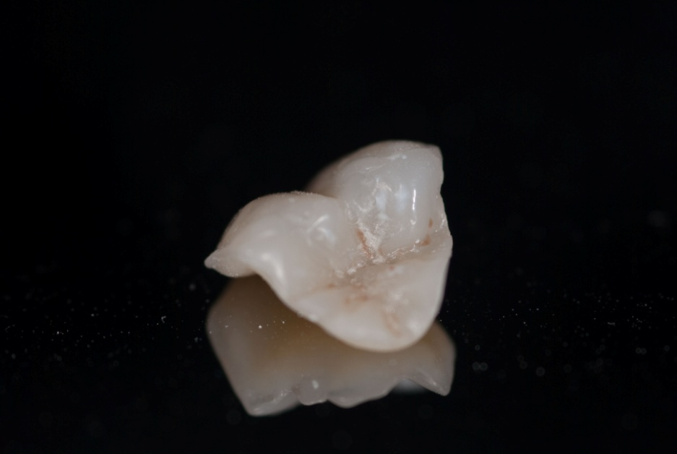
Cementing the indirect resin composite restoration
The clinical and biological longevity of adhesive restorations is dependent on the performance of the adhesive systems
Cetin et al, 2009

Slide 23
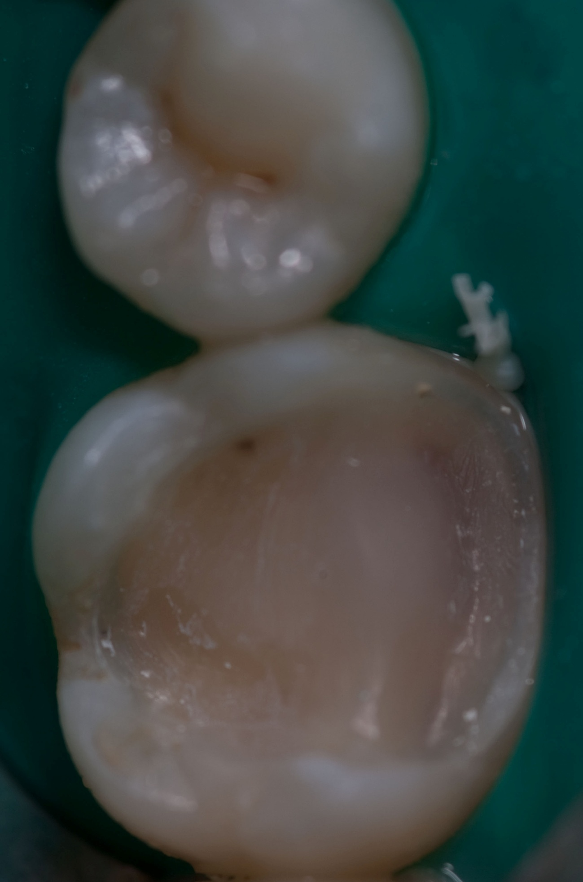
Temporary filling removal and Prophylaxis with Pumice
There is no negative influence if:
  Prophylaxis with pumice after two weeks, if there is eugenol presence;
  Adhesive System Application.
  Gomes AJ et al., 2006
  Wazzam KA et al., 2000

Slide 24
Surface Treatment
If no surface treatment is done, the outcome can be:
  Microinfiltration;
  Margin discoloration.
With Aluminum Oxide jet as surface treatment it is believed to obtain the best adhesive properties.
D’Arcangelo C e Vanini L, 2007
Dos Santos et al, 2014

Slide 25
Self-Etch and Self-Adhesive System vs. Etch and rinse Adhesive System
There are no differences in Adhesion Potential.
Krämer et al., 2006
Rosentritt et al., 2004
Self-etch
Strong adhesion to dentine
Low adhesion to enamel.
Perdigão J et al., 2009

Slide 26
Etch and Rinse Adhesive Systems promote better results. For example:
  Less interface crack formation;
  Good marginal adaptation;
  Better adhesive resistance;
  Correct enamel adhesion.
Cantoro A et al., 2008
Chieffi N et al., 2007
Frankenberger et al., 2007
Frankenberger et al., 2008
Zorba et al, 2009

Slide 27
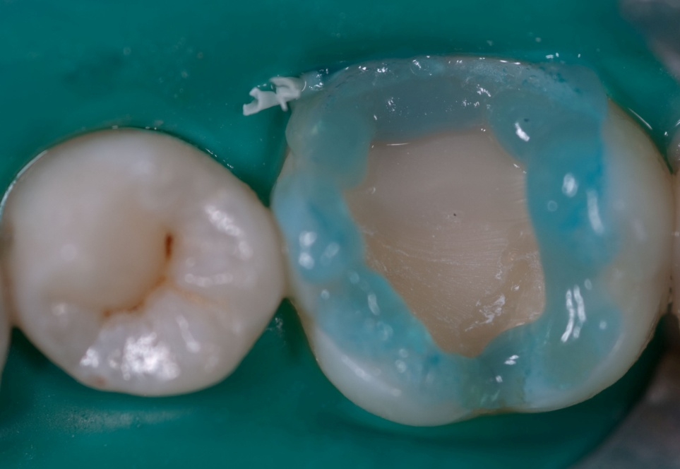
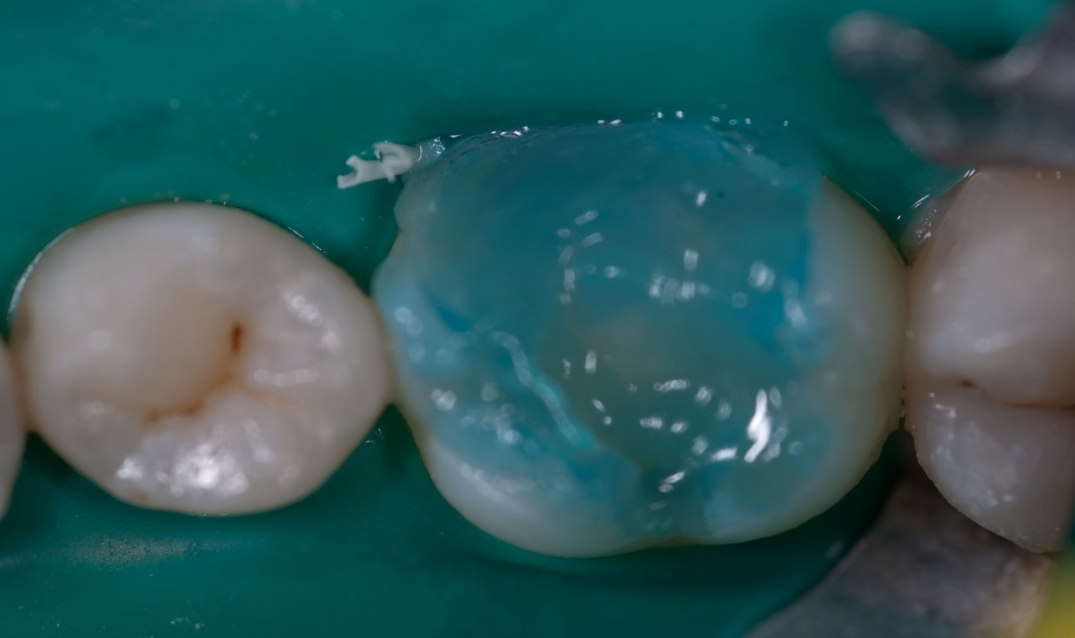
Adhesive System Application
All-Bond 2® (Bisco – Illinois, USA) Adhesive System.

Slide 28
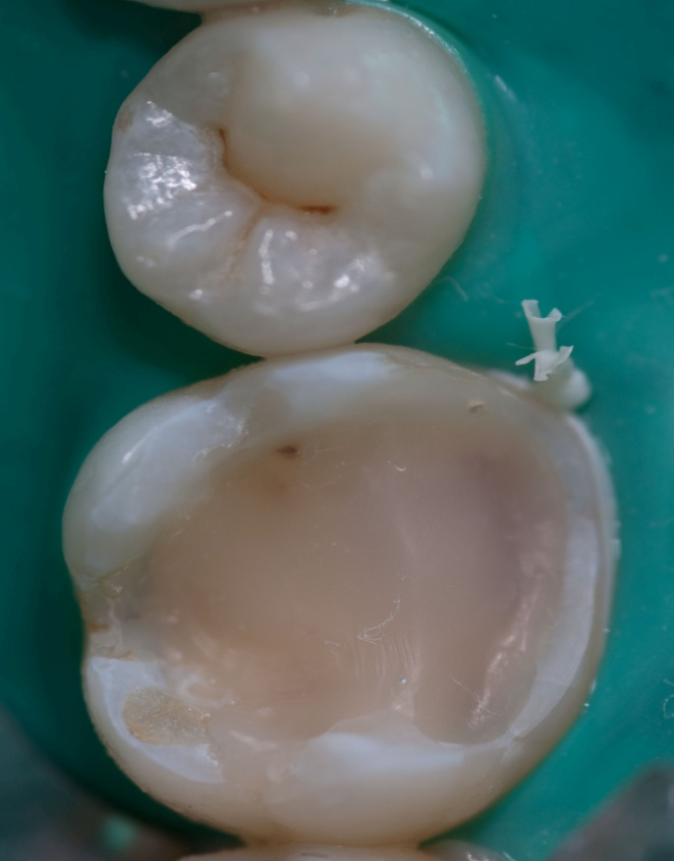
Dry enamel and wet dentine after etching technique.

Slide 29
Ideal Dental Cement
Requirements during Placement
Requirements after Cementation
Patient Comfort
Easy to use
Most important
Resin cements produce high levels of stress during polymerization.
The incorporation of air bubbles during the manipulation of the cement weakens it and makes it more susceptible to fractures.
Medina et al, 2012

Slide 30
Cement Types
Light-Cure
Increased working-time excess removal is easier;
Self-curing
Increased curing time;
Weak adhesion during the first hour.
Dual-Cure
Reduced working time;
Incomplete Polymerization.
Correct and definitive monomer conversion.
Color instability;
Size of the cavity (light reach)
Jivraj SA et al., 2006
Ferrari M et al., 2007
Fonseca RG et al., 2005
Habekost et al., 2007
Schneider R et al., 2007
Jivraj SA et al., 2006
Ferrari M et al., 2007

Slide 31
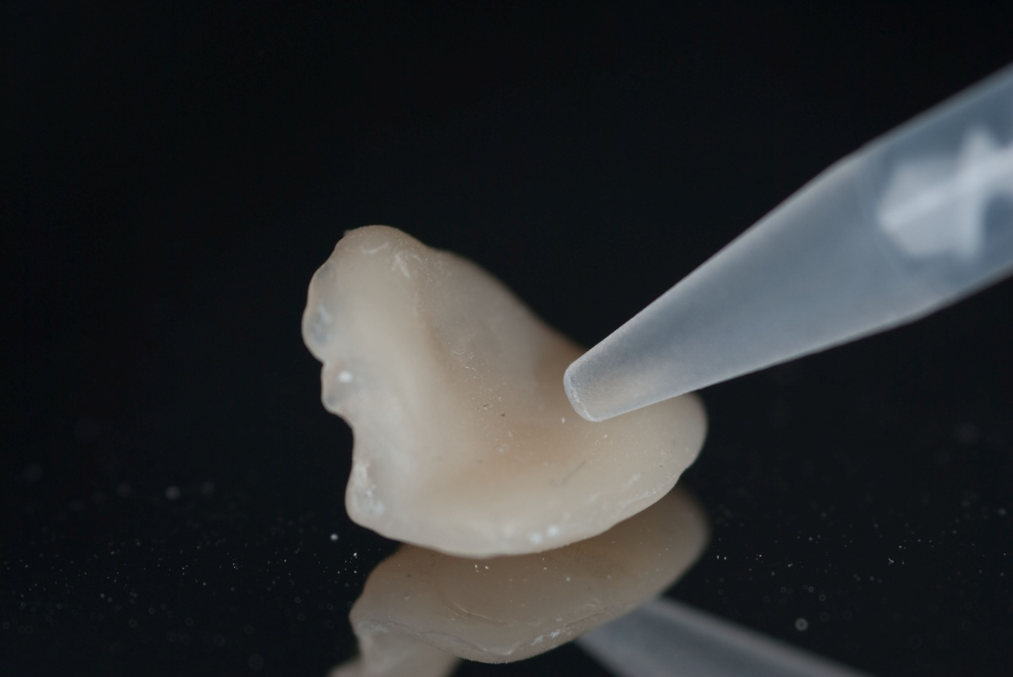
Resin Cement Application
Resin Cement Multilink Automix® - Ivoclar Vivadent – Schaan, Liechtenstein) transparent.
“The quality of indirect restorations depends on the properties of the luting cements used”
Rosentritt M et al., 2004.

Slide 32
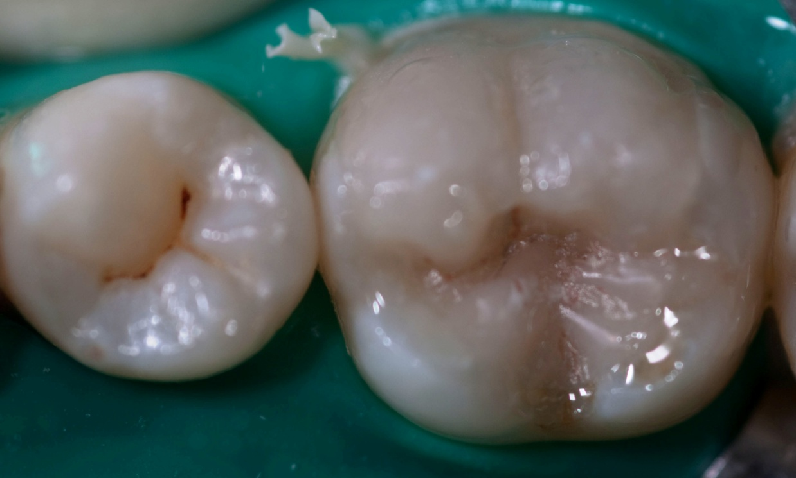
Applied Pressure Influence
Extending the application of pressure
Improved interface integrity
Increased bond strength
Adhesive Permeability Reduction
Reduce intracoranal stress
Chieffi N et al., 2007
Sakrana, 2013

Slide 33
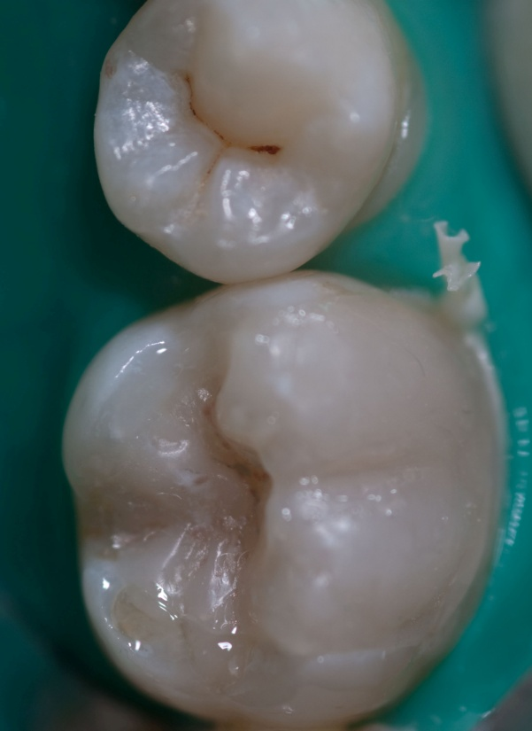
Excess Removal

Slide 34
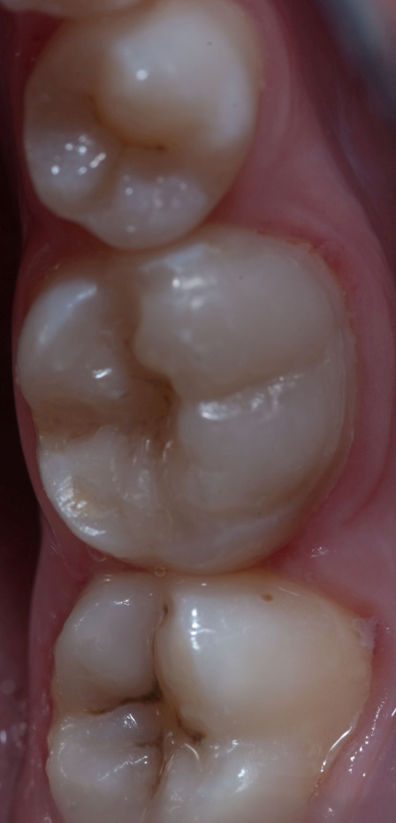
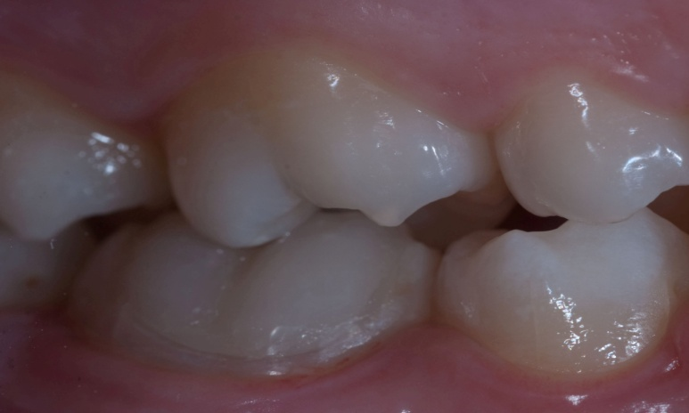
Final Result

Slide 35
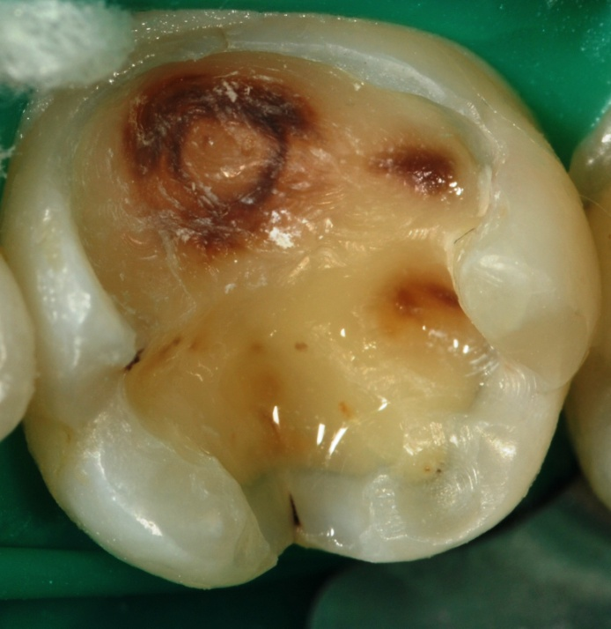
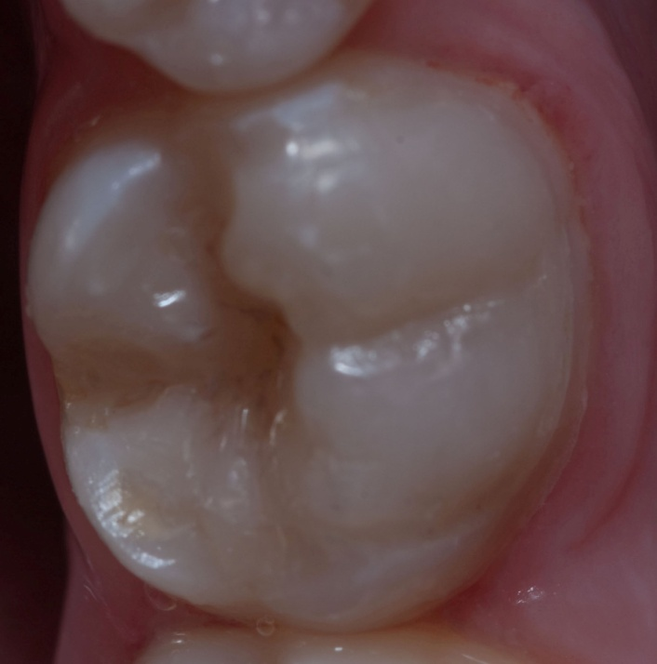
Before and After
Begin
End
“Adequate cement/adhesive combination is essential to avoid postoperative hypersensitivity”,
Ferrari M et al., 2007

Slide 36
Discussion

Slide 37
Discussion
The extra-oral polymerization of composite resins increases the degree of conversion.
  Improved mechanical properties. Dejak B et al., 2008
  (in vitro)
The ceramic has low fracture resistance because it is harder than enamel and a low deformation limit.
  Lower cost in indirect composite resin restorations;
  Cannot withstand elastic deformation while resinous materials can;
  High levels of abrasion on antagonizing teeth with ceramics.
  Dejak B et al., 2008
  Sakrana, 2013
On the other hand, the ceramic gets a superior stability on maintaining color and marginal discoloration.
Fabianelli A et al., 2006
(in vivo)

Slide 38
Surface conditioning has a significant effect on the shear bond strength.
    Zorba et al, 2009
Surface treatment can be carried out by chemical treatment silanization.
Soares JC et al., 2004
(in vitro)
If there is no prior mechanical treatment of the surface of the restoration, the silanization does not influence in any way the bonding.
  The hydrofluoric acid followed by silane application is plausible.
  The oxide aluminum jet gets the best adhesive properties.
D’Arcangelo C e Vanini L, 2007
(in vitro)

Slide 39
The self-etch adhesives are not as effective in enamel as etch and rinse are, but are relatively effective in dentin and post-operative sensitivity.
Yoneda S et al., 2005
There is no difference between the postoperative sensitivity depending on the choice of adhesive system and is rather related to a good or bad technical execution.
Perdigão et al., 2003
In cementing indirect restorations is advocated an etch and rinse adhesive system and resin cement application that is not only light-curing.
Ritter AV et al., 2009

Slide 40
Conclusions
Indirect restorations in composite resin are a current and rapidly developing technique.
With this work it is concluded that the growing clinical success of resin cements.
  Influence the aesthetics and longevity of this type of restorations.
  For this is necessary an effective adhesion to the remaining tooth .

Slide 41
Yet to assess in the long-term:
  Secondary caries;
  Postoperative sensitivity;
  Color stability;
  Integrity of the restoration;
  Cement wear at marginal level.

Slide 42



Muito Obrigado!
Hartelijke Dank!
Thank you very much!

