Slide 1
Conference Series LLC Conferences
Conference Series LLC is a pioneer and leading science event organizer, which publishes around 500 open access journals and conducts over 500 Medical, Clinical, Engineering, Life Sciences, Pharma scientific conferences all over the globe annually with the support of more than 1000 scientific associations and 30,000 editorial board members and 3.5 million followers to its credit.
Conference Series LLC has organized 500 conferences, workshops and national symposiums across the major cities including San Francisco, Las Vegas, San Antonio, Omaha, Orlando, Raleigh, Santa Clara, Chicago, Philadelphia, Baltimore, United Kingdom, Valencia, Dubai, Beijing, Hyderabad, Bengaluru and Mumbai.

Slide 2


Overcoming the challenges
of biosimilar development
as a mid-size player
  Dr Rüdiger Jankowsky
  Managing Director
  Cinfa Biotech GmbH
5th European Biosimilars Congress
ValenCia, June 27, 2016

Slide 3
Disclaimer
The information contained in this presentation does in no way constitute a representation or warranty of Cinfa Biotech regarding the accuracy and or completeness thereof. This relates in particular but not limited to the non-infringing character of any third party IP relating to the products or technology as described herein unless otherwise explicitly agreed upon. Accordingly, Cinfa Biotech assumes no liability whatsoever for any damages occurring from the reliance on such information by any recipient.

Slide 4
agenda
Introduction to Cinfa Biotech
Mid-size pharma in the evolving biosimilars market
Challenges and opportunities in biosimilar development for mid-size pharma

Slide 5
agenda
Introduction to Cinfa Biotech
Mid-size pharma in the evolving biosimilars market
Challenges and opportunities in biosimilar development for mid-size pharma

Slide 6
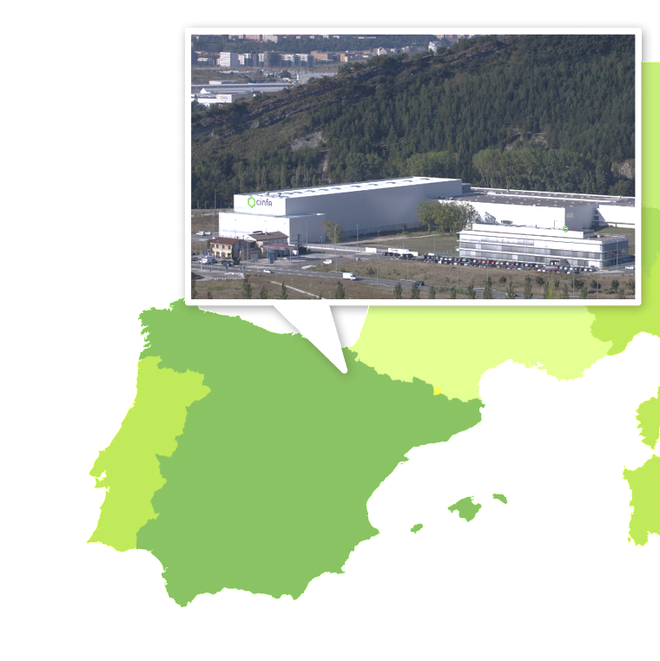
Cinfa biotech - the biosimilars company of infarco
Dedicated to biosimilars
Integrated development, manufacturing and commercialisation
Headquarters in Pamplona, Spain
Offices in Munich, Germany
Subsidiary of Infarco

Slide 7
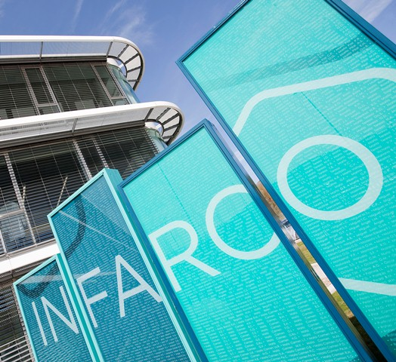


Cinfa biotech - the biosimilars company of infarco
Infarco: private holding owning a portfolio of pharmaceutical companies
Headquarters in Pamplona, Spain
50 years of experience in pharmaceutical products
Laboratorios Cinfa, leading supplier of quality drugs in Spain and other markets, is a subsidiary of Infarco

Slide 8


Cinfa biotech creates high-quality biosimilars
Fully integrated: Development, manufacturing, commercialisation
Tailored commercialisation models, according to markets and partners
Product development and manufacturing conducted in Europe
Global scope: Made in Europe, successful worldwide

Slide 9
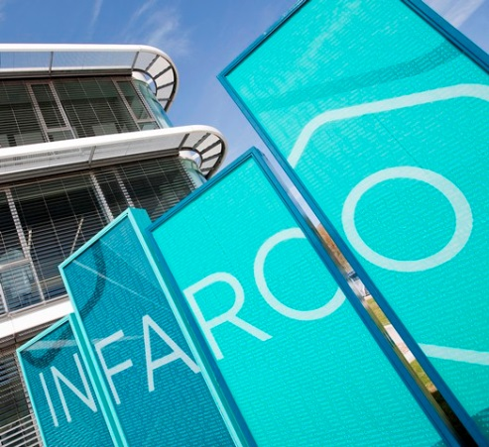
Dedicated resources for biosimilars are established
Complete team of in-house experts
Decades of experience in biosimilar development and commercialisation
Embedded in operational and economic infrastructure of Infarco
Strong and sustainable economic commitment by Infarco

Slide 10
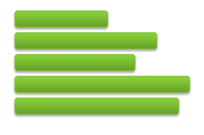
A sustainable product pipeline is being created
Pipeline of products in several indications
Oncology & inflammatory diseases
First product candidate: B12019, proposed biosimilar to Neulasta® (pegfilgrastim) for use in oncology

Slide 11
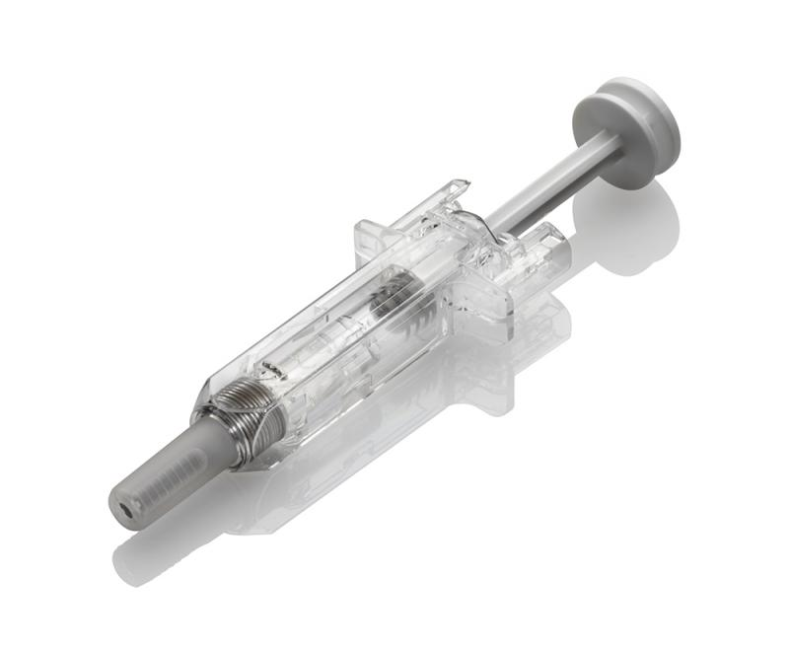
B12019 is in clinical development
GMP manufacturing process established at commercial scale
High molecular and functional similarity demonstrated
Preclinical program completed
Clinical development started in 2015, based on scientific advice from EMA
Clinical data to be published soon
Exemplary depiction, not representing the final B12019 product

Slide 12
agenda
Introduction to Cinfa Biotech
Mid-size pharma in the evolving biosimilars market
Challenges and opportunities in biosimilar development for mid-size pharma

Slide 13














Will the biosimilars market be dominated by large companies?
List not complete

Slide 14



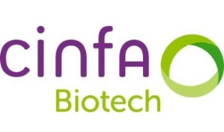



Will there be a place for mid-size companies?
List not complete

Slide 15
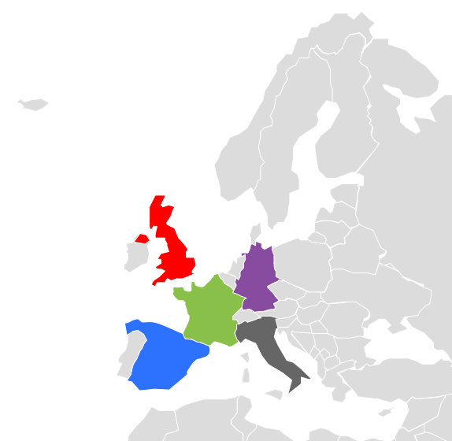


Mid-size players have many opportunities
Market access through strong local presence
Flexibility in development and marketing
Nimbleness

Slide 16
agenda
Introduction to Cinfa Biotech
Mid-size pharma in the evolving biosimilars market
Challenges and opportunities in biosimilar development for mid-size pharma

Slide 17





Challenges in biosimilar development as mid-size player
Funding
Expert team
Timelines
Development risk
Regulatory uncertainty
Partner network

Slide 18

Early Definition of strategy
Define strategy for product design, development and market launch at the start of development
Consider requirements from all stakeholders
Consult pharmacists for product design

Slide 19
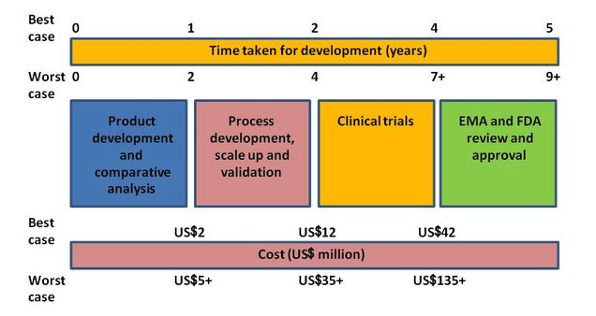
Costs and timelines for Biosimilar Development
Source: GaBI

Slide 20
Robust funding
Ensure sustainable commitment from investors
Communicate costs, timelines and risks

Slide 21
strong team and network
Build efficient internal expert team
Project operations and project management
Use resources provided by external partners

Slide 22
Challenge: clinical development
Long development periods for biosimilars
Mainly driven by long and expensive clinical studies
In many cases, clinical study designs are insensitive to detect differences to reference product

Slide 23
So far: comprehensive clinical data package required
Comparative data
  PK, PD
  Safety (incl. immunogenicity), efficacy in patients
Resulting in requirement of
  PK, PD trials
  Patient studies (hundreds of patients)

Slide 24
Efficient development programs
Biosimilar concept makes development efficient
  Establish biosimilarity on analytical level (physico-chemical, functional)
  Confirm biosimilarity by sensitive clinical trials
  Detect clinically relevant differences to reference product

Slide 25
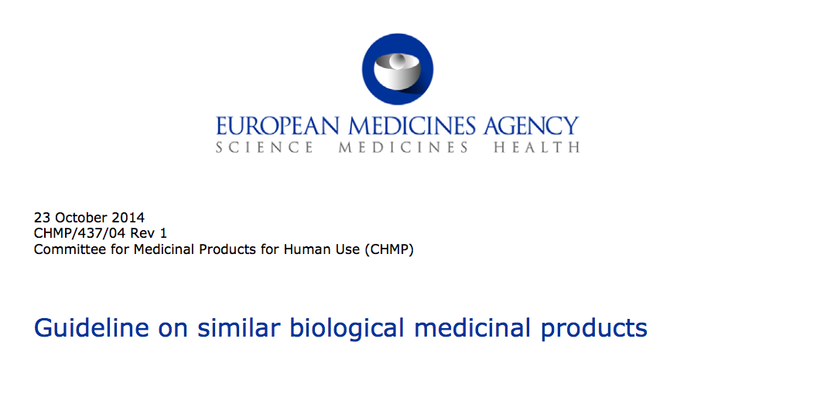
Revised EU guidelines allow for tailored approaches
Comprehensive analytical comparability data
Reduced preclinical programs possible
No mandatory confirmatory patient studies, if justified
Sensitive biomarkers accepted for clinical studies
Concept included in revision of product-specific guidelines, e.g. biosimilar G-CSF, insulin
CHMP/437/04 Rev. 1
July 2014

Slide 26
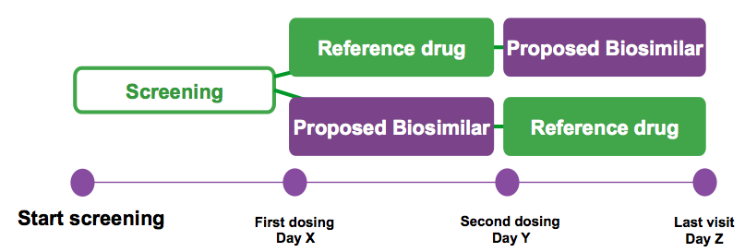
Example: Cross-over design for clinical studies
Cross-over studies: Subsequently administer biosimilar and reference product in the same subject
  Two-arm
  Three-arm
  Two-period
  Three-period
Reduced sample size

Slide 27
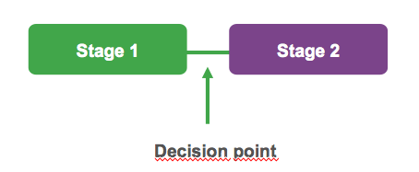
Example: Two-stage design for clinical studies
Concept: conduct first stage of study and open second stage in case of inconclusive data (additional subjects)
Useful for molecules with high variability in clinical endpoint
Reduced sample size

Slide 28
most sensitive population is crucial
Patients or healthy volunteers
Pharmacokinetics: Healthy volunteers most sensitive
Efficacy: Validated biomarkers as surrogates
Immunogenicity: Healthy volunteers most sensitive

Slide 29
Tailored clinical programs allow for efficient development
More sensitive models, higher quality data
Less time needed for clinical programs
Lower sample size
  Less costly
  Faster
  Ethical: fewer subjects

Slide 30
summary
Mid-size pharma companies to play a significant role in biosimilars if properly positioned
Funding and expert team are key for success
Early definition of strategy
Consistent application of biosimilar concept helps to reduce time and budget for clinical development

Slide 31
cinfa biotech
... a passion for biosimilars

Slide 32
Let us meet again..
We welcome you to our future conferences of Conference Series LLC
through
6th International Conference and Exhibition on Biologics and Biosimilars
October 19-21, 2016 Houston, TX, USA
http://biosimilars-biologics.pharmaceuticalconferences.com/europe

