Slide 1
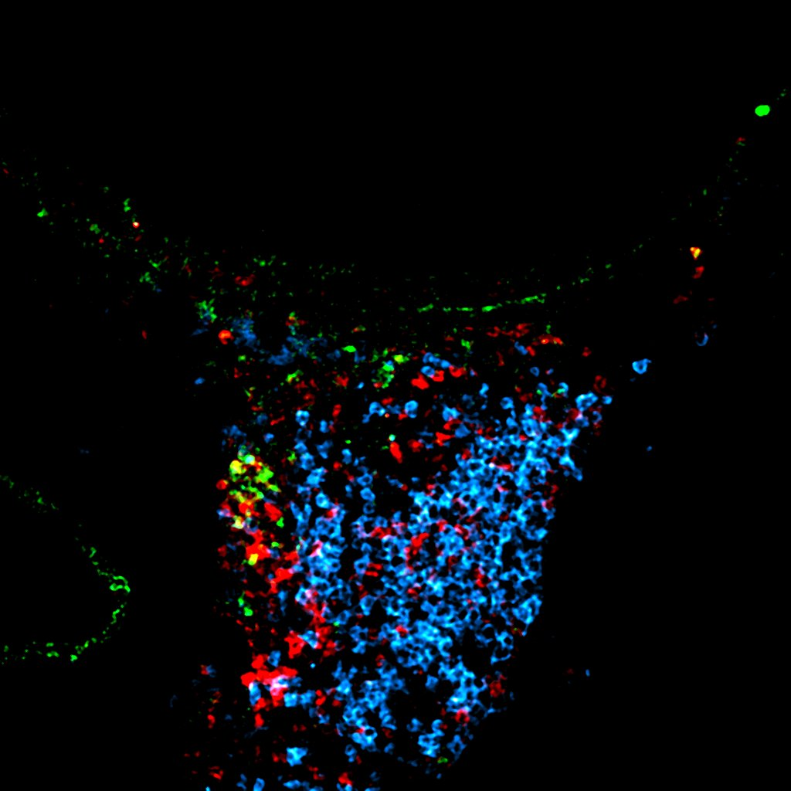

Differential roles of Th2 and ILC2
in allergic airway inflammation
ILC2
ILC2
ILC2
Rudi Hendriks
Department of Pulmonary Medicine
Erasmus MC Rotterdam, the Netherlands
Th2
ILC2

Slide 2
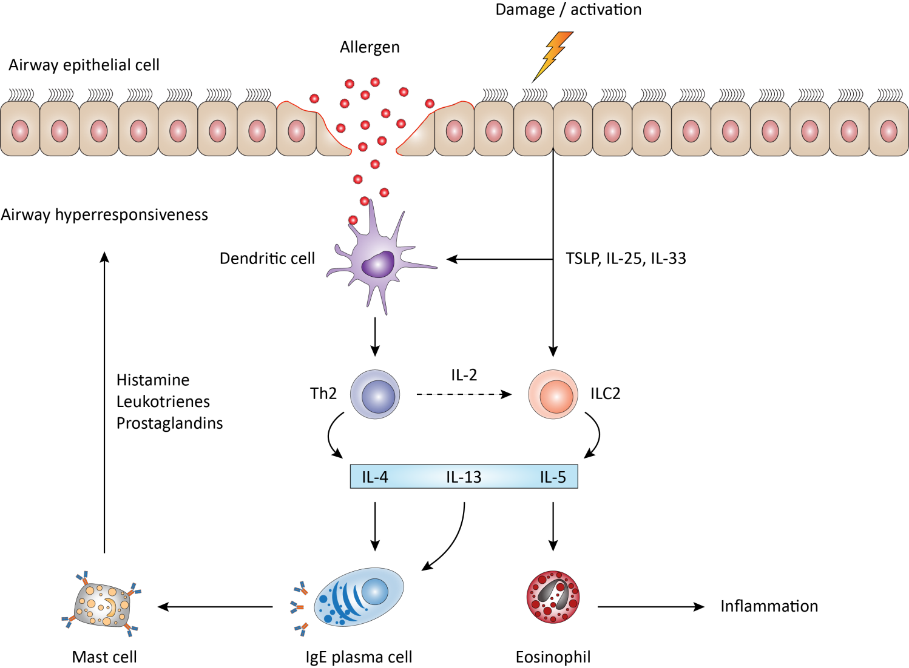
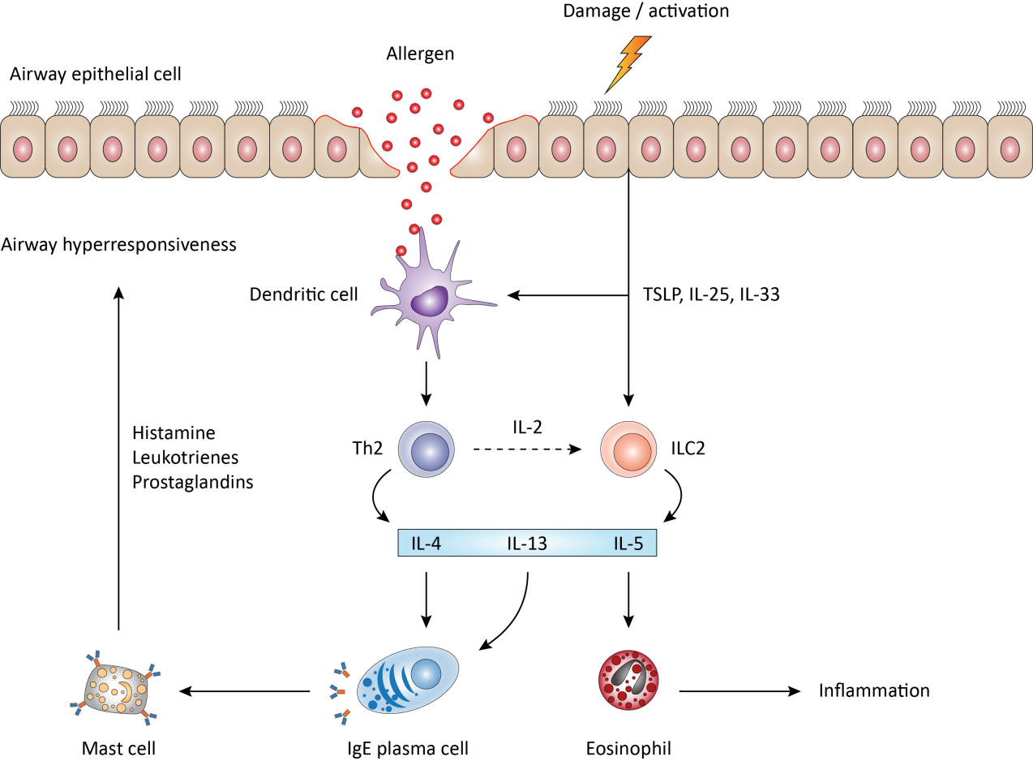

Allergic airway inflammation: role of Th2 cells and ILC2
Allergen (HDM)
Airway epithelium
Dendritic
cell
IL-1α GM-CSF
IL-33 IL-25 TSLP
T_{H}2
Histamine
Leukoctrienes
Prostaglandines
Smooth muscle cell: AHR
Goblet cell hyperplasia
DC Migration
M2 macrophages
Mast cell
Inflammation
IgE⁺
Plasma cell
Eosinophil

Slide 3
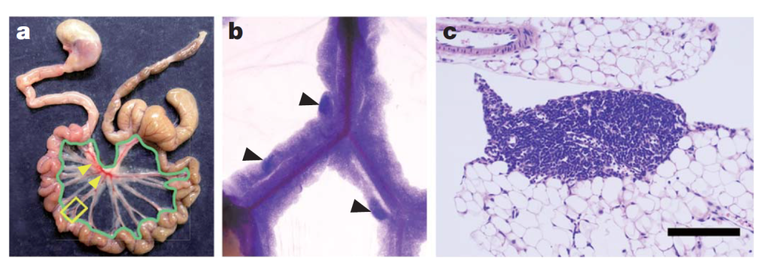
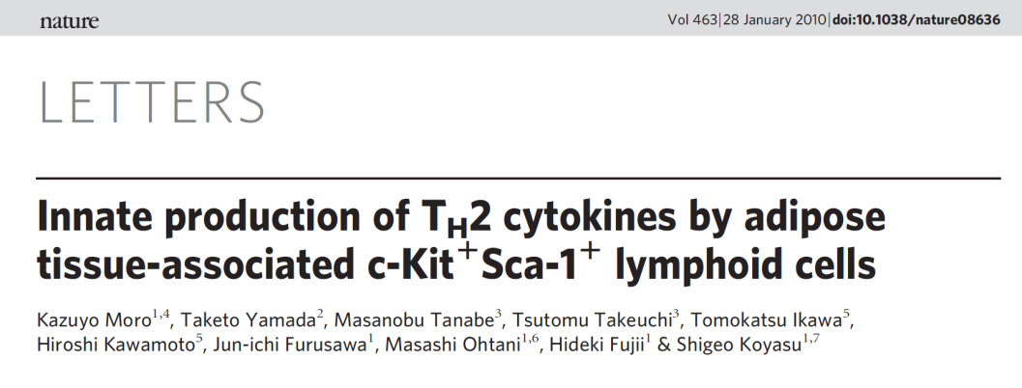
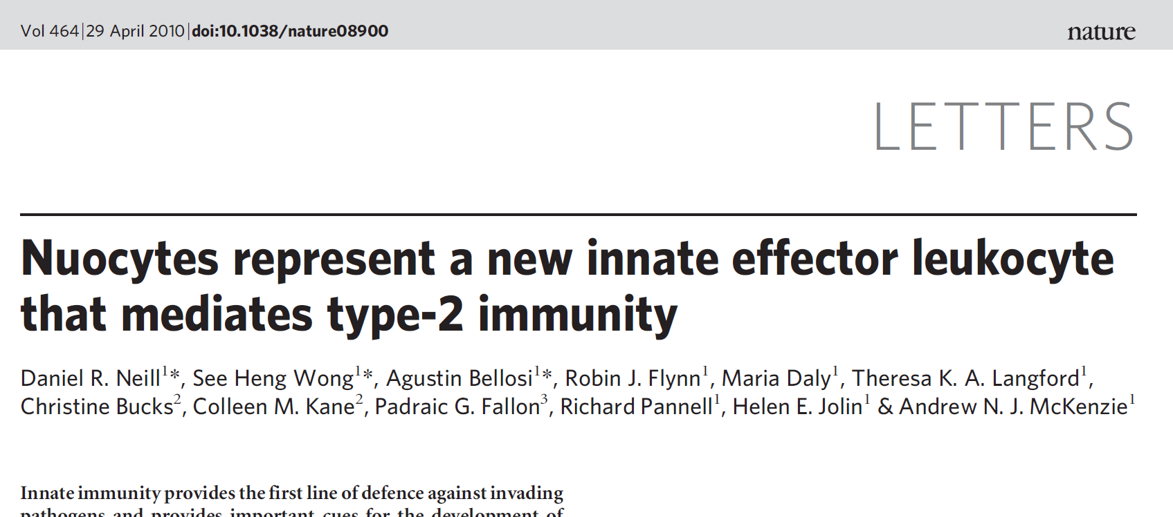
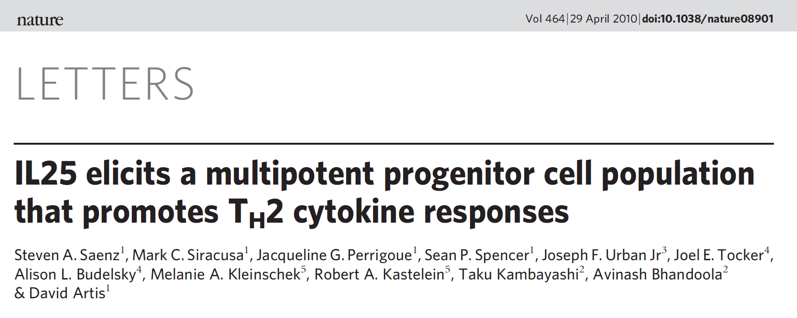
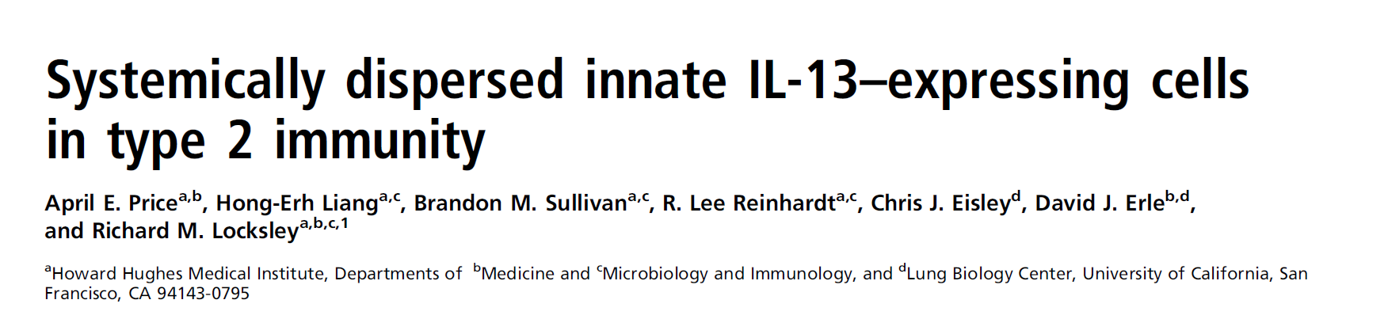

The discovery of Group 2 Innate Lymphoid Cells (ILC2) in 2010
IL-25 induces a non-B/non-T cell population to produce IL-4, IL-5 and IL-13
(Fort et al., 2001; Hurst et al., 2002; Fallon et al., 2006)
Koyasu, Tokio Japan, January 2010
Fat associated lymphoid tissue (FALC)
McKenzie, Cambridge UK, April 2010
Artis, Philadelphia USA, April 2010
Locksley, San Francisco USA, June 2010

Slide 4
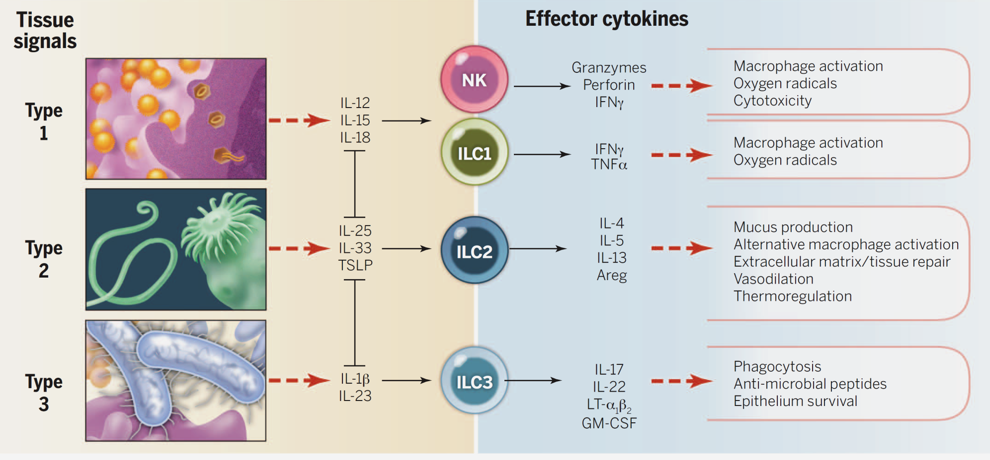
The ILC2 is a member of the family of ILCs
ILC:
Lineage^{neg} CD45^{pos} nonB/nonT lymphocytes
Dependent on IL-7
Produce vast amounts of cytokines upon activation
Eberl et al., Science 2015

Slide 5
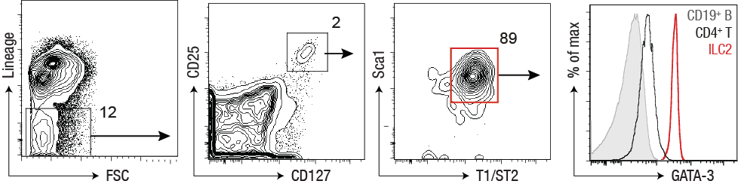
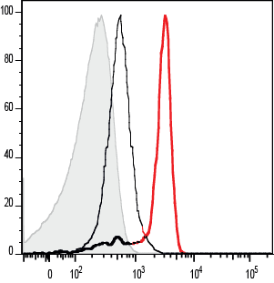
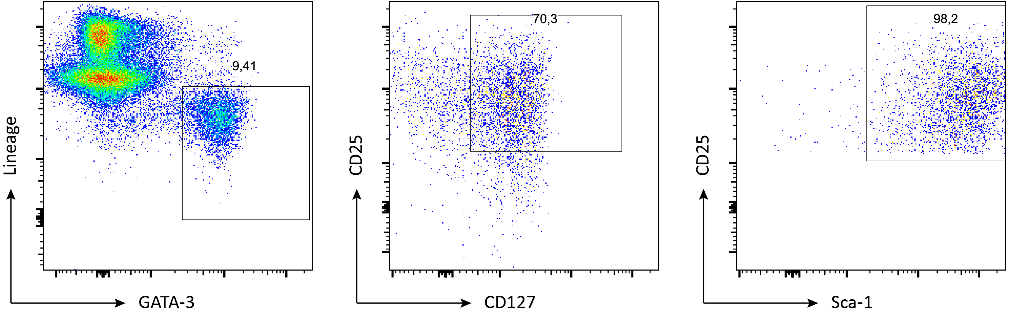
Identification of ILC2s by multi-color FACS
C57BL/6 bone marrow
lung
Lineage mix:
CD3, CD4, CD5, CD8, CD11b, CD11c, CD19, B220, NK1.1, Ter-119, Gr-1, FcεRI
ILC2 Express:
IL-33R (T1/ST2)
CD117 (c-kit)
CD25 (IL-2R)
CD127 (IL-7R)
Sca1
ICOS
(mostly) KLRG1
CD45⁺ lymphocytes
Lineage
CD25
CD25
GATA-3
CD127
Sca-1
Klein Wolterink et al, PNAS 2013

Slide 6
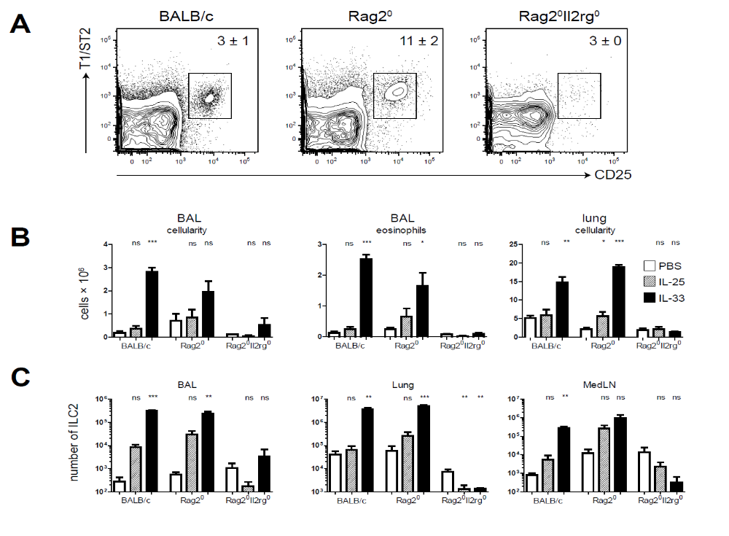
IL-33 induces ILC2s in the lung, independent of B or T cells
Day 1, 3, 5
IL-25 or IL-33
1 μg by inhalation
Day 6
Analysis
BAL eosinophils
ILC2 in lung
Klein Wolterink et al, Eur. J. Immunol 2012

Slide 7
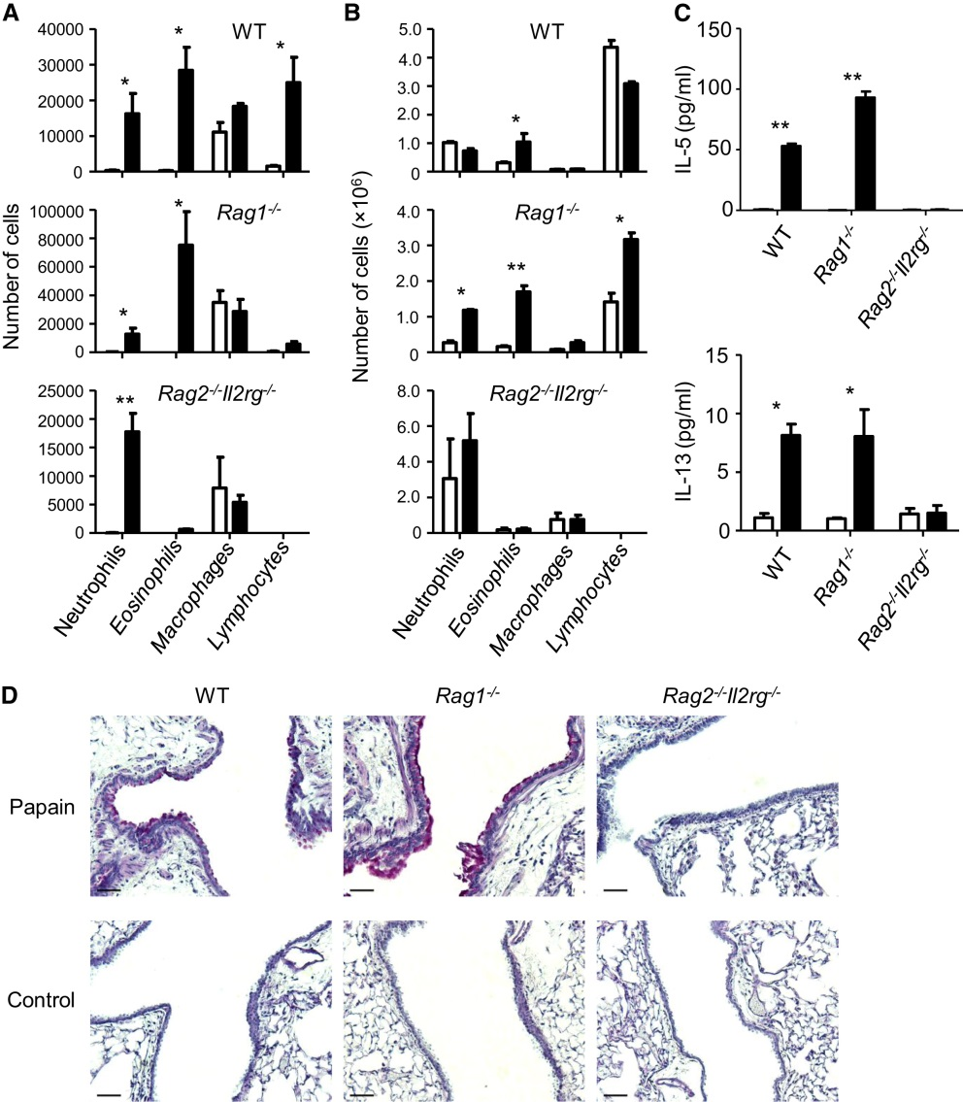
Evidence for a role of ILC2s in disease models
BAL
Papain exposure
Allergic Asthma
ILC2 are activated upon exposure to protease allergens, such as Alternaria and papain, in Rag^{-/-} mice
Induction of eosinophilia and AHR (Bartemes et al, J Immunol, 2012; Doherty et al, AJPhLCLMPh 2012; Wilhelm et al, Nat Immunol, 2011; Halim et al, Immunity 2012;
Influenza
AHR, dependent on IL-33
Tissue repair (amphiregulin restores lung epithelium integrity) (Chang et al, Nat Immunol 2011; Monticelli et al, Nat Immunol 2012)
Atopic dermatitis
ILC2 expansion and interactions with mast cells
(Kim et al, Sci Transl Med 2013; Salimi et al, J Exp Med 2013)
Lung fibrosis
ILC2 expansion in bleomycin-induced lung fibrosis model
(Li et al., JACI 2014)
Metabolic homeostasis
Depletion of ILC2 increases obesity
(Hams et al, J Immunol 2013; Nussbaum et al, Nature 2014; Molofsky J Exp Med, 2013; Lee et al, Cell 2015; Brestoff et al, Nature 2015)
Halim et al, Immunity 2012

Slide 8
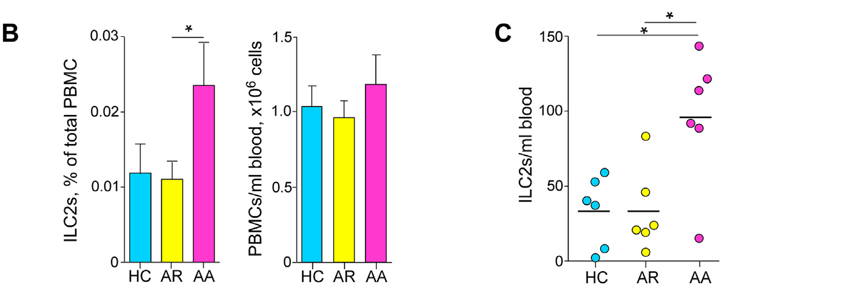
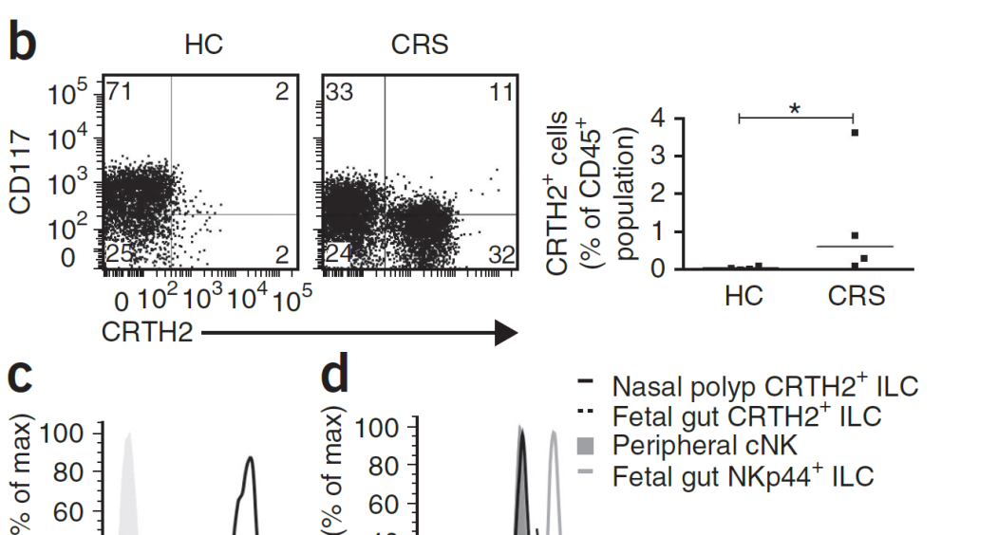
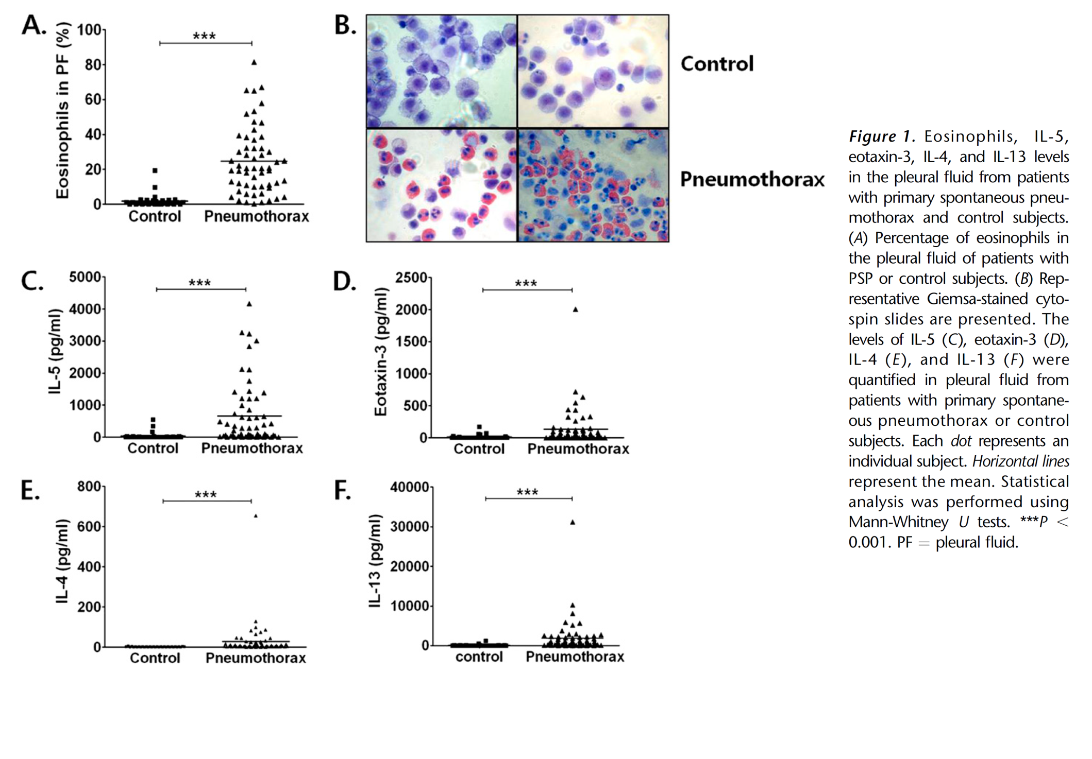
Evidence for a role of ILC2s in human disease
Allergic Asthma
GWAS shows association with IL1RL1 (IL-33R), IL33, IL13, RORA (Mofatt et al., New Eng J Med, 2010)
Increased presence of CD34⁺IL-5⁺ or CD34⁺IL-13⁺ non-T cells in sputum of allergic patients (Allakhverdi et al., JACI 2009)
    ILC2 are increased in peripheral blood (Bartemes et al, JACI 2014)
    Chronic rhinosinusitis (CRS)
    ILC2 are increased in nasal polyps (Mjösberg et al, Nat Immunol 2011)
    ILC2 are increased in peripheral blood upon cat-allergen or pollen exposure (Doherty et al, JACI 2014; Lao-Araya et al, JACI 2014)
    Idiopathic pulmonary fibrosis (IPF)
ILC2 are increased in BAL; increased IL-25 in the lung
(Hams et al, PNAS 2014)
Primary spontaneous pneumothorax
Increased eosinophils, Th2 cytokines and ILC2 in pleural fluid
(Kwon et al, AJRCCM 2013)
Atopic dermatitis
ILC2 are increased in lesional skin and after local allergen challenge (Kim et al, Sci Transl Med 2013; Salimi et al, J Exp Med 2013)

Slide 9
What about ILC2 activation in a more physiological model (House Dust Mite)??

Slide 10
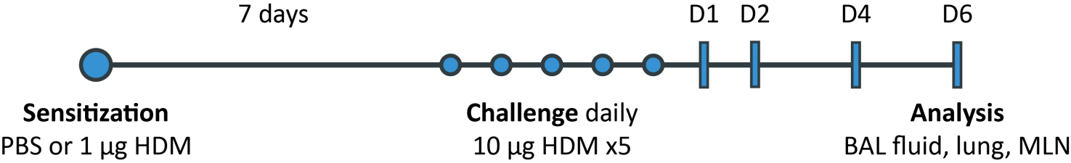
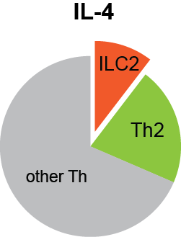
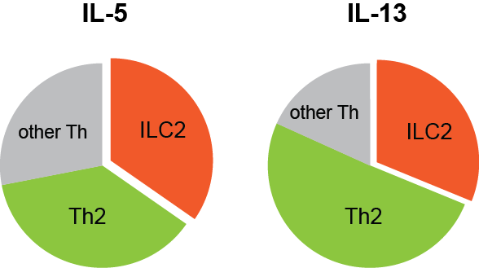
ILC2s are major cytokine producers (in HDM-mediated AAI)
in vivo: BAL
IL-4
IL-5
IL-13
ILC2: T1/ST2⁺Lin⁻CD25⁺CD127⁺
Th2: T1/ST2⁺CD3⁺ CD4⁺
other Th: T1/ST2⁻ CD3⁺ CD4⁺
Significant contribution of ILC2 to the total populations of IL-5⁺ and IL-13 ⁺ cells
Klein Wolterink et al, Eur J Immunol. 2012

Slide 11
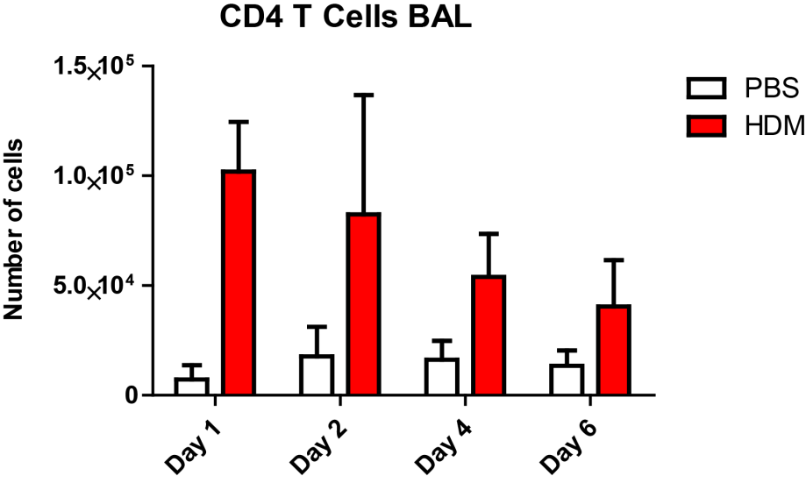
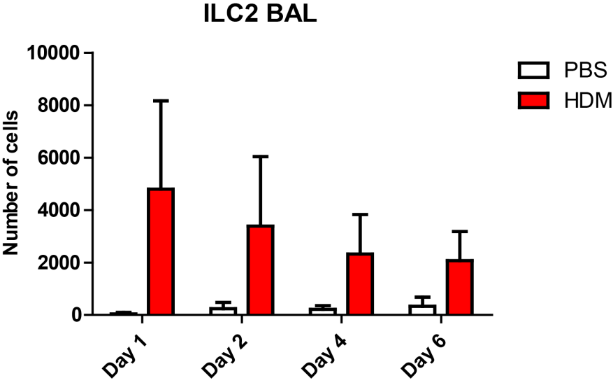
ILC2 activation requires sensitization (in HDM-mediated AAI)
in vivo: BAL
CD4⁺ T cells
ILC2
PBS/HDM
HDM/HDM
ILC2 are induced in HDM-sensitized mice, but not in PBS-sensitized mice
Li et al, Eur J Immunol 2016

Slide 12
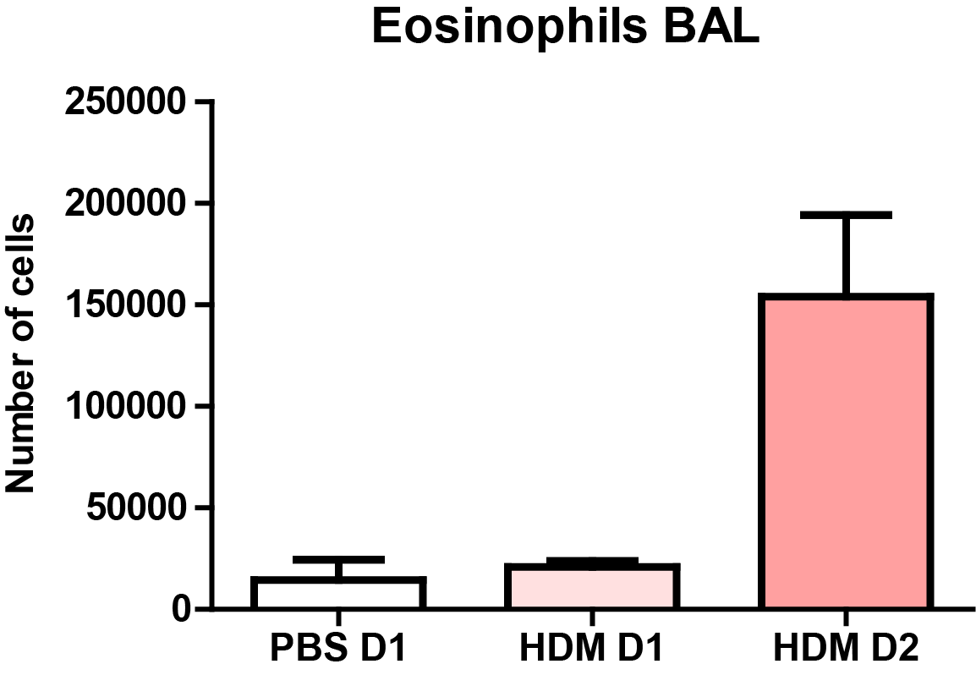
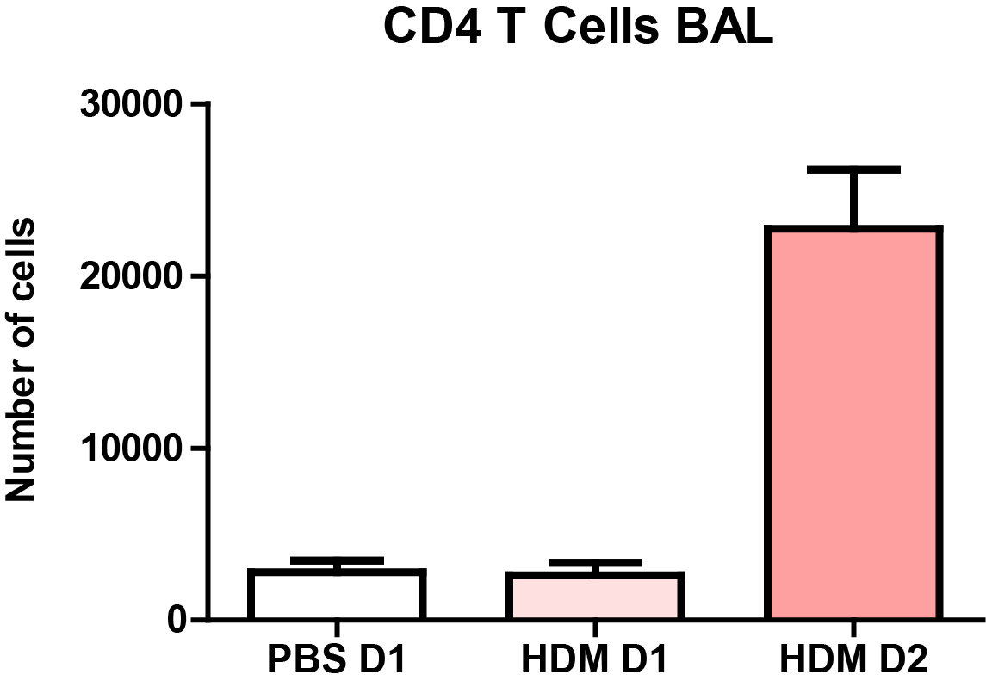
ILC2 induction follows T cell activation (in HDM-mediated AAI)
Analysis
BAL fluid, lung, MLN
D1 D2
200,000
Eosinophils
Challenge
100 μg HDM
100,000
0
in vivo: BAL
30,000
20,000
CD4+ T cells
Cell numbers
10,000
0
ILC2 induction follows the induction of eosinophils and T cells
(but not in absence of sensitization)
10,000
B cells
5,000
0
1000
500
ILC2s
0
PBS
1 2
days after HDM challenge
Li et al, Eur J Immunol 2016

Slide 13
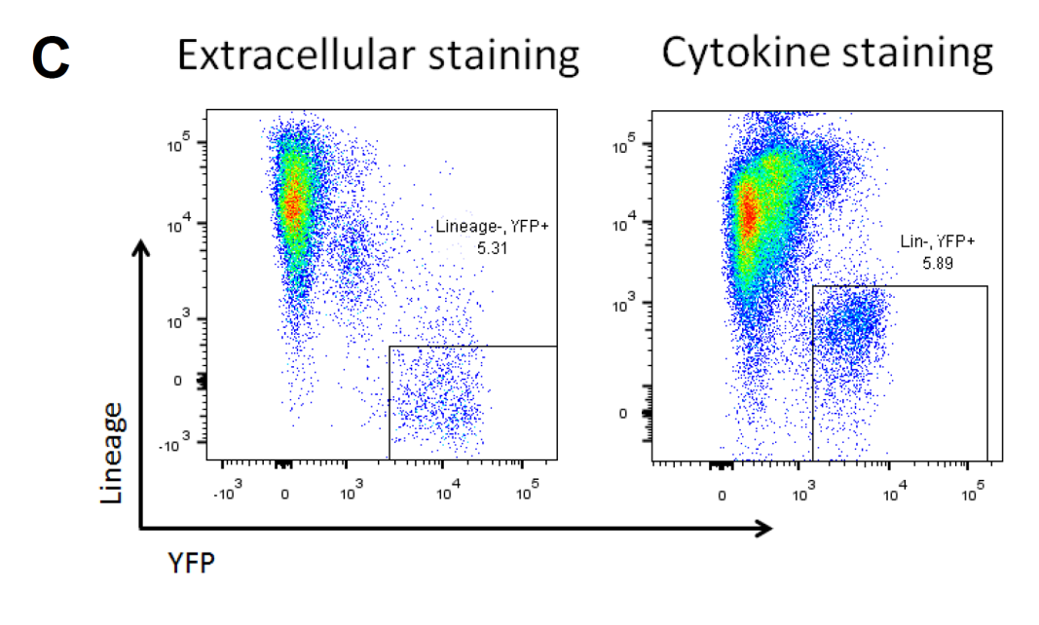
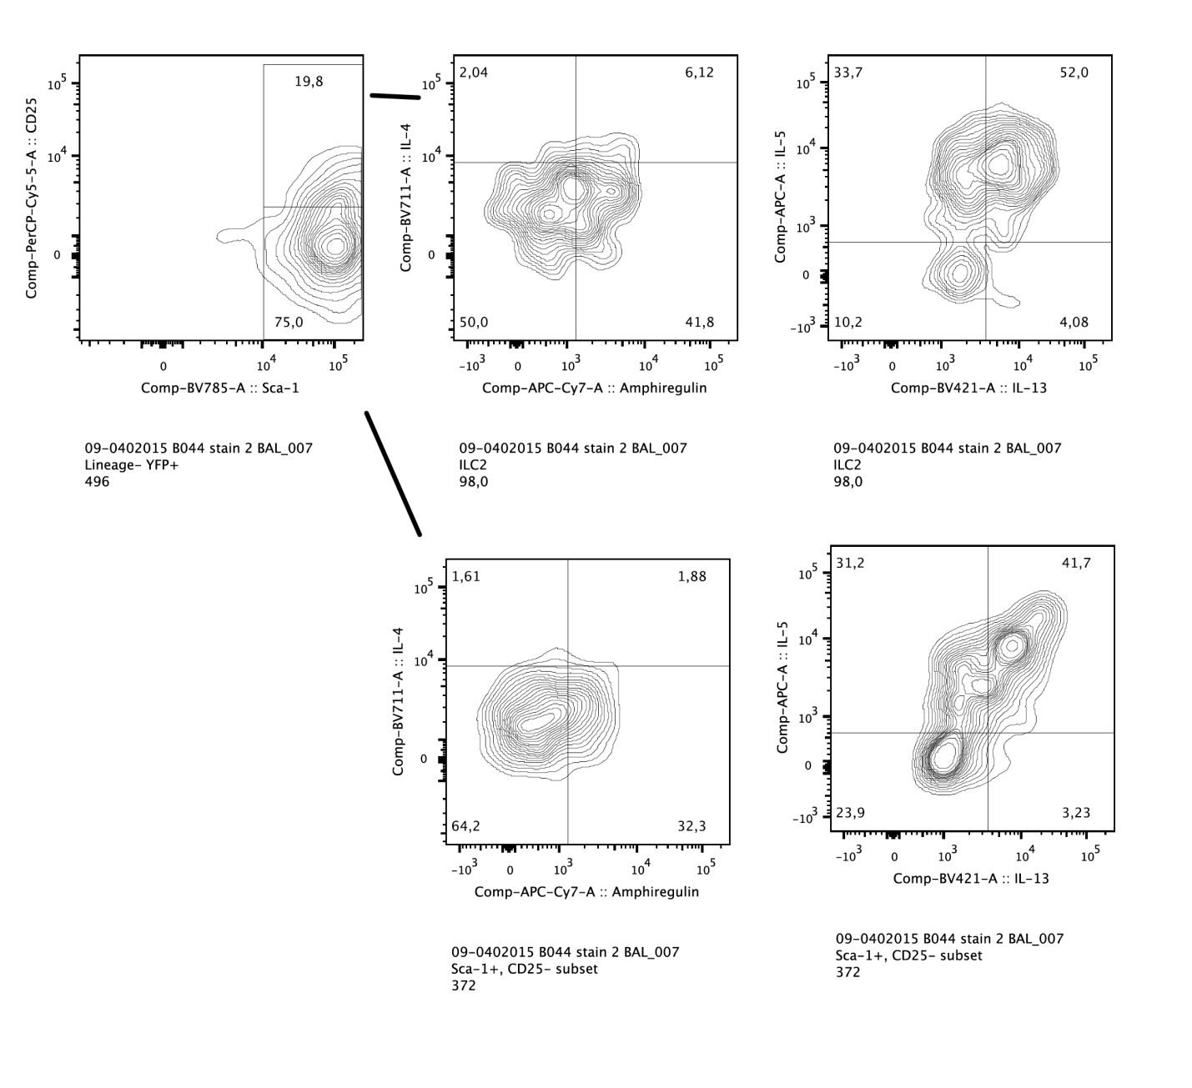

Analysis of GATA3 expression using a GATA3-IRES-YFP knock-in mouse
Unfixed cells
PFA/saponin
Lineage
34
52
GATA3-YFP
TN Rao and J Fehling, unpubl.
CD25⁺
31
42
CD25⁻
CD25
Sca-1
IL-5
CD25⁺ and CD25⁻ GATA3⁺ ILC2 in BAL fluid in HDM AAI
IL-13
Li, Beerens et al, unpubl.

Slide 14
Phenotype of ILC2 induced by HDM differs from ILC2 induced by IL-33
Markers such as CD25 (IL-2R), ICOS, KLRG1 or T1?ST2 (IL-33R) are only expressed on a fraction of ILC2 in BAL and lung
Li, Beerens et al, unpubl.

Slide 15
Involvement of both Th2 cells and ILC2 in allergic airway inflammation
Papain-induced AAI:
Early, essential role of ILC2
ILC2 are activated in the absence of T cells
ILC2 are essential to drive DC migration to draining LN
ILC2 are high in CD25, ICOS and KLRG1
IL-1α GM-CSF
IL-33 IL-25 TSLP
DC
IL-13
ILC2
T_{H}2
IL-4
IL-5
IL-13
HDM-induced AAI:
No innate induction of ILC2
ILC2 induction is dependent on T cells
ILC2 induction is independent of B cells
ILC2 require IL-33 for cytokine induction but not for proliferation
ILC2 also produce IL-4 in chronic HDM AAI
ILC2 have heterogeneous phenotype
IL-1α GM-CSF
IL-33 IL-25 TSLP
DC
IL-2
T_{H}2
ILC2
IL-4
IL-5
IL-13

Slide 16
Are there common and unique roles of Th2 cells and ILC2 in allergic airway inflammation?

Slide 17
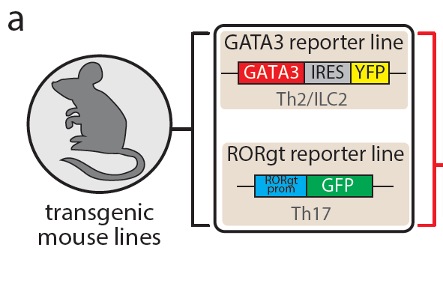
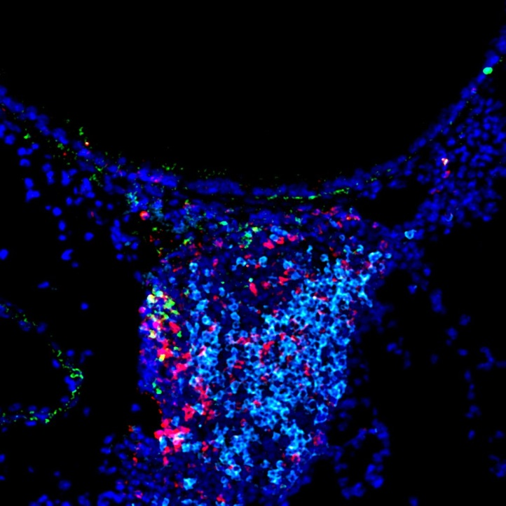
ILC2 and Th2 cells in chronic HDM-mediated airway inflammation
ILC2
Hans Jörg Fehling
Ulm Germany
ILC2
CD3+ T cells
B220+ B cells
GATA3-YFP
DAPI
ILC2
Th2
ILC2
Li et al., unpubl.

Slide 18
Research question and approach
ILC2 and Th2 cells are similar in their capacity to produce IL-5 and IL-13
ILC2 are different from Th2 cells, because they lack TCRs
ILC2 are different from Th2 cells, in terms of localization (and interactions with other cells)
ILC2
Research question: what are the genome-wide differences between ILC2 and Th2 cells?
Approach: analysis of epigenome
extremely rich resource, providing information on:
→ History of development and stimulation
→ Present identity and function
→ Future potential
most of which cannot be obtained by only studying gene expression
Th2

Slide 19
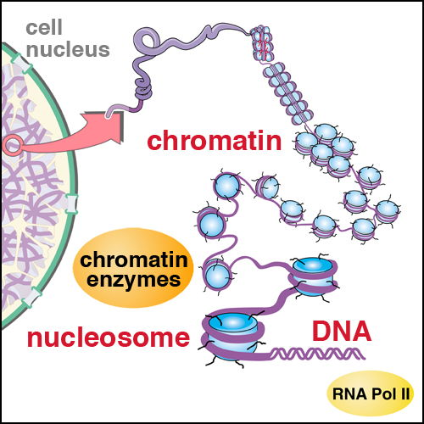
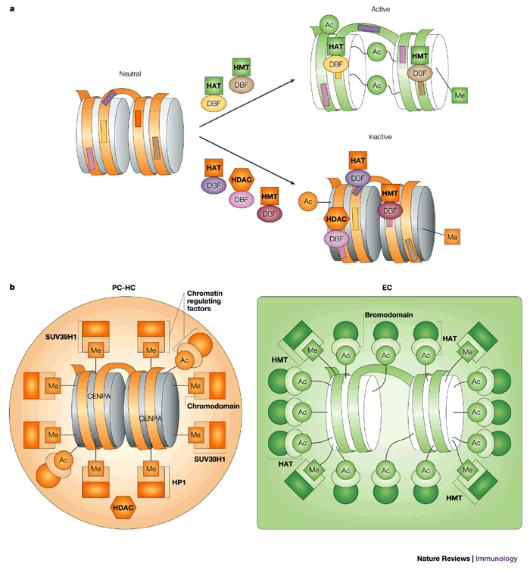
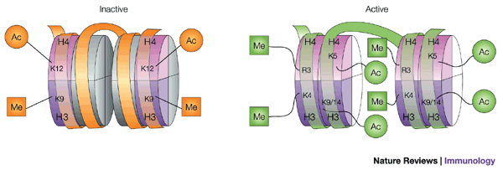
Chromatin codes impose gene activity or gene inactivity
Active chromatin mark
H3K4Me2
Active
Neutral
Inactive
HAT= histone acetyl transferases
HDAC= histone deacetylases
HMTs= histone methyl transferases
DBF= sequence-specific DNA-binding factors
Georgopoulos, Nat Rev Immunol, 2003

Slide 20
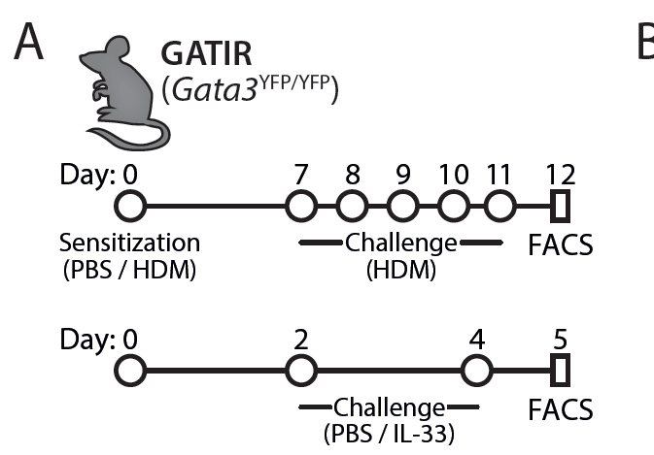
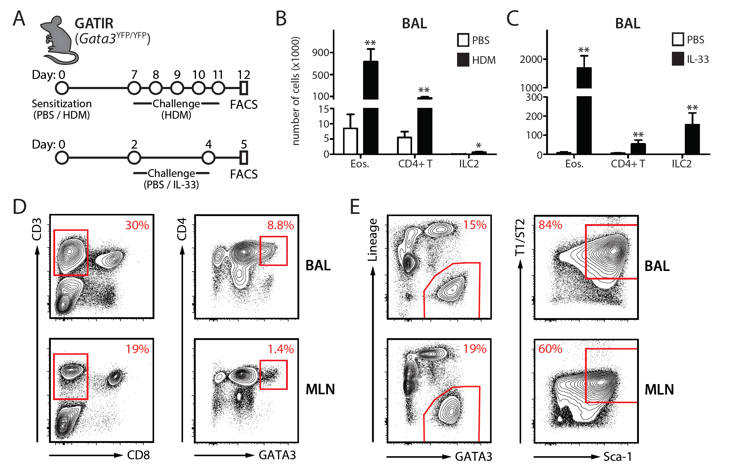
Approach I: FACS sorting of Gata3+ Th2 cells and ILC2
T cell
ILC2

Slide 21
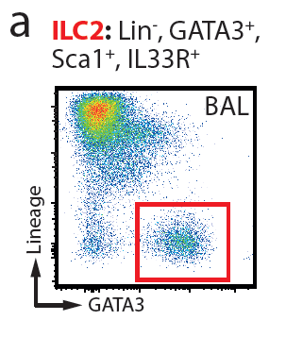
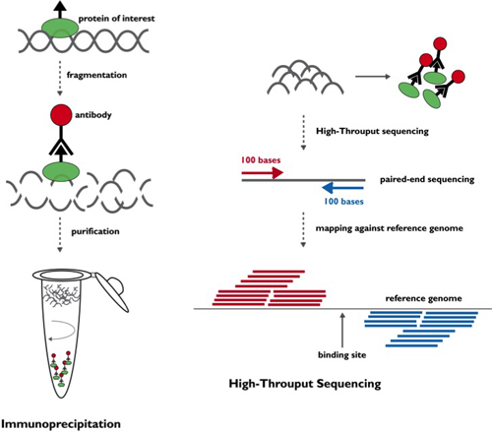
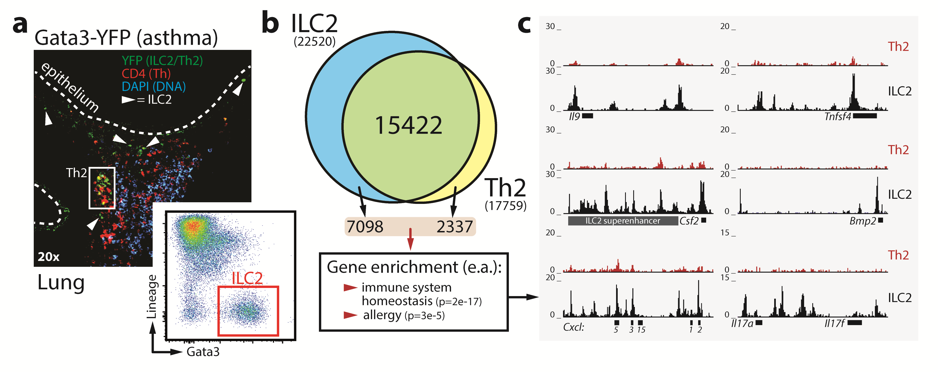
Approach II: genome-wide H3K4Me2 Chip-Seq
isolation of
chromatin
Naive mice
Acute HDM (Th2)
IL-33 (ILC2)
FACS Sort
50,000 cells
fragmentation
H3K4Me2-specific
antibody
purification
Deep
Seq
immuno
precipitation
Stadhouders et al., unpubl.

Slide 22
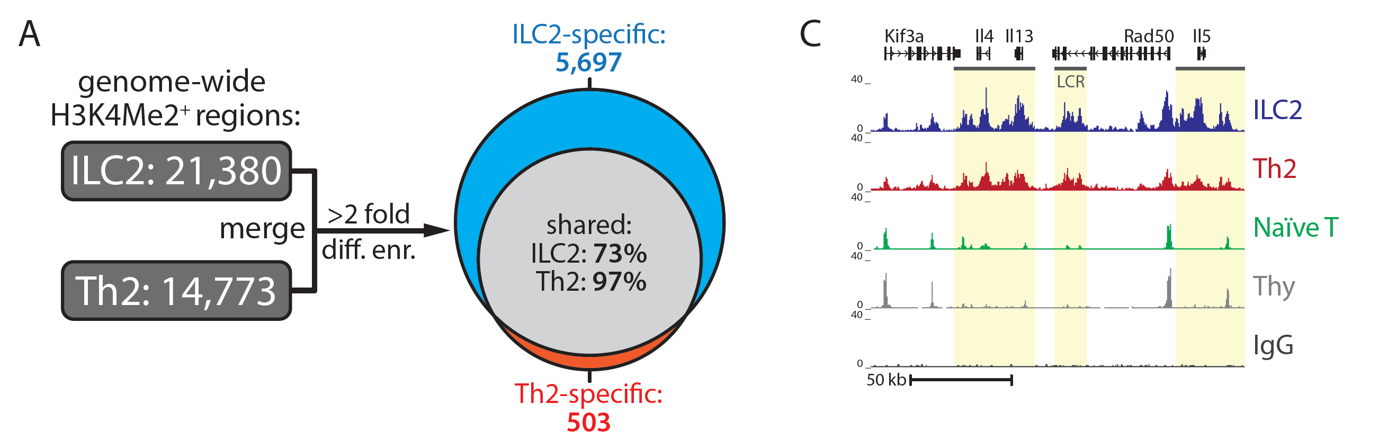
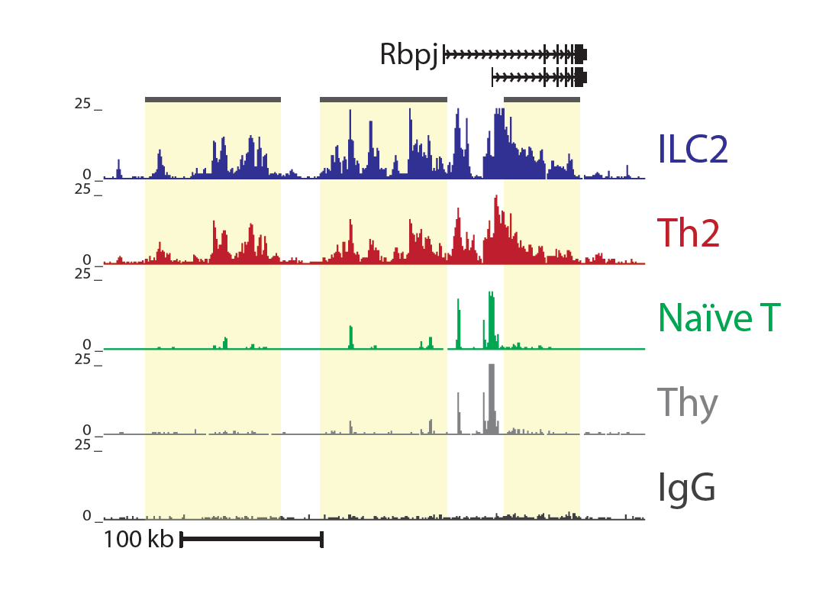
Most H3K4Me2 chromatin marks are shared between ILC2 and Th2 cells
→ Active H3K4Me2 marks at the Th2 locus are often similar in ILC2 and Th2 cells
Stadhouders et al., unpubl.

Slide 23
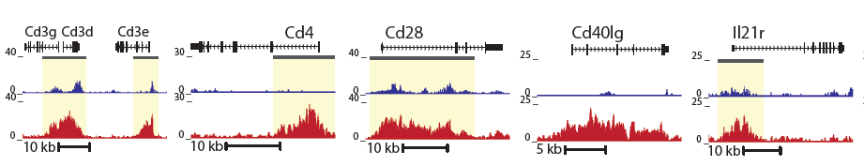
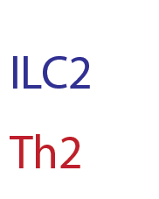
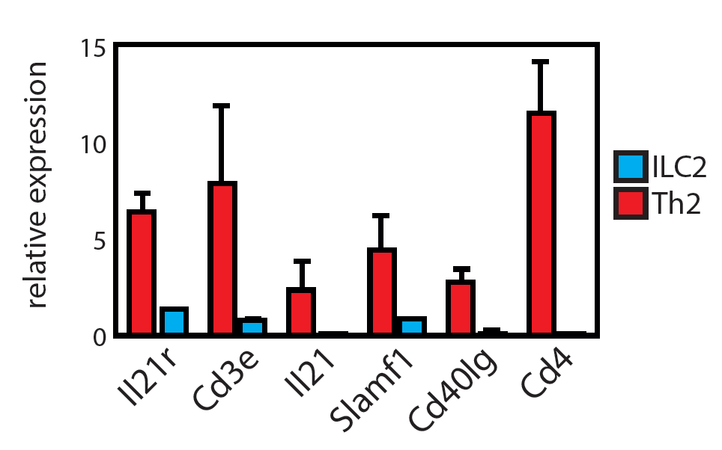
Approximately 500 H3K4Me2 chromatin marks are T cell-specific
→ Correlate with expression in Th2 cells
Stadhouders et al., unpubl.

Slide 24
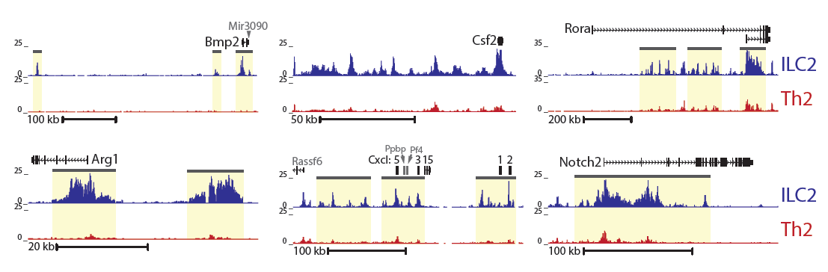
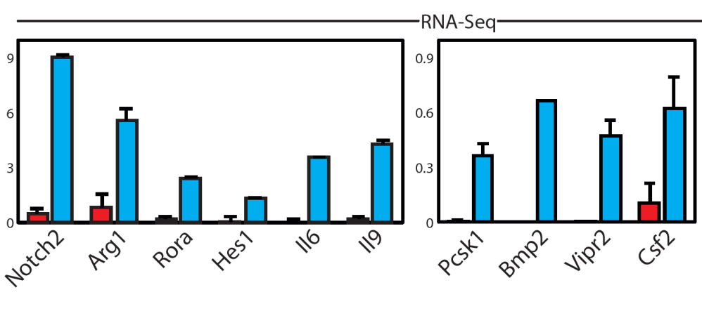
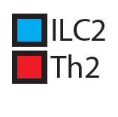
Approximately 5,700 H3K4Me2 chromatin marks are ILC2-specific
→ Active H3K4Me2 marks specific for ILC2 cells include genes involved in cell-cell interaction (such as Csf2, chemokines and Notch2)
→ Correlate with expression in ILC2
Stadhouders et al., unpubl.

Slide 25
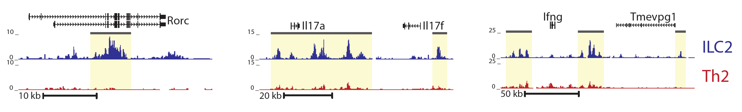
Some of the ILC2-specific chromatin marks are quite surprising
→ Active H3K4Me2 marks specific for ILC2 cells include:
  genes that point to ILC2 plasticity (RORγ, IL -17 and IFNγ)
  genes that point to relation with T cells (TCR loci, Rag2)
  fatty acid metabolic genes (Acetyl-CoA carboxylase), FA transport and FA sensing and adipose tissue function ILC2 (Pcsk1, Vipr2)
  asthma genes: Alox5 (5-lipoxygenase), Zbtb16, Bmp2, Rora
  ariway remodeling genes:
      TNF-family member LIGHT
      TFGβRII/Activin A
      Hyaluronan
      CXCL1, CXCL3, CXCL5 (smooth muscle cell migration)

Slide 26
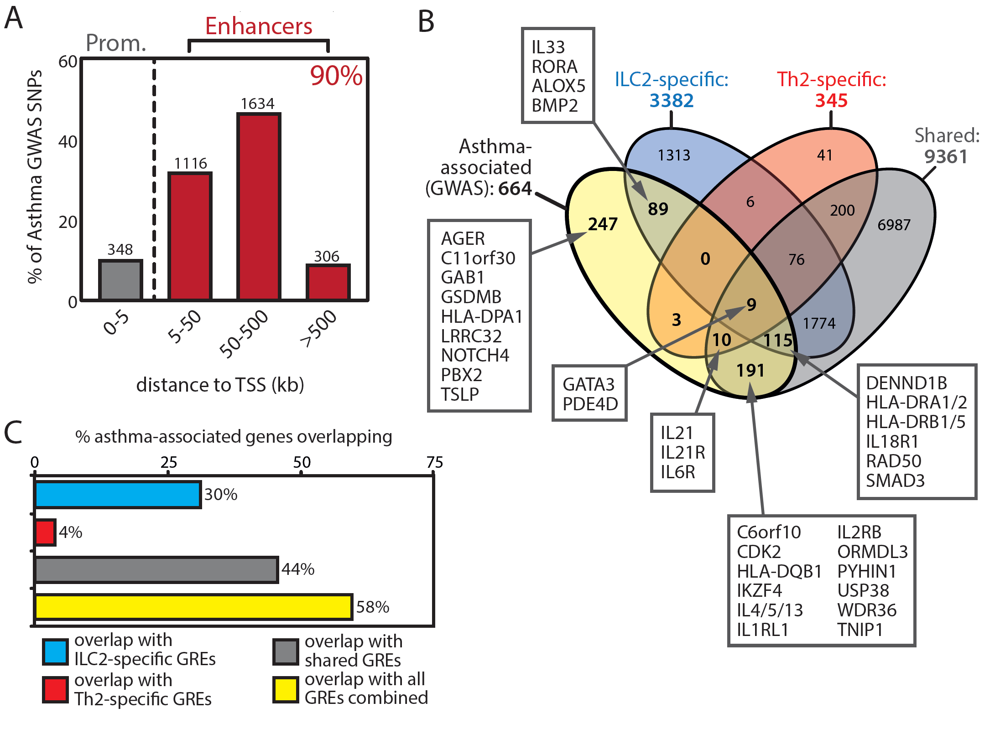
1/3 Genes associated with asthma have ILC2-specific regulatory elements

Slide 27
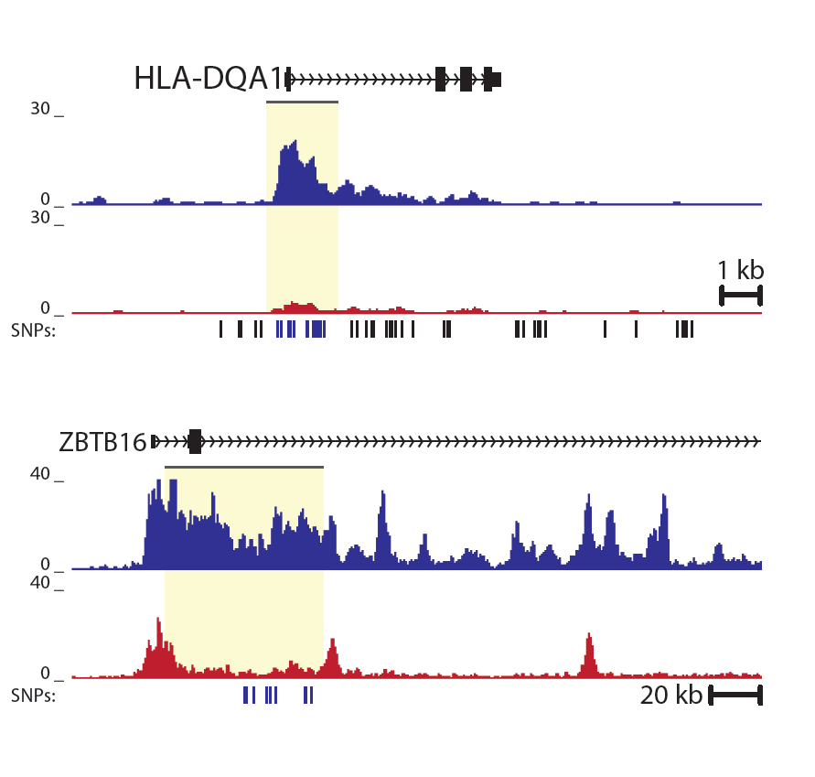
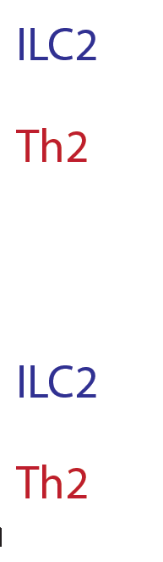
Asthma-associated SNPs in human ILC2-specific regualtory elements
SNPs
SNPs

Slide 28
Summary and conclusions
In a chronic HDM-asthma model:
ILC2 are located under the mucosa as individual cells
Th2 cells are located in clusters in iBALT
Genome wide epigenetic analyses shows that:
ILC2 have many more active marks than Th2 cells
ILC2 have active marks at specific loci implicated in asthma, tissue remodeling, homeostasis and metabolism
ILC2 significantly contribute to asthma susceptibility (combination with GWAS studies)

Slide 29




Acknowledgements
ERASMUS MC ROTTERDAM
ERASMUS MC ROTTERDAM
Department of Pulmonary Medicine
Roel Klein Wolterink, Bobby Li,
Maarten Brem, Dior Beerens
Alex Kleinjan, Melanie Lukkes
Marjolein de Bruijn, Ingrid Bergen
Heleen Vroman, Mirjam Kool
Department of Cell Biology
Frank Grosveld
INSTITUT PASTEUR
PARIS, FRANCE
Jim Di Santo
Nikolas Serafini
UNIVERSITY CLINICS
ULM, GERMANY
Tata Rao
Hans Jörg Fehling
CENTER FOR GENOMIC REGULATION, BARCELONA, SPAIN
Ralph Stadhouders
Antonio Gomez, Thomas Graf

