Slide 1

Facet Joint Arthrosis
Disc Degeneration and Lumbago
Dr.Ruchira Sethi
Dr. Vishram Singh
Department of Anatomy
Santosh University, India

Slide 2
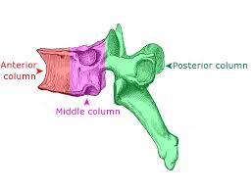
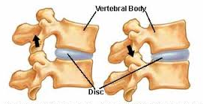
INTRODUCTION
The initial division of spine into three columns for describing post traumatic injury by Denis Francis was a landmark in defining and describing stability of spine.
However in Degenerative or Aging spine , there have been proposed two strong columns- Anterior and Posterior columns which maintain the integrity and stability of spine
Three Column Spine
Two Column Spine

Slide 3
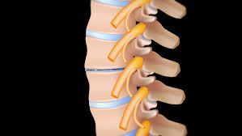
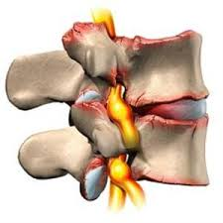
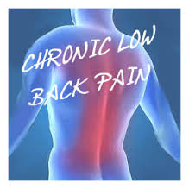
SEQUENCE OF EVENTS
Disc Degeneration
Facet Joint Arthrosis

Slide 4
DISC DEGENERATION OUTCOMES:
INSTABILITY
HERNIATION
STENOSIS
STRESS ON FACET JOINTS--FJA

Slide 5
AIM OF PRESENT STUDY
An MRI Study Of Lower Lumbar Spine Was Done In Low Back Pain Individuals
- For Assessment Of Prevalence And Grade Of Facet Joint Arthrosis and its association with Degenerative Disc Disease

Slide 6
MATERIALS & METHOD
Fifty cases of LBP were enrolled for the study; age-group 20-70 years; Males=23, Females=27 (mean age=41.92 yrs & 44.19 yrs respectively)
LBP
By pre-defined questionnaire
LSS/
DD
FJA
Decreased facet joint space with/without hypersclerosis of joint margins
Osteophyte formation
Decreased osseous diameter of vertebral canal
Oswestry low back pain
Decreased IVD height, Herniation and/or Disc Prolapse
Philips 1.5 T Achieva
Axial,
coronal and sagittal images , 4mm slice gap

Slide 7
RESULTS
The LSS was seen at lower vertebral levels in cases of LBP
The highest prevalence of FJA was seen at L4-L5 vertebral level
FJA was evident without DD
The highest prevalence of DD was seen at the caudal most vertebral level
Association of DD, LSS & FJA

Slide 8
GRADING FJA
Grade 0 --Normal facet joint space (2±4 mm )
Grade 1 --Narrowing of the facet joint space (< 2 mm)
Grade 2-- grade1+ sclerosis of joint margins + mild sub-articular bone erosions
Grade 3– Grade2 + small osteophytes +severe sub-articular bone erosions
Grade 4- grade3+ large osteophytes and/or subchondral cysts
Prevalence of different grades of FJA
Vertebral Level | Grade 1 | Grade 2 | Grade 3 | Grade 4
L5-S1 | 2(0.04) | 28(0.61) | 16(0.35) | 0
L4-L5 | 8(0.17) | 26(0.54) | 14(0.29) | 0
L3-L4 | 18(0.44) | 19(0.46) | 4(0.09) | 0

Slide 9
Prevalence Of Different Grades Of FJA

Slide 10
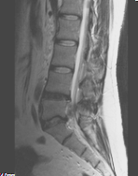
L4
L5
S1
MRI image showing Disc Degeneration

Slide 11
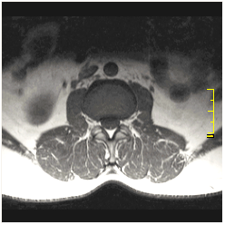
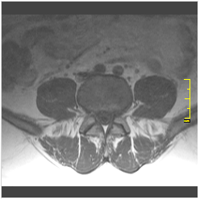
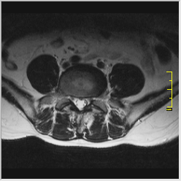
GRADE 2
GRADE 1
GRADE 3

Slide 12
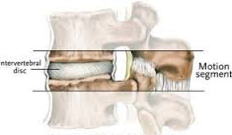
DISCUSSION
Disc degeneration is an inevitable process , occurring in normal response to aging.
The anatomy and functional biomechanics of facet joints provides the concept of “three joint complex” where
IVD and the associated facet joints act as the anterior and posterior joints respectively to stabilize each motion segment
(two consecutive vertebral bodies and
associated facet joints).
The interdependence of IVDs and facet
joints suggest that change in any one joint
will cause degenerative changes to ensue at the
other two, referred to as the “Tripod effect”.

Slide 13
The Tripod Effect defines the interdependence of two components without highlighting the fact as to which is affected first.
It has been suggested that IVD is first to undergo degenerative changes, and is an important component to produce LBP
In the present study however LBP was evident without DD
-in cases with FJA, highlighting the fact that degenerative changes occur earlier in facet joint which are typical synovial joint as against fibro-cartilaginous joint of IVD.
However, once degeneration of disc occurs, it produces segmental load bearing alterations on the facet joints, precipitating the arthritic changes in the joints,as evident by higher Grade of FJA on spinal motion segment (L5-S1) caudal to level of disc degeneration(L4-L5).

Slide 14
CONCLUSION
The ongoing debate on choosing criteria for
conservative and surgical treatment depends not only on the degeneration of IVD but also on the degenerative changes setting in at the facet joints.
Hence the present study clearly demonstrates that facet joints should also be taken as a criteria for conservative
and surgical management of LBP.
in patients with
low back pain.

Slide 15


