Slide 1
Cell-selective delivery of IFNγ peptidomimetic inhibits chronic liver fibrosis and tumor angiogenesis in vivo
Ruchi Bansal, Ph.D.
MIRA Institute of Biomedical Technology
University of Twente
The Netherlands

Slide 2
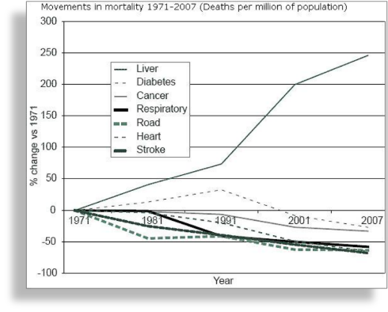
Liver Fibrosis
Growing health problem (1.5 million deaths per year).
No curative therapy available.
Transplantation option?

Slide 3


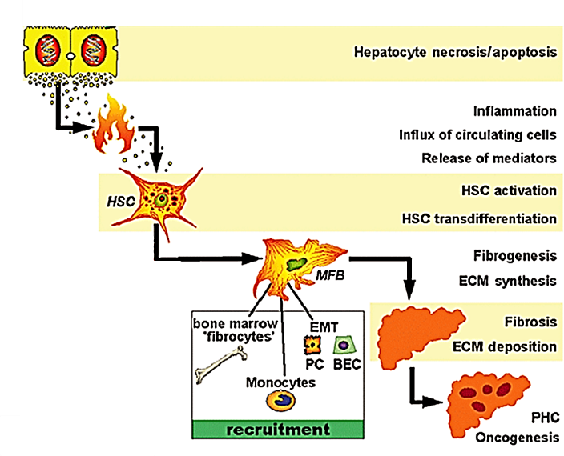
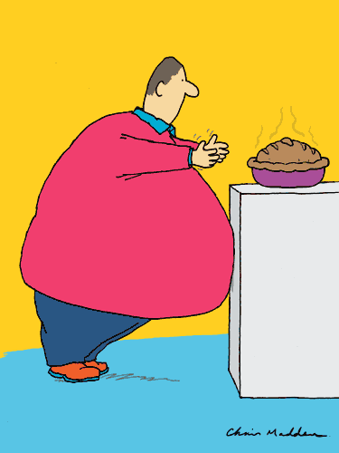
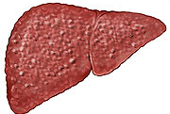
Pathogenesis of Liver Fibrosis
Viral infections
Alcohol
obesity
Stellate cells
Liver cirrhosis or
carcinoma
FIBROSIS

Slide 4
Interferon gamma
Interferon gamma (IFNγ) is produced by activated inflammatory cells (NK cells, B cells, T cells, macrophages, and antigen presenting cells).
It possesses potent anti-fibrotic, anti-viral, anti-tumor and immunomodulatory activities.
However, IFNγ failed in many clinical trials for liver cirrhosis and idiopathic pulmonary fibrosis:
  lack of efficacy (possibly short half-life and low doses)
  severe adverse effects (ubiquitous expression of IFNγ receptors)
King Jr et al Lancet 2009, Pockros et al Hepatology 2007

Slide 5
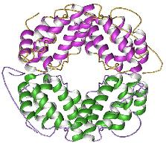
PART I:
PEGYLATION OF IFNγ

Slide 6
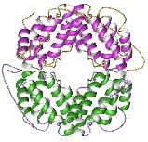
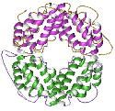
PEGylation
+
Enhanced solubility and stability
Prolonged Circulation Half-life
Decreased Renal clearance
To investigate the pharmacokinetics, therapeutic efficacy and adverse effects of different PEGylated IFNγ constructs (PEG5, PEG10 and PEG20).
Bansal et al., Journal of Controlled Release 2011

Slide 7
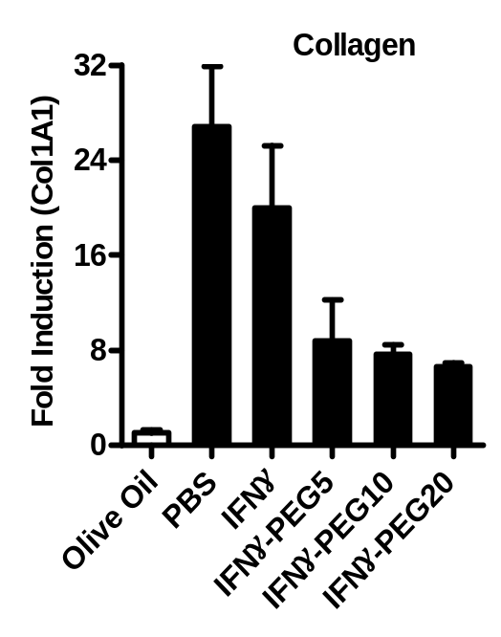
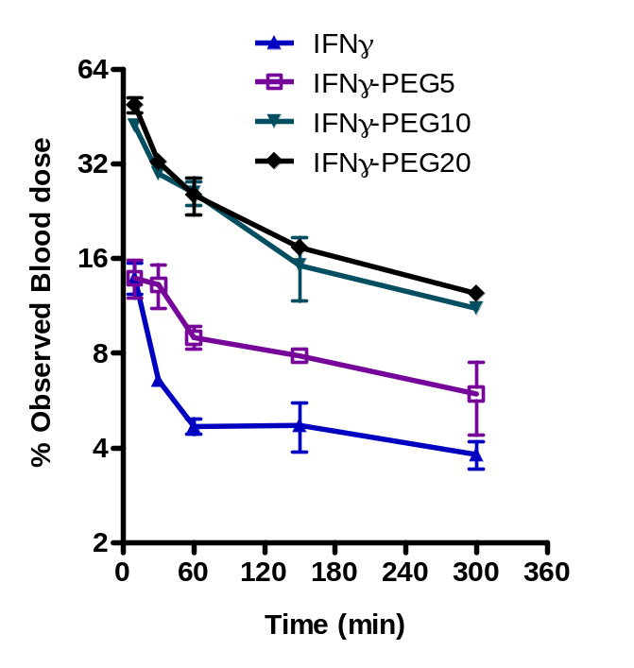
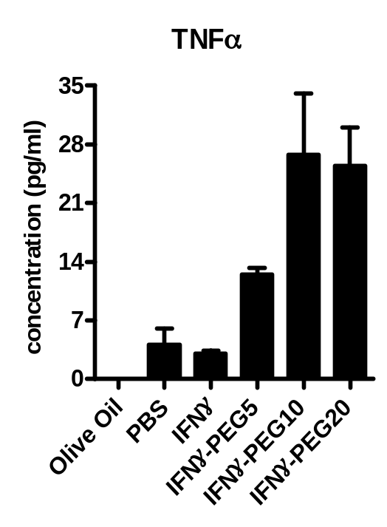
PEGylated Interferon gamma constructs
#
Extracellular matrix
accumulation
*
##
**
**
##
#
Increasing size of Pegylation:
Increased therapeutic efficacy in acute liver injury model
Increasing size of Pegylation:
prolonged circulation time and decreased renal clearance
Increasing size of Pegylation:
Increased systemic inflammation
Bansal et al., Journal of Controlled Release 2011

Slide 8
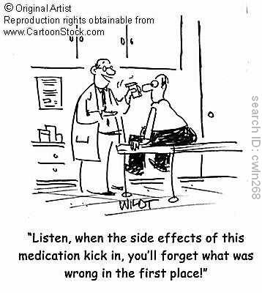

Slide 9
PART II:
TARGETING OF IFNγ
Hepatocytes
scar matrix
Targeted IFNγ
or mimIFNγ
Activated HSC
with high receptor expression
Untargeted IFNγ
Macrophages

Slide 10

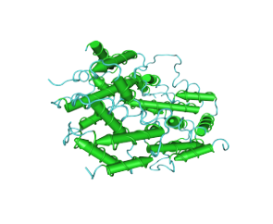


Targeting of IFNγ to the stellate cells
IFNγ
Targeted IFNγ
IFNγR
IFNγR
PDGF Receptor
Anti-fibrotic effects
+
Adverse effects
Stellate cell
Anti-fibrotic effects

Slide 11
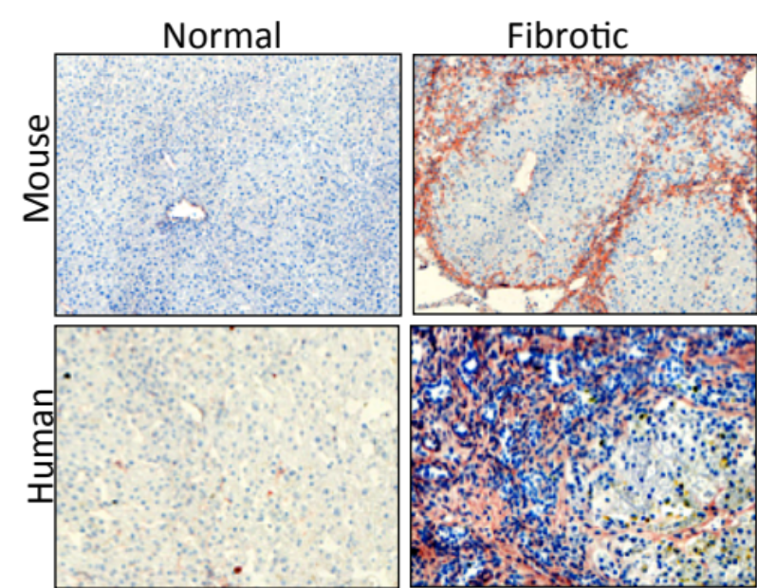
Targeting IFNγ to stellate cells through PDGFβR
PDGFβR expression
PDGFβR binding cyclic peptide
Receptor binding region (8 a.a.)
PDGF receptor binding peptide (pPB)
S S
IFNγ-pPB construct
IFNγ
Bansal et al., Hepatology 2011

Slide 12
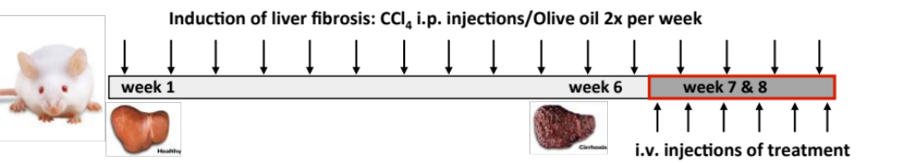
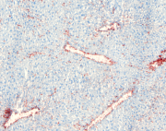
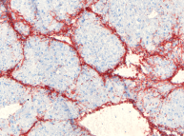
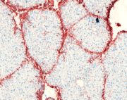
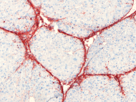
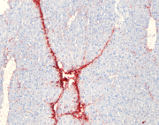
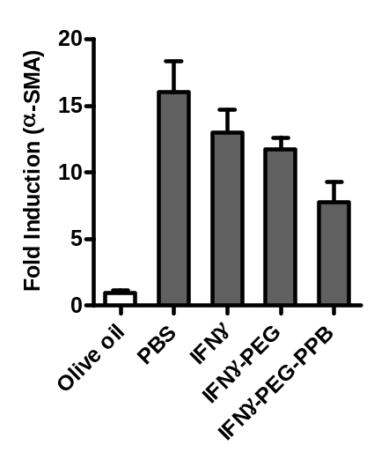
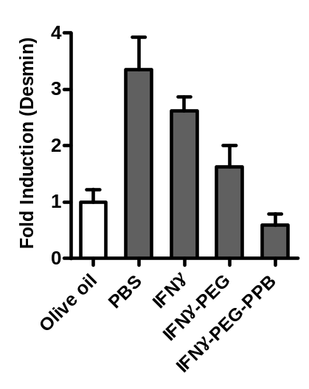
Targeted IFNγ inhibits advanced liver fibrosis
IFNγ
2.5 µg/mouse
Olive Oil
PBS
IFNγ
IFNγ-PEG
IFNγ-PEG-PPB
Collagen I
α-SMA
Desmin
#
#
#
#
fold induction
**
fold induction
**
Bansal R, et al., Hepatology 2011

Slide 13
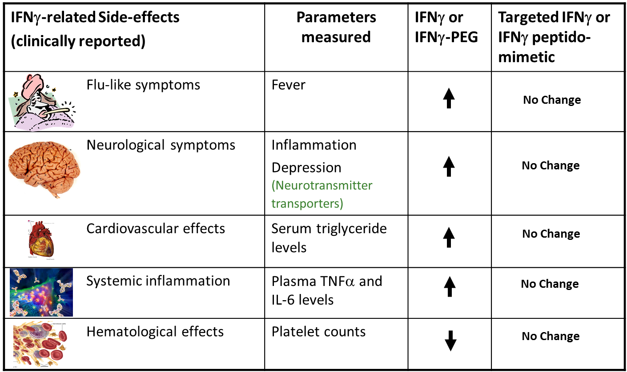
Adverse effects of IFNγ and IFNγ-PEG in
chronic liver fibrosis mouse model
Bansal et al., Hepatology 2011

Slide 14
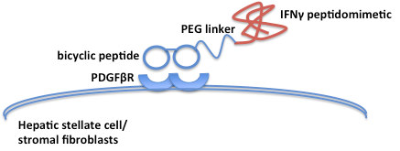
PART III:
TARGETED PEPTIDOMIMETIC OF IFNγ

Slide 15
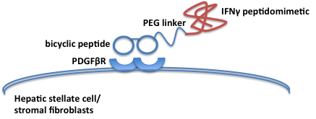
Re-design of construct in view of clinical development
Earlier design
New design
IFNγ
Bansal R, Poelstra K, Beljaars L, Prakash J. (Patent granted)

Slide 16
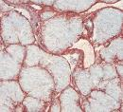
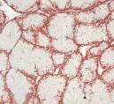
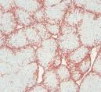
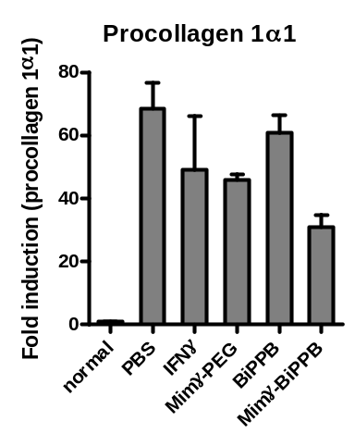
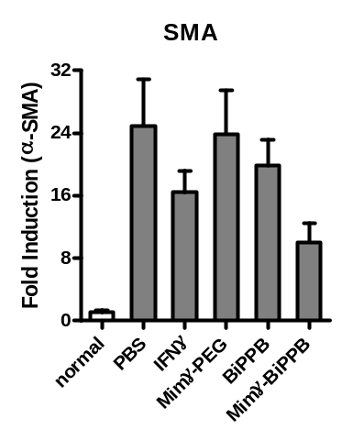
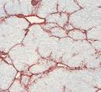
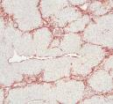
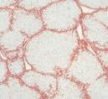
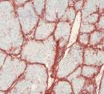
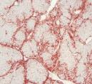
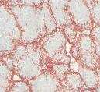
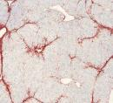
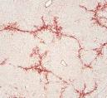
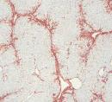
Mimγ-BiPPB inhibits advanced liver fibrosis in mice
Induction of liver fibrosis: CCl₄ i.p. injections
week 1
week 6
week 7 & 8
Collagen I
α-SMA
Desmin
Treatment by i.v. injections (5 ug/mouse)
PBS
#
#
#
#
#
IFNγ
#
**
*
Mimγ-PEG
Mimγ-BiPPB

Slide 17
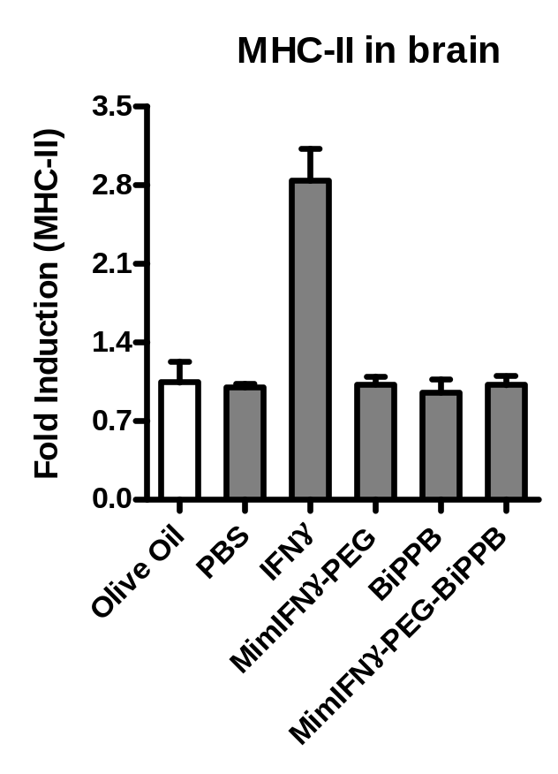
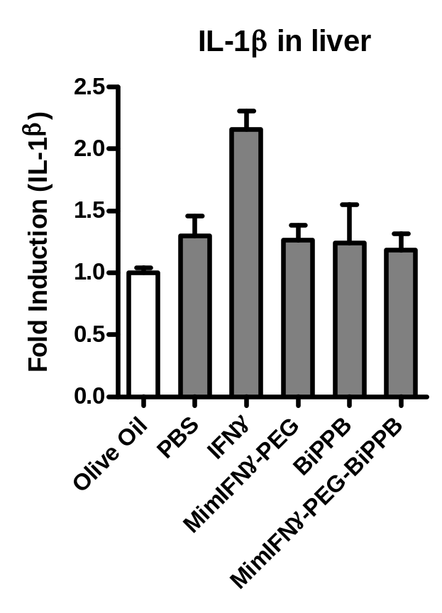
Mimγ-biPPB showed no IFNγ-related side-effects
**
*

Slide 18
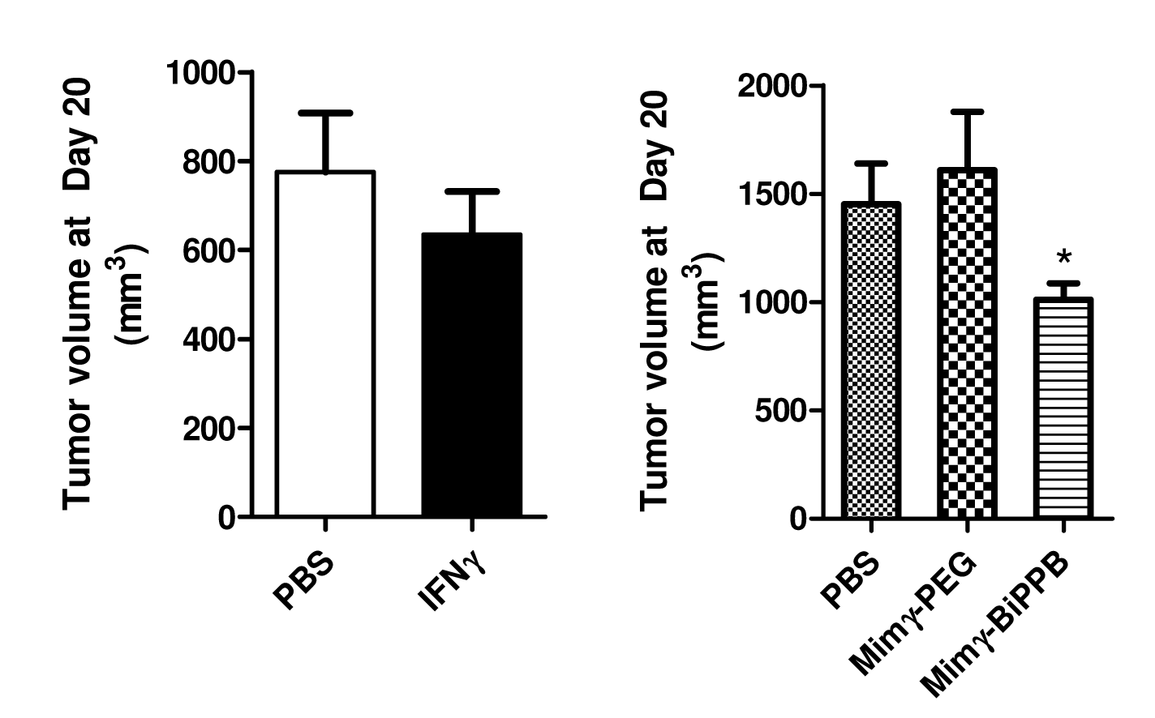
Effect of Mimγ-BiPPB on C26 colon carcinoma model
Treatment by i.v. injections (5 ug/mouse)
C26 tumor cell injection s.c.
day 20 sacrificed

Slide 19
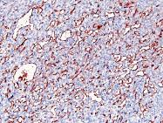
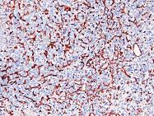
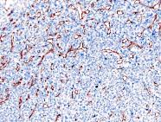
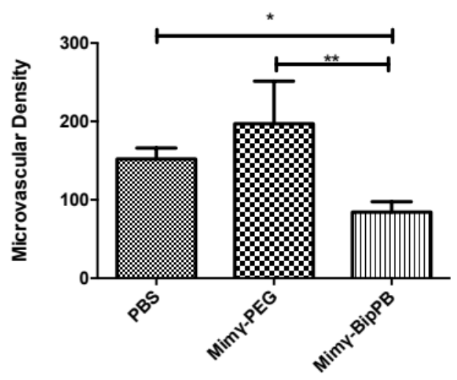
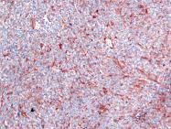
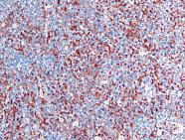
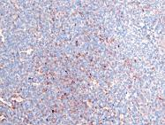
Mimγ-BiPPB reduces angiogenesis in tumor
PBS
Mimγ-PEG
Mimγ-BiPPB
CD31
Angiopoietin-1

Slide 20
Conclusions
PEGylation of IFNγ drastically improved the therapeutic efficacy but also leads to systemic inflammation.
HSC-specific targeting of IFNγ to fibrotic liver increased its therapeutic efficacy and eliminated IFNγ-related adverse effects.
Mimetic IFNγ coupled to a PDGFβR-specific bicyclic peptide induced potent anti-fibrotic effects in liver fibrosis models, while off-target effects were eliminated.
The targeted construct also reduces tumor angiogenesis in colon carcinoma model, which provides new opportunities to explore it as an anti-cancer therapeutic.

Slide 21
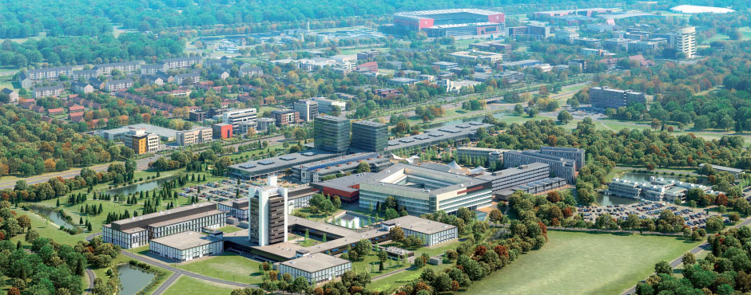




Acknowledgements
University of Twente.
Targeted Therapeutics
Ruchi Bansal
Leonie Beljaars
Eduard Post
  Tushar Tomar
  Klaas Poelstra
Jai Prakash
Saleh Yazdani
Karin Postma
Praneeth Kuninty
Gert Storm
Herman Steen

Slide 22

Thank you for your attention

