Slide 1

Adult Immunization in tertiary care hospital: An Initiative

Slide 2
Authors:
R Bansal, N Gupta
Crosslay AIDS & Wellness Centre
Pushpanjali Crosslay Hospital

Slide 3
When the abstract was submitted, the hospital was Pushpanjali Crosslay Hospital but over the course of time, this hospital was taken over by Max Healthcare
So, Pushpanjali Crosslay Hospital
is now
Max Super Speciality Hospital

Slide 4











Vaccines Work!
10 Greatest Public Health Achievements
Healthier moms
and babies
Tobacco as a
health hazard
Vaccinations
&
Control of Infectious Disease
Safer workplace
Decline in deaths from
coronary heart disease
Safer and
healthier
foods
Fluoridation of
drinking water
Motor-vehicle safety
Family Planning
Notes:
The top 10 list include all of these public health achievements, many of these we find are so much a part of our daily lives, we hardly give them a second thought…flouridation of our drinking water is a perfect example….or our traffic laws which we deal with and follow on a daily basis. Could you imagine what getting around would be like and how many unnecessary deaths would occur if we did not have agreed upon laws directing traffic flow? It would be quite chaotic.

Slide 5
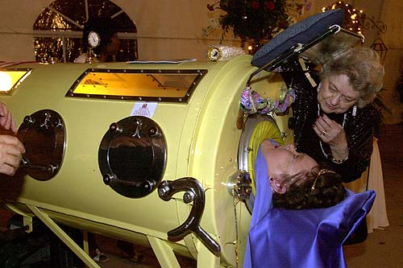
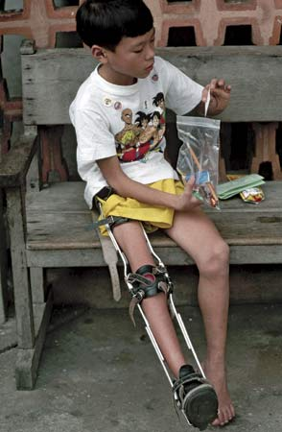
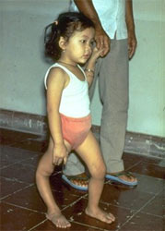
Vaccines Work!
Polio 1952 - >21,000 cases of paralytic polio in the U.S.
Polio vaccine licensed in 1955
Incidence of disease: In 1960, a total of 2,525 paralytic cases were reported, compared with 61 in 1965
Last case of wild-virus polio acquired in the U.S. was in 1979
Polio is not eradicated from the world
Disease has no border! **
Photo: Courtesy of World Health Organization Photo: Helen Comer/AP Photo: Encyclopædia Britannica; © Steve Raymer/Corbis
Notes:
Picture of little girl from WHO – Severely deformed leg
Dianne Odell, a woman who spent 58 years of her life in an iron lung after being diagnosed with polio as a child, died May 28, 2008 after a power failure shut down the iron lung. Odell, 61, had been confined to the 7-foot-long machine since she was stricken by polio at 3 years old.
Young boy stricken with polio.

Slide 6
A brief history of vaccines & vaccination in India
Vaccination is a proven and one of the most cost-effective child survival interventions.
All countries in the world have an immunization program to deliver selected vaccines to the targeted beneficiaries, specially focusing on pregnant women, infants and children, who are at a high risk of diseases preventable by vaccines

Slide 7
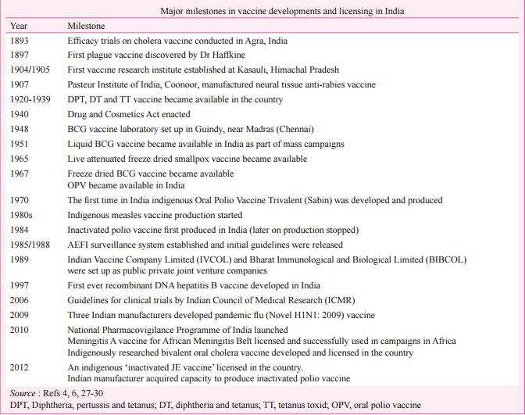

Slide 8
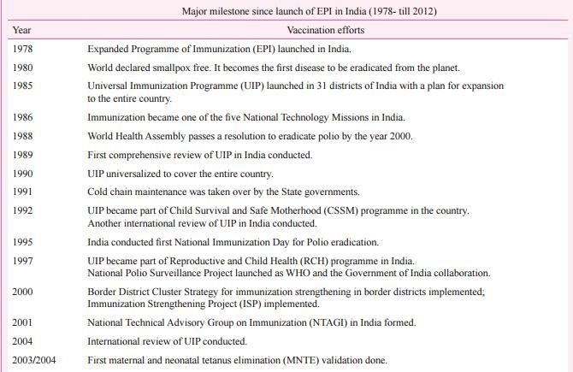

Slide 9
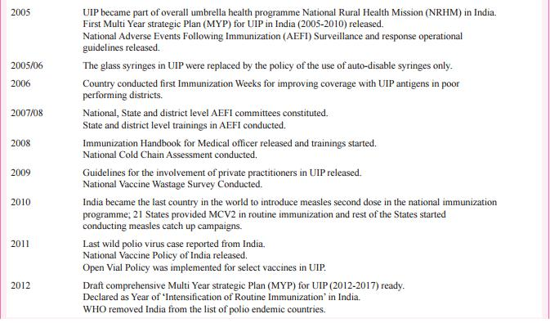

Slide 10
Disease eradication through vaccination in India
Small Pox
Polio

Slide 11

But…….

Slide 12
Vaccines aren’t just for kids
As adults our immune systems have been bombarded by many viruses and bacteria. In response, the immune system develops memory cells.
However there are reasons why vaccines are still needed for adults.
Not always lifelong protection – diphtheria, tetanus, pertussis, influenza
Viruses and bacteria change over time – influenza
Older age groups more susceptible – shingles, pneumococcus

Slide 13
Disease Burden

Slide 14
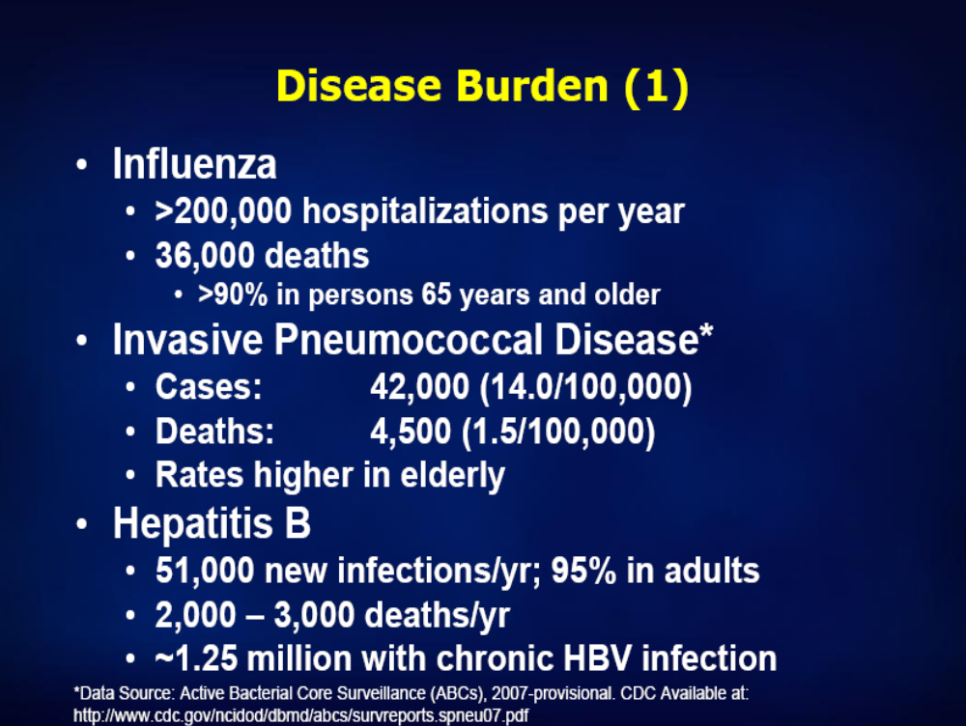

Slide 15
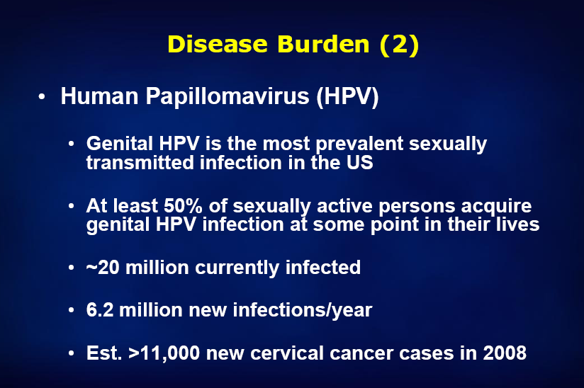

Slide 16
Recommended vaccinations for adults

Slide 17
Tetanus-diphtheria-pertussis (Td or Tdap)
Tdap is a combination vaccine that protects against three potentially life-threatening bacterial diseases: tetanus, diphtheria, and pertussis (whooping cough).
The CDC recommends the Tdap vaccine for all adults ages 19 and older who have never received the vaccine, especially:
Health care workers who have direct contact with patients
Caregivers of infants under 1 year old, including parents, grandparents, and babysitters
Pregnant women in their third trimester (ideally 27th through 36th week), even if they have previously received Tdap vaccine; this can protect a newborn from whooping cough in the first months of life.
New mothers who have never received the Tdap
People who travel to countries where pertussis is common

Slide 18
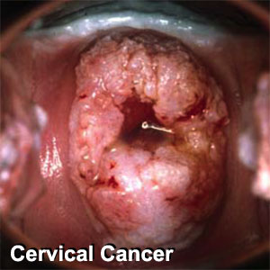
Human Papillomavirus (HPV)
A virus that infects the genitals and the lining of the cervix
Two vaccines are available
  Quadrivalent vaccine
  Bivalent vaccine
Recommended for females aged 9 – 45
Ideally, vaccine should be given before potential exposure to HPV through sexual activity; however, females who are sexually active should still receive the vaccine
Three dose series – second dose two months after the first and third dose administered six months after the first (at least 24 weeks after first dose)

Slide 19
Measles, Mumps, Rubella (MMR)
People born during or after 1957 who have not had measles, mumps, or rubella or the MMR vaccine should get the MMR vaccine
People entering college
Healthcare workers
International travelers

Slide 20
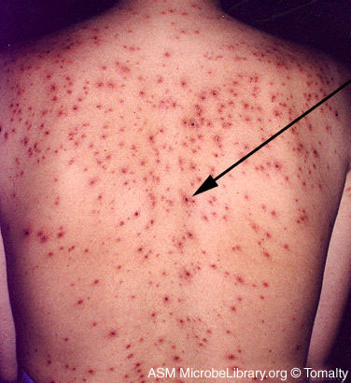
Varicella (chickenpox)
All adults without evidence of immunity to varicella should receive 2 doses of single-antigen varicella vaccine unless they have a medical contraindication.
Two doses at 0 then 4-8 weeks
Notes:
Picture of 30 year old female.

Slide 21
Influenza (flu)
Infects the respiratory system
Complications include pneumonia, fever, croup, and bronchitis
People with asthma, chronic diseases of the lungs, heart, or kidneys are at greater risk, metabolic diseases , HIV , and Immunosuppressive treatment
Most deaths from flu occur in people 65 or older
Recommended for Healthcare Personnel
During the outbreak of flu
This vaccine is taken annually

Slide 22
Pneumococcal (polysaccharide)
Pneumonia most common symptoms; high fever, cough, rapid, difficult breathing
People with asthma, chronic diseases of the lungs, heart, or kidneys are at risk.
Every year pneumococcal disease kills more than 1.6 million patients worldwide, more than any vaccine preventable disease.
People without a spleen, undergoing chemotherapy, infected with the AIDS virus
Adults 65 years of age and older
One time revaccination after 5 years esp. for Immunocompromised, CRF/ Nephrotic syndrome / Asplenia / HIV / Leukemia / Lymphoma/ multiple Myeloma / Bone Marrow Transplant
Notes:
Pneumonia – Lungs
Bacteremia – Blood
Meningitis – brain and spinal cord
Spread person to person by coughing and sneezing

Slide 23
Hepatitis A
Persons with chronic liver disease and persons who receive clotting factor concentrates
Persons traveling to or working in countries that have high or intermediate endemicity of hepatitis A
Primary immunization is recommended at least 2 weeks before expected exposure to hepatitis A virus.

Slide 24
Hepatitis B
Persons with end-stage renal disease, including patients receiving hemodialysis; persons seeking evaluation or treatment for a sexually transmitted disease (STD); persons with HIV infection; and persons with chronic liver disease
Occupational indications: Health-care personnel and public-safety workers who are exposed to blood or other potentially infectious body fluids
Behavioral indications: Sexually active persons who are not in a long-term, mutually monogamous relationship (e.g., persons with more than 1 sex partner during the previous 6 months); current or recent injection-drug users; and men who have sex with men
Three doses at 0, 1-2, 4-6 months apart

Slide 25
Meningococcal
Adults with anatomic or functional asplenia, or terminal complement component deficiencies.
Persons who travel to or live in countries in which meningococcal disease is epidemic (e.g., portions of Africa during the dry season)
Meningococcal conjugate vaccine is preferred for adults with any of the preceding indications who are aged <55 years, although meningococcal polysaccharide vaccine (MPSV4) is an acceptable alternative.
Revaccination after 3–5 years might be indicated for adults previously vaccinated with MPSV4 who remain at increased risk for infection
One or more doses (consult with provider)

Slide 26
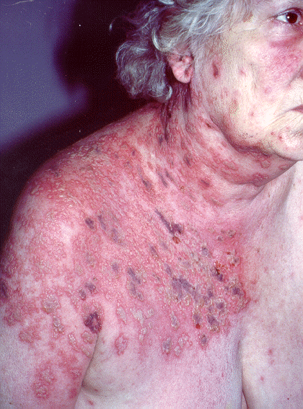

Herpes zoster (shingles)
Recommended for adults aged >60 years regardless of whether they report a prior episode of herpes zoster and to people at high risk for developing recurrent herpes zoster, such as patients with chronic medical conditions (e.g., CKD, diabetes mellitus, rheumatoid arthritis, and chronic pulmonary disease); persons who are likely to have severe immunosuppression in near future.
Single dose ( Zostavax)

Slide 27
Typhoid Fever
Typhoid vaccine is recommended as part of routine immunization in adolescents Either Ty21a or Vi vaccine may be used as both have comparable efficacy (51% vs 55% at 3 years) and both are safe
Due to insufficient data, the Expert Group currently does not recommend routine immunization of adults

Slide 28
Rabies
Recommendations: post exposure Human Rabies Immunoglobulin to be given ; if not available double dose of first dose of vaccination to be given
Pre-exposure prophylaxis is recommended for risk groups like veterinarians, laboratory personnel working with rabies virus, medical and paramedical personnel treating rabies patients; others, such as dog catchers, forest staff, zoo keepers; postmen, policemen, courier boys, and school children in endemic countries.

Slide 29
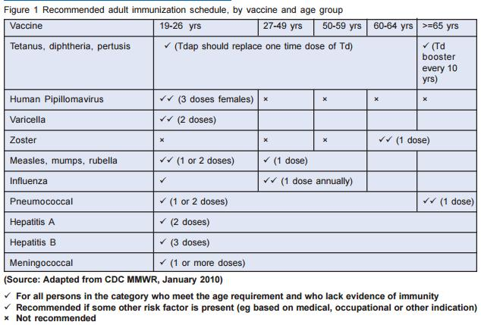

Slide 30
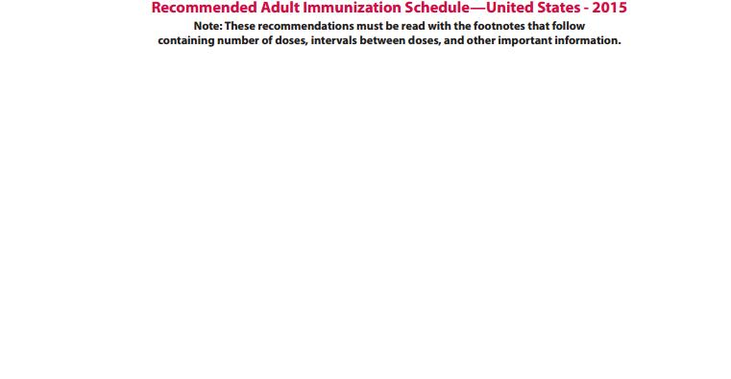

Slide 31
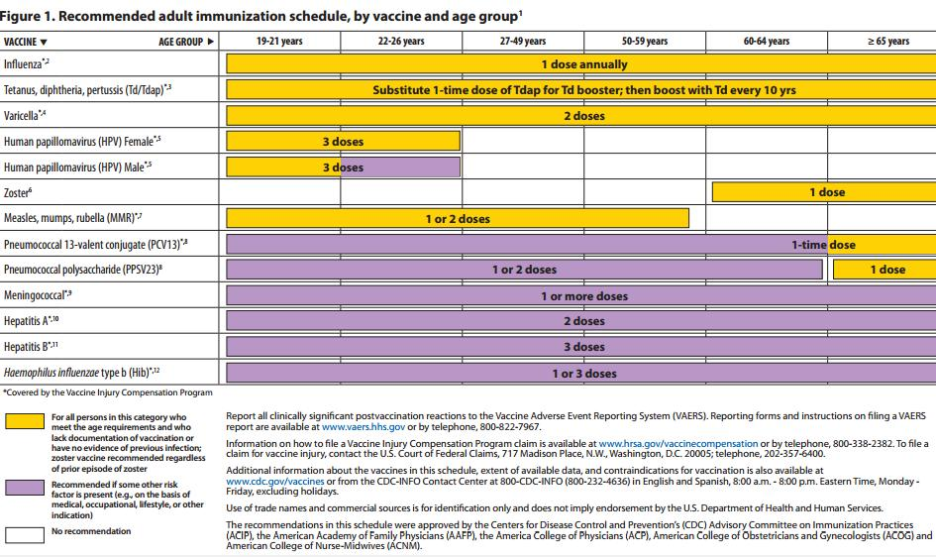

Slide 32
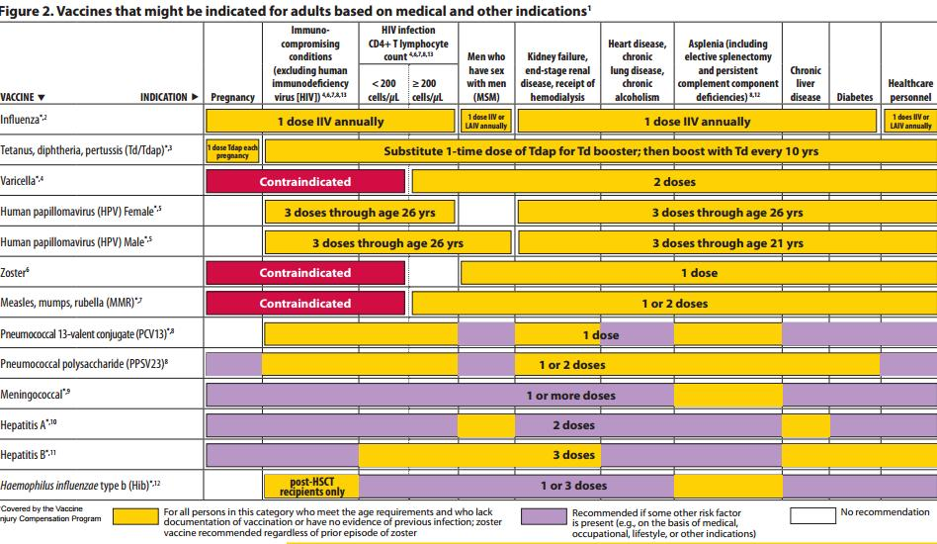

Slide 33
Screening Patients for Vaccines
Screen every patient regardless of reason for visit
Utilize screening tools; H-A-L-O
Health condition
Age
Lifestyle
Occupation

Slide 34
Reasons for starting Adult Immunization Program at Pushpanjali Crosslay Hospital

Slide 35
1. Condition of the hospital before Adult Immunization Program
No proper guidelines for adult immunization
Unimmunized Hospital Staff
Hue and cry at the time of needle stick injury because of unimmunized staff
Increase in illnesses among staff
Improper patient care
Drop in number of patients
Increase in rate of attrition among staff

Slide 36
2. Preventive Health Check-Up
The major work under Crosslay Wellness centre is Preventive Health Check-up
Number of health check up were done and it was found that the patients suffering from problems; can be prevented through vaccination
Women found to be having cervical cancer but our hospital being a tertiary care hospital, no vaccine were available for cervical cancer

Slide 37
One part of preventive health check-up is Pre-employment check-up
Need of Hepatitis B was felt among medical and para medical staff
Typhoid vaccine for F & B staff
Many five star hotels also demanded for typhoid vaccine during health check-up program

Slide 38
3. Outbreak of Swine-Flu in India
2009 flu pandemic in India is the outbreak of swine flu in various parts of India.
And Pushpanjali Crosslay Hospital is the approved centre for treatment of Swine flu.
With the increase in the number of admitted cases, even the hospital staff started to acquire this virus.

Slide 39
4. Vaccination for students
Dearth of knowledge about adult immunization in India
Lack of availability of vaccines
No effective guidelines were available for the students who were to travel abroad for their further studies

Slide 40
As per the hospital condition observed in the years 2008-2011
The need of having Adult Immunization Program was felt. So, it got started under the purview of Crosslay Wellness Centre, Pushpanjali Crosslay Hospital in the year 2012
It aims at sensitizing masses about immunization and abolishing the myth that the vaccines are only meant for the children.

Slide 41
Type of the vaccines available in this center:
Hepatitis A
Hepatitis B
Cervical Cancer
Chicken Pox
Pneumococcal
Typhoid
Flu
Measles
Meningitis
Td or Tdap

Slide 42
Activities under Adult Immunization Program
Regular vaccination for the patients (referrals, walk-ins)
Proper certification of vaccination for students traveling abroad
Sensitization program (in house and community)

Slide 43
Total no. of adults vaccinated:
Name of Vaccination | 2012 | 2013 | 2014 | Jan - August, 2015 | Total No. of patients Vaccinated
Hepatitis B | 37 | 112 | 180 | 150 | 479
Hepatitis A | 3 | 11 | 20 | 18 | 52
Influvac | 52 | 98 | 228 | 197 | 575
Yellow Fever | 0 | 5 | 0 | 0 | 5
HPV | 5 | 18 | 43 | 34 | 100
Pneumococcal | 18 | 72 | 108 | 72 | 270
Chicken Pox | 2 | 5 | 11 | 7 | 25
MMR | 0 | 2 | 11 | 7 | 20
T-Dap | 0 | 1 | 6 | 4 | 11
Typhoid | 25 | 18 | 7 | 8 | 58
Meningococcal | 0 | 1 | 2 | 2 | 5

Slide 44
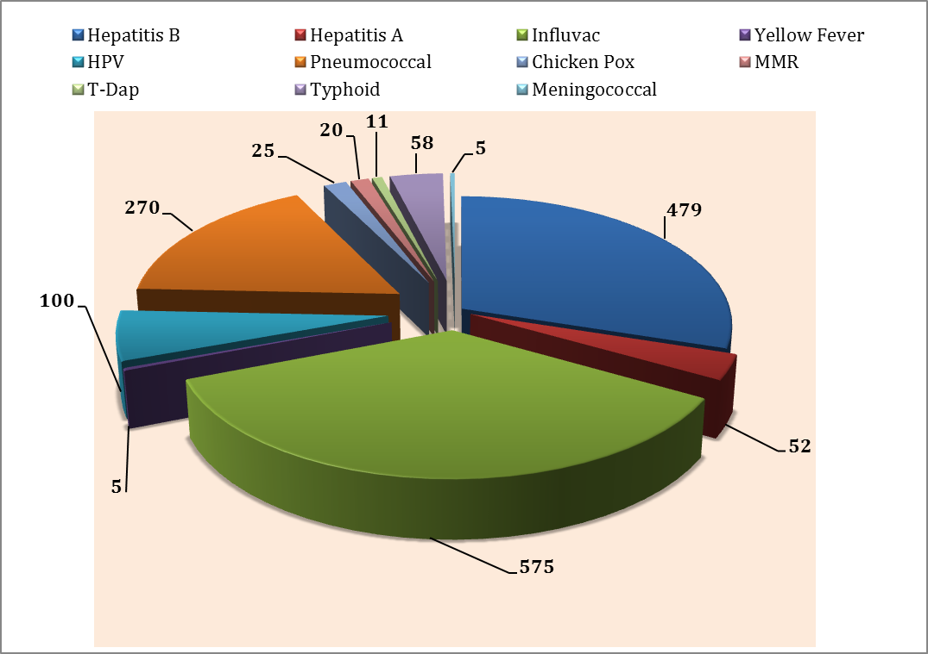
Total numbers of adults vaccinated: 1600

Slide 45
Sensitization program under Adult Immunization program
In-House awareness program
Community awareness program

Slide 46
In-house awareness program
Community awareness program
Promotion of vaccination in Schools, colleges, corporates and RWAs
Workshops on prevention of needle stick injuries
Vaccination history taking during pre-employment check-up
Introduction of titer for already Hepatitis B vaccinated employees who reported of being already vaccinated with Hep B
Introduction of a brochure containing the complete information about Adult Immunization
Introduction of Typhoid Vaccine for F & B staff of various hotels
Availability of vaccines for students visiting abroad for further studies
Vaccination camps
Monthly lectures for hospital staff
Time to time lectures for DNB students

Slide 47
Changes made in the Program:
Mandatory Hepatitis B vaccination for hospital staff
Compulsory Flu vaccine for hospital staff during epidemy of flu
Proper vaccination card for everybody taking vaccination in our center
Regular lectures to disseminate the knowledge about Adult Immunization

Slide 48
Efficacy observed:
The impact of immunization could be observed among hospital staff where Hep B vaccine is mandatory. Since this hospital is treating Hep B positive patients; due to this vaccine health care professionals (HCP) are working audaciously with them without any stigma and discrimination and working so closely with the patients also lead to needle stick injuries but no HCP acquired this virus.

Slide 49
Likewise, it is compulsory for all the hospital staff to get them vaccinated with Influenza Vaccine during the epidemy of flu. Our hospital is an approved centre for swine flu; every year many patients are admitted for the treatment of swine flu and identical illnesses and because of the efficacy of vaccines no case of flu is reported among staff this year.

Slide 50
Crosslay Wellness Centre envisions this program to be a role model for various other tertiary care hospitals not only in India but in Asia-Pacific region as we believe that
“Vaccinations are one of the best ways to put an end to the serious effects of certain diseases”.
Now, we aim to make Hepatitis B titer mandatory for all

Slide 51
THANK YOU

