Slide 1

Efficacy of immunization among HIV infected adults:
An Observation
R Bansal, N Gupta
Crosslay AIDS & Wellness Centre
^{Pushpanjali Crosslay Hospital}
^{Vaishali Ghaziabad}

Slide 2
Pushpanjali Crosslay Hospital, a tertiary care hospital situated at Vaishali, Ghaziabad has a Uttar Pradesh State AIDS Control Society (UPSACS) approved Integrated Counseling and Testing Center (ICTC) center with the name Crosslay AIDS & Wellness Centre which was established in the year 2008.

Slide 3
This center is working extensively for the overall well-being of the HIV infected patients.
We have a dedicated pool of professionals for HIV/AIDS patients:
HIV Specialist
HIV Counselor
A Dedicated nurse
Advanced Laboratory facilities

Slide 4
Immunization is one of the vital parts of this center. All the patients who are enrolled with this center are encouraged to get them vaccinated.

Slide 5
Vaccination is more important for immunocompromised patients because they are more vulnerable to infections and illnesses.
In addition, these patients are in frequent contact with medical environments and may therefore also have greater exposure to germs and viruses but the rate of vaccination among this population is lower than the normal population because of the dearth of knowledge and information among the clinicians.

Slide 6
Vaccination recommendations for HIV-infected patients are similar to those for HIV-uninfected patients in many respects expect live vaccines as per the CDC guidelines and for HBV vaccine additional shots may be given if antibody levels are too low.

Slide 7
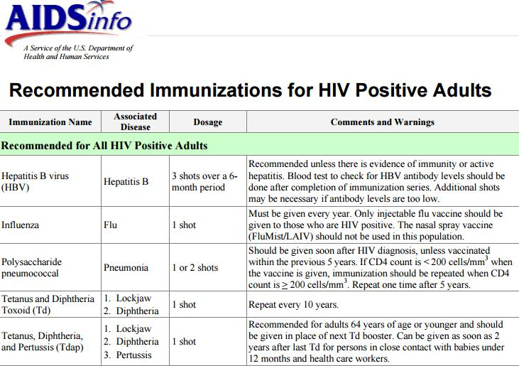

Slide 8
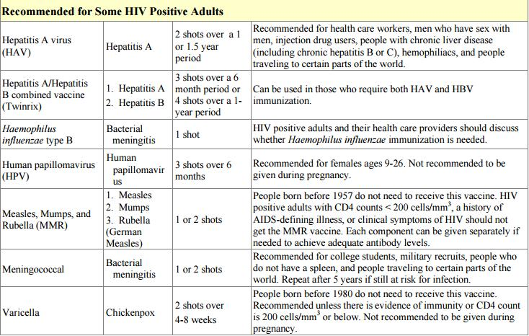

Slide 9
Safety of Live, Attenuated Virus Vaccines in HIV Infection
In general, HIV-infected individuals who are on ART with well-controlled HIV RNA levels and CD4 counts of >200 cells/µL (or ≥15%) may receive indicated live-virus vaccines such as measles, mumps, rubella (MMR) and varicella if lacking immunity; but these vaccines should be avoided in patients with CD4 counts of <200 cells/µL.
BCG should not be given to those with severe immunocompromise owing to HIV, and it is not recommended routinely in the United States.
The live, attenuated oral polio vaccine (OPV) is not recommended for persons with HIV infection outside resource-limited settings if the inactivated polio vaccine (IPV) is available.
Notes:
In general, it is preferable to avoid live-virus vaccines if an alternative inactivated vaccine is available, as in the case of influenza. However, many vaccines are available only as live-virus vaccines, and there are concerns about administration of live, attenuated disease-causing organisms to HIV-infected patients with severe immunocompromise. There are several reports of severe illness or death involving HIV-infected individuals after live-virus vaccination. In one case, a military recruit with asymptomatic HIV infection developed severe, disseminated vaccinia after receiving smallpox vaccination.(18) Another patient, who received bacillus Calmette-Guérin (BCG) for tuberculosis vaccination, developed disseminated disease,(19) and there are reports of HIV-infected patients with disseminated BCG infection from vaccination administered many years earlier.(20)
Considerations for use of live, attenuated influenza vaccine (LAIV), MMR, varicella, and zoster vaccines in HIV infection are examined in the appropriate sections below.
For persons in whom it is deemed appropriate to give both MMR and varicella vaccines, they can be given simultaneously. If they are not given on the same day, the varicella vaccine should be given at least 28 days after MMR, based on data in children showing that failure rates are higher if given <28 days after MMR vaccination.(22) Live-virus vaccination should be avoided during and 3 months after intravenous immunoglobulin (IVIG) treatment, if possible, because passive antibodies in IVIG may impair response to live-virus vaccination with MMR or varicella for up to 3 months after IVIG infusion.(23)

Slide 10
Live Vaccines Contraindicated in HIV-Infected Adults
Live Attenuated Influenza Vaccine
Varicella or Zoster Vaccine
Vaccinia (Smallpox) Vaccine
Live Oral Polio Vaccine( IPV can be given)
Measles Vaccine (avoid with severe immunosuppression)*
Yellow Fever Vaccine
Typhoid Ty21a
*Can be considered in patients without advanced immunosuppression
Notes:
1

Slide 11
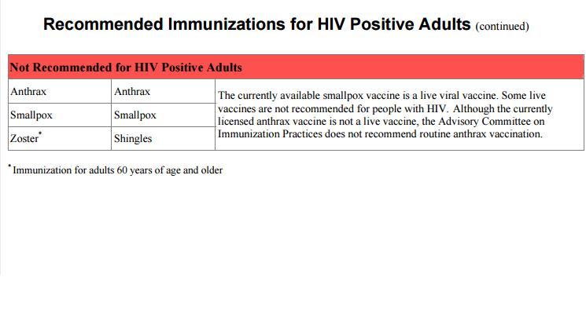

Slide 12
Since HIV infected patients have an increased rate of acquiring infectious diseases due to low immunity, so following vaccines are advised to HIV/AIDS patients in our center:
Hepatitis B Vaccine
Influenza
Pneumococcal vaccine
HPV Vaccine

Slide 13
Hepatitis B Vaccine
The routes of transmission for hepatitis B virus (HBV) are similar to those for HIV. Thus, most patients who have acquired HIV infection are at risk of HBV infection and could benefit from effective HBV vaccination
HIV-seropositive hepatitis B carriers also are more likely to have high levels of hepatitis B virus, making them potentially more infective, and they may have more rapidly progressive hepatic disease than HIV-uninfected individuals.

Slide 14
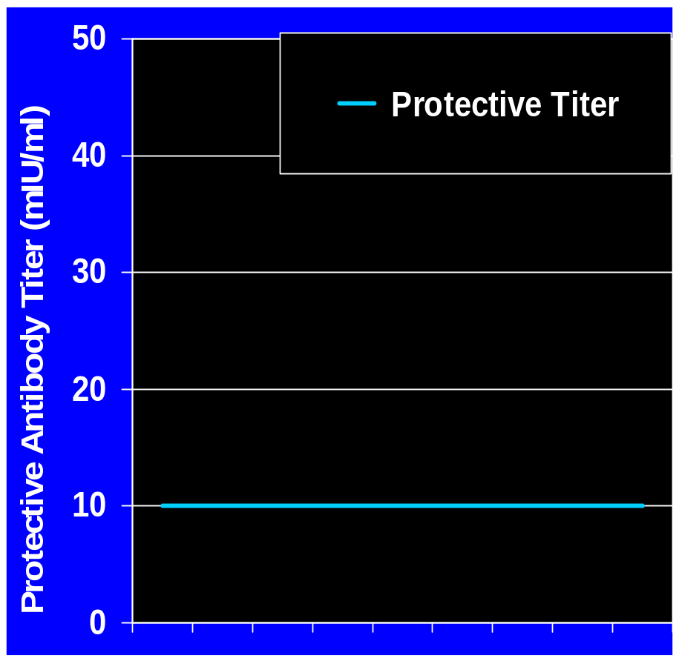
ACIP: Hepatitis B Vaccine Recommendations
Indications & Schedule
HBV Protective Titers
Vaccine Indications
- All HIV-infected persons without
evidence of prior HBV infection
(anti-HBc negative)
Vaccine Schedule (Adults)
- ENGERIX-B: 20 ug (0,1,6 m)
- RECOMBIVAX HB: 10 ug (0,1,6m)
- TWINRIX*: 0,1,6m
Post-Vaccine Antibody Testing
- Test 1-6 months after series
*TWINRIX= HAVRIX 720 EL.U plus ENGERIX 20 ug
From: (1) ACIP. MMWR 2005;54:Q1-Q4.
(2) ACIP. MMWR 1991;40 (RR-13):1-25.
Notes:
1

Slide 15
Influenza
The duration and severity of influenza appear to be increased in HIV-infected persons.
In addition, owing to immunocompromise, HIV-infected patients may be at increased risk of bacterial complications of influenza; therefore, they may have increased benefit from vaccination.

Slide 16
Influenza Vaccine in HIV Infected Adults
Recommendations
Vaccinate annually with trivalent inactivated vaccine
Vaccinate regardless of CD4 cell count or HIV RNA level
Live, attenuated, trivalent vaccine CONTRAINDICATED
From: MMWR 2006;55:1-41.
Notes:
1

Slide 17
Pneumococcal vaccine
Pneumococcal disease remains a source of significant morbidity and mortality among HIV-infected individuals. Although the availability of ART has decreased the rates of pneumococcal bacteremia.
Therefore, pneumococcal vaccination is recommended in HIV infection to help reduce invasive pneumococcal disease.

Slide 18
HPV Vaccine
There is increasing interest in human papillomavirus (HPV) vaccination in HIV-infected persons, given the high burden of HPV infection and growing rates of HPV-related cancers in this population.
HPV infection rates are high in persons with HIV infection, with prevalence of 66% in women and up to 90% in MSM, much higher than in HIV-uninfected counterparts.
HPV-related cancer as such anal and cervical cancer occur at increased rates in the HIV-infected population.
The risk of anal cancer for patients with HIV infection remains 2-fold higher than for HIV-uninfected patients, despite effective immune reconstitution with ART.

Slide 19
Observation
at
Crosslay AIDS & Wellness Centre

Slide 20
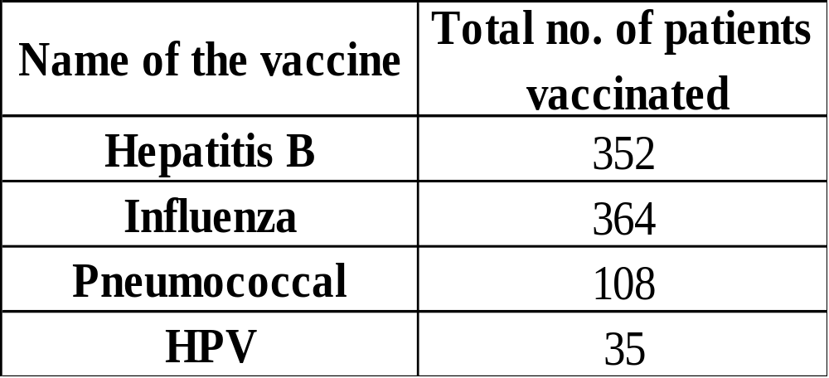
We have ~500 HIV infected patients enrolled in this center, counseling is done to make patients aware about the importance of immunization

Slide 21
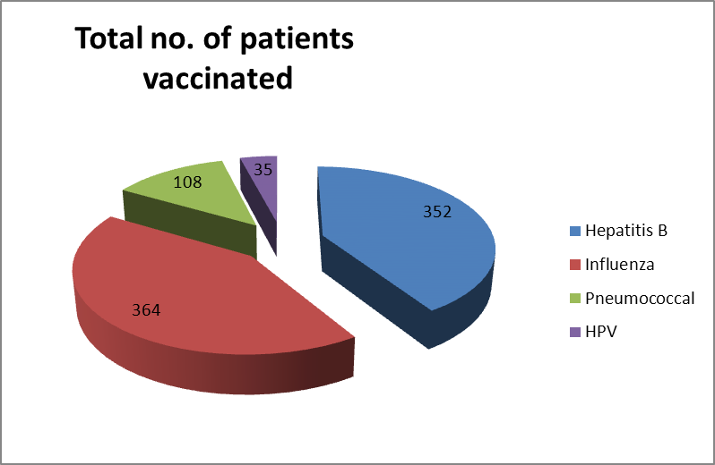

Slide 22
Result of vaccination in our center
In this center, the vaccinations given to the patients are generally HBV, Influenza and Pneumococcal vaccines (as mentioned earlier).
According the data available, no patients have acquired Pneumonia so far and no swine flu case has been reported this year.

Slide 23


