Slide 1



DIET INFLUENCE IN PROTEIN AND FATTY ACID CONTENT OF BREAST MILK FROM DIFFERENT ORIGIN
FATTY ACID
PROTEIN
Rubén López Nicolás
rubenln@um.es

Slide 2





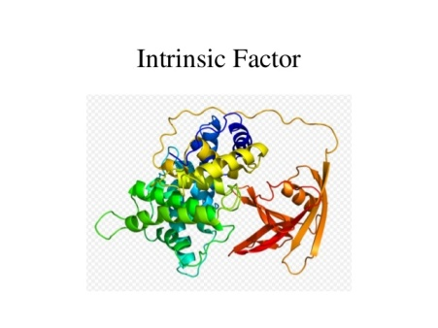
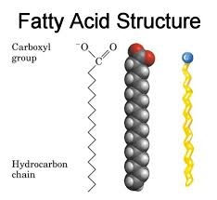
INTRODUCTION
INTRODUCTION
OBJECTIVES
MATERIAL AND METHODS
RESULTS
CONCLUSIONS
Wada Y., Lönnerdal B. (2014) Bioactive peptides derived from human milk proteins – mechanisms of action. The Journal of Nutritional Biochemistry
HUMAN MILK IS THE OPTIMAL MODE OF INFANT FEEDING
BIOACTIVE PROTEINS
LONG-CHAIN FATTY ACIDS
THE BENEFITS
TO INFECTIOUS GASTROINTESTINAL DISEASE
1/12
Notes:
Human milk is the optimal mode of infant feeding for the first several months of life. Breastmilk is uniquely engineered for human infants, and is the biologically natural way to feed infants. Breastfeedinghas numerous health benefits in comparison to feeding substitutes such as infant formula. The benefits of breastfeeding infants in less developed countries, particularly in relation to infectious gastrointestinal disease, have long been recognized. Early reviews considered that the evidence was strongest for a protective effect against infectious disease, even in developed countries. However, there is evidence that breastfeeding protects against a wide range of immediate and longer term adverse health outcomes in developed countries.These benefits can be attributed to bioactive proteins and long-chain fatty acids present in human milk.
We studied specifically 2 bioactive proteins: lactoferrin (LF) and haptocorrin (HC). The most common purpose known for LF and HC is the assistance in the absorption of iron and vitamin B12, respectively. But less known roles for these proteins are their antimicrobial activity (LF and HC), prebiotic effect (LF), involvement in immune-competence (LF) and promotion of gastrointestinal tract development

Slide 3


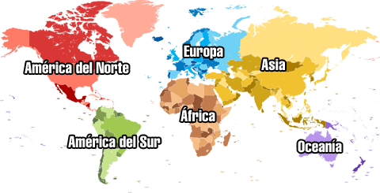
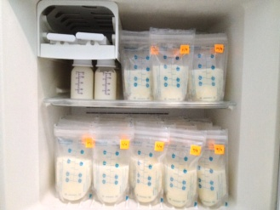
INTRODUCTION
INTRODUCTION
OBJECTIVES
MATERIAL AND METHODS
RESULTS
CONCLUSIONS
BIOACTIVE PROTEINS LACTOFERRIN (LF) HAPTOCORRIN (HC)
LONG-CHAIN FATTY ACIDS
ARACHIDIC ACID
LINOLELAIDIC ACID
ELAIDIC ACID
CIS-10-HEPTADECANOIC ACID
PALMITOLEIC ACID
MYRISTOLEI ACID
TRIDECANOIC ACID
CAPRYLIC ACID
2/12

Slide 4


OBJECTIVES
MATERIAL AND METHODS
RESULTS
CONCLUSIONS
Study the effect of maternal diet and geographical localization in the protein and fatty acid composition in breast milk.
SPECIFIC OBJECTIVES:
The determination of Lactoferrin content in breast milk from women from Honduras, Egypt and Spain.
The determination of Haptocorrin content in breast milk from women from Honduras, Egypt and Spain.
The determination of long-chain fatty acid content in breast milk from women from Honduras, Egypt and Spain.
The comparison of protein and fatty acid profiles of human milk samples from each origin.
3/12

Slide 5








MATERIAL AND METHODS
RESULTS
CONCLUSIONS
MATERIAL AND METHODS
Breast milk samples were analyzed from each point of origin: 8 samples from Egypt, 7 samples from Honduras and 2 samples from Spain.
These samples were taken during the 2nd to 4th month after birth
Lactoferrin and Haptocorrin analysis
Fatty Acid Extraction and Analysis
4/12

Slide 6


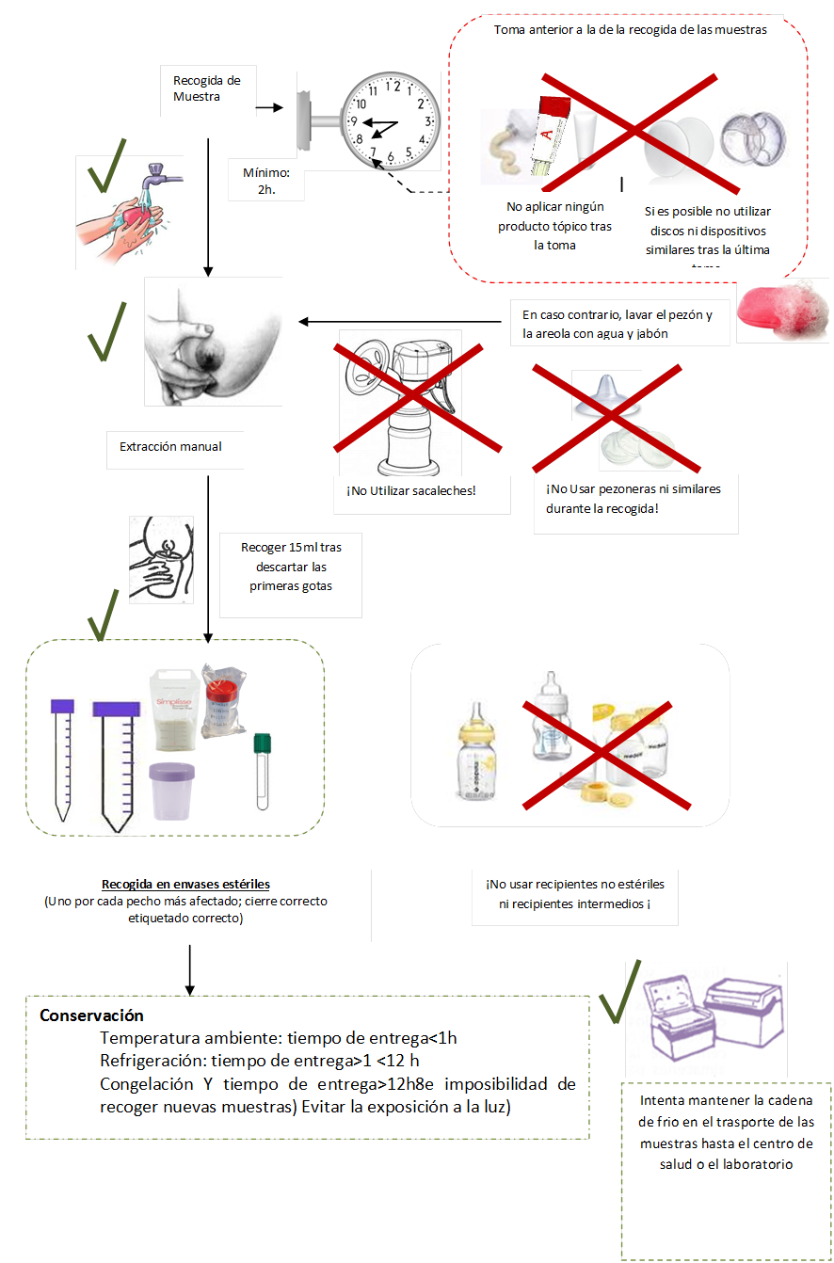

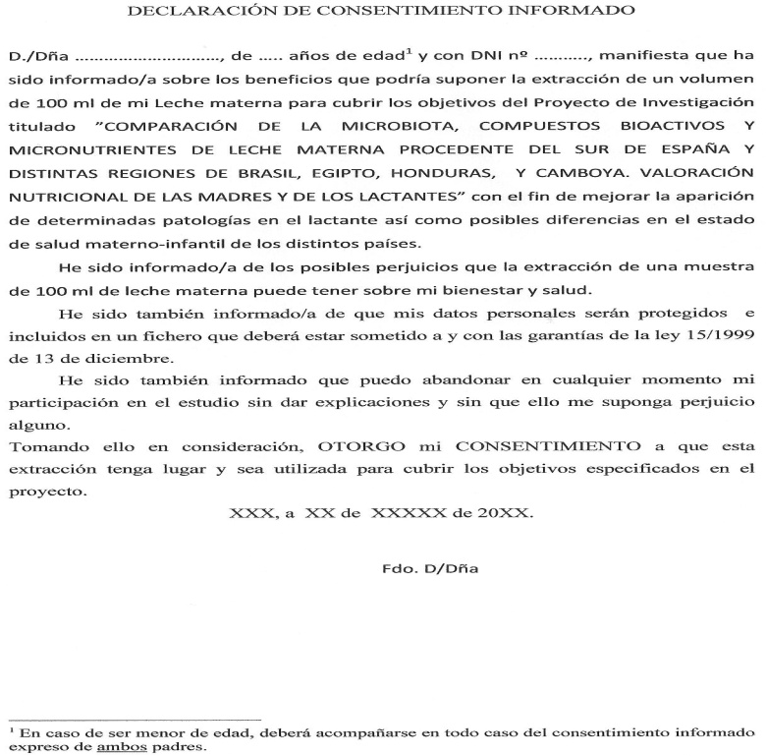
MATERIAL AND METHODS
RESULTS
CONCLUSIONS
MATERIAL AND METHODS
5/12

Slide 7


MATERIAL AND METHODS
RESULTS
CONCLUSIONS
MATERIAL AND METHODS
WETERN BLOT
Diagram of the electrophoresis of the Western Blot procedure
Diagram of the antibody exposion phase of the Western Blot procedure
6/12

Slide 8
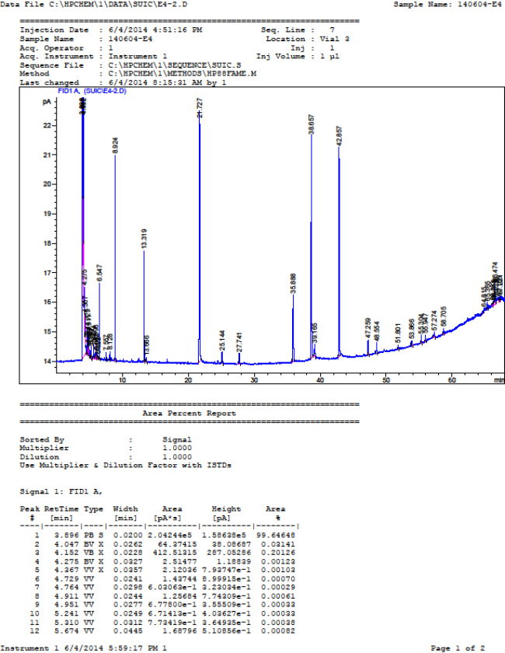
MATERIAL AND METHODS
RESULTS
CONCLUSIONS
MATERIAL AND METHODS
FATTY ACID EXTRACTION AND ANALYSIS
Or-Rashid M.M., Fisher R., Karrow N., AlZahal O., McBride B.W. (2010) Fatty acid profile of colostrum and milk of ewes supplemented with fish meal and the subsequent plasma fatty acid status of their lambs. Journal of Animal Science
7/12
Notes:
The method of fatty acid extraction used was the method proposed by Or-Rashid et al. (2010)⁽⁸⁾. A quantity of 0.06 mL of milk sample was taken in a 15 mL screw-top culture tube with Teflon cap and mixed with water to a total volume of 1 mL; then 2.5 mL of methanol and 1.25 mL of chloroform were added in the same tube and vortexed. The contents of the culture tube were kept at room temperature for 60 minutes with vortexing every 10 minutes. After 1 hour, 1.25 mL of chloroform, 1.15 mL of water and 0.1 mL of 3 M HCl were added, the tube was then vortexed and centrifuged at 1,200 x g for 3 minutes at room temperature. The acid was added to ensure the pH of the extract was acidic. The chloroform layer (bottom phase) containing the lipids was removed using a glass Pasteur pipette. We repeated the process, adding to the methanol-water phase an additional 1.25 mL of chloroform, vortexing and centrifuging to make sure we extracted the total lipid quantity in the samples. The chloroform phases were combined, dried over anhydrous Na₂SO₄, filtered and then transferred into a 4 mL vial. The chloroform was removed from the vial under a stream of N₂, and 3 drops of benzene were added and vortexed. The lipid content in the vial was methylated by adding 200 μL of NaOCH₃ (0.5 M solution in methanol; Cruz-Hernandez et al., 2004; Müller et al., 2005). The vials were kept at room temperature for 25 minutes. Then, 1 mL of 1 N methanolic sulfuric acid (2.8 mL of 96% sulfuric acid in 100 mL methanol) was added. After vortexing, the vials were heated at 50ºC for 15 minutes and cooled at -20ºC for 3 minutes. Then, 1 mL of water and 1 mL of hexane were added, vortexed and centrifuged at 1,200 x g for 3 minutes at room temperature. The upper portion (hexane layer), containing the fatty acid esters, was transferred into another vial for GC analysis.
The column used in the GC was a HP-88, 60m x 0.25mm x 0.20micras. The carrier gas was hexane at a flow of 1.4 mL/min. The oven program settings were set at a starting point of 125ºC with a gradual increase of 8ºC/min up to 145ºC and stayed at that temperature for 26 minutes. Then it gradually increased again at 2ºC/min up to 220ºC for 1 minute and finished at that temperature. The temperature of the FID (Flame Ionization Detector) was at 260ºC. The injector temperature was at 250ºC with a 1/50 split. Only 1 µL of every sample was injected.The final results were expressed as relative percentages of the fatty acids identified

Slide 9
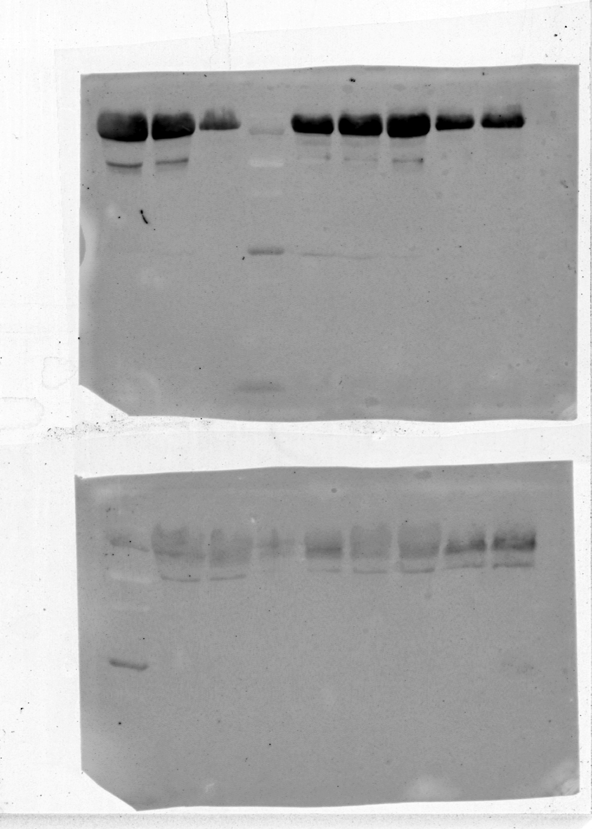
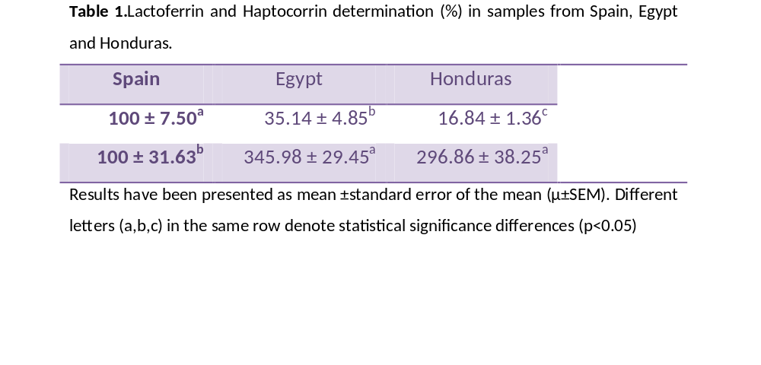
RESULTS
RESULTS
CONCLUSIONS
LACTOFERRIN AND HAPTOCORRIN
Lactoferrin
Haptocorrin
8/12
Notes:
The results obtained for the Lactoferrin and Haptocorrin determination have been presented as the percentage of Egypt and Honduras considering Spain as 10% (Table 1).

Slide 10

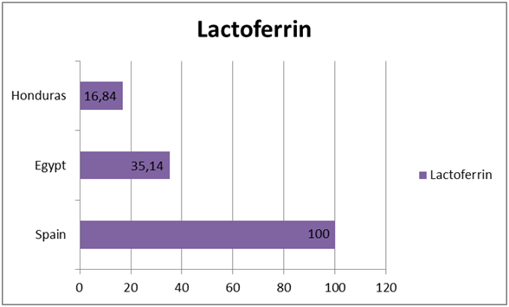
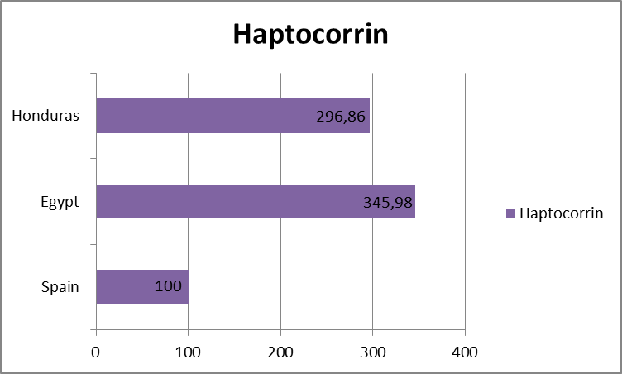


RESULTS
RESULTS
CONCLUSIONS
LACTOFERRIN HAPTOCORRIN
Figure 1.Percentage of LF in human breast milk from different countries
Figure 2.Percentage of HC in human breast milk from different countries
9/12
Notes:
As we can see in and Figure, lactoferrin is very present in all three countries being Spain the country with most LF content in milk, followed by Egypt and Honduras in last place. This could be due to the lower consumption of meat protein in Honduras than in Spain and Egypt. The lower quantity of LF found in samples from Honduras breast milk could mean a higher incidence in gastrointestinal infections in infants in that country but it doesn’t necessarily mean that they have problems in iron absorption since this mineral can be absorbed without the protein, although in a lower proportion than iron absorbed with LF presence.
Figure 2.Percentage of HC in human breast milk from different countries
As seen in Figure 2, haptocorrin was most present in samples from Egypt and Honduras than in Spain. This could be because of the types of meat that are consumed in Spain (a lot of cured meats), which are different from the ones consumed in Egypt (beef, chicken) or Honduras (chicken).This doesn’t mean that Spanish infants suffer of more vitamin B12 deficiencies because they probably ingest just enough cobalamin to avoid these problems, but Spanish lactating mothers should think about changing their diets to increase the concentration of haptocorrin in their breast milk.

Slide 11

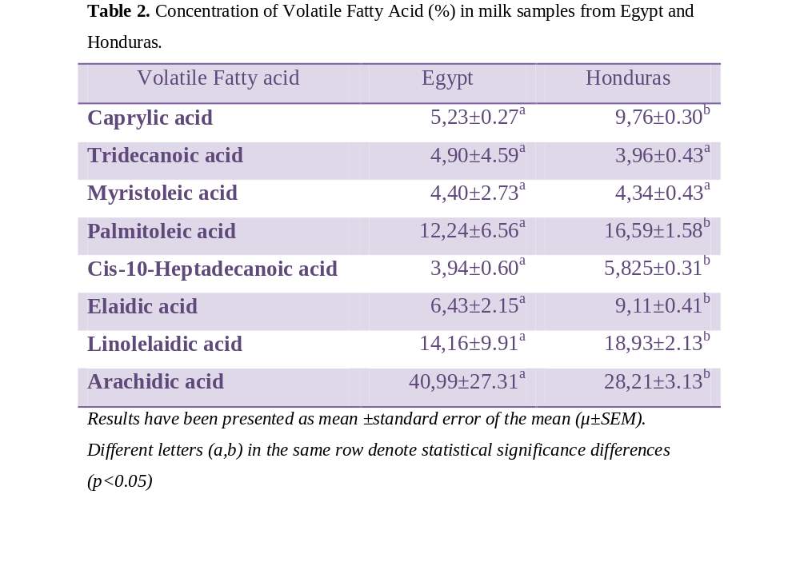
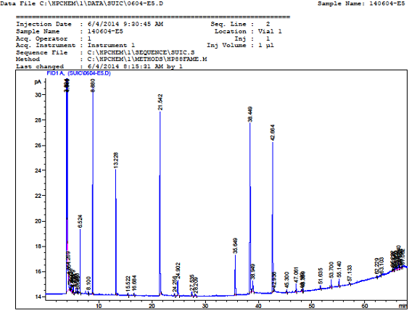
RESULTS
RESULTS
CONCLUSIONS
LONG-CHAIN FATTY ACIDS
10/12
Notes:
The relative percentage of different long chain fatty acids with respect the total fatty acid content in human milk from Honduras and Egypt is shown in Table 2.

Slide 12
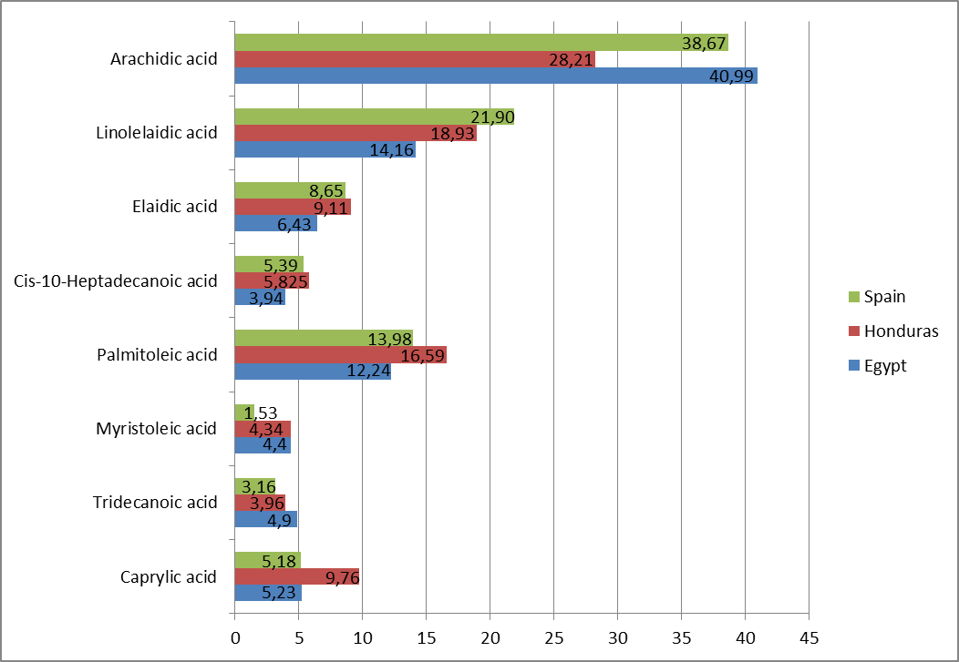
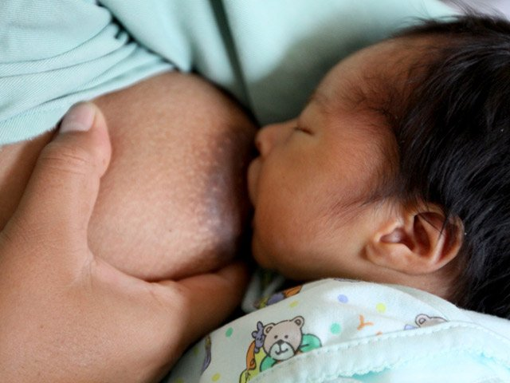
RESULTS
CONCLUSIONS
RESULTS
LONG-CHAIN FATTY ACIDS
Figure 3. Relative percentage of LCFA from Spain, Honduras and Egypt
11/12
Notes:
As can be seen in Figure 3, arachidic acid (AA) is the predominant LCFA in the breast milk of all three countries, being the highest in Egypt, followed by Spain and last Honduras. Honduras might have a lower concentration of AA because the only meat they eat is chicken and this fatty acid is more present in the fatty tissue of animals like pork. That AA is the highest LCFA in breast milk is a good sign because it avoids development problems in infants and, as we have seen before, it helps develop visual and mental acuity^{(2,13)}.
Honduras excels in almost every other LCFA. The main difference in fat consumption in Honduras compared with the other two countries is the use of canola oil. This oil should be further studied to assess if it really makes a difference in the fatty acid composition of breast milk.
Spain has especially low concentrations of myristoleic acid than the other two countries. This could be because Spanish women don’t include coconut or palm oil in their diets.If we use Spain as a reference, Egypt surpasses Spain in arachidic acid, myristolein acid and tridecanoic acid. Honduras surpasses Spain in palmitoleic acid, myristoleic acid, tridecanoic acid and caprylic acid. Comparing Egypt with Honduras, Egypt surpasses Honduras in arachidic acid and tridecanoic acid. Honduras surpasses Egypt in linolelaidic acid, elaidic acid, cis-10-heptadecanoic acid, palmitoleic acid and caprylic acid.

Slide 13



RESULTS
CONCLUSIONS
CONCLUSIONS
The differences observed in the three countries could perfectly be because of the different diets consumed in each country. Infants in Spain ingest more LF so that could explain a lower incidence in gastrointestinal infections, lower anemia rates, etc. Infants in Egypt and Honduras consume more HC, so that would involve a better neural development and lower megaloblastic anemia rates.
Infants from all three countries have a high consumption of arachidic acid which would help with the development of the nervous system and the immune system.
12/12
Notes:
Diet in each country
In Honduras, the partners who were taking the samples of breast milk, also made the donors fill out a food frequency survey so we could assess what a normal diet in that country. The results showed that a typical diet there is varied in fat and oils used for cooking, canola oil being the most used by Honduran women. It appears that Honduran women don’t eat very much, with very little egg consumption or none at all. They ate a lot of fruit and the major cereal consumed was rice with beans every day or almost every day. The only meat they ate was chicken and no fish at all.
For Egypt we could obtain more specific data about their diet. The fats and oils that are mostly consumed in Egypt are olive oil, sunflower oil and margarine. Basically all types of food products can be found in this country, especially fruits and vegetables which are consumed every day. Rice is also very important in a typical Egyptian diet and is eaten in large quantities. Bread represents the biggest part of the meal and is eaten at least 3 times a day. Because of their religion, the only meat products they consume are chicken, beef and fish, and the animals they eat are generally raised at home. Meat is eaten from 1 to 3 times a week. Milk based products like yogurt, cheese and, of course milk, are mostly eaten at night before bed and in the morning during breakfast. Tea is the typical drink in Egypt being consumed about 2 times a day. Water is not normally consumed because the only water source they have is the Nile River and it is extremely polluted, and bottled water is very expensive.
Spanish donors also took a food frequency survey. Results showed that their diet was very high in meat and industrial sweets. Homemade meals were predominant and mostly made with legumes, green beans, potatoes and meat. Several types of cured meats were also consumed. They ate fish about twice a week and mostly batter-coated and fried. Milk consumption was low but it did include goat cheese and yogurt once in a while. No alcohol or coffee consumption. They drank a lot of water and ate fruit every day.

Slide 14







ACKNOWLEDGEMENTS
Department of Food Technology, Nutrition and Food Science, Faculty of Veterinary Medicine University of Murcia
Notes:
University of Murcia
Spanish Agency for International Development Cooperation
Seneca Foundation
Private Foundation CajaMar
All mothers and Volunteers who participated in the project

Slide 15


THANK YOU SO MUCH

