Slide 1
Ru-Band Lu, MD.
Shiou-Lan Chen, PhD.
Yun-Hsuan Chang, PhD.
National Cheng Kung University, Taiwan
Anti-Inflammation and neuroprotective drugs benefit the treatment of heroin dependent patients

Slide 2
Neurodegeneration in Mental Illnesses
Schizophrenia
Bipolar disorders
Substance use disorders (alcohol)
Anxiety disorders?
Personality disorders?

Slide 3
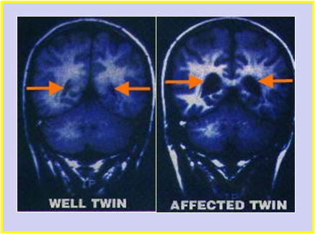
Neuronal degeneration in schizophrenia
Schizophrenia and bipolar disorders
  Decreased grey & white matter and lateral ventricular dilatation (Largen et al., 1984; De Peri l et al., 2012)

Slide 4
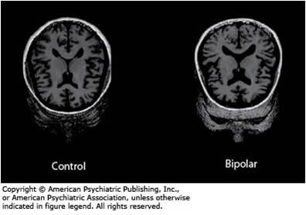
Neuronal degeneration in Bipolar Disorder
Diffused gray and white matter loss, enlarged ventricles & mild prefrontal volume loss. (Wilde, et al., 1985)
17% larger lateral ventricles and 2.5 times in deep white matter hyperintensities.
(Kempton, M.J., et al., 2008.)

Slide 5
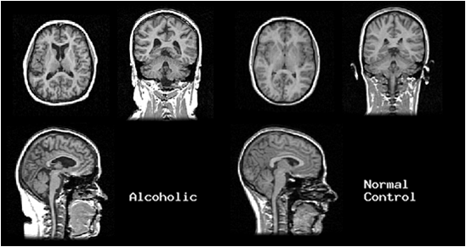
Neuronal degeneration in Substance Abuse
Both MRI's are of middle-aged women

Slide 6
Inflammation and neurodegeneration

Slide 7
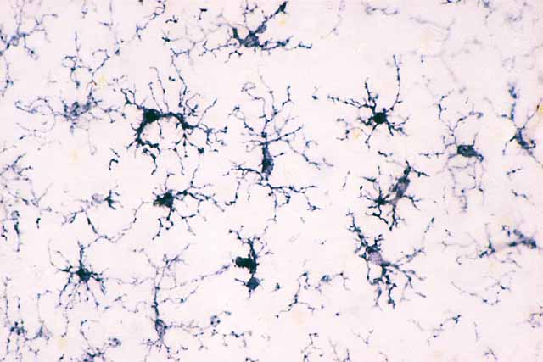
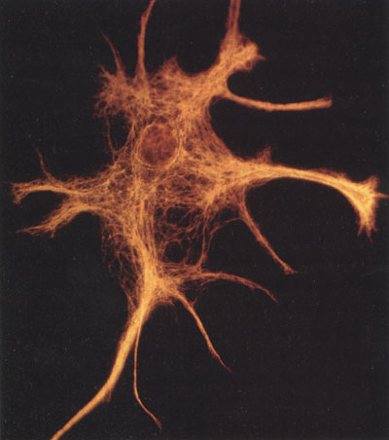
Glial cells :
Key roles in disease and prime targets for therapy
^{Astroglia}
^{Microglia}
^{Source for}
^{neurotrophin production}
^{Target for}
^{anti-inflammation}
Notes:
1.The major advance in research in neurobiology for the last few decades has been the understanding of the role of neuronal systems in brain function..
2.As a consequence, most of the drugs to treat neurodegenerative disorders has been developed that work by altering chemical neurotransmission in the brain.
3. Curiously, little attention has been paid to the nonneuronal cellular components of the brain, which outnumber neurons by a factor of 10 to 1.
4.Glia, a heterogeneous population of cells, have largely been viewed as passive handmaidens to the neurons, which have been considered the primary arbiters of information processing in the brain.
5. Recent research, however, has demonstrated that glia are far from passive but actively participate in the communicational processes of the brain.
6.Disturbances of glial function could conceivably contribute to psychopathology, and glial cells may, therefore, serve as appropriate targets for therapeutic interventions.

Slide 8
Role of microglia in toxin-induced progressive neurotoxicity
(Working Model)
LPS
(Extra Neurotoxin)
MPTP
(Intra Neurotoxin)
Activation
Reactive Microgliosis
Microglia
Dopaminergic
Neuronal Damage
(Self-propelling)
Pro-inflammatory Factors
(ROS, NO., TNFa, IL-1, PGs)
Notes:
The progressive nature of PD is a well-described phenomenon, however, very little is known about its mechanism.
2. Our working model of the progressive nature centers on microglia.
3. Earlier work from our lab using LPS-induced inflammation as a PD model indicate activation of microglia by LPS is responsible for the damage of dopaminergic neurons.
4. Later on we found that the microglial dependence is not only limited to the action of LPS, MPTP, is known to exert direct and selective neurotoxic to DA neurons.
5. We have recently found that the presence of microglia is necessary for the expression of the full potency of MPTP.
6.This is mediated from reactive microgliosis which is different from LPS.
7. The way LPS and MPTP kills DA neurons are different, however, the death of DA neurons would further activate microglia through “reactive Microgliosis”, which in turn will release more proinflammatory factors to cause further damage of DA neurons
8.Thus,it appears that there exists a vicious cycle which form a self –propelling force to cause a progressive DA neuronal degeneration even LPS or MPTP disappear from the brain long time before PD occurs.

Slide 9
NADPH oxidase (PHOX)
Naloxone,
Dextromethorphan
Memantine
LPS
O₂
O₂ • –
MAC-1
out
α
β
gp91
in
p22
rap1a
PKC
NADPH
NADP⁺ + H ⁺
P
rac2
p47
P
p67
p40
Activated
Resting

Slide 10
Dual Functions of Superoxide Radicals
LPS
O₂
MAC1
LPS
PKC
PHOX
LBP
gp91
CD14
TLR4
O₂ • –
ROS
Microglia
H₂O₂
NF-kB,AP-1
O₂ • –
NO •
2) Gene Expression
TNF-α
IL-1
ONOO ⁻
1) Neurotoxicity
DA neurons

Slide 11
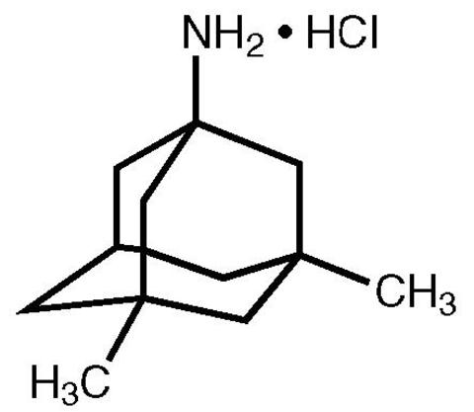
Dextromethorphan (DM)
Memantine
Non-competitive NMDA receptor inhibitor in large dose for anti-cough effect
Neuroprotective effects in vitro and in vivo at low dose
Non-competitive NMDA receptor inhibitor in large dosage
Alzheimer's disease (20 mg/day)
Neuroprotective effects in vitro and in vivo at low dosage

Slide 12
Novel anti-inflammatory therapy
LPS
Novel Strategy: Modulation of microglial activity
Morphinans : Naloxone, D-Morphine
    Dextromethorphan
Dynorphins, Enkephalin, PACAP
Memantine
Microglia
TNF-α
IL-1β
NO •
O₂ ^{• -}
Conventional Regimen:
• Aspirin, COX 2 inhibitors (PG)
• Anti-oxidants (Free radicals)
Antibodies (TNF-α, IL-1)
Receptor antagonists (TNF-α)
• Cortisone (toxic for long-term use)
PG’s
ONOO⁻
Neuronal death
Notes:
This slide illustrates the strategies for developing novel anti-inflammatory drugs.
The conventional anti-inflammatory drugs shown here, such as aspirin, COX 2 inhibitors are designed to inhibit a single pro-inflammatory factor. For example, COX-2 inhibitor inhibit the production of PGs by inhibiting COX 2 enzyme. These types of anti-inflammatory drugs are limited in their efficacy, and this figure explains the reason.
When the immune cells are over-activated, they secret a large number of factors. Thus, by targeting only one or two factors, these anti-inflammatory drugs are not able to contain the inflammation.
We took a different approach at the upstream by preventing the over-activation of immune cells. We hypothesized if we can contain the over-activation of microglia, which will not cause the secretion of down stream factors, then we do not need to deal with the individual factors.
Over the last few year, we do find some old drugs which can serve this kind of purpose and turn out to be very potent and safe anti-inflammatory drugs and excellent nreuroprotective agents.

Slide 13

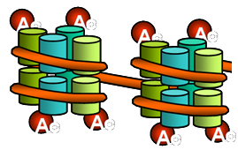
Mechanism underlying Memantine induced increase in
expression of neurotrophic factors in astroglia
Memantine
Depakine, 3-HM
HATs
HDAC
A
C
A
C
A
A
C
C
Nuclear
A
C
A
C
A
A
C
C
Astroglia
mRNA of GDNF, BDNF
GDNF, BDNF
Chen et al., 2009
Notes:
The second approach is targeting astroglia by releasing neurotrophic factors.
Recently, we found a series of widely anti-convulsants, such as valproate or VPA, are neruoprotective.
Mechanistic studies showed that VPA inhibits Histone deactylase and increase the acetylation of histone protein, leading to chromation rearrangement and increase the expression of triphic factors.

Slide 14


Therapy for neurodegenerative diseases and neuroprotective effect
LPS
Activation
Memantine, 3-HM
Astroglia
Memantine, DM
Stimulation
Inhibition
Trophic factors:
(GDNF, BDNF, NGF)
Neurogenesis
Reactive Microgliosis
Microglia
(Self-propelling)
DA neuron
Pro-inflammatory factors:
Superoxide, iROS
NO, TNFα, PGE₂

Slide 15
Hypotheses & Experimental Protocol in Addition
Neuro-inflammation worsen progress and neurodegeneration
Neurondegeneration causing the etiology and progress of mental illness

Slide 16
Treatment of Neurodegeneration disease
Current therapy treatment symptom or slowing or inhibiting the progress
Development of novel therapy for central and peripheral diseases

Slide 17
Research Aims
Analysis of plasma cytokine and BDNF levels
  Cytokine through BBB and correlation of BDNF in central and plasma
  (Laske, 2006)
The relationship of plasma cytokine, BDNF levels with heroin dependent
Memantine and DM development of neuroprotective and neurogenesis therapy
Notes:
The major theme of our research is to test the hypothesis that------
Why is it important? Although progression of PD is so obvious in PD patients, but little is known about the mechanism. Thus, so far no effective treatment for halting the disease progression.
We speculate that neuroinflammation play a major role in driving the disease progression.
Three aims are inter-related.

Slide 18
The relationship between inflammation and opioid dependence

Slide 19
Animal data
Morphine addiction behavior model
(Condition Place Preference: CPP)

Slide 20
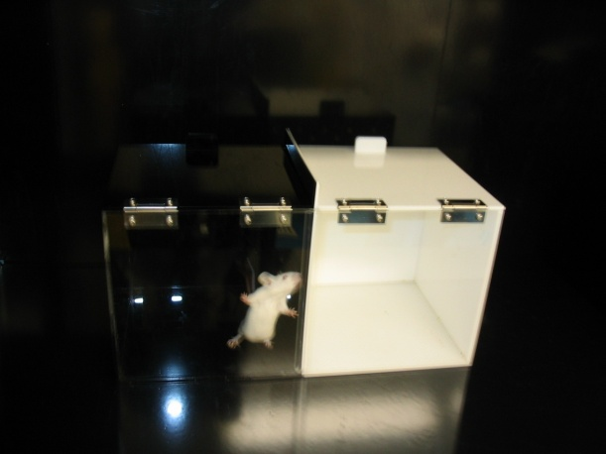
CPP Test (Condition Place Preference Test)
Conditioning
S(Saline)
Black chamber
CPP
CPP
CPP
CPP
0 1 2 3 4 5 6 7 8 9 10 11 12 13 days
S + M (Morphine 5mg/kg)
or Mem (Memantine)
+M White chamber

Slide 21
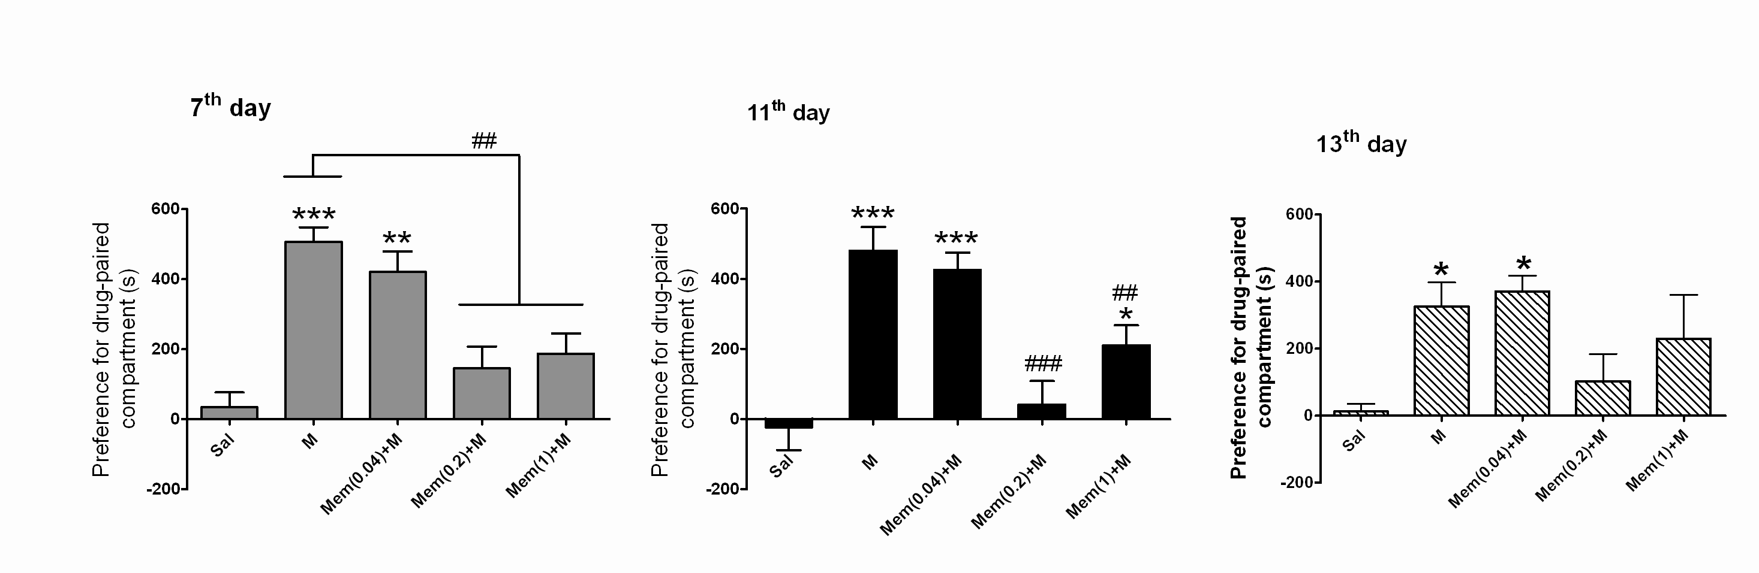
Memantine attenuate chronic morphine induced-CPP in rats
M: Morphine 5mg/kg
Mem: Memantine 0.04-1 mg/kg
*P<0.05, **p<0.01, ***p<0.001 vs Saline group.
##P<0.01, ### p<0.001 vs Morphine group.
Chen et al., J. of Neuroimmune Pharm. Dec.2011

Slide 22
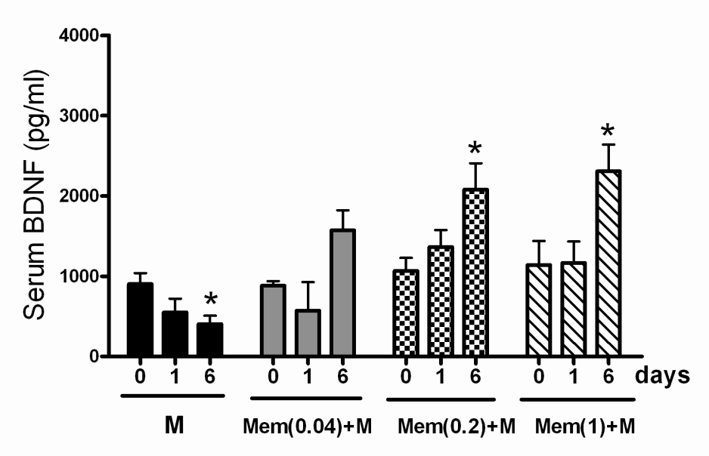
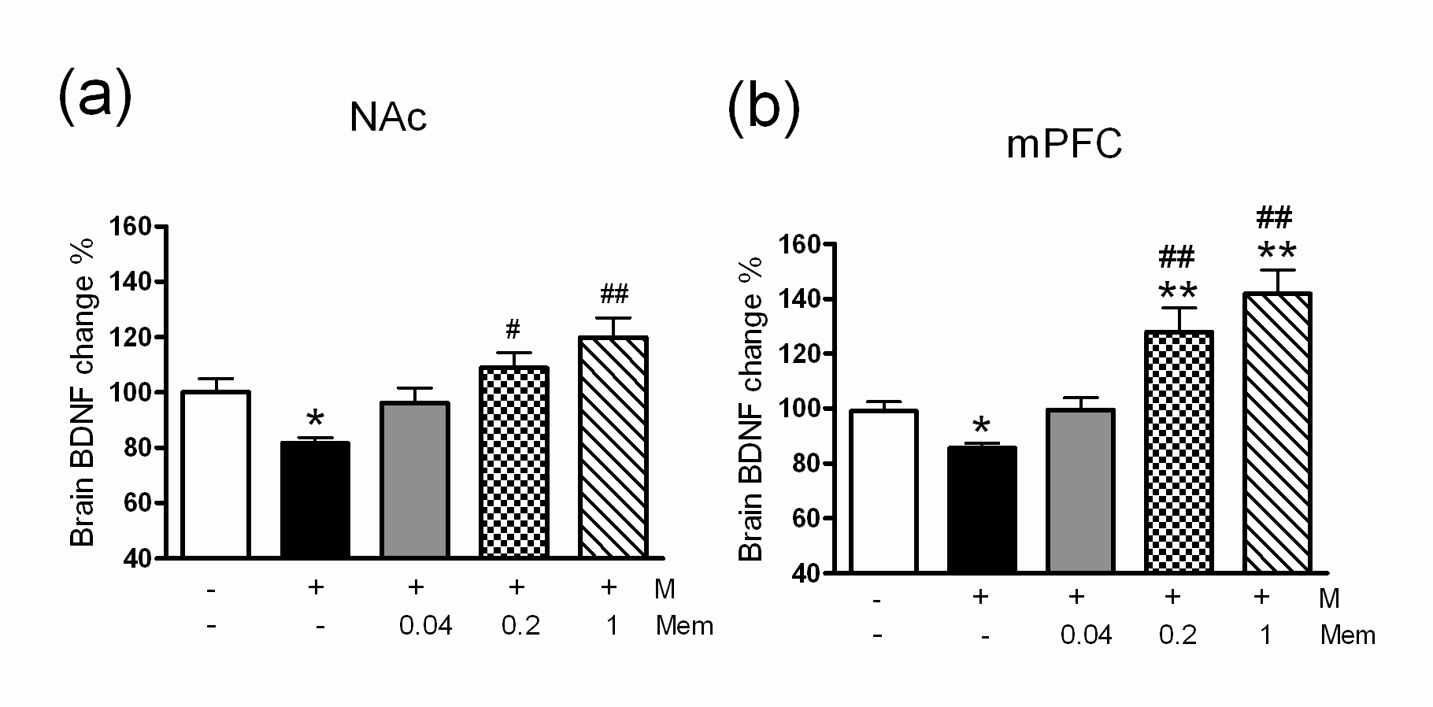
Memantine potentiate serum BDNF expression
M: Morphine 5mg/kg
Mem: Memantine 0.04-1 mg/kg
*P<0.05, **p<0.01 vs Saline group.
#P<0.05, ## p<0.01 vs Morphine group.
J. of Neuroimmune Pharm. Dec.2011

Slide 23
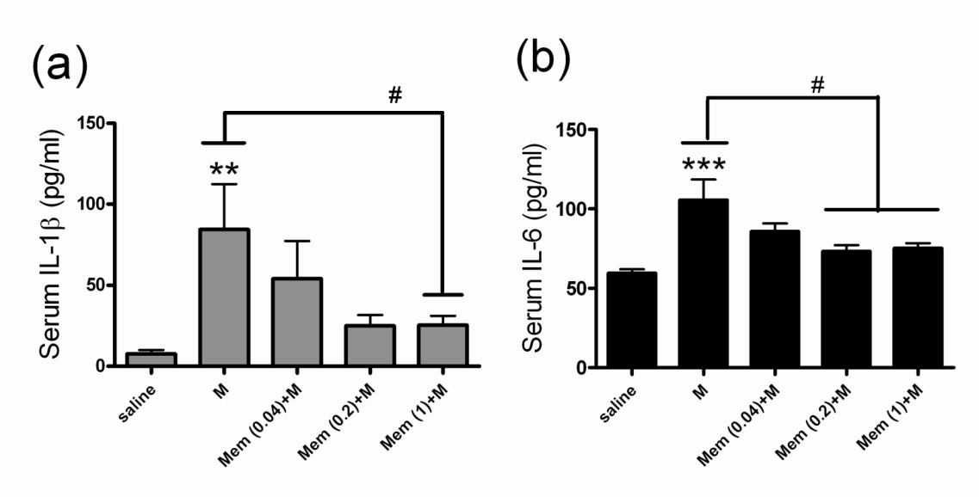
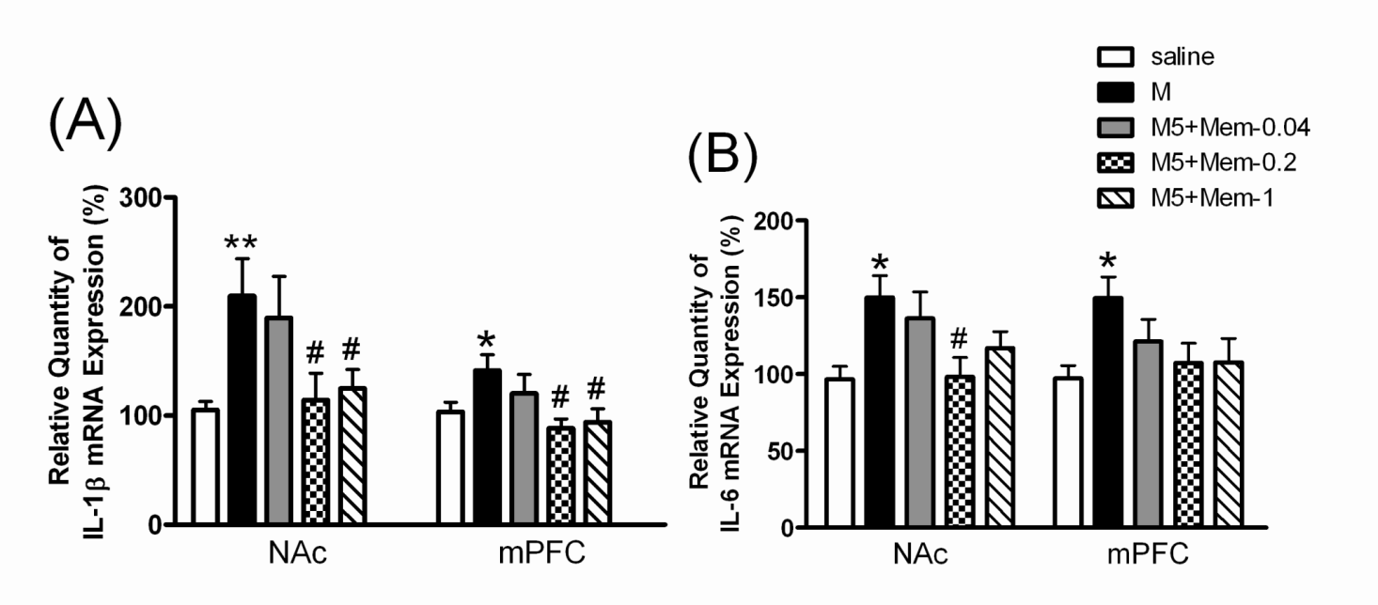
Memantine attenuate chronic morphine induced
serum and brain cytokines expression
*P<0.05, **p<0.01, ***p<0.001 vs Saline group.
#P<0.05 vs Morphine group.
J. of Neuroimmune Pharm.Dec.2011

Slide 24
Comments
  Large dose memantine 7.5 – 20mg/kg effective in NMDA receptor
  Low dose memantine (0.2 - 1mg/kg) not effective in NMDA receptor antagonist in rat
  Low dose memantine ( 0.2 – 1 mg/kg ) inhibition morphine addiction, decreasing cytokines and increasing BDNF in rat.
  Benefit in neuroprotection and neurogenesis
(Chen et al. 2012)
(Chen et al. 2012)

Slide 25
Comments
Inflammation relative addictive behavior
in rat
Low dose memantine effective inhibition inflammation and addictive behavior
(Chen et al. 2012)

Slide 26
Human Heroin dependence treatment

Slide 27
Method and results
Double-blind, Placebo-Controlled, Randomized
Heroin dependence with methadone treatment
  DM(60 or 120 mg/day) /placebo
  196 recruited at baseline and 48 DM60mg, 44 DM120mg
  and 42 placebo left after 12 weeks treatment
  memantine (5mg/day) /placebo
  133 recruited at baseline and 52 memantine and
  53 placebo left after 12 weeks treatment

Slide 28
Method and results
Double-blind, Placebo-Controlled, Randomized
Heroin dependence with methadone treatment
  DM(60 or 120 mg/day) /placebo
  170 recruited at baseline and 42 DM60mg, 32 DM120mg
  and 33 placebo left after 12 weeks treatment
  memantine (5mg/day) /placebo
  133 recruited at baseline and 52 memantine and
  53 placebo left after 12 weeks treatment

Slide 29
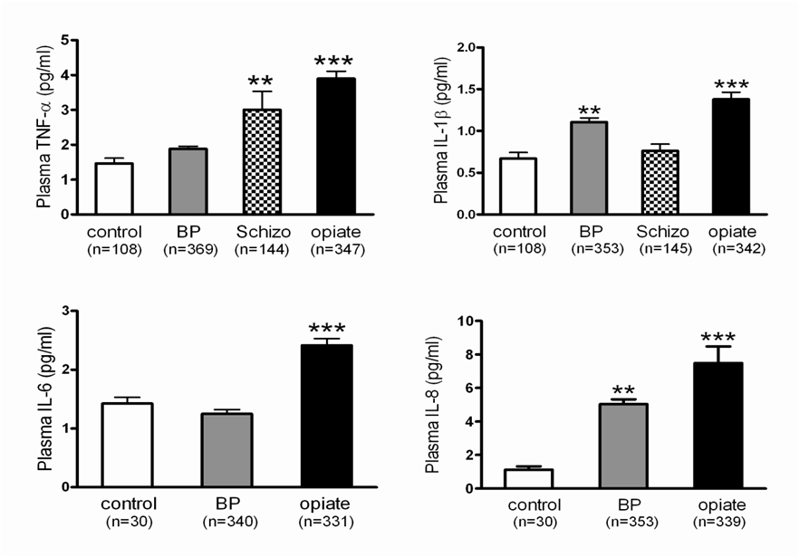
Plasma Cytokine
(Chen et al., 2012)

Slide 30
DM for Heroin Addiction with Methadone Maintenance Treatment

Slide 31
The effects of dextromethorphan on plasma cytokines, methadone dose, and combined use of substances in patients undergoing methadone maintenance therapy
 | MTD+Placebo |  | p-value | MTD+DM60 |  | p-value | MTD+DM120 |  | p-value
 | Week 0 | Week 12 |  | Week 0 | Week 12 |  | Week 0 | Week 12
TNF-α (pg/mL) | 4.4 ± 0.5 | 4.3 ± 0.9 | 0.571 | 5.0 ± 0.6 | 3.0 ± 0.4** | 0.0005 | 4.0 ± 0.4 | 2.9 ± 0.3** | 0.0009
IL-8 (pg/mL) | 4.8 ± 0.9 | 4.3 ± 0.9 | 0.145 | 7.4 ± 1.1 | 2.8 ± 0.3* | 0.021 | 7.7 ± 1.3 | 2.92 ± 0.30* | 0.03
MTD dose (mg) | 40.0 ± 4.6 | 44.8 ± 5.7 | 0.349 | 47.4 ± 3.2 | 42.0 ± 2.8 | 0.061 | 44.1 ± 4.0 | 41.9 ± 5.3 | 0.224
MTD dose change (%) | 100.0 ± 0 | 117.1±10.0 | 0.096 | 100.0 ± 0 | 91.7 ± 5.2* | 0.019 | 100.0 ± 0 | 92.3 ± 5.1* | 0.034
Urine morphine⁺ | 19 | 18 |  | 15 | 7 |  | 18 | 12
Plasma morphine (pg/mL) | 16.5 ± 4.1 | 39.6 ± 12.0 | 0.064 | 22.0 ± 7.4 | 14.6 ± 3.1 | 0.236 | 24.1 ± 6.7 | 17.9 ± 4.0 | 0.52
Urine AMPH⁺ | 3 | 0 |  | 4 | 1 |  | 2 | 0
(Chen et al., 2012)

Slide 32
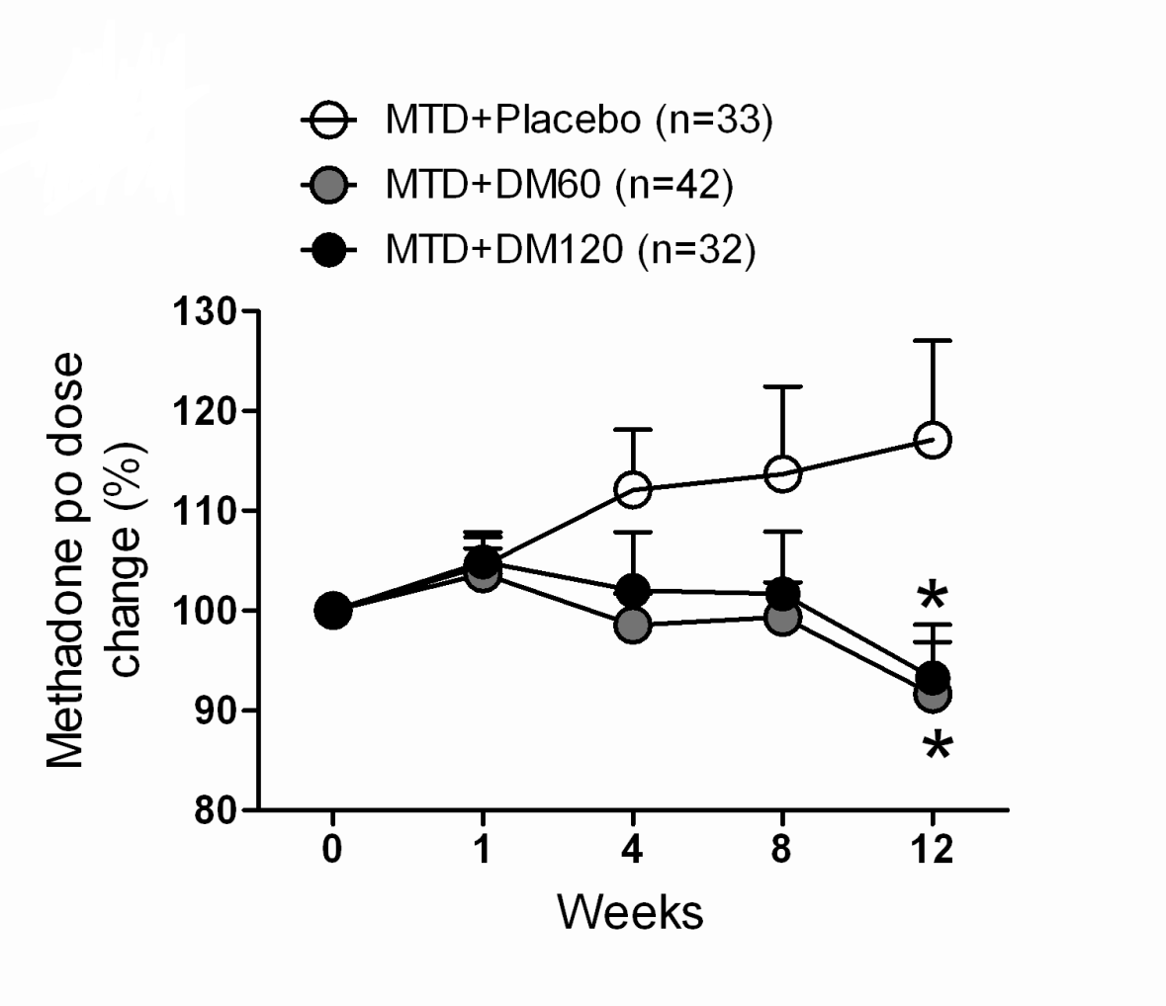
Heroin-dependent with methadone (MTD) therapy add on Placebo, dextromethorphan (DM) 60 mg/day (MTD+DM60) or MTD+DM120
(Chen et al., 2012)

Slide 33
Comments
Low dose DM (60-120mg/day, 1-2mg/kg)
Plasma level 10–200 ng/ml (28-560 nM)
No effect in NMDA receptor antagonist
(IC50: 5–50 μM) (Church et al. 1994)
Effective in morphine addiction with methadone treatment
Inhibition of methadone tolerance (one of important factors of addiction)
  Benefit in neuroprotection and decreasing neurodegeneration
  (Chen et al. 2013)

Slide 34
Heroin dependence with methadone treatment taking memantine or placebo
 | Baseline |  |  |  | Endpoint
 | Memantine | Placebo | P-value |  | Memantine | Placebo | P-value
Number (n) | 53 | 75 |  |  | 45 | 58
Gender (male/female) (n) | 43/10 | 63/12 | 0.813 |  | 40/5 | 49/9 | 0.575
Age, mean (SD), (years) | 37.06 ± 6.97 | 36.93 ± 7.15 | 0.923 |  | 37.91 ± 6.66 | 37.09 ± 6.94 | 0.524
Year of Heroin Use, mean (SD) | 8.48 ± 7.10 | 7.58 ± 6.44 | 0.465 |  | 8.39 ± 7.27 | 7.35 ± 5.98 | 0.436
TNF-α (pg/mL), mean (SD) | 3.65 ± 2.67 | 3.77 ± 3.30 | 0.824 |  | 2.28 ± 1.89 | 3.84 ± 3.78 | 0.006
CRP (ng/mL), mean (SD) | 3902 ± 2929 | 3933 ± 3164 | 0.956 |  | 2518 ± 1951 | 3130 ± 2339 | 0.161
IL-6 (pg/mL), mean (SD) | 2.40 ± 2.16 | 2.49 ± 2.56 | 0.833 |  | 1.81 ± 1.39 | 2.34 ± 2.67 | 0.229
IL-8 (pg/mL), mean (SD) | 6.22 ± 9.77 | 5.01 ± 4.50 | 0.351 |  | 3.50 ± 4.78 | 2.99 ± 2.85 | 0.503
TGF-β1 (ng/mL), mean (SD) | 23.12 ± 15.69 | 23.62 ± 15.70 | 0.860 |  | 23.65 ± 12.55 | 18.00 ± 14.63 | 0.042
BDNF (ng/mL), mean (SD) | 9.08 ± 6.11 | 11.35 ± 8.49 | 0.098 |  | 9.00 ± 4.74 | 8.87 ± 5.91 | 0.905
Methadone dosage (mg) | 34.32 ± 20.00 | 36.07 ± 22.90 | 0.655 |  | 35.84 ± 22.40 | 44.14 ± 24.22 | 0.082

Slide 35
Changes in Methadone dosage and cytokines after memantine or placebo treatment
Parameter | Estimate | SE | t | p-value
Primary Outcome
Methadone Dose Required | −0.948 | 0.446 | −2.128 | 0.034*
% of Change from baseline of Methadone Dose Required | −0.031 | 0.014 | −2.242 | 0.025*
Secondary Outcome
TNF-α (pg/mL) | −0.035 | 0.012 | −2.924 | 0.004**
CRP (pg/mL) | −0.017 | 0.010 | −1.630 | 0.104
IL-6 (pg/mL) | 0.003 | 0.010 | 0.283 | 0.777
IL-8 (pg/mL) | −0.016 | 0.017 | −0.921 | 0.357
TGF-β1 (pg/mL) | 0.028 | 0.012 | 2.403 | 0.017*
BDNF | 312.75 | 212.40 | 1.472 | 0.142

Slide 36
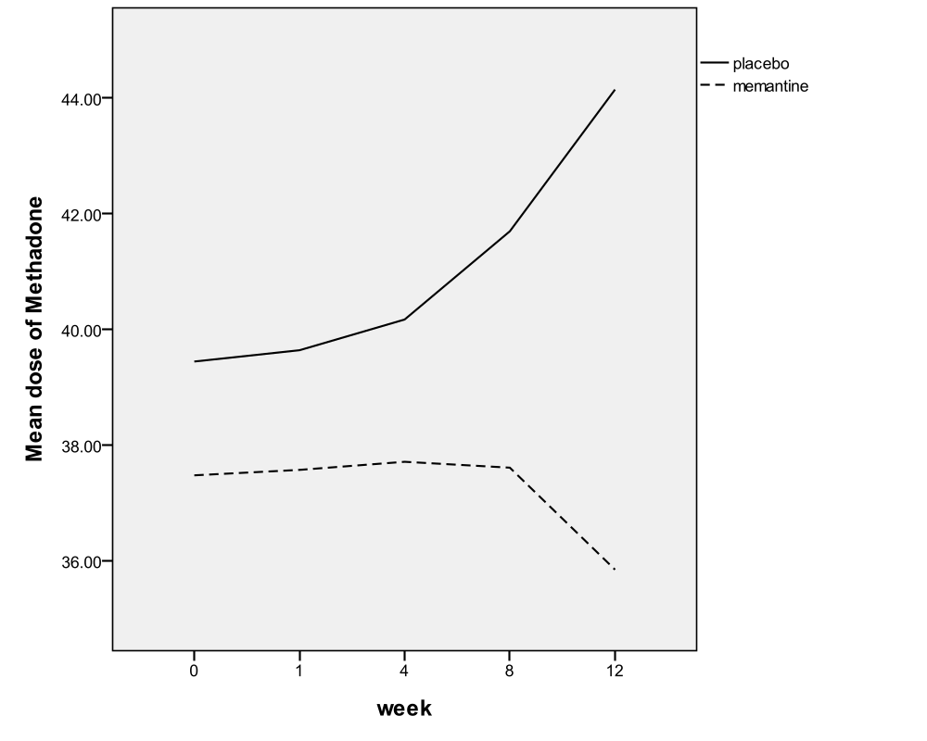
Change of Methadone dose in memantine and placebo after 12 weeks of treatment

Slide 37
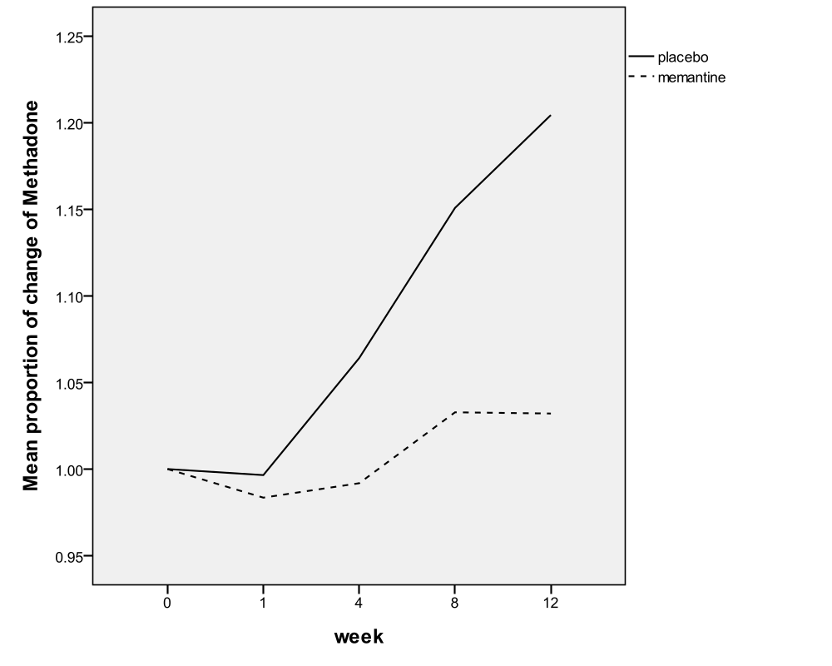
Change of Methadone dose normalized using the baseline (week 0 = 100%) after treatment

Slide 38
Comments
Low dose memantine (5mg/day)
Plasma level 10–50 ng/ml (0.05–0.2 μM)
No effect in NMDA receptor antagonist
(IC50: 2–3 μM) (Parsons et al. 1999)
Effective in morphine addiction with methadone treatment
Inhibition of methadone dosage & tolerance (important factors of addiction)
  Benefit in neuroprotection and decreasing neurodegeneration
  (Chen et al. 2013)

Slide 39
Potential beneficial effects of anti-inflammation-related drugs
Addiction
  Opiate abuse
  Alcohol abuse
  Smoking
  Compulsive eating disorder
CNS diseases
  Bipolar disorders
  Depression
  Schizophrenia
  Alzheimer’s dis.
  Brain ischemia
  Parkinson’s dis.
  MS
  Spinal injury
Peripheral diseases
  Asthma
  Arthritis
  Arteriosclerosis
  Cancer
  Diabetes
  Heart attack
  Hepatitis
  Inflammatory pain
  Crohn’s dis.
  Lupus
  Sepsis (endotoxemia)

Slide 40
Peripheral effect in animal and human

Slide 41
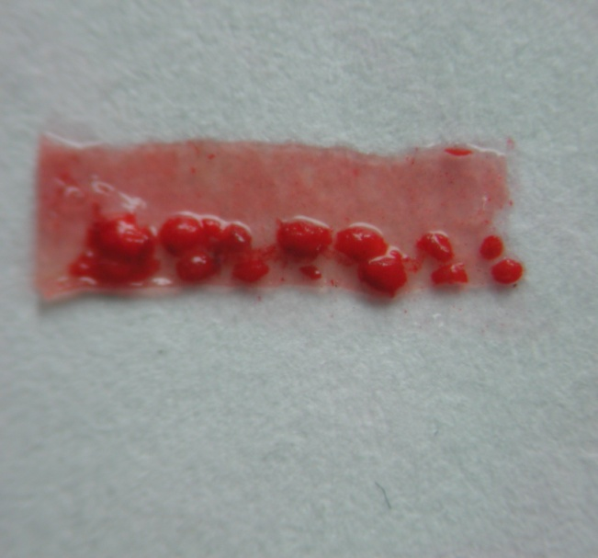
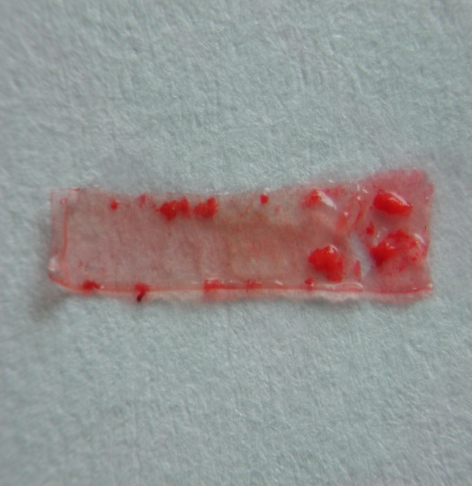
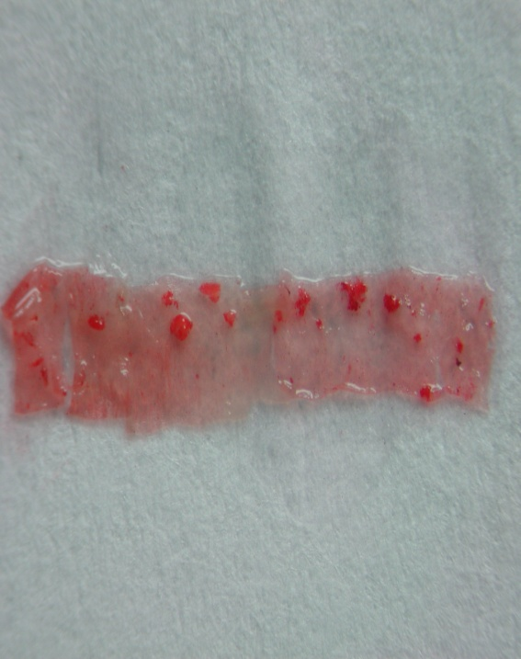
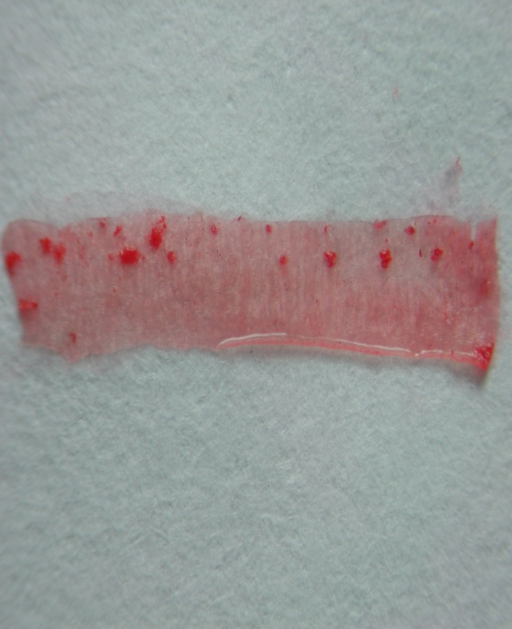
Dextromethorphan (DM) decreases high lipid diet-induced
atherosclerotic lesion formation in apo-E-deficient mice
Control
DM(10mg/kg)
25
20
15
Lesion area (%)
*
10
*
*
5
0
DM(20 mg/kg)
DM(40 mg/kg)
PBS
5
10
20
40
DM (mg/kg)
The lipid-rich atherosclerotic lesions were
identified with Oil-Red-O staining.
(Liu et al. 2009)

Slide 42
Conclusions
Regulating over-inflammation and/or autoimmune
effectiveness from central to peripheral
Treatment symptoms and treatment progress

Slide 43
Acknowledgement
Professor Jau-Shyong Hong, PhD.
Professor Pao-Luh Tao, PhD.
Professor San-Yuan Huang, MD., PhD.
Professor Yen Kung Yang, MD.
Associate professor Hung-Ming Wu, MD., PhD.
Associate professor Po See Chen, MD., PhD
Shiou-Lan Chen, PhD.
Shih-Heng Chen, PhD.
Chun-Hsien, Chu, PhD.
Sheng-Yu, Lee MD, MS.
Yun-Hsuan Chang, Ph.D

Slide 44

Thank you

