Slide 1


Vaccines for Australian Arboviruses
Roy Hall
Australian Infectious Diseases Research Centre
School of Chemistry and Molecular Biosciences
University of Queensland

Slide 2
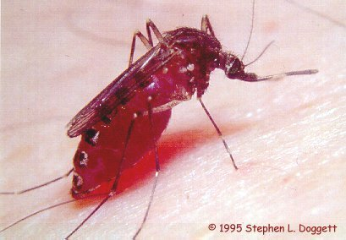
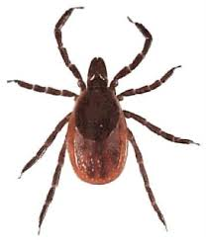
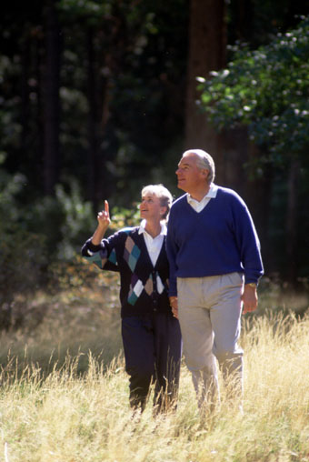
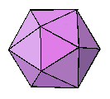
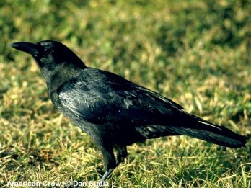
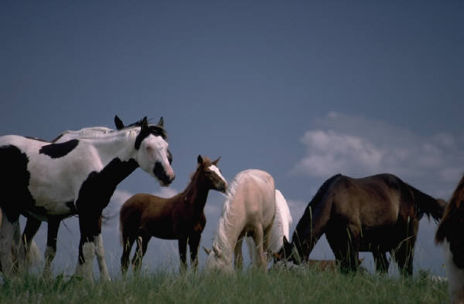
Typical Arbovirus
Transmission Cycles

Slide 3
Mosquito-borne viruses of Medical Significance in Australia
Endemic
Ross River virus
Barmah Forest virus
Murray Valley encephalitis virus
Kunjin strain of West Nile virus
Introduced
Dengue viruses
Japanese encephalitis virus
Chikungunya virus

Slide 4
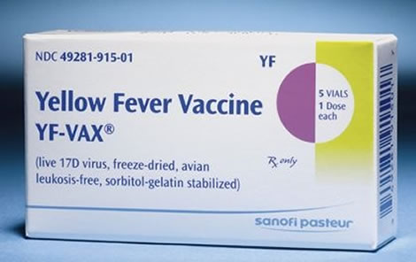
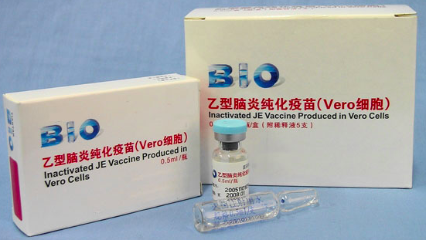
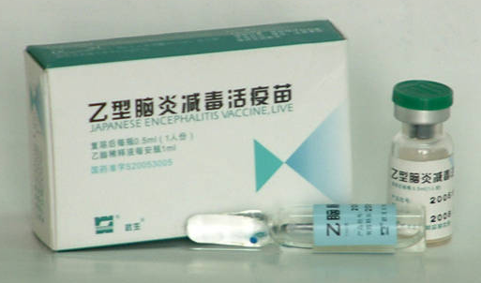
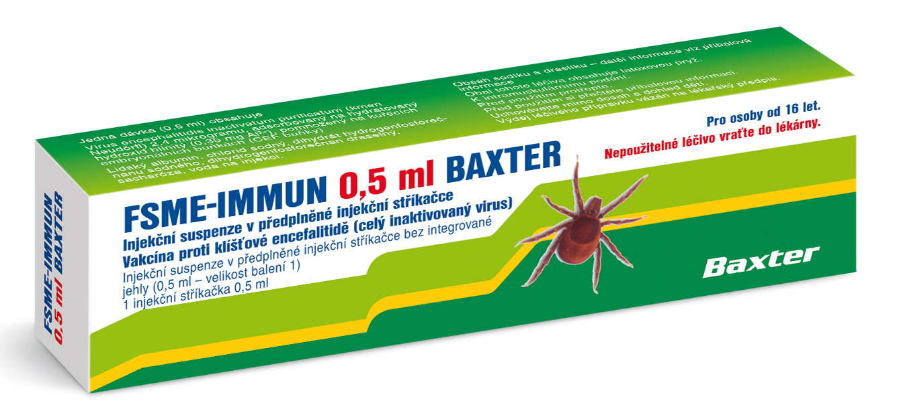
Existing arbovirus vaccines for humans

Slide 5
Ross River Virus Disease
Epidemic polyarthritis (EPA)
Most common arbovirus disease in Australia
≈ 5000 cases/year in Australia (1000-2000cases BFV)
- >7767 notifications RRV this year
  Symptoms and Pathogenesis:
  polyarthritis (weeks to months)
    ankles, fingers, knees, feet and wrists
      associated with an inflammatory response to infection of joints
  Fever and rash on trunk
  Often asymptomatic infections in children!

Slide 6
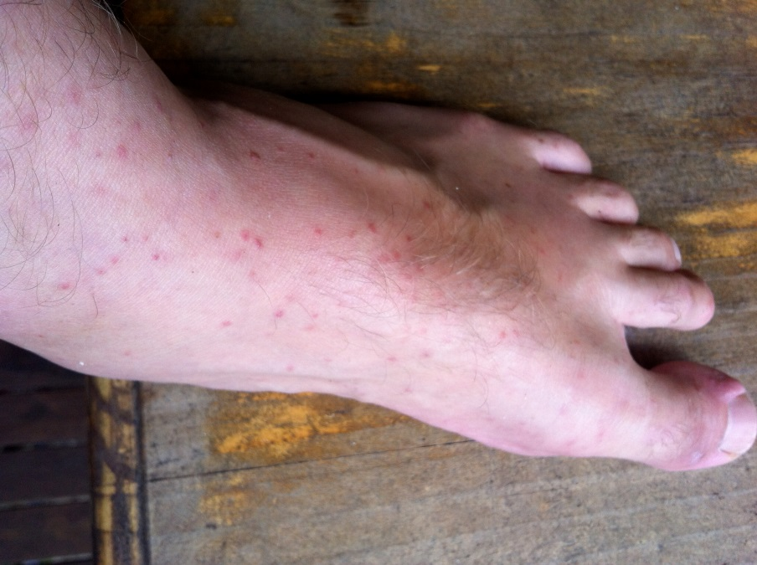
Treatment and Prevention of RRV disease
Treatment of EPA:
Analgesics used to reduce the pain
Anti-inflammatory drugs for arthritic symptoms
Rest and reduced alcohol intake!
Prevention:
Avoid mosquito bites:
- protective clothing, repellents, house screens
- control of vector breeding
No vaccine currently available

Slide 7
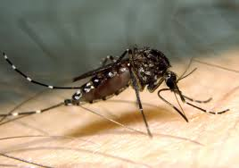
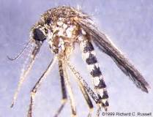
Major mosquito vectors of RRV
Culex annulirostris
Aedes vigilax
Aedes camptorynchus

Slide 8
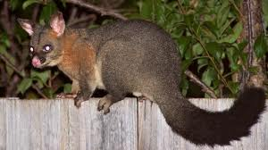
RRV Transmission Cycle

Slide 9
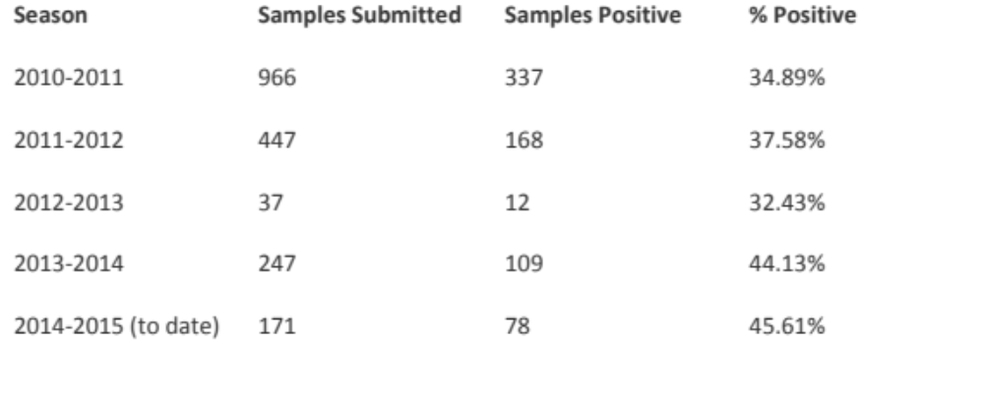
Ross River virus disease in horses
“Clinical symptoms include exercise intolerance, joint swelling, vascultis and oedema of the lower limbs, generalized musculoskeletal stiffness and a transient pyrexia - 4 case studies. Much more research is needed to gain a better understanding of this disease in horses”
Horse samples tested for RRV IgG by Victorian Arbovirus Disease Program
Anita Barton and Helle Bielefeldt-Ohmann ⁻ submitted to AVJ

Slide 10
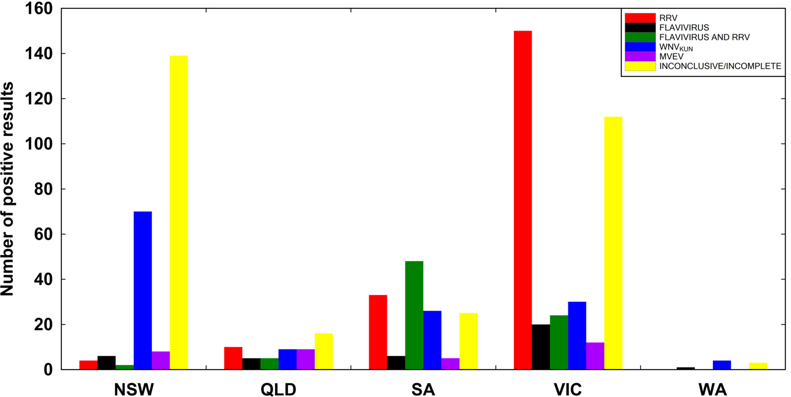
Serological evidence of arbovirus infections
in a subset of horses tested during the 2011 outbreak
Roche et al 2013, AVJ

Slide 11
RRV seroprevalence in horses in south-eastern Queensland
117 race horses, 2.5-7 yr, tested 2012 - 2013
37% positive for RRV neutralizing antibodies
Conclusion: horses in SEQ at major risk of RRV exposure

Slide 12


RRV vaccine in trials
Evaluation of an inactivated Ross River virus vaccine Holzer et al 2011, Vaccine
- 2 doses of Vero, whole virus, formalin and UV inactivated vaccine
- Alum adjuvant
- protective immune responses in mice (partial protection against CHIKV)
An inactivated Ross River virus vaccine is well tolerated and immunogenic in an adult population in a randomized phase 3 trial Wressnigg et al 2015 Clin Vacc Immunol
~ 2000 human volunteers
~ 90 % seroconversion and neutralising responses in young adults
Prof John Aaskov, QUT

Slide 13

Recombinant strategy for a RRV vaccine?
Effective chikungunya virus-like particle vaccine produced in insect cells.
Metz et al 2013 PLoS Negl Trop Dis.
Dr Gorben Pijlman
Wageningen University, Netherlands

Slide 14
RRV Summary
Debilitating arthritic disease affects 1,000s of humans each year in Australia
Disease syndrome also documented in some horses - infection very prevalent
  more studies required
Killed vaccine assessed in human trials
VLP approach for horse vaccine?

Slide 15
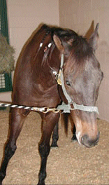
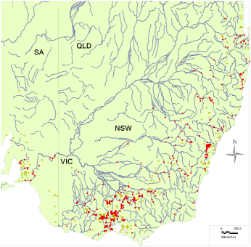
West Nile virus in Australia!
≈≈
Ataxia
Hind-limb weakness
Facial paralysis
Altered behavior
Fever
>1000 cases of equine encephalitis in 2011
≈ 15% mortality
Distribution of equine cases
in S-E Australia in 2011
- Followed extensive rainfall and flooding in many regions of Australia

Slide 16

West Nile Virus Transmission Cycle

Slide 17
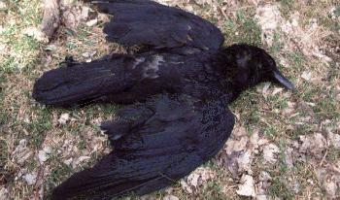
WEST NILE VIRUS IN THE US - 1999-2014
41,762 Reported human
cases - 1765 deaths.
Many bird deaths
>25,000 equine cases
>30% mortality
But no WNV disease reported in humans or avians
during 2011 equine outbreak in Australia!
Notes:
Transmitted in blood transfusions and transplants
Bird to bird transmission
Several candidate vaccines developed for human and veterinary application

Slide 18
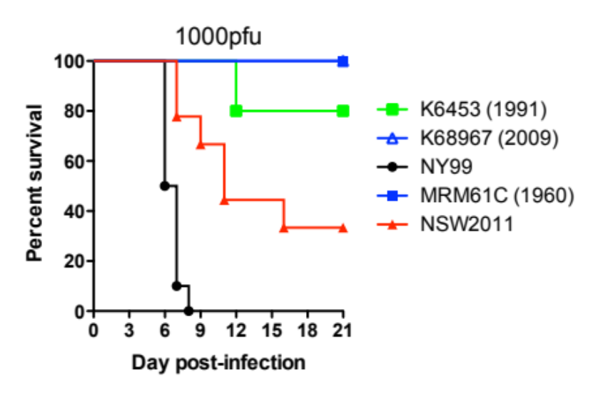
WNV_{NSW2011} is more virulent than most WNV_{KUN} isolates
WNV_{Russia88-90} (Lineage 4)
WNV_{Rabensburg} (Lineage 3)
WNV_{Sarafend}
Lineage 2
WNV_{Uganda}
WNV_{INDIA} (Lineage 1, Clade 1c)
WNV_{NY99}
Lineage 1, Clade 1a
WNV₂₀₀₂
WNV_{KUN-MRM16}
WNV_{KUN-MRM61C}
Lineage 1,
Clade 1b
WNV_{KUN-K2499}
WNV_{KUN-K6453}
WNV_{NSW2011}
Frost et al 2012 EID

Slide 19
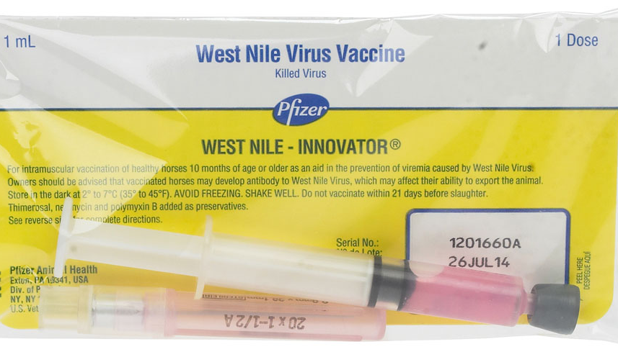
WNV Vaccine for Horses
Licensed vaccine
  Killed product
  2 doses
    3-6 weeks apart
  Annual booster
  Restricted use to veterinarians only
    pending approval for use in Australia
Notes:
There are currently no vaccines against WNV for humans at this stage, however
A killed West Nile virus vaccine for horses has been available since August 2001 and became fully licensed in November of 2002. It requires two doses of the vaccine given 3 to 6 weeks apart followed by an annual booster. This product is restricted in use to licensed veterinarians. Clients should be cautioned that effectiveness of the vaccine occurs AFTER the second dose and it is best to set a vaccination schedule to get the second dose into them at least 2 weeks before the mosquito season begins.

Slide 20
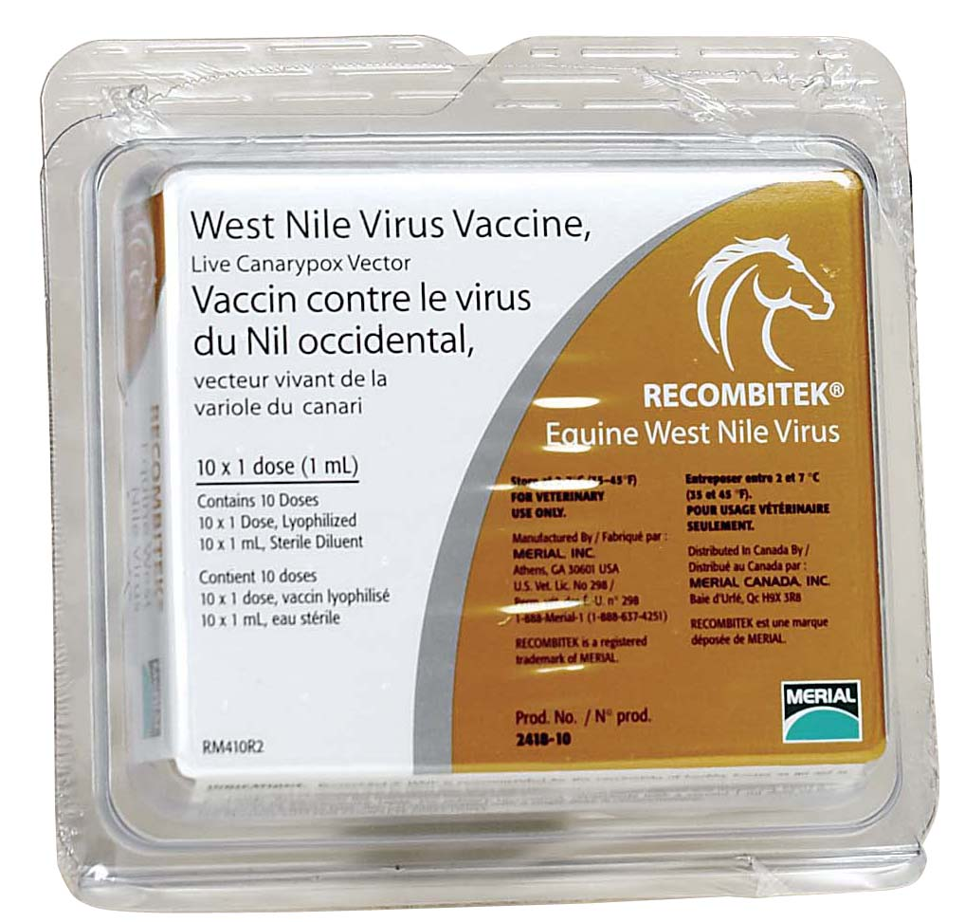
WNV Vaccine for Horses
Merial Canarypox vaccine
Recombinant virus encoding WNV proteins.
Can infect mammalian cells, but does not multiply
Induces humoral and cell-mediated immune responses
    pending approval for use in Australia
Notes:
There is a second WNV vaccine that is pending approval for use in Australia and this is manufacured by Merial
It is a vaccine based on a recombinant canarypox virus whereby the recombinant virus encodes WNV protein
This virus is able to infect mammalian cells, but is unable to multiply, so is very safe to use
What is good about this virus is that it is Similar to a natural infection and thus induces both humoral and cell-mediated immune responses

Slide 21
Comparison of WNV horse vaccines
WNV neutralizing titers for vaccinated and control horses
No/day mean neut Ab titer for each group
of injection
CP-WN K-WN Controls
Injection 1 <5 <5 <5*
Injection 2 2 8 <5*
PC D0 26 224 <5
PC D7 66 260 <5
PC D14 258 320 <5
PC D21 258 320 35
Seino et al 2007, Clin Vacc Immunol

Slide 22

Recombinant WNV_{KUN} DNA vaccines
TC
X
Standard DNA
++
prME
TC
KUNV
Live infectious
+++++
SRIP
SRIPs
Codes for replicon
and packaging Protein
++++
TC
X
prME
prME
Hall et al, 2003, PNAS
Chang et al 2008, Nat Biotech
Prof Alexander Khromykh, UQ

Slide 23
pKUNdC/C DNA vaccine model
Single Round Infectious Particles
(SRIPs)
No further
viral spread
pKpKUNdC/C
DNA
SRIP secretion
SRIP infection
C
KUNdC RNA release & replication
prM
E
NS1-5
Ab
prM
E
NS1-5
prM
E
NS1-5
prM
E
NS1-5
prM
E
NS1-5
prM
E
NS1-5
NS
NS
NS
NS
NS1
NS1
CTLs
prME immunogenic particles
CTLs
Ab
Ab

Slide 24
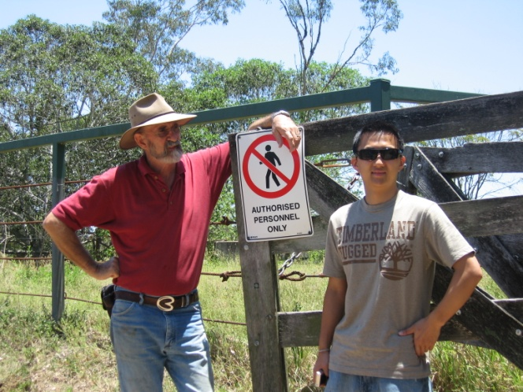
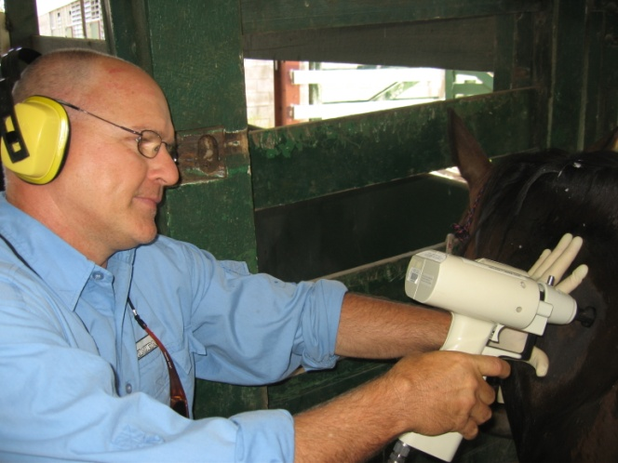
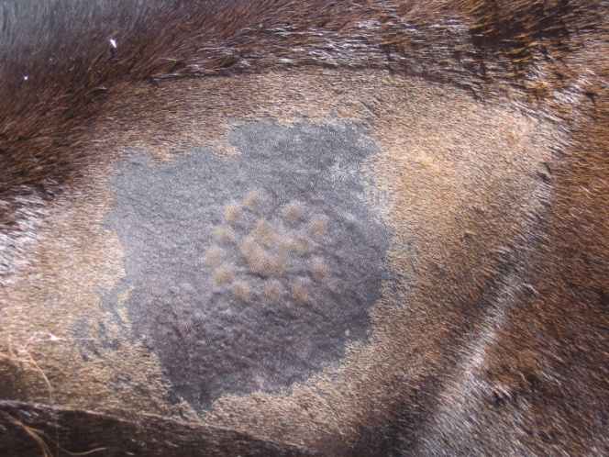
Large animal trial for WNV SRIPs vaccine in horses

Slide 25

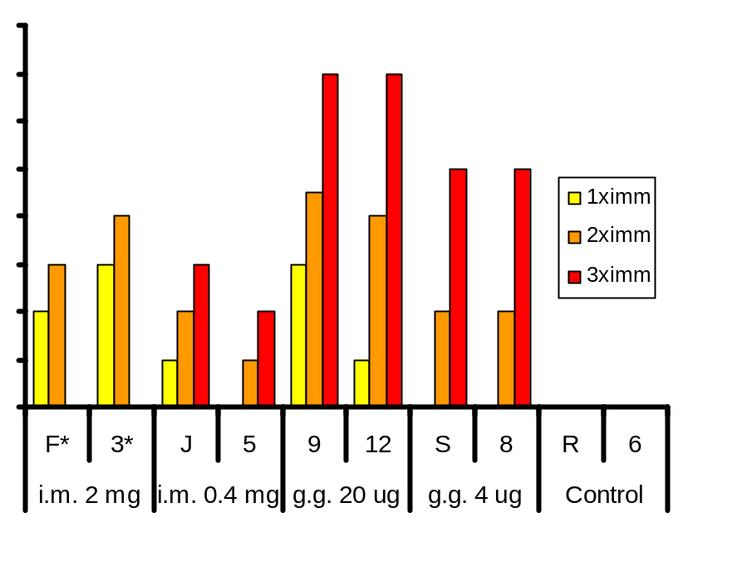
Immunization with WNV SRIPs vaccine induces neutralizing antibodies in horses
640
WNV Neutralizing assay
320
160
80
40
KUN neutralizing antibody titer
20
10
5
<5
intramuscular (i.m.) gene-gun (g.g.)
Chang et al. Nature Biotech, 2008
http://www.nature.com/nbt/journal/vaop/ncurrent/index.html

Slide 26
Equine WNV Summary
Large outbreak of WNV in horses in Australia
  virulent strains of WNV_{KUN} identified
WNV vaccines licensed for use in US and Europe
  Approval for use in Australia pending
Novel experimental vaccines also effective
Equine outbreaks unpredictable
  Linked to ecological and environmental factors

Slide 27
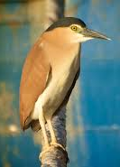
Murray Valley encephalitis virus

Slide 28
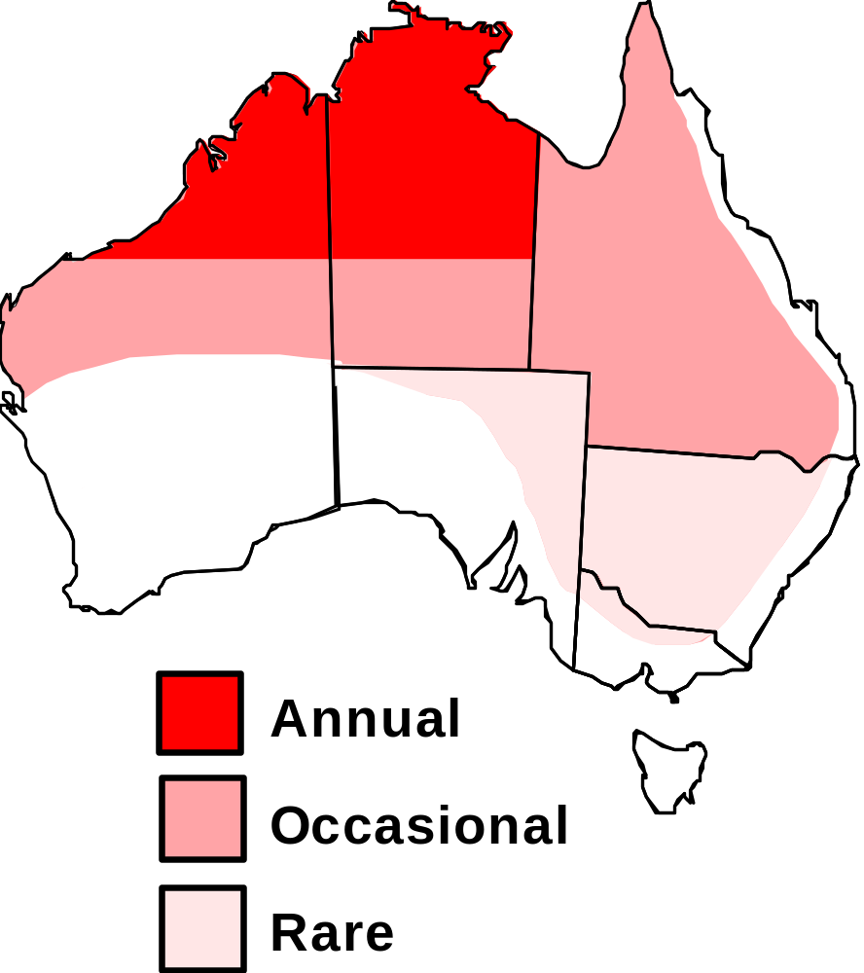
Distribution of Murray Valley encephalitis virus
(MVEV)
Slide from Prof Richard Russell

Slide 29
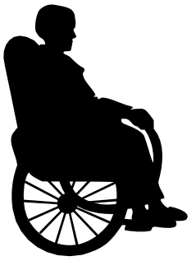

MVE encephalitis: Clinical features
Case-to-infection ratio
1:1000 to 1:100
Presentation
Anorexia, malaise, fever, vomiting
Adults – severe headache
Children – fitting
Encephalitis
  Paralysis
  Coma
  Death
25-50%
10-15%
No vaccines or therapeutics
Supportive Treatment - ventilation

Slide 30
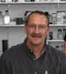
Experimental Recombinant vaccines to MVE
Protective immune responses to E and NS1 proteins of Murray Valley encephalitis virus in mice.
Hall et al 1996, J Gen Virol.
DNA-based and alphavirus-vectored immunisation with prM and E proteins elicits long-lived and protective immunity against the flavivirus, Murray Valley encephalitis virus.
Colombage et al 1998, Virology
But, <20 human cases
between 2008-2012!
Dr Mario Lobigs, ANU

Slide 31
JEV vaccines induce cross-protection against MVEV in vaccinated horses
An inactivated Vero cell-grown JE vaccine formulated with Advax, a novel inulin-based adjuvant, induces protective neutralizing antibody against homologous and heterologous flaviviruses
Lobigs et al 2010, J Gen Virol
Neutralising Ab titres induced in 3 vaccinated horses
JEV MVEV WNV
#1 1600 80 10
#2 1600 320 90
#3 200 20 10
many equine cases of MVE in northern Victoria during 2011

Slide 32
MVE Summary
MVEV affects humans and horses on Australia
Large outbreaks in SE Australia are rare
  too few annual cases to warrant an MVE vaccine
Cross protective antibody response to MVEV induced in horses and mice by JEV vaccination

Slide 33
Conclusions
RRV, MVEV and WNV cause significant human or equine disease in Australia
  climate change may exacerbate prevalence?
Existing or experimental vaccines are available to each of these viruses
Should these vaccines be approved for veterinary use in horses in Australia?
Use in combination with current equine vaccines?
  Hendra, Tetanus, Strangles etc.

Slide 34



Acknowledgements
UQ
Helle Bielefeldt-Ohmann
Anita Barton
Alex Khromykh
Natalie Prow
Jody Hobson-Peters
Chris Pollitt
David Chang
Justin Roby
Mario Lobigs (ANU)
Peter Kirkland (EMAI, NSW DPI)
Nikolai Pretovsky (Flinders University, SA)
Gorben Pijlman (Wageningen University, Netherlands)

