Slide 1
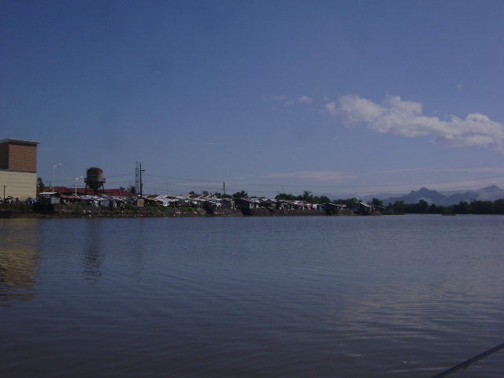




Water quality in relation to phytoplankton abundance and density of mining-impacted river in Zambales, Central Luzon, Philippines
Sazon, Rowena R. & Migo, V. P.
rrsazon1@up.edu.ph; rsazon@yahoo.com
1st International Conference on Natural Hazards & Disaster Management, Hyatt Regency Hotel, Osaka, Japan,
June 1-3, 2017.

Slide 2
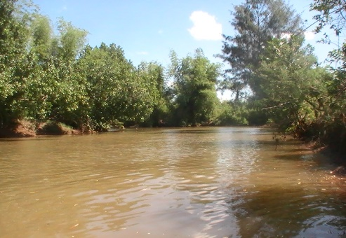
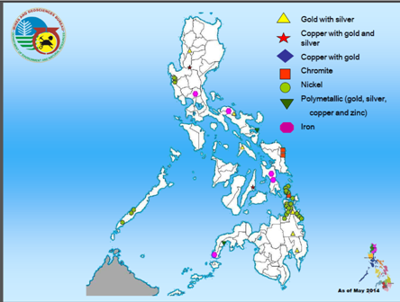
INTRODUCTION
Philippines known for rich mineral resources (ranked 5th)
Zambales in Central Luzon –
declared mineral reservation
Six MPSA’s (Mineral Production
Sharing Agreement) in Sta. Cruz
(10,877.83 hectares or 24.81%)
Approved commodities :
Ni, Cr , associated
mineral deposits
Notes:
Zambales known for its rich deposits of Cr and Ni
15 MPSAs approved between 1991-2010
25% of total land area under MPSA (10,877.83 has).
Mining is one of the high dollar earning industries in the Philippines (MGB-DENR, 2014) with Zambales in Central Luzon as one of its mineral reservation sites. The municipality of Sta. Cruz has six Mineral Production Sharing Agreements (MPSAs) which give permission to large scale mining on about 10,877.83 hectares or 24.81% of its total land area. The area was reported to have high concentration of heavy metals such as Cr, Ni, Fe, Mn, Co and other metals such as Ca and K (Sazon, 2016).

Slide 3
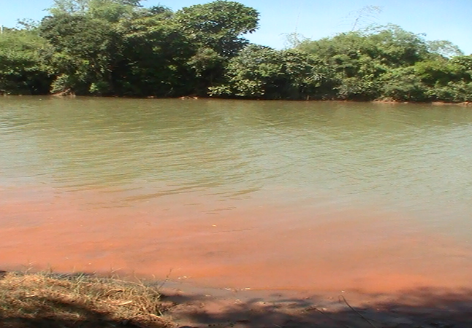
INTRODUCTION
Open pit mining method in nickel extraction
  removal of vegetation triggering soil erosion, runoff & sedimentation
continuous silt deposition in water bodies & flood plains
Fluxes of waste
Water quality
Structure & functions of biological communities
Poor water quality can lower economic value of goods & services that support the livelihood of the community.
Notes:
Open pit mining method employed in nickel extraction within the watershed resulted to removal of vegetation triggering soil erosion, runoff and sedimentation. After years of operation, environmental issues related to water and soil quality arose due to continuous silt deposition in water bodies and flood plains.
Fluxes of wastes can change the chemical composition of water which can influence the structure and functions of biological communities in water.
Environmental issues related to water and soil quality arose due to continuous silt deposition in water bodies and flood plains.
Poor water quality is a sign of freshwater ecosystem degradation
Hence, a need for assessment of the ecological conditions of water bodies in Zambales such that proper regulatory and rehabilitation measures can be formulated to rehabilitate the river for it to continually sustain its provision of goods and services.

Slide 4
Objectives
General:
Assess the ecological condition of surface water in Zambales to aid the decision makers in the formulation of rehabilitation measures and strategies for restoration and sound utilization of its water resources.
Notes:
Open pit mining method employed in nickel extraction within the watershed resulted to removal of vegetation triggering soil erosion, runoff and sedimentation. After years of operation, environmental issues related to water and soil quality arose due to continuous silt deposition in water bodies and flood plains.
Environmental issues related to water and soil quality arose due to continuous silt deposition in water bodies and flood plains.
Hence, a need for assessment of the ecological conditions of water bodies in Zambales such that proper regulatory and rehabilitation measures can be formulated to rehabilitate the river for it to continually sustain its provision of goods and services.
Mining can bring out materials long buried on the earth surface and these are commonly discharged in the surface waters causing pollution, particularly of heavy metals. This is of major concern since HM persists in the environment, non-degradable, and can bioconcentrate and enter the food chain.
Since metals tend to sorb or form a complex with particulate & OM in the sediments, sediments then serve as repository or sink of metals in the aquatic system.
Physical method of metal cleanup such as dredging and several other technologies as listed by Rai (2008) are available but may not be economical. An alternative method is the use of plants with phytoremediation ability, like mangroves. Several studies mentioned that …
===
Mining wastes discharged in surface water or carried downstream by sedimentation, runoff and soil erosion
Once enter the river system, metals tend to bound to the sediments
Mangroves absorb & store non-essential metals in perennial tissues minimizing their export to adjacent ecosystem via leaf litter transport
Mangroves with extensive rhizosphere that provides rich culture zone for various microorganisms and a wider sediment zone that provides reducing condition necessary for metal removal pathway. They are also low-cost, abundant and easy to handle (Rai, 2008).

Slide 5
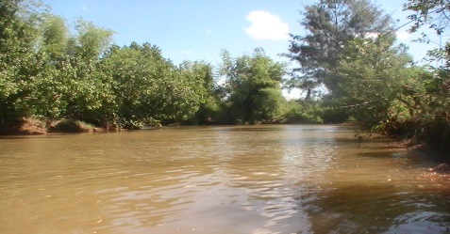
Objectives
Assess the seasonal changes in water quality of Alinsaog River in terms of its physico-chemical characteristics (pH, temperature, dissolved oxygen, total dissolved solids, salinity, Secchi disk visibility, chemical oxygen demand, and nitrate and phosphate content);
Determine the stream flow in the four sampling stations during the wet and dry season;
Determine seasonal changes in the composition, abundance and density of phytoplankton; and
Correlate water quality parameters with phytoplankton density and abundance.

Slide 6
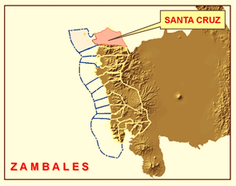
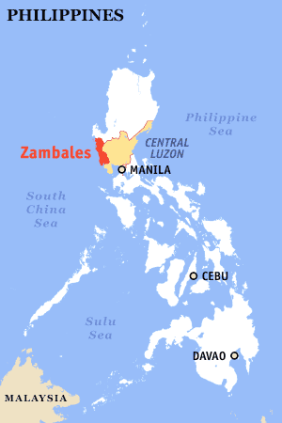
THE STUDY AREA
Sta. Cruz, Zambales in Central Luzon lies at 15⁰46’1” north latitude and 119⁰ 54’ 32” east longitude.
Notes:
Sta. Cruz – northernmost town in Zambales

Slide 7
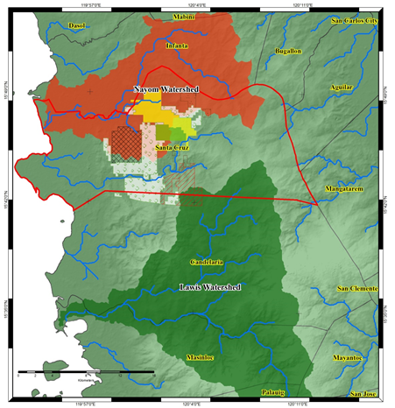
The Study Area
Nayom Watershed
  most mining companies operate
  four river systems draining its water into the West Philippine Sea
Alinsaog River- heavy siltation
Notes:
Sediment & mangrove samples collection stretch of Alinsaog River & pond near river mouth which both drain their water into the West Philippine Sea.
Alinsaog – main river; pond near river mouth; drain its water into the West Phil. Sea
Land uses :
nickel & chromite mining
aquaculture & rice farming
pond (A3, Sa3) : closed to commercial establishments & fishing communities

Slide 8
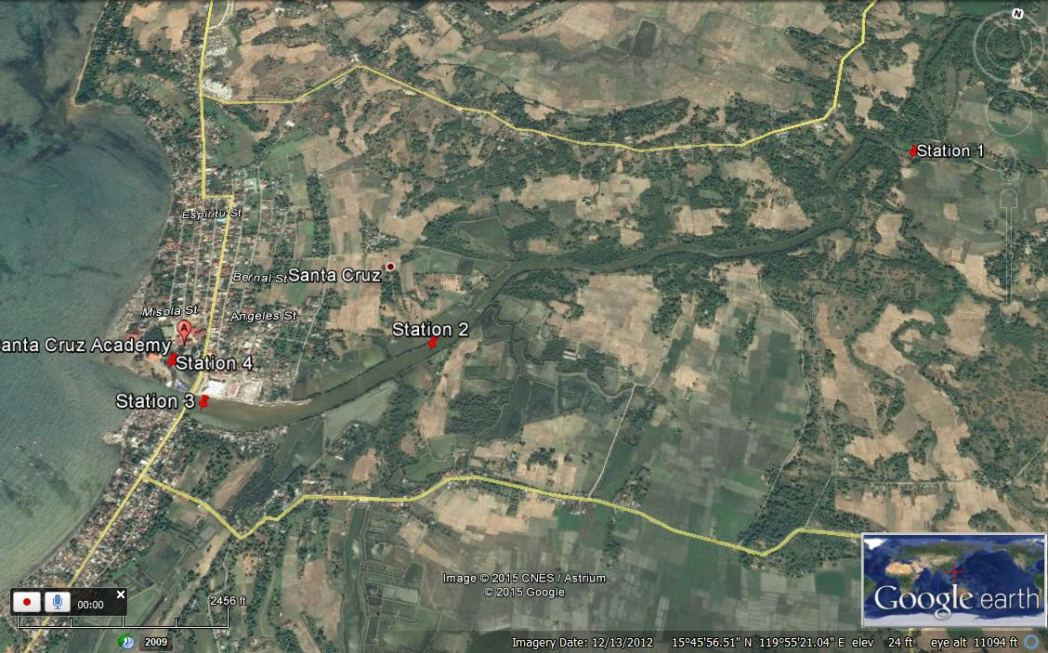
Land uses :
  nickel & chromite mining; aquaculture & rice farming
  S4: close to commercial establishments & fishing communities
Notes:
Here is the satellite image of the area showing the 4 stations designated as S1, S2, S3 and S4. Aside from nickel and chromite mining, other land uses in the area include aquaculture & rice farming.

Slide 9
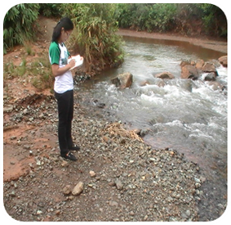
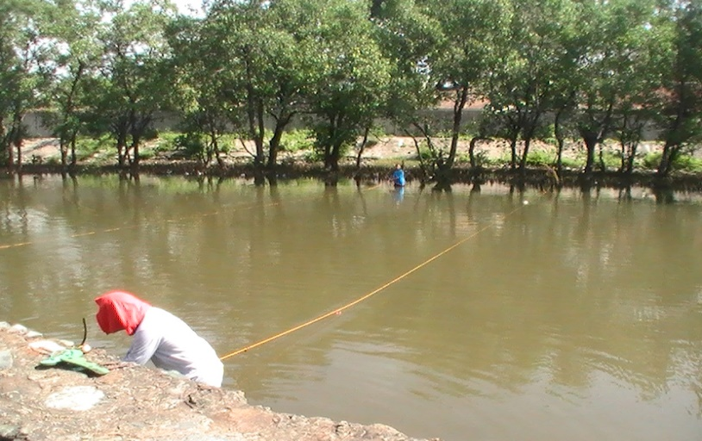
METHODOLOGY
Reconnaissance survey/Characterization of study sites
Coordination with concerned agencies
GPS coordinates
Stream Flow measurement
Float method as prescribed in WQ Monitoring Manual (ERDB-EMB, 2008)
2 transect lines laid perpendicular to the banks
Depth measured at each transect at 4 interval points (A, B, C, D).
Calculation of ave. depth, width, cross sectional area & stream flow
Notes:
Measurement of stream flow was also conducted. Also known as river discharge, it refers to the volume of water that moved over time in a waterway (EMB-DENR, 2008). Measurement was done following the WQ monitoring manual of ERDB-DENR on the months of August to represent the wet and on the month of December to represent the dry season.
It has known to influence water quality as well as the rate of sediment transport in the water bodies.
Measurement of stream flow or river discharge was done using the float method as described in the Water Quality Monitoring Manual of EMB-DENR (2008).
C –coefficient of correction factor (0.8 for rough, rocky bottom; 0.9 for smooth sandy, muddy and smooth bedrock)

Slide 10
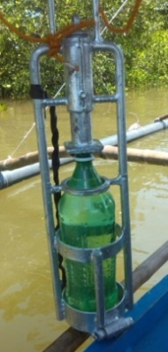
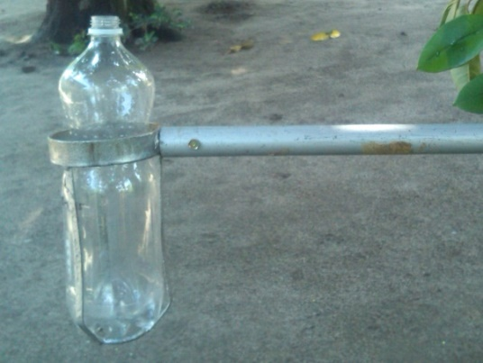
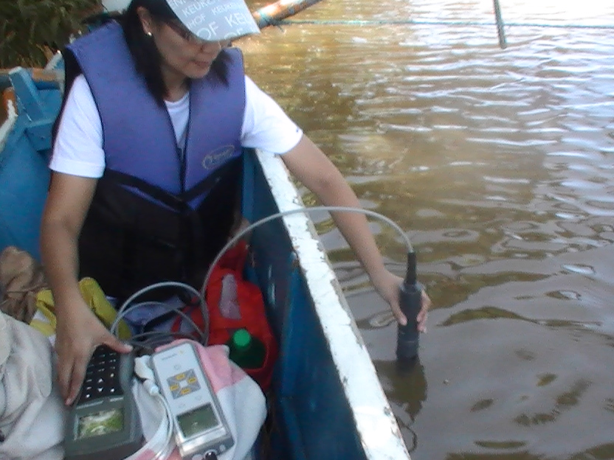
METHODOLOGY
Water Sampling & Analysis
Periodic water sampling at mid-depth using improvised
weighted water catcher (S1, S2, S3) & dip/pond sampler (S4)
Physico-chemical analysis
  Temperature, pH, DO (in-situ by
  Hannah HI9828/4/-2 Multiparameter WQ meter)
  EC, TDS, salinity (Sartorius PT 20 hand-held
  Conductivity meter)
  COD (open reflux method)
  NO3-N, PO4 (colorimetric method)
  mean values compared against DENR Administrative
  Order (AO) 34, s. 1990 & DAO 35.
Notes:
HOW ABOUT SECCHI DISK VISIBILITY?
The sampler was designed in such a way that once it is lowered to the desired depth, the lid would open filling it up with water and would close by pulling the string before lifting it to the surface.
Pond sampler was used for Station 4 since the site was not accessible by boat. The sampler consists of a fixed clamp to secure the container and is attached to a metal pole that serves as the handle. Using the sampler, the container was lowered vertically halfway to the bottom with the neck facing down and then lifted towards the water flow until it was filled up with water.

Slide 11
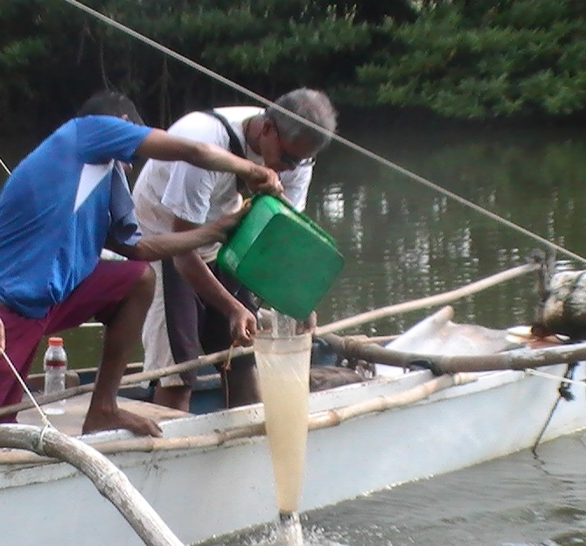
METHODOLOGY
Phytoplankton sampling & identification
Data Analysis
Analysis of Variance (ANOVA)
Pearson Correlation Analysis using SAS software
60L plankton sample
Sampling by bucket method (25 microns)
Filtration
Settling, filtration, collected residuum diluted with filtrate
Plankton identification & counting
1 ml aliquot in Sedgwick-Rafter counting chamber (20 mm x 50 mm)
Plankton density
Cells/ml to cells/L
Notes:
Phytoplankton sampling
Bucket method (plankton net 25 microns )
Settling of samples for 24-48 hours
Filtration using 26µm sieve
collected residuum was diluted with 50 ml of water filtrate. One (1) ml of the thoroughly mixed aliquot was dispensed on a Sedgwick-Rafter counting chamber (20 mm x 50 mm). The phytoplankton was identified to the lowest possible taxon. The number of plankton in 3 (1ml) replicate subsamples was counted (cells/ml) and the plankton density was extrapolated into number of cells/L
Phytoplankton identification
Sample in PET bottle added with formalin as preservative
Identification to the lowest possible taxon

Slide 12
RESULTS
Notes:
Plakton of that size : micro, nanno, pico, mesoplankton
About 60 L of water was filtered using plankton net (30 microns mesh size). The samples in the receiving container was transferred to a PET bottle and added with 4% formalin as preservative. Two samples were collected per station. Samples were allowed to settle for 24-48 hrs. In the laboratory, the samples were filtered using 26µm sieve and the collected residuum was diluted with 50 ml of water filtrate. A 1ml of the thoroughly mixed aliquot was dispensed on a Sedgwick-Rafter counting chamber (20 mm x 50 mm). The observed phytoplankton and zooplankton were identified to the lowest possible taxon. The number of plankton in 3 (1ml) replicate subsamples was counted (cells/ml) and the plankton density was extrapolated into number of individuals/L by multiplying the number of plankton with 50 ml and dividing by the total volume of water samples (60L).

Slide 13
Physico-chemical characteristics
Temperature
pH
pH range:
7.34 – 8.20
DAO 34 limit :
7.5 – 8.5
indicates good buffering capacity of water
Temperature : 28.27 – 35.31 ⁰C
Highest : April, June
Lowest : September
Notes:
The physico-chemical properties of the river on the 4 sampling stations at 6 sampling periods were presented.
TYPE 1 CORONA CLIMATE CLASSIFICATION – dry season from November to April ; wet season on the rest of the months
June – considered onset of rainy season (still with high temp)
temp. range still within the limits set by DENR (favorable for aquatic life)
S4: highest temperature among stations (slightly shaded; low depth)
pH 7.34 – 8.2 within the limits set by DAO 34 which is 6.5-8.5
water temperature ranged from 28.27 – 35.31 ⁰C, the lowest on the month of December (due to amihan or cold front); the highest was on August

Slide 14
Physico-chemical characteristics
Dissolved oxygen
DO range: 3.73 – 8.77 mg/L
DO < 5mg/L lower [Oct. & Dec.]
Factors affecting DO:
Temperature
Pollution level
Water movement
Notes:
The amount of oxygen dissolved in water was lower during dry months. Solubility of oxygen in water is lower at higher temp.
Aeration of water during rainy months caused the increase in DO.
Most stations- below the standard limit (not less than 5 mg/L) set by DENR, agency with regulatory functions in the Philippines.
Inverse relationship of DO and temperature.
Station 4 – DO lower than 5 mg/L - indicates pollution, particularly of OM, since microorganisms tend to utilize O for decomposition of OM.
This station has many possible sources of OM- situated closed to commercial establishments
Water movement : S4 registered lowest flow (indicate here) both on the wet and dry season, where water is almost stagnant in most times of the day except during high tide where water flows from S3.
High DO level at S4 on September was due to the
slight rain/drizzle before sampling. S4 normally had a DO lower than 5 mg/L.

Slide 15
Physico-chemical characteristics
Chemical oxygen demand
COD exceeded DAO 34, s. 1990 limit (wet & dry season)
High COD contributes to lowering of DO
Notes:
Sources of OM in S1 and S2 – riparian vegetation, allochthnous OM
S3, S4 – direct discharge of waste from fishing community and establishments nearby
COD in relation to mining?
COD in relation to BOD?
Exceeded the standard limit for Class C water

Slide 16
Stream flow
 | WET SEASON (AUGUST) |  |  |  | DRY SEASON (DECEMBER)
 | S1 | S2 | S3 | S4 | S1 | S2 | S3 | S4
Ave. width (m) | 31 | 56.8 | 105 | 24 | 26 | 52 | 105 | 42.4
Ave. depth (m) | 2.1 | 1.9 | 1.10 | 0.61 | 1.4 | 1.1 | 1.15 | 0.34
Ave. cross sectional area (m²) | 64.9 | 105.1 | 115.6 | 14.7 | 34.9 | 57.2 | 120.8 | 14.3
Stream flow (m³/s) | 11.8 | 18.69 | 22.2 | 0.46 | 4.5 | 4.9 | 20.5 | 0.46
Highest stream flow – S3 (downstream) Lowest flow at S4 – low DO
High stream flow, higher DO
Notes:
River discharge
- volume of water that moved over time in a waterway.
- can influence water quality and metal levels of the sediments (thru sediment transport during high stream flow)
When the stream flow is high, there would be more stress exerted on the river bed causing more sediment transport.

Slide 17
Physico-chemical characteristics
TDS range: 968-2890 mg/L
exceeded limit for Class C water
  indication of sedimentation
  dissolution of minerals from rocks
Same trend with EC and salinity
Total dissolved solids
Notes:
TDS – measure of combined organic & inorganic substances dissolved in water; directly related with salinity
Salinity – surrogate measure of EC
TDS- sum of ions (+, -) present in water (amount of ions dissolved in water)
TDS exceeded the limit for Class C water
indication of sedimentation from land-based activities (EMB-DENR)
dissolution of minerals from rocks (after processing)
Important implications on the aquatic biota since it could lead to reduced penetration of light in the water column affecting the photosynthetic activity of the plankton (at the base of the food chain)
Can be measured by Secchi disk visibility
Salinity refers to the total concentration of salts dissolved in water.
brackish water salinity ranges from 0.5-17 ppt
strong contributor to EC.

Slide 18
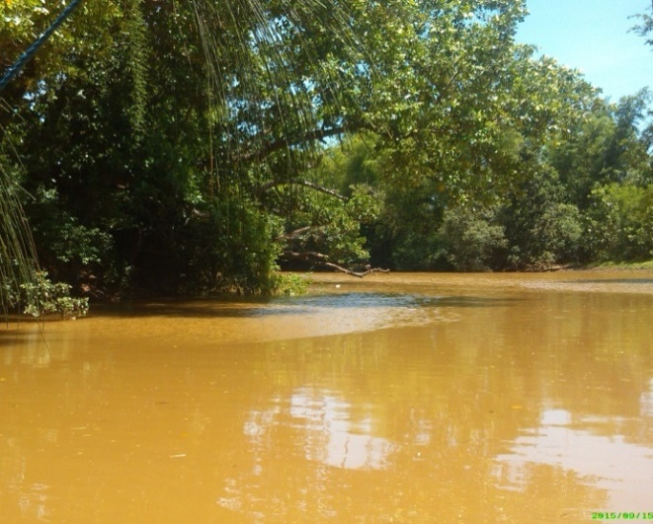
Secchi disk visibility
Secchi disk visibility (cm) | Stations | SAMPLING PERIOD
 |  | Oct. 2014 | Apr. 2105 (D) | June 2015 (W) | Aug. 2015 (W) | Sept. 2015 (W) | Dec. 2015 (D)
 | S1 | 57.0 | 123.0 | 129.0 | 103.7 | 27.7 | 136.7
 | S2 | 61.7 | 102.7 | 99.0 | 153.7 | 27.2 | 117.5
 | S3 | 71.0 | 140.3 | 80.3 | 150.7 | 30.8 | 121.2
 | S4 | -- | 39.7 | 64.0 | 39.0 | 41.3 | 46.5
Safe optimum level : 30-45 cm (BFAR, 2013)
>60 cm : indicates inadequate primary productivity (Boyd, 2004)
<30 cm : excessive turbidity
Notes:
Transparency – measures the depth of water that can be penetrated by sunlight
Photic zone- layer of water that can be reached by sunlight
In clean water, photic zone is deeper
Safe optimum level for transparency was 30-45 cm (BFAR, 2013). It indicates good condition if transparency is due to presence of phytoplankton.
>60 cm - indication of inadequate primary productivity (Boyd, 2004)
<30 cm - excessive turbidity (Boyd, 2004) ----could result to lowering of DO
High TDS & low transparency – important implications on primary productivity
Related to this is the level of N and P in water

Slide 19
Nutrient content
Nitrate-N & phosphate
SAMPLING STATION | NITRATE – N (mg/L) |  |  | PHOSPHATE (mg/L)
 | 26-Oct-14 | 1-Aug-15 | 19-Dec-15 | 26-Oct-14 | 1-Aug-15 | 19-Dec-15
1 | 0.172 ± 0.005 | 0.116 ± 0.00 | 0.616 ± 0.007 | nd | 0.002 ± 0.001 | 0.310 ± 0.000
2 | 0.128 ± 0.032 | 0.051 ± 0.001 | 0.464 ± 0.004 | nd | 0.003 ± 0.002 | 0.003 ± 0.001
3 | 0.117 ± 0.004 | 0.065 ± 0.004 | 0.191 ± 0.016 | nd | 0.009 ± 0.002 | 0.005 ± 0.001
4 | 0.023 ± 0.011 | 0.064 ± 0.006 | 0.204 ± 0.020 | nd | 0.012 ± 0.002 | 0.267 ± 0.001
Class C ª | 10 |  |  | 0.2
Class D ª | -- |  |  | 0.4
Notes:
NO₃⁻ - N < 1 mg/L, very low compared with the 10mg/L limit for Class C water
indicating that water course has limited nutrient; typical for freshwater (Behar, 1997)
Phosphate level
limited, except for upstream (0.31 mg/L) and pond-like (0.267 mg/L) station on December, two months after flooding brought about by typhoon Koppu
Probable origin of phosphate:
agricultural runoff
carried downstream during flooding
Phosphate has inherent characteristics to bind to sediments. Sediment has the capacity to retain and release phosphorous depending on the existing environmental condition.
Khalil and Rifaat (2013) reported that deposition of inorganic P from the overlying water to the sediments exceeded the rate at which it is released by desorption or diffusion.

Slide 20
Phytoplankton composition
5 major taxonomic groups
  Bacillariophyta
  Chlorophyta
  Cyanophyta
  Dinophyta
  Ciliates
Number of taxa on four sampling stations at different periods.
Fewer taxa during wet season
38 taxa (58% diatoms/ Bacillariophyta)
SAMPLING PERIOD | Number of taxa
 | S1 | S2 | S3 | S4
October 2014 (D) | 16 | 18 | 11 | 11
August 2015 (W) | 1 | 3 | 3 | 6
December 2015 (D) | 9 | 2 | 7 | 6
Notes:
Taxa which are found abundant in some stations and at different seasons reflect the condition of the river.
Phytoplankton that are present in high density can be considered as indicators of the condition of the river.
5 major taxonomic groups
Bacillariophyta
Chlorophyta
Cyanophyta
Dinophyta
Ciliates
Dominant species during wet season; Sphaerocystis sp. (August)
Dominant species during dry season : dinoflagellates (December)

Slide 21
Phytoplankton composition
Bacillariophyta (Diatoms) - 22 taxa
Dominance of diatoms flora
  indicates alkaline environment (Buzer, 1981)
  pH range : 7.34 – 8.20
Percentage composition of phytoplankton in Alinsaog River, Sta. Cruz, Zambales (October 2014, August 2015, December 2015).
Diatoms prefer alkaline environment.
Silica needed for cell wall synthesis has increased solubility at higher pH.
Notes:
Bacillariophyta had the highest number of taxa (22), followed by Chlorophyta (10), Cyanophyta (3), Dinophyta (2) and lastly Protista with only one species.
Highest proportion of Diatoms
Dominance of diatoms flora indicates an alkaline environment notably the presence of alkaliphilic diatoms such as Fragilaria and Cyclotella (Buzer, 1981)
Highest proportion of Diatoms
recorded pH ranged from 7.34 – 8.20
Diatoms possess inorganic cell walls comprise of hydrated silica (Spaulding et. al., 2010).
solubility of silica, required for the synthesis of diatom cell walls, increased at higher pH (Kempter et. al., 2013)
explained the preference of diatoms on alkaline conditions relative to other taxa

Slide 22
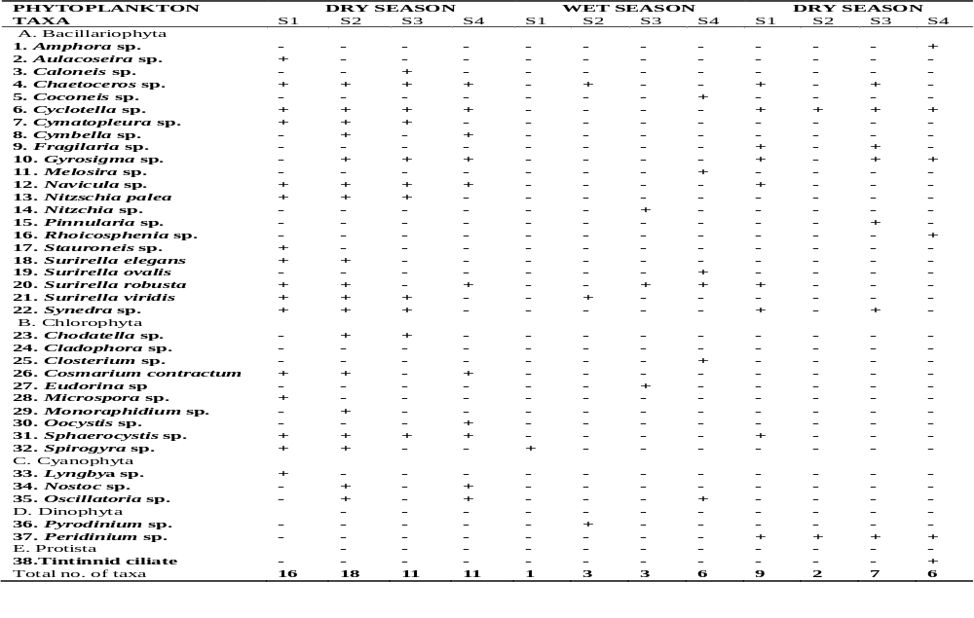
Notes:
Fewer taxa and lower density per taxon- wet season - can be attributed to dilution effect of the rain.
This was also the same explanation offered by Bhat et al. (2015) in their study on variability of plankton community in India. Pundhir and Rana (2002, as cited by Bhat et. al., 2015) added that rainy season, cloudy weather, low transparency and flood can contribute to lower phytoplankton density. Likewise, Malik and Bharti (2012) explained that the recorded low density of phytoplankton during the monsoon months was due to high water velocity.
Higher density of phytoplankton on dry season - due to the warm water & high temp., which is very important in phytoplankton productivity.

Slide 23
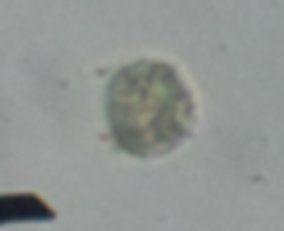
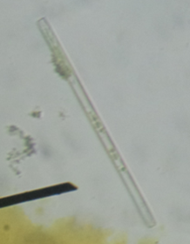


Phytoplankton composition
Sphaerocystis sp.- stress survivor species
Cyclotella, Synedra and Scenedesma, Navicula, Nitzschia sp. & Oscillatoria sp. - indicators of organic pollution
Navicula sp. - indicator of excess siltation
Cyclotella species - indicator of oligotrophy
Melosira and Microcystis - pollution resistant species
Notes:
Taxa which are found abundant in some stations and at different seasons reflect the condition of the river.
Phytoplankton that are present in high density can be considered as indicators of the condition of the river.
Sphaerocystis, Synedra, Navicula, Cyclotella
Dominant species during wet season; Sphaerocystis sp. (August)
Dominant species during dry season : dinoflagellates (December)

Slide 24
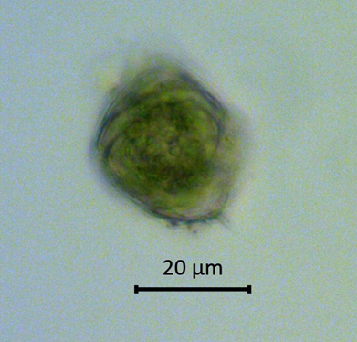
Phytoplankton density
Phytoplankton density on four sampling stations at different periods.
SAMPLING PERIOD | DENSITY (cells/L)
 | S1 | S2 | S3 | S4 | Total
October 2014 (dry) | 11.7 | 452.1 | 13.2 | 12.4 | 489.3
August 2015 (wet) | 3.5 | 2.5 | 3.6 | 38.2 | 47.8
December 2015 (dry) | 111,987. | 104,395 | 87,265 | 74.2 | 303,721
Wet season - fewer taxa, lower density of phytoplankton
presence of Pyrodinium sp. but at low density
After flooding (Koppu)
high density of dinoflagellates (Peridinium sp.) 111, 982 cells/L
Notes:
Wet season - fewer taxa, lower density of phytoplankton
Pyrodinium sp. on the wet (August 2015) sampling, though at a low density, had ecological significance considering that the bloom of toxic red tide organism Pyrodinium was a frequent occurrence in Zambales-Bataan waters.
Pyrodinium sp. – what taxa?
High density of dinoflagellates (Peridinium sp.) reaching to about 111, 982 cells/L which can be associated with:
sudden increase in phosphate level of water Stations 1 and 4 exceeded the phosphate level for Class C water on that period.
Enhanced light penetration in the water column might have triggered the germination of the cyst of dinoflagellates increasing their density in water.
Not toxic organism but their high density might result to oxygen depletion in water.

Slide 25
Phytoplankton abundance
Notes:
Abundance of Chlorophyta (green algae) and Bacillariophyta (diatoms) on the first two sampling. High abundance of dinoflagelllates (Peridinium sp) sampling two months after the flooding event.

Slide 26
Correlation between WQ variables and phytoplankton
Cyanophyta density with TDS, EC, and salinity (+)
  TDS contains minerals
Dinoflagellates density correlated with EC (-)
Diatoms abundance correlated with pH (+)
  Silica is highly soluble at alkaline pH
Total density of phytoplankton correlated with EC (-)
  High EC, high TDS, reduced light penetration, lower photosynthetic activity
Notes:
Diatoms abundance correlated with pH (+)
Silica needed for their cell wall synthesis highly soluble at alkaline pH
Table 17 shows that the density of Cyanopyhta or the blue-green algae was significantly positively correlated with salinity (P>0.0283), electrical conductivity (P>0.0371) and total dissolved solids (P>0.0295). These three parameters are related to each other and its association with blue green green algae can use TDS as a basis. TDS, according to Harsha and Malammanavar (2004 as cited by Sharma et. al., 2016), was favorable for the growth of Cyanophyta. Weber-Scannell and Duffy (2007) reported that TDS contains both the minerals and the toxic metals and organics. The former can serve as nutrients to phytoplankton which explained the correlation between Cyanophyta and the dissolved solids. But this was only up to a certain limit since osmotic stress could negatively affect aquatic biota.
EC – surrogate measure of salinity
Total density of phytoplankton correlated with EC (-)
This implies that the density of the phytoplankton is reduced with increasing electrical conductivity. Kawabata et. al. (1997) reported also that density of phytoplankton gradually decreased with increasing EC, a surrogate measure of salinity. Hussian et. al. (2015) likewise reported that electrical conductivity, together with water temperature, were the most common factors negatively controlling phytoplankton density. EC implies the presence of high concentration of dissolved salts in water (TDS), including the silt and clay particles and other particulate matters that could reduce light penetration in the water column (US EPA, 2012).
In terms of relative abundance, Pearson Correlation Analysis showed that the abundance of diatoms (Bacillariophyta) was significantly positively correlated with pH (P>0.0484). As previously explained, solubility of silica, an important constituent for the formation of shells of the diatoms, was hastened at alkaline pH. No other significant association was found between the abundance of phytoplankton and the other water quality parameters.
Total density of phytoplankton correlated with EC (-)
EC & water temp. significant factors controlling phytoplankton density
EC implies high concentration of dissolved salts in water (TDS), including silt and clay particles and other PM particulate matters ---reduced light penetration
Cyanophyta density with TDS, EC, and salinity (+)
TDS - favorable for growth of Cyanophyta
TDS contains minerals, toxic metals & organics
Minerals as source of nutrients for phytoplankton

Slide 27
PHYTOPLANKTON GROUP |  | PHYSICO-CHEMICAL PARAMETERS
 |  | Temp. | pH | DO | Salinity | EC | TDS | Water depth
Bacillario phyta | Density | 0.50067 | 0.2389 | 0.49432 | 0.2311 | 0.2157 | 0.2324 | -0.5647
 | Abundance | 0.5170 | 0.7101* | 0.5238 | 0 .0545 | 0.1038 | 0.0749 | -0.1031
Chlorophyta | Density | 0.1811 | 0.1496 | -0.0647 | 0.3538 | 0.3188 | 0.3466 | 0.1795
 | Abundance | 0.2018 | 0.0990 | -0.1046 | 0.3955 | 0.3976 | 0.3983 | 0.5591
Cyanophyta | Density | 0.5004 | --- | -0.1014 | 0.6294* | 0.6051* | 0.6257 * | -0.2111
 | Abundance | 0.4615 | --- | -0.0882 | 0.5521 | 0.5359 | 0.5500 | -0.2534
Dinophyta | Density | -0.4177 | -0.4739 | -0.2218 | -0.5351 | -0.6005* | -0.5559 | -0.0771
 | Abundance | -0.6195 | -0.6390 | -0.2898 | -0.4497 | -0.4859 | -0.4668 | -0.3149
Protista | Density | -0.4568 | -0.4650 | -0.2941 | 0.1903 | 0.2544 | 0.1865 | -0.5541
 | Abundance | -0.4568 | -0.4650 | -0.2941 | 0.1903 | 0.2544 | 0.1865 | -0.5541
Total density |  | -0.4173 | -0.4739 | -0.2220 | -0.5344 | -0.5999 * | -0.5552 | -0.0767
Notes:
Pearson’s Product Moment Correlation Analysis - quantifies the strength and the direction of association.
Correlation between WQ variables and phytoplankton density
+ correlation
density of Cyanopyhta & salinity, EC, TDS
abundance of Bacillariophyta & pH
- correlation
dinoflagellates density & EC
total density of phytoplankton & EC
rainy season, cloudy weather, low transparency and flood can contribute to lower phytoplankton density. Likewise, Malik and Bharti (2012) explained that the recorded low density of phytoplankton during the monsoon months was due to high water velocity.

Slide 28
CONCLUSION
The river in general is not in healthy state (DO, COD and TDS exceeded the DAO standard limit).
Stream flow influences other water quality parameters
Composition and density of plankton species indicated poor water quality of the study area.
Predominant plankton - adapted to grow at low N and P & high organic pollution; stress tolerant; pollution resistant
Large scale mining operations by open pit method coupled with unfavorable weather conditions & insufficient interventions caused heavy siltation in the river system leading to poor water quality and reduced primary productivity.
Notes:
Other findings :
WQ parameters – generally, significant difference of the WQ parameters across stations
WQ parameters – generally no significant difference on the river channel portions (no difference in WQ on the left, middle and right bank of the river).
Correlation of phytoplankton with WQ parameters
Cyanophyta + correlation with TDS, EC, salinity
Dinoflagellates - correlation with TDS
Composition and density of plankton species indicates poor water quality of the study area.
fewer taxa and lower density during rainy season

Slide 29
RECOMMENDATIONS
Conduct regular monitoring & assessment of water quality of rivers affected by siltation;
Formulation & implementation of regulatory/intervention measures addressing point source of pollution;
Enforce strict compliance of the contract holders on their ECC commitment;
Policy review (granting of MPSA, etc.);
Rehabilitation of the rivers with thick silt deposits; and
Economic valuation of the social cost and benefits of mineral resource exploitation.
Notes:
Formulation & implementation of regulatory/intervention measures addressing point source of pollution (number & size of silt pond, stability of silt pond considering the volume of water that flows during rainy months)
ECC commitment – EEP (environmental enhancement & protection)
Appropriate regulatory measures and policies should be instituted by the concerned agencies addressing the point source of pollution.
Interventions should be in place focusing on the issues that affect the livelihood source of the local populace.
Remediation should be in placed on the affected ponds
Given the magnitude of impact on livelihood, concerned agencies should reconsider valuating the social cost and benefits of mineral resource exploitation in Zambales and in other parts of the country where mining of metals is flourishing.

Slide 30
Maraming Salamat!
Mabuhay!

Slide 31



Acknowledgement
Accelerated Science and Technology Human Resource Development Program - National Science Consortium (ASTHRDP-NSC) and Student Research Support Fund (SRSF) of the Department of Science and Technology (DOST)

